Slide 1
Recap
Possible words
  Tracheae
  Diffuses
  Pizza
  All parts
  Branch
  Slower
  Spiracles
  Quicker
  Hydrogen
  Oxygen
  Carbon dioxide
  Atmosphere
  Diffusion

Slide 2
Answers
The breathing system in insects consists of a series of tubes called tracheae. The tracheae connect to the atmosphere by openings called spiracles. Air diffuses through the spiracles and tracheae to all parts of the body supplying the organs directly with air.
The tracheae branch repeatedly until they end as very fine, thin-walled tubules through which oxygen and carbon dioxide can diffuse freely into and out of the tissues.
Along a diffusion gradient
  When cells are respiring oxygen is used up and so its concentration towards the end of the tracheoles falls. This creates a diffusion gradient for O2 towards the cells. CO2 is produced by cells creating a diffusion gradient with the atmosphere (CO2 moves out of the insect). As diffusion in air is much quicker than in water, respiratory gases are exchanged quickly by this method

Slide 3
Oxygen vs. Water
Life on land poses a continual conflict between the needs for oxygen and water.

Slide 4
Terrestrial insects have to cope with obtaining oxygen from air without dying from dehydration.
It is vital for terrestrial insects, especially those such as locusts that live in desert conditions, to be able to exchange respiratory gases without losing too much water.

Slide 5
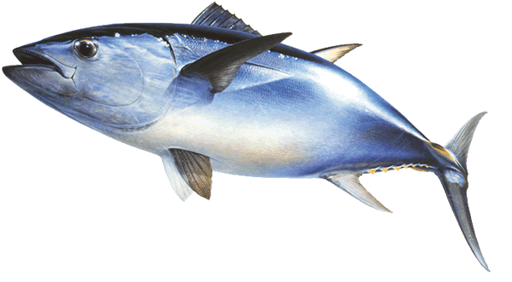
Gas Exchange in Fish

Slide 6
Lesson Objectives
(ALL) Practice and develop our dissection skills and anatomical drawing skills.
(D) How are fish gills adapted to maximize gaseous exchange?
(C) What is the difference between parallel flow and counter current flow?
(A/B) How does counter current flow increase the rate of gas exchange?

Slide 7
Waterproof body
Large or small SA:V?
What does that mean for gas exchange?
Notes:
What does that mean for gas exchange?
Small surface area to volume ratio

Slide 8
Fish are aquatic animals adapted to extracting oxygen from water.
Oxygen content in air; 20.9 %
Oxygen content in water; approx 0.8 %
Therefore fish have to pass large volumes of water over their gas exchange systems relative to the volumes of air ventilated by terrestrial animals.

Slide 9
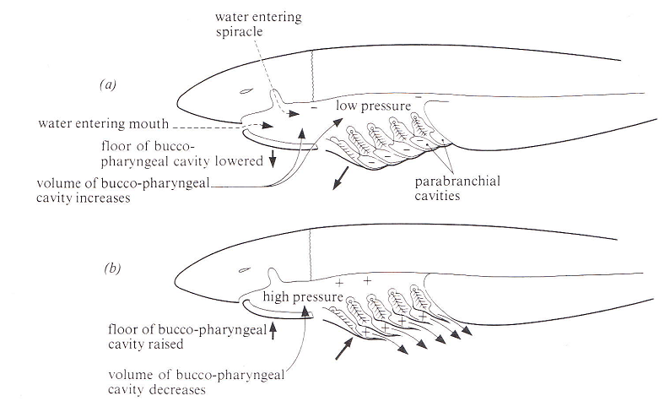
Some fish actively pumping water!!

Slide 10
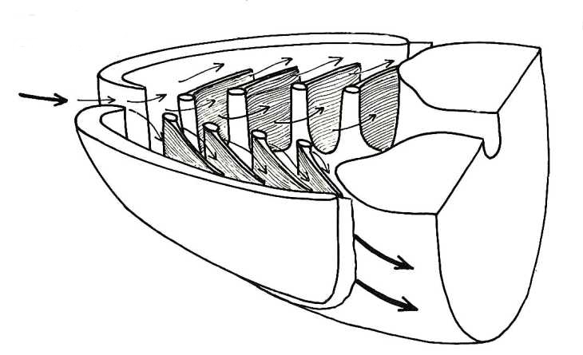

Slide 11
Fish can extract as much as 80% of available oxygen passing through its gills
Due to;
A very large surface area for gaseous exchange
A short diffusion distance across the gaseous exchange system
A high concentration gradient between the blood in the gills and the water passing over them

Slide 12
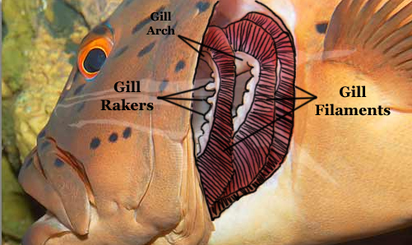
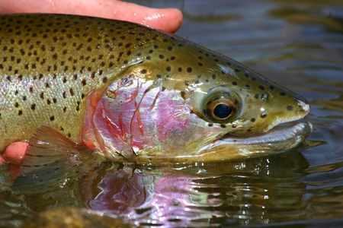
1. Large surface area -
Developed a specialised internal gas exchange surface: the gills

Slide 13
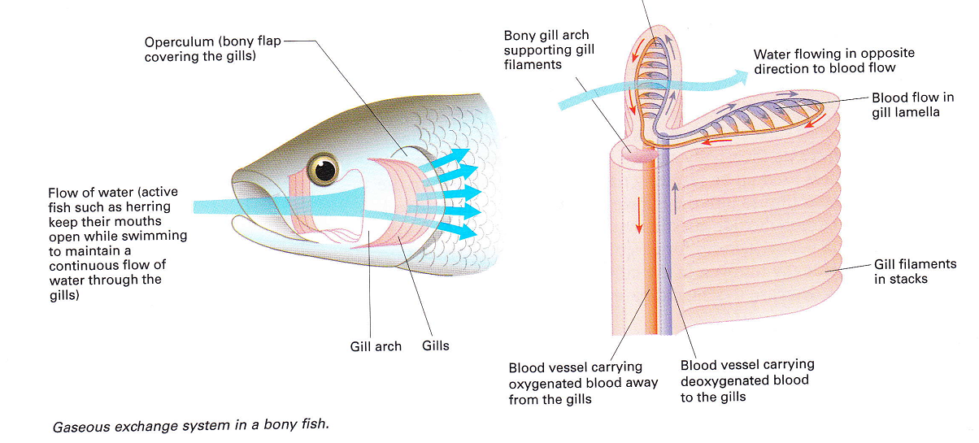
Structure of the gill

Slide 14
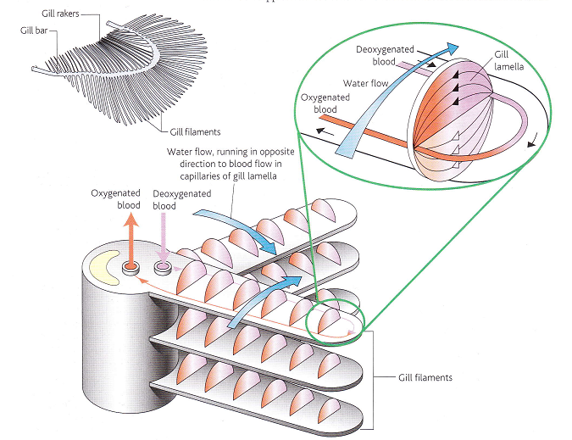

Slide 15
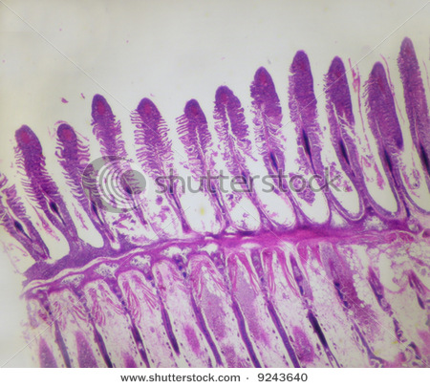
2. Short diffusion distance
Gill plates – exceedingly delicate and very thin so that blood flowing through them is only a short distance from seawater (about 5µm in active fish such as mackerel).

Slide 16
3. High concentration gradient - Countercurrent exchange in bony fish
The blood and the water flow over the gill lamella in opposite directions
Blood that is already well loaded with oxygen meets water, which has its maximum concentration of oxygen. Therefore diffusion of oxygen from the water to the blood takes place.
Blood with little or no oxygen in it meets water which has had the most, but not all, of its oxygen removed. Again, diffusion of oxygen from the water to blood takes place.

Slide 17
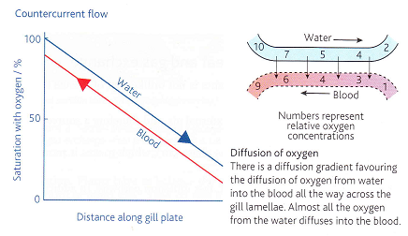
Countercurrent exchange
Relatively constant rate of diffusion

Slide 19
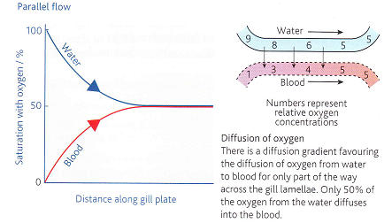
Parallel flow system - dogfish
Blood and water move in the same direction and only about 50% of the oxygen is absorbed.

Slide 20
Haemoglobin
Fish blood contains haemoglobin.
  Helps to carry oxygen away from the gills and maintain a high concentration gradient.
Unloading is made easier by the Bohr effect!
Notes:
What is the Bohr effect?

Slide 21
Examiners Tips
Maintaining steep diffusion gradients for oxygen involves bringing it constantly to the exchange surface (by ventilation) and carrying it away from the surface (by mass transport in the blood)
Always refer to blood and water flowing in opposite directions in the counter current system. Describe how this maintains a difference in oxygen concentration and a diffusion gradient across the whole length of the gill lamella.

Slide 22
Dissection Questions
Sketch the fish head and label the relevant parts.
  Add labels to explain how water passes through the gills
Remove the fish gills and identify the;
  Gills
  Operculum
  Single gill lamella
  Blood vessels
Examine a single gill.
  Can you detect the gill plates? (running a needle along the surface of the lamellae may help)
Examine the gill under a microscope
  Approximately how many lamella are there per gill?
  How many plates per lamellae?
  Make a detailed and labelled drawing
Take a horizontal cross section of the gill parallel to the lamellae and examine it under the microscope
Now take a vertical cross section of the gill (at right angle to the lamellae)
  Make a detailed and labelled drawings identifying the lamellae and gill plates
  Examine the blood vessels, how many cells separate the lumen of the vessels and the exterior?
Notes:
Whats the point in the branchial valve?

Slide 23
Gas exchange in Leafs

Slide 24
Lesson Objectives
(D) How do plants exchange gases?
(C) What is the structure of a dicotyledonous plant leaf?
(A/B) How is the leaf adapted for efficient gas exchange?

Slide 25
Plant cells
All respire like animal cells
  Use oxygen and produce carbon dioxide
Some carry out photosynthesis
  Use carbon dioxide and produce oxygen
Thus, plant cells able to interchange gases between respiration and photosynthesis

Slide 26
Structure of a plant leaf
‘short, fast diffusion pathway’
Very large surface area compared with the volume of living tissue
Thus, no specialised transport system is needed for gases
No living cell is far from the external air, and therefore a source of oxygen and carbon dioxide
Diffusion takes place in the gas phase (air), which makes it more rapid than if it were in water

Slide 27
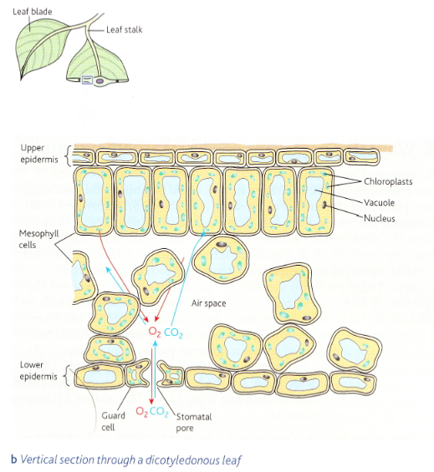

Slide 28
Adaptations for rapid diffusion;
Large surface area (thin flat shape of leaves)
Many small pores, called stomata (mostly in lower epidermis)
Numerous interconnecting air-spaces that occur throughout the mesophyll.

Slide 29
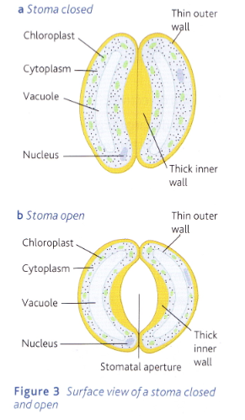

Slide 30
Examiner’s tip
The diffusion gradients in and out of the leaf are maintained by mitochondria carrying out respiration and chloroplasts carrying out photosynthesis.

Slide 31
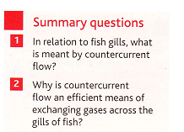
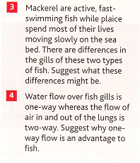
Summary Questions

Slide 32
Summary Questions
State two similarities between gas exchange in a plant leaf and gas exchange in a terrestrial insect.
State two differences between gas exchange in a plant leaf and gas exchange in a terrestrial insect.
What is the advantage to a plant of being able to control the opening and closing of stomata?

Slide 33
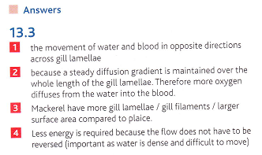
Answers
Any 2 from; no living cells is far from the external air / diffusion takes place in the gas phase / need to avoid excessive water loss / diffuse air through pores in their outer covering (can control the opening and closing of these pores).
Any 2 from; insects may create mass air flow – plants never do / insects have a smaller surface area to volume ratio than plants / insects have special structures (tracheae) along which gas can diffuse - plants do not / insects do not interchange gases between respiration and photosynthesis – plants do.

Slide 34
Homework Questions
WARNING Some independent research required!
Diffusion is a passive, physical process that takes place everywhere. Why is diffusion not the only means of gaseous exchange in large organisms? (2 marks)
With reference to surface area and heat exchange explain why having small ears is an adaptaticounter-current exchange with reference to gaseous exchange in fish.
By what process does carbon dioxide enter photosynthesizing cells in leaves?
Why is there a conflict between obtaining carbon dioxide for photosynthesis and conserving water?
Why does the stoma open when guard cells are turgid?
How do the stomata in plant cells open and close?
What are xerophytes?
on to a cold environment. (2 marks)
In which structures in the tracheal system does most gaseous exchange take place? Explain why. (2 marks)
Name two features of gills that maximize diffusion of respiratory gases across their membranes.
Explain the term halophytes?
How are xerophytes adapted to minimise water loss?
What is the significance of sarguaro cacti being shaped like an organ pipe?

Slide 35
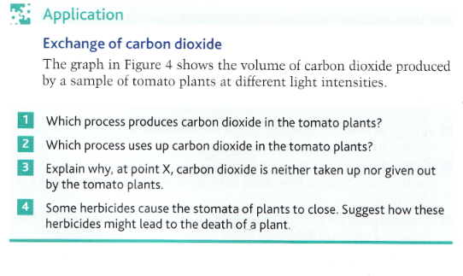
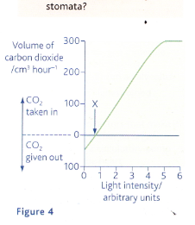

Slide 36
