Slide 1
Respiratory System
Gas exchange

Slide 2
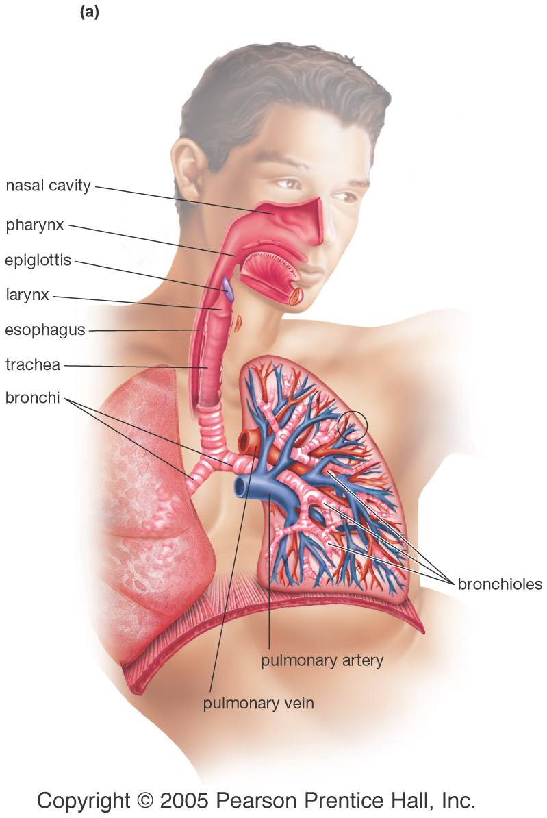
Human respiratory system
Parts of the respiratory system include:
Trachea
Bronchi
Bronchioles
Alveoli

Slide 3
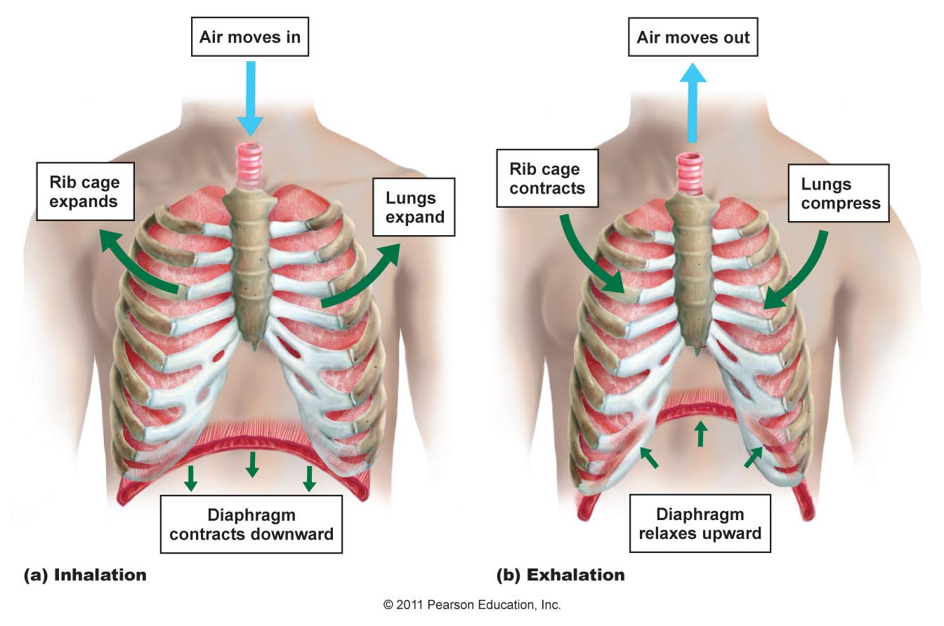
Moving air in and out
During inspiration (inhalation), the diaphragm and intercostal muscles contract.
During exhalation, these muscles relax. The diaphragm domes upwards.

Slide 4
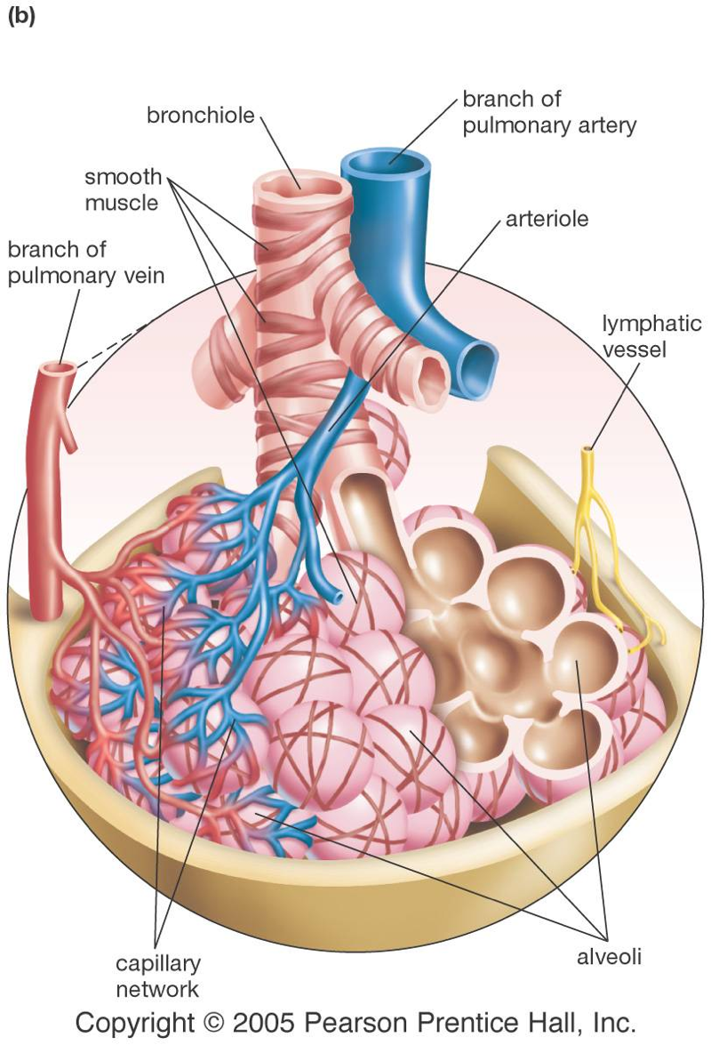
Alveoli
The alveoli are moist, thin-walled pockets which are the site of gas exchange.
A slightly oily surfactant prevents the alveolar walls from collapsing and sticking together.

Slide 5
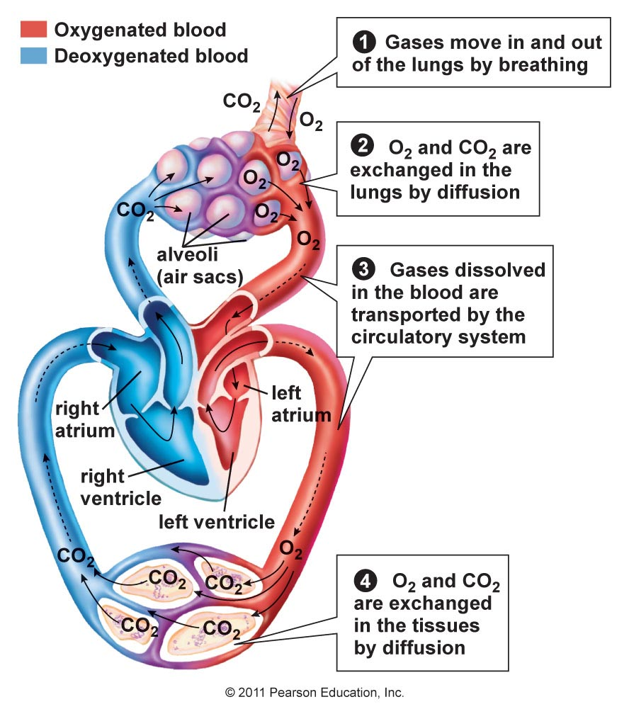
Circulation and Gas Exchange
Recall the interconnection between circulation and the respiratory system.
Gas exchange at the lungs and in the body cells moves oxygen into cells and carbon dioxide out.

Slide 6
What happens when you breathe in?
The rib muscles relax.
The diaphragm contracts.
Air leaves the alveoli.
Air moves between the chest wall and the lung.

Slide 7
W
O
R
K
T
O
G
E
T
H
E
R
Premature infants sometimes die of lung collapse and other lung problems. What might preemies be missing? How could this be remedied?

Slide 8
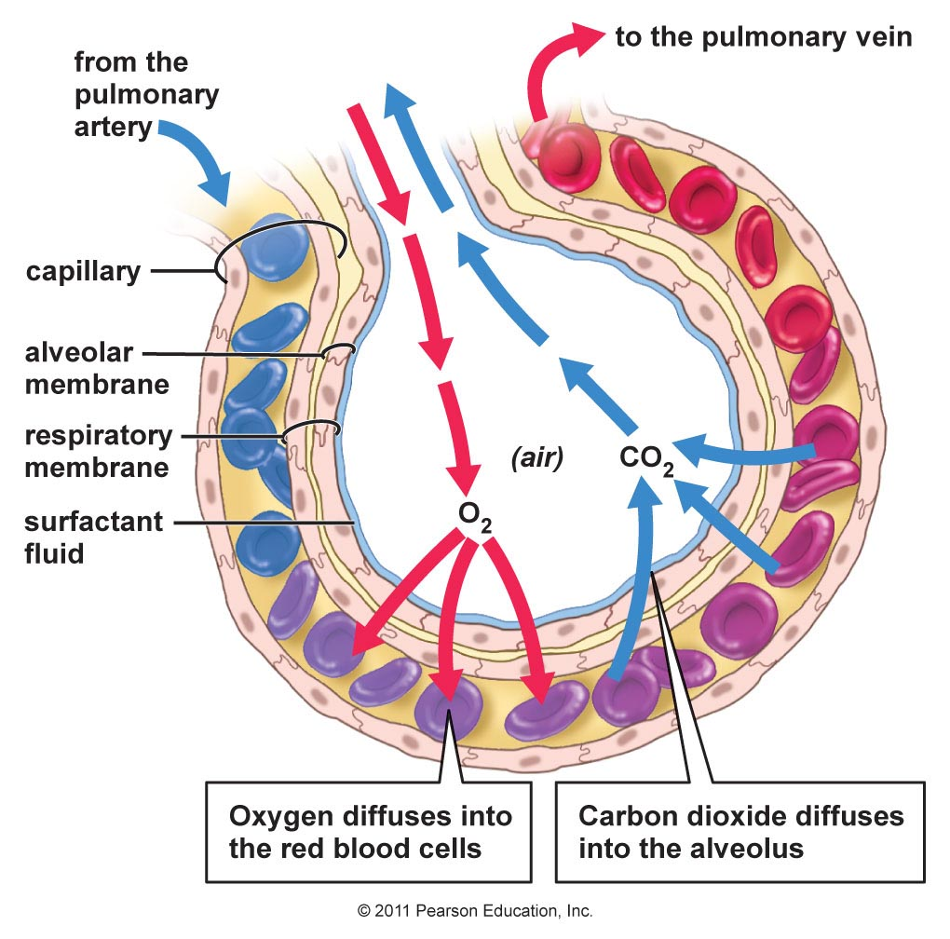
In the alveolus
The respiratory surface is made up of the alveoli and capillary walls.
The walls of the capillaries and the alveoli may share the same membrane.

Slide 9
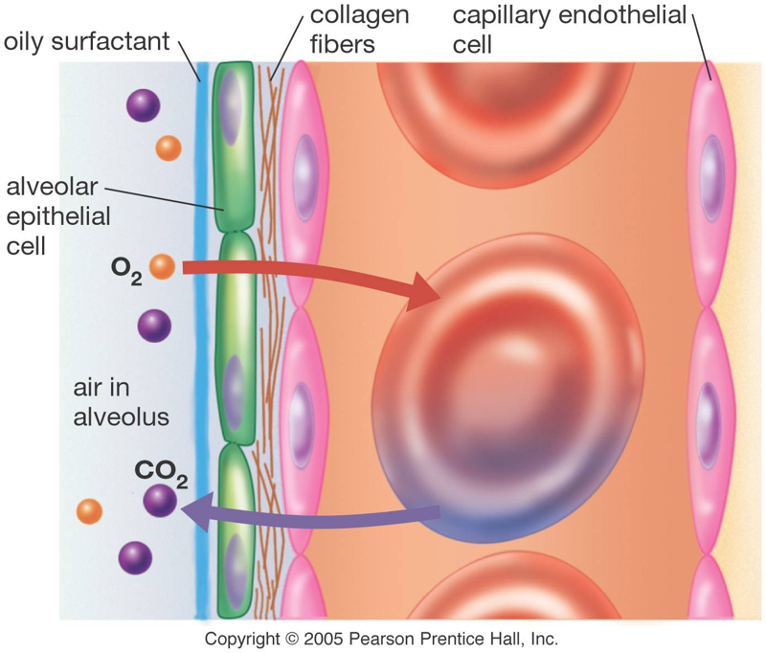
Gas exchange
Air entering the lungs contains more oxygen and less carbon dioxide than the blood that flows in the pulmonary capillaries.
How do these differences in concentrations assist gas exchange?

Slide 10
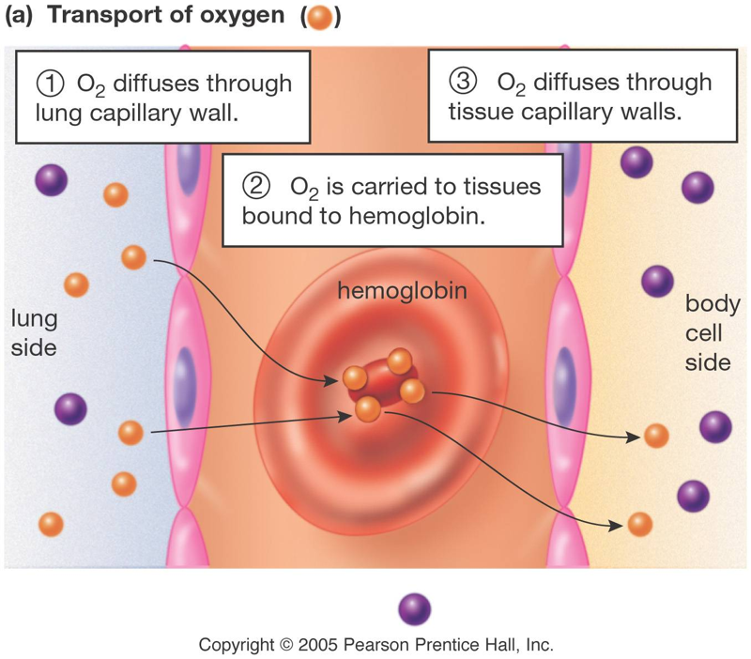
Oxygen transport
Hemoglobin binds to oxygen that diffuses into the blood stream.
What are some advantages to using hemoglobin to transport oxygen?

Slide 11
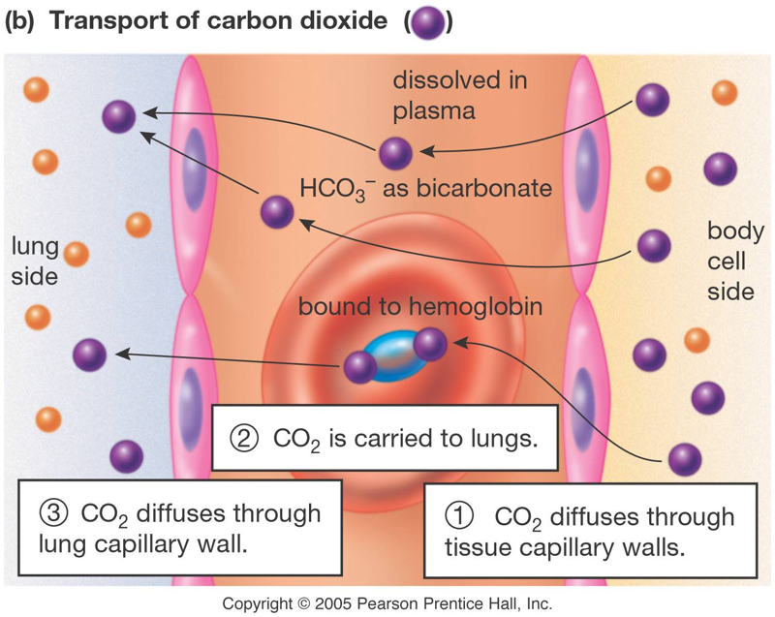
Carbon dioxide transport
Carbon dioxide can dissolve in plasma, and about 70% forms bicarbonate ions.
Some carbon dioxide can bind to hemoglobin for transport.

Slide 12
At the cells
Cells use up oxygen quickly for cellular respiration. What does this do to the diffusion gradient? How does this help cells take up oxygen?
Cells create carbon dioxide during cellular respiration, so CO2 levels in the cell are higher than in the blood coming to them. How does this help cells get rid of oxygen?

Slide 13
Diffusion of O₂ from lungs to blood is rapid because:
Active transport moves oxygen.
Hemoglobin takes up oxygen, keeping plasma concentration low.
Blood plasma is oxygen-rich.

Slide 14
Most of the oxygen in blood is:
In the white cells.
Bound to hemoglobin.
Combined with carbon to make carbon dioxide.
Dissolved in the plasma.

Slide 15
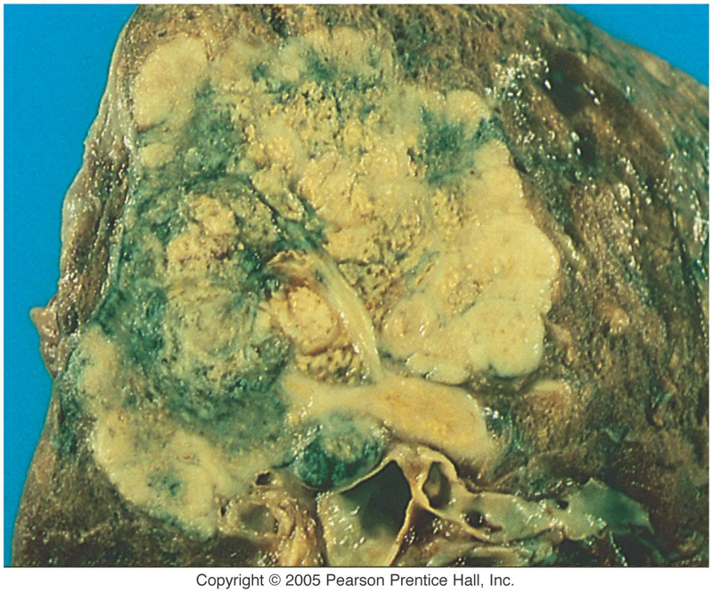
Effects of smoking
Inhaled smoke contains:
CO2, which affects the CO2 diffusion gradient.
carcinogenic chemicals that can trigger tumors.
toxic nicotine, which paralyzes cilia that normally clean the lungs.
Gross, isn’t it?

Slide 16
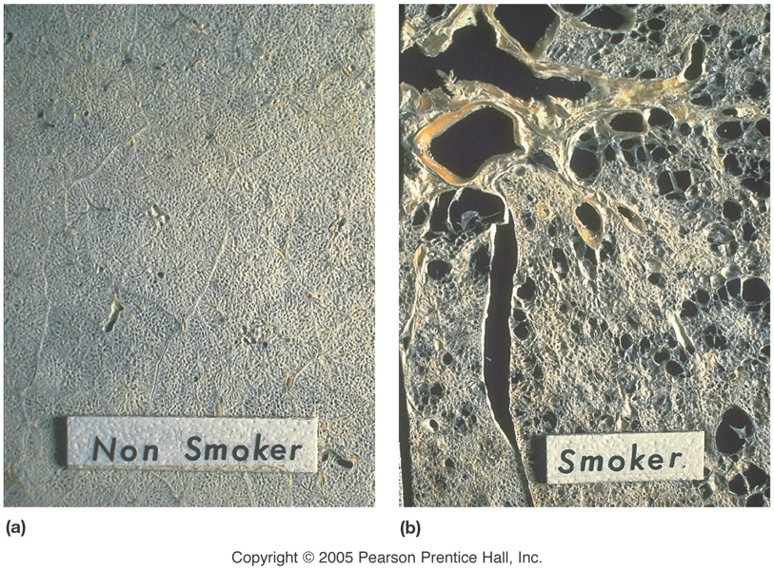
Emphysema
Besides cancer, smoking can also lead to emphysema. Alveoli become dry and brittle, and eventually rupture.
Both active and passive smoking (“second-hand” smoke) can lead to can lead to lung problems.
All types of smoke, not just tobacco, can cause cancers and emphysema.

Slide 17
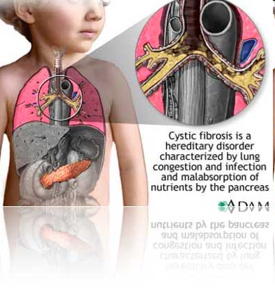
Cystic Fibrosis
Cystic fibrosis is one of the most common inherited disorders in the Caucasian population in the U.S.
CF is caused by mutation of a single gene, the CFTR gene, which controls salt balance in the lungs.

Slide 18
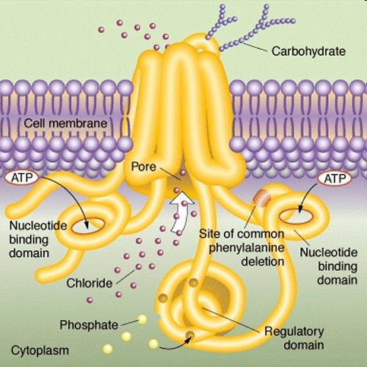
Cystic Fibrosis
A normal CFTR protein regulates the amount of chloride ions across the cell membrane of lung cells.
If the interior of the cell is too salty, water is drawn from lung mucus by osmosis, causing the mucus to become thick and sticky.

Slide 19
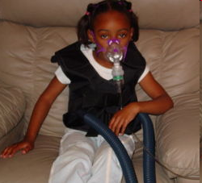
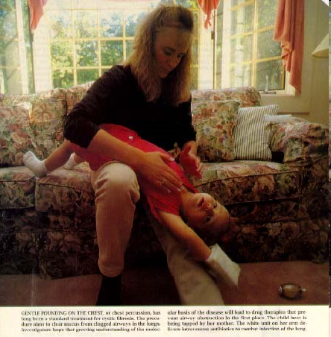
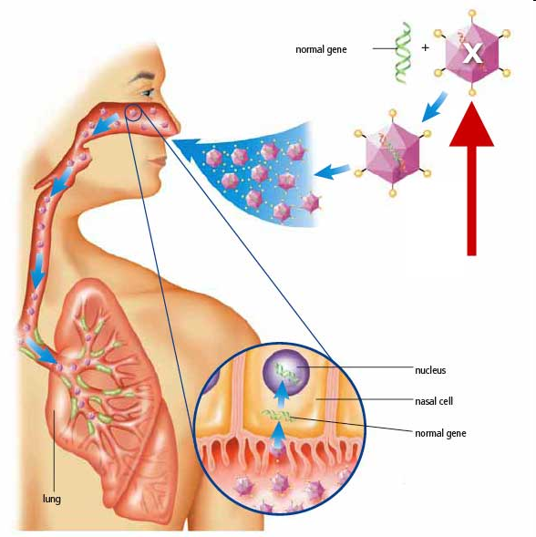
Cystic Fibrosis
At this point there is no cure for CF, though there are therapies that have extended the lives of CF patients, including lung transplants.
Gene therapy may one day insert “good” CFTR genes into lung cells to make them operate normally.

Slide 20
“Two lies and a truth” – which one is true?
Cigarette smoke cures colds because it kills bacteria in the lungs.
Nicotine is one of the most potent neurotoxins on earth.
“Passive” smoking is less harmful than “regular” smoking.

Slide 21
W
O
R
K
T
O
G
E
T
H
E
R
When people quit smoking, if the lungs are not damaged they can often clean themselves because the cilia are no longer paralyzed. People with cystic fibrosis have trouble with lung infections because their lung mucus is thick and sticky. What roles do cilia and mucus play in lung health?

