Slide 1
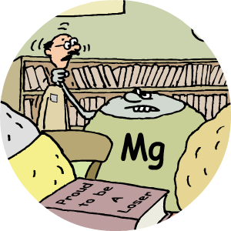
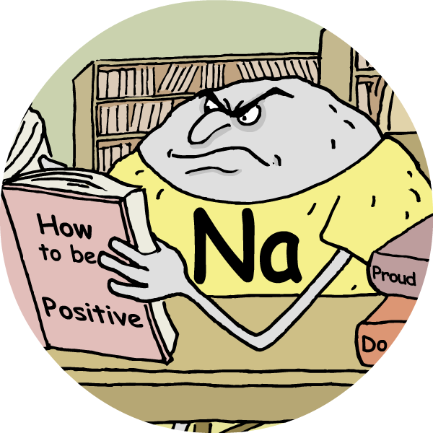
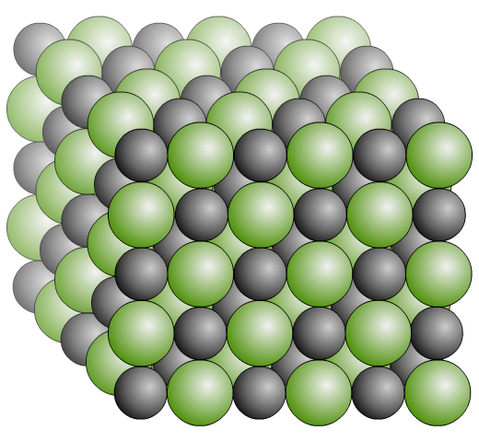
Ionic Bonding

Slide 2
Elements
Elements are the simplest substances. There are about 100 different elements.
Each element is made up of just one particular type of atom, which is different to the atoms in any other element.
C
S
N
O
K
Atoms usually join together. This is called bonding.
In some elements, atoms bond to form small, simple structures. In other elements, atoms bond into giant structures with millions of atoms.

Slide 3
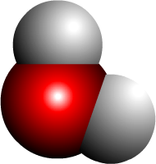

Compounds
Compounds are formed when different elements chemically react with each other. In these reactions different types of atom become chemically bonded.
H
Some compounds, like water, have small, simple structures with just a few atoms bonded together.
O
H
Others compounds, like DNA, have large, complex structures containing thousands or even millions of bonded atoms.

Slide 4
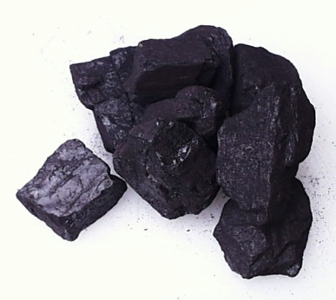
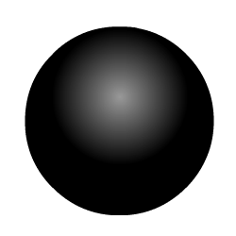
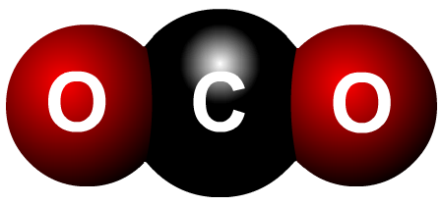
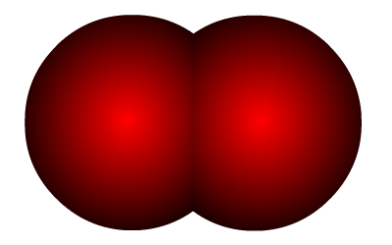


Properties of compounds
A compound has different properties to the elements from which it is made because the atoms are joined differently.
carbon
+
oxygen
carbon dioxide
+
Black solid used as fuel.
Colourless gas in which many substances burn.
Colourless gas used in fizzy drinks and fire extinguishers.
C
+
O
O

Slide 5
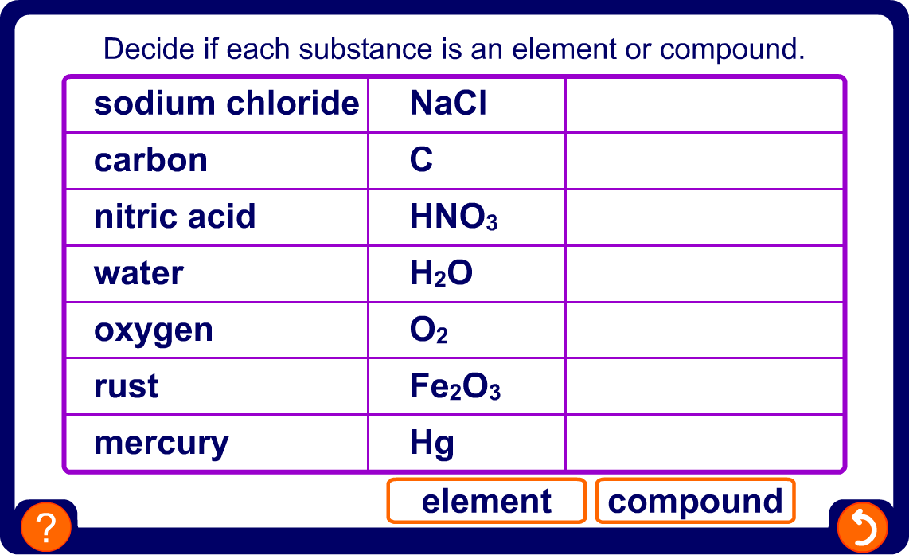
Element or compound?

Slide 6
Subatomic particles
Atoms consist of three types of subatomic particles:
proton
exist in
the dense nucleus
neutron
electron
orbit the nucleus in layers called shells

Slide 7
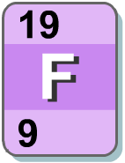
Atoms and electrical charge
An important feature of subatomic particles is their electrical charge:
Particle | proton | neutron | electron
Charge | +1 | 0 | -1
Atoms have equal numbers of protons and electrons, which means their overall charge is zero.
For example, fluorine:
9 protons = +9
9 electrons = -9
10 neutrons = 0
Total charge = 0

Slide 8
Full electron shells
Each shell has a maximum number of electrons that it can hold. Electrons will fill the shells nearest the nucleus first.
2nd shell holds
a maximum of
8 electrons
1st shell holds
a maximum of
2 electrons
3rd shell holds
a maximum of
8 electrons
Atoms of noble gases have completely full outer shells. This makes them very unreactive or stable.

Slide 9
Types of bonding
Atoms can be bonded in three different ways:
Ionic bonding
Metal and non-metal atoms
Covalent bonding
Non-metal atoms only
Metallic bonding
Metal atoms only
Bonding occurs because atoms with incomplete outer electron shells are unstable. By forming bonds, atoms completely fill their outer shells and become stable.
All types of bonding involve changes in the number of electrons in the outer shells of atoms.

Slide 10
Making ions

Slide 11
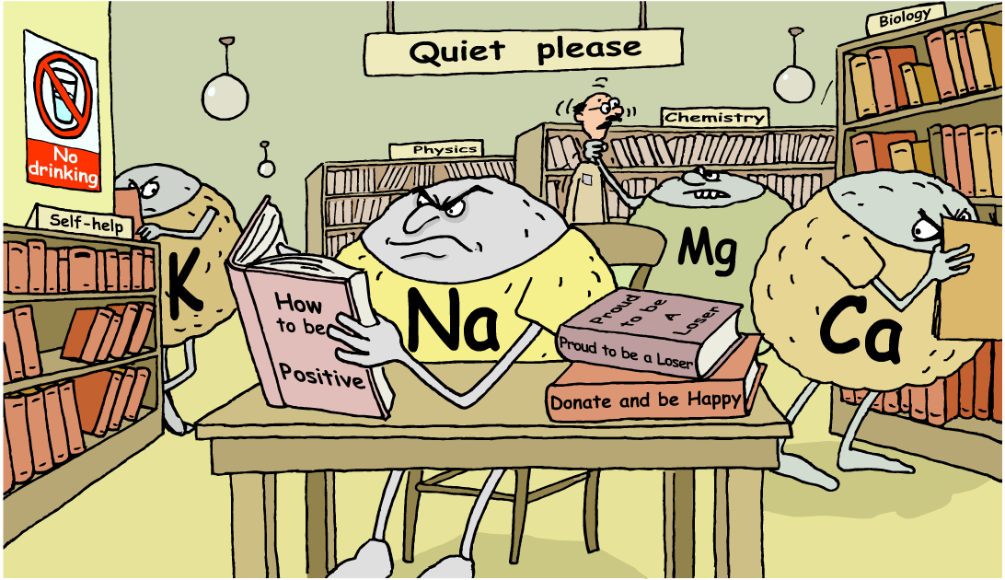
From atoms to ions
How can reactive metal atoms become stable positive ions?

Slide 12
Atoms and electron changes
Atoms can obtain completely full outer electron shells by either gaining or losing electrons when they react with other atoms. When this happens, atoms become ions.
Unlike atoms, ions have an electrical charge because they contain an unequal number of protons and electrons.
Atoms that lose electrons have more protons than electrons and so have a positive charge. They are called positive ions or cations.
Atoms that gain electrons have more electrons than protons and so have a negative charge. They are called negative ions or anions.

Slide 13
Charges on ions
When atoms form ions they obtain an outer electron shell that is either completely full or completely empty.
For atoms with a nearly empty outer shell, it takes less energy to lose electrons to have a full outer shell than it does to gain electrons.
For atoms with a nearly full outer shell, it takes less energy to gain electrons to have a full outer shell than it does to lose electrons.
The electron configuration of an atom gives information about how many electrons it must lose or gain to achieve a stable, noble gas configuration.

Slide 14
Positive ions
An atom that loses one or more electrons forms a positive ion.
Metal atoms, such as sodium, magnesium and iron, form positive ions.
Positive ions have a small ‘+’ symbol and a number by them to indicate how many electrons they have lost.
This number is usually the same as the number of electrons
in the atom’s outer shell. For example:
lithium atom = 2.1
ion = Li⁺ (not Li¹⁺)
magnesium atom = 2.8.2
ion = Mg²⁺
aluminium atom = 2.8.3
ion = Al³⁺

Slide 15
The sodium ion
Sodium atom:
Sodium ion:
11 protons = +11
11 protons = +11
11 electrons = -11
10 electrons = -10
Total charge = 0
Total charge = +1
+
one electron is lost
Na
Na
Electron arrangement: 2.8.1 (partially full outer shell)
Electron arrangement: [2.8]⁺
(full outer shell)

Slide 16
The magnesium ion
Magnesium atom:
Magnesium ion:
12 protons = +12
12 protons = +12
12 electrons = -12
10 electrons = -10
Total charge = 0
Total charge = +2
2+
two electrons are lost
Mg
Mg
Electron arrangement: 2.8.2 (partially full outer shell)
Electron arrangement: [2.8]²⁺
(full outer shell)

Slide 17
Negative ions
An atom that gains one or more electrons forms a negative ion. Non-metal atoms, such as chlorine, oxygen and nitrogen, form positive ions.
Negative ions have a small ‘-’ symbol and a number by them to indicate how many electrons they have gained to fill their outer shell. For example:
chlorine atom = 2.8.7
chloride ion = Cl⁻ (not Cl¹⁻)
oxygen atom = 2.6
oxide ion = O²⁻
nitrogen atom = 2.5
nitride ion = N³⁻
The name of the ion is slightly different to that of the atom – it ends ‘–ide’.

Slide 18
The fluoride ion
Fluorine atom:
Fluoride ion:
9 protons = +9
9 protons = +9
9 electrons = -9
10 electrons = -10
Total charge = 0
Total charge = - 1
-
one electron is gained
F
F
Electron arrangement: 2.7 (partially full outer shell)
Electron arrangement: [2.8]⁻
(full outer shell)

Slide 19
The sulfide ion
Sulfur atom:
Sulfide ion:
16 protons = +16
16 protons = +16
16 electrons = -16
18 electrons = -18
Total charge = 0
Total charge = - 2
2-
two electrons are gained
S
S
Electron arrangement: 2.8.6 (partially full outer shell)
Electron arrangement: [2.8.8]²⁻
(full outer shell)

Slide 20
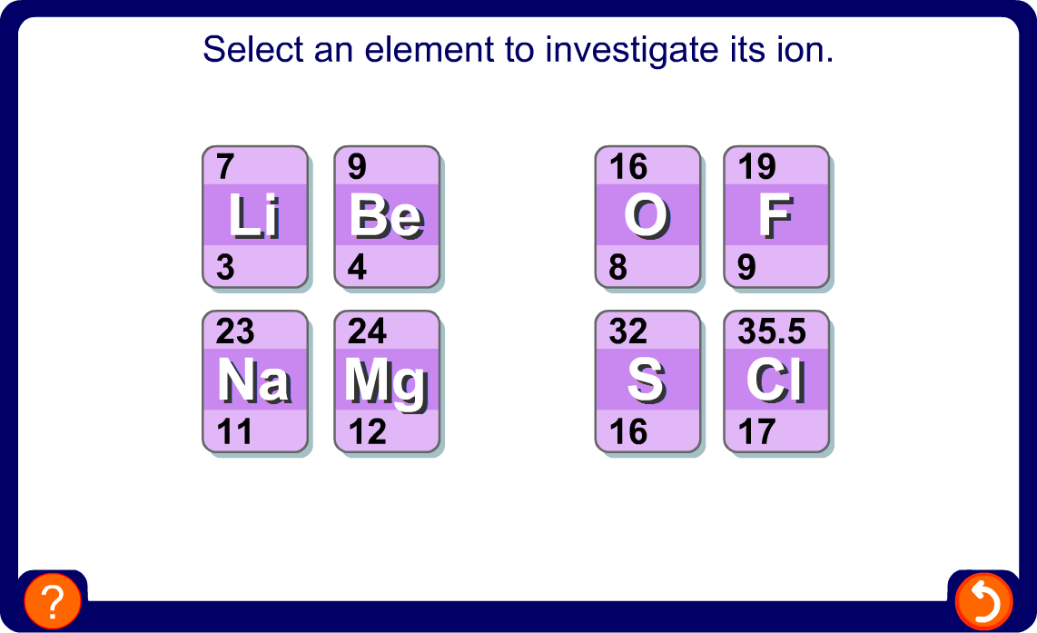
Building an ion

Slide 21
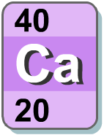
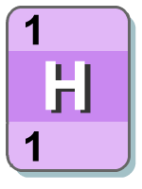
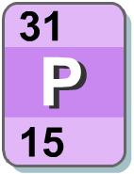
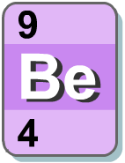
Calculating ion charges
What charges will the ions of these elements have?
Element | calcium | hydrogen | phosphorus | fluorine | beryllium
Electrons | 2.8.8.2 | 1 | 2.8.5 | 2.7 | 2.2
Charge
2+
+
3-
1-
2+

Slide 22
Transition metal ions
Some transition metals only make one type of ion.
For example:
silver only forms Ag⁺ ions;
zinc only forms Zn²⁺ ions.
However, most transition metals make more than one type of ion by losing different numbers of electrons. For example:
Metal Ion Example of compound
Cu⁺ copper (I) oxide – Cu₂O
copper
Cu²⁺ copper (II) oxide – CuO
Fe²⁺ iron (II) chloride – FeCl₂
iron
Fe³⁺ iron (III) chloride – FeCl₃

Slide 23
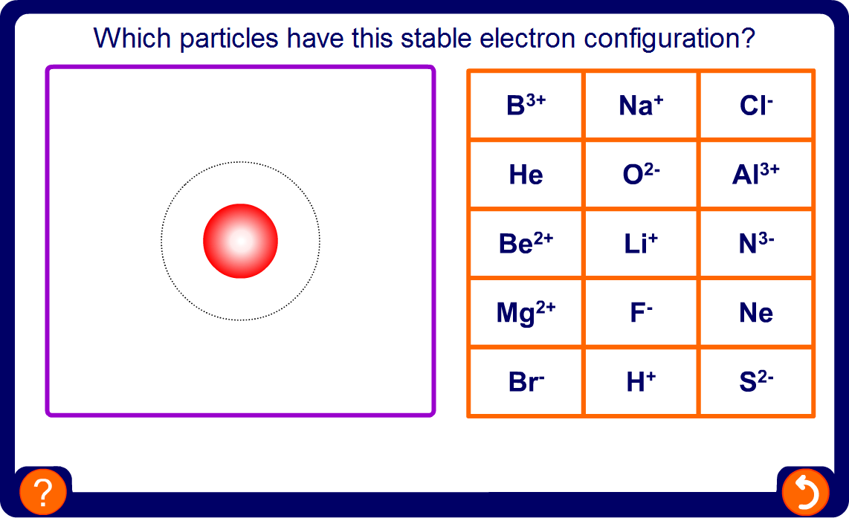
Comparing electron configurations

Slide 24
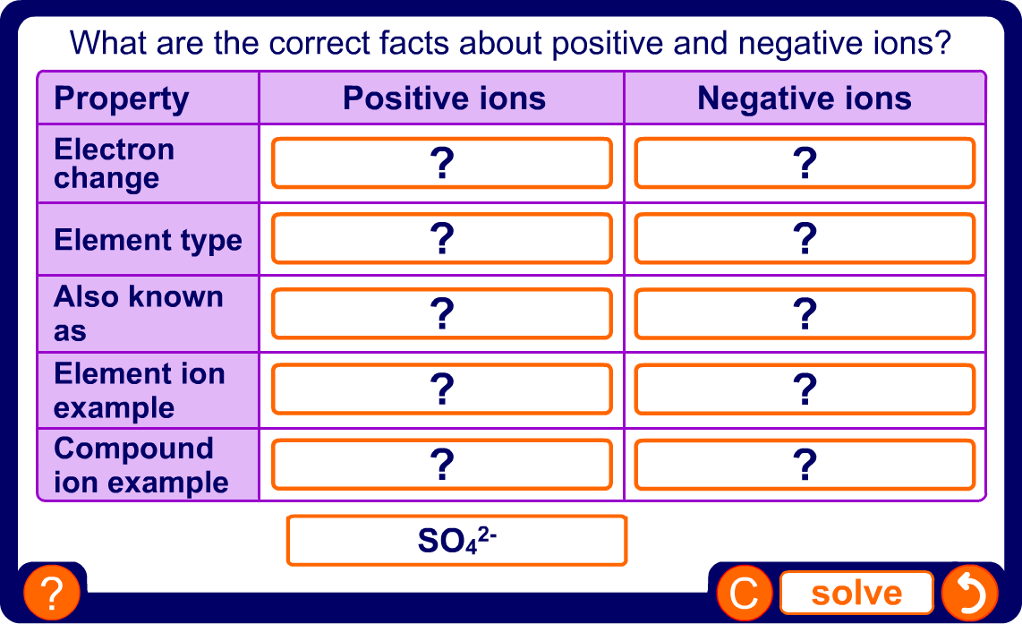
Comparing positive and negative ions

Slide 25
Ionic Bonding

Slide 26
Ionic compounds
Compounds that contain ions are called ionic compounds. These compounds are usually formed by a reaction between
a metal and a non-metal.
Why do these substances react?
Both the metal and non-metal atoms have incomplete outer electron shells and so are unstable.
One or more electrons are transferred from each metal atom to each non-metal atom. The metal and the non-metal atoms end up with completely full outer shells and become very stable.
The positive and negative ions are strongly attracted to each other. This electrostatic attraction is called an ionic bond.

Slide 27
Sodium chloride: part 1
Sodium chloride is an ionic compound formed by the reaction between the metal sodium and the non-metal chlorine.
sodium
Na
chlorine
Cl
sodium chloride
NaCl
+
During the reaction, one electron is transferred from each sodium atom to each chlorine atom.

Slide 28
Sodium chloride: part 2
Sodium has 1 electron in its outer shell. If it loses this electron, it will have no partially-filled shells.
Chlorine has 7 electrons in its outer shell. If it gains 1 electron, it will completely fill its outer shell.
-
+
Cl
Na
Cl
Na
2.8.1
[2.8]⁺
2.8.7
[2.8.8]⁻

Slide 29
Sodium chloride: part 3
The positive sodium ions and the negative chloride ions are strongly attracted to each other and form an ionic bond.
-
+
Na
Cl

Slide 30
Magnesium oxide: part 1
More than one electron can be transferred during ionic bonding.
Magnesium oxide is another ionic compound, formed by the reaction between magnesium and oxygen.
magnesium
Mg
oxygen
O
magnesium oxide
MgO
+
During this reaction, two electrons are transferred from each magnesium atom to each oxygen atom.

Slide 31
Magnesium oxide: part 2
Magnesium has 2 electrons in its outer shell. If it loses these, it will have no partially-filled shells.
Oxygen has 6 electrons in its outer shell. If it gains two electrons, it will completely fill its outer shell.
2+
2-
Mg
Mg
O
O
2.8.2
[2.8]²⁺
2.6
[2.8]²⁻

Slide 32
Magnesium oxide: part 3
The positive magnesium ions and the negative oxide ions are strongly attracted to each other and form an ionic bond.
2+
2-
Mg
O

Slide 33
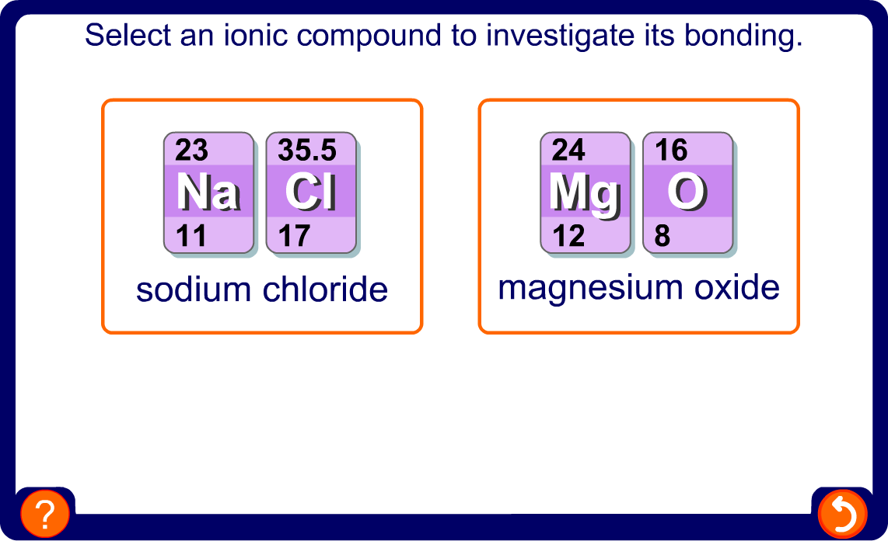
Formation of an ionic bond

Slide 34
Simplified bonding diagrams
The inner electron shells can sometimes be left out of bonding diagrams because they are not involved in bonding.
+
+
can also be drawn as
Na
Na
-
-
can also be drawn as
Cl
Cl

Slide 35
Drawing simplified bonding diagrams
Draw a simplified electron bonding diagram for magnesium sulfide.
2-
2+
Mg
Mg
S
S
2.8.2
[2.8]²⁺
2.8.6
[2.8.8]²⁻

Slide 36
More complicated ionic bonding
Sodium chloride and magnesium oxide are simple ionic compounds. In each case, the metal and non-metal need to lose and gain the same number of electrons.
Na
Cl
Na⁺
Cl⁻
1 electron
Mg
O
Mg²⁺
O²⁻
2 electrons
This is not always the case.

Slide 37
Sodium oxide
What happens in the reaction between sodium and oxygen?
Sodium (2.8.1) needs to lose 1 electron but oxygen (2.6) needs to gain 2 electrons. Therefore, two sodium atoms are required for each oxygen atom.
Na
Na⁺
1 electron per atom
O
O²⁻
Na
Na⁺

Slide 38
Magnesium chloride
What happens in the reaction between magnesium and chlorine?
Magnesium (2.8.2) needs to lose 2 electrons but chlorine (2.8.7) needs to gain 1 electron. Therefore, two chlorine atoms are required for each magnesium atom.
Cl
Cl⁻
1 electron for each atom
Mg
Mg²⁺
Cl
Cl⁻

Slide 39
Bonding in lithium oxide
Draw a simplified electron bonding diagram for lithium oxide.
+
Li
Li
2-
2.1
[2]⁺
O
O
+
Li
Li
2.6
[2.8]²⁻

Slide 40
Bonding in magnesium fluoride
-
Draw a simplified electron bonding diagram for magnesium fluoride.
F
F
2+
2.7
[2.8]⁻
Mg
Mg
-
F
F
2.8.2
[2.8]²⁺

Slide 41
Further ionic bonding
Draw simplified electron bonding diagrams for the following atoms:
1. Lithium (2.1) and fluorine (2.7)
2. Sodium (2.8.1) and sulfur (2.8.6)
3. Magnesium (2.8.2) and sulfur (2.8.6)
4. Magnesium (2.8.2) and fluorine (2.7)
5. Aluminium (2.8.3) and nitrogen (2.5)
total number of electrons lost
by the metal
total number of electrons gained by the non-metal
=

Slide 42
Formulae of ionic compounds

Slide 43
Formulae of ionic compounds
A formula uses chemical symbols and numbers to show the ratio of atoms of each element present in the compound.
To work out the formula of an ionic compound, follow this procedure:
1. Write down the symbol for each atom.
2. Calculate the charge for each ion.
3 Balance the number of ions so the positive and negative
charges equal zero. This gives a ratio of ions.
4. Write down the formula without the ion charges – the metal is always written first.

Slide 44
Formula of sodium fluoride
What is the formula of sodium fluoride?
Symbol
Ion charge
Balance the number of ions
Ratio of ions Formula
Na
F
1+
1-
1 sodium ion is needed for each fluoride ion
1 : 1
NaF
Na
Fl
Na⁺
Fl⁻
1 electron

Slide 45
Formula of aluminium bromide
What is the formula of aluminium bromide?
Symbol
Ion charge
Balance the number of ions
Ratio of ions Formula
Al
Br
3+
1-
3 bromide ions are needed for each aluminium ion
1 : 3
AlBr₃
Br
Br⁺
Al
1 electron for each atom
Br
Al³⁺
Br⁺
Br
Br⁺

Slide 46
Formula of aluminium oxide
What is the formula of aluminium oxide?
Symbol
Ion charge
Balance the number of ions
Ratio of ions Formula
Al
O
3+
2-
2 aluminium ions are needed for 3 oxide ions
2 : 3
Al₂O₃
Al
O
O²⁻
Al³⁺
2 electrons for each atom
O
O²⁻
Al³⁺
Al
O
O²⁻

Slide 47
More ionic formulae
Work out the formulae of all the possible ionic compounds from combinations of these metals and non-metals.
 | Li | Ca | Na | Mg | Al | K
F
O
N
Br
S
Cl
metals
non-
metals
LiF CaF₂ NaF MgF₂ AlF₃ KF
Li₂O CaO Na₂O MgO Al₂O₃ K₂O
Li₃N Ca₃N₂ Na₃N Mg₃N₂ AlN K₃N
LiBr CaBr₂ NaBr MgBr₂ AlBr₃ KBr
Li₂S CaS Na₂S MgS Al₂S₃ K₂S
LiCl CaCl₂ NaCl MgCl₂ AlCl₃ KCl

Slide 48
Compound ions
Ionic compounds can contain ions consisting of groups of atoms rather than a single atom. These are compound ions.
Ion Formula Charge Atoms present
hydroxide OH⁻ 1-
O
H
sulfate SO₄²⁻ 2-
S
O
O
O
O
nitrate NO₃⁻ 3-
N
O
O
O
carbonate CO₃²⁻ 2-
C
O
O
O
ammonium NH₄⁺ 1+
N
H
H
H
H
hydrogen-
carbonate
HCO₃⁻ 3-
H
C
O
O
O

Slide 49
More complicated formulae
Working out the formulae for compounds containing compound ions is the same as for simple ionic compounds. The compound ion is treated as a single particle, not individual particles.
1. Write down the symbol for each atom.
2. Calculate the charge for each ion.
3 Balance the number of ions so the positive and negative
charges equal zero. This gives a ratio of ions.
4. Write down the formula without the ion charges. If more than one compound ion is required, brackets must be put around the ion, before the number.

Slide 50
Formula of lithium nitrate
What is the formula of lithium nitrate?
Symbol
Ion charge
Balance the number of ions Ratio of ions
Formula
Li
NO₃
1+
1-
1 lithium ion is needed for each nitrate ion
1 : 1
LiNO₃

Slide 51
Formula of magnesium nitrate
What is the formula of magnesium nitrate?
Symbol
Ion charge
Balance the number of ions
Ratio of ions Formula
Mg
NO₃
2+
1-
2 nitrate ions are needed for each magnesium ion
1 : 2
Mg(NO₃)₂
The brackets around NO₃ indicate that the ‘2’ refers to a complete nitrate ion.

Slide 52
Formula of sodium sulfate
What is the formula of sodium sulfate?
Symbol
Ion charge
Balance the number of ions
Ratio of ions Formula
Na
SO₄
1+
2-
2 sodium ions are needed for each sulfate ion
2 : 1
Na₂SO₄
Although ‘Na’ contains 2 letters, it represents a single atom, so no brackets are required.

Slide 53
Formula of aluminium hydroxide
What is the formula of aluminium hydroxide?
Symbol
Ion charge
Balance the number of ions
Ratio of ions Formula
Al
OH
3+
1-
3 hydroxide ions are needed for each aluminium ion
1 : 3
Al(OH)₃

Slide 54
Formula of ammonium sulfate
What is the formula of ammonium sulfate?
Symbol
Ion charge
Balance the number of ions
Ratio of ions Formula
NH₄
SO₄
1+
2-
2 ammonium ions are needed for each sulfate ion
2 : 1
(NH₄)₂SO₄

Slide 55
Formula of aluminium carbonate
What is the formula of aluminium carbonate?
Symbol
Ion charge
Balance the number of ions
Ratio of ions Formula
Al
CO₃
3+
2-
2 aluminium ions are needed for 3 carbonate ions
2 : 3
Al₂(CO₃)₃
Although ‘Al’ contains 2 letters, it represents a single atom, so no brackets are required.

Slide 56
Properties of ionic compounds

Slide 57
Ionic lattices
In an ionic compound, millions and millions of ions are packed together in a regular cubic arrangement, joined by ionic bonds. This forms a giant 3D structure called an ionic lattice.
+
-
+
-
+
-
-
+
-
+
-
+
-
-
-
-
+
-
+
-
+
+
+
+
-
-
-
+
-
+
-
+
-
+
+
+
-
-
-
-
-
+
-
+
-
+
+
+
-
+
-
+
+
+
-
-
-
-
+
-
+
-
+
+
+
+
-
-
-
-
+
-
+
-
+
-
+
-
+
-
+
+
+
+
-
-
-
+
-
+
-
+
-
+
+
+
-
-
-
-
+
-
+
-
+
+
-
+
-
+
-
+
+
+
-
-
-
-
+
-
+
-
+
+
+
+
-
-
-
+
-
+
-
+
-
+
-
+
+
+
-
+
-
+
+
-
+
-
+
-

Slide 58
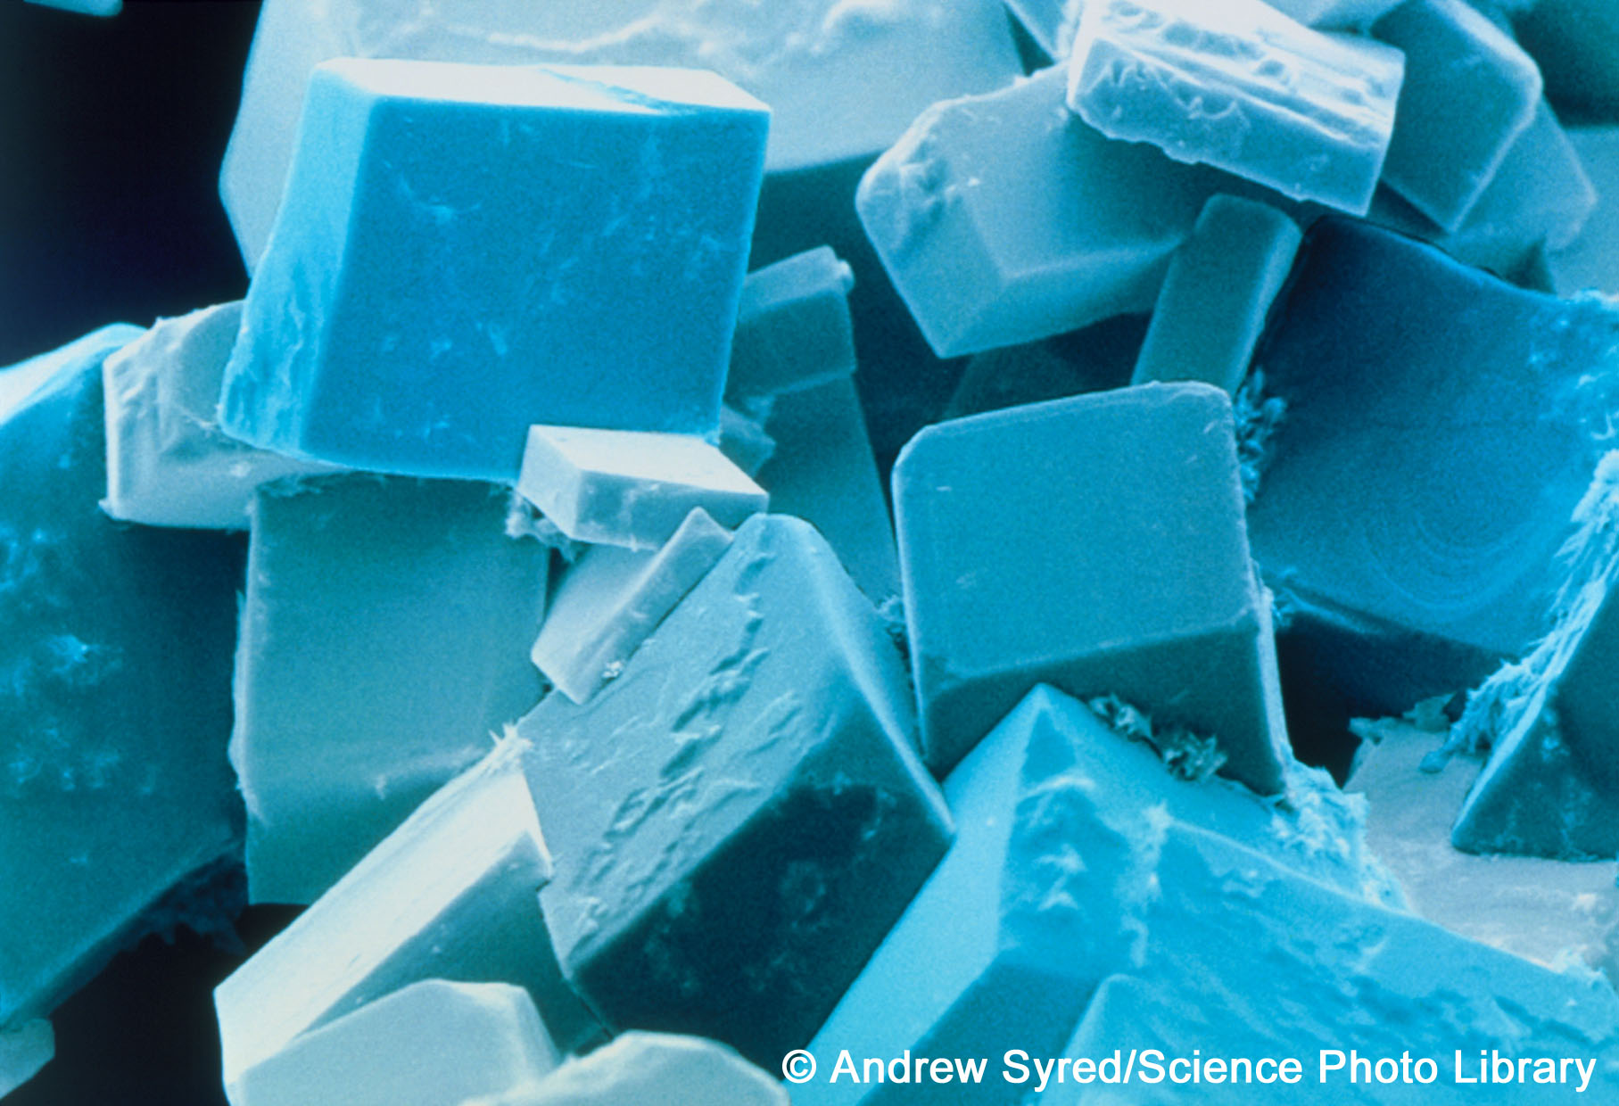
Ionic lattices and crystals
The structure of the lattice means that the ionic compound forms a crystal. This has flat sides and straight edges.
These are crystals of sodium chloride
All ionic compounds form lattices and crystals when solid.
Notes:
Acknowledgement
The image is a coloured scanning electron micrograph (SEM) of common salt, sodium chloride, recrystallised from distilled water. The salt crystal is built up from a cubic lattice of sodium and chloride ions. In the absence of impurities the exact cubic crystal form is produced. This micrograph shows that in practice this basic cube is usually disrupted by dislocations; these give rise to crystals with a variety of shapes, although they all retain the basic cubic symmetry. Magnification: x280 at 5x7cm size. x975 at 10x8‘.
Credit: Andrew Syred/Science Photo Library

Slide 59
Heating ionic compounds
Ionic bonds are strong and require a lot of heat to break them. This means that ionic compounds are solid at room temperature.
A larger ionic charge produces stronger ionic bonds, which means that more heat is required to break the bonds.
Compound Ion Melting Boiling
charges point (°C) point (°C)
sodium
chloride
1⁺ and 1⁻ 801 1,413
magnesium
oxide
2⁺ and 2⁻ 2,852 3,600

Slide 60
Electricity, solubility and ionic compounds
Ionic compounds do not conduct electricity when they are solid because the ions are packed together and cannot move.
When molten, however, the lattice breaks up and the ions are free to move. Because they are charged particles, they can carry an electric current.
Ionic compounds are usually soluble in water because water molecules have a slight electrical charge and can attract the ions away from the lattice.
When dissolved, the ions are free to move and can carry an electric current.

Slide 61
Strength of ionic compounds
Ionic compounds are brittle – they shatter when they are hit.
force
+
-
+
-
+
-
-
-
-
+
+
+
+
+
+
-
-
-
-
-
-
-
+
-
+
-
+
+
+
+
-
-
-
-
+
-
+
-
+
+
+
+
+
+
+
-
-
repulsion
-
-
-
+
+
-
+
+
-
-
-
-
-
-
+
+
-
+
+
+
+
+
+
+
-
+
-
+
When the lattice is hit, a layer of ions is shifted so that ions with the same charges are lined up together.
These like charges repel each other, thereby splitting the lattice.

Slide 62
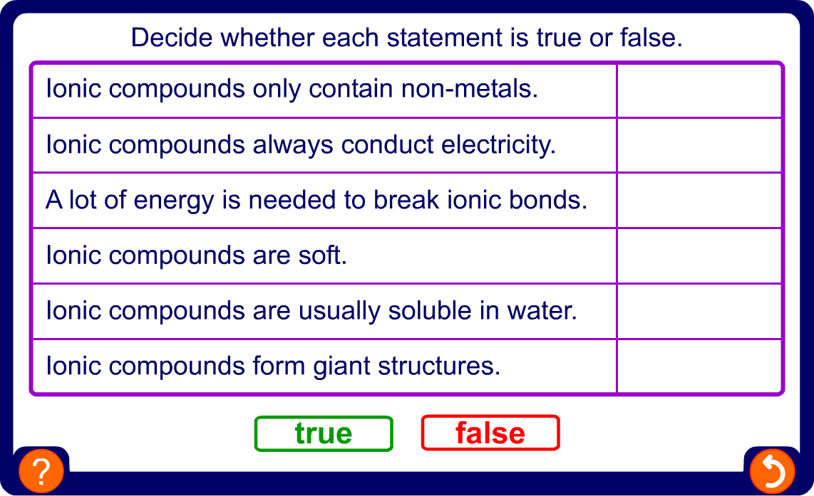
Properties of ionic compounds

Slide 63
Summary activities

Slide 64
Glossary
 bond – A strong force that joins atoms or ions together in molecules and giant lattices.
 compound ion – An ion made up of a group of atoms, rather than one single atom.
 ionic bond – The electrostatic force of attraction between oppositely charged ions.
 ionic compound – A compound made up of ions.
 ionic lattice – A giant 3D structure of closely packed, oppositely-charged ions.
 negative ion – An atom or group of atoms that has gained electrons and so has a negative charge.
 noble gas – An element that has a full outer electron shell and so is very stable and unreactive.
 positive ion – An atom or group of atoms that has lost electrons and so has a positive charge.

