Slide 1
MAKING SALTS

Slide 2
Making Soluble Salts
There are 3 types of reaction that can be used to make soluble salts. All 3 involve:
An Acid
A metal or metal compound
Method 1
METAL + ACID SALT + HYDROGEN
e.g. magnesium + hydrochloric acid magnesium chloride + hydrogen
Method 2
METAL OXIDE + ACID SALT + WATER
Method 3
METAL HYDROXIDE (Alkali) + ACID SALT + WATER

Slide 3
Making salts
To form the name of a salt, you just combine the name of the metal involved, with the salt type associated with the acid. Hydrochloric acid makes chlorides, Sulfuric makes sulfates, Nitric makes nitrates.
Complete the table as practice
 | Hydrochloric acid | Sulphuric acid | Nitric acid
Sodium hydroxide | Sodium chloride + water
Potassium oxide |  | Potassium sulfate + water
Calcium |  |  | Calcium nitrate + water

Slide 4
Reactions of metals with acids
When a metal reacts with an acid it gives off hydrogen (which can be “popped” using a lit splint). The other product is a salt.
METAL + ACID SALT + HYDROGEN
e.g. magnesium + hydrochloric acid magnesium chloride + hydrogen
Copy and complete the following reactions:
Calcium + hydrochloric acid
Zinc + hydrochloric acid
Iron + hydrochloric acid
Lithium + sulphuric acid

Slide 5
Quiz on acids and alkalis
Acid, alkali or both???
This a pH of less than 7
This could kill cells
A metal hydroxide (e.g. sodium hydroxide) would be an _____
When this reacts with a metal hydrogen is released
A metal carbonate (e.g. calcium carbonate) would be an _____
This would feel soapy on your skin
This could be a corrosive
This will turn universal indicator purple
This would taste sour
This means “a base that can be dissolved”

Slide 6
Neutralisation reactions
When acids and alkalis react together they will NEUTRALISE each other. Neutralisation is an example of a displacement reaction:
Sodium hydroxide
Hydrochloric acid
Na
OH
H
Cl
The sodium DISPLACES the hydrogen from HCl
Na
Cl
H₂O
Sodium chloride
Water

Slide 7
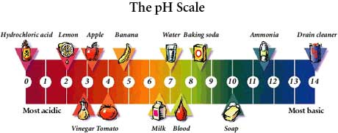
H ions and OH ions
+
-
+
H ions make acids acidic.
OH ions make alkalis alkaline.
The pH scale measures the alkalinity or acidity of a solution.
-
+
During neutralisation reactions the H ions react with the OH ions to form H2O (water).
-
+
-
H (aq) + OH (aq) → H2O(l)

Slide 8
Neutralisation experiment
Sodium hydroxide + hydrochloric acid → sodium chloride + water
A ____ was formed during the reaction, and we could have separated this by __________ the solution, allowing the salt to Crystallise. The salt that we formed depended on the acid:
  Hydrochloric acid will make a CHLORIDE
  Nitric acid will make a _________
  Sulphuric acid will make a _________
Words to use – nitrate, neutralised, alkali, sulphate, salt, evaporating

Slide 9
Reactions of metal oxides with acid
A metal oxide is a compound containing a metal and oxide. They are sometimes called BASES. A BASE is simply an insoluble alkali – it neutralises acids, but does not dissolve in water. For example:
O
O
Al
Mg
O
Na
O
Na
Al
O
Magnesium oxide
Sodium oxide
Aluminium oxide
METAL OXIDE + ACID SALT + WATER
H
Cl
O
Cl
H
Mg
Mg
Cl
O
H
Cl
H
Copy and complete the following reactions:
Magnesium oxide + hydrochloric acid
Calcium oxide + hydrochloric acid
Sodium oxide + sulphuric acid

Slide 10
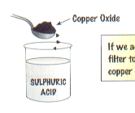
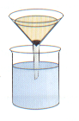

Using Bases to Make Salts
Because Bases are insoluble the procedure for making a salt is very slightly different…
…Instead of simply evaporating off the water, you have to first remove any remaining (or excess) Base by filtration.
1) Drop the base into the acid…
2) Filter it to remove any leftover base
3) Evaporate it to get the salt

Slide 11

Ammonium Salts
Ammonia (NH3) is a gas that dissolves in water to make an alkali (Ammonium hydroxide).
This can then be used to make Ammonium salts by reacting it with an acid.
Ammonia + Nitric acid Ammonium Nitrate
NH3(g) + HNO3(aq) NH4NO3(aq)
Notice how NO water is made in this neutralisation reaction.
Ammonium salts make good fertilisers because plants need nitrogen to make proteins (to grow). Ammonium Nitrate is the best for this purpose – can you see why??

Slide 12
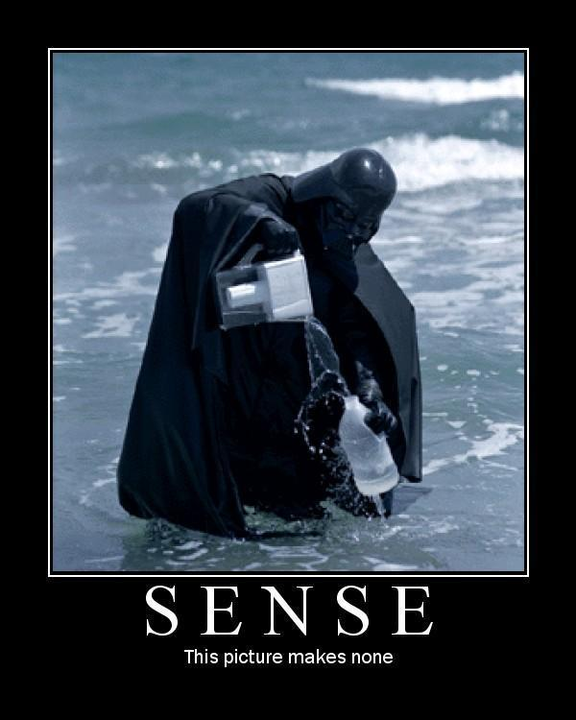
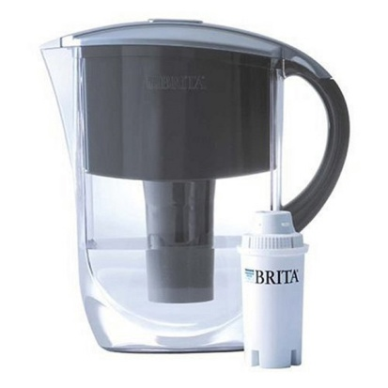
Making Insoluble Salts
Doesn’t usually require an acid.
Insoluble salts can be made by mixing appropriate solutions of ions (soluble salts), so that a precipitate is formed.
Barium chloride + Sodium sulfate Barium sulfate + Sodium chloride
BaCl2(aq) + Na2SO4(aq) BaSO4(s) + 2NaCl(aq)
Precipitation can be used to remove unwanted ions from solutions, for example in treating water for drinking or in treating effluent. – The filter is covered in ions, which form precipitates with ions in the water.

Slide 13
An example question on reactivity
Which metal is most reactive?
Metal | Reaction with dilute acid | Reaction with water | Reaction with oxygen
A | Some reaction | Slow reaction | Burns brightly
B | No reaction | No reaction | Reacts slowly
C | No reaction | No reaction | No reaction
D | Violent reaction | Slow reaction | Burns brightly
E | Reasonable reaction | Reacts with steam only | Reacts slowly

