Slide 1
Kidney – structure and function
Biological principles in action

Slide 2
Learning Outcomes
5.4.6 (a), (b) and (d).
List main components of 3 body fluids
Describe how to test for glucose, protein and urea
Describe how to find concentration of urea in a solution
Determine the urea concentration of a fluid
Outline the roles of the kidney in excretion and osmoregulation

Slide 3
Kidney – structure and function
Where are they?
What are they for?

Slide 4
Roles of the kidney
excretion
homeostasis
osmoregulation
regulation of salts in the body
regulation of pH
production of a hormone (EPO)

Slide 5
Testing Body fluids
You have three fluids labelled as X, Y and Z
You are provided with:
  Clinistix / Diastix
  Albustix
  Urease and litmus paper
Find out what is in each of the three fluids.

Slide 6
Testing Body fluids
Draw out a flow chart to show how you would identify the following fluids using observations and simple laboratory tests like those you have just used:
whole blood, plasma, serum, tissue fluid (filtrate), urine, bile, saliva.

Slide 7
Urea Determination
Follow the instructions to produce a graph
to determine the urea concentration of an
unknown solution (U).

Slide 8
Urea Determination
Answer questions (a), (b) and (c) and 8.
Present as a coherent report.
No need to reproduce the instructions, but you may if you wish.

Slide 9
Homework materials
Today’s work sheets
Homework Exercises
Useful Links
Go to www.rfosbery-biology.co.uk
Use: life, line, lifeline to enter the site
Click on OHS, username is oxford,
password is soapysam

Slide 10
Kidney dissection
Learning outcomes
Describe the external features of the kidney
Describe the position of the kidneys in the body and relationships with blood supply and rest of u/g system
Draw and label LS kidney
Recognise different parts of the kidney
Make a drawing to scale

Slide 11
Kidney functions
filtration of blood
selective reabsorption by
  active transport
  passive absorption
secretion

Slide 12
Kidney - structure
Gross structure – what you can see with the naked eye
Histology – what you can see through the microscope

Slide 13
Kidney – gross structure
Position of kidneys in the body
External structure
Internal structure

Slide 14
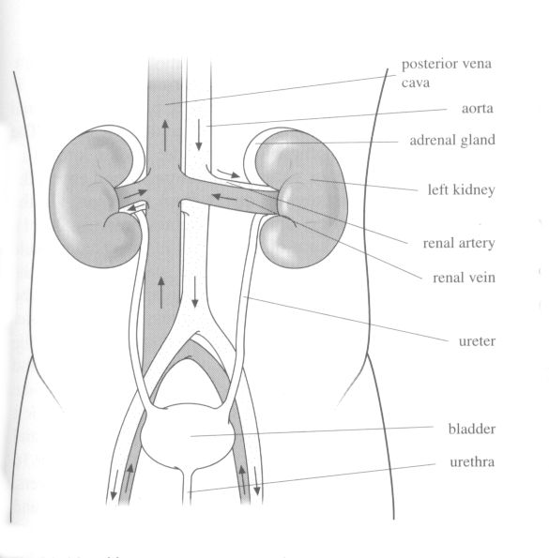

Slide 15
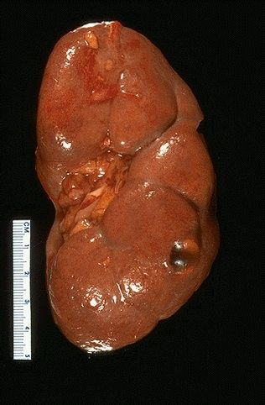
Human kidney
ureter renal artery renal vein attached here

Slide 16
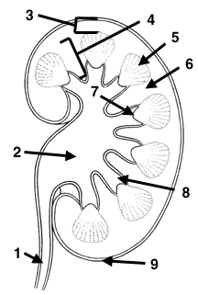
Kidney – vertical section
1 = ureter
2 = pelvis
3 = cortex
4 = medulla

Slide 17
Histology of the kidney
Learning outcomes
Find cortex, medulla and pelvis under the microscope
Describe the internal structure of the kidney
Draw a low power plan
Draw high power, labelled drawings of Mb, PCT, thick and thin loops, DCT and CD
Relate structure to function for the above
Make measurements with graticule eyepiece

Slide 18
Kidney – vertical section
1 = ureter
2 = pelvis
3 = cortex
4 = medulla

Slide 19
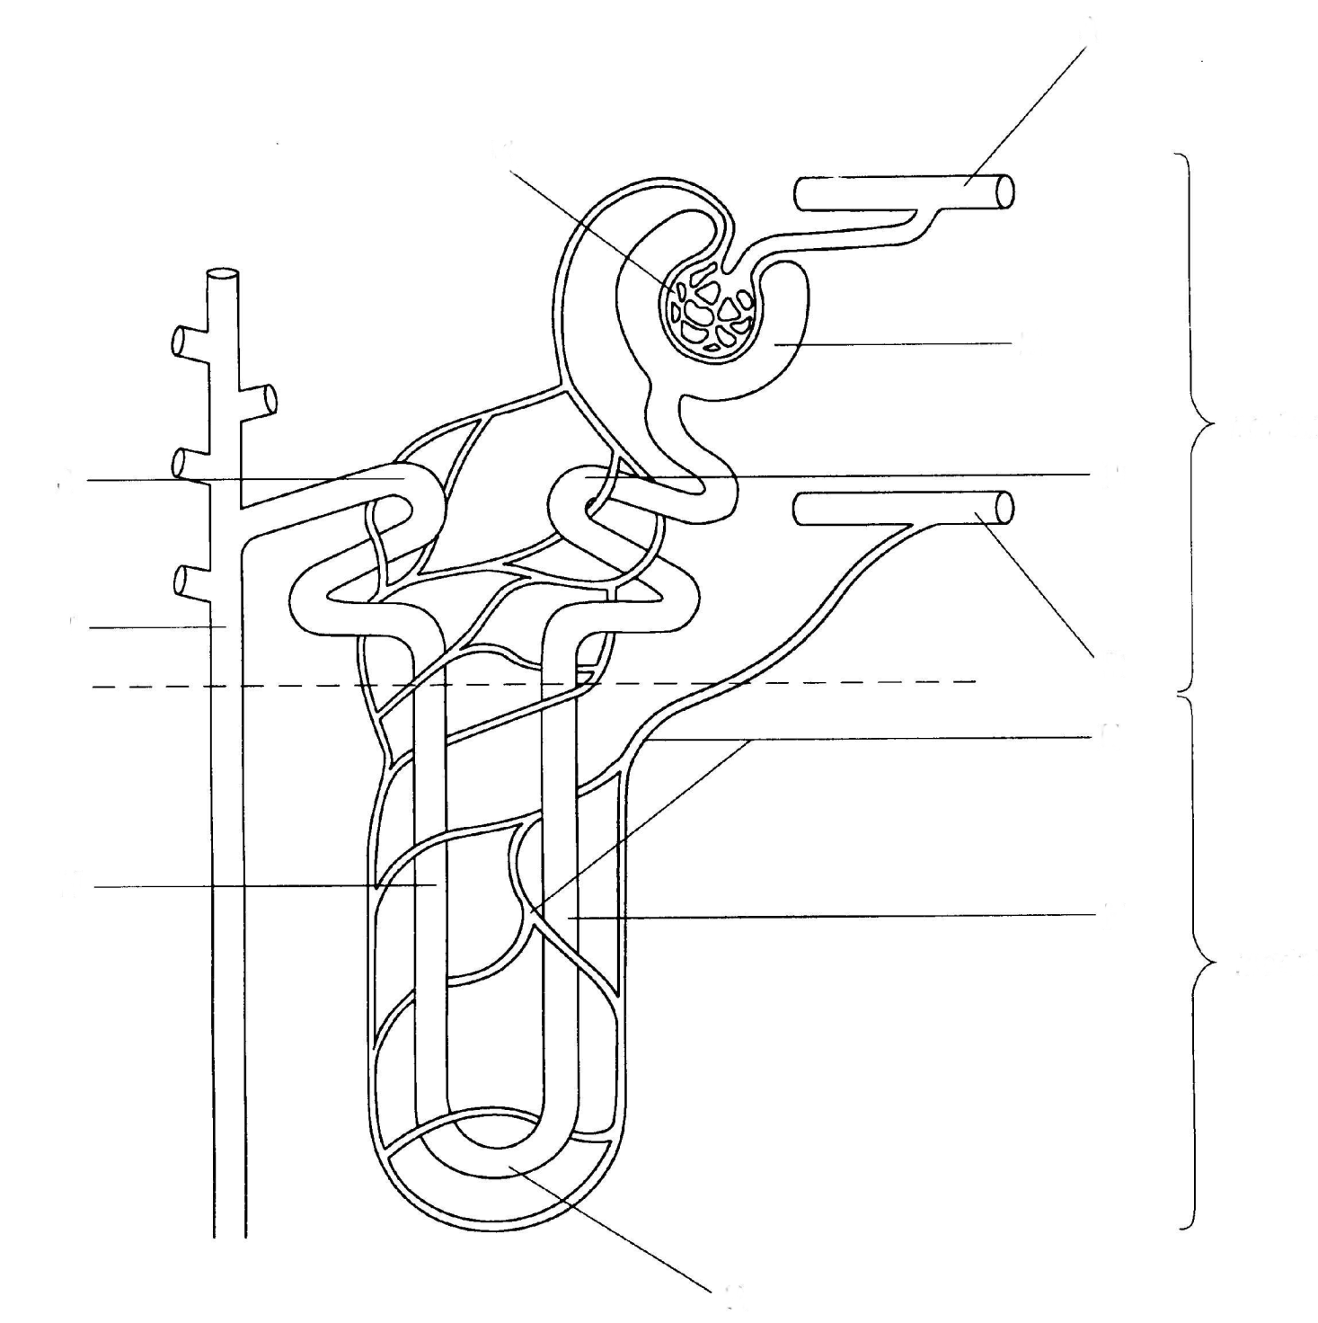
Kidney nephron
cortex
medulla
name the parts?

Slide 20
branch of renal artery
glomerulus
Bowman’s capsule
DCT
PCT
collecting duct
branch of renal vein
capillaries
loop

Slide 21
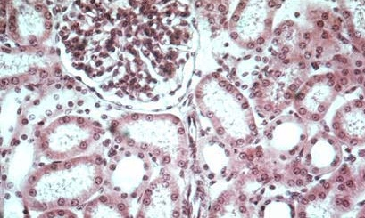
Kidney – cortex (LP)
glomerulus
Bowman’s capsule
proximal
and distal
convoluted
tubules

Slide 22
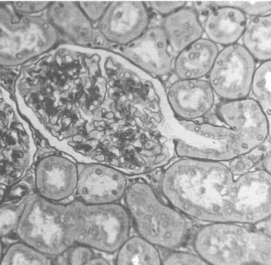
Bowman’s capsule
Glomerulus
PCT

Slide 23
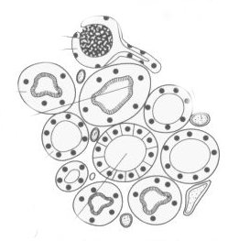
PCT
microvilli
DCT

Slide 24
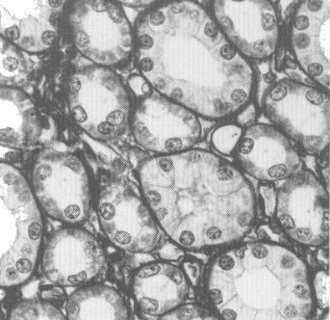
Kidney - medulla
loops
collecting ducts
capillaries

Slide 25
Excretion and the kidneys
Learning outcomes
State main excretory substances
Describe production and transport of urea
Explain why urea is produced
Explain why [salts] are regulated

Slide 26
Composition of urine
Substance | Plasma / % | Urine / % | Increase
Water | 90 | 95 | -
Protein | 8 | 0 | -
Glucose | 0.1 | 0 | -
Urea | 0.03 | 2 | 67x
Uric acid | 0.004 | 0.05 | 12x
Ammonia | 0.0001 | 0.04 | 400x
Creatinine | 0.001 | 0.075 | 75x
Na⁺ | 0.32 | 0.35 | 1x
K⁺ | 0.02 | 0.15 | 7x
Cl⁻ | 0.37 | 0.60 | 2x
PO₄³⁻ | 0.009 | 0.27 | 30x
SO₄²⁻ | 0.002 | 0.18 | 90x

Slide 27
Sources
Where do these come from?
Water
Protein
Glucose
Urea
Uric acid
Creatinine
Ammonia

Slide 28
Sources
Water ingested drink and food / metabolic water
Protein ingested food / tissue breakdown
Glucose ingested food / glycogen / other compounds
Urea deamination / urea cycle
Uric acid metabolism of nucleotide bases
Creatinine metabolism of creatine (creatine phosphate)
Ammonia deamination

Slide 29
Urea formation
Excess protein / excess amino acids
Where from?
Deamination
Where?
Urea formation
Where?
Transport and excretion

Slide 30
Deamination
Oxidative deamination
Aerobic!
Liver (and other tissues)
Amino acid (glutamic acid) + oxygen
Keto acid + ammonia
Coupled with reduction of NAD (co-enzyme)
Ammonia!! Beware.
Ammonia enters the urea cycle
What happens to the keto acid?

Slide 31
Deamination
Deamination is part of protein metabolism
Catabolic reaction
Details are at:
http://www.elmhurst.edu/~chm/vchembook/632oxdeam.html

Slide 32
Urea/ornithine cycle
Ammonia comes from
  deamination
  and from aspartic acid produced from transamination
Carbon dioxide comes from link reaction and Krebs cycle
Urea is excreted
Requires ATP

Slide 33
Urea/ornithine cycle
Linked to:
  deamination
  transamination
  Krebs cycle
  phosphorylation of ADP (because ATP is required)
Details are at:
http://www.elmhurst.edu/~chm/vchembook/633ureacycle.html

Slide 34
Protein metabolism
Deamination and urea cycle are part of the metabolism of proteins and amino acids in the body.
More details of biochemistry (useful for MPB) at:
http://www.elmhurst.edu/~chm/vchembook/index.html
The link is on my web site for you.

Slide 35
Question 5
Name?
Purpose?
Where?
Product
Intermediate (that gives its name to the cycle)

Slide 36
Sources
Where do these come from?
Sodium
Potassium
Chloride
Phosphate
Sulphate

Slide 37
Sources
Where do these come from?
Sodium extracellular cation
Potassium intracellular cation
Chloride extracellular anion
Phosphate bone / tissue fluid
Sulphate amino acids

Slide 38
Functions of the nephron
Learning outcomes
Explain how ultrafiltration occurs relating structure to function
Explain how selective reabsorption occurs relating structure to function
Explain how structure of medulla is related to water potential gradients
Explain how water is reabsorbed throughout the nephron

Slide 39
Build a nephron
Sort the cards into three groups:
  structures
  substances
  processes
Make a drawing/diagram of a nephron.
Use the structure cards to label it
Which ones are left over?
Use the substance cards to identify those carried into the kidney
Use the process cards to locate where these processes occur
You could use this approach to one of the tasks in your homework – BUT you don’t have to!

Slide 40
Processing in the kidneys
Ultrafiltration
Selective reabsorption
Secretion
Osmoregulation

Slide 41
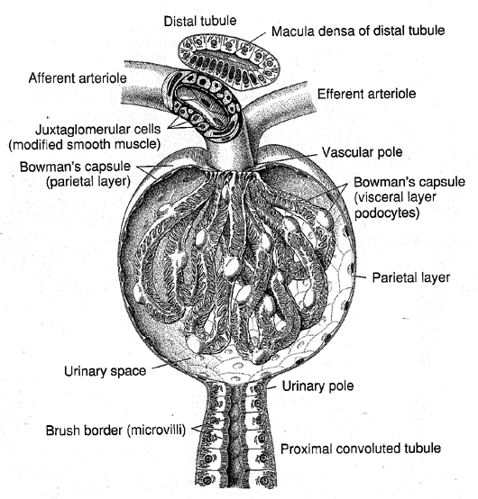
Bowman’s capsule
capillaries in the glomerulus

Slide 42
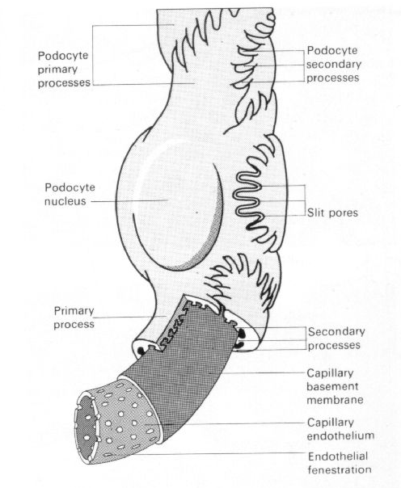

Slide 43
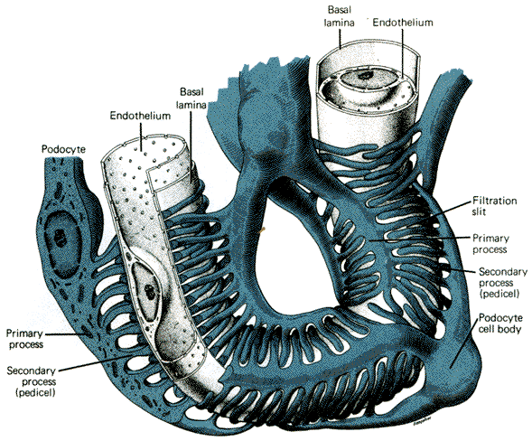

Slide 44
Ultrafiltration
blood pressure gives hydrostatic pressure that brings about filtration
capillaries have endothelium with pores
basement membrane is the filtration membrane
podocytes give support and do not provide resistance to filtration

Slide 45
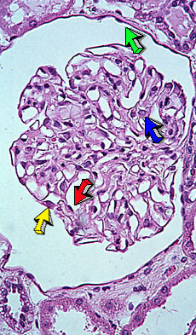
lumen of
Bowman’s
capsule
glomerulus

Slide 46
Ultrafiltration
Relate structure to function
Similar to filtration elsewhere in the body to produce tissue fluid
Composition of filtrate is similar to blood plasma.
What is missing?

Slide 47
Question 6
X?
Y?
Z?
Bullet points for (b)
Explain…..

Slide 48
Kidney nephron
cortex
medulla

Slide 49
PCT
microvilli
DCT

Slide 50
Selective reabsorption
absorption of glucose, amino acids, ions, vitamins by PCT
absorption of ions by DCT
these are substances required by the body

Slide 51
Selective reabsorption
Proximal convoluted tubule
Returning substances to the blood
Active uptake
Requires energy
Co-transport
Passive uptake
Endocytosis

Slide 52
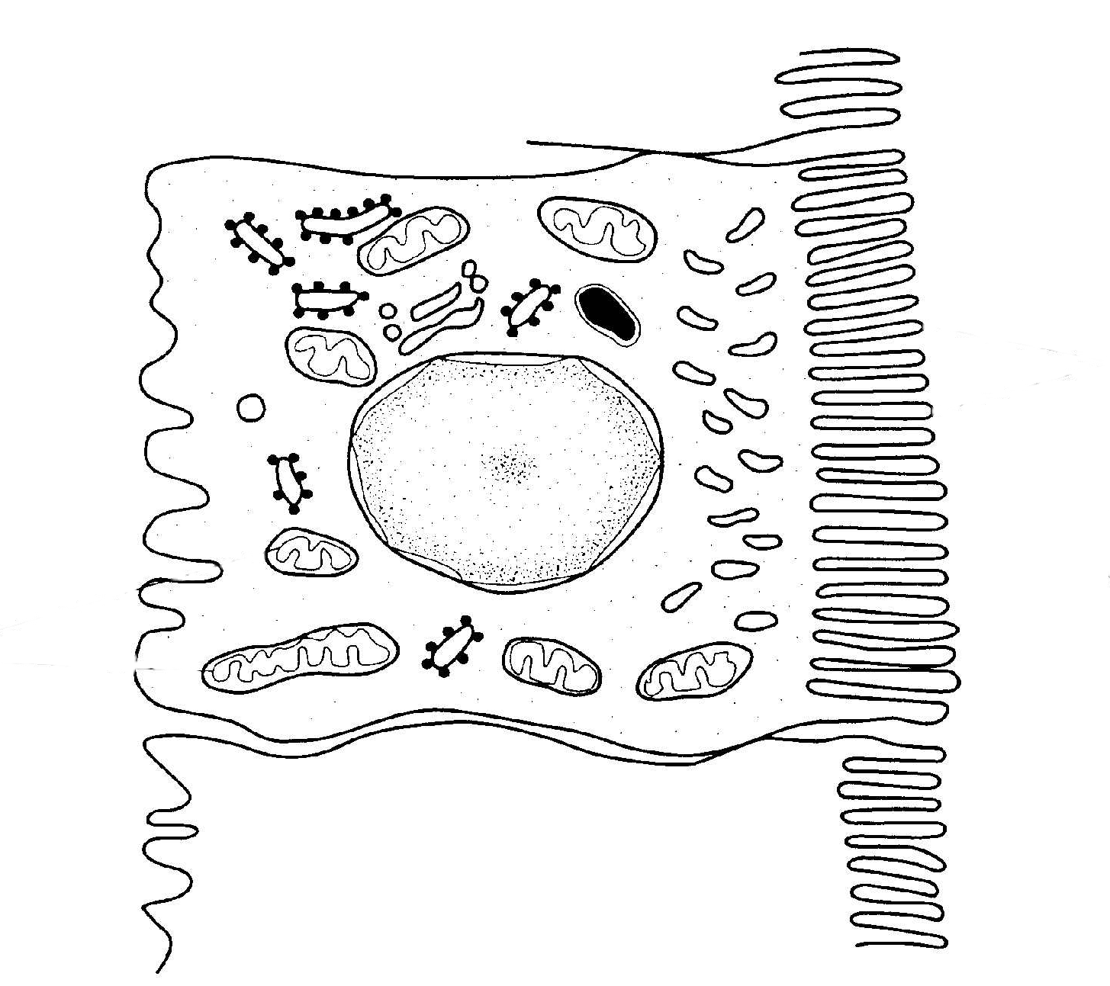
tight junction
filtrate
blood
microvilli
large surface area
mitochondria – ATP for active transport

Slide 53
PCT cells are adapted to their functions
tight junctions between cells to ensure transcellular movement
microvilli to give a large surface area for absorption
mitochondria to form ATP for active transport
infoldings of basal membrane to allow movement of substances into the blood

Slide 54
Selective reabsorption
Relate structure to function (see q. paper)
Note outline of PCT cell. Describe
Note detail inside cell. What?
Edge of adjacent cells
Draw in blood capillary
Show direction by which substances are reabsorbed
How is the composition of the filtrate changed?

Slide 55
Movement across membranes
Driven by ATP
Driven by sodium pumps that create low intracellular concentration of sodium ions
Require specialised membrane proteins
Occurs across two cell membranes – that have different permeability/pumping properties
http://users.rcn.com/jkimball.ma.ultranet/BiologyPages/D/Diffusion.html#indirect

Slide 56
Co-transporter
Binding sites for two substances
E.g. Na⁺ and glucose
Absorption of glucose driven by electrochemical gradient for Na⁺
This gradient is maintained by sodium pumps in basal and lateral membranes
The pumps maintain a low intracellular concentration of Na⁺

Slide 57
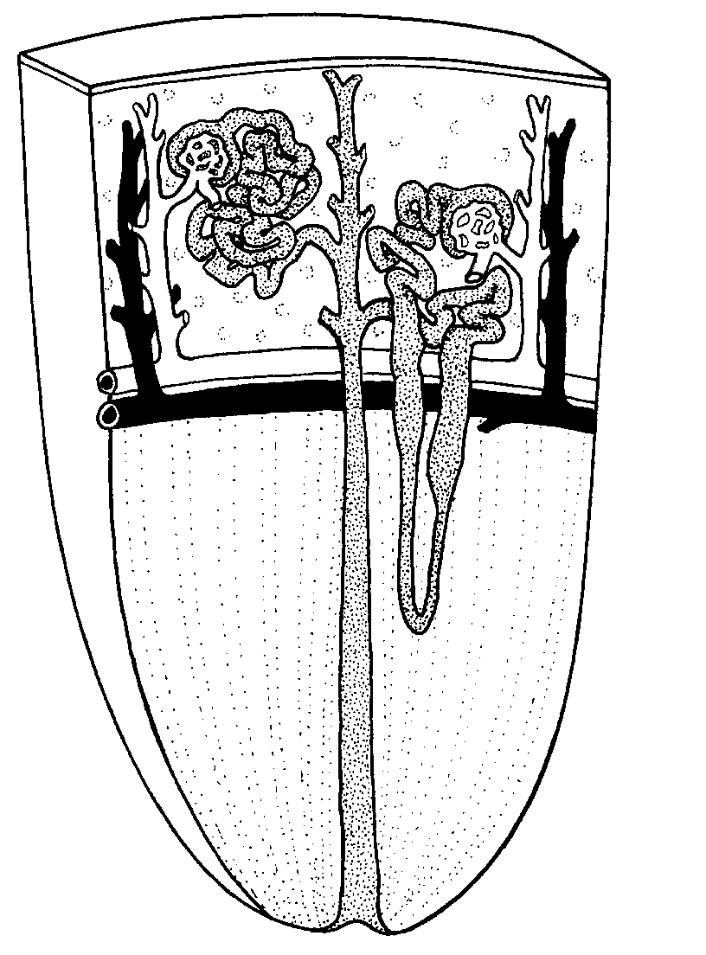
medulla:
loops and
collecting ducts
arranged in parallel

Slide 58
Question 5 (b)
Describe the relationship between the length of part D and water potential of the urine
Suggest an explanation for the relationship you have described.

Slide 59
Differential permeability
Descending loop is permeable to sodium ions and water
Ascending loop is permeable to sodium ions but not to water
Upper part of ascending loop pumps sodium ions out of the filtrate into the tissue fluid

Slide 60
Sodium and chloride ions move from ascending limb of loop to tissue fluid
Ions move from tissue fluid to descending limb of loop
Urea diffuses out of the urine from the collecting ducts into the tissue fluid
Urea and ions lower water potential of tissue fluid
Actual water potential depends on depth of medulla and so lengths of loops

Slide 61
U-shaped loops help to retain solutes (ions and urea) in tissue fluid of medulla
This gives a low water potential in this area
When water is conserved – collecting ducts become permeable and water diffuses from urine into the tissue fluid and into the capillaries

Slide 62
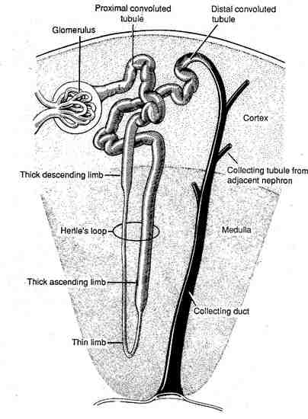

Slide 63
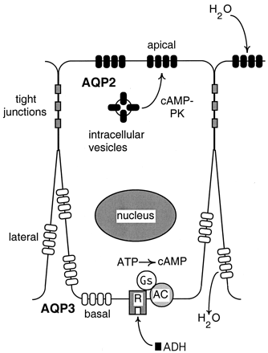
Collecting duct cell with aquaporins
When open 3 billion molecules of water a second move through each aquaporin
AQP 2
present when needed
AQP 3
present all the time

Slide 64
Aquaporin
Animation 1
Animation 2

Slide 65
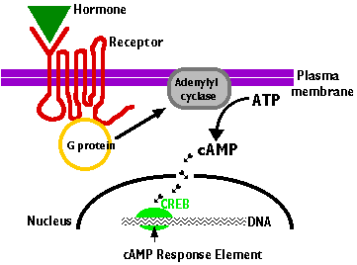
Mode of action of ADH
e.g. ADH
acts within cytoplasm
cyclic AMP is a secondary messenger

Slide 66
Match these statements to areas in the diagram
site of ultrafiltration
deoxygenated blood
oxygenated blood
blood at highest pressure
blood vessel with highest concentration of urea
blood vessel with lowest concentration of urea
site of selective reabsorption
area with lowest water potential (highest concentration of solutes)

Slide 67
3 + 4 + 5
1
7
2 + 6
8

Slide 68
The Kidneys
receive
20-25% of the total output of the heart
filter
170 000 cm³ filtrate a day
reclaim
1300 g of NaCl each day
180 g glucose each day
almost all the water (180 litres) that is filtered each day
produce
1200 to 2000 cm³ urine a day
expect to carry out calculations on these sorts of figures

