Slide 1
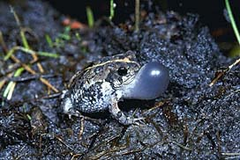
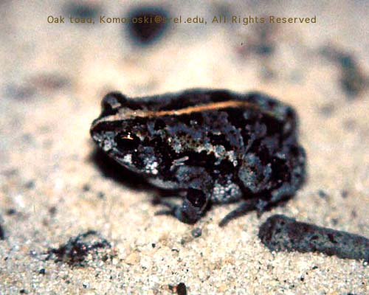
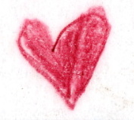
Hormones and
Feedback Mechanisms
03.01.05
How the endocrine system controls everything

Slide 2
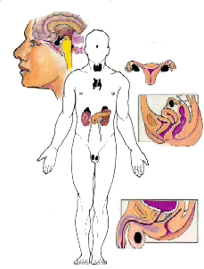
The Endocrine System
General Overview
Basic Anatomy
Control of the endocrine system
Specific endocrine events

Slide 3
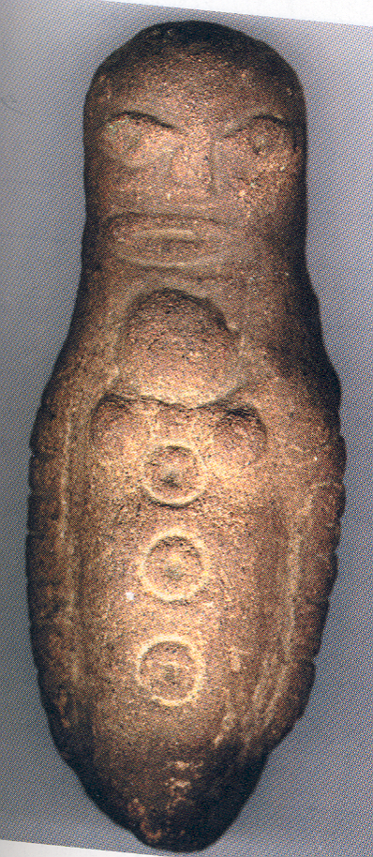

Slide 4
I. A General Overview
ES (endocrine system) and homeostasis
Anatomy
  Endocrine glands, cells, neurosecretory cells
  Hormones
  Target cells
ES as a Control System
  Hormone + target = change in cell function (return to homeostasis)

Slide 5
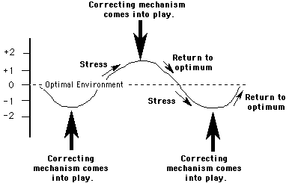
ES and Homeostasis
Homeostasis

Slide 6
Feedback Mechanisms
Stimulus
  change in homeostatic environment
  signal sent to CNS
Response
  signal sent from CNS
  produce effect
  body returns to homeostasis

Slide 7
Basic ES cont.
ES and NS = 2 main control systems of body
Endocrine organs located throughout body
Actions mediate all tissues
Control of ES through feedback mechanisms

Slide 8
II. ES anatomy basics
Exocrine gland
  Ducts
  Lumen and surfaces
Endocrine gland
  Chemical messengers
  Blood stream

Slide 9
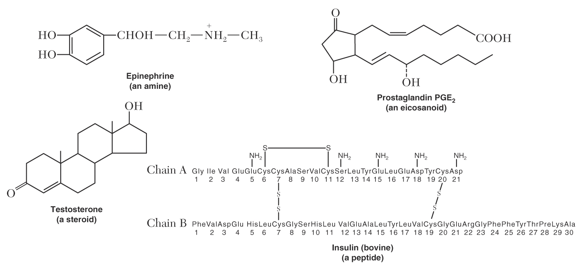
C. Hormones
Chemical messenger
  Secreted by endocrine gland
  Specific to target
  Activate cellular change
  Of 4 different chemical types

Slide 10
C. 4 Classes of Hormones
Peptide/ Protein
Steroid
Amine
Eicosanoid

Slide 11
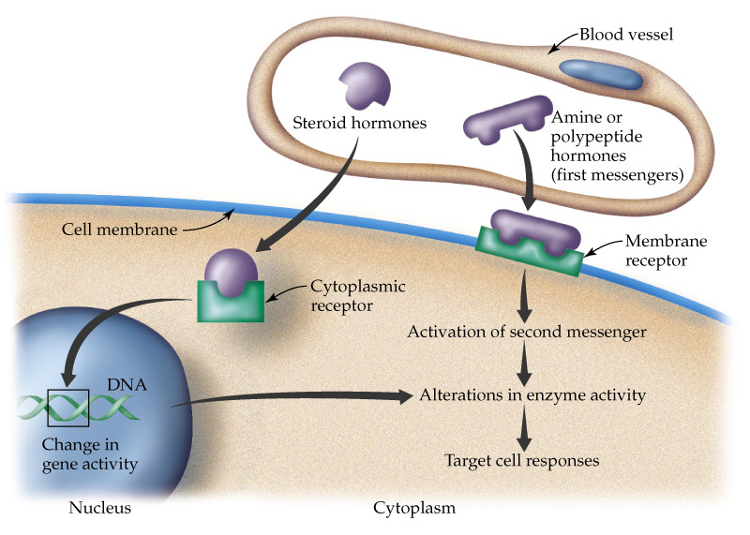
Hormone + Receptor

Slide 12
Protein/Peptide Hormones
Hydrophilic
Large
Can't fit through membrane
Second messenger mechanism of action
Most hormones
Example: Insulin

Slide 13
Steroid Hormones
Small
Hydrophobic/Lipophilic
Travel in blood w/carrier
Cytoplasmic or nuclear receptors
change protein synthesis
Example: estradiol

Slide 14
Amine
Synthesized from a single amino acid
Melatonin from tryptophan
Thyroid hormone from tyrosine
Catecholamines (EPI, DA) from tyrosine

Slide 15
Eicosanoid
Produced from 20-carbon fatty acid, arachadonic acid
Produced in all cells except RBCs
2nd messenger
Prostaglandins and leukotrienes
inflammation

Slide 16
Hormone + Receptor

Slide 17
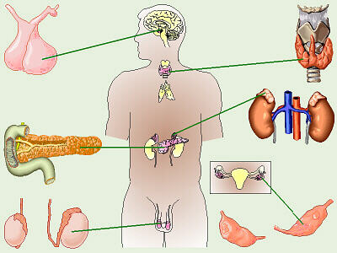
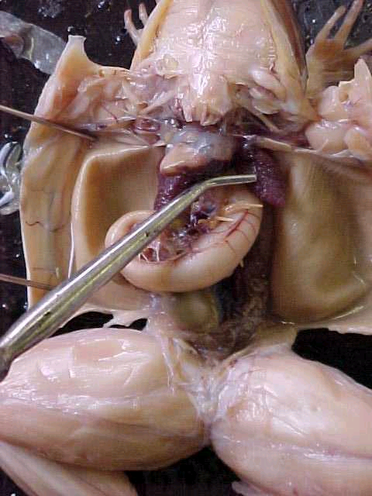
Where are Hormones Made ?

Slide 18
The H-P-A
Hypothalamic-Pituitary Axis
Most feedback loops run through this axis
HPA mediates growth, metabolism, stress response, reproduction.
is secondarily in charge of almost everything else.

Slide 19
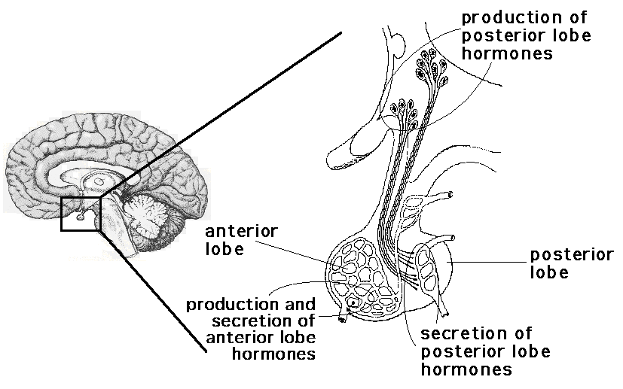
p. 503

Slide 20
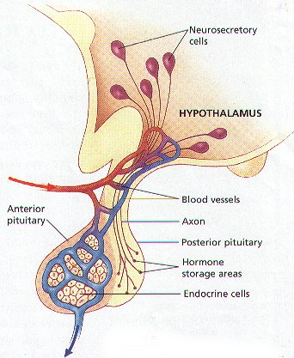
D. Neurosecretory Cells
Specialized neurons
  Synthesize and secrete hormones
Extend from HYPOTHALAMUS to POSTERIOR PITUITARY

Slide 21
2. Neurosecretory cells in Hypothalamus
Nuclei synthesize and secrete hormones
Neuronal connection to POSTERIOR pituitary
Antidiuretic Hormone (ADH), Oxytocin

Slide 22
E. Hypothalamus (general)
Connection to pituitary
  Neuronal to POSTERIOR PITUITARY
  Endocrine to ANTERIOR PITUITARY
    RH = Pituitary releasing hormones
    RIH = Pituitary release inhibiting hormones

Slide 23
Why is the Hypothalamus so Important?
Secretes regulatory homones
  RH
  RIH
"Directs" pituitary

Slide 24
STIMULUS
Hypothalamus
Releasing Hormone
(Release-Inhibiting Hormone)
Pituitary
Stimulating Hormone
Gland
Hormone
Target

Slide 25
Hypothalamic Hormomes
Release Inhibiting Hormones
  Somatostatin
  Prolactin release inhibiting hormone-PIH
Releasing Hormones
  Thyrotropin releasing hormone-TRH
  Growth hormone releasing hormone-GHRH

Slide 27
1. Posterior Pituitary Hormones
Manufactured in Hypothalamus, released from Post. Pit.
Oxytocin
  Target = smooth ms. Uterus and Breast (&brain)
  Function = labor and delivery, milk ejection,(pair bonding)
ADH (Vasopressin AVP)
  Target = kidneys
  Function = water reabsorption

Slide 28
How about in frogs ?
Hormone structure/function tightly conserved
Mesotocin
  yolking of eggs
  egg-laying
Vasotocin (AVT)
  water balance
  REPRODUCTIVE BEHAVIORS

Slide 29
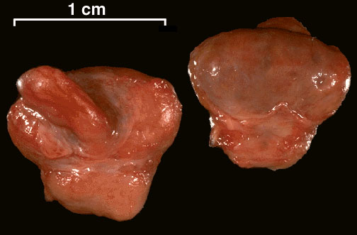
E. Pituitary gland
MASTER GLAND
Anterior and posterior portions
Posterior connected to hypothalamus by infundibulum
Anterior connected via blood stream

Slide 32
2. Anterior Pituitary Hormones
HORMONE | TARGET | FUNCTION
Thyroid (TSH) Stimulating | Thyroid gland | TH synthesis & release
Growth (GH) | Many tissues | growth
Adrenocortico- Tropin (ACTH) | Adrenal cortex | Cortisol release (androgens)
Prolactin (Prl) | Breast | Milk production
Follicle (FSH) | Gonads | Egg/sperm prod.
Luteinizing (LH) | Gonads | Sex hormones

Slide 33
Hormones To Study
Hypothalamic Hormones
Posterior Pituitary (Neurohypophysis)
Anterior Pituitary (Adenohypophysis)
  Thyroid
  Growth
  Sex Steroid

Slide 34
III.Control of Endocrine Function
Positive
or Negative Feedback mechanisms
Self-regulating system

Slide 35
STIMULUS
Hypothalamus
Releasing Hormone
(Release-Inhibiting Hormone)
Pituitary
Stimulating Hormone
Gland
Hormone
Target

Slide 36
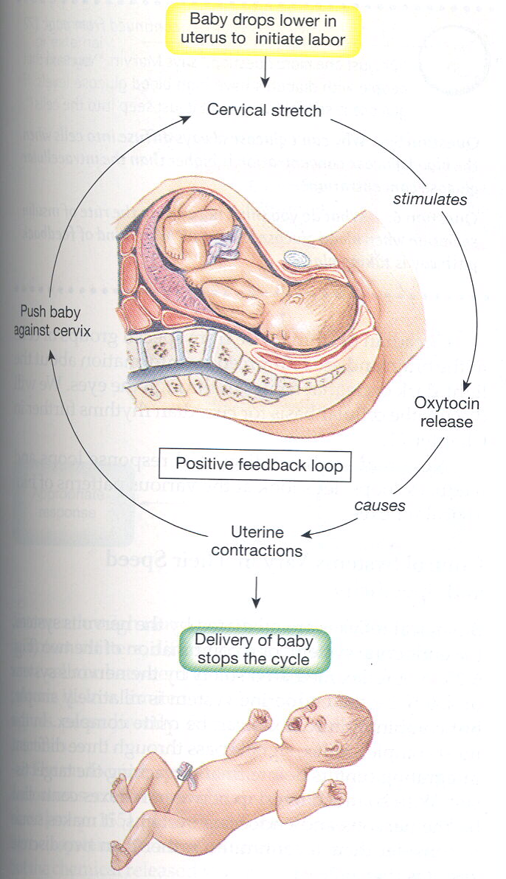
A. Positive Feedback
Not common
Classic example:
Action of OXYTOCIN on uterine muscle during birth.

Slide 37
Positive Feedback
Baby pushes on cervix
Nervous signal to Hypothalamus
Hypothal. manufactures OXY
OXY transported to POSTERIOR PITUITARY & released
OXY stimulates uterine contraction
Loop stops when baby leaves birth canal

Slide 38
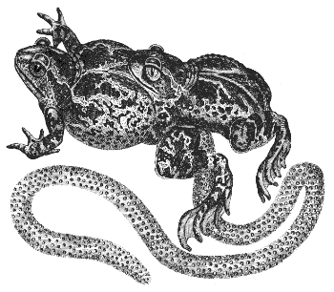
Same with frogs?

Slide 39
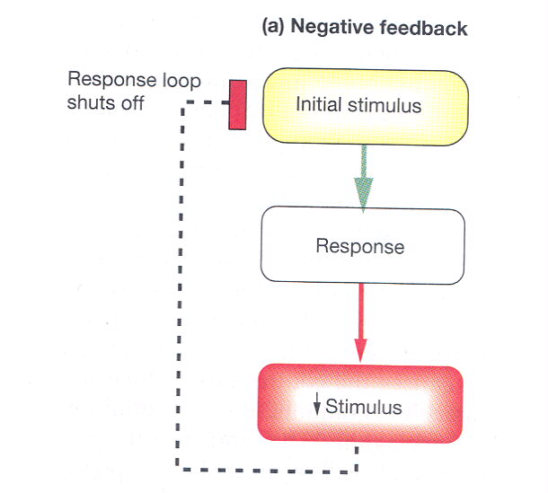
B. Negative Feedback
Most common control mechanism
Level of hormone in blood or body’s return to homeostasis shuts off loop at hypothalamus and pituitary

Slide 40
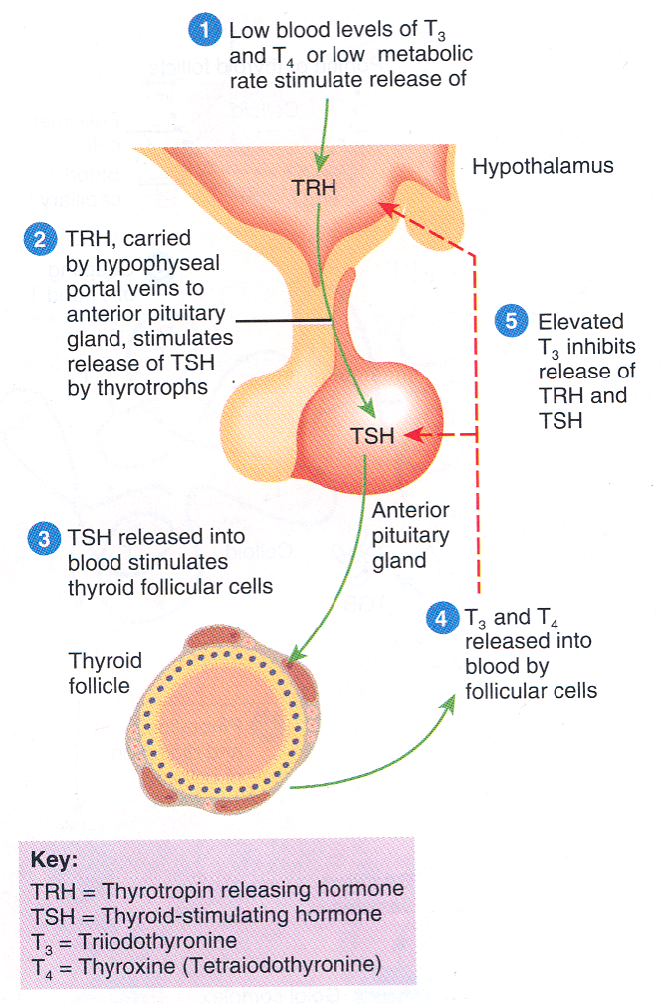
Negative Feedback: Thyroid

Slide 41
Basic Structure of Feedback Loop
Environmental Stimulus
Stimulates Control Center (Brain-hypothal.)
Hypothalamic hormones stim. Pituitary
Pituitary hormone stim. Target area
Target area produces change
Change acts negatively or positively on the cycle.

Slide 42
IV. Specific Endocrine Events
Thyroid Hormone
Growth Hormone
Adrenal Cortex Hormones
Sex Steroids

Slide 43
A. Thyroid Hormone
↓ T3 & T4 stim. Or environmental stim. Hypothalamus
TRH stim. Anterior Pituitary
TSH stim. Thyroid
↑ T3 & T4 shuts off TRH and TSH production

Slide 44
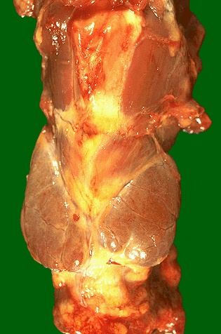
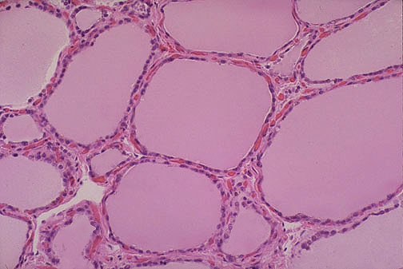

Slide 45
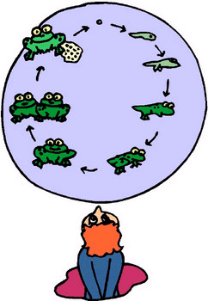
Growth

Slide 46
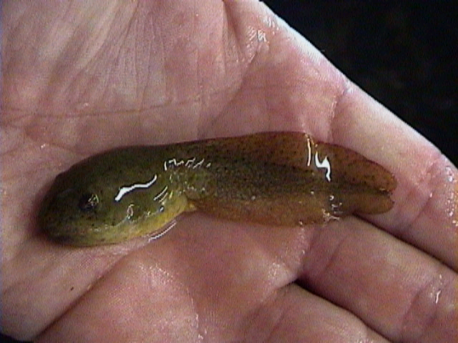
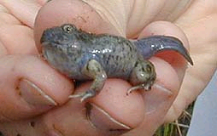
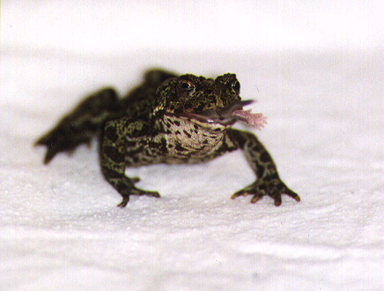
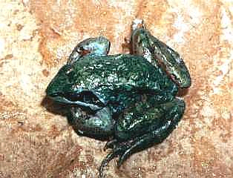
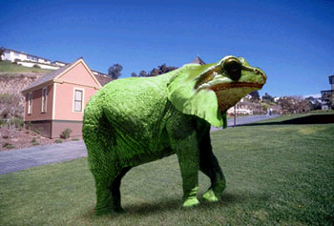
metabolism and
growth

Slide 47
Thyroid Problems
What would happen if the thyroid could no longer produce T3 and T4?
No negative feedback to hypothalamus and anterior pituitary

Slide 48
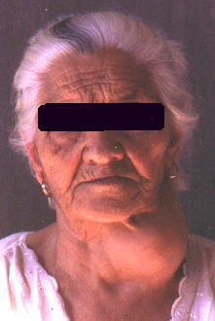
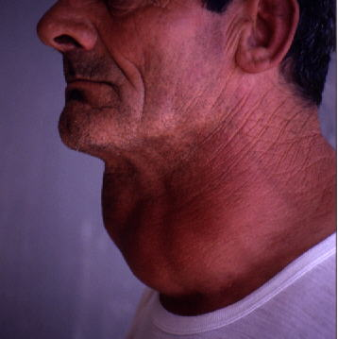
Goiter

Slide 49
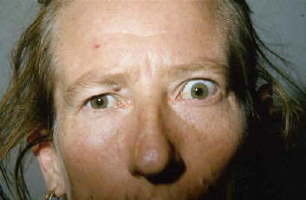
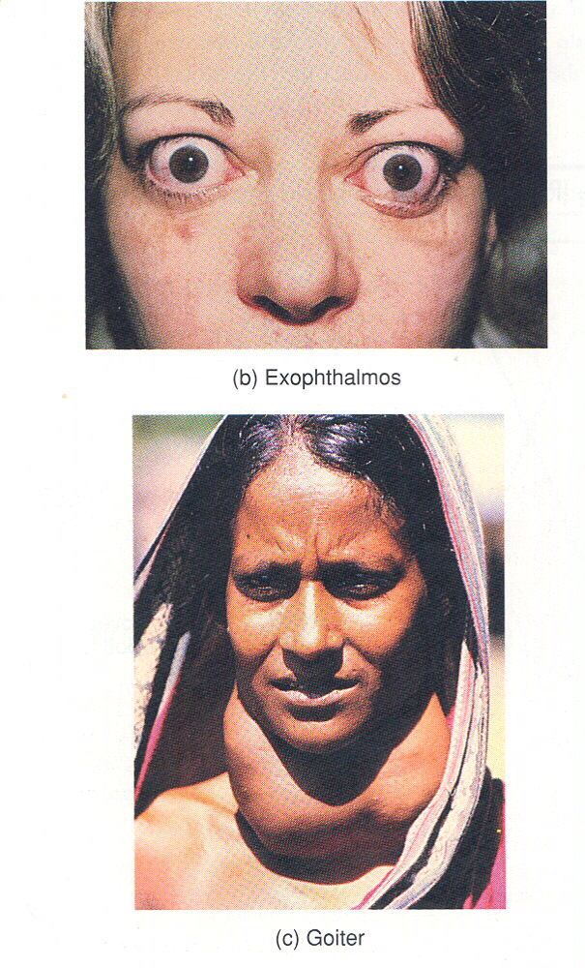
Hypersecretion of TSH or TH

Slide 50
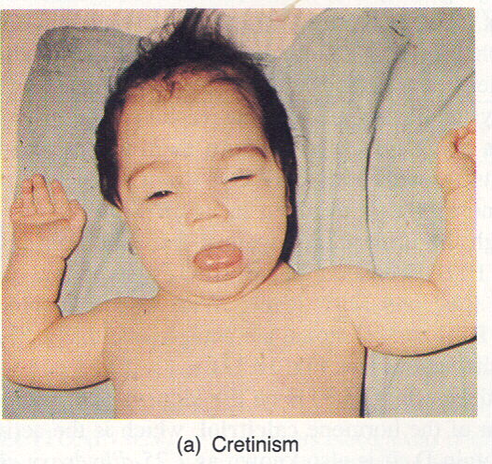
Hyposecretion of TH

Slide 51
B. Growth Hormone
Stimulus = Tissue growth/ repair
Hypothalamus releases GHRH
Anterior Pituitary releases GH
↑ Protein synthesis, growth, etc.
↑GH and release of somatostatin shuts off GHRH and GH release

Slide 52
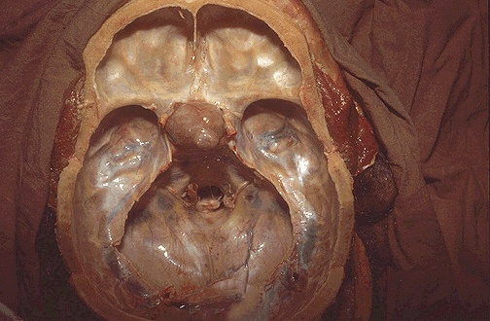
What happens with excess GH?

Slide 53
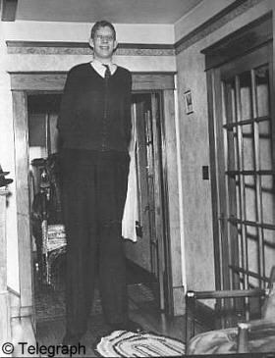
↑GH as Juvenile

Slide 54
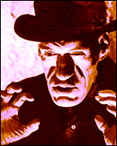
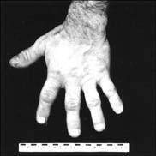
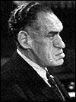
↑GH as an Adult

Slide 55
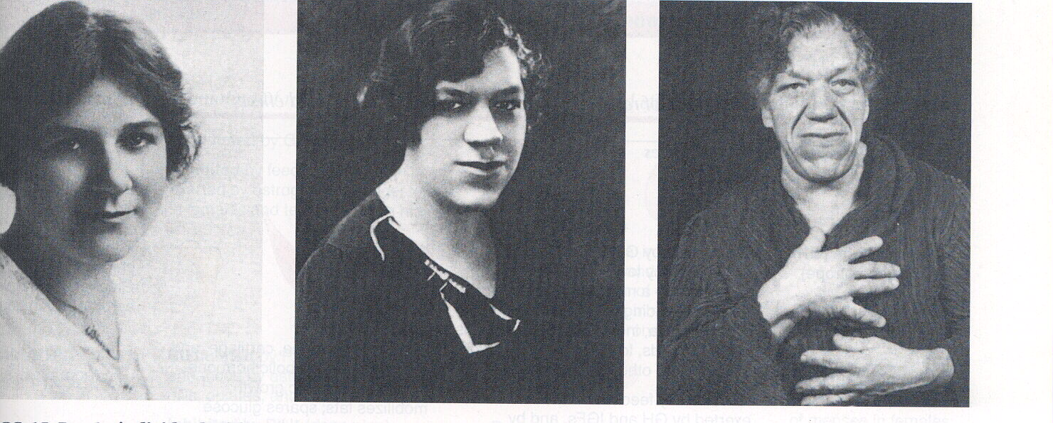
How Does Hypersecretion of GH Happen?

Slide 56
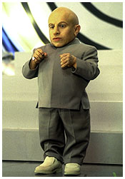
↓GH = pituitary dwarfism

Slide 57
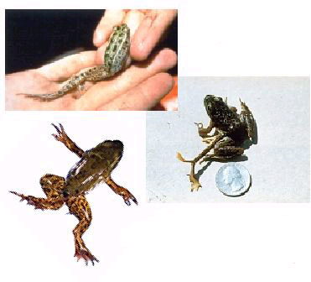

Slide 58
Adrenal Gland
Adrenal gland located atop kidney
Outer part = cortex
  Secretes Cortisol (stress), Androgens, Aldosterone (electrolytes)
Inner part = medulla
  SNS control
  Secretes EPI & NEPI (fight or flight)

Slide 59
Adrenal Insufficiency
Addison’s disease--hyposecretion of cortisol
JFK
Darkened skin (ACTH mimics MSH)
Weight loss, hypoglycemia
Find the anomaly in the feedback loop.
Inability to handle stress

Slide 60
4. Sex Steroids
Stimulus = low circulating T or E
Hypothalamus = GnRH
Anterior Pituitary = FSH & LH
Gonads produce T and E
High T and E shut off GnRH and FSH/LH

Slide 61
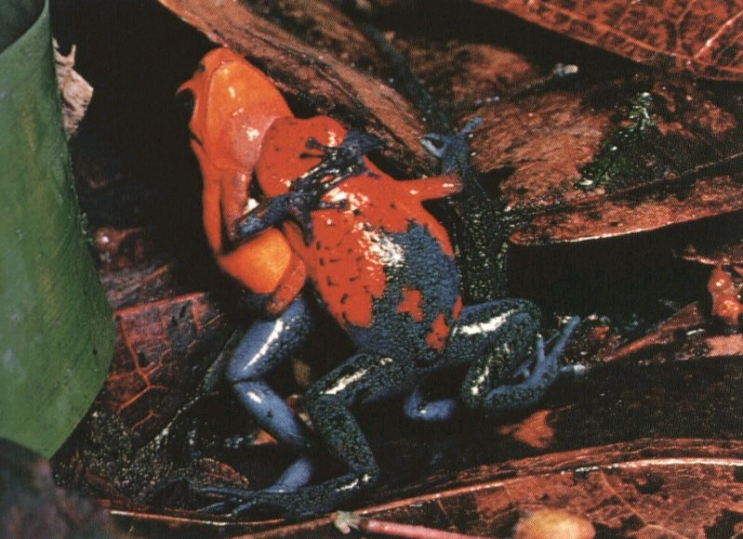
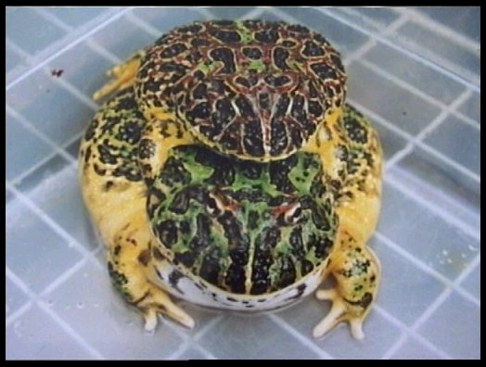
Importance
Reproduction/Mating Behavior (duh)
Formation of reproductive organs
  gonads
  brain

Slide 62
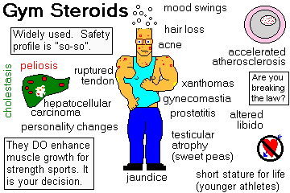

Slide 63

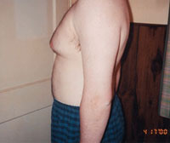

Too many steroids

Slide 65
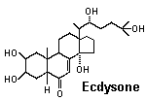
Invertebrates
Hormones involved in:
  Molting
  Pupation
  Metamorphosis

Slide 66
Insect Hormones
Juvenile Hormone
  maintains juvenile cuticle for pre-adulthood molts
  secreted by corpus allatum near brain
Ecdysone
  Molting Hormone
  Prothoracic Glands (in thorax of insect)
  PTTH = Brain hormone that stimulates Prothoracic Glands

Slide 67
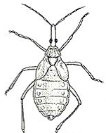
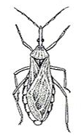
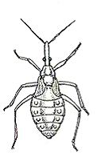
Ecdysone
Ecdysone
Juvenile Hormone
p.523

Slide 68
Points
History
Anatomy
Terms
Hormones
Feedback control
Specific Points discussed

Slide 69
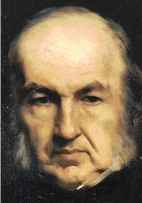
I. Endocrine History
Claude Bernard (mid 1800s)
  pancreas, liver
  brain, smooth ms.
  internal environ.
A.A. Berthold (1849)
  repro hormones and
  behavior

Slide 70
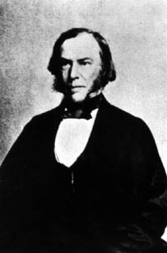
Endocrine History
Charles Brown-Sequard (1889)
  Harvard 1864-1868
  M.D. in NY 1873-1878
  bull testis extracts

Slide 71
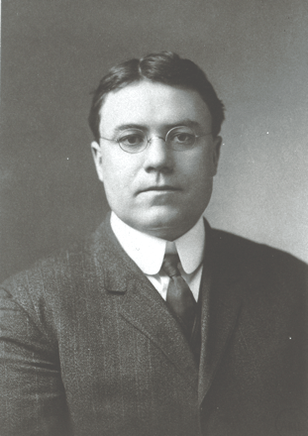
Important Physiologists
Walter Cannon
  homeostasis
  sympathetic nervous system
    Bodily Changes in Hunger, Fear, and Rage

Slide 72
1. Peptide/Protein Hormones
Most common hormone
translated, packaged, & sent
Hydrophilic/Lipophobic
Bind surface receptors at target
Binding mediates signal transduction/2nd messenger system

Slide 73
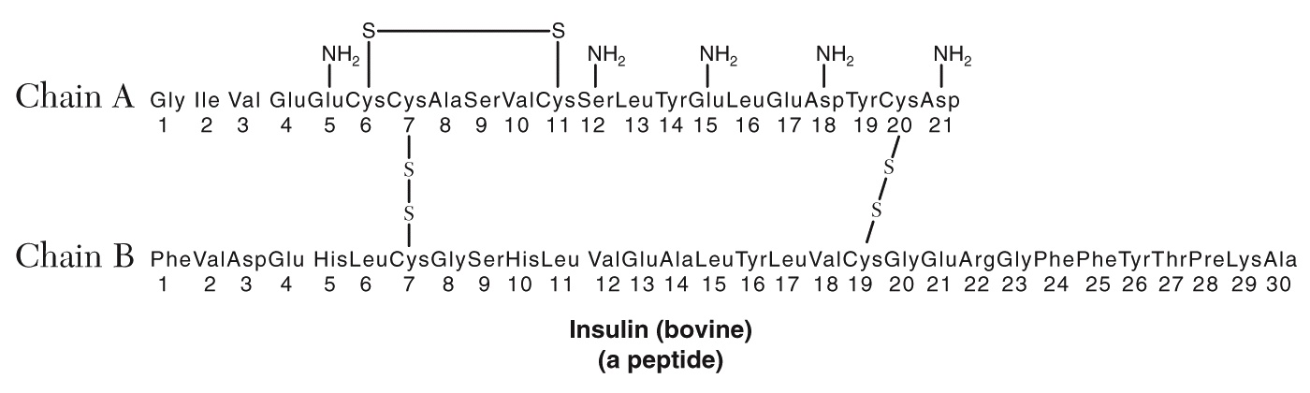
Peptide Hormones cont.
Short 1/2-life
Pancreas
  Insulin/glucagon
Hypothalamus
  RH (releasing hormones)
  RIH (release inhibiting hormones)

Slide 75
2. Steroid Hormones
Derived from cholesterol
Hydrophobic/Lipophilic
Travel with a protein carrier
Long 1/2-life
Binds to cytoplasmic or nuclear receptor
  1st Messenger

Slide 76
Steroid hormones cont.
Genomic effect
  Activates genes
  Directs synthesis of new proteins
Lag time between hormone binding and effect = long time.
Gonads & placenta
Adrenal cortex

Slide 78
3. Amine Hormones
Synthesized from a single amino acid
Melatonin from tryptophan
Thyroid hormone from tyrosine
Catecholamines (EPI, DA) from tyrosine

Slide 79
4. Eicosanoid hormones
Produced from 20-carbon fatty acid, arachadonic acid
Produced in all cells except RBCs
2nd messenger
Prostaglandins and leukotrienes
inflammation

Slide 80
4 Classes of Hormones
Peptide/ Protein 2M
Steroid
Amine
Eicosanoid

Slide 81
4 Classes of Hormones
Peptide/ Protein 2M
Steroid 1M
Amine
Eicosanoid

Slide 82
4 Classes of Hormones
Peptide/ Protein 2M
Steroid 1M
Amine 2M
Eicosanoid

Slide 83
4 Classes of Hormones
Peptide/ Protein 2M
Steroid 1M
Amine 2M
Eicosanoid 2M

Slide 84
Negative Feedback
Low levels of T3 or T4 in blood or low BMR = stimulus
Hypothalamus releases TRH
TRH stimulates the ANTERIOR PITUITARY to release TSH
TSH stim. Thyroid to release T3 & T4
Levels of T3 & T4 shut off Hypothal. & Anterior Pituitary

Slide 85



Slide 86

Adrenal cortex feedback
Low glucocorticoid (cortisol) levels or low blood sugar
Stim. Hypothal. = CRH
CRH stim. Anterior Pit. = ACTH
ACTH stim. Adrenal Cortex.
Increase glucocort. Level then blood sugar level

Slide 87

Adrenal gland

Slide 88

Adrenal Problems

Slide 89


Hypersecretion of Adrenal Cortex

Slide 90

What Would the Feedback Loop Look Like for Cushing’s Syndrome?

