Slide 1
Chordates
Chapter 23

Slide 2
Phylum Chordata
By the end of the Cambrian period, 540 million years ago, an astonishing variety of animals inhabited Earth’s oceans.
One of these types of animals gave rise to vertebrates, one of the most successful groups of animals.

Slide 3
Phylum Chordata
Chordates are bilaterian animals that belong to the clade of animals known as Deuterostomia.
Two groups of invertebrate deuterostomes, the urochordates and cephalochordates are more closely related to vertebrates than to invertebrates.

Slide 4
Phylum Chordata
Chordates have:
  Bilateral symmetry
  A coelom
  Deuterostome development
    Radial, indeterminate cleavage
    Enterocoelous coelom development
  Metamerism
  Cephalization.

Slide 5
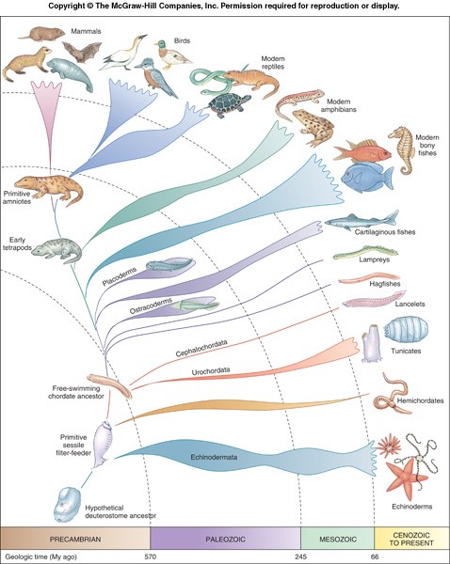
Phylogenetic Tree of Chordates

Slide 6
Phylum Chordata
Five distinctive characteristics define the chordates:
  Notochord
  Dorsal tubular nerve cord
  Pharyngeal pouches (gill slits)
  Endostyle
  Postanal tail
All are found at least at some embryonic stage in all chordates, although they may later be lost.

Slide 7
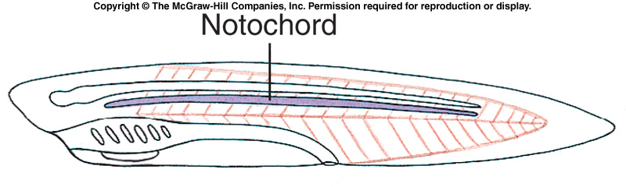
Notochord
The notochord is a flexible, rod-like structure derived from mesoderm.
  The first part of the endoskeleton to appear in an embryo.
  Place for muscle attachment.
  In vertebrates, the notochord is replaced by the vertebrae.
    Remains of the notochord may persist between the vertebrae.

Slide 8
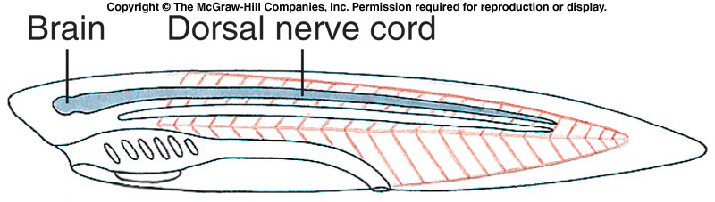
Dorsal Tubular Nerve Cord
In chordates, the nerve cord is dorsal to the alimentary canal and is a tube.
  The anterior end becomes enlarged to form the brain.
  The hollow cord is produced by the infolding of ectodermal cells that are in contact with the mesoderm in the embryo.
  Protected by the vertebral column in vertebrates.

Slide 9
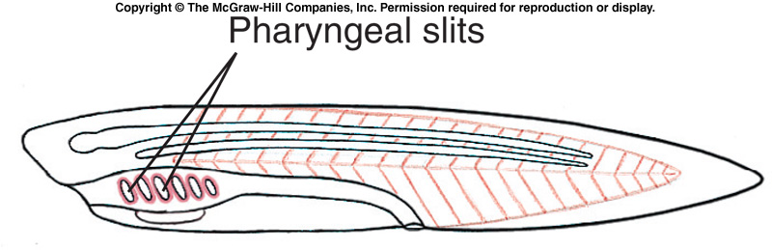
Pharyngeal Pouches and Slits
Pharyngeal slits are openings that lead from the pharyngeal cavity to the outside. They are formed when pharyngeal grooves and pharyngeal pouches meet to form an opening.
  In tetrapods, the pharyngeal pouches give rise to the Eustachian tube, middle ear cavity, tonsils, and parathyroid glands.

Slide 10
Pharyngeal Pouches and Slits
The perforated pharynx evolved as a filter feeding apparatus.
Later, they were modified into internal gills used for respiration.

Slide 11
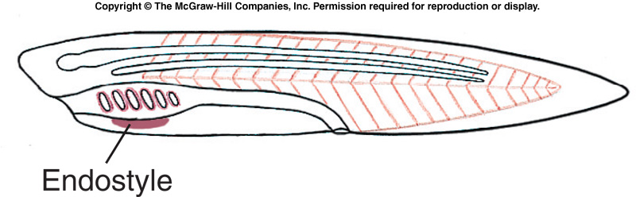
Endostyle or Thyroid Gland
The endostyle in the pharyngeal floor, secretes mucus that traps food particles.
  Found in protochordates and lamprey larvae.
  Secretes iodinated proteins.
Homologous to the iodinated-hormone-secreting thyroid gland in adult lampreys and other vertebrates.

Slide 12
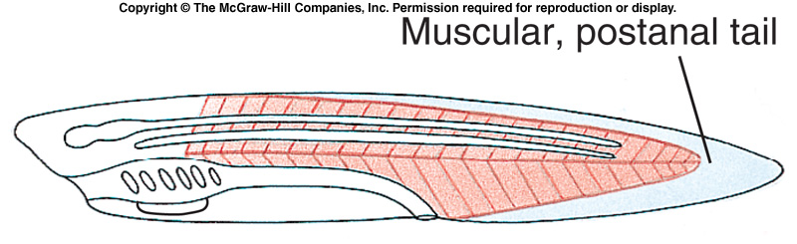
Postanal Tail
The postanal tail, along with somatic musculature and the stiffening notochord, provides motility in larval tunicates and amphioxus.
  Evolved for propulsion in water.
  Reduced to the coccyx (tail bone) in humans.

Slide 13
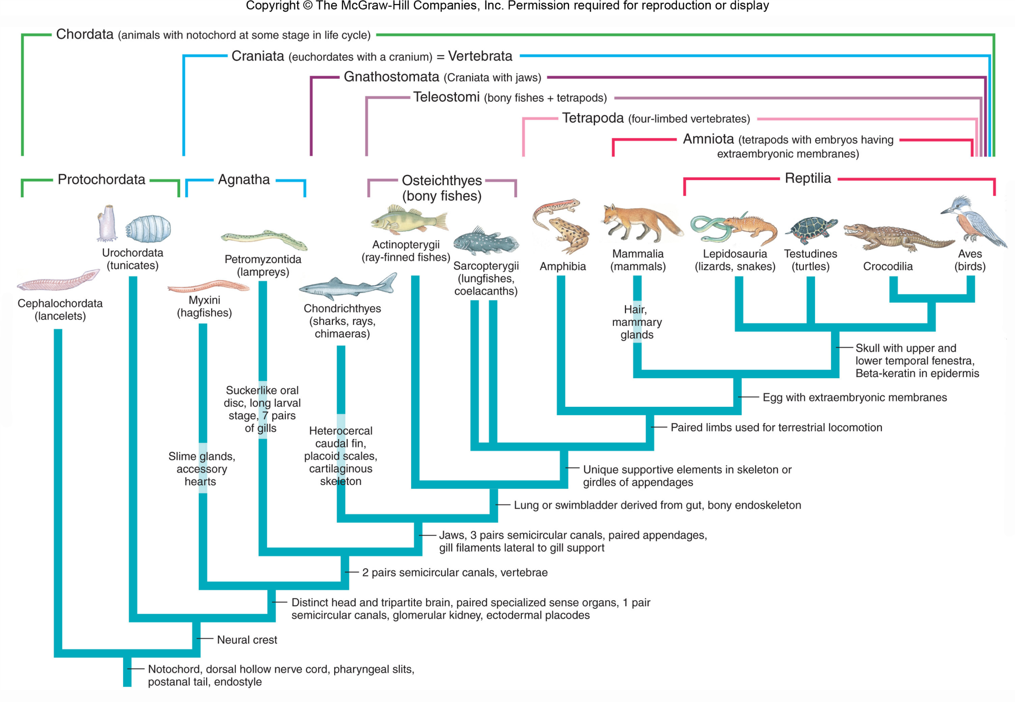

Slide 14
Traditional and Cladistic Systems Diverge
Traditional classification:
  Convenient way to indicate the taxa included in each major group.
Cladistic systems:
  Some traditional taxa no longer used.
  Reptiles are paraphyletic because they do not contain all of the descendants of recent common ancestor.
  Reptiles, birds and mammals compose a monophyletic clade called Amniota.

Slide 15
Traditional and Cladistic Systems Diverge
Reptiles can only be grouped as amniotes that are not birds or mammals.
No derived characters that group only reptiles to the exclusion of birds and mammals.
Likewise, agnathans (hagfishes and lampreys) are paraphyletic.
  Most common recent ancestor is also an ancestor of all remaining vertebrates.
The branches of a phylogenetic tree represent real lineages with geological information.

Slide 16
Traditional and Cladistic Systems Diverge
Traditional classification:
  Protochordata (Acraniata) are separated from Vertebrata (Craniata) that have a skull.
  Vertebrates may be divided into Agnatha (jawless) and Gnathostomata (having jaws).
  Vertebrates are also divided into Amniota, having an amnion, and Anamniota lacking an amnion.
  Gnathostomata is subdivided into Pisces with fins and Tetrapoda, usually with two pair of limbs.
  Many of these groupings are paraphyletic.
  Alternative monophyletic taxa are suggested.
  Some cladistic classifications exclude Myxini (hagfishes) from the group Vertebrata because they lack vertebrae, although retaining them in Craniata since they do have a cranium.

Slide 17
Phylum Chordata
Two protochordate subphyla
  Subphylum Urochordata
  Subphylum Cephalochordata

Slide 18
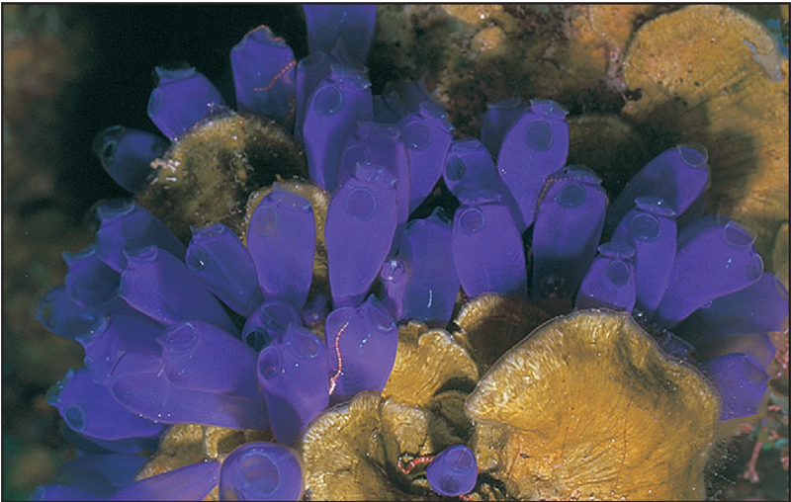
Subphylum Urochordata
Tunicates (subphylum Urochordata) are found in all seas.
Most are sessile and highly specialized as adults.

Slide 19
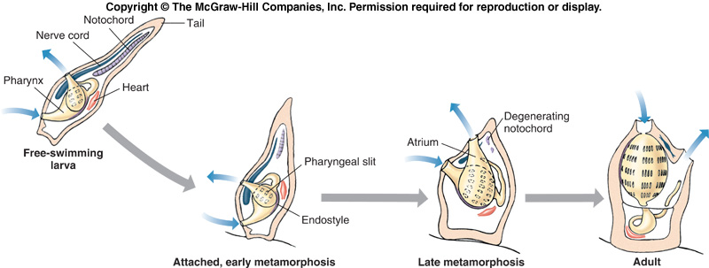
Subphylum Urochordata
In most species, only the larvae show all of the chordate hallmarks.
  Tadpole larva

Slide 20
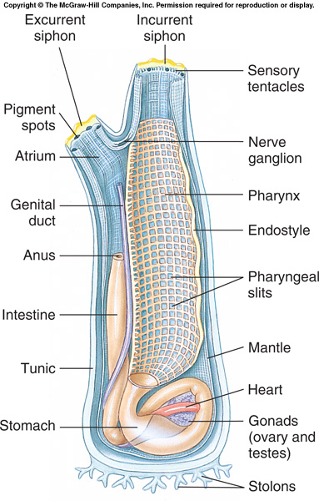
Subphylum Urochordata
Tunicates filter feed using the pharyngeal slits and a mucous net secreted by the endostyle.

Slide 21
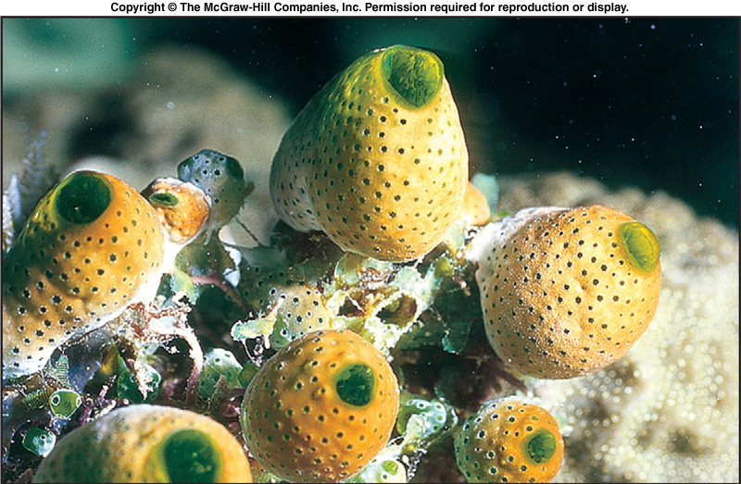
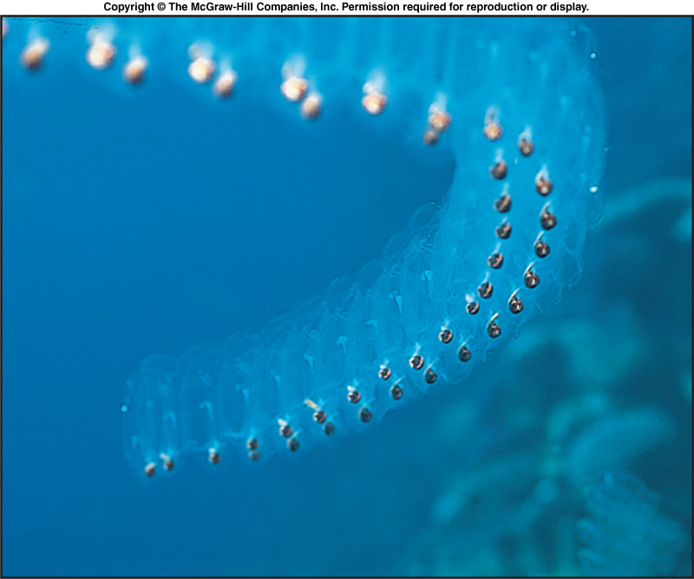
Subphylum Urochordata
Some tunicates are colonial.

Slide 22
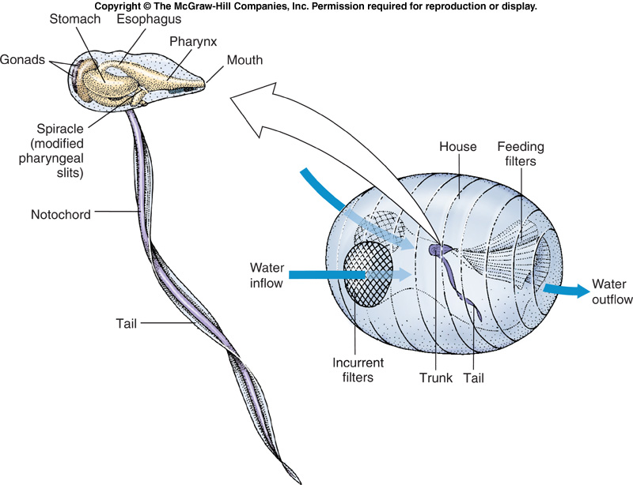
Subphylum Urochordata
Larvaceans are paedomorphic.
  Adults retain larval characteristics.

Slide 23
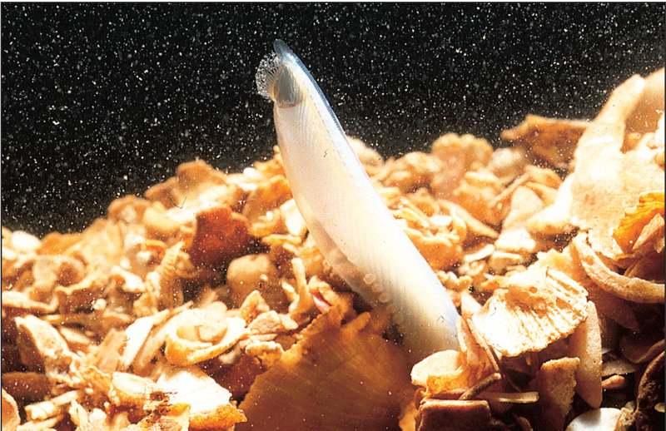
Subphylum Cephalochordata
Cephalochordates are the lancelets, also called amphioxus.

Slide 24
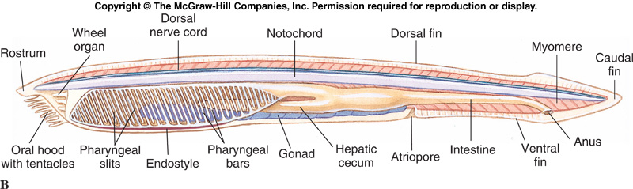
Subphylum Cephalochordata
All five chordate characters are present in a simple form.
Filter feeding is accomplished using pharyngeal slits and a mucous net secreted by the endostyle.

Slide 25
Subphylum Cephalochordata
The dorsal, hollow nerve cord lies just above the notochord.
The circulatory system is closed, but there is no heart.
  Blood functions in nutrient transport, not oxygen transport.
Segmented trunk musculature is another feature shared with vertebrates.

Slide 26
Subphylum Cephalochordata
Many zoologists consider amphioxus a living descendant of ancestors that gave rise to both cephalochordates and vertebrates
  Would make them the living sister group of the vertebrates

Slide 27
Subphylum Vertebrata
Subphylum Vertebrata is a monophyletic group that shares the basic chordate characteristics with the urochordates and cephalochordates.

Slide 28
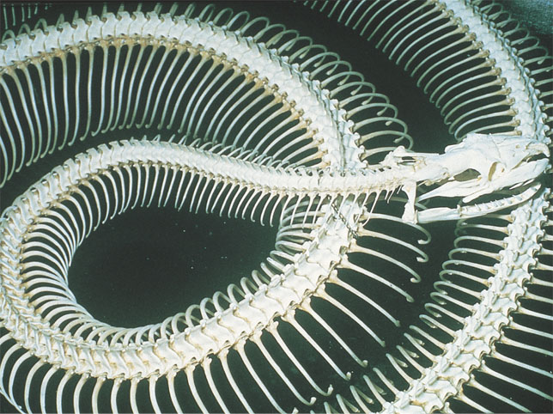
Subphylum Vertebrata
The animals called vertebrates get their name from vertebrae, the series of bones that make up the backbone.

Slide 29
Subphylum Vertebrata
There are approximately 52,000 species of vertebrates which include the largest organisms ever to live on the Earth.
  Fishes
  Amphibians
  Reptiles
  Birds
  Mammals

Slide 30
Subphylum Vertebrata = Craniata
Craniates are chordates that have a head.
The origin of a head opened up a completely new way of feeding for chordates: active predation.
Craniates share some common characteristics:
  A skull, brain, eyes, and other sensory organs.

Slide 31
Endoskeleton
Vertebrates have an endoskeleton made of cartilage or bone.
  All have a cranium to protect the brain.
  Almost all have vertebrae to protect the spinal cord.
  Important for muscle attachment.

Slide 32
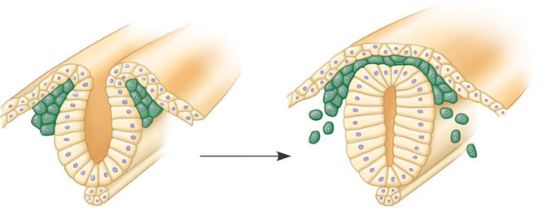
Neural Crest Cells
One feature unique to vertebrates is the neural crest, a collection of cells that appears near the dorsal margins of the closing neural tube in an embryo.
Dorsal edges
of neural plate
Neural
crest
Neural
tube
Ectoderm
Ectoderm
Migrating neural
crest cells
Notochord
(a) The neural crest consists of
bilateral bands of cells near
the margins of the embryonic
folds that form the neural tube.
(b) Neural crest cells migrate to
distant sites in the embryo.

Slide 33
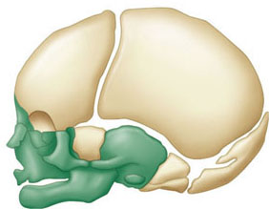
Neural Crest Cells
Neural crest cells give rise to a variety of structures, including some of the bones and cartilage of the skull.

Slide 34
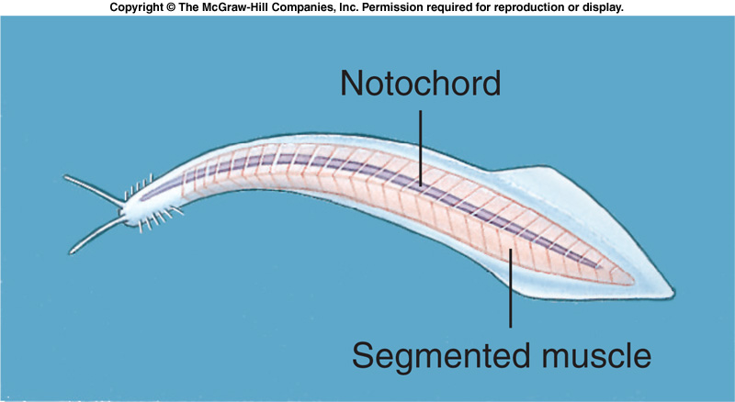
The Origin of Vertebrates
Vertebrates evolved at least 530 million years ago, during the Cambrian explosion.
Pikaia was an early chordate discovered in the Burgess Shale.
  Cephalochordate?

Slide 35
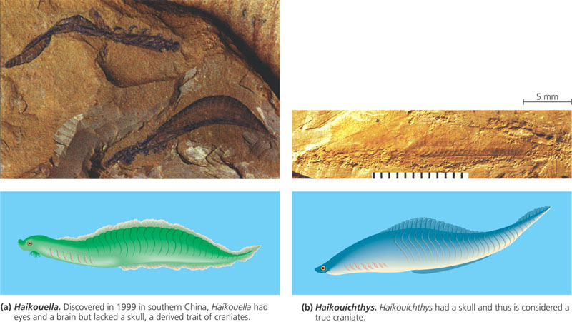
The Origin of Vertebrates
The most primitive of the early vertebrate fossils are those of the 3-cm-long Haikouella.
  Eyes and brain present, but no skull.
  It is transitional in morphology between cephalochordates and vertebrates
  Some hypothesize Haikouella is the sister taxon of vertebrates.

Slide 36
The Origin of Vertebrates
In other Cambrian rocks, paleontologists have found fossils of even more advanced chordates, such as Haikouichthys.
  Skull present.

Slide 37
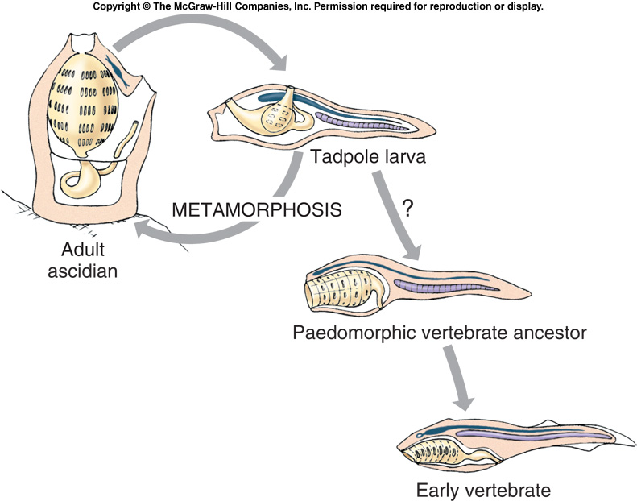
The Earliest Vertebrates
In 1928, Walter Garstang proposed that the tadpole larvae of tunicates may have led to early vertebrates.
The larva may have failed to metamorphose into an adult tunicate.
  Paedomorphosis – retention of larval traits in an adult body.
  Now rejected – urochordates are likely a derived condition.

Slide 38
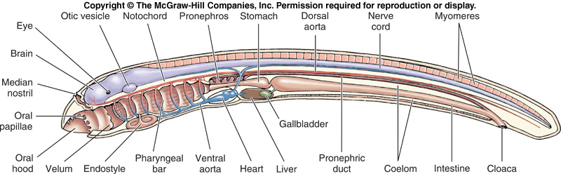
Ammocoete Larva of Lampreys
Lampreys have a freshwater larval stage, the ammocoete, that resembles amphioxus.
  Filter feeders
  Closely approaches ancestral body plan.

Slide 39
The Earliest Vertebrates
The earliest known vertebrate fossils belong to two fishlike 530 million year old vertebrates.
  Haikouichthys
  Recently discovered (1999) they push back vertebrate origins to the early Cambrian.

Slide 40
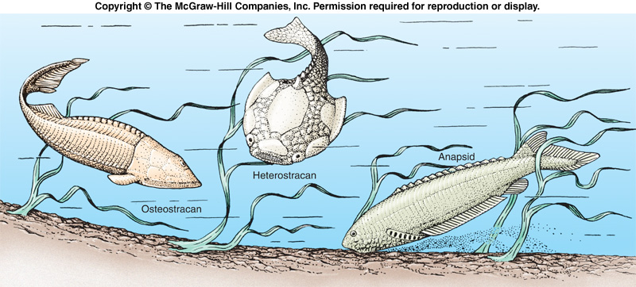
The Earliest Vertebrates
Other early vertebrate fossils include the armored jawless fishes called ostracoderms from the late Cambrian.
  Heterostracans had dermal armor, but lacked paired fins.
  Osteostracans had paired pectoral fins as well as dermal armor.
  Anaspids were more agile and streamlined.

Slide 41
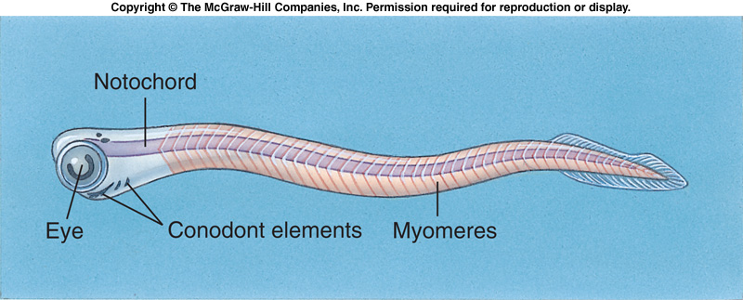
The Earliest Vertebrates
Conodonts resemble amphioxus, but have greater cephalization.

Slide 42
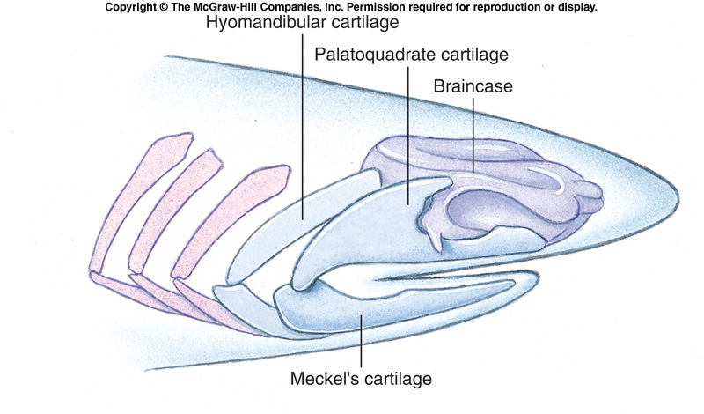
The Earliest Vertebrates
Vertebrates lacking jaws are known as agnathans.
  Paraphyletic
Gnathostomes refers to the jawed vertebrates, both living and extinct.
  Jaws arose from modifications to the first and second gill arches.
  Mandibular arch may have first become enlarged to assist gill ventilation - perhaps to meet increasing metabolic demands of early vertebrates.
  Monophyletic

Slide 43
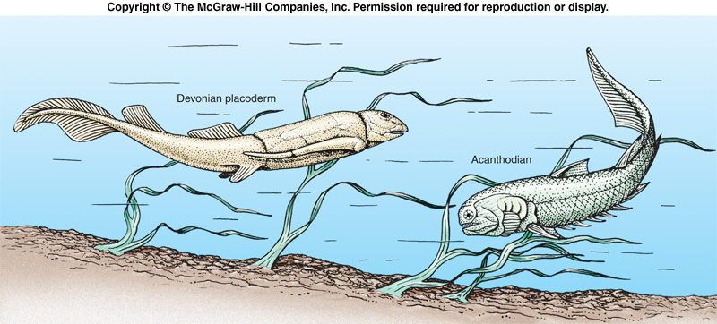
The Earliest Vertebrates
Placoderms were among the first jawed vertebrates.
  Silurian, extinct in the Devonian.
Another group of early jawed vertebrates, the acanthodians, with paired fins and large spines may have given rise to the bony fishes.

