Slide 1
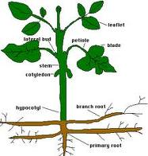
Kingdom plantae

Slide 2
Plant evolution in brief
Early green algae gave rise to early non-vascular plants, which gave rise to non-vascular plants we see today and vascular plants
Hugely diverse kingdom – from mosses to trees
Difference between vascular and non-vascular?
Vascular plants (tracheophytes) have a water and nutrient transport system; non-vascular (bryophytes) don’t

Slide 3
Major plant phyla
Draw flow chart (Figure 2) on page 374

Slide 4
General plant life cycle
Plants alternate between a diploid sporophyte generation (starts with zygote and undergoes mitosis) and a haploid gametophyte generation (starts with gametophyte and undergoes meiosis).

Slide 5



Phylum: bryophyta
No vascular system
Examples: mosses – sphagnum peat, coal

Slide 6

Phylum: Tracheophyta
Have vascular system (phloem (transport from upper plant to roots) and xylem (from roots to other plant parts)
Subdivision – Pteridophyta (plants without seeds)
Example: ferns
  No seeds
  Pioneer plants
  Most prefer shaded, moist areas

Slide 7
Phylum: tracheophyta
Subdivision: Spermatophyta
plants with seeds
-seed contains embryo; provides protection
Most widely distributed of all plants
At least 270 000 species known

Slide 8
Spermatophyta
Two classes – Gymnospermae and Angiospermae
Gymnospermae
-produce unprotected seeds in conelike structures (usually conifers)
Wide rather than deep roots
Examples: pines, spruces, junipers, cedars
Alternation of generations producing pollen (vs. Spores in pteridophytes)
Economic and medicinal value

Slide 9
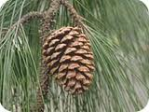
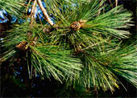

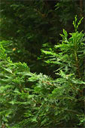

Slide 10
Class: Angiospermae
Alternation of generations produces seeds that are borne in fruits
More diverse than any all other plant classes combined
There are monocots (one seed leaf) and dicots (two leaf seeds)
Monocots – examples include Trillium, water lilies, orchids, onions
Dicots – examples include asters, maples, peas, cabbage

Slide 11

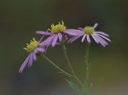
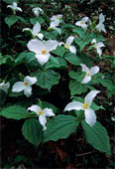
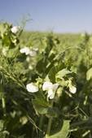



Slide 12
Debate: conventional vs. Organic agriculture
Is genetic diversity important in agriculture?
What are the environmental impacts of either system?
What are the benefits?
Do you agree that most conventional farmers should switch to organic farming?

