Slide 1
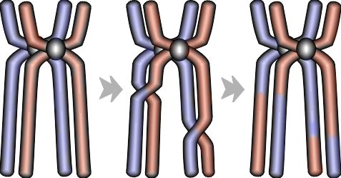
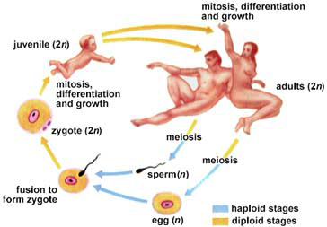
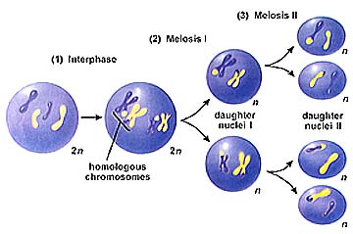
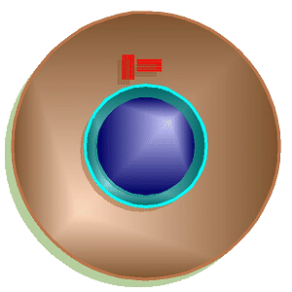
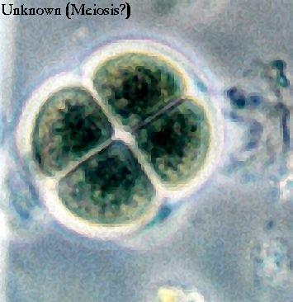
Chapter 13.
Meiosis &
Sexual Reproduction

Slide 2
Cell division / Asexual reproduction
Mitosis
  produce cells with same information
    identical daughter cells
  exact copies
    clones
  same amount of DNA
    same number of chromosomes
    same genetic information
Aaaargh!
I’m seeing
double!

Slide 3
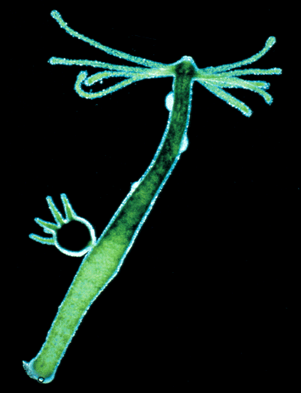
Asexual reproduction
Single-celled eukaryotes reproduce asexually
  yeast
  Paramecium
  Amoeba
Simple multicellular eukaryotes reproduce asexually
  Hydra
    budding
What are the
disadvantages of
asexual reproduction?
What are the
advantages?

Slide 4
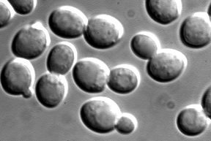
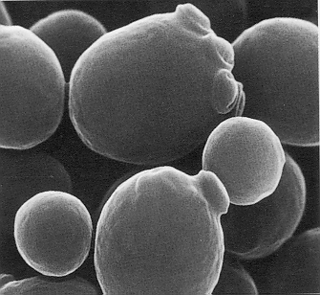
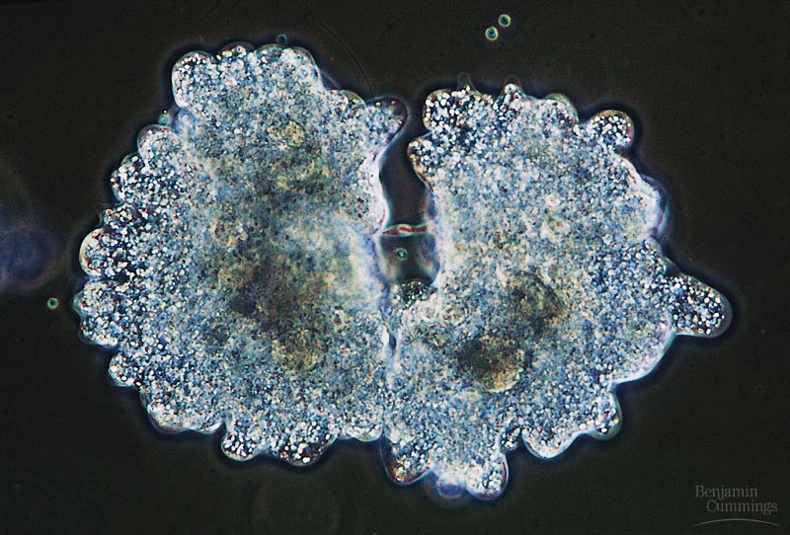
Budding in Yeast
Binary fission in Amoeba

Slide 5
How about the rest of us?
What if a complex multicellular organism (like us) wants to reproduce?
  joining of egg + sperm
Do we make egg & sperm by mitosis?
46
+
46
92
egg
sperm
zygote

Slide 6
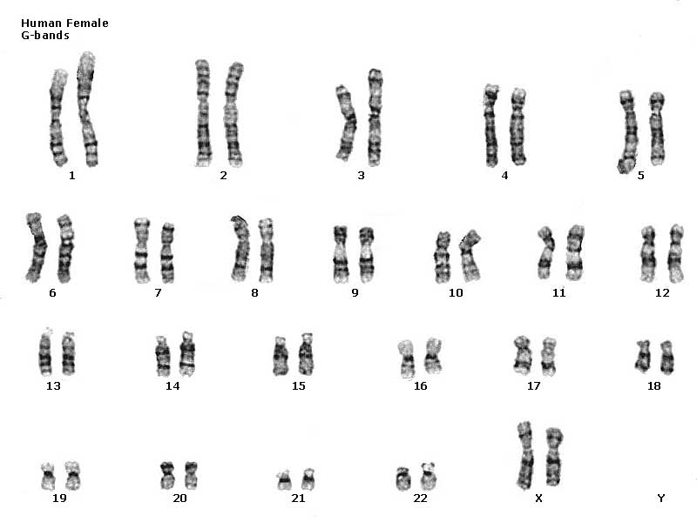
Human female karyotype

Slide 7
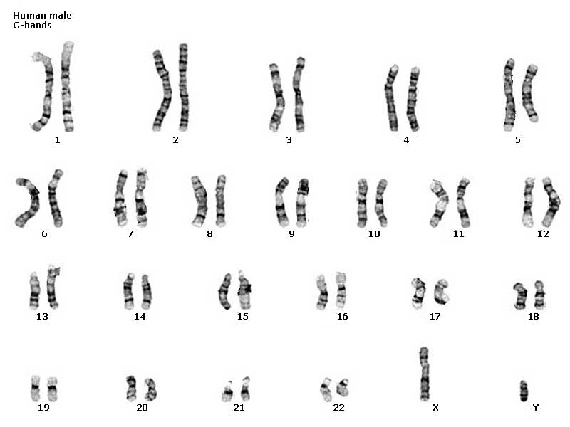
Human male karyotype

Slide 8
How do we make sperm & eggs?
reduce 46 chromosomes → 23 chromosomes
  half the number of chromosomes
23
46
23
egg
46
meiosis
23
46
23
fertilization
sperm

Slide 9
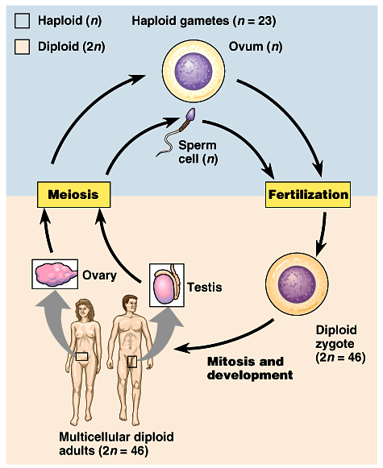
Meiosis: production of gametes
Alternating processes,
alternating stages
  chromosome number must be reduced
    diploid → haploid
    2n → n
      humans: 46 → 23
    meiosis reduces chromosome number
  fertilization restores chromosome number
    haploid → diploid
    n → 2n

Slide 10
Homologous chromosomes
Paired chromosomes
  both chromosomes of a pair carry genes
    control same inherited characters
    homologous = same information
diploid
2n
homologous
chromosomes
double stranded
homologous chromosomes

Slide 11
Sexual reproduction: Fertilization
- 1 copy
- haploid
- 1n
from Mom
from Dad
- 2 copies
- diploid
- 2n

Slide 12
Making gametes for the next generation
- 2 copies
- diploid
- 2n
We’re
mixing things
up here!
- 1 copy
- haploid
- 1n

Slide 13
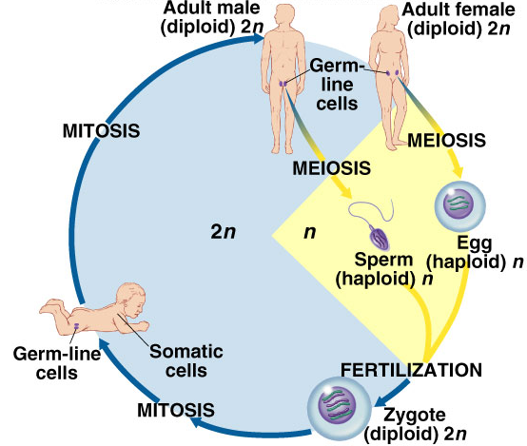
Meiosis = reduction division
Meiosis
  special cell division in
  sexually reproducing
  organisms
  reduce 2n → 1n
  diploid → haploid
    half
  makes gametes
    sperm, eggs
Warning: meiosis evolved from mitosis, so stages & “machinery” are similar but the processes are radically different. Do not confuse the two!

Slide 14
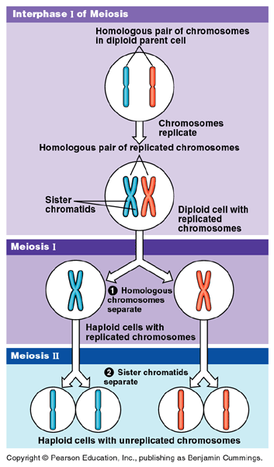
Double division of meiosis
DNA replication
1st division of
meiosis separates homologous pairs
2nd division of meiosis separates sister chromatids

Slide 15
Preparing for meiosis
1st step of meiosis
  Duplication of DNA
  Why bother?
    meiosis evolved after mitosis
    convenient to use
    “machinery” of mitosis
    DNA replicated in
    S phase of interphase
    of MEIOSIS
    (just like in mitosis)
2n = 6
single
stranded
2n = 6
double
stranded
M1 prophase

Slide 16
Preparing for meiosis
2n = 4
single
stranded
1st division of meiosis separates homologous pairs
2n = 4
double
stranded
prophase1
2n = 4
double
stranded
metaphase1
synapsis
telophase1
tetrad
1n = 2
double
stranded

Slide 17
Meiosis 2
2nd division of
meiosis separates
sister chromatids
1n = 2
double
stranded
What does
this division
look like?
prophase2
1n = 2
double
stranded
metaphase2
1n = 2
single
stranded
telophase2

Slide 18
Steps of meiosis
Meiosis 1
  interphase
  prophase 1
  metaphase 1
  anaphase 1
  telophase 1
Meiosis 2
  prophase 2
  metaphase 2
  anaphase 2
  telophase 2
1st division of
meiosis separates homologous pairs
(2n → 1n)
2nd division of meiosis separates sister chromatids
(1n → 1n)
* just like mitosis *

Slide 19
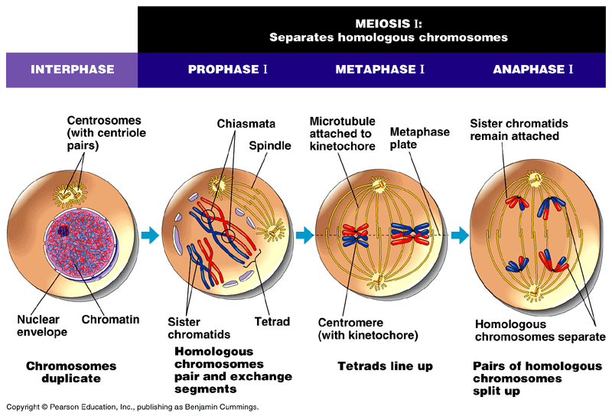

Slide 20
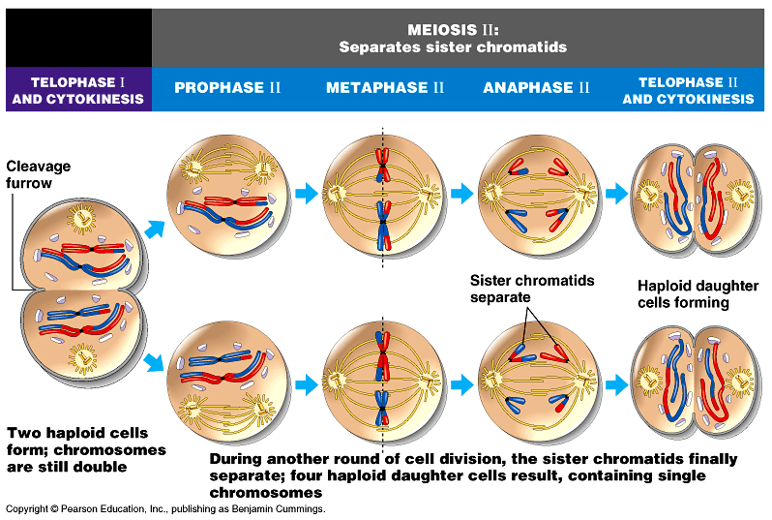

Slide 21
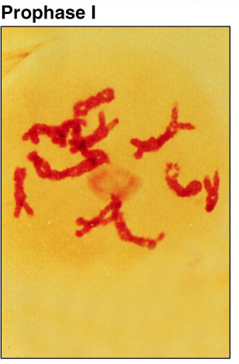
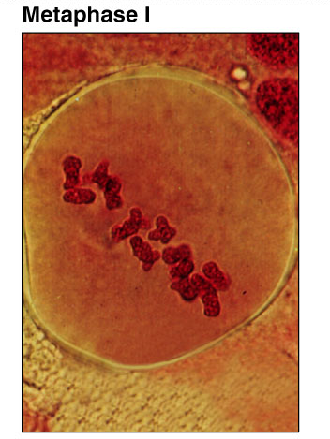
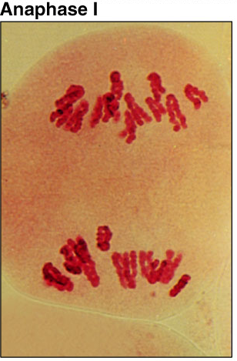
Meiosis 1

Slide 22
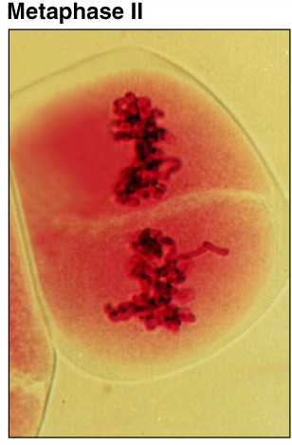
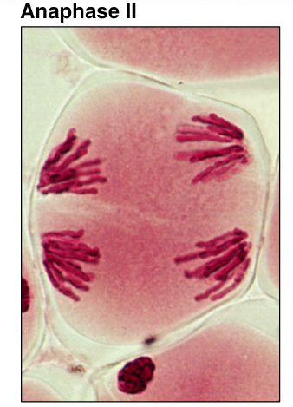
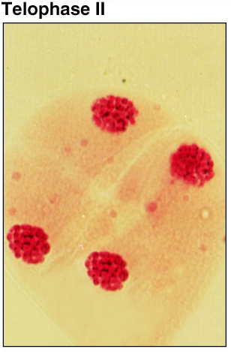
Meiosis 2

Slide 23
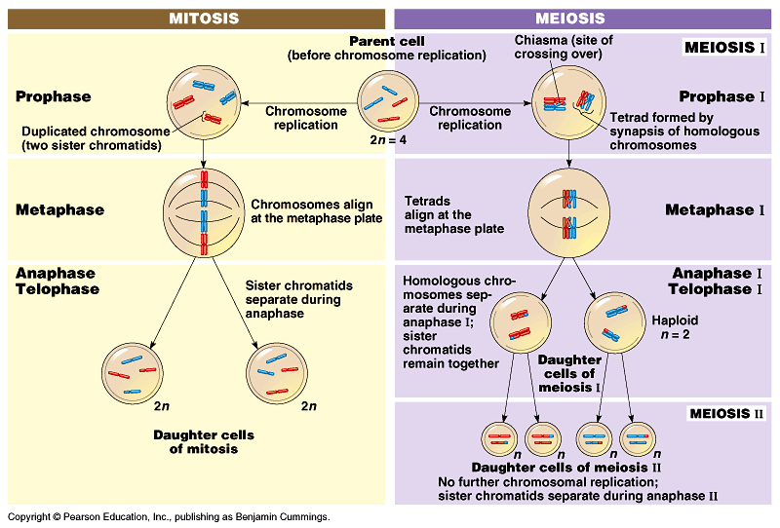
Mitosis vs. Meiosis

Slide 24
Mitosis vs. Meiosis
Mitosis
  1 division
  daughter cells genetically identical to parent cell
  produces 2 cells
  2n → 2n
  produces cells for growth & repair
  no crossing over
Meiosis
  2 divisions
  daughter cells genetically different from parent
  produces 4 cells
  2n → 1n
  produces gametes
  crossing over

Slide 25
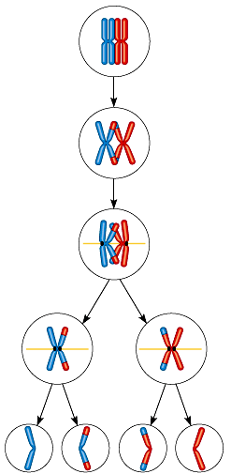

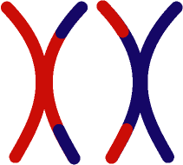
Crossing over
During Prophase 1
  homologous pairs swap
  pieces of chromosome
  sister chromatids intertwine
  crossing over
tetrad
synapsis

Slide 26
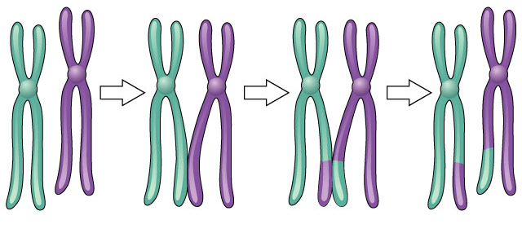
Crossing over
What are the
advantages of
sexual reproduction?
3 steps
  cross over
  breakage of DNA
  re-fusing of DNA
New combinations of traits

Slide 27
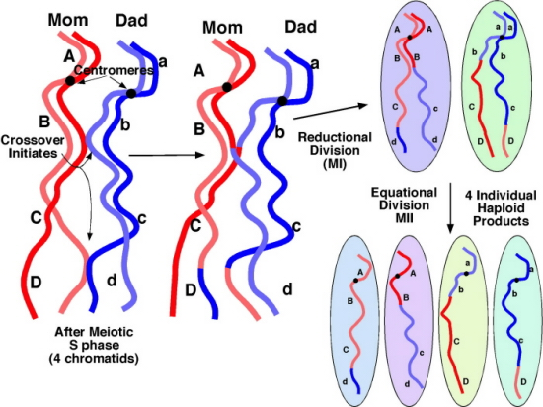
Genetic variation
Meiosis & crossing over introduce great genetic variation to population
  drives evolution
Notes:
Consider the greater variation with 23 pairs of chromosomes = mixing and matching

Slide 28
The value of meiosis
Meiosis introduces genetic variation
  gametes of offspring do not have same genes as gametes from parents
  genetic recombination
    random assortment in humans produces 2²³ (8,388,608) different combinations
new gametes
made by offspring
from Mom
from Dad

Slide 29
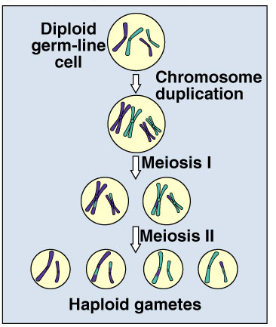
And more variation…
Crossing over
  creates completely new combinations of traits
  in next generation

Slide 30
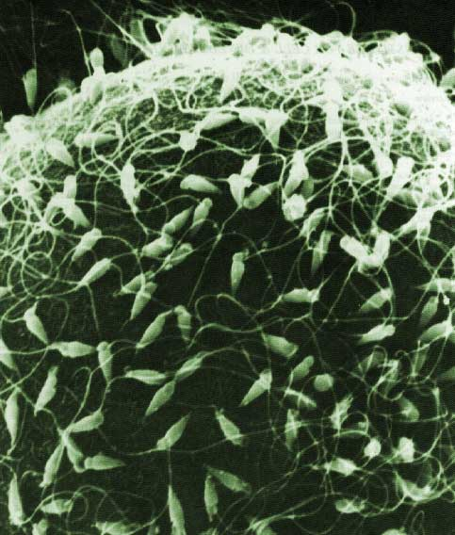
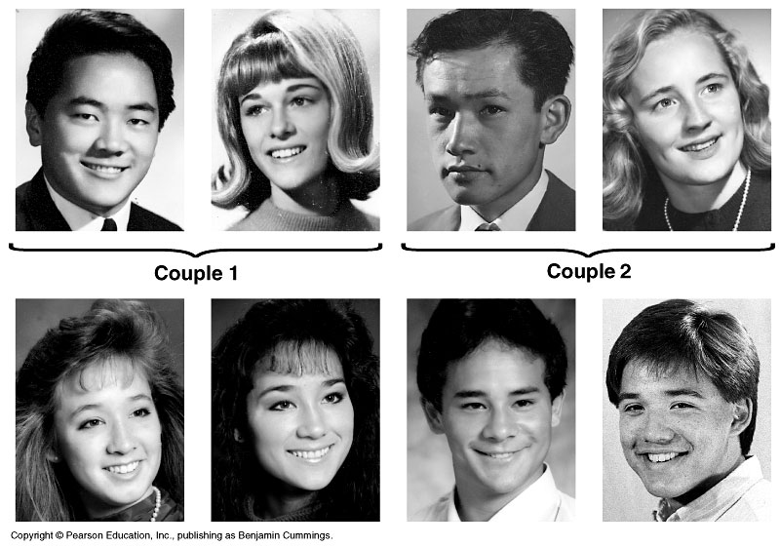
Random fertilization
Any 2 parents will produce a zygote with over 70 trillion (2²³ x 2²³) diploid combinations

Slide 31
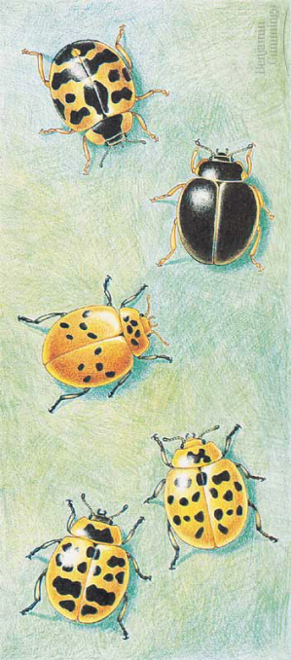
Sources of genetic variability
Genetic variability in sexual reproduction
  independent assortment
    homologous chromosomes in Meiosis 1
  crossing over
    between homologous chromosomes in prophase 1
  random fertilization
    random ovum fertilized by a random sperm
metaphase1

Slide 32
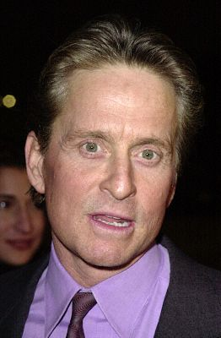
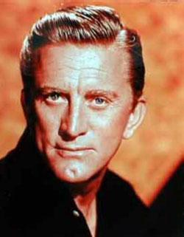
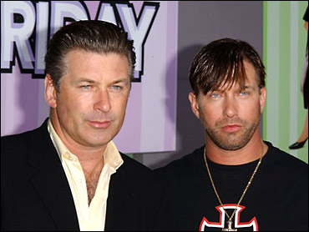


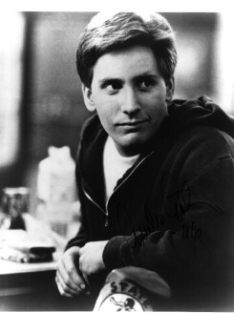
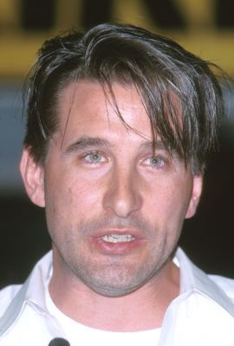

Sexual reproduction creates variability
Sexual reproduction allows us to maintain both genetic similarity & differences.
Michael & Kirk
Douglas
Baldwin brothers
Martin & Charlie Sheen, Emilio Estevez

Slide 33
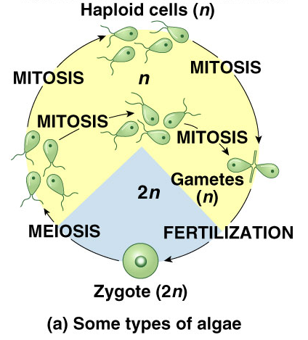
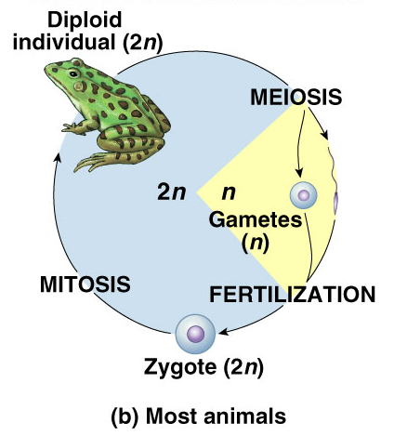
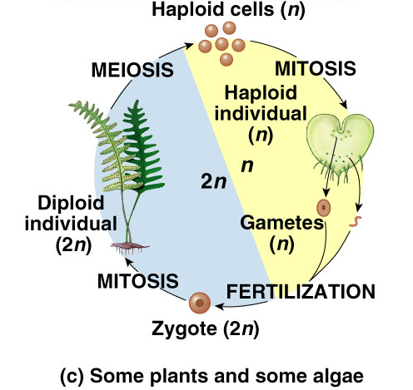
Differences across kingdoms
Not all organisms use haploid & diploid stages in same way
  which one is dominant (2n or n) differs
  but still alternate between haploid & diploid
    have to for sexual reproduction

Slide 34
Any Questions??
What are the
DISadvantages of
sexual reproduction?

