Slide 1

Amphibians

Slide 2
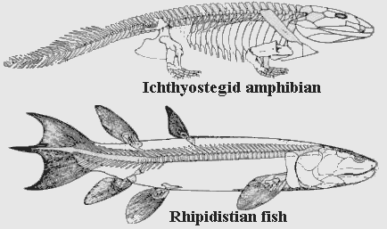
Evolution of Amphibians

Slide 3
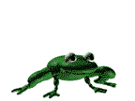
"Amphibian" comes from the Greek meaning "both life". Amphibians can live on water and on land.
Scientist infer that amphibians evolved from lobe-finned fishes called crossopterygians.

Slide 4
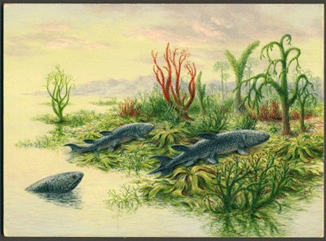
Crossopterygian

Slide 5
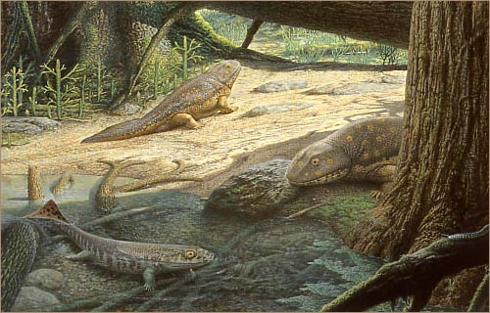
Biologist conclude that amphibians appeared during the late Devonian period, about 345 million years ago.

Slide 6
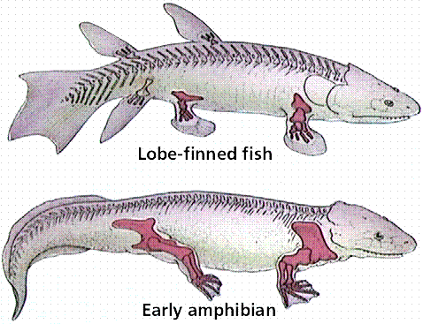
Crossopterygians had no gills but they had internal nostrils and a primitive lung that may have enabled them then to respire for periods of time on land.

Slide 7

Characteristics of Amphibians

Slide 8
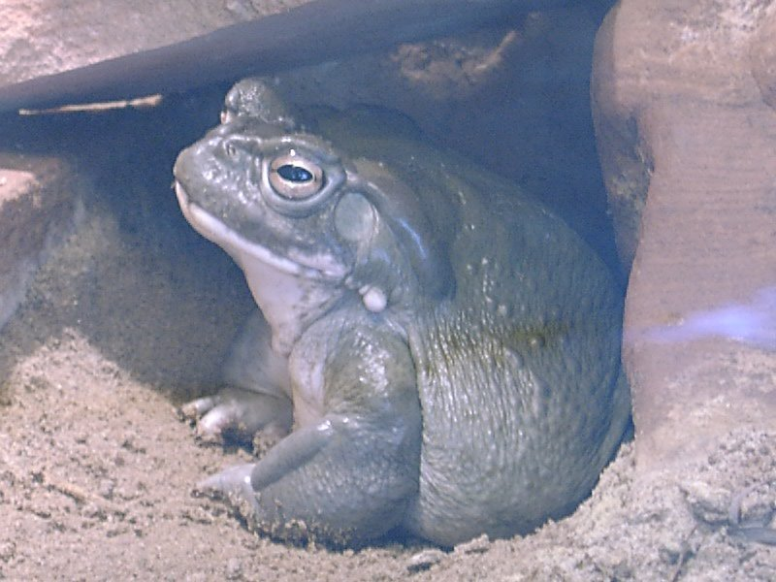
Amphibians are cold-blooded, which means their blood temperature rises and falls with that of the surrounding environment
•

Slide 9
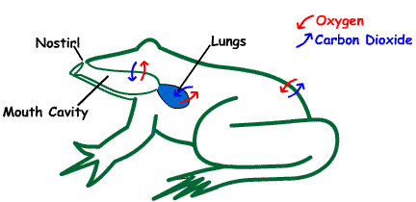
They use gills, lungs, skin, and mouth cavity in respiration.

Slide 10
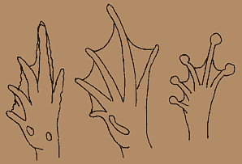
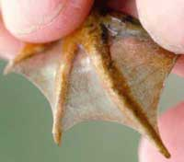
They have moist, smooth, thin skin with no scales.Feet are webbed and the toes lack claws.

Slide 11
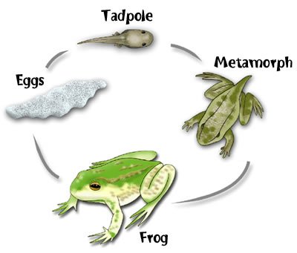
Amphibians have many prominent characteristics that are adaptations to a life spent both on land and in water:
They change from an aquatic larval stage to a terrestrial adult form. This transformation is called metamorphosis

Slide 12
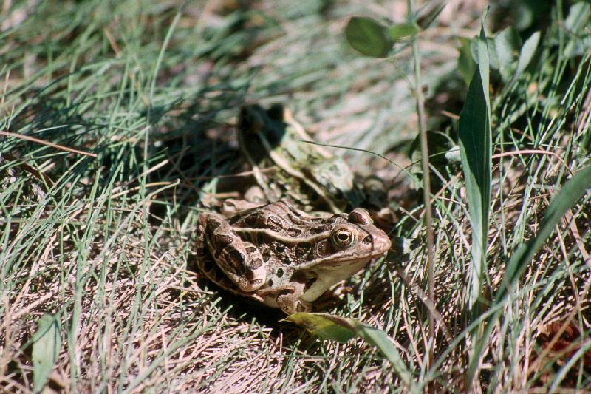
Amphibians enter a state of dormancy or torpor when conditions are unfavorable.
They often bury themselves in mud or leaves, emerging when conditions are better.

Slide 13
Such states of inactivity are known as known as:
Hibernation when it occurs in the winter
Estivation when it occurs in the summer

Slide 14
Larvae have two-chambered hearts; adults have three-chambered hearts and well-developed circulation.

Slide 15
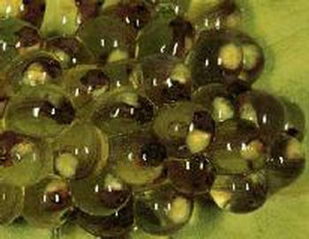
Eggs lack multicellular membranes or shells. They are usually laid in water or in a moist environment and fertilized externally.

Slide 16
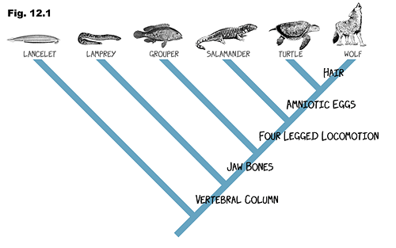
Classification of Amphibians

Slide 17
Biologists have identified about 2,375 living species of amphibians and have classified them into four orders
Anura – Frogs & Toads
Urodela – Salamanders
Trachystoma – Mud eels
Apoda - Caecillians

Slide 18
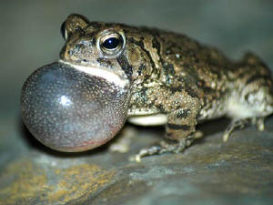
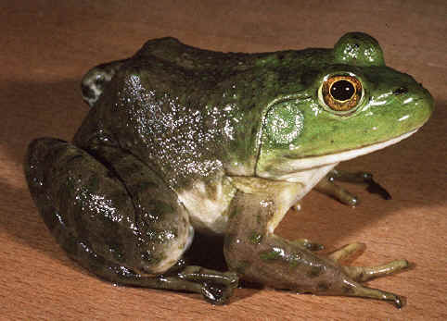
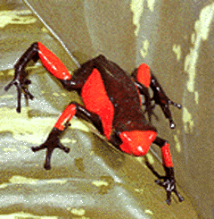
Frogs and toads make up the Order Anura ("without a tail").

Slide 19
Salamanders and other amphibians with legs and tails make up the Order Urodela ("visible tail").

Slide 20
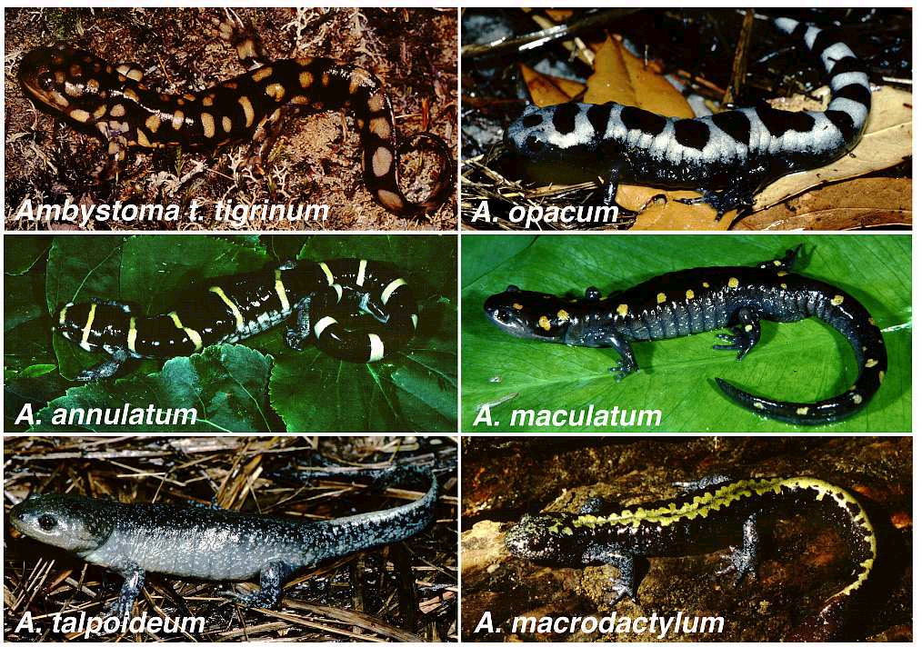

Slide 21
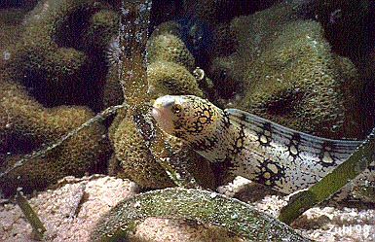
.
Some aquatic amphibians (mud eels & sirens) belong to the Order Trachystoma ("rough mouth")

Slide 22
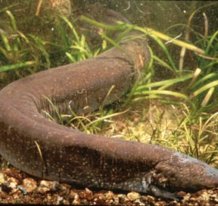
Siren

Slide 23
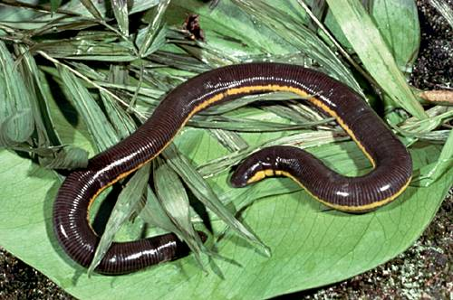
Apoda includes caecilians, a tropical, burrowing worm-like amphibians that is often
Legless

Slide 24
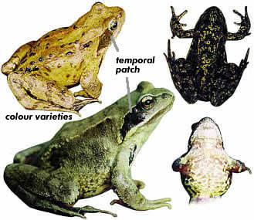
Anuran Characteristics

Slide 25
Frogs and toads comprise the order Anura
There are about 3,500 known species of frogs and 300 kinds of toads
They are found on every continent except Antarctica

Slide 26
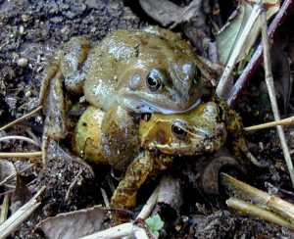
Some types spend their entire life in or near water, but others live mainly on land and come to the water only to mate

Slide 27
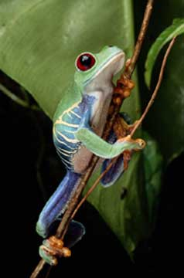
Some frogs and toads are climbers that dwell in trees or burrowers that live underground.

Slide 28
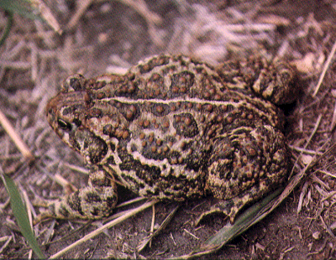
Toads and frogs have many similarities in the way they look. Some basic differences between them are: toads have dry, warty skin, while frogs have smooth, wet skin.

Slide 29

Both frogs and toads return to water to reproduce. In nearly all species eggs are fertilized externally. The fertilized eggs hatch into swimming larval forms called tadpoles

Slide 30
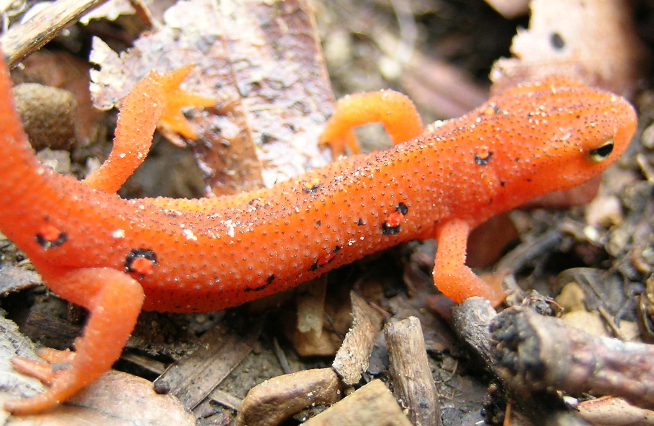
Urodelan Characteristics

Slide 31
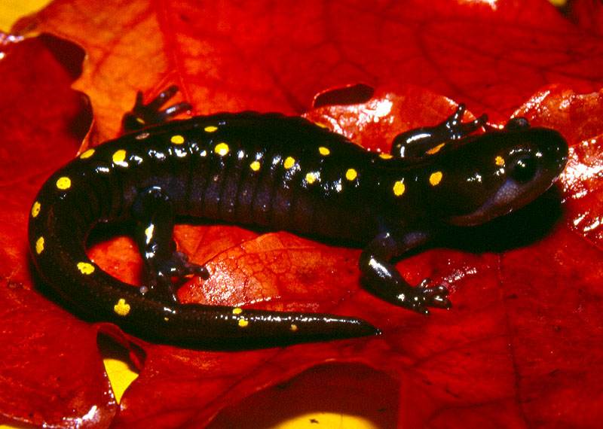
Salamanders, typical members of the Order Urodela, have elongated bodies, long tails, and smooth, moist skin

Slide 32
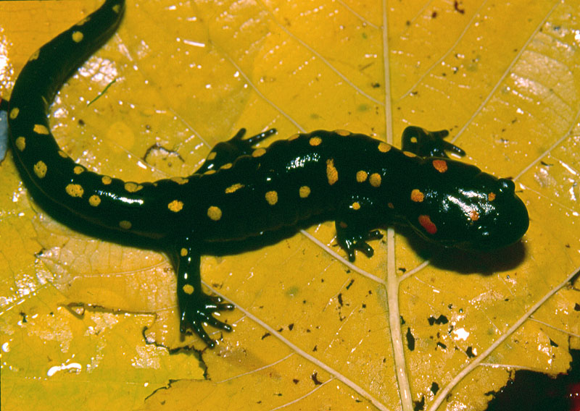
Compared to the anurans, salamanders are less able to remain on dry land, although some can live in dry areas by remaining inactive during the day

Slide 33
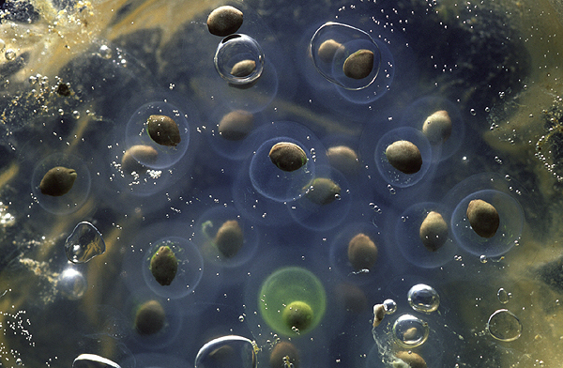
Salamander lay their eggs in water and like anurans they hatch into swimming larva
Salamander eggs

Slide 34
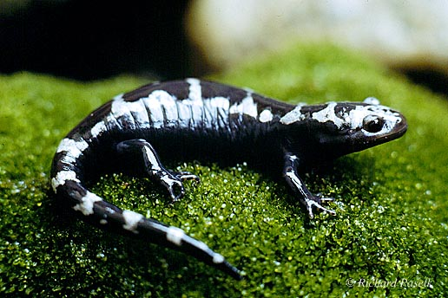
Other species can reproduce in damp land environments. Eggs laid on land hatch into miniature adult salamanders
Marbled Salamander

Slide 35
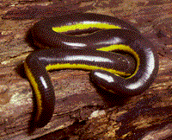
Apodan Characteristics

Slide 36
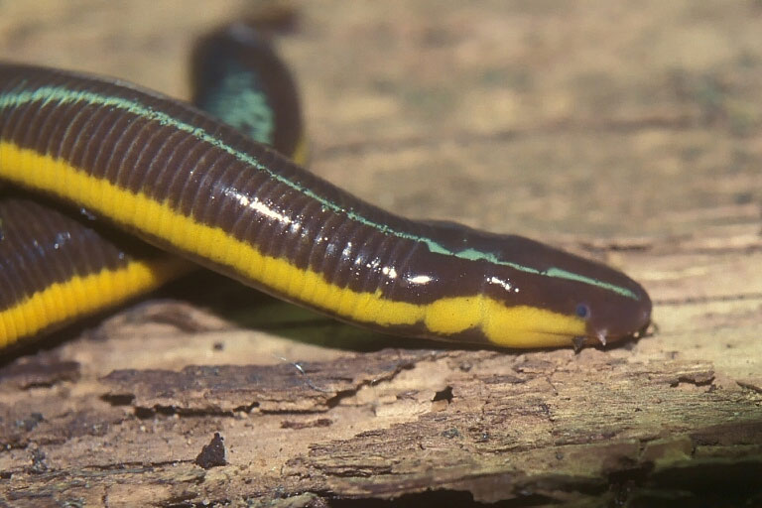
Caecilians, members of the Order Apoda, compose a highly specialized group of tropical burrowing amphibians

Slide 37
These legless wormlike creatures average 30 cm long, but they can be up to 1.3m long.
They have very small eyes and are often blind.
They eat worms and other invertebrates

Slide 38
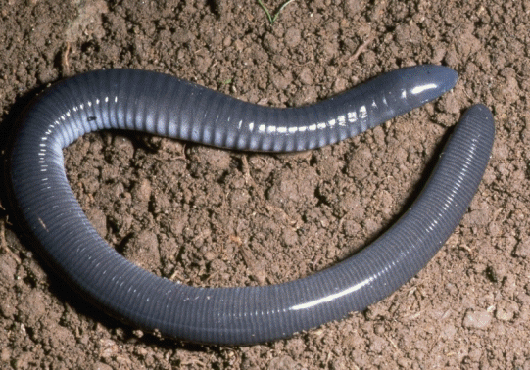
The caecilian male deposits sperm directly into the female, and the female bears live young

Slide 39
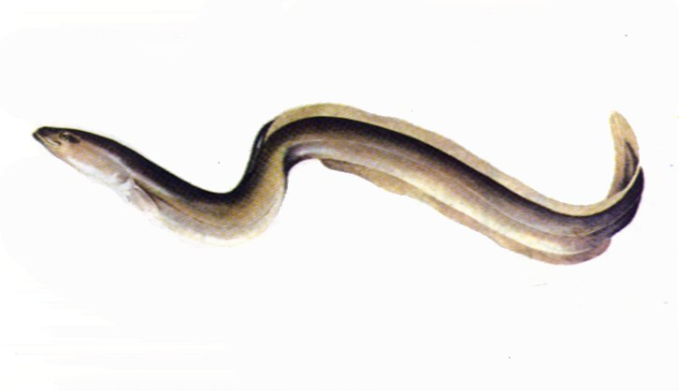
Trachystoma Characteristics

Slide 40
The Order Trachystoma contains three living species of mud eels, or sirens.
Sirens live in the eastern United States and north­eastern Mexico.

Slide 41
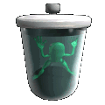
Frog External Anatomy

Slide 42

The frog's powerful hind legs are equally effective in jumping or swimming. On land frogs sit with their hind legs folded against the body, poised to jump at the first sign of danger.
Most frogs can make leaps many times their body length

Slide 43
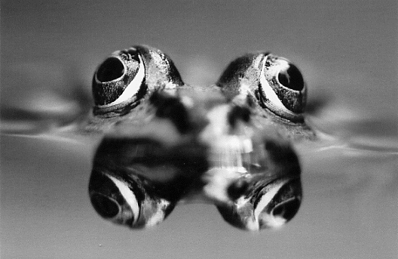
Frog's eyes also work equally well in or out of water. Because the eyes bulge out from the head, the frog can stay submerged while literally "keeping an eye out" for predators

Slide 44
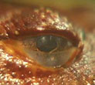
Eyelids that can blink protect the frog's eyes from dust and dehydration
In addition to upper and lower eyelids, a third, transparent eyelid called a nictitating membrane covers each eyeball and joins the lower eyelid
This membrane keeps the eyelid moist and protects it when it is under water

Slide 45
Frogs have eardrums, or tympanic membranes, which are circular structures located behind each eye
Tympanic membrane

Slide 46
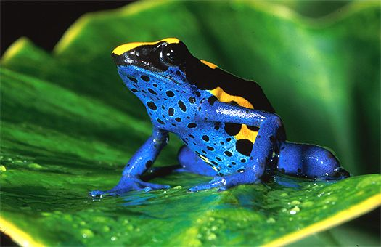
The frog's thick, moist skin serves two important functions— respiration and protection
Glands secrete mucus to keep it from drying up

Slide 47
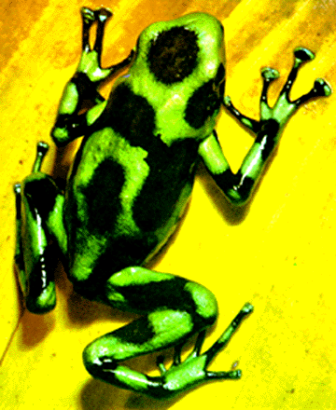
Some glands secrete foul-tasting or poisonous substances that protect the frog from enemies

Slide 48
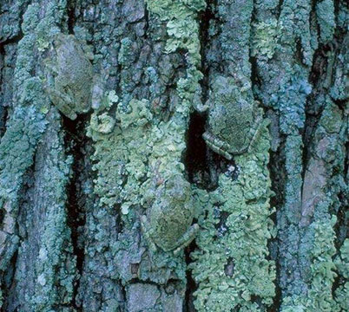
Some frogs, such as Hyla versicolor, can change color in order to blend with the environment.
Count the number of frogs in the picture?

Slide 49
Frog Internal Anatomy

Slide 50
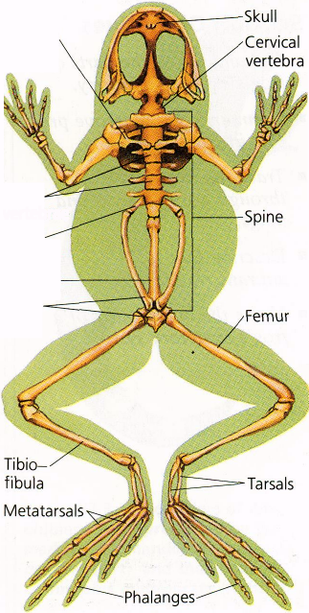
Skeletal System
The frog's spine has nine vertebrae
The cervical vertebra at the anterior end of the spine allows neck movement that helps frogs catch prey

Slide 51
Skeletal System
Posterior to this are seven trunk vertebrae, and then a single sacral vertebra that supports the hind legs
A long, slim bone called the urostyle extends from the sacral vertebra

Slide 52
Skeletal System
Bones of the pectoral girdle, which form the shoulders, connect to the front legs
They also provide the primary protection to the internal organs, since the frog has no ribs
The pelvic girdle connects to the hind legs

Slide 53
Digestive System

Slide 54

Digestive System
Most frogs feed on insects, and their digestive system is adapted to their diet
A frog's tongue is an excellent insect catcher. The frog simply flicks out its long sticky tongue, curls it around its prey, and pulls the insect back into its mouth. Then the frog snaps its mouth shut and swallows.

Slide 55
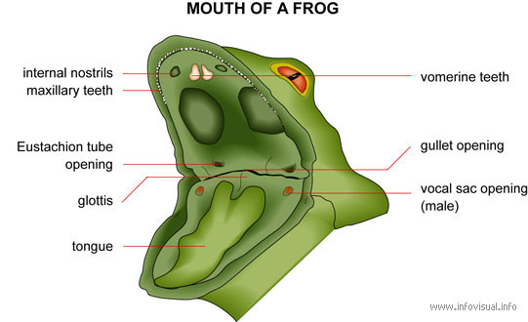
Digestive System
Frogs have two types of teeth that hold on to prey. A row of maxillary teeth line the perimeter of the upper jaw. Two patches of vomerine teeth project from bones in the roof of the mouth.

Slide 56
Digestive System
Sometimes the frog blinks, pulls its eyes inward, and presses them against the roof of its mouth. This action helps push the food down its throat
Digestion in frogs takes place in the alimentary canal, which includes the esophagus, stomach, small intestine, large intestine, and cloaca

Slide 57
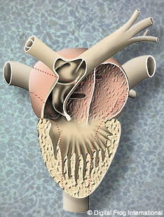
Circulatory System
An adaptation to the greater oxygen needs of land animals is a more efficient circulatory system than the fish's two-chambered heart.
The amphibian's three-chambered heart partially mixes oxygenated with deoxygenated blood and pumps the blood throughout the body at higher pressure than does the fish's heart

Slide 58
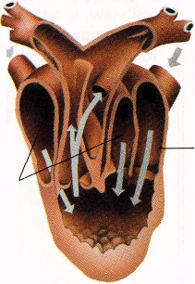
The left atrium receives oxygenated blood from the lungs, and the right atrium receives deoxygenated blood from the body.
Both the atria empty into the ventricle, the main pumping chamber of the heart.
In the ventricle oxygenated and deoxygenated blood mix partially and are pumped to the lungs and the rest of the body.
Blood to body
Oxygenated blood from lungs
Deoxygenated blood from body
R

Slide 59
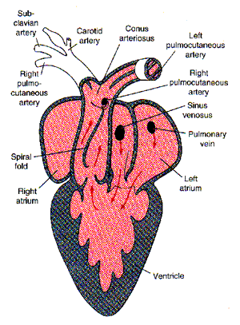
From the right atrium the blood enters the single ventricle. The ventricle then contracts, pumping some blood to the lungs to receive oxygen and some to the rest of the body.
The blood going to the body leaves the ventricle through the conus arteriosus, a large vessel that lies against the front side of the heart

Slide 60
This vessel divides into a right and a left truncus arteriosus, which immediately branch again into three arches that carry blood to various parts of the body.
Deoxygenated blood travels in veins back to the right atrium from the various regions of the body.
Oxygenated blood returns from the lungs to the left atrium via the pulmonary veins

Slide 61
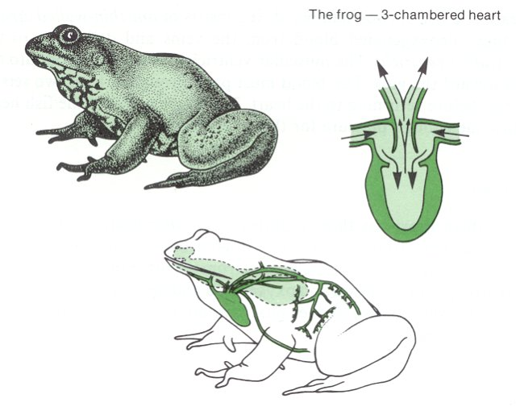

Slide 62
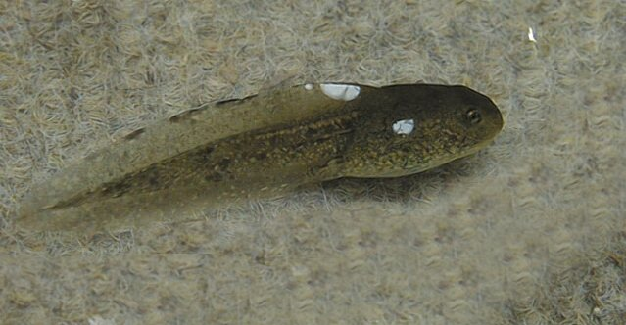
Respiratory System
Tadpoles respire, or exchange carbon dioxide and oxygen, through gills

Slide 63
Respiratory System
Adult frogs lose the gills but can respire in three ways: through the lungs, through the skin, and through the mouth.
Respiration through the lungs is called pulmonary respiration.
A frog breathes by changing the volume and pressure of air in its mouth while either opening or closing its nostrils

Slide 64
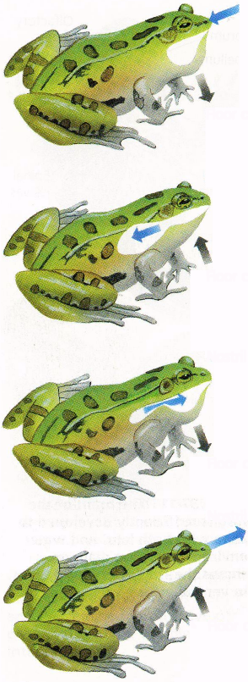
Respiratory System
Air moves from the throat to the lungs through a slit-like passage called the glottis.
Because the frog's lungs are small, cutaneous respiration, or respiration through the skin in both air and water, is very important, especially during estivation or hibernation.
Oxygen can diffuse across the lining of the mouth and into the blood.
Frogs use mouth breathing for only a relatively small amount of their respiration.

Slide 65
Excretory System
Urine and wastes from the digestive system are eliminated through the anus.
When a frog is in water, its permeable skin allows the water to enter its body.
Frogs that live primarily in water rid themselves of excess water by excreting a large volume of very dilute urine.
Frogs that live mainly on land conserve water by producing a small volume of more concentrated urine.

Slide 66
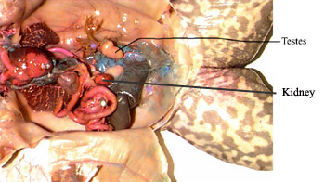
Excretory System
Amphibians eliminate two primary types of metabolic waste products—carbon dioxide from respiration and waste com­pounds from the breakdown of foods.
Are the primary excretory organs and lie on either side of the spine against the dorsal body wall. The kidneys filter nitrogenous wastes from the blood

Slide 67
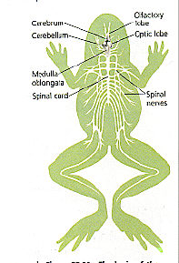
The Nervous System
The frog brain is more complex than the fish brain, enabling the frog to contend with a more varied environment.
The optic lobes, which control vision, lie behind the cerebrum.
The cerebellum, a small band of tissue lying at right angles to the long axis of the brain, is the center of balance and coordination.

Slide 68
Nervous System
The medulla oblongata lies at the back of the brain and joins the spinal cord. It controls organ functions.
Ten pairs of cranial nerves extend out directly from the brain.
The spinal cord transmits signals from all parts of the body to the brain and from the brain back to the body.
The spinal nerves branch from the spinal cord to various parts of the body.

Slide 69
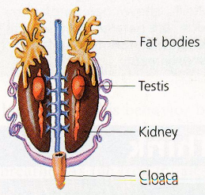
Reproductive System
Both male and female frogs have internal sex organs
The male frog's fore­leg muscles and first fingers swell
These swellings help the male maintain his grasp on the female
The reproductive system of the male frog includes two bean-shaped creamy white or yellowish testes located near the kidneys
Sperm cells develop in the testes and pass through tubes to the kidneys and urinary ducts
Male System

Slide 70

Reproductive System
Female frogs a pair of large, lobed ovaries containing thou­sands of tiny immature eggs lie near the kidneys
During the breeding season eggs enlarge, mature, and burst through the thin ovarian walls into the body cavity.
They remain in structures called ovisacs until ovulation is complete and then leave the body through the cloacae opening.
Female System

Slide 71

Reproductive System
The vast majority of eggs and tadpoles are eaten by predators such as fish, birds, snakes, and turtles. Some species of frogs have
The vast majority of eggs and tadpoles are eaten by predators such as fish, birds, snakes, and turtles.
Amplexus

Slide 72
Metamorphosis
Newly hatched tadpoles live off yolk stored in their bodies. They gradually grow larger and develop three pairs of gills.
Tadpoles have a two-chambered heart. Tadpoles can also regenerate injured or lost body parts such as a leg or tail.
Legs grow from the body, and the tail disappears.

Slide 73

Metamorphosis
The mouth broadens, developing teeth and jaws. A saclike bladder in the throat divides into two sacs that become lungs. The heart develops a third chamber.
A hormone called thyroxin circulates throughout the bloodstream and stimulates metamorphosis.
The cells of the tad­pole are genetically programmed to respond to thyroxin at the appropriate stage of development.

