Slide 1
Aging and Development
How do we duplicate and how do we get here?
Where are we going?
Notes:
Ideas fetus can regrow limbs.
Prevention, regeneration, early diagnosis
Idea by allan russsel on regenerating our bidies.

Slide 2
The Prenatal Period Begins at Fertilization and Ends at Birth
Fertilization, cleavage, and implantation characterize the pre-embryonic period
You Are aware of the Embryo and prenatal stages
The Postnatal Period Begins at Birth
Infancy, childhood, puberty, adolescence and adulthood are all a part of the process of Aging and Development.

Slide 3
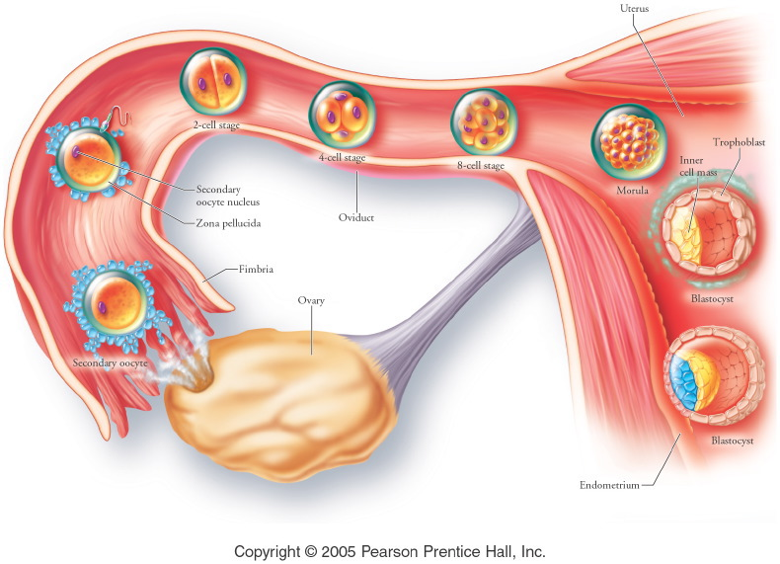
Fertilization to implantation: Know where this happens.
Notes:
Similar to 21.5
Title:
Early stages in the reproductive process.
Caption:
Early stages in the reproductive process.

Slide 4
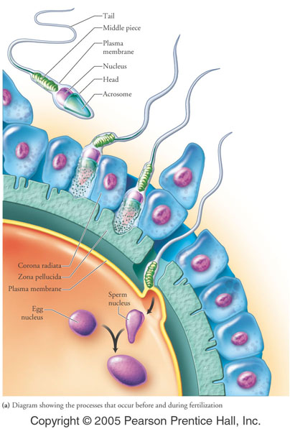
Sperm parts
Acrosome
tail
Egg parts
Corona radiata
zona pellucida
Plasma membrane
Polyspermy prevented by a change in the zone pellucida membrane charge as one sperm enters
Notes:
Figure: 18-03a
Title:
Fertilization.
Caption:
(a) Diagram showing the processes that occur before and during fertilization.

Slide 5
Fertilization
Sperm and egg meet in the oviduct 4 to 6 hrs after intercourse. Sperm may live for days.
Enzymes from the activated sperm penetrate the corona radiata and zona pellucida to enter the egg cell membrane
Entry of sperm triggers the final maturation of the oocyte.
Egg and sperm nuclei unite to create a single diploid cell.

Slide 6
Plan B pills. High levels of Progesterone or Estrogen and Progesterone, prevent ovulation and possibly fertilization.
Mifepristone (RU486) prevents implantation of fertilized eg.

Slide 7
Twins
Fraternal: more than one oocyte fertilized by different sperm, may be different sex
Identical: one oocyte fertilized, split before 16 cell stage, same sex
Conjoined twins: separation not complete

Slide 8
Development
Cleavage: cell division without cell growth, up to about day four
Morphogenesis: Movement of cells to physically develop organs, ongoing through development
Differentiation: individual cells take on specialized forms and functions
Growth: at implantation, growth in size

Slide 9
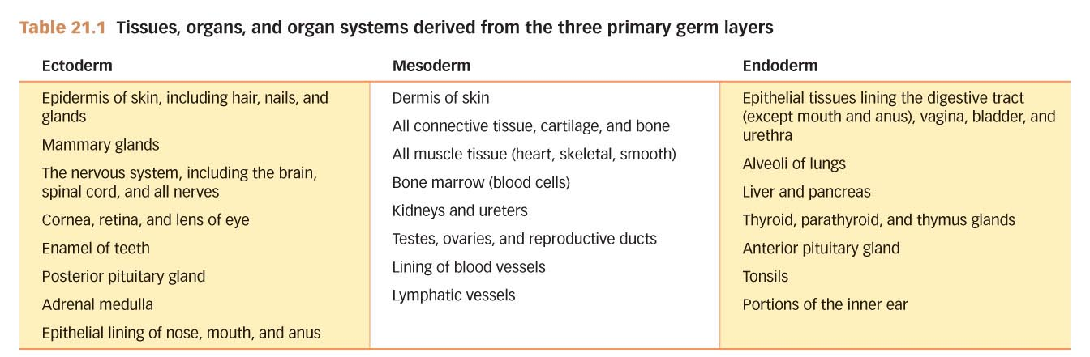
Embryonic Development: Tissues, Organs, and Organ Systems, come from the first 3 layers of the developing embryo
Table 21.1

Slide 10
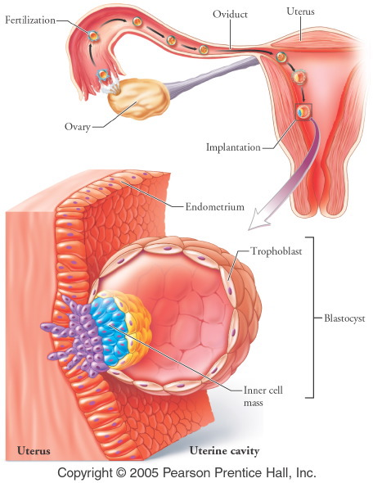
Implantation:
After 6 days the blastocyst imbeds into the endometrium. Usually on the high back wall of the uterus
Notes:
Title:
Implantation.
Caption:
About 6 days after fertilization, the blastocyst attaches to the endometrium of the uterus and begins to digest its way inward.

Slide 11
Stages of Development
Gamete formation-fertilization-cleavage-blastula-Gastrulation (3 primary tissues)-organogenesis (growth and tissue specialization)- morphogenesis (production of recognizable structures.

Slide 12
Pre and post fertilization in development
In the vagina a sperm will undergo capacitation
Sperm binds to zona pellucida of the egg
Only one sperm enters without mitochondria
Now is a zygote and will undergo repeated cell divisions without an increase in size. (Pre-Embryonic)

Slide 13
Implantation in the uterus
A week after fertilization, the continuously dividing ball of cells adheres to the uterine lining. (Implantation)
part of this becomes the embryo part becomes the placenta (Embryonic state weeks 3-8)
the implanted embryo (blastocyst)releases HCG which prods the corpus luteum to secrete estrogen and progesterone
pregnancy tests look for HCG

Slide 14
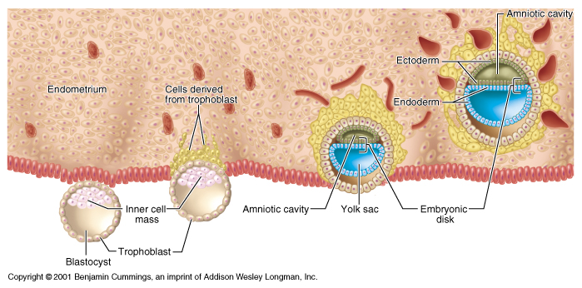
Implantation figure
It is the embryonic disk that will develop into the individual.

Slide 15
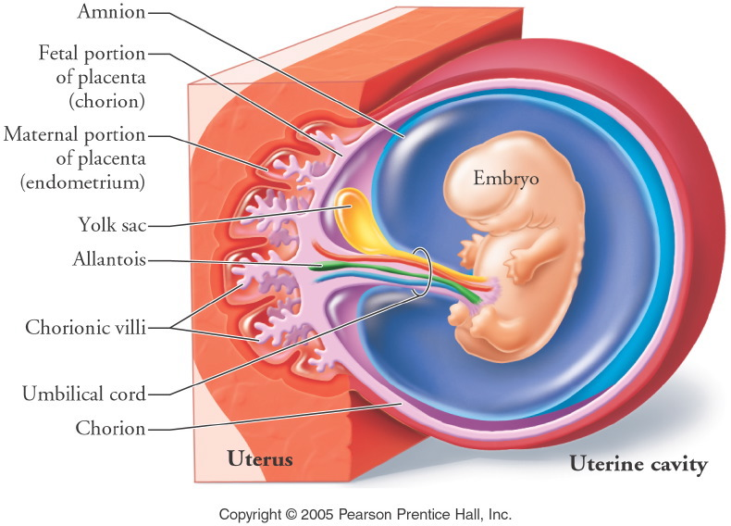
Roughly 5 weeks to this stage.
Notes:
Figure: 18-06
Title:
Extraembryonic membranes.
Caption:
The amnion, yolk sac, chorion, and allantois form during the second to third week after fertilization.

Slide 16
The placenta
Endometrial tissue and embryonic chorion
Extends into the maternal tissue as tiny chorionic villi
Materials are exchanged from blood capillaries of the mother to fetus and vise versa by diffusion
Maternal and fetal bloods do not mix at this time.
Chorionic villi grow into the endometrium

Slide 17
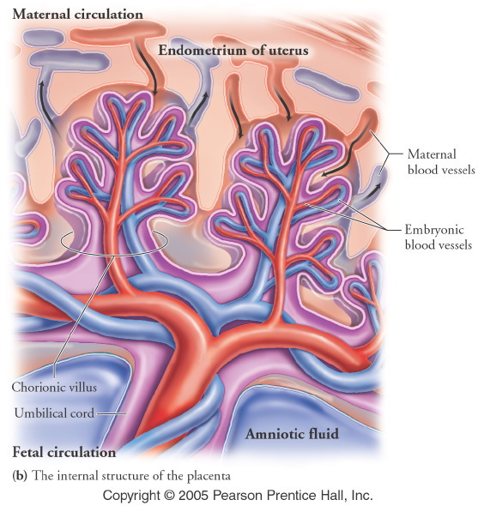
Notes:
Figure: 18-07b
Title:
The placenta is formed from the chorion of the embryo and the endometrium of the mother.
Caption:
(b) The internal structure of the placenta.

Slide 18
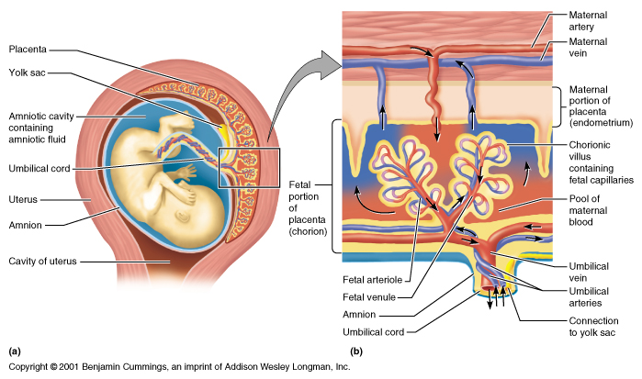

Slide 19
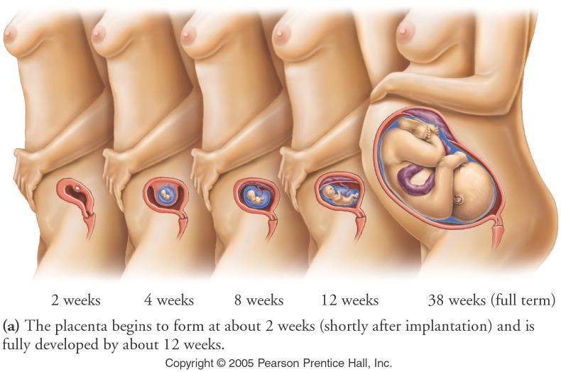
1 inch long
Notes:
Figure: 18-07a
Title:
The placenta is formed from the chorion of the embryo and the endometrium of the mother.
Caption:
(a) The placenta begins to form at about 2 weeks (shortly after implantation) and is fully developed by about 12 weeks.

Slide 20
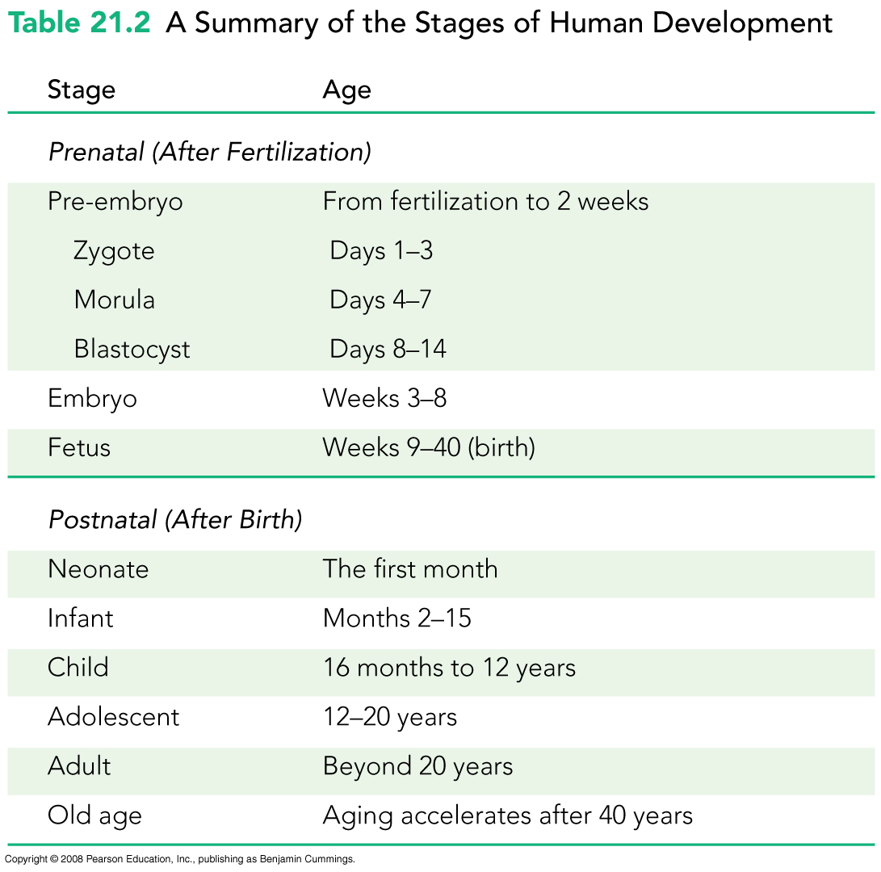
Human Development Summary
Table 21.2

Slide 21
Events of the first trimester
1 week placenta and membranes are forming
week 3 the heart begins to beat
the neural tube forms if incomplete results in spina bifida
at 5 weeks the embryo is distinctly human
gonads develop during 2nd half of first trimester
At 8 weeks circulation is set, sex has been determined
miscarriage 20% of all conceptions, 1/2 congenital defects

Slide 22
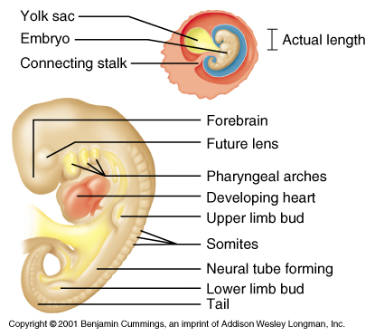
Week 4

Slide 23
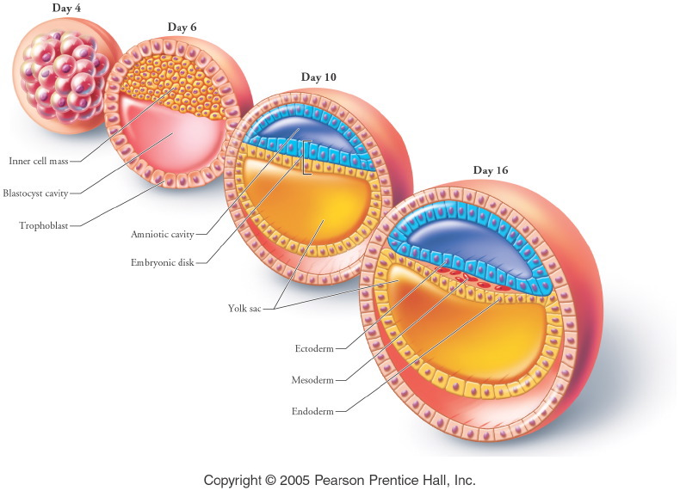
Totipotent stem cells, can become whole organism.
Pluripotent stem cells can become many tissue sets
Notes:
Figure: 18-08
Title:
Early stages of development in cross section.
Caption:
Early stages of development in cross section.

Slide 24
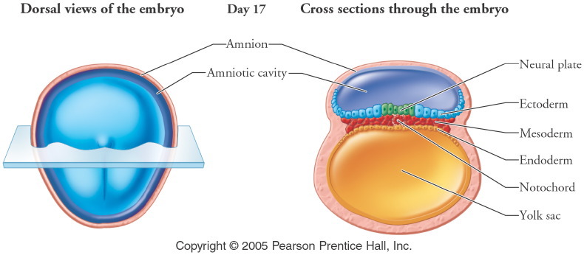
Notes:
Figure: 18-09-1
Title:
Formation of the central nervous system from ectoderm.
Caption:
Step 1.

Slide 25
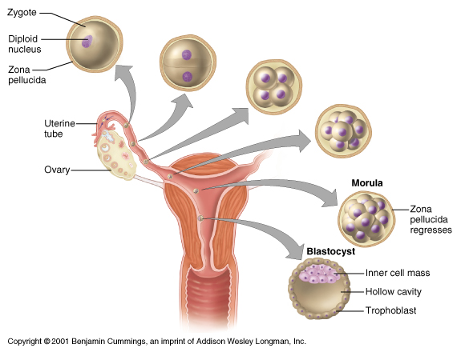

Slide 26
Fetal period
Week 1-8 at the end starts to look human

Slide 27
Gender Development: Six Weeks
Y chromosome gene for sex-determining region Y (SRY) activated
Testes-determining factor synthesized
Testes secrete testosterone
Mullerian hormone made to suppress female development
Absence of Y chromosome results in female development

Slide 28
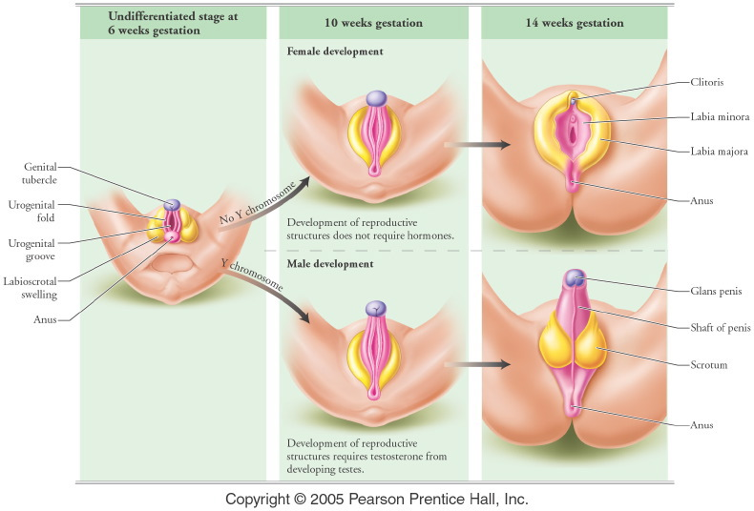
Week 6 SRY gene on Y chromosome initiates development of testes and testosterone developed. In absence of testosterone female develops
Notes:
Figure: 18-10
Title:
Development of external genitalia.
Caption:
Development of external genitalia.

Slide 29
Fetal development
2nd trimester
  suckling reflex 4-5 inches long
3rd trimester
  7th month is earliest at which the fetus may survive
  often have respiratory distress syndrome
  Full term is 38 weeks
fetal circulation is different

Slide 30
Maternal lifestyle and early development
Nutrition- proper vitamins minerals calories needed for proper development
infections certain viral diseases may cause deformities
drugs and alcohol
  antibiotics tetracycline, streptomycin
  cocaine disrupts nervous system
  alcohol has its own syndrome
  cigarette smoke

Slide 31
Birth and Early Postnatal period
Full term 38 weeks
  Corticotropin-releasing hormone (CRH)signals birth
Dilation, expulsion and Afterbirth
At birth the newborns cardiovascular system changes
  Umbilical vessels regress
  Ductus arteriosus
  Foramen ovale

Slide 32
Birth Is the Transition from Prenatal to Postnatal Development
True labor consists of three stages
  Dilation stage cervix opens
  Expulsion stage newborn is delivered
  Placental stage the placenta is expelled from the mothers body.

Slide 33
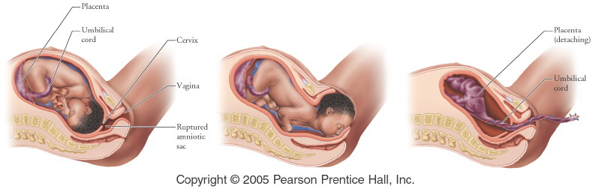
Notes:
Figure: 18-14
Title:
The stages of true labor.
Caption:
The stages of true labor.

Slide 34
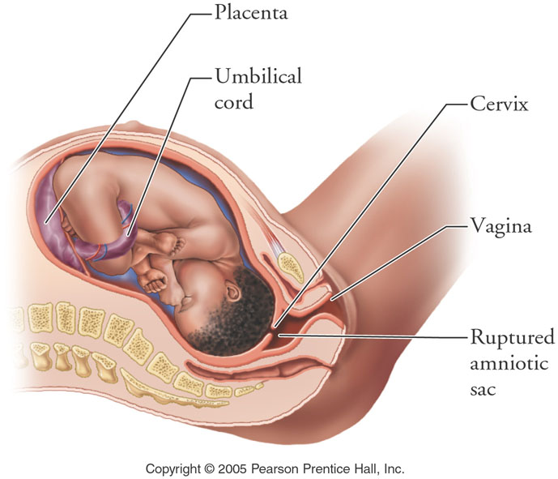
Notes:
Figure: 18-14-1
Title:
The stages of true labor.
Caption:
Step 1.

Slide 35
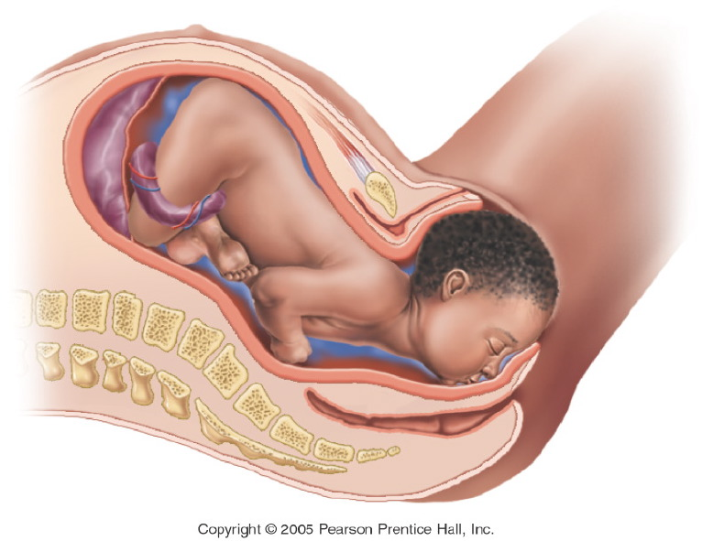
Notes:
Figure: 18-14-2
Title:
The stages of true labor.
Caption:
Step 2.

Slide 36
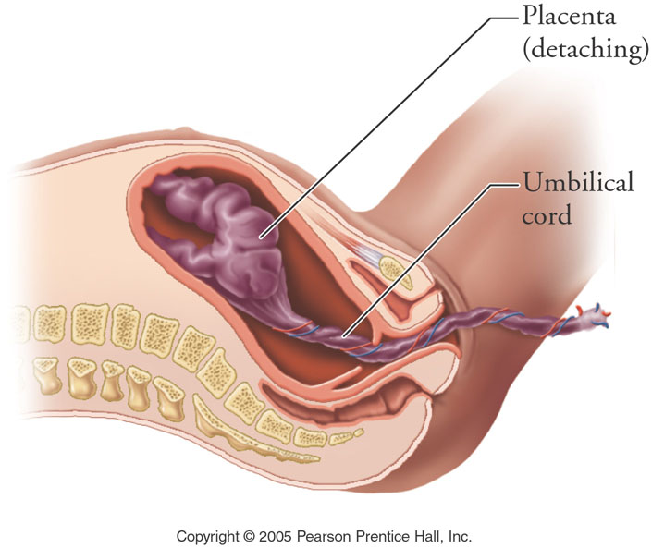
Notes:
Figure: 18-14-3
Title:
The stages of true labor.
Caption:
Step 3.

Slide 37
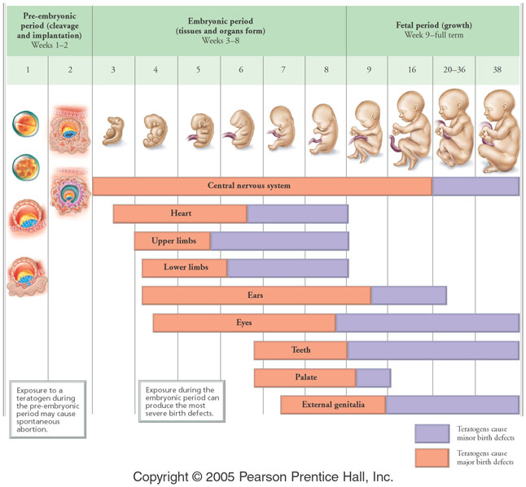
Notes:
Figure: 18-16
Title:
Critical periods in development.
Caption:
Critical periods in development.

Slide 38
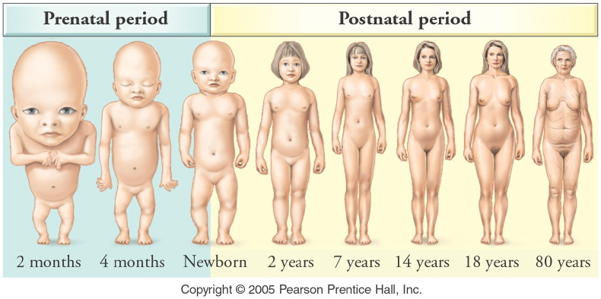
Notes:
Figure: 18-11
Title:
Allometric growth.
Caption:
Changes in body proportions occur throughout prenatal and postnatal development. For comparison, all stages are drawn to the same total height.

Slide 39
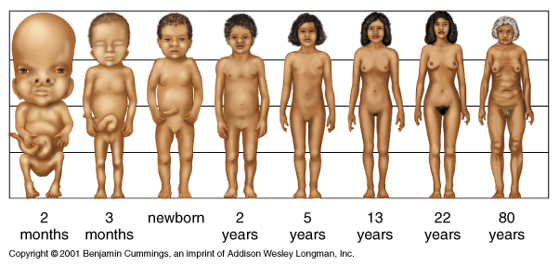
Changes with Age

Slide 40
Early Postnatal Period
Transition from fetus to newborn:
  Taking the first breath: pulmonary surfactants necessary
Changes in cardiovascular system:
  Umbilical circulation cut off
  Ductus venosus regresses to connective tissue
  Foramen ovale and ductus arteriosus close in days/weeks
  All blood from the digestive tract goes to liver
Lactation: colostrum to milk

Slide 41
Birth to Adulthood
Neonatal period: helpless period, movement by reflex
Infancy; rapid development and maturation of organ systems
Childhood: continued development and growth
Adolescence: transition to adulthood
Puberty

Slide 42
Aging: Change Over Time
Causes of aging: theories:
  Internal cellular program that counts finite number of cell divisions, thus determining cell death
  Cell DNA damaged beyond repair
  Aging a whole-body process; all systems interdependent

Slide 43
Aging
Cells have internal mechanism that limits the number of times they can divide.
Cumulative unrepaired cellular damage as a consequence of metabolic activity may limit the life of cells.
Aging affects all systems.

Slide 44
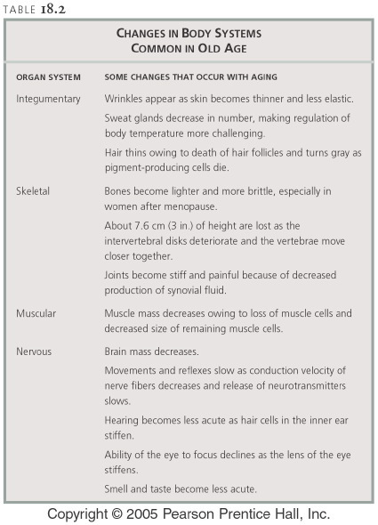
This is from another text. Author Black.
Notes:
Table: 18-T02t
Title:
Changes in body systems common in old age.
Caption:
Top: Integumentary system through nervous system.

Slide 45
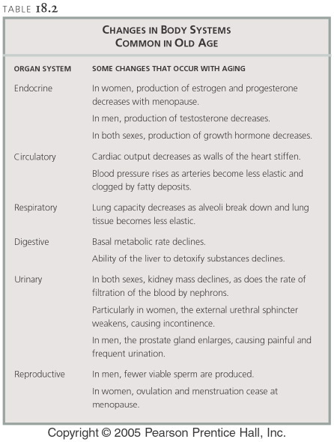
Notes:
Table: 18-T02b
Title:
Changes in body systems common in old age.
Caption:
Bottom: Endocrine system through reproductive system.

Slide 46
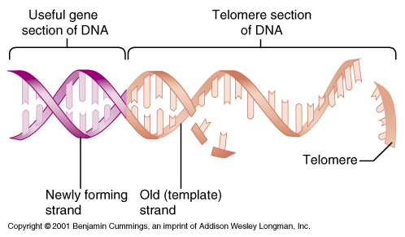
Chromosomal Telomeres and aging

Slide 47
Do you think we can develop better treatments or a cure for Aging?

Slide 48
The price of sex is death
According to leading Aging researchers
  It is our genes that are immortal not our bodies
  Old bodies are harder to maintain that young ones, so our genes switch bodies in order to remain fresh
  Also, evolution selected for the young not the old.
    Relatively recently do people live to old age

Slide 49
Biological Clocks
Every living thing has a predictable pattern of life.
Modern diseases were always present, just not seen as much because people died of other things
Lowest death rate is in your 10’s
It doubles every year afterwards
Is there some vitality factor?

Slide 50
Manufactured survival
Due to medical intervention many of us do not die at a young age.
  Accidents
  Other defects
  Infections

Slide 51
What is the clock?
DNA damage
Telomerase
Something other?
Can we do something about it?

Slide 52
Proof that we can cure aging?
Telomerase studies triple life span of worms
Genetic selection increase the life span of flies
Trees and fish that do not appear to age
Various things work for various people
  DNA damage
  Free radicals
  Metabolism

Slide 53
Death: Final Transition
Legal and medical criteria:
  Irreversible cessation of circulatory and respiratory functions
  Irreversible cessation of all functions of the entire brain, including the brain stem

Slide 54
All mammals including humans begin life as embryos that have the potential to be either male or female in three ways
  Brain
  Gonads and Internal Duct Systems
  External Genetalia

Slide 55
Fertilization determins XX or XY
Female Sexual development does not depend on the presence of ovaries
Male sexual development depends on the presence of functioning testes and responsive end 0rgns
Females exposed to androgens in utero will be masculin.

Slide 56
Humans start sex neutral
Genital tubercle (phalus)
Labioscrotal swellings
Urogenital folds
Urogential sinus.

Slide 57
in the absence of androgens female external genitalia develop.
  Is the set point female?
In the sex neutral stage both a Wolfian duct and Mullerian duct.
  IN males the Mullerian duct atrophies
  In females the wolfian duct atrophies
The gonades in this early state are called ovotesties

Slide 58
Androgen insensitivity syndrome (AIS) is a condition that results in the partial or complete inability of the cell to respond to androgens.^{[1][2][3]}

