Slide 1
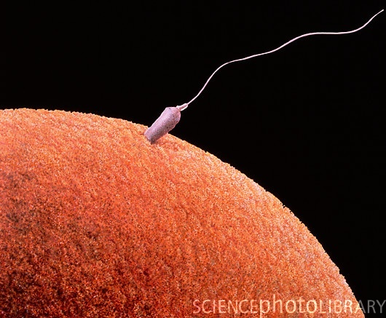
REPRODUCTION
ASEXUAL
SEXUAL

Slide 2
REPRODUCTION
ASEXUAL:
One parent is involved
No fertilisation occurs.
No specialised sex cells
Cell division occurs via mitosis
Offspring are genetically identical to each other & parent (produce clones)
Few organisms reproduce asexually – Hydra, amoeba, flowering plants, celery & strawberry.

Slide 3
FORMS OF ASEXUAL REPRODUCTION
Budding e.g. Hydra
Binary fission e.g. Amoeba
Vegetative propagation – e.g. runners (celery, strawberry) & bulbs (onions)
Cuttings – sugar cane
Grafting e.g. citrus, mango
Parthenogenesis – occurs in aphids (greenflies).

Slide 4
Parthenogenesis – this is where an egg develops w/o being fertilised.
Abundant food = production of many eggs
Young aphids – born fully developed

Slide 5
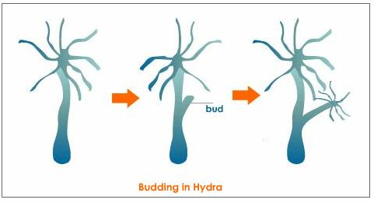
Tentacles
Hypostome
Buds
Foot

Slide 7
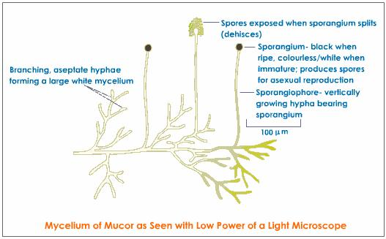

Slide 8
Spore Formation
It is generally seen in bacteria and most fungi. Example bread mould. One of the cells enlarges and forms the sporangium (literally meaning spore sac).
The nucleus divides many times and then the daughter nuclei are surrounded with protoplasm bits to form daughter cells called spores.
The spores are covered with a thick wall called the cyst.
On maturation, the sporangium bursts and releases the spores. The spores germinate on getting favourable conditions. For example, fungi such as Mucor and Rhizopus
Spore formation also occurs in bacteria such as Clostridium and Bacillus. The bacterial spores are also called endospores. They are thick-walled and lightweight

Slide 9
ADVANTAGES & DISADVANTAGES OF ASEXUAL REPRODUCTION
See Atwaroo-Ali page 196-7

Slide 10
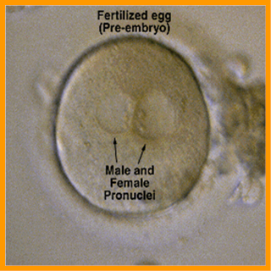
SEXUAL REPRODUCTION
Four key stages in sexual reproduction:
Sex cells (sperm & ova) are produced.
Male sex cell is transferred to female sex cell.
Fertilisation must occur i.e. sperm fuses with ovum.
The zygote formed develops into a new individual.

Slide 11
SEXUAL REPRODUCTION
Involves 2 parents producing special reproductive cells/gametes (egg & sperm)
Gametes fuse = fertilisation = zygote: – continues to divide form a new organism
Meiosis - hence offspring are different from each other and parents
Sex cells/gametes – half # of chromosomes thus are different from other cells in the body that make up parts such as organs

Slide 12
Gametes have half # of chromosomes so that when they fuse the zygote formed will have the correct # of chromosomes (e.g. 46 in humans)
We have 46 chromosomes in each body cell but 23 chromosomes are present in each egg and sperm.
Thus when egg & sperm fuse 2 fertilisation: 23 + 23 = 46 chromosomes
The 46 chromosomes are of 23 different kinds and are 2 of each kind.

Slide 13
W.r.t 2 chromosomes of each kind – homologous chromosomes.
A cell with a full # of chromosomes with 2 of each kind – DIPLOID (2n)
A cell with half # of chromosomes – HAPLOID (n) e.g. egg & sperm
Gametes are haploid but form a diploid zygote when they fuse together.

Slide 14
ADVANTAGES & DISADVANTAGES OF SEXUAL REPRODUCTION
See Atwaroo-Ali page 197

Slide 15
SEXUAL REPRODUCTION

Slide 16
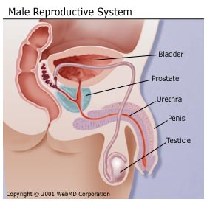
STRUCTURE OF MALE REPRODUCTIVE SYSTEM

Slide 17
The penis and the urethra are part of the urinary and reproductive systems.
The scrotum, testes, vas deferens, and prostate gland comprise the rest of the reproductive system.

Slide 18
The purpose of the organs of the male reproductive system is to perform the following functions:
To produce, maintain, and transport sperm (the male reproductive cells) and protective fluid (semen)
To discharge sperm within the female reproductive tract during sex
To produce and secrete male sex hormones responsible for maintaining the male reproductive system

Slide 19
Unlike the female reproductive system, most of the male reproductive system is located outside of the body. These external structures include the penis, scrotum, and testicles.
Penis
Scrotum: loose pouch-like sac of skin that hangs behind and below the penis. contains the testicles (also called testes), as well as many nerves and blood vessels.
Notes:
PENIS - The body of the penis is cylindrical in shape and consists of three circular shaped chambers. These chambers are made up of special, sponge-like tissue. This tissue contains thousands of large spaces that fill with blood when the man is sexually aroused. As the penis fills with blood, it becomes rigid and erect, which allows for penetration during sexual intercourse.
Semen, which contains sperm (reproductive cells), is expelled (ejaculated) through the end of the penis when the man reaches sexual climax (orgasm). When the penis is erect, the flow of urine is blocked from the urethra, allowing only semen to be ejaculated at orgasm.
SCROTUM - The scrotum acts as a "climate control system" for the testes. For normal sperm development, the testes must be at a temperature slightly cooler than body temperature. Special muscles in the wall of the scrotum allow it to contract and relax, moving the testicles closer to the body for warmth or farther away from the body to cool the temperature.

Slide 20
3. Testicles (testes):
Oval organs that lie in the scrotum, secured at either end by a structure called the spermatic cord.
The internal organs of the male reproductive system, also called accessory organs, include the following:
1. Epididymis:
The epididymis is a long, coiled tube that rests on the backside of each testicle.
Transports and stores sperm cells that are produced in the testes.
Notes:
Most men have two testes. The testes are responsible for making testosterone, the primary male sex hormone, and for generating sperm. Within the testes are coiled masses of tubes called seminiferous tubules. These tubes are responsible for producing sperm cells.
It also is the job of the epididymis to bring the sperm to maturity, since the sperm that emerge from the testes are immature and incapable of fertilization. During sexual arousal, contractions force the sperm into the vas deferens.

Slide 21
Vas deferens: The vas deferens is a long, muscular tube that travels from the epididymis into the pelvic cavity, to just behind the bladder.
Urethra: The urethra is the tube that carries urine from the bladder to outside of the body.
Seminal vesicles: The seminal vesicles are sac-like pouches that attach to the vas deferens near the base of the bladder.
Prostate gland: The prostate gland is a walnut-sized structure that is located below the urinary bladder in front of the rectum.
Notes:
The vas deferens transports mature sperm to the urethra, the tube that carries urine or sperm to outside of the body, in preparation for ejaculation.
Urethra - In males, it has the additional function of ejaculating semen when the man reaches orgasm. When the penis is erect during sex, the flow of urine is blocked from the urethra, allowing only semen to be ejaculated at orgasm.
The seminal vesicles produce a sugar-rich fluid (fructose) that provides sperm with a source of energy to help them move. The fluid of the seminal vesicles makes up most of the volume of a man's ejaculatory fluid, or ejaculate.
The prostate gland contributes additional fluid to the ejaculate. Prostate fluids also help to nourish the sperm. The urethra, which carries the ejaculate to be expelled during orgasm, runs through the center of the prostate gland.

Slide 22
How Does the Male Reproductive System Function?
Dependent on hormones - follicle-stimulating hormone (FSH), luteinizing hormone (LH), and testosterone.
Follicle-stimulating hormone is necessary for sperm production (spermatogenesis) and luteinizing hormone stimulates the production of testosterone, which is also needed to make sperm.
Testosterone is responsible for the development of male characteristics, including muscle mass and strength, fat distribution, bone mass, facial hair growth, voice change, and sex drive.

Slide 23
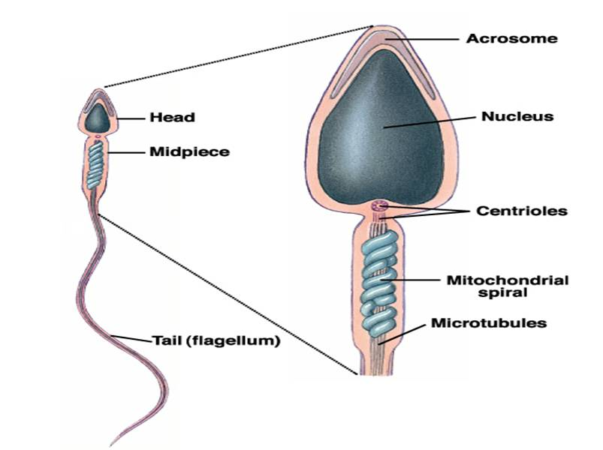
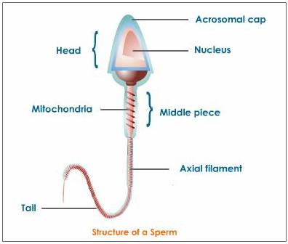
http://lgfl.skoool.co.uk/content/keystage3/biology/pc/learningsteps/MRSLC/launch.html
STRUCTURE OF SPERM

Slide 24
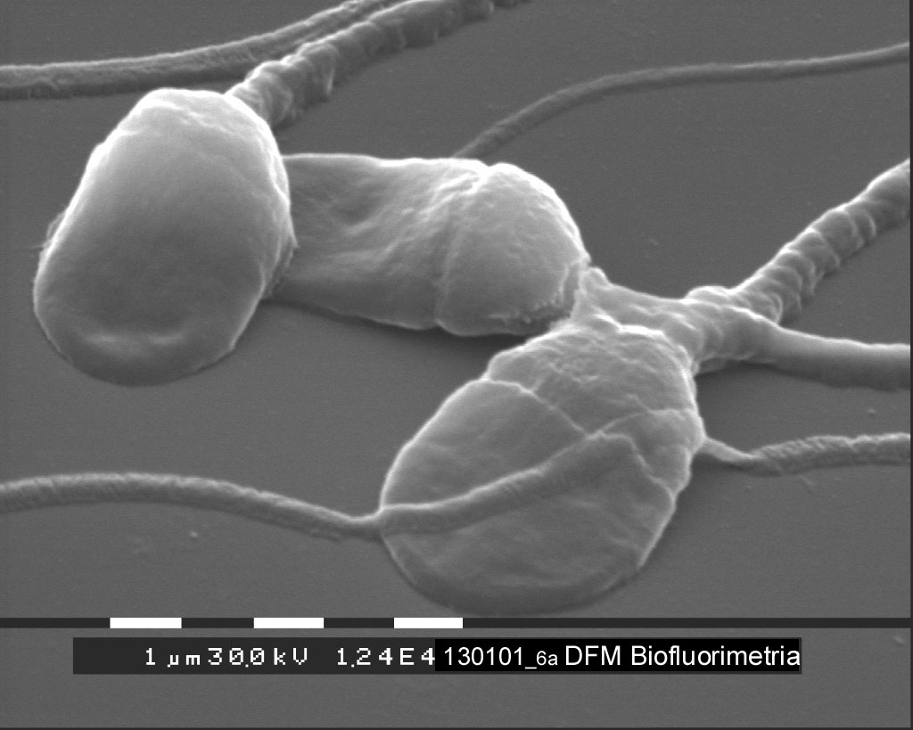
Sperm cells have three distinct regions, the head, midpiece and tail.
Head - an acrosome and a nucleus.
Midpiece - packed with mitochondria that break down glucose (present in semen) producing ATP to power the movement of the flagella.
The tail is a single flagellum. Source of locomotion.
Notes:
The acrosome is a specialized lysosome containing enzymes that digest the protective outer layers of the ovum allowing the sperm to penetrate and fertilize the egg. The nucleus contains the father’s contribution of chromosomes for the soon to be embryo. Sperm can move about 3 mm per hour and must wave their flagellum more than 1000 times to move half an inch.

Slide 25
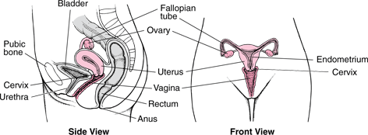
STRUCTURE OF FEMALE REPRODUCTIVE SYSTEM
More complex than male reprod’ve system
Located in the pelvic region
Structures are the ovary, uterine tubes, uterus, vagina, vulva, and mammary glands.
It produces ova (egg cells); nourishes, carries, and protects the developing embryo; and nurses the newborn after birth.

Slide 26
The internal genital organs form a pathway (the genital tract). This pathway consists of the following:
Vagina (part of the birth canal), where sperm are deposited and from which a baby can emerge
Uterus, where an embryo can develop into a fetus
Fallopian tubes (oviducts), where a sperm can fertilize an egg
Ovaries, which produce and release eggs
Sperm can travel up the tract, and eggs down the tract.

Slide 27
Vagina:
A narrow, muscular but elastic organ about 4 to 5 inches long in an adult woman.
It connects the external genital organs to the uterus.
Main female organ of sexual intercourse.
Uterus and Cervix:
A thick-walled, muscular, pear-shaped organ located in the middle of the pelvis, behind the bladder, and in front of the rectum.
Main function is to sustain a developing foetus.

Slide 28
The cervix is the lower part of the uterus, which protrudes into the upper end of the vagina.
Fallopian Tubes/oviduct:
The two fallopian tubes, which are about 2 to 3 inches (about 5 to 7 centimeters) long, extend from the upper edges of the uterus toward the ovaries.
Ovaries:
The ovaries are usually pearl-coloured, oblong, and about the size of a walnut. They are attached to the uterus by ligaments
Notes:
The tubes do not directly connect with the ovaries. Instead, the end of each tube flares into a funnel shape with fingerlike extensions (fimbriae). When an egg is released from an ovary, the fimbriae guide the egg into the relatively large opening of a fallopian tube.
The fallopian tubes are lined with tiny hairlike projections (cilia). The cilia and the muscles in the tube's wall propel an egg downward through the tube to the uterus. The egg may be fertilized by a sperm in the fallopian tube
In addition to producing female sex hormones (estrogen and progesterone ) and male sex hormones, the ovaries produce and release eggs. The developing egg cells (oocytes) are contained in fluid-filled cavities (follicles) in the wall of the ovaries. Each follicle contains one oocyte.

Slide 29
PRODUCTION OF EGGS
Eggs are produced from cells in outer layer/epithelium of ovary via cell division.
Some cells move towards the centre of ovary.
A small space filled with fluid forms around each cell.
Space & cell inside – follicle.
This occurs before a girl is born.

Slide 30
When puberty occurs some follicles begin to develop usually 1 @ a time.
The cell inside the follicle grows bigger along with fluid filled space around it.
The follicle moves to the edge of ovary – Graafian follicle ~ 1 cm across & bulges outside of ovary.
cell inside G. follicle undergoes meiosis.
Only 1 cell becomes an egg.
Follicle bursts & egg is released from ovary (ovulation).
This occurs once a month.

Slide 31
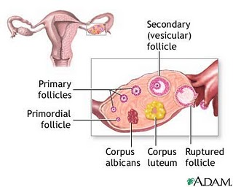
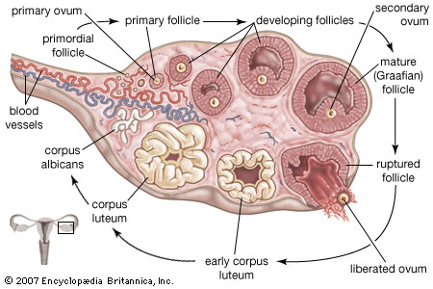

Slide 32
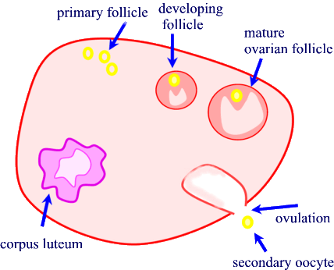
http://www.cix.co.uk/~argus/Dreambio/control%20of%20reproduction/ova%20production.htm

Slide 33
MENSTRUAL CYCLE
http://lgfl.skoool.co.uk/content/keystage3/biology/pc/learningsteps/MENLC/launch.html
There are four major hormones (chemicals that stimulate or regulate the activity of cells or organs) involved in the menstrual cycle: follicle-stimulating hormone, luteinizing hormone, oestrogen, and progesterone.
The menstrual cycle is the repeating series of changes in the uterine lining of a fertile female provided fertilisation and implantation does not happen. This cycle ranges from 24 to 35 days, and is commonly 28 days.

Slide 34
Events of the female reproductive cycle: A. Day 1 to day 5 Day 1 is the first day of menstruation. The corpus luteum of the previous cycle has disintegrated so the level of oestrogen and progesterone declined greatly. Low progesterone level leads to the menstruation - breakdown and discharge of the outer layer of the uterine lining. Low oestrogen and progesterone levels permit the secretion of FSH by the pituitary gland.

Slide 35
B. Day 6 to day 13 FSH stimulated the formation of a Graafian follicle. The maturing follicle secretes oestrogen which inhibits FSH secretion preventing other follicles maturing. Oestrogen also stimulates repair of the uterine lining and a surge of LH just before ovulation (Follicular phase).
C. Day 14 The surge of LH stimulates ovulation - release of the egg cell from the mature Graafian follicle at the ovary's surface (Ovulatory phase). The egg cell is drawn into the Fallopian tube.

Slide 36
D. Day 15 to day 26 A corpus luteum develops from the remains of the Graafian follicle. The corpus luteum secretes progesterone and oestrogen stimulating the final maturation of the uterine lining (Luteal phase). High levels of these hormones also inhibit FSH and LH secretion from the pituitary. If implantation does not take place by day 26, the corpus luteum disintegrates.

Slide 37
E. Day 26 to day 28 Rapid decline in the levels of progesterone and oestrogen due to the degeneration of the corpus luteum.
The first sign that pregnancy has occurred is the failure of menstruation. Implantation occurs about six days after fertilisation. The developing embryo releases a hormone into the mother's blood which maintains the corpus luteum. The surviving corpus luteum continues to secrete progesterone and oestrogen and so the endometrium does not breakdown.
Pregnancy ends with the birth of the foetus - on average 38 weeks after fertilization or 40 weeks after the last menstruation.

Slide 38
FERTILISATION
http://lgfl.skoool.co.uk/content/keystage3/biology/pc/learningsteps/HUFLC/launch.html
http://www.britannica.com/EBchecked/topic-art/436140/19665/The-ovaries-in-addition-to-producing-egg-cells-secrete-and
See Atwaroo-Ali and Chinnery.

Slide 40
PLACENTA
The functions of the placenta :
Protection of the embryo: impedes the entry of pathogens from the mother, allows the entry of antibodies from the mother and keeps the embryo separated from the mother's higher blood pressure, prevents exchange of red blood cells avoiding the deadly possibility of agglutination.
Gas exchange: supply of O2 the mother and excretion of CO2 from the embryo to the mother's blood.
Nutrient supply: glucose, amino acids, lipids, vitamins and minerals pass to the embryo from the mother's blood.

Slide 41
Endocrine: secretes a variety of hormones including oestrogen and progesterone to maintain the pregnancy and prepare the mother's body for birth and lactation.
Excretion: metabolic wastes, CO2 and urea, pass from embryo into the mother's blood.
The placenta is connected to the embryo by the umbilical cord along which run two arteries and a large vein.

Slide 42
Birth or parturition - three major stages: A. Labour: gradual dilation of the cervix to a diameter allowing safe passage of the head into the vagina.
Oxytocin hormone is secreted by the pituitary stimulating the contraction of the uterine muscles.
The amniotic sac ruptures and the amniotic fluid escapes by way of the vagina.
B. Birth: passage of the baby from the uterus through the cervix and along the vagina to the outside. The umbilical cord is clamped closed near to the baby and cut on the far side of the clamp.
C. Afterbirth: the expulsion of the placenta from the mother.

Slide 43
Lactation (breastfeeding with milk) The placenta produced very high levels of oestrogen and progesterone. After the birth of the baby these hormone levels fall rapidly allowing the pituitary to secrete prolactin hormone. Prolactin stimulates the glands in the breasts to produce milk.
The suckling of a baby at the breast stimulates the mother's pituitary to release prolactin, maintaining milk production and oxytocin which causes the milk duct to contract, thus ejecting the milk from the breast.
Human milk has a lot of advantages for the baby's growth and development. Besides being nutritionally balanced it also contains a wide variety of beneficial chemicals which include mother's antibodies that will protect the child against common pathogens.

Slide 44
HOMEWORK
Review whole chapter on reproduction (sexual & asexual), contraception, breast milk in Atwaroo-Ali and Chinnery.
Read Chapter 19 in Atwaroo-Ali.

Slide 45
REFERENCES
http://health.howstuffworks.com/human-reproduction10.htm
Hydra - http://bioweb.uwlax.edu/zoolab/Lab-3b/Hydra-Budding-1.htm
Hydra - http://www.warrenphotographic.co.uk/mdh/05836.htm
***http://www.yteach.co.uk/page.php/resources/view_all?id=Blastocyst_Blastomere_Capacitation_Cleavage_Ejaculation_Embryo_Endometrium_Implantation_Morula_Ovulation_Zygote_sperm_cell_egg_cell_fertilization_zona_pellucida_acrosome_reaction_copulatory_organ_penis_vagina_page_2
http://www.bbc.co.uk/schools/gcsebitesize/science/add_gateway/living/sexcelldivisionrev2.shtml
http://biology.about.com/library/weekly/aa090700a.htm
http://southwest.mpls.k12.mn.us/sites/ad26dc17-c8bc-4970-8795-bae99167aab3/uploads/Human_Reproduction_and_ovulation.pdf
**http://faculty.ksu.edu.sa/71910/Zoo%20106/Reproduction.ppt#257,1,Slide 1
**http://www.webmd.com/sex-relationships/guide/male-reproductive-system

Slide 46
http://www.cchs.net/health/health-info/docs/2300/2376.asp
http://www.cchs.net/health/health-info/docs/2400/2418.asp?index=9118
http://www.merck.com/mmhe/sec21/ch237/ch237b.html
http://www.ccs.k12.in.us/chsBS/kons/kons/sperm_cells.htm
http://www.uh.edu/~tgill2/image010.jpg
http://www.merck.com/mmhe/sec22/ch241/ch241c.html?qt=female reproductive system&alt=sh
http://www.biotopics.co.uk/human2/reprsy.html
Menstrual cycle - http://www.tutorvista.com/content/biology/biology-ii/reproduction/menstruation-and-menstrual-cycle.php
Menstrual - http://www.webmd.com/sex-relationships/guide/your-guide-female-reproductive-system?page=2
****http://www.skoool.ie/skoool/examcentre_sc.asp?id=619
http://mcb.berkeley.edu/courses/mcb32/Miller%20notes-Reproduction
http://www.cix.co.uk/~argus/Dreambio/control%20of%20reproduction/ova%20production.htm
dralaamosbah.blogspot.com/2008_01_01_archive.html
http://www.emc.maricopa.edu/faculty/farabee/BIOBK/BioBookREPROD.html

