Slide 1
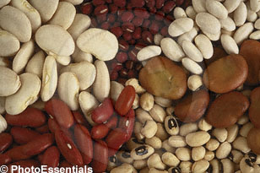
FABACEAE: Bean or Pea Family
Class: Magnoliopsida (dicot)
Sub-Class: Rosidae
Order: Fabales
Family: Fabaceae
Subfamily: 1. Papilionoideae
2. Caesalpinoideae
3. Mimosoideae

Slide 2
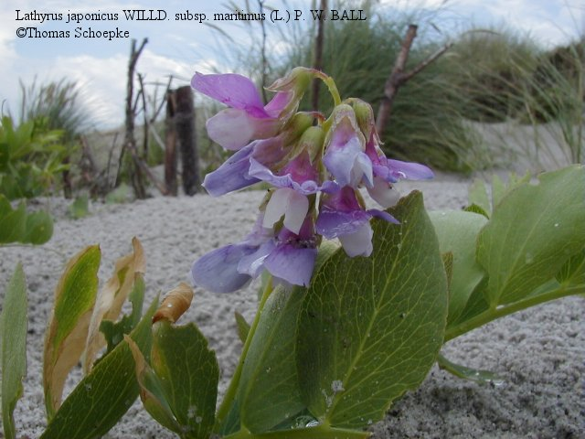
400 genera
10,000 species
Found all over the world, concentrated in warm temperate regions in the Northern and Southern Hemisphere (3rd largest family of flowering plants)
http://pharm1.pharmazie.uni-greifswald.de/gallery/gal-faba.htm

Slide 3
Habit: Trees, Shrubs, Herbs
Self supporting, or epiphytic, or climbing
Halophytic, or mesophytic, or xerophytic
What’s that mean?

Slide 4
FLOWER

Slide 5
Flowers: Bisexual, zygomorphic, perigynous (perianth and stamens united by bases)
Floral Formula: CA⁵ COZ⁵ A^{10 or 9+1}G¹
Floral Diagram: Bonus Point

Slide 6
FABACEAE FLORAL DIAGRAM

Slide 7
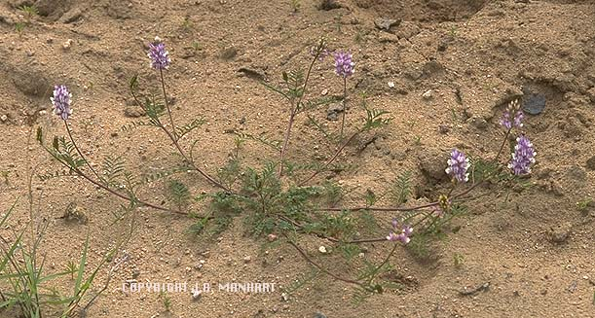
Calyx: 5 sepals united below tube
Corolla: 5 petals (1 standard, 2 wing, 2 keel)
http://www.csdl.tamu.edu ASTRAGALUS

Slide 8
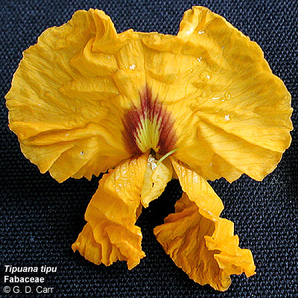
Standard or Banner
Keel
Wing
http://www.botany.hawaii.edu/faculty/carr/images/tip_tip_2666.jpg

Slide 9
Gynoecium: one simple pistil
(1 carpel, 1 locule),
ovary superior,
marginal placentation

Slide 10
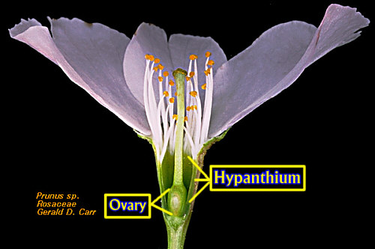
PERIGYNOUS
http://www.botany.hawaii.edu/faculty/webb/BOT410/Angiosperm/Adnation.htm

Slide 11
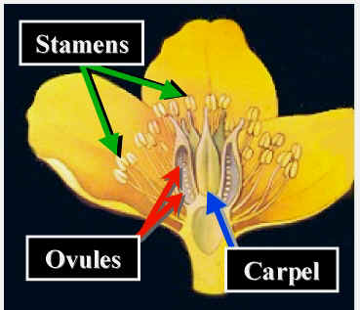
HYPOGENOUS

Slide 12
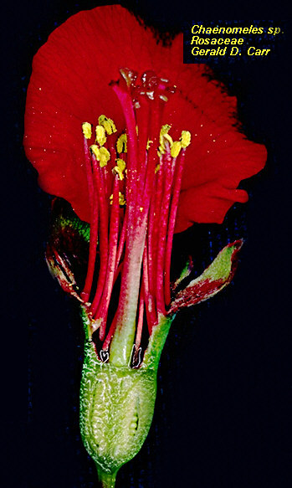
http://www.botany.hawaii.edu/
EPIGYNOUS

Slide 13
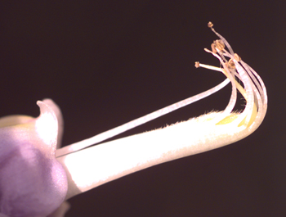
Androecium: 10 stamens, monadelphous (A ¹⁰) or diadelphous (A ⁹⁺¹)
Wisteria sinensis (9+1)
http://www.csdl.tamu.edu/FLORA/

Slide 14
INFLORESCENCE

Slide 15
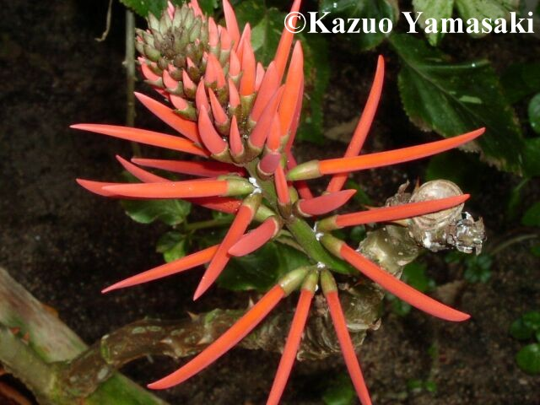
Racemes
Indeterminate Growth and Pedicellate
Erythrina speciosa
http://pharm1.pharmazie.uni-greifswald.de/gallery/gal-faba.htm

Slide 16
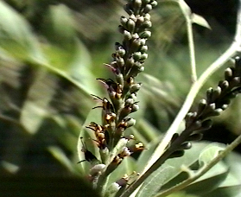
Spikes
Indeterminate/Sessile

Slide 17
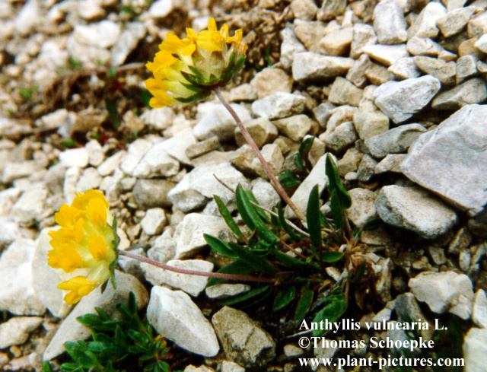
Heads
Sessile
Anthyllis vulneraria

Slide 18
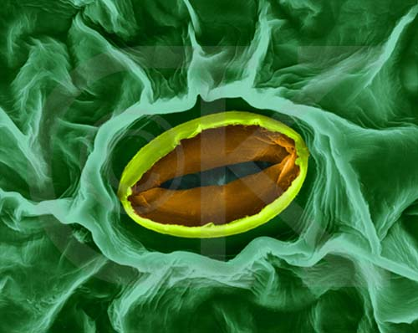
LEAVES

Slide 19
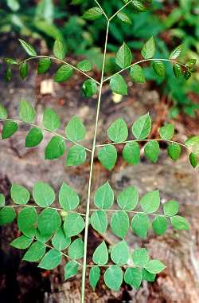
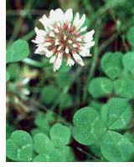
Compound (pinnate or palmate) rarely simple, alternate
PALMATE
ODD-BIPINNATE
Gymnocladus dioicus
Trifolium repens
http://www.borealforest.org/world/herbs_shrubs/white_clover.htm
http://www.forestry.auburn.edu/

Slide 20
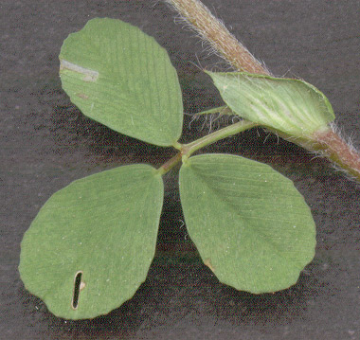
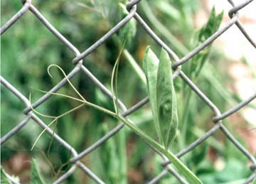
Stipules may be modified into tendrils
Lathyrus Odoratus
Trifolium campestre
http://www.bioimages.org.uk/HTML/R151135.HTM
www.botgard.ucla.edu/.../typesofshoots/ tendril/b0371tx.html

Slide 21
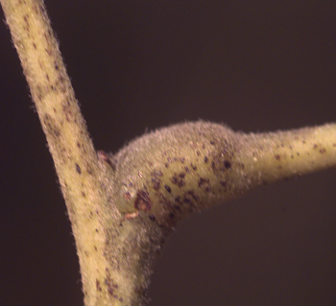
PULVINUS
(enlarged petiole base)
http://www.csdl.tamu.edu/FLORA/

Slide 22

Associated with leaf movement-in response to touch or heat
Mimosa – “Sensitive Plant”

Slide 23
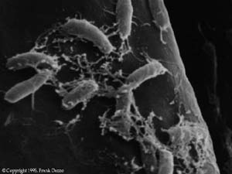
Roots: nodules and nitrogen fixing bacteria
Rhizobia on Root Hair
http://www.nmsu.edu/~molbio/plant/peas.html

Slide 24
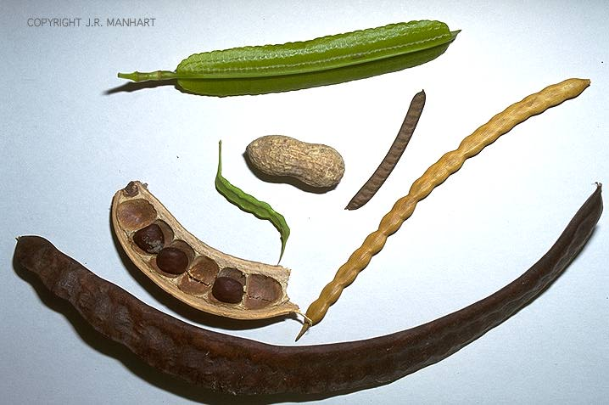
Fruit: Simple, Capsule: dehiscent legume
or a loment
LEGUME
LOMENT
http://www.csdl.tamu.edu/FLORA/

Slide 25
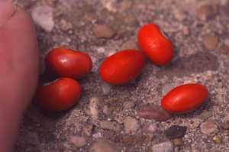
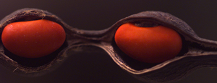
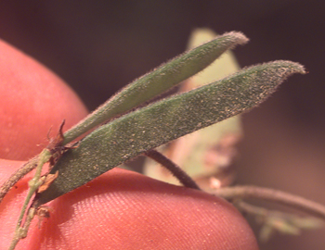
Seed: May have food reserves in the cotyledons
LOMENT
Erythrina herbacea
LEGUME
http://www.csdl.tamu.edu/FLORA/i

Slide 26
SEEDS CONT…
Varying shape and size

Slide 27
Composed of embryonic axis and two cotyledons
The axis has embryonic root (radicle), the hypocotyl, and the first true leaves (plumule)

Slide 28
Germination is Epigeal or Hypogeal
Epigeal-
Hypogeal-
Cotyledons push above soil surface
Cotyledons remain beneath the soil surface

Slide 29
Genus | Common Name
Ceratonia | Carob
Medicago | Alfalfa
Astragalus | Milk Vetch
Arachis | Peanut
Lupinus | Lupines
Phaseolus | Common Bean
Glycine | Soybean
Cicer | Chickpea
Pisum | Garden Pea
Lens | Lentil
Lathyrus | Sweet Pea
Clitoria | Butterfly Pea

Slide 30
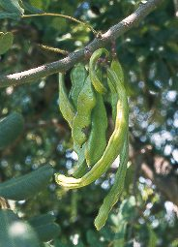
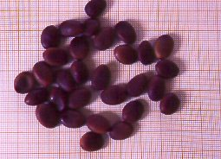
Ceratonia- Coffee and Chocolate
http://www.floraguide.es/arboles/Ceratoniasiliqua.htm

Slide 31
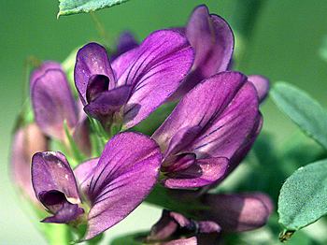
Medicago – Livestock Feed
http://www.csdl.tamu.edu/FLORA/

Slide 32
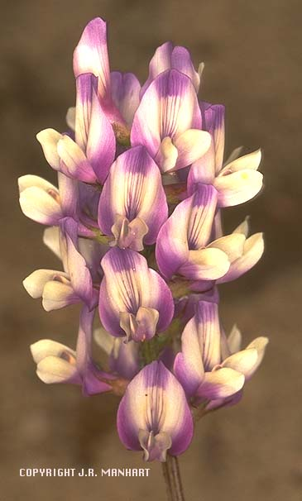
Astragalus - Aphrodisiac
http://www.csdl.tamu.edu/FLORA/

Slide 33
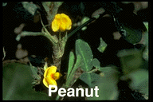
Arachis – WHAT A GOOBER!
http://www.hort.purdue.edu/

Slide 34
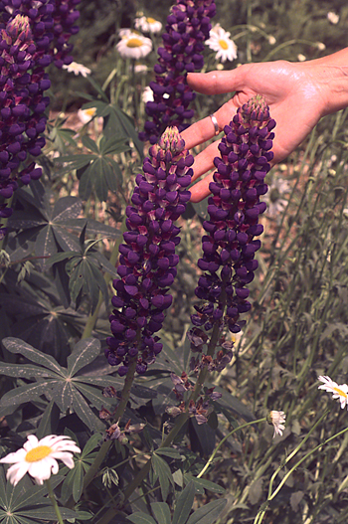
Lupinus - poisonous
http://www.csdl.tamu.edu/FLORA/

Slide 35
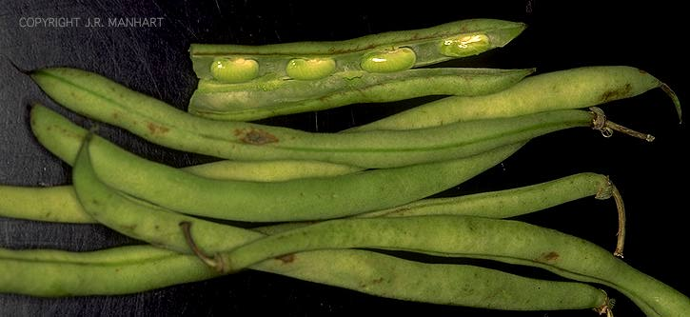
Phaseolus – Wash your face with Beans?

Slide 36
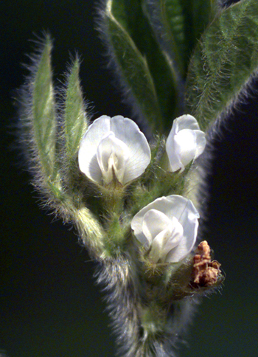
Glycine – Watch out for the oligosaccharides!

Slide 37
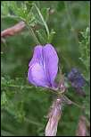
Cicer - Protein
http://www.funet.fi/pub/sci/bio/life/warp/album-Kosterin-8.html

Slide 38
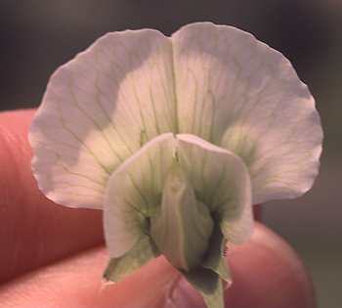
Pisum – Anti-sex horomonic effects
http://www.csdl.tamu.edu/FLORA/

Slide 39
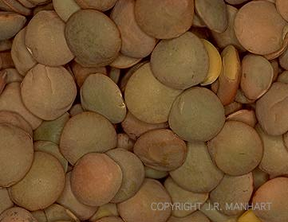
Lens – Better than a cold shower!

Slide 40
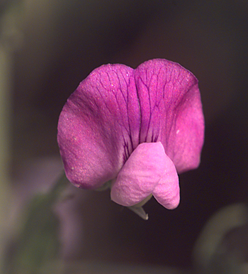
Lathyrus – Oh Sweet Pea!
http://www.csdl.tamu.edu/FLORA/

Slide 41
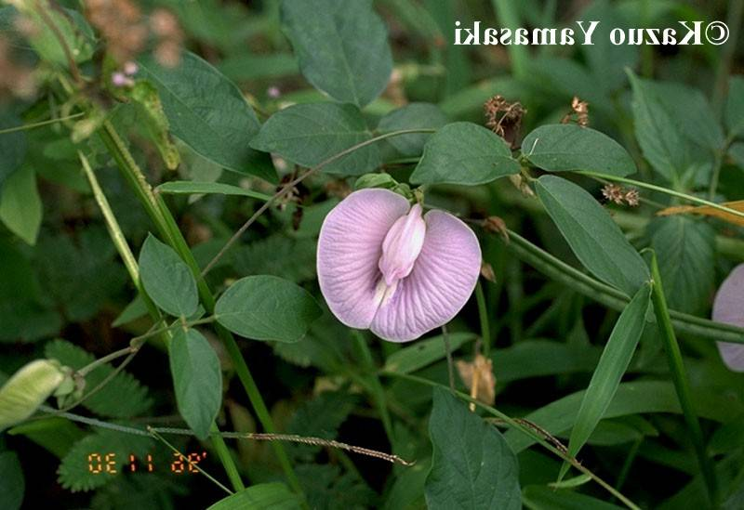
Clitoria – May Promote Nausea and Vomiting
http://pharm1.pharmazie.uni-greifswald.de/gallery/gal-faba.htm

