Slide 1

Insect

Slide 2
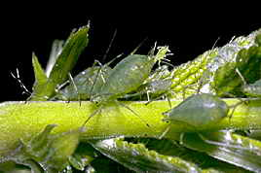
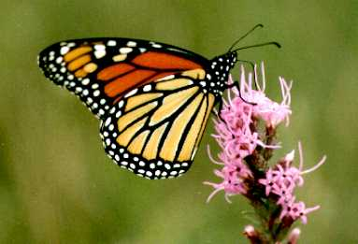
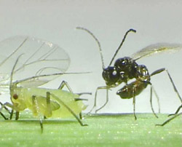
Outline
Insect life cycles & damage
Key insect pest groups
Principles of integrated pest management (IPM)

Slide 3
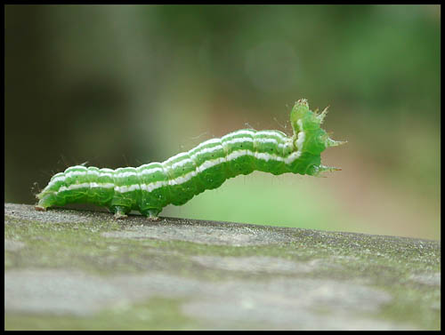
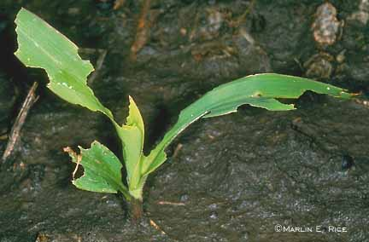
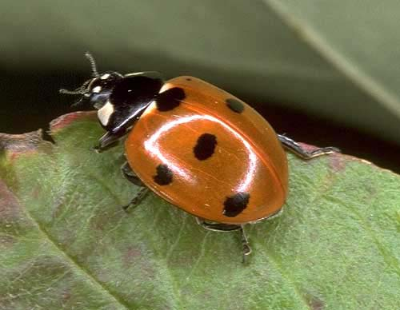
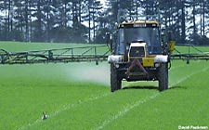
Why knowledge of insect life cycles is essential
Stage(s) causing injury
Prediction of damage
Effects of mortality factors
Timing of control operations

Slide 4
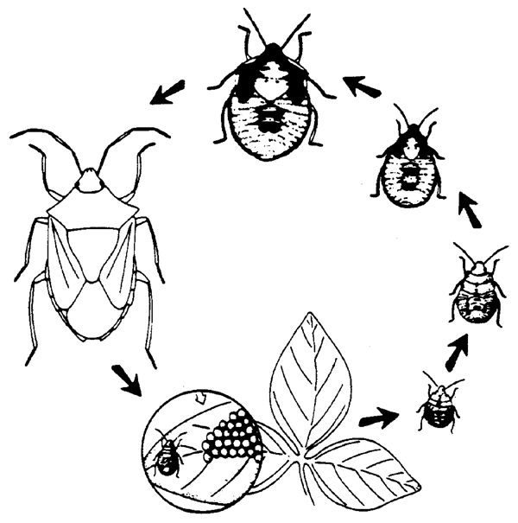
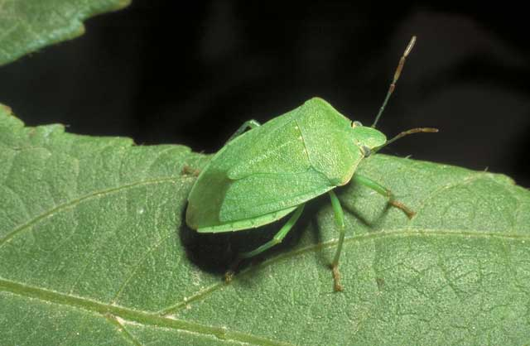
Insect development
Hemimetabolous (incomplete metamorphosis)
Adult
Nymph
(instars)
Green vegetable bug
Moult
Orders:
Hemiptera/Homoptera
Orthoptera
Eggs

Slide 5
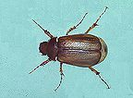
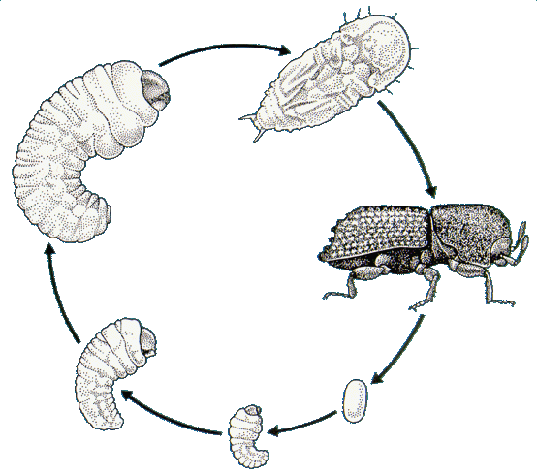
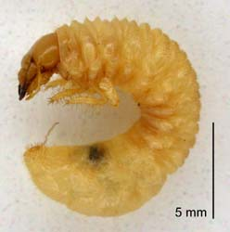
Insect development
Holometabolous (complete metamorphosis)
NZ grass grub
Pupa
Adult
Orders:
Coleoptera
Lepidoptera
Hymenoptera
Diptera
L3
Larva (instars)
L2
Egg
Moult
L1

Slide 6
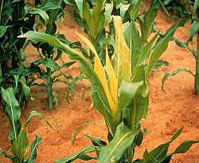
How do insects cause injury?
Direct feeding
- leaves (caterpillars)
- stems (Argentine stem weevil)
- roots (grass grub)
- flowers & seeds (aphids, mirids)
transmission of plant pathogens (aphids)
contamination (aphids & honeydew)
others (e.g., egg laying, webbing)

Slide 7
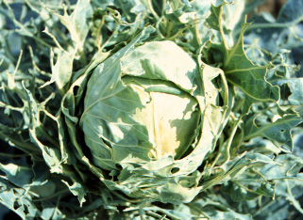
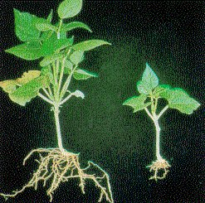
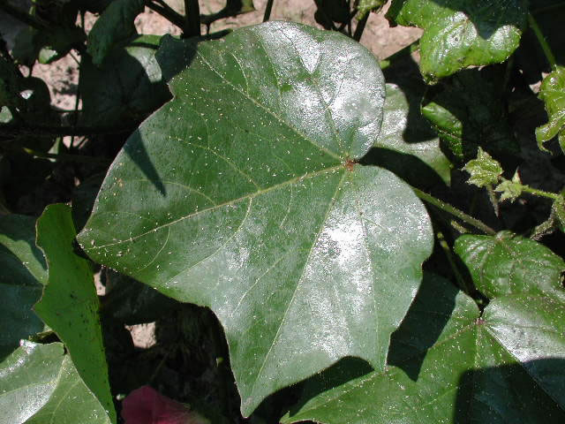
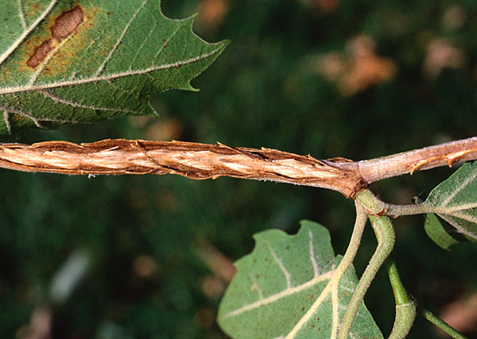
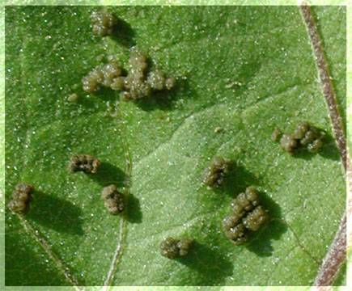
Injury caused by insects
Feeding injury
Transmission of pathogens
Effect on plant physiology
Honeydew
Ovipositor injury
Frass

Slide 8
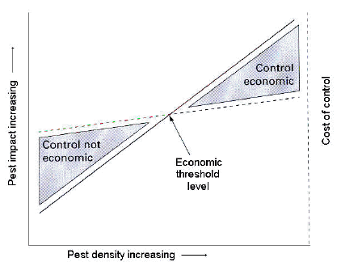
Key principle of pest control
Driven by economics

Slide 9
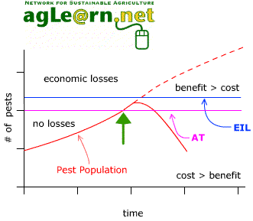
Pest threshold levels
Generalised concept of pest threshold levels
AT = action threshold
EIL = economic injury level
Control action

Slide 10
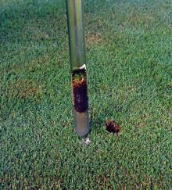
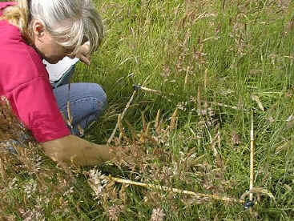
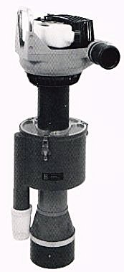
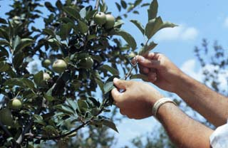
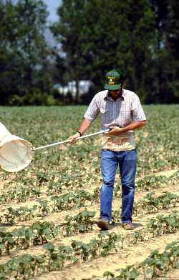
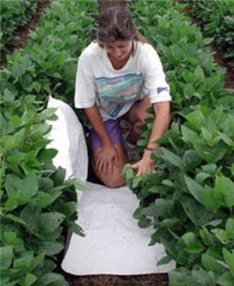
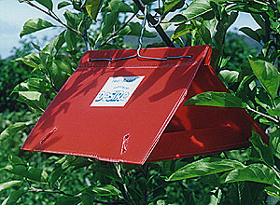
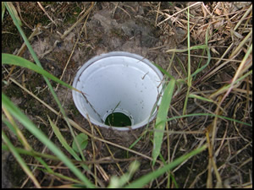
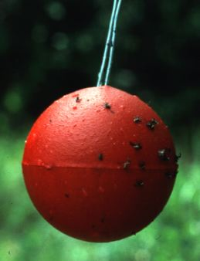
Tools for monitoring insects
Direct methods (absolute #s)
  Soil pests – soil cores, spade squares, quadrats
  Plant pests – leaf, stem, fruit samples; timed counts, suction samplers
Indirect methods (relative #s)
sticky traps, pheromone traps, pitfall traps, band traps, beating trays, sweep nets

Slide 11
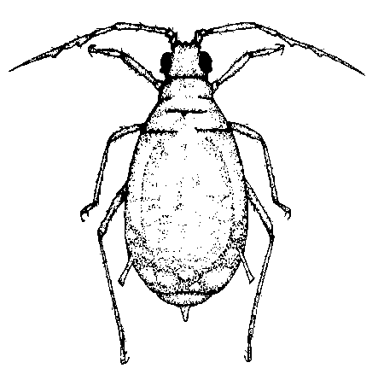
Aphids
Species
Cereal crops:
cereal aphid,
grain aphid,
rose grain aphid,
others
Potato crops
Potato aphid, green peach aphid, others
Brassicas - grey cabbage aphid, green peach aphid
Biological features
spring, autumn flights
rapid colonisation
rapid asexual reproduction
many generations per year
vector virus diseases

Slide 12
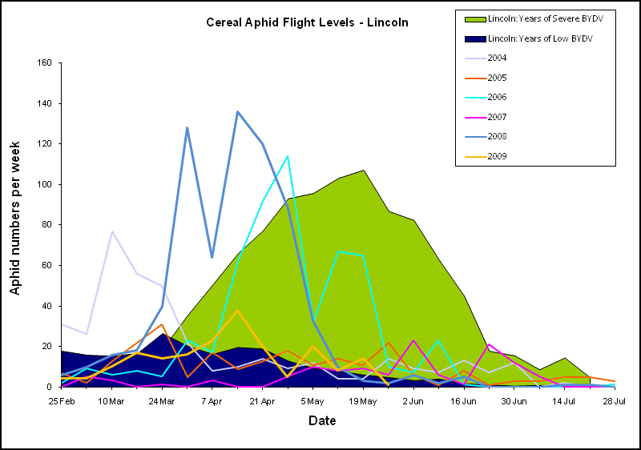
Source: Plant & Food Research – Aphid Watch website – www.aphidwatch.com

Slide 13

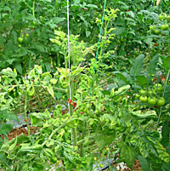

Tomato/potato psyllid
Biological features
Recent invader
Attacks tomato, potato
Causes ‘psyllid yellows’ & ‘zebra chip’ (Liberibacter)
Adults 3-4 mm, highly mobile
Scale-like nymphs
4-7 generations/year
Adult psyllid
Psyllid yellows symptoms
Zebra chip symptoms

Slide 14




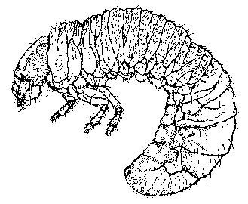
Grubs
Species
common grass grub
Tasmanian grass grub
Black beetle
Native scarabs
Biological features
larval damage autumn, early winter
1 generation/year
slow build up
most damaging to crops out of pasture

Slide 15
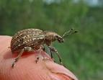
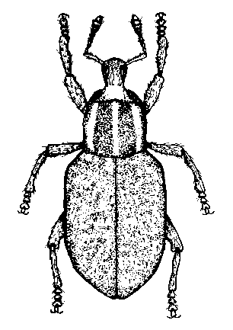
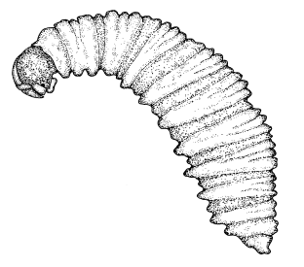
Weevils
Species
Argentine stem weevil
Clover root weevil
Whitefringed weevil
Black vine weevil
Fullers rose weevil
Others
Biological features
legless larvae burrow in tillers, roots, nodules
most damaging to newly sown crops, pasture
1-3 generations per year

Slide 16


Caterpillars
Species
Leafrollers
Diamondback moth
Loopers
Cutworms
Armyworms
Porina
Others
Biological features
peak egg laying during spring, early summer
larvae feed on foliage
most damaging to young plant growth
1-6 generations per year

Slide 17
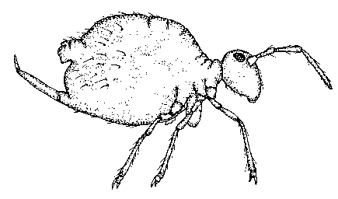

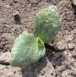
Springtails
Species
several species
Biological features
small, soft-bodied, wingless insects
nymphs and adults feed on surface of leaves
most damaging in spring and autumn
several generations/year

Slide 18



Thrips
New Zealand flower thrips
Western flower thrips
Onion thrips
Other species
Biological features
Reproduce and disperse rapidly
Severe damage to young foliage
Potential vectors of plant diseases
Some species resistant to chemicals
Onion thrips and damage

Slide 19
Key principles of integrated pest management (IPM)
The IPM approach
An economically viable strategy for pest management that exploits a range of compatible control methods.
Key rules
the earlier the pest is recognised or anticipated, the more control options
use a range of controls, at different time - chemicals are the last resort.

Slide 20
Insecticides
Key classes Action MoA
Carbamate nerve poison, contact systemic 1A
Organophosphate nerve poison, contact, systemic, fumigant 1B
Pyrethroids nerve poisons, contact 3A
Neonicotinoids nerve poison, contact, systemic 4a
Spinosyns nerve poison, contact 5
Insect growth regulators disruption of growth, development 15-18
Microbial insectcides various actions
Some issues:
Resistance and resistance management
Withholding periods and residues (MRLs, international markets)
Product availability (registration of new, de-registration of older)
Cost

