Slide 1
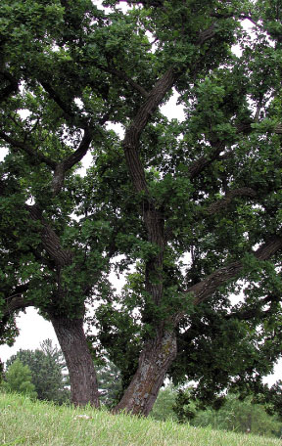
Plant Form
Chapter 35

Slide 2
Meristems
Meristematic tissues are clumps of small cells with dense cytoplasm and proportionately large nuclei.
  Elongation of roots and shoots takes place by repeated cell divisions and subsequent elongation by the apical meristem.
  In some species, lateral meristems produce an increase in girth.

Slide 3
Meristems
Apical meristems
  located at tip of stems and roots
    Plant tissues that result from primary growth are called primary tissues.
      make up primary plant body
    root apical meristem protected by root cap

Slide 4
Apical Meristems
Give rise to three types of primary meristems
  protoderm - forms epidermis
  procambium - forms primary vascular tissue
  ground meristem - differentiates into ground tissue
    intercalary meristems may arise in stem internodes

Slide 5
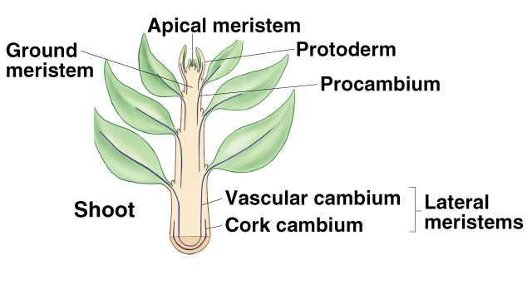

Slide 6
Lateral Meristems
Most trees, shrubs, and some herbs have active lateral meristems.
  increases girth in nonwoody plants - secondary growth
Woody stems
  cork cambium
    produces cork cells
  vascular cambium
    produces secondary vascular tissue

Slide 7
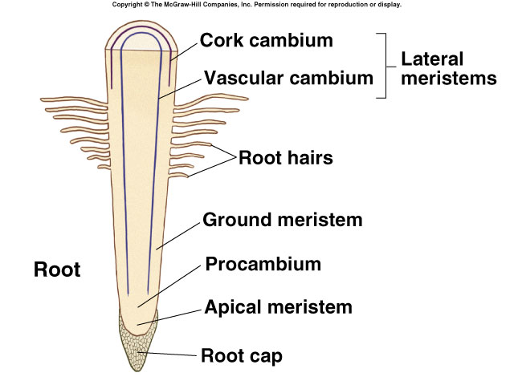

Slide 8
Organization of the Plant Body
Vascular plant consists of:
  root system - anchors plant and penetrates soil to absorb water and ions
  shoot system
    stems – framework for positioning leaves
    leaves - principle sites of photosynthesis
      vegetative shoot - internode, node leaf and axillary buds

Slide 9
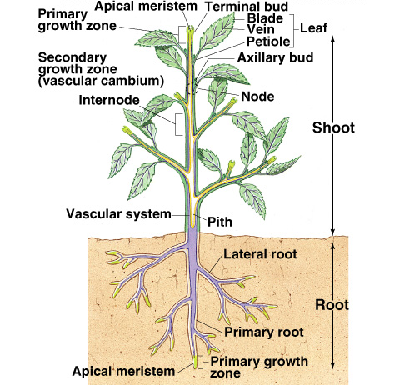
Plant Body Diagram

Slide 10
Organization of the Plant Body
Tissue types
  ground tissue - parenchyma cells
  dermal tissue - outer covering
    epidermis in primary growth plants
      cuticle
    bark in secondary growth plants
  vascular tissue - conduction
    xylem - water and dissolved materials
    phloem - carbohydrates

Slide 11
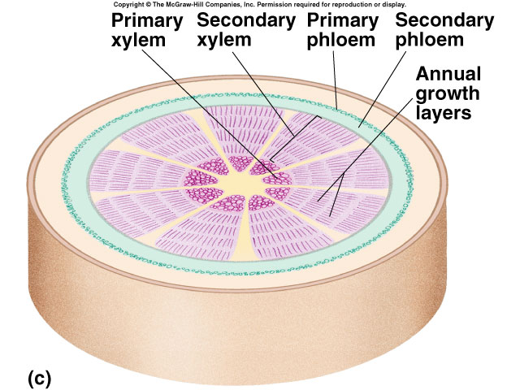
Primary and Secondary Growth
Primary growth results from cell division at the apical meristem at the plant tip.
Secondary growth results from cell division at the lateral meristem, increasing the shoot’s girth.

Slide 12
Dermal Tissue
Epidermal cells originating from the protoderm cover all parts of the primary plant body.
  guard cells - dumbbell-shaped cells flanking stomata
  trichomes - hairlike outgrowths
    regulate microclimate
  root hairs - tubular extensions of epidermal cells
    increase root’s surface area

Slide 13
Ground Tissue
Parenchyma
  store food and water
Collenchyma
  provide support for plant organs
Sclerenchyma
  supporting function
  secondary walls impregnated with lignin
    fibers and sclerids
    may be nonliving at maturity

Slide 14
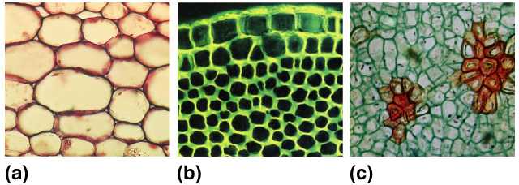
Ground Tissue

Slide 15
Vascular Tissue
Xylem
  principle water-conducting tissue
    combination of vessels and tracheids
  primary xylem derived from procambium
  secondary xylem formed by vascular cambium
    wood made of accumulated secondary xylem

Slide 16
Vascular Tissue
Phloem
  principle food-conducting tissue in vascular plants, located toward the outer part of roots and stems
    carried out through sieve cells and sieve-tube members
      some sieve areas (pores) have larger pores called sieve plates
      each sieve-tube member associated with companion cell

Slide 17
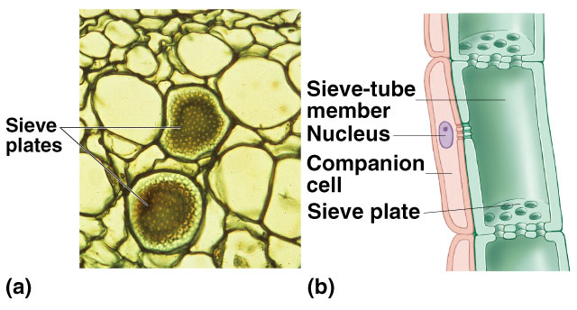
Sieve-Tube Member

Slide 18
Root Cells Differentiate
Root structure
  root cap
    composed of inner columella cells and lateral root cap cells
    new root cap produced when existing cap is removed
      functions in gravity perception

Slide 19
Root Structure
Zone of cell division
  cells divide every 12 to 36 hours toward the edges of the concave dome
    Apical meristem daughter cells divide into protoderm, procambium, and ground meristem tissues.
Zone of elongation
  roots lengthen because cells produced by primary meristems grow longer than wide

Slide 20
Root Structure
Zone of maturation
  cells differentiate into specific cell types
    root surface cells mature into epidermal hairs, each with root hair
    cortex produced by parenchyma cells
      inner boundary differentiates into endodermis
        surrounded by Casparian strips composed of suberin

Slide 21
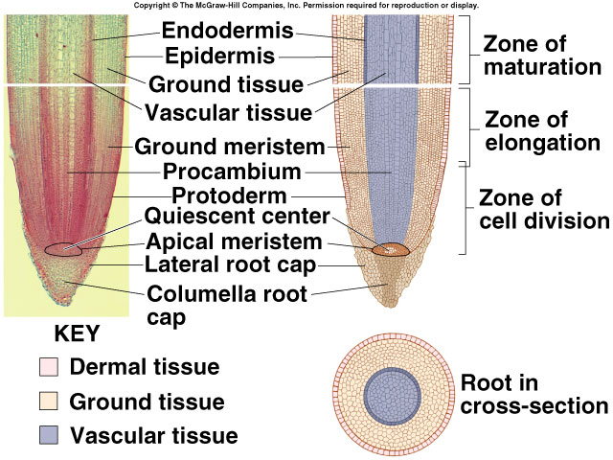
Root Structure

Slide 22
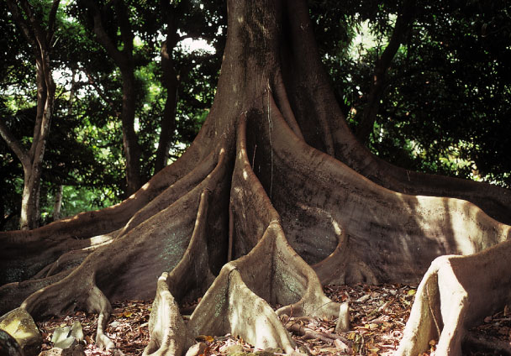
Modified Roots
Most plants produce either a taproot system (single large root with smaller branch roots) or a fibrous root system (many smaller roots of smaller diameter).

Slide 23
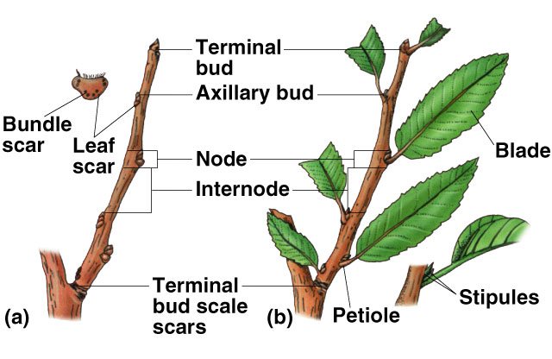
Woody Twig

Slide 24
External Stem Form
Leaf
  blade - flattened portion
  petiole - stalk
    sessile - no petiole
    axil - space between petiole and stem
      axillary bud
      terminal bud
  stipules - appendages at base of leaf
    stipule scars

Slide 25
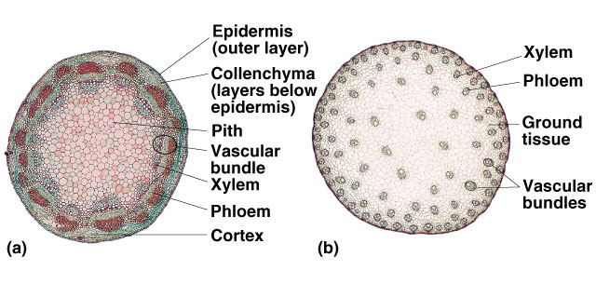
Stems

Slide 26
Modified Stems
Special purpose modifications
  bulbs
  corms
  rhizomes
  runners and stolons
  tubers
  tendrils
  cladophylls

Slide 27
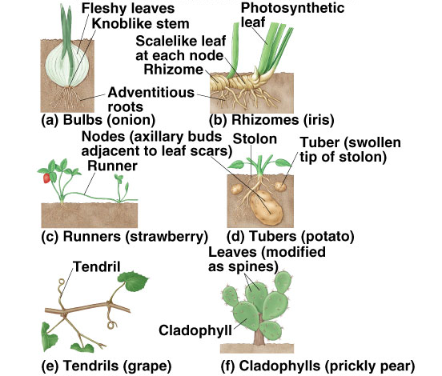

Slide 28
Leaves
Leaf external structure
  microphylls - have one vein that does not leave a gap when it branches from the vascular cylinder of the stem
  megaphylls - have several veins that leave a gap when they branch from the vascular cylinder of the stem

Slide 29
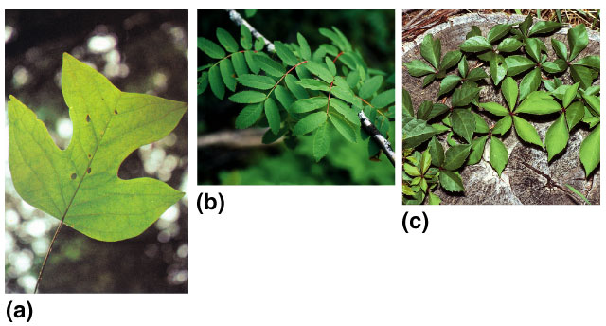
Leaf External Structure
Simple leaves - undivided blades
Compound leaf - blade divided into leaflets
  pinnately compound - leaflets arranged in pairs along common axis
  palmately compound - leaflets radiate out from common point

Slide 30
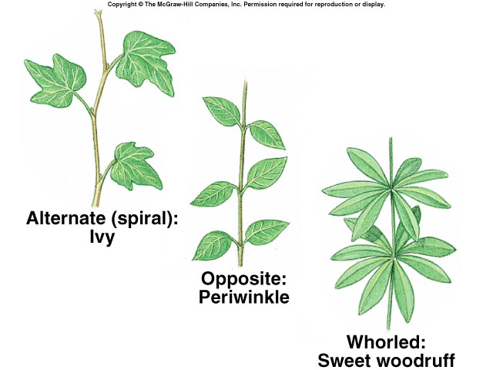
Leaf External Structure
Leaf arrangement
  alternate - one leaf per node
  opposite - two leaves per node
  whorl - circle of leaves at same level

Slide 31
Leaf Internal Structure
Epidermis has waxy cuticle and may have tricomes
  lower epidermis contains stomata flanked by guard cells
Mesophyll - tissue between upper and lower epidermis
  Dicots have rows of cholenchyma cells constituting the palisade mesophyll.
    spongy mesophyll between palisade mesophyll and lower epidermis
  monocot mesophyll not differentiated

Slide 32
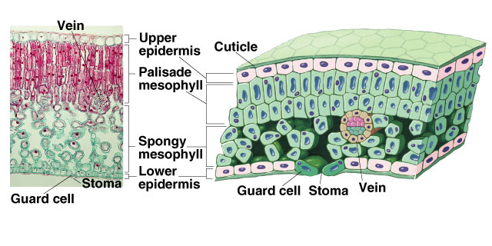
Leaf Cross Section

Slide 33
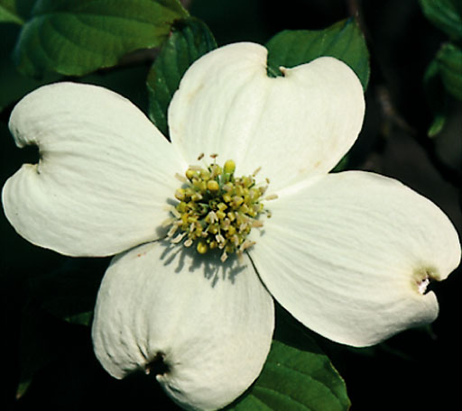
Modified Leaves
Modifications
  floral leaves (bracts)
  spines
  reproductive leaves
  window leaves
  shade leaves
  insectivorous leaves

