Slide 1
Anatomy of the Seed
Topic # 2023
Mr. Christensen

Slide 2
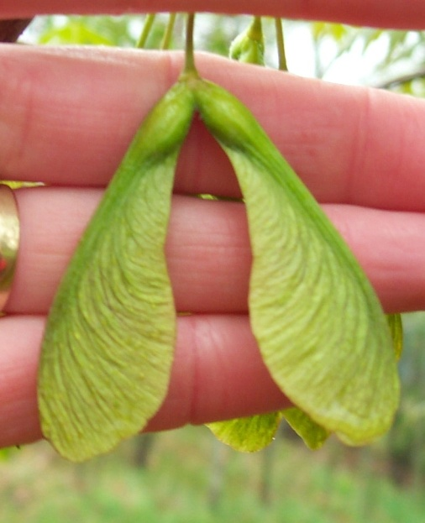
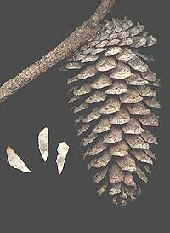
Taxonomic Classes
Angiosperm—The flowering plants, seeds are borne in an enclosed ovary (Examples Corn, beans and Maples 250,000 species).
Gymnosperm—The seeds of gymnosperms are borne naked with no ovary (Examples: Pines, spruces, and ginkgo 700 species)
Minnesota Tree Care Advisors
www.mntca.org/Reference_manual/tca_silver_maple.htm
http://backyardnature.net/gymnos.htm

Slide 3
Subclasses of Angiosperms
Monocot—Plants that have one cotyledon (seed leaf) in their seeds (60,000 species).
Dicot—Plants that have two cotyledons in their seeds (185,000 species).

Slide 4
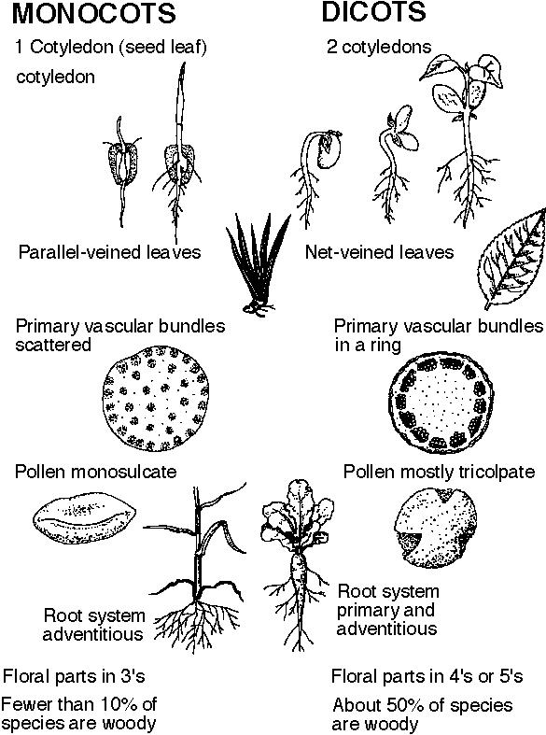
Oklahoma Education--www.howe.k12ok.us/~jimaskew/bplants.htm

Slide 5
Seed Components
A seed contains all of the genetic information needed to develop into an entire plant. It contains three parts.
(1) Embryo-a miniature plant which will grow when conditions are favorable.
(2) Endosperm-built in food supply for the plant.
(3) Seed Coat—Hard outer covering, protects the seed from disease and insects. Prevents water from entering the seed before the proper time.

Slide 6
Seed Germination
Germination-Seed embryo goes from a dormant state to an active, growing state.
Conditions for germination—
1. The seed absorbs water through the seed coat
2. The seed has oxygen
3. The seed has a favorable temperature
4. Some species, require light (Celery) others darkness.
5. Dormancy Period

Slide 7
Favorable Temperature
Most species require 65-86⁰F.
Some species have specific temperature requirements
Cool temps (40-77) ⁰F (broccoli, carrot, celery, lettuce, onion, coleus, delphinium)
Warm temps
-above 50 ⁰F; asparagus, corn, tomato
-above 60 ⁰F; beans, pepper, cucurbits

Slide 8
Seed Dormancy
Seed coat dormancy-a hard seed coat does not allow water to penetrate (Redbud, locust). Scarification-breaking of the seed coat (fire, insects, digestion, fungi, mechanically or with chemicals.
Embryo dormancy-seeds must go through a chilling period before germinating (elm, witch hazel) Stratification is used storing seeds in moist medium at temperatures between 32⁰ and 50⁰F.

Slide 9
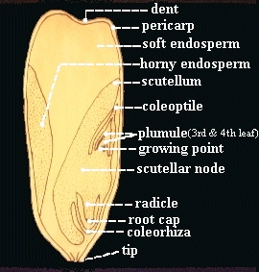
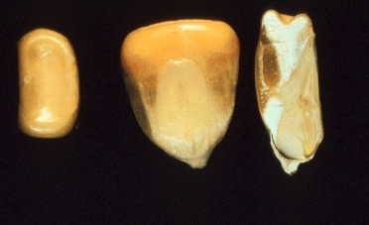
Monocot Seed Parts
http://www.pssc.ttu.edu/pss1321/web%20Topics/cpa2.htm

Slide 10
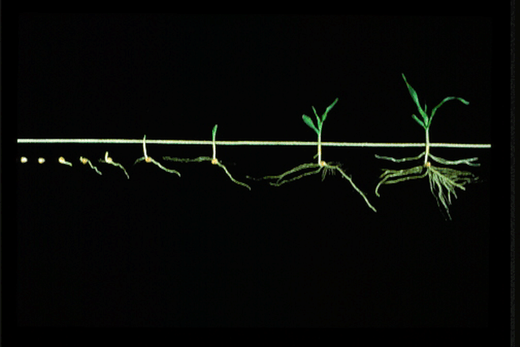
Hypogeal Emergence
Iowa State University http//maize.agron.iastate.edu/images/corn/fig1.gif

Slide 11
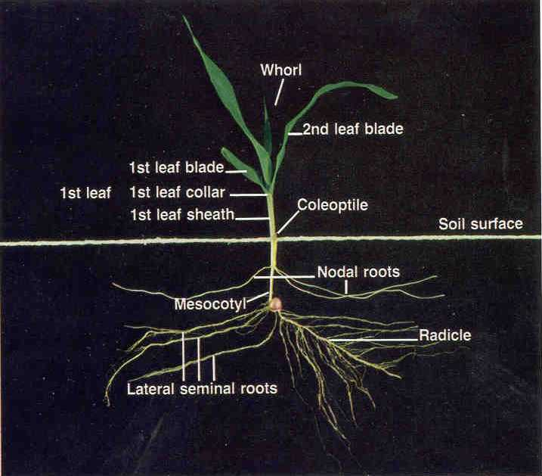
Iowa State University http//maize.agron.iastate.edu/images/corn/fig1.gif

Slide 12
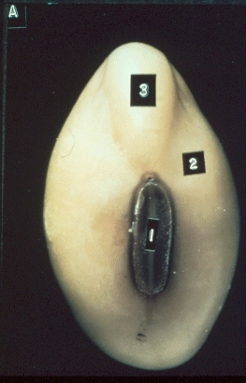
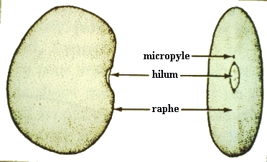
Dicot Seed Parts
http://www.pssc.ttu.edu/pss1321/web%20Topics/cpa2.htm

Slide 13
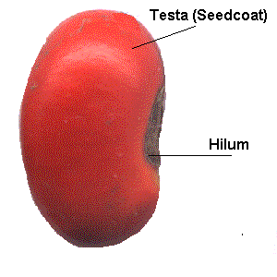
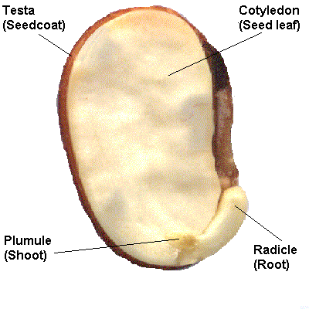
The seedsite.co.uk/seedparts.html

Slide 14
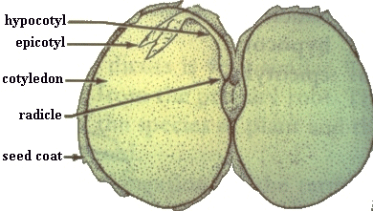
http://www.pssc.ttu.edu/pss1321/web%20Topics/cpa2.htm

Slide 15
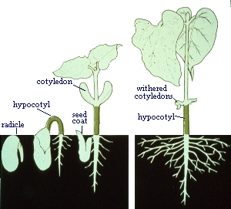
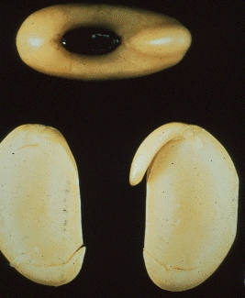
http://www.pssc.ttu.edu/pss1321/web%20Topics/cpa2.htm

Slide 16
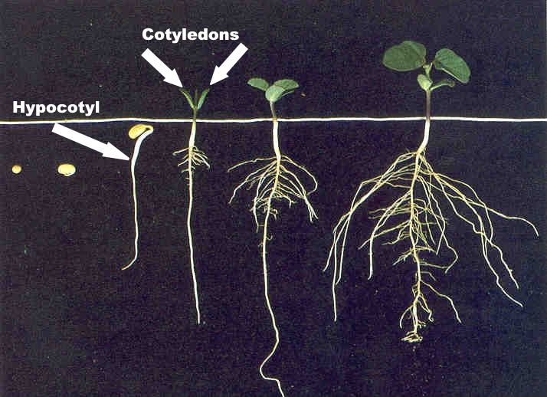
Epigeal Emergence
Iowa State University http//www.extension.iastate.edu/pages/hancock/agriculture/soybean/bean_develop/emergence.html

Slide 17
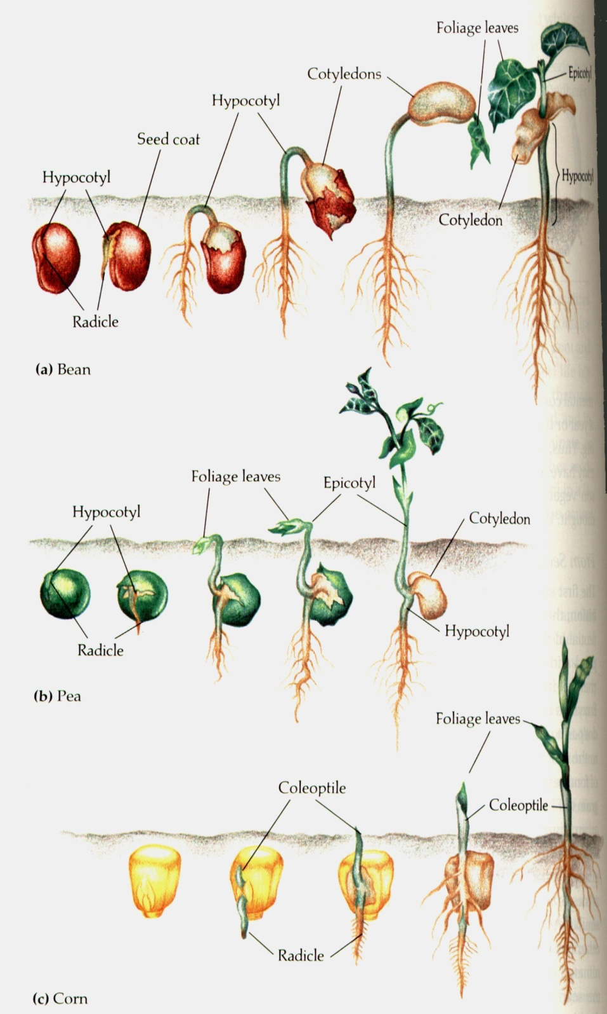
Epigeal Emergence
Hypogeal Emergence
Mrs. Killough’s AP Biology Class www.flashnet/~ben8403/seedanat.html

