Slide 1
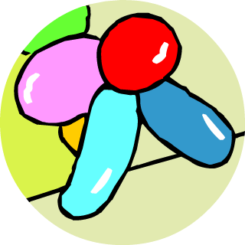

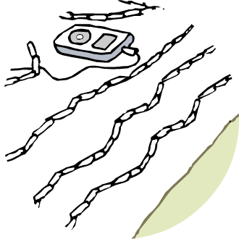
KS4 Chemistry
Alkanes and Alkenes

Slide 2
Contents
Alkanes and Alkenes
Alkanes
Combustion of alkanes
Alkenes
Cracking and polymerization
Summary activities

Slide 3
Pure hydrocarbons
Because the main use of hydrocarbons is as a fuel there is no point in going to the effort to separate them into individual hydrocarbons.
It is, however, possible to obtain pure hydrocarbons by very careful distillation.
This section is about pure hydrocarbons.

Slide 4
Organic chemistry: carbon
Carbon is an unusual atom in that it is able to form very strong covalent bonds with other carbon atoms.
When we then include its ability to also bond with other elements we open up the possibility of the highly diverse and complex molecules (like DNA) that have led to the possibility of life.
Because of this, the chemistry of carbon containing compounds is often called organic chemistry.

Slide 5
Alkanes
The simplest hydrocarbons form a series of compounds known as alkanes.
These all consist of carbon and hydrogen only and every carbon has four single covalent bonds.
Hydrocarbon | Formula | Structure
Methane | CH₄
Ethane | C₂H₆
Propane | C₃H₈
Butane | C₄H₁₀
hydrogen
carbon

Slide 6
Names of alkanes
The names of the 4 simplest alkanes are methane, ethane, propane and butane.
After that the names are systematic (like the words used to describe geometric shapes). E.g.
  5 carbons = pentane C₅H₁₂
  6 carbons = hexane C₆H₁₄
  7 carbons = heptane C₇H₁₆
  8 carbons = octane C₈H₁₈
  9 carbons = nonane C₉H₂₀
  10 carbons = decane C₁₀H₂₂
hydrogen
pentane
carbon

Slide 7
Structure of alkanes
Alkanes all have very similar structures.
They all consist of carbon and hydrogen only and every carbon has four single covalent bonds.
They have a CH₃ at each end of the molecule.
What differs is the number of CH₂ groups between the two ends.
It is possible to build up a series by simply adding an extra CH₂ group
This leads to a general formula of C_{n}H_{2n+2}
n= 1 n=2 n=3 n=4
hydrogen
carbon

Slide 8
What’s the formula?
What will be the formula for alkanes containing the following numbers of carbons?
Number of carbons | Formula
12
16
31
19
C₁₂H₂₆
C₁₆H₃₄
C₃₁H₆₄
C₁₉H₄₀

Slide 9
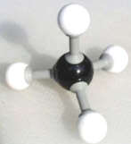
Formulae and models of alkanes
Although normal chemical formula - like C₅H₁₂ - are used to describe alkanes, they do not convey which atom is joined to which other atom.
To get around this we often used displayed formulae to describe organic molecules.
Displayed formulae show which 4 atoms each carbon is bonded to, but even these do not show the actual 3D shapes. For that we use models.
H
methane, CH₄
H
C
H
H

Slide 10
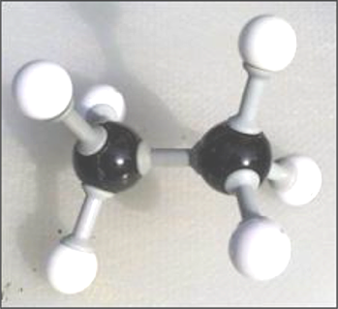
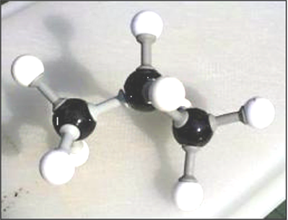
Formulae and models of alkanes
H
H
C
H
methane, CH₄
H
H
H
H
C
C
H
ethane, C₂H₆
H
H
H
H
H
H
C
C
C
H
propane, C₃H₈
H
H
H

Slide 11
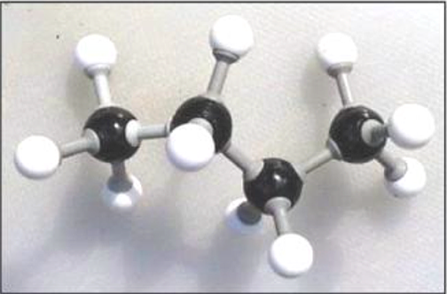
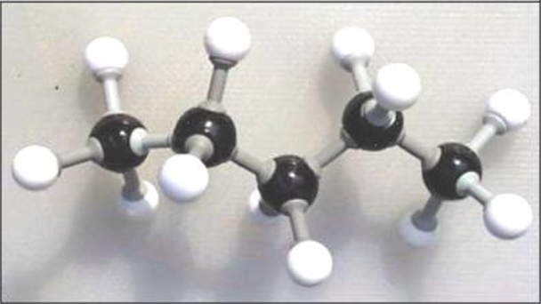
Formulae and models of alkanes
butane, C₄H₁₀
H
H
H
H
H
C
C
C
C
H
H
H
H
H
pentane, C₅H₁₂
H
H
H
H
H
H
C
C
C
C
C
H
H
H
H
H
H

Slide 12
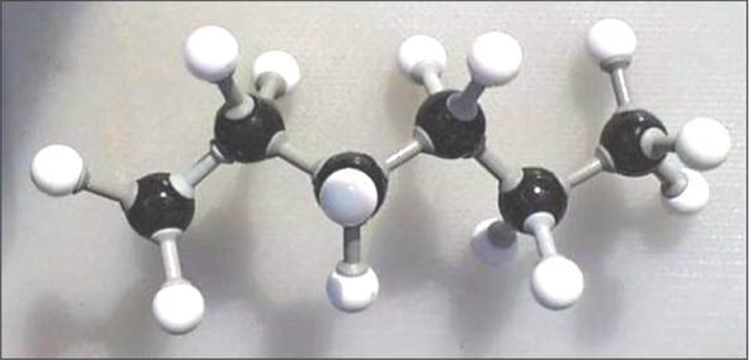
Formulae and models of alkanes
hexane, C₆H₁₄
H
H
H
H
H
H
H
C
C
C
C
C
C
H
H
H
H
H
H
H
Notice
the carbon chain
is not really
straight
and so on…………

Slide 13
Isomerism
Alkanes of the same formula can have different arrangements of atoms. Such different arrangements are known as isomers.
Two isomers of C₄H₁₀ are shown:
Isomers of butane

Slide 14
Bonding in alkanes: methane
Alkanes contain atoms held together by single covalent bonds.
In the displayed formula we show these bonds as a single line.
Each line is really a pair of shared electrons.
H
H
H
H
C
H
C
H
H
H

Slide 15
Bonding in alkanes: ethane
Ethane is the simplest alkane containing a
C-C single covalent bond.
H
H
H
H
H
C
C
H
H
C
C
H
H
H
H
H

Slide 16
Bonding in alkanes: propane
Complete the diagram below including its electrons.
Carbon electron
Hydrogen electron
H
H
H
H
C
C
C
H
H
H
H

Slide 17
Contents
Alkanes and Alkenes
Alkanes
Combustion of alkanes
Alkenes
Cracking and polymerization
Summary activities

Slide 18
Combustion of alkanes
Alkanes are not especially reactive but they do undergo one very important reaction: combustion.
With an adequate supply of air they react to form carbon dioxide and water.
methane + oxygen ➔ water + carbon dioxide
CH₄ + 2O₂ ➔ 2H₂O + CO₂

Slide 19
Incomplete combustion of alkanes
In the absence of an adequate supply of air, alkanes may react to form carbon monoxide and water.
Carbon monoxide is highly poisonous and this is one reason why gas boilers must be serviced regularly.
A carbon monoxide detector
methane + oxygen ➔ water + carbon monoxide
2CH₄ + 3O₂ ➔ 4H₂O + 2CO

Slide 20
Complete the equation
Complete the equations below assuming an adequate supply of oxygen for complete combustion. (These are quite tricky!)
2C₂H₆ + 7O₂ ⇨
C₃H₈ + 5O₂ ⇨
2C₄H₁₀ + 13O₂ ⇨
2C₂H₆ + 7O₂ ⇨ 4CO₂ + 6H₂O
C₃H₈ + 5O₂ ⇨ 3CO₂ + 4H₂O
2C₄H₁₀ + 13O₂ ⇨ 8CO₂ + 10H₂O

Slide 21
Contents
Alkanes and Alkenes
Alkanes
Combustion of alkanes
Alkenes
Cracking and polymerization
Summary activities

Slide 22
Alkenes
When carbon forms compounds each carbon atom always forms four bonds.
This does not, however, mean that each carbon is joined to four other atoms.
It is possible to have bonds grouped into pairs. These are called double bonds.
Alkenes contain carbon atoms joined by double covalent bonds.
C
C
Single covalent bond
C
C
Double covalent bond

Slide 23
Structure of alkenes
A series of alkanes exist, differing only in the number of CH₂ groups.
The same is true for alkenes.
This leads to a homologous series with the general formula C_{n}H_{2n}.
Alkenes
n= 1 n=2 n=3 n=4
hydrogen
=
=
=
none
carbon

Slide 24
What’s the formula?
What will be the formula for alkenes containing the following numbers of carbons?
Number of carbons | Formula
11
13
32
21
C₁₁H₂₂
C₁₃H₂₆
C₃₂H₆₄
C₂₁H₄₂

Slide 25
The formula of ethene
The simplest alkene is ethene.
It has the formula C₂H₄
The carbon atoms are joined together by a double bond.
Its displayed formula may be drawn in slightly different forms but should always clearly show the double bond.
H
H
C
C
or
H
H

Slide 26
The electron structure of ethene
In all alkenes there are two carbon atoms that are joined by two pairs of electrons.
This is the double bond.
H
H
C
C
H
H

Slide 27
The structure of pentene
Displayed formula for propene and butene are shown.
Draw a displayed structure for pentene.
H
H
H
H
H
H
H
H
C
C
H
C
H
C
H
C
C
H
H
C
H
H
C
H
C
C
H
C
C
H
H
H
H
H
H
H

Slide 28
Saturated or unsaturated?
Saturated means “full up”.
Alkanes are saturated.
Every carbon atom has already used all four of its bonds to join to four other atoms. No other atoms can be added.
Alkenes are unsaturated.
They have a double bond that could instead become two single bonds. This means that other atoms can be added. It is not “full up”.

Slide 29

Testing for alkanes and alkenes
Alkenes are unsaturated and so extra atoms can be added to alkene molecules.
This forms the basis of a test to distinguish between alkanes and alkenes.
When bromine water is added to an alkane nothing happens, but when bromine is added to an alkene the red colour of the bromine disappears.
+
Br₂
➔
Bromine loses this red colour
gas red colourless

Slide 30
Identify the compound
Copy the table and complete the empty boxes.
Number of carbons | Name | Alkane or alkene | Formula
5 | pentene
8 | octane
4 | butene
10 | decane
alkene
C₅H₁₀
alkane
C₈H₁₈
alkene
C₄H₈
alkane
C₁₀H₂₂

Slide 31
Contents
Alkanes and Alkenes
Alkanes
Combustion of alkanes
Alkenes
Cracking and polymerization
Summary activities

Slide 32
Source of alkenes
Crude oil contains many large molecules.
If these are to be used as fuels or feedstock for the chemical industry then they have to be broken down (or cracked) into smaller molecules.
Small molecules
Big molecules
Medium molecules

Slide 33
Catalytic cracking
Large hydrocarbons are broken down into smaller molecules using heat and a catalyst.
This process is known as catalytic cracking.
The small molecules produced are then separated by distillation.
Distillation
tower
pressure
Catalytic
cracker
Heat to
vaporize
Big molecules
Smaller molecules
Molecules break up

Slide 34
Catalytic cracking
In the catalytic cracker long chain molecules are split apart or ‘cracked’. An example of such a reaction is:
octane
heat &
pressure
hexane
catalyst
ethene
+
Used
to make
plastics
Used as a fuel
C₈H₁₈ ➔ C₆H₁₄ + C₂H₄

Slide 35
Cracking decane
Draw out displayed formulae of a pair of products formed by cracking decane.
H
H
H
H
H
H
H
H
H
H
decane
H
C
C
C
C
C
C
C
C
C
C
H
H
H
H
H
H
H
H
H
H
H
Heat &
pressure
catalyst
H
H
H
H
H
H
H
H
+
H
C
C
C
C
C
C
C
C
H
H
H
H
H
H
H
H
H
ethene
octane

Slide 36

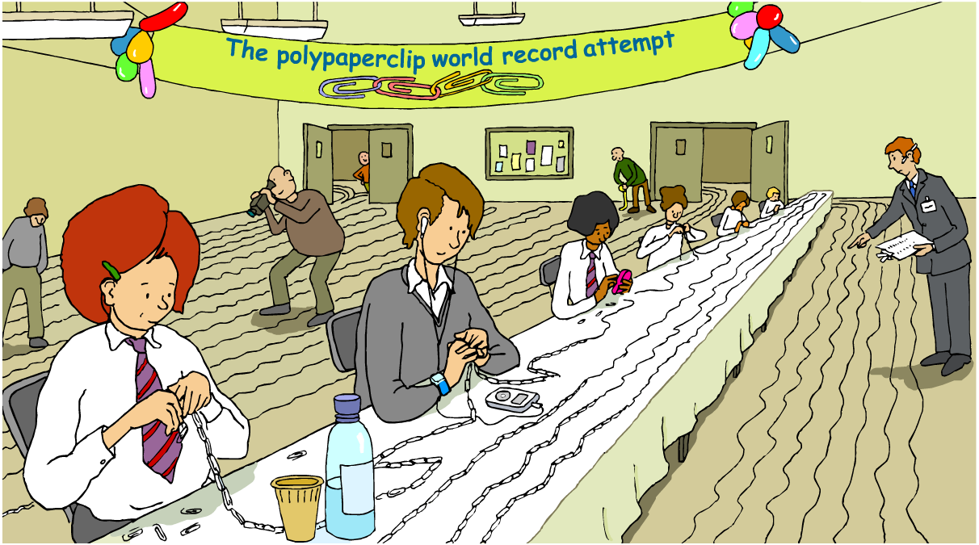
Making polymers
How do monomers become polymers?
Notes:
An additional exercise would be to identify objects in the scene that are made of, or contain, plastics, and therefore rely on alkenes.

Slide 37
Production of polythene
One important reaction of alkenes involves the joining together of alkene molecules.
H
H
H
H
H
H
H
H
H
H
And
lots
more...
H
C
C
C
C
C
C
C
C
C
C
H
H
H
H
H
H
H
H
H
H
1 2 3 4 5 thousands
This is called addition polymerization and is written as:
poly(e)thene
pressure
high
temperature
catalyst
n
n
ethene

Slide 38
Polypropene
Ethene is only one alkene. Other unsaturated molecules such as propene, vinyl chloride and styrene can also be polymerized to produce a range of plastics. E.g. propene:
n
poly(propene)
n
propene

Slide 39
PTFE
Tetrafluoroethene is another alkene that is made into an important plastic used to coat non-stick pans: polytetrafluoroethene or PTFE.
n
n
tetrafluoroethene
poly(tetrafluoroethene)
or PTFE

Slide 40
Polymerization of vinyl chloride
Fill in the products that will be obtained from vinyl chloride
H
Cl
H
Cl
C
C
n
C
C
H
H
H
H
n
pvc
Vinyl chloride

Slide 41
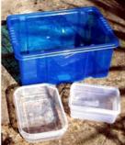

Uses of plastics
Poly(e)thene
Shopping bags
Bottles
Buckets
Washing-up bowls
Polypropene
Milk crates
Rope
Carpet fibres
Polystyrene
Packing
Insulation
Ball pens

Slide 42
Contents
Alkanes and Alkenes
Alkanes
Combustion of alkanes
Alkenes
Cracking and polymerization
Summary activities

Slide 43
Glossary
alkanes – A family of saturated hydrocarbons used as fuels.
alkenes – A family of unsaturated hydrocarbons containing one double bond, and which are used to make plastics.
cracking – The process in which large molecules are broken down into smaller molecules by heating.
monomer – A molecule that joins with others to form a polymer.
polymerization – The process in which small molecules are joined together to form a much larger molecule.
saturated – A molecule in which all the bonds are single.
unsaturated – A molecule in which at least one bond is double or triple.

Slide 44

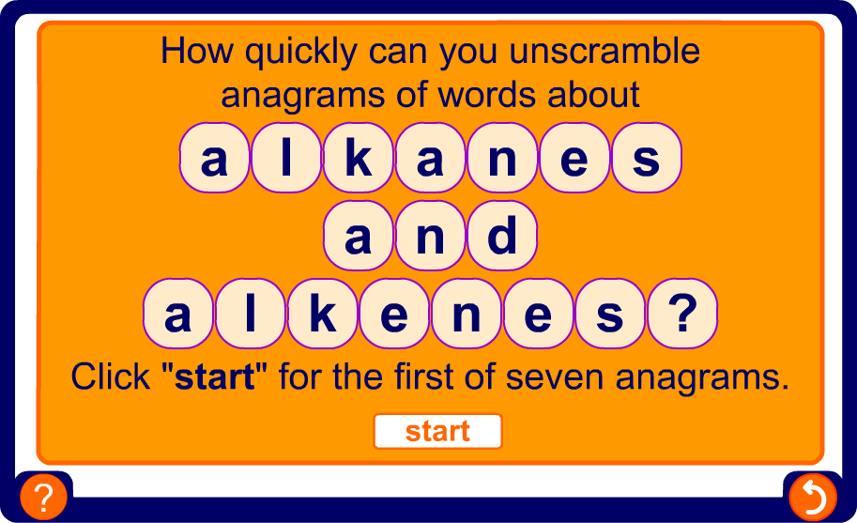
Anagrams

Slide 45
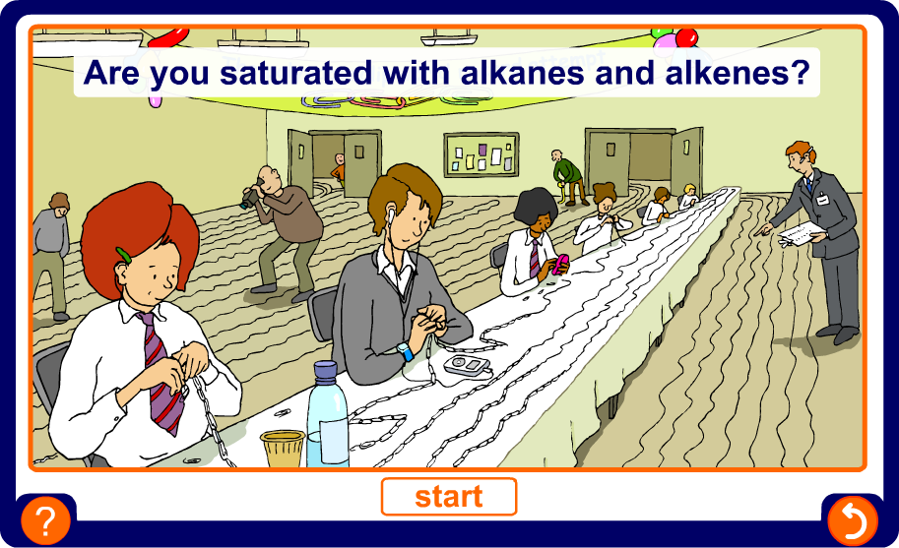
Multiple-choice quiz

