Slide 1
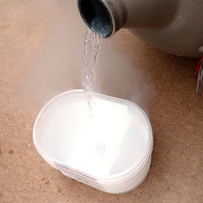
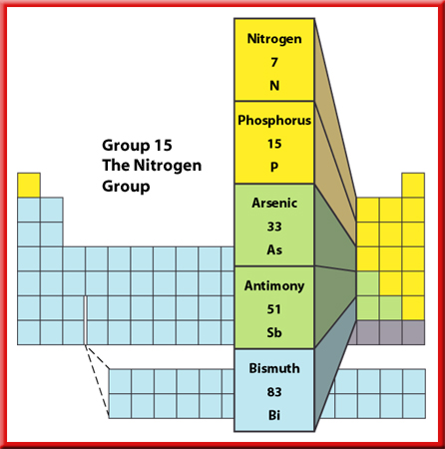

Liquid nitrogen
Group V. Nitrogen and its compounds.

Slide 2
General properties
1st member of group VA
Colourless, odourless gas
78% by volume in air
Liquid nitrogen as a coolant
Most important use is in the manufacture of ammonia and nitrogenous fertilizers
Can form a large number of inorganic compounds
A major constituent of organic compounds such as amines, amino acids and amides.

Slide 3
Unreactive nature of nitrogen
N
N
Strong N≡N bond,
Bond energy:944 kJ/mol
Reactions involving N₂ have
high activation energy and
unfavourable equilibrium constant.
N₂+O₂2NO K_{c} =4.5x10⁻³¹
ΔH=180.5 kJ/mol

Slide 4
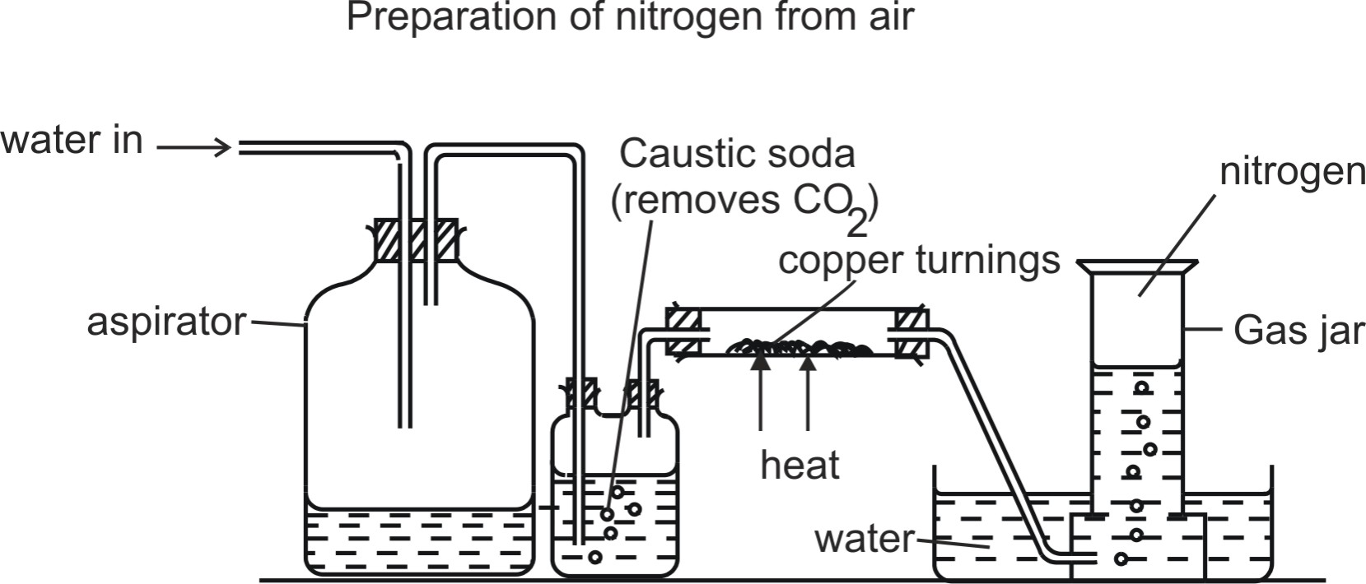
Laboratory Preparation of Nitrogen
Nitrogen can be prepared from the air as shown below.

Slide 5
Nitrogen can be prepared from the air as shown.
Air flows into the respirator and onto caustic soda
which dissolves carbon dioxide gas.
It is then passed through a heated combustion tube
containing heated copper turnings which remove
oxygen. Nitrogen is then collected over water.
Traces of noble gases present in air still remain
in the final product.

Slide 6
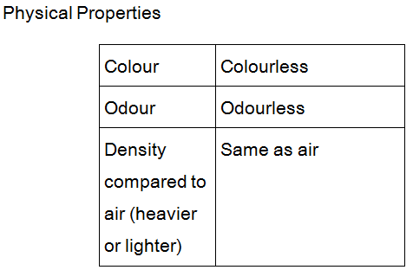

Slide 7
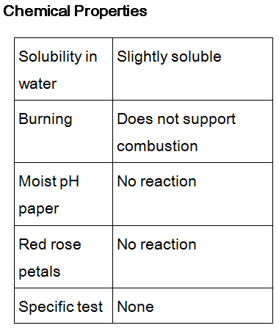

Slide 8
Reactions of nitrogen
With reactive metals, Li and Mg, to form nitrides.
  3Mg(s) + N₂(g) → Mg₃N₂(s), an ionic cpd.
With oxygen at very high temperature
  N₂(g) + O₂(g) → 2NO(g) , at very high T
  2NO(g) + O₂ → 2NO(g)
With hydrogen at special conditions
  N₂(g) + 3H₂(g)  2NH₃(g) , Haber Process

Slide 9
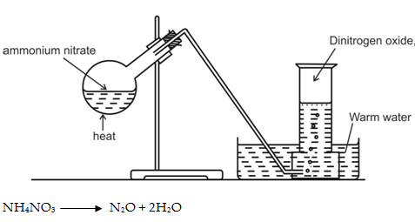
Nitrous oxide:
Nitrous oxide (dinitrogen oxide), N₂O, is prepared by gentle heating
of ammonium nitrate:

Slide 10
Nitrous oxide is a linear molecule. It has a boiling point of -88 ºC,
and a melting point
of -102 ºC. It is colourless and has a faintly sweet smell. It is used
as an anesthetic,
popularly called laughing gas.

Slide 11
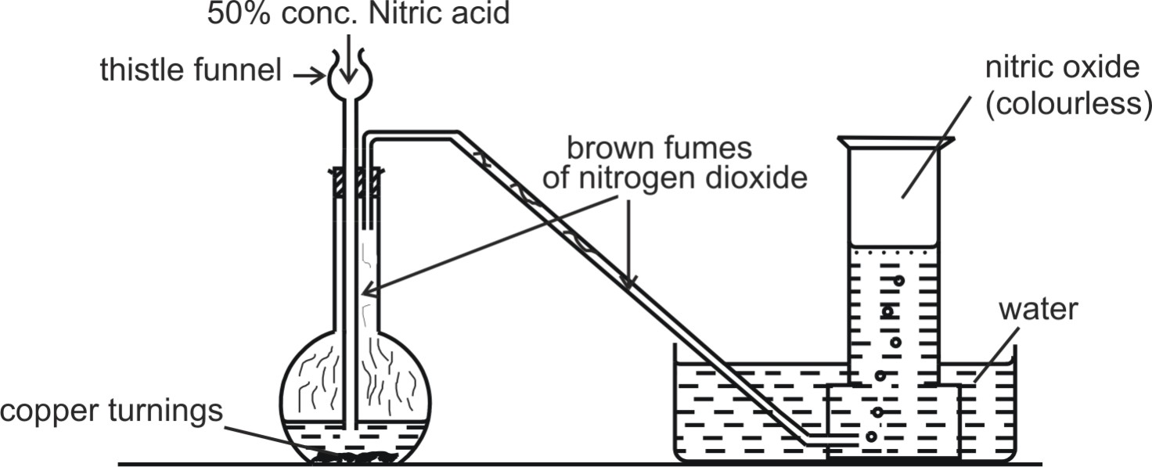
NITRIC OXIDE
Nitric oxide, NO, may be prepared by the action of dilute nitric acid
on copper:

Slide 12
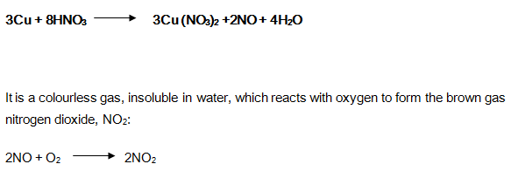
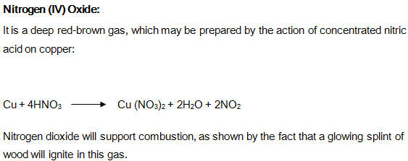

Slide 13
AMMONIA GAS

Slide 14
Laboratory Preparation
Ammonia can be prepared by heating an ammonium salt with an alkali .
2NH₄Cl (s) + Ca(OH)₂ (s)
→ 2NH₃ (g) + CaCl₂ (aq) + 2H₂O (l)

Slide 15
Drying of Ammonia
The drying agent used for ammonia is quick lime.
Other drying agents such as concentrated sulphuric acid
or phosphorus (V) oxide or fused calcium chloride
cannot dry an alkaline gas like ammonia.
Sulphuric acid and phosphorus (V) oxide are both acidic.
They react with ammonia, forming their respective
ammonium salt.

Slide 16
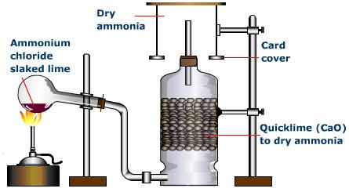

Slide 17
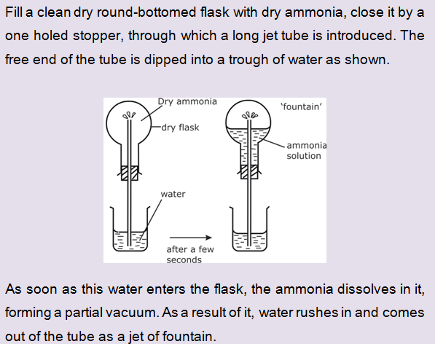
Fountain experiment

Slide 18
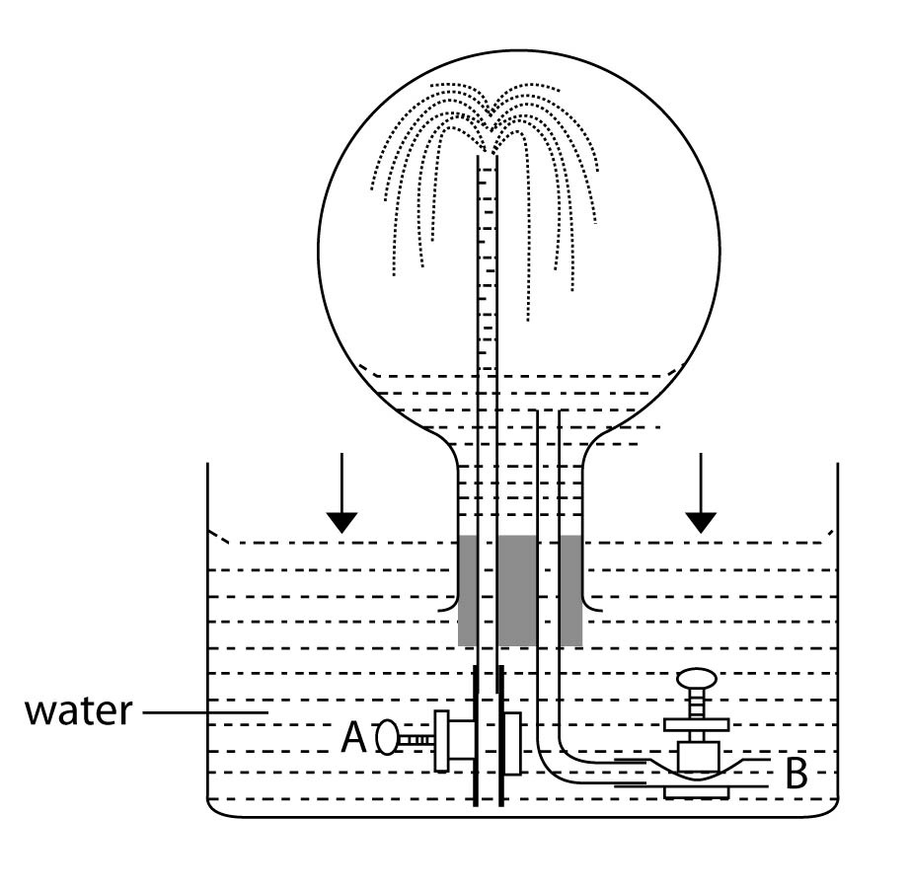

Slide 19
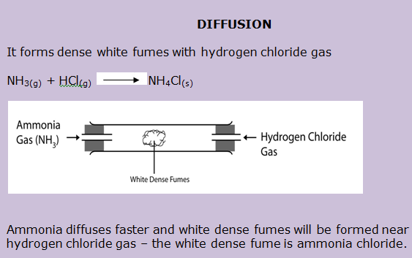

Slide 20
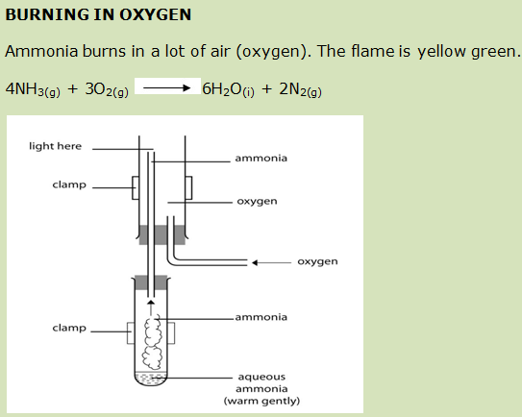

Slide 21
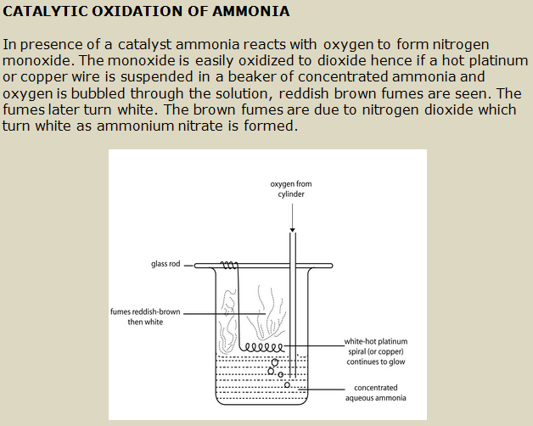

Slide 22
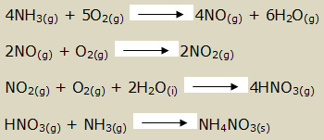

Slide 23
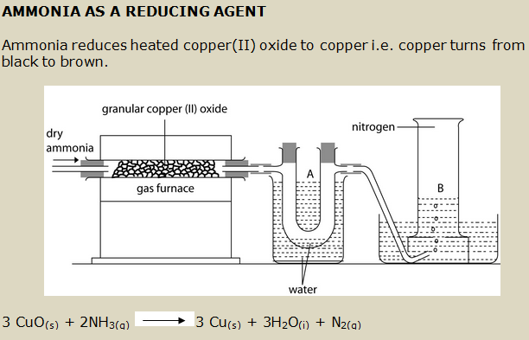

Slide 24
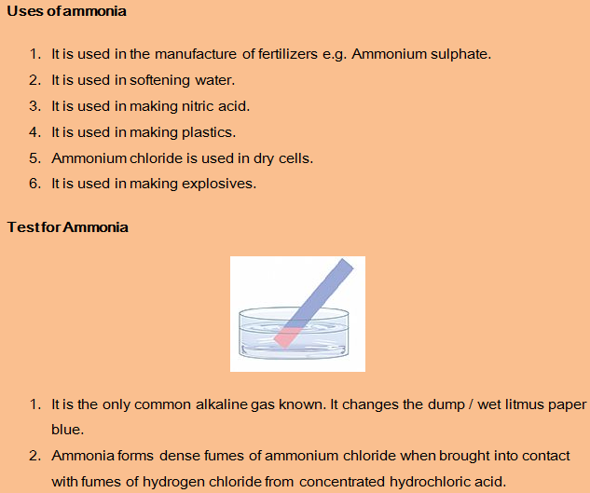

Slide 25
Ammonia
A colourless, pungent gas
Easily liquefied (b.p. –33ºC)
Extremely soluble in water to form a weakly alkaline solution
Synthesized by Haber Process
Starting material for HNO₃ and many other important chemicals

Slide 26
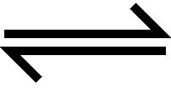
The Haber Process
In the early 1900’s a German chemist called Fritz Haber came up with his chemical process to make ammonia using the “free” very unreactive Nitrogen from the air. (N2 is 80% of atmosphere)
This is the reaction:
Nitrogen + Hydrogen Ammonia
N2 (g) + 3H2 (g) 2NH3 (g)

Slide 27
Raw Materials
N2 (g) is taken from the air via a process of fractional distillation.
H2 (g) comes from natural gas, CH4 (g)
CH4 (g) + H2O (g) 3H2 (g) + CO (g)
The carbon monoxide then reacts with more steam:
CO (g) + H2O (g) H2 (g) + CO2 (g)

Slide 28

Raw Materials cont
H2 (g) from methane
Reaction
Vessel
NH2 (g)
N2 (g) from air
The Reaction
This reaction is exothermic. We increase yield by running the reaction at low temperatures. However at low temperatures the reaction rate is incredibly slow.
Compromise between rate and yield has to be reacted. Haber process runs at about 450 c

Slide 29
The Reaction cont
The reversible reaction to form ammonia:
N2 (g) + 3H2 (g) 2NH2 (g)
4 moles of gas 2 moles of gas
96 litres (4x24) 48 litres (2x24)
If pressure is increased in reaction vessel, the reversible reaction favours ammonia production.
Increase external pressure favours side with least gas (ammonia). Haber process runs at about 200 atmospheres in order to maximise yield of ammonia.

Slide 30
The Reaction cont
Third condition present within the reaction vessel is an Iron catalyst.
The catalyst is a fine mesh designed to maximise surface area. Iron is a transition metal, and like many transition metals it makes a good catalyst.
N2 from air
450oc
200 atmospheres
Iron catalyst
NH3 (g)
H2 from methane and steam
REMEMBER THIS!

Slide 31
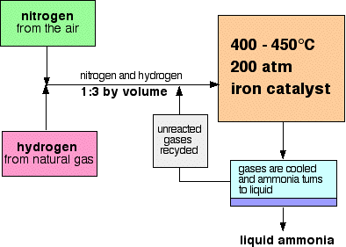
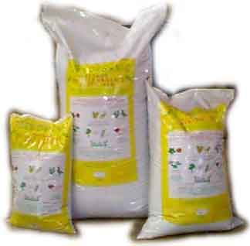

After the Reaction Vessel
Coming out the reaction vessels is NH3 (g) and unreacted N2 (g) and H2 (g).
First job is to isolate the NH3 (g). This is done by cooling. The NH3 (g) changes state. The nitrogen and hydrogen are recycled back into the reaction vessel.

Slide 32
Chemical properties of NH₃
Weak alkali
Reaction with acids
Reaction with metal ions
As a reducing agent
  Burning in oxygen 4NH₃ + 3O₂ → 2N₂ + 6H₂O
  Catalytic oxidation 4NH₃ + 5O₂ (Pt) → 4NO + 6H₂O
  Reaction with CuO 2NH₃+3CuO→3Cu+N₂+3H₂O

Slide 33
Nitric(V) Acid
A very strong acid.
Turns yellow because of dissolved NO₂ formed from the decomposition of HNO₃.
Kept in amber bottle to avoid exposure to light
Commonly used in making explosives, nylon, fertilizers and dyes

Slide 34
Ostwald process
Catalytic oxidation of NH₃
  4NH₃ + 5O₂ (Pt/heat) → 4NO + 6H₂O
Oxidation of NO
  2NO + O₂ → 2NO₂
Dissolving NO₂ in water and O₂
  4NO₂ + O₂ + 2H₂O → 4HNO₃
Distillation to obtain 68.5% (15M) HNO₃ as azeotrope

Slide 35
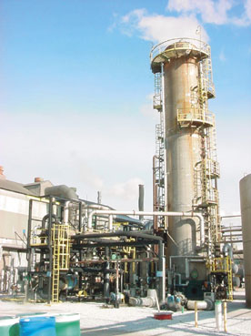
The Ostwald Process
The Ostwald process was invented by Wilhelm Ostwald. In the Ostwald process ammonia is oxidised to form Nitric acid. Nitric acid is one of the largest user’s of ammonia. The process has 3 stages:
Stage 1
Mixture of air & ammonia heated to 230oc and is passed through a metal gauze made of platinum (90%) & Rhodium (10%).
Reaction produces a lot of heat energy..
Energy is used to keep reaction vessel temp at 800oc.

Slide 36
Stage 1 cont
Reaction produces nitrogen monoxide (NO) and water.
Ammonia + oxygen Nitrogen monoxide + water
4NH3 (g) + 5O2 (g) 4NO (g) + 6H2O (g)
REMEMBER ALL SYMBOL EQUATIONS!
Stage 2
Colourless nitrogen monoxide gas produced from 1st stage is then reacted with oxygen from the air to form brown nitrogen dioxide gas (NO2).

Slide 37
Stage 2 cont
Nitrogen monoxide + oxygen Nitrogen dioxide
2NO (g) + O2 (g) 2NO2 (g)
Stage 3
The nitrogen dioxide is then dissolved in water to produce nitric acid.
Nitrogen dioxide + water Nitric acid + nitrogen
monoxide
3NO2 (g) + H2O (l) 2HNO3 (aq) + NO (g)

Slide 38
Oxidizing properties of HNO₃
Concentrated HNO₃
  2NO₃⁻ + 8H⁺ + 6e⁻ → 2NO + 4H₂O
Diluted HNO₃
  2NO₃⁻ + 4H⁺ + 2e⁻ → 2NO₂ + 2H₂O
Reactions with
  Copper
  Iron(II) ions
  Sulphur

Slide 39
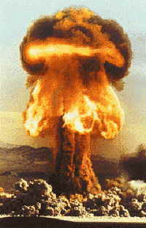
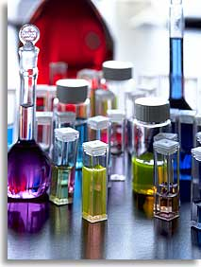
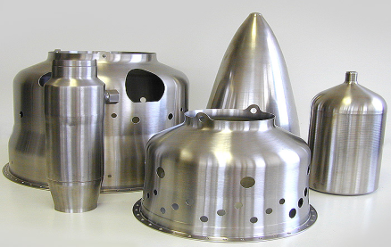
Uses of Nitric acid
Nitric acid produced is used in the manufacture of the following:
Artificial fertilisers – Ammonium nitrate.
Explosives, such as 2,4,6-TNT.
Dyes.
Artificial fibres, such as nylon.
Used in treatment of metals.

Slide 40
Nitrates(V)
Thermal stability
  K,Na 2MNO₃→2MNO₂ + O₂
  Ca to Cu 2M(NO₃)₂→2MO+4NO₂+O₂
  Hg,Ag Hg(NO₃)₂→Hg + 2NO₂ + O₂
  NH₄NO₃ → N₂O + 2H₂O

Slide 41
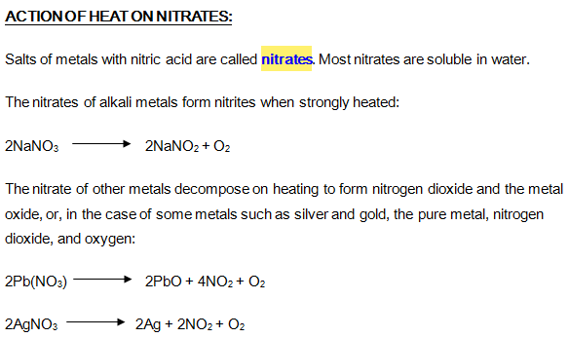

Slide 42
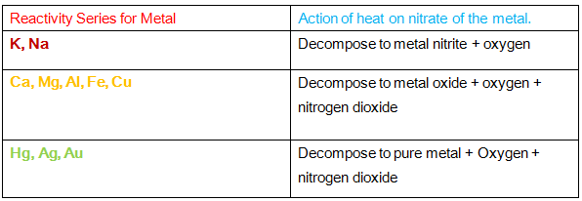

Slide 43
Brown ring test for NO₃⁻
Concentrated
H₂SO₄(l)
Fresh FeSO₄(aq) and NO₃⁻(aq)
NO₃⁻ + H₂SO₄ → HNO₃ + HSO₄⁻
HNO₃ + 3Fe²⁺ + 3H⁺ → 2H₂O + NO + 3Fe²⁺
FeSO₄ + NO → FeSO₄.NO (brown complex)

