Slide 1
Sulfuric Acid

Slide 2
9.5.3 –
Present information to describe the steps and chemistry involved in the industrial production of sulfuric acid and analyse the process to predict ways in which the output of sulfuric acid can be maximized.

Slide 3
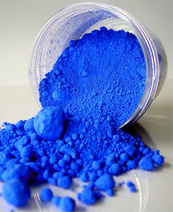
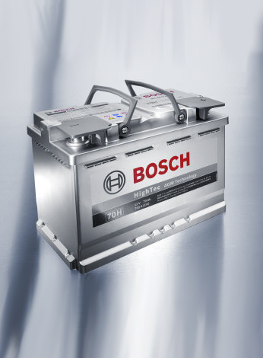
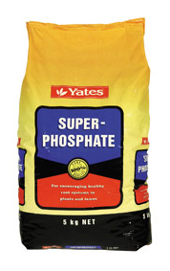
Uses of Sulfuric Acid
Car Batteries
Fertilisers
Dyes & Pigments

Slide 4
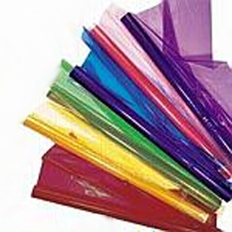
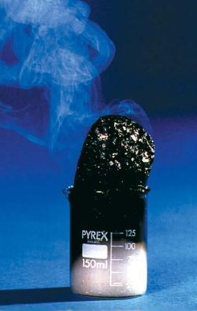
More Uses…
Explosives
Cellophane
Dehydrating Agent

Slide 5
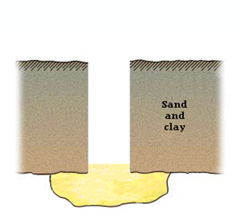
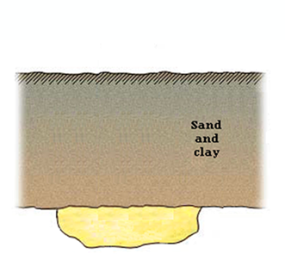
Sulfur Extraction
Pressurised
air
S
Super-heated
steam
The
Frasch
Process
The low melting point of sulfur facilitates its melting
Molten sulfur is forced through the middle pipe to the surface
The foam is cooled and sulfur extracted
Sulfur melts…

Slide 6
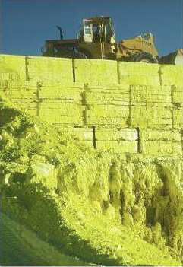
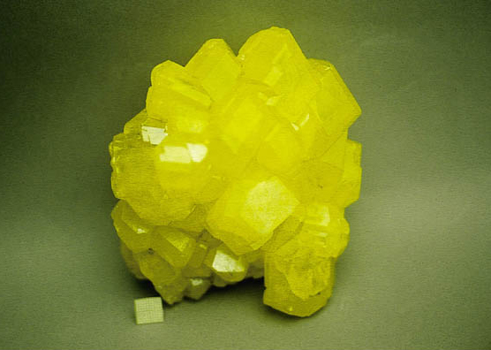
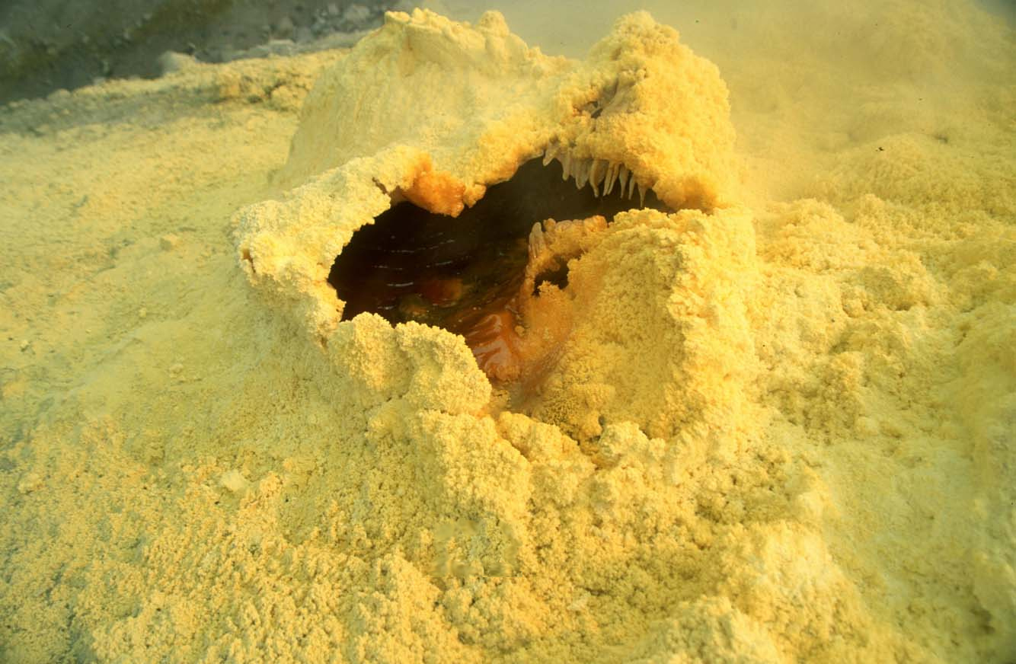
The Sulfur Product

Slide 7
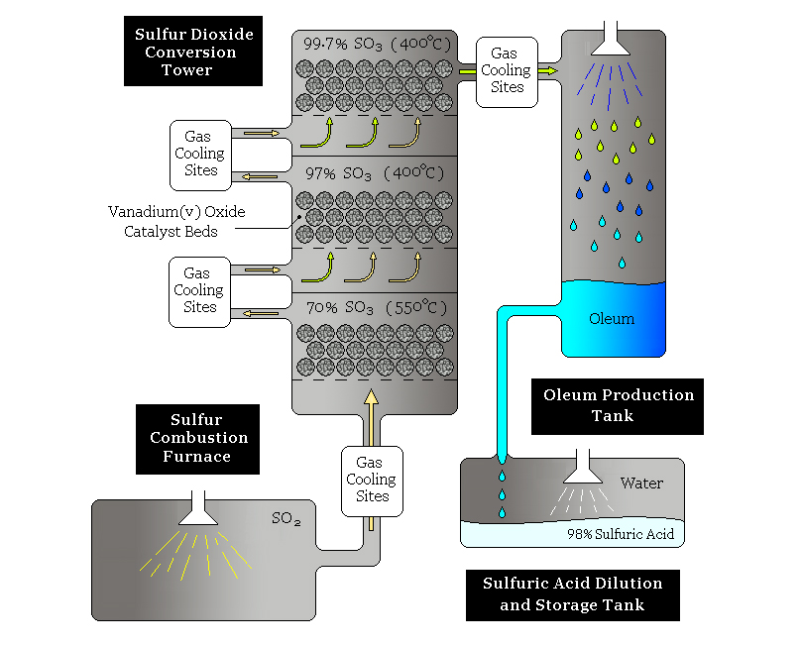
The Contact Process
The Contact Process is the chemical process used to make sulfuric acid.
It is composed of a number of chemical reactions, or steps, each occurring under different conditions and in different industrial chambers.
The FOUR steps are:
Combustion of sulfur into sulfur dioxide
Conversion of sulfur dioxide into sulfur trioxide
Dissolving sulfur trioxide in sulfuric acid to form oleum
Diluting this oleum to form sulfuric acid

Slide 8
Sulfur Combustion
Sulfur is liquefied, and sprayed into a combustion furnace containing an excess of dry air at atmospheric pressure. The liquefaction of the sulfur greatly increases its surface area, and the excess air promotes the reaction.
The resulting reaction is strongly exothermic and goes to completion:

Slide 9
Catalytic Conversion
The conversion of sulfur dioxide (SO₂) into sulfur trioxide (SO₃) is the most difficult step of the process.
This is because the conversion is an equilibrium reaction, and as such yield and rate considerations must be made:

Slide 10
Equilibrium Considerations
According to the Le Chatelier’s Principle, the output can be maximised by:
Using a LOW temperature; lower temperatures encourage the counter-acting heating effect of the exothermic forward reaction, to re-establish equilibrium with a higher yield.
Using HIGH pressure; there are 2 moles of product gas, compared to 3 moles of reactant gas, so a higher pressure will encourage the pressure-reducing forward reaction, as it produces less moles of gas.
Using an EXCESS of oxygen; this forces the equilibrium to the right, creating more product.
However, these are PURELY equilibrium considerations, which only relate to yield. In an industrial process, the rate of reaction, is also important.

Slide 11
Rate Considerations
In any chemical reaction, the rate of reaction increases as the temperature increases.
This is because greater thermal energy means greater kinetic energy, which leads to more collisions between reactant molecules, and hence more reactions can occur.
Hence, to maximize the output of sulfur trioxide:
A HIGH temperature favours a fast reaction
A CATALYST is used to speed up the reaction

Slide 12
The Compromise Reaction
Through analysing the reaction, with all of the above, industrial chemists have decided on compromise conditions for this step of the contact process, in order to maximise the yield of sulfur trioxide, and hence the yield of sulfuric acid. The conditions are:
A pressure of a little above atmospheric (100 kPa; large pressures, are not used, even though it would increase the yield, because high pressure equipment is expensive and dangerous to build and maintain).
A small excess of oxygen.
A catalyst of vanadium(V) oxide is used.
Moderate temperature ranging from 400-550°C.

Slide 13
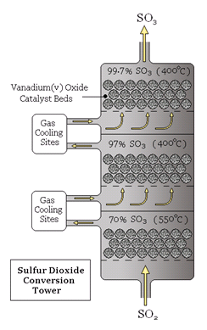
The Reaction Beds

Slide 14
Oleum Production
Sulfur trioxide + water = BOOM (i.e. not good)
Instead, the 99.7% SO₃ that leaves the conversion tower is dissolved into a stream of concentrated sulfuric acid, forming oleum (H₂S₂O₇).
The sulfur trioxide dissolves very easily into sulfuric acid, and the reaction is stable:

Slide 15
Final Dilution
Lastly, the oleum is diluted with distilled water
This forms 98% concentration sulfuric acid
This dilution is stable, and continuously carried out:

Slide 17
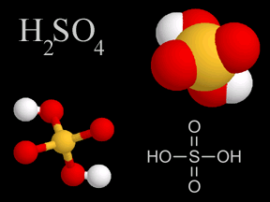
Final Product

