Slide 1
PRACTICAL EXAM
SKILLS

Slide 2
What are you expected to do?
You are usually asked to do the following:
heat a substance
add a substance to another
describe a sample

Slide 3
What must you observe?
You must be alert to observe the following:
changes in colour
production of gases
formation of precipitate

Slide 5
Test for Gases
Conclusion
Observations
Notes:
Observations : Gas evolved …
Conclusion : ... gas evolved (Note: not … gas present).

Slide 6
Test for Gases – Ammonia (NH₃)
Observations : Effervescence observed.
Gas evolved turns damp litmus paper blue.
Conclusion : Ammonia gas is evolved.
Notes:
1. Test for ammonium ions (NH₄⁺)
2. Test for nitrate ions (NO₃⁻)

Slide 7
Test for Gases – Carbon Dioxide (CO₂)
Observations : Effervescence observed.
Gas evolved gives white ppt. with limewater.
Conclusion : Carbon dioxide gas is evolved.
Notes:
Heating of solid metal carbonates (Note: no effervescence observed)
Addition of acid to metal carbonates

Slide 8
Test for Gases – Chlorine (Cl₂)
Observations : Effervescence observed.
Gas evolved turns damp litmus paper red, then white.
Conclusion : Chlorine gas is evolved.

Slide 9
Test for Gases – Hydrogen (H₂)
Observations : Effervescence observed.
Gas evolved extinguishes a lighted splinter with a ‘pop’ sound.
Conclusion : Hydrogen gas is evolved.
Notes:
1. Addition of acid to solid metals (e.g. Ca / Mg / Zn / Fe)

Slide 10
Test for Gases – Oxygen (O₂)
Observations : Effervescence observed.
Gas evolved relights a glowing splinter.
Conclusion : Oxygen gas is evolved.
Notes:
Hint: “heat strongly” (Note: no effervescence observed)
Decomposition of hydrogen peroxide, using manganese (IV) oxide as catalyst.

Slide 11
Test for Gases – Sulfur Dioxide (SO₂)
Observations : Effervescence observed.
Gas evolved turns aqueous acidified potassium dichromate (VI) from orange to green.
Conclusion : Sulfur dioxide gas is evolved.
Notes:
Sulfur dioxide is a reducing agent.
Sulfur dioxide turns aqueous acidified potassium manganate (VII) from purple (MnO₄⁻) to colourless (Mn²⁺).
Sulfur dioxide turns aqueous acidified potassium dichromate (VI) from orange (Cr₂O₇²⁻) to green (Cr³⁺).

Slide 12
Test for Cations
Conclusion
Observations

Slide 14
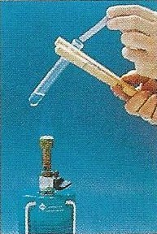
Test for Cations – Na⁺/K⁺/NH₄⁺
Observation:
No ppt. observed.
Observation:
No visible reaction on warming.
Conclusion:
Na⁺ / K⁺ is present.
Observation:
Ammonia produced on warming.
Conclusion:
NH₄⁺ is present.

Slide 15
Test for Cations – Ca²⁺ / Pb²⁺ / Zn²⁺
Observation:
White ppt. observed.
Observation:
White ppt., soluble in excess, giving a colourless solution.
Conclusion:
Pb²⁺ / Zn²⁺ is present.
Observation:
White ppt., insoluble in excess.
Conclusion:
Ca²⁺ is present.

Slide 16
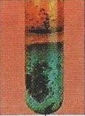
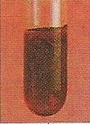
Test for Cations – Cu²⁺ / Fe²⁺ / Fe³⁺
Observation:
Light blue ppt., insoluble in excess.
Conclusion:
Cu²⁺ is present.
Observation:
Green ppt., insoluble in excess.
Conclusion:
Fe²⁺ is present.
Observation:
Red-brown ppt., insoluble in excess.
Conclusion:
Fe³⁺ is present.

Slide 17
Test for Anions
Conclusion
Observations

Slide 18
Test for Anions – Cl⁻
Test:
To 2 cm³ of solution, add an equal amount of dilute nitric acid, followed by aqueous silver nitrate.
Observation:
White ppt. observed.
Conclusion:
Cl⁻ is present.
Notes:
Observation: White ppt. observed. (correct)
Observation: The solution turned white. (incorrect)

Slide 19
Test for Anions – SO₄²⁻
Test:
To 2 cm³ of solution, add an equal amount of dilute nitric acid (dilute hydrochloric acid), followed by aqueous barium nitrate (aqueous barium chloride).
Observation:
White ppt. observed.
Conclusion:
SO₄²⁻ is present.
Notes:
Observation: White ppt. observed. (correct)
Observation: The solution turned white. (incorrect)

Slide 20
OXIDISING AND REDUCING AGENTS
Oxidising agents undergo reduction.
Reducing agents undergo oxidation.

Slide 21
Common Oxidising Agents
Oxidising agents undergo reduction.
OXIDISING AGENT | BEFORE | AFTER
Aqueous acidified potassium manganate (VII) H⁺ / KMnO₄ (aq) | Purple (MnO₄⁻) | Colourless (Mn²⁺)
Aqueous acidified potassium dichromate (VI) H⁺ / K₂Cr₂O₇ (aq) | Orange (Cr₂O₇²⁻) | Green (Cr³⁺)
Aqueous iron (III) compounds | Yellow (Fe³⁺) | Pale green (Fe²⁺)
Aqueous iodine | Dark brown (I₂) | Colourless (I⁻)

Slide 22
Common Reducing Agents
Reducing agents undergo oxidation.
REDUCING AGENT | BEFORE | AFTER
Aqueous iron (II) compounds | Pale green (Fe²⁺) | Yellow (Fe³⁺)
Aqueous potassium iodide | Colourless (I⁻) | Dark brown (I₂)

Slide 23
DISPLACEMENT REACTIONS
A more reactive metal displaces a less reactive metal from its solution.

Slide 24
Common Metals
Metal | Colour of Metal | Colour of Metallic Salt Solution
Magnesium | Shiny | Colourless (Mg²⁺)
Aluminium | Shiny | Colourless (Al³⁺)
Zinc | Dull Grey | Colourless (Zn²⁺)
Iron | Dark grey | Pale green (Fe²⁺) / Yellow (Fe³⁺)
Lead | Dull grey | Colourless (Pb²⁺)
Copper | Reddish-brown | Blue (Cu²⁺)
Silver | Shiny | Colourless (Ag⁺)

Slide 25
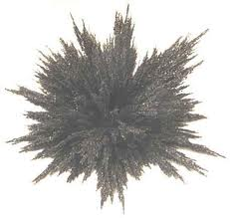
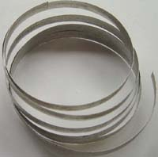
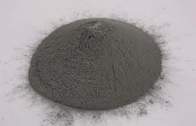
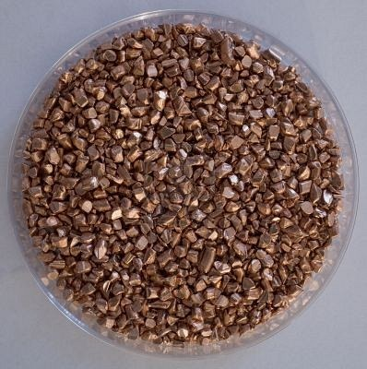
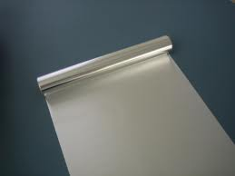
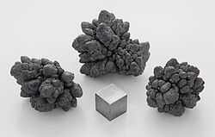
Common Metals
iron filings
magnesium ribbon
zinc powder
aluminium foil
lead
copper turnings

Slide 26
Displacement Reactions
Magnesium
Mg (s) + CuSO₄ (aq) → MgSO₄ + Cu (s)
Effervescence observed.
The magnesium ribbon dissolves rapidly into the solution.
The blue solution turns colourless slowly.
A reddish brown solid is deposited at the bottom of the test-tube.

Slide 27
Displacement Reactions
Magnesium
Mg (s) + FeCl₂ (aq) → MgCl₂ + Fe (s)
Effervescence observed.
The magnesium ribbon dissolves rapidly into the solution.
The pale green solution turns colourless slowly.
A grey solid is deposited at the bottom of the test-tube.

Slide 28
Displacement Reactions
Zinc
Zn (s) + CuSO₄ (aq) → ZnSO₄ + Cu (s)
Effervescence observed.
The zinc powder dissolves slowly into the solution.
The blue solution turns colourless.
A reddish brown solid is deposited at the bottom of the test-tube.

Slide 29
Displacement Reactions
Zinc
3 Zn (s) + 2 FeCl₃ (aq) → 3 ZnCl₂ + 2 Fe (s)
Effervescence observed.
The zinc powder dissolves slowly into the solution.
The yellow solution turns colourless.
A grey solid is deposited at the bottom of the test-tube.

Slide 30
Displacement Reactions
Copper
Cu (s) + 2 AgNO₃ (aq) → Cu(NO₃)₂ (aq) + 2 Ag (s)
The colourless solution turns blue.
A silvery, shiny solid is deposited at the bottom of the test-tube.

Slide 31
Recording Observations
The examination format usually comes in the form of a table, with answer spaces opposite the instructions for each test or experiment.
Your observations must be recorded directly opposite these instructions, so that it is clear which test your observations apply to.
This is important when the test instructions consist of two or more separate steps.

Slide 32
Recording Observations
Observations are changes which are seen in tests.
These changes are:
Colour changes in solids or liquids,
Precipitates formed,
Effervescence (bubbles) of gases evolved, and if they are coloured or have strong smells,
Flames produced.

Slide 33
Recording Observations
A gas is being produced if you can see bubbles in a liquid or if you can observe its colour or detect its strong smell.
When a gas is observed, it must be identified with a test. You must then record the name of the gas, its colour and smell (if any) and the test which identifies it.
When testing for a gas, make sure the gas is still being produced. There is no point in testing for a gas after it has all disappeared.
Gases produced by reagents alone are not observations.
Notes:
For example, aqueous ammonia gives off ammonia gas by itself. When you add aqueous ammonia to a substance, you are bound to smell ammonia – it is not a change and hence should not be recorded as an observation.

Slide 34
Recording Observations
When carrying out an experiment, always leave the test-tube to stand for one or two minutes as some changes take a slightly longer time.
There is an observation for every test.
If you do not observe any change, then you should record ‘no visible change’.
Do not leave a blank space in your record.

Slide 35
RECORDING CONCLUSIONS

Slide 36
Recording Conclusions
You are usually expected to draw conclusions from the results of your tests.
These conclusions consist of a number of deductions from your observations concerning:
The identity of the substances in the unknown, such as cations and anions present,
The nature of the unknown, such as whether or not it is an oxidising agent or a reducing agent,
The elements present in the unknown.

Slide 37
Recording Conclusions
It is important to realise that it may not be possible to completely identify the unknown from the result of your tests, because:
either you do not have enough facts to work it out,
or the unknown is a substance not in the O-level syllabus.

Slide 38
General Comments from Examiners
Candidates should be encouraged to observe carefully and record all changes, not just the first ones they see.
Generally, a question which instructs candidates to continue until no further change is seen indicates that more than one observation can be made.
Candidates should be reminded to use the correct terminology; for example, the words ‘precipitate’, ‘solution’ and ‘mixture’ have specific meanings in chemistry.

Slide 39
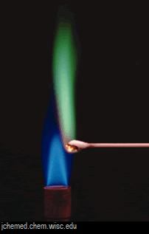
General Comments from Examiners
When conducting a flame test, candidates should focus on the colour of the flame, and record accordingly.
Some candidates wrongly reported that the flame burnt, or relit, or that the solid turned black.

Slide 40
General Comments from Examiners
Ambiguous reporting
You must always report on the colour and state (whether it is a precipitate or a solution) when describing a result).
Incorrect (✗) | Correct (✓)
It turns blue. | A blue ppt. is formed. The xxx solution turns blue.
A solid is formed. | A white ppt. is formed.
The filtrate is clear. | The filtrate is a colourless solution.
The solution is clear. | The white solid dissolves completely to give a colourless solution.

Slide 41
General Comments from Examiners
Incomplete reporting
You must always report completely to let the examiners know how you arrive at a conclusion.
Incorrect (✗) | Correct (✓)
Carbon dioxide gas is evolved. | Effervescence observed. Gas evolved gives a white ppt. with limewater.
The precipitate dissolves. | Light-blue ppt., soluble in excess, giving a dark blue solution.

Slide 42
General Comments from Examiners
Incorrect reporting
The common errors involve the use of the term white / clear to mean colourless.
Incorrect (✗) | Correct (✓)
The solution becomes white. | The white solid dissolves completely to give a colourless solution.

Slide 43
Be calm and do your BEST
!!!

