Slide 1
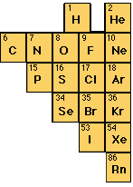
Remember that you can search using “edit”!
GCSE Questions and Answers
Inorganic: Non-metals
^{Includes Industrial Process:} ^{Contact, Ostwald, Haber-Bosch}
6 consecutive GCSE Chemistry papers: 2002-7

Slide 2
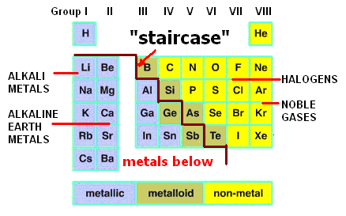
General Introduction.

Slide 3
5 Ammonia is an important industrial chemical in many different manufacturing processes. a) Give two uses of ammonia. 1. ___________________________ 2. ________________________ [2]

Slide 4
NH₃ + HNO₃ → NH₄NO₃
Ammonia + Nitric → Ammonium Nitrate
Acid
------------------------------------
2NH₃ + H₂SO₄ → (NH₄)₂SO₄
Ammonia + Sulphuric → Ammonium Acid Sulphate
-----------------------------------------
3NH₃ + H₃PO₄ → (NH₄)₃PO₄
Ammonia + Phosphoric → Ammonium Acid Nitrate
Consider adding your own illustrations here.

Slide 5
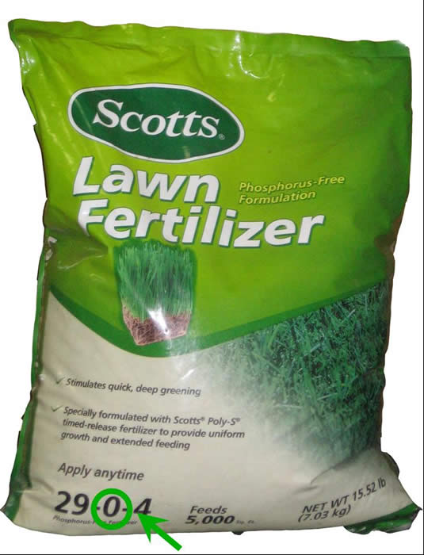
5 Ammonia is an important industrial chemical in many different manufacturing processes. a) Give two uses of ammonia. Fertilizers / Nitric Acid / Explosives/ Dyes [2]

Slide 6
b) Ammonia is prepared industrially from nitrogen and hydrogen gases. The equation for the reaction is: N₂ + 3H₂ = 2NH₃ (i) What is the name of the industrial process used to manufacture ammonia? ______________________________ [1]

Slide 7
b) Ammonia is prepared industrially from nitrogen and hydrogen gases. The equation for the reaction is: N₂ + 3H₂ ⬄ 2NH₃ (i) What is the name of the industrial process used to manufacture ammonia? Haber [1] (Bosch) process

Slide 8
(ii) Give the temperature and pressure which are used in this process. Temperature __________◦C [1] Pressure _____________ atmospheres [1] (iii) What catalyst is used for this process? _______________________________ [1]

Slide 9
(ii) Give the temperature and pressure which are used in this process. Temperature 450◦C (accept 350-500) [1] Pressure 250 atmospheres [1] (accept 200- 1000) (iii) What catalyst is used for this process? Iron [1]

Slide 10
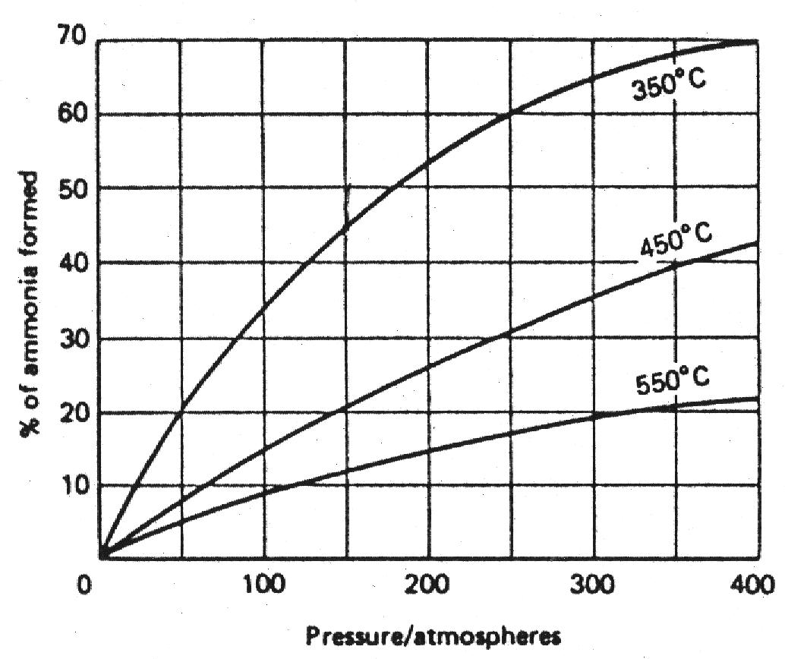
Influence of Temperature and Pressure on the % Yield
N₂(g) + 3 H₂(g) ⬄ 2 NH₃(g) Energy Change = – 76 kJ/mol

Slide 11
c) Give a chemical test for ammonia and the observations you would make if ammonia was present. Test: ______________________ [1] Observations: __________________ __________________________ [2]

Slide 12
c) Give a chemical test for ammonia and the observations you would make if ammonia was present. Test: Hydrogen chloride [1] Observations: white [1] fumes / cloud / smoke [1]

Slide 13
Manufacture of Hydrogen Chloride.
2NaCl + H₂SO₄ → NaHSO₄ + HCl
sodium sulphuric sodium hydrogen
chloride acid hydrogen chloride
chloride

Slide 14
d) Ammonia is an alkaline gas and it reacts readily with dilute sulphuric acid to produce a solution of ammonium sulphate. (i) Describe the test you would carry out to confirm the presence of the sulphate ion. Name of reagent used: ____________ [1] Result of test: ______________________ _______________________________ [2]

Slide 15
Ba²⁺ | Cu²⁺
Cl⁻ Cl⁻ | SO₄²⁻
_{Barium chloride} | _{Copper(II) sulphate}
BaCl₂ | CuSO₄
BaCl₂
White
ppt
Complete Formula Equation:
BaCl_{2(aq)} + CuSO_{4(aq)} BaSO_{4(s)} + CuCl_{2(aq)}
Complete Ionic Equation:
Ba²⁺_{(aq)} +2 Cl⁻_{(aq)} + Cu²⁺_{(aq)} +SO₄²⁻_{(aq)} = BaSO₄(s) + Cu²⁺_{(aq)} +2 Cl⁻_{(aq)}
Establishing the Net Ionic Equation:
Ba²⁺ + 2 Cl⁻ + Cu²⁺ + SO₄²⁻ = BaSO_{4(s)} + Cu²⁺ + 2 Cl⁻
Ba²⁺_{(aq)} + SO₄²⁻_{(aq)} BaSO_{4(s)}
CuSO₄

Slide 16
d) Ammonia is an alkaline gas and it reacts readily with dilute sulphuric acid to produce a solution of ammonium sulphate. (i) Describe the test you would carry out to confirm the presence of the sulphate ion. Name of reagent used: barium chloride [1] Result of test: white [1] ppt [1]

Slide 17
(ii) Ammonia sulphate reacts with sodium hydroxide when heated. Write a balanced equation for the reaction. ___________________________ [2]

Slide 18
(ii) Ammonia sulphate reacts with sodium hydroxide when heated. Write a balanced equation for the reaction. (NH₄)₂ SO₄ + 2NaOH → Na₂ SO₄ + 2NH₃ + 2H₂O [2]

Slide 19
e) Ammonia dissolves readily in water to form aqueous ammonia. Aqueous ammonia is used to test for metal cations in solution. (i) What would you observe if aqueous ammonia was added dropwise to a solution of copper (II) sulphate CuSO_{4(aq)}? __________________________________ _______________________________ [2]

Slide 20
e) Ammonia dissolves readily in water to form aqueous ammonia. Aqueous ammonia is used to test for metal cations in solution. (i) What would you observe if aqueous ammonia was added dropwise to a solution of copper (II) sulphate CuSO_{4(aq)}? Blue [1] ppt [1]

Slide 21
(ii) What further observations would you make if an excess of aqueous ammonia was added? _____________________________ ___________________________ [3]

Slide 22
(ii) What further observations would you make if an excess of aqueous ammonia was added? ppt re-dissolves [1] dark [1] blue [1] solution [1]

Slide 23
4a) Ammonia is used in many household cleaning products. It has a very strong penetrating smell. State two other physical properties of ammonia. __________________________ [2]
2003, Paper 2

Slide 24
4a) Ammonia is used in many household cleaning products. It has a very strong penetrating smell. State two other physical properties of ammonia. Gas / low melting point / low boiling point [1] Higher than air [1] (very) soluble in water [1] colourless [1] Max [2]

Slide 25
b) The diagram shows some of the essential reactions and industrial processes associated with ammonia.

Slide 26
(i) Describe a chemical test for ammonia, giving the result of the test. _____________________________ ___________________________ [3] (ii) Name the compound A. ___________________________ [1]

Slide 27
(i) Describe a chemical test for ammonia, giving the result of the test. Hydrogen chloride / concentrated hydrochloric acid [1] white [1] smoke/fumes/solid [1] (ii) Name the compound A. Ammonium Chloride [1]

Slide 28
(iii) Describe the production of ammonia in the Haber-Bosch process. Your answer should include the name of the catalyst used, the approximate temperature and pressure and a balanced, symbol equation. __________________________________ __________________________________ __________________________________ ______________________________ [7]

Slide 29
(iii) Describe the production of ammonia in the Haber-Bosch process. Your answer should include the name of the catalyst used, the approximate temperature and pressure and a balanced, symbol equation. The key points of this answer are: nitrogen [1] hydrogen [1] catalyst = iron [1], temperature = 450ºC [1], pressure = 200 atm [1], N₂ + 3H₂ ⬄ 2NH₃ [2] reversible arrow not essential Cool to liquify ammonia [1] Unreacted gases recycled [1] Max [7] from [9] but some parts marked essential

Slide 30
c) Garden lawn fertiliser often contains ammonium nitrate in addition to iron(II) sulphate, which is used to kill moss. (i) write a balanced, symbol equation for the reaction of ammonia and nitric acid to produce ammonium nitrate. ___________________________ [2]

Slide 31
c) Garden lawn fertiliser often contains ammonium nitrate in addition to iron(II) sulphate, which is used to kill moss. (i) write a balanced, symbol equation for the reaction of ammonia and nitric acid to produce ammonium nitrate. NH₃ + HNO₃ → NH₄NO₃ [2]

Slide 32
(ii) Describe, giving practical details, how you would prove that lawn fertiliser pellets contain iron(II) sulphate and not iron(III) sulphate. Give the expected result. _____________________________ _____________________________ __________________________ [5]

Slide 33
(ii) Describe, giving practical details, how you would prove that lawn fertiliser pellets contain iron(II) sulphate and not iron(III) sulphate. Give the expected result. Add water [1], add ammonia solution/NaOH solution [1], green [1], ppt [1], red brown (ppt) indicates Fe³⁺ [1]

Slide 34
(iii) State two environmental problems which occur when excess fertiliser is leached out of the soil and into lakes and rivers. _____________________________ __________________________ [2]

Slide 35
(iii) State two environmental problems which occur when excess fertiliser is leached out of the soil and into lakes and rivers. Eutrophication [1] Contamination of water supply [1]

Slide 36
d) Ammonia is used to manufacture nitric acid. This process involves the catalytic oxidation of ammonia and occurs in three stages. Stage 1 _____________________ Stage 2 _____________________ Stage 3 _____________________[6]

Slide 37
d) Ammonia is used to manufacture nitric acid. This process involves the catalytic oxidation of ammonia and occurs in three stages . Stage 1 4NH₃ + 5O₂ → 4NO + 6H₂O Stage 2 2NO + O₂ → 2NO₂ Stage 3 4NO₂ + O₂ + 2H₂O → 4HNO₃

Slide 38
(ii) Name the material used as a catalyst in this process. ___________________________ [1] (iii) Which stage, 1, 2 or 3 involves use of the catalyst? ___________________________ [1]

Slide 39
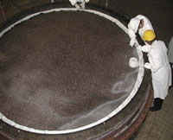
(ii) Name the material used as a catalyst in this process. Platinum / platinum-rhodium [1] (iii) Which stage, 1, 2 or 3 involves use of the catalyst? Stage 1 [1]

Slide 40
4a) Air is a mixture of nitrogen, oxygen, carbon dioxide, water vapour and noble gases. The diagram below shows how an impure sample of nitrogen gas may be prepared from air. The conical flask containing the sodium hydroxide is used to absorb carbon dioxide from the air.
2005, Paper 1

Slide 41
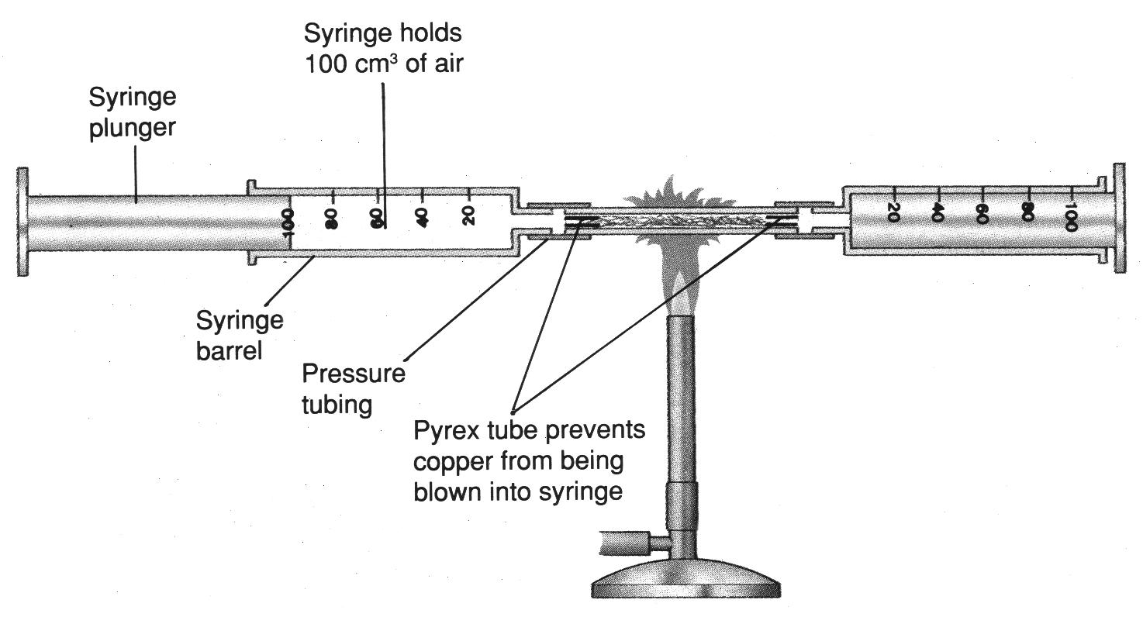
Finding the fraction of Normal Air that is Oxygen

Slide 42
(i) Write a balanced symbol equation for the reaction of carbon dioxide with sodium hydroxide solution. _______________________________ _______________________________ [3]

Slide 43
(i) Write a balanced symbol equation for the reaction of carbon dioxide with sodium hydroxide solution. CO₂ + 2NaOH → Na₂CO₃ + H₂O [3]

Slide 44
(ii) What is the purpose of the heated copper in the diagram. _______________________________ _______________________________ [2] (iii) Name one impurity in the gas collected. _______________________________ [1]

Slide 45
(ii) What is the purpose of the heated copper in the diagram. Remove [1] oxygen [1] [2] (iii) Name one impurity in the gas collected. Argon/neon/helium/krypton/water vapour Any one [1]

Slide 46
b) Nitrogen can be converted into ammonia in the Haber-Bosch Process through a reaction with hydrogen gas. (i) Write a balanced symbol equation for the production of ammonia gas in the Haber- Bosch Process. _______________________________ _______________________________ [3]

Slide 47
b) Nitrogen can be converted into ammonia in the Haber-Bosch Process through a reaction with hydrogen gas. (i) Write a balanced symbol equation for the production of ammonia gas in the Haber- Bosch Process. N₂ + 3H₂ → 2NH₃ [3]

Slide 48
(ii) Complete the table below to give the operating conditions which are used in the Haber-Bosch Process.
Name of Catalyst
Temperature (°C)
Pressure (atm)

Slide 49
(ii) Complete the table below to give the operating conditions which are used in the Haber-Bosch Process.
Name of Catalyst | Iron [1]
Temperature (°C) | 450 [1]
Pressure (atm) | 350 [1]

Slide 50
c) Ammonia may be prepared by heating ammonium chloride with solid calcium hydroxide and collecting the gas as shown in the diagram.

Slide 51
(i) Suggest why ammonia gas is collected in the way shown. _______________________________ [1] (ii) Write a balanced symbol equation for the reaction of ammonium chloride with calcium hydroxide. _______________________________ [3]

Slide 52
(i) Suggest why ammonia gas is collected in the way shown. Less dense than air [1] (ii) Write a balanced symbol equation for the reaction of ammonium chloride with calcium hydroxide. 2NH₄Cl + Ca(OH)₂ → 2NH₃ + CaCl₂ + 2H₂O [3]

Slide 53
(iii) A glass rod, dipped in concentrated hydrochloric acid is held under test tube A. What observations would you make? _______________________________ [2]

Slide 54
(iii) A glass rod, dipped in concentrated hydrochloric acid is held under test tube A. What observations would you make? White [1] fumes / smoke [1] [2]

Slide 55
d) Ammonia solution is used to detect the presence of metal cations in solution. (i) Describe what would be observed when ammonia solution is added slowly until it is in excess to a solution copper(II) sulphate. _______________________________ _______________________________ _______________________________ [4]

Slide 56
4a) Chlorine gas can be prepared in the laboratory using concentrated hydrochloric acid. The reaction can be represented by the equation. 2HCl + [O] → H₂O +Cl₂ (i) State the name and type of substance represented by [O]. Name: ____________________________ Type: __________________________ [2]

Slide 57
4a) Chlorine gas can be prepared in the laboratory using concentrated hydrochloric acid. The reaction can be represented by the equation. 2HCl + [O] → H₂O +Cl₂ (i) State the name and type of substance represented by [O]. Potassium permanganate / manganese dioxide [1] oxidising agent [1]

Slide 58
(ii) Describe the appearance of the chlorine gas produced. _______________________________ [1] b) In industry, chlorine can be produced by the electrolysis of concentrated sodium chloride solution using carbon electrodes. (i) State the electrode at which chlorine is produced. _______________________________ [1]

Slide 59
(ii) Describe the appearance of the chlorine gas produced. Green [1] b) In industry, chlorine can be produced by the electrolysis of concentrated sodium chloride solution using carbon electrodes. (i) State the electrode at which chlorine is produced. Anode [1]

Slide 60
(ii) The electrodes cannot be made from iron, since iron reacts with chlorine. Write a balanced symbol equation for the reaction of iron with chlorine. _______________________________ [1]

Slide 61
(ii) The electrodes cannot be made from iron, since iron reacts with chlorine. Write a balanced symbol equation for the reaction of iron with chlorine. 2Fe + 2Cl₂ → 2FeCl₃ [1] [1] [1] +[1] for balancing

Slide 62
c) Chlorine is a reactive gas. Write balanced symbol equations and give the observations for the following reactions. (i) Chlorine + sodium hydroxide solution. Equation: _______________________ [3] Observations: ____________________ [1]

Slide 63
c) Chlorine is a reactive gas. Write balanced symbol equations and give the observations for the following reactions. (i) Chlorine + sodium hydroxide solution. Equation: Cl₂ + 2NaOH → NaCl + NaOCl + H₂O [1] [1] +[1] for balancing [3] Observations: Heat evolved/temperature increases, smell of bleach [1], yellow/green colour fades [1], colourless solution [1] (Maximum [1])

Slide 64
(ii) Chlorine + sodium bromide solution Equation: _______________________ [3] Observations: ____________________ [2]

Slide 65
(ii) Chlorine + sodium bromide solution Equation: Cl₂ + 2NaBr → Br₂ + 2NaCl [1] [1] + [1] for balancing [3] Observations: Colourless solution [1], changes to red brown [1], yellow/green colour disappears [1] (Maximum [2])

Slide 66
d) Large amounts of liquid chlorine are transported in tankers by road to water treatment works. (i) How is the chlorine gas turned into liquid chlorine? _______________________________ [1] (ii) Why is chlorine transported as a liquid and not as a gas? _______________________________ [1]

Slide 67
d) Large amounts of liquid chlorine are transported in tankers by road to water treatment works. (i) How is the chlorine gas turned into liquid chlorine? Cooled/pressure applied [1] (ii) Why is chlorine transported as a liquid and not as a gas? Ease of transportation/takes up less space [1]

Slide 68
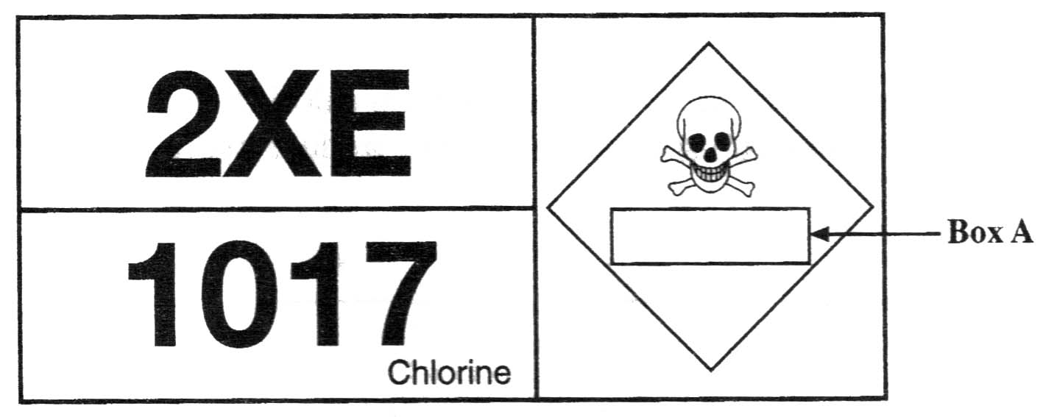
Every tanker transporting chlorine must have a Hazchem warning label as shown below.

Slide 69
(iii) What word is missing from Box A on the Hazchem label to describe the hazard associated with chlorine? _______________________________ [1] (iv) Why are small amounts of chlorine added to water at the water treatment works? _______________________________ [1]

Slide 70
(iii) What word is missing from Box A on the Hazchem label to describe the hazard associated with chlorine? Toxic [1] (iv) Why are small amounts of chlorine added to water at the water treatment works? Kills [1] germs, microbes, bacteria [1] or sterilise [2]

Slide 71
(v) Give another use of chlorine. _______________________________ [1]

Slide 72
(v) Give another use of chlorine. Bleach (for cotton, lined, wood pulp)/PVC manufacture [1]

Slide 73
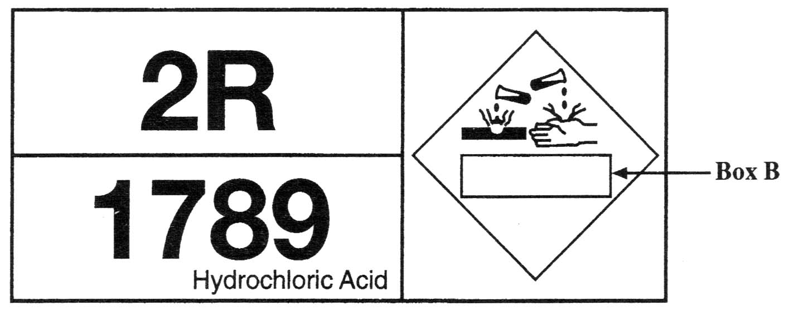
e) Hydrochloric acid can also be transported by road in tankers. The tanker has the Hazchem warning label shown below.

Slide 74
(i) What is the word missing from Box B on this Haschem label to describe the hazard associated with hydrochloric acid? _______________________________ [1] (ii) Hydrocholoric acid can be made by using sodium chloride. What other substance reacts with sodium chloride to produce hydrogen chloride gas? _______________________________ [2]

Slide 75
(i) What is the word missing from Box B on this Haschem label to describe the hazard associated with hydrochloric acid? Corrosive [1] (ii) Hydrocholoric acid can be made by using sodium chloride. What other substance reacts with sodium chloride to produce hydrogen chloride gas? Concentrated [1] sulphuric acid [1] [2]

Slide 76
(iii) Describe the test for hydrogen chloride gas and give the expected result. _______________________________ _______________________________ _______________________________ _______________________________ [4]

Slide 77
(iii) Describe the test for hydrogen chloride gas and give the expected result. Glass rod [1] dipped in concentrated [1] ammonia [1] white [1] fumes/smoke [1] (Maximum [4])

Slide 78
1 In the laboratory, a student carried out experiments using the elements sulphur and magnesium. a) Complete the table below, stating the colour of each element.
2007, Paper 2
Element | Colour
Sulphur
Magnesium

Slide 79
1 In the laboratory, a student carried out experiments using the elements sulphur and magnesium. a) Complete the table below, stating the colour of each element.
Element | Colour
Sulphur | Yellow [1]
Magnesium | Grey [1]

Slide 80
b) The student burned some sulphur and then some magnesium in air. Complete the table below, giving observations which occur during heating and describe the products of each reaction.
Element | Observations during heating | Description of products
Sulphur
Magnesium

Slide 81
b) The student burned some sulphur and then some magnesium in air. Complete the table below, giving observations which occur during heating and describe the products of each reaction.
Element | Observations during heating | Description of products
Sulphur | Brown [1] liquid/melts [1] blue [1] flame [1] gas produced / bubbles [1] smell [1] | Colourless / misty [1] pungent [1] gas [1]
Magnesium | White [1] light / flame [1] | Grey / white [1] solid / powder / ash [1]

Slide 82
c) Write balanced symbol equations for the following reactions: (i) Sulphur burning in air _______________________________ [2] (ii) Magnesium burning in air _______________________________ [3]

Slide 83
c) Write balanced symbol equations for the following reactions: (i) Sulphur burning in air S + O₂ → SO₂ [2] [1] [1] (ii) Magnesium burning in air 2Mg + O₂ → 2MgO [3] [1] [1] +[1] for balancing

Slide 84
d) Many laboratory reactions involve oxidation. (i) Explain why the burning of sulphur in air is an oxidation reaction. _______________________________ _______________________________ [2]

Slide 85
d) Many laboratory reactions involve oxidation. (i) Explain why the burning of sulphur in air is an oxidation reaction. Sulphur gains oxygen [1] gain of oxygen is oxidation [1] [2]

Slide 86
e) Most fossil fuels contain sulphur impurities. When these fossil fuels burn the sulphur is oxidised to sulphur dioxide. (i) Write a balanced symbol equation for the oxidation of sulphur to sulphur dioxide. _______________________________ [2]

Slide 87
e) Most fossil fuels contain sulphur impurities. When these fossil fuels burn the sulphur is oxidised to sulphur dioxide. (i) Write a balanced symbol equation for the oxidation of sulphur to sulphur dioxide. S + O₂ → SO₂ [2]

Slide 88
Sulphur dioxide leads to the formation of acid rain. (ii) What are the three main harmful effects of acid rain? _______________________________ _______________________________ _______________________________ [3]

Slide 89
Sulphur dioxide leads to the formation of acid rain. (ii) What are the three main harmful effects of acid rain? Trees damaged/killed [1], fish killed/harmed, buildings/statues corroded [1] [3]

Slide 90
(iii) Give two measures which can be taken to reduce the formation of acid rain. _______________________________ _______________________________ _______________________________ _______________________________ [2]

Slide 91
(iii) Give two measures which can be taken to reduce the formation of acid rain. Burn less fossil fuels [1], remove sulphur from fuels [1], alternative energy forms [1], remove acidic gases from power station emissions [1], catalytic converters in cars [1] (Max [2]) [2]

Slide 92
6a) The quantity of sulphuric acid produced by a country has been linked to economic stability. (i) Name the industrial process used to produce sulphuric acid. _______________________________ [1]
2007, Paper 2

Slide 93
6a) The quantity of sulphuric acid produced by a country has been linked to economic stability. (i) Name the industrial process used to produce sulphuric acid. Contact [1] process [1]

Slide 94
(ii) Complete the table below to give the operating conditions which are used in the industrial manufacture of sulphuric acid.
Temperature (°C)
Pressure (atm)
Catalyst

Slide 95
(ii) Complete the table below to give the operating conditions which are used in the industrial manufacture of sulphuric acid.
Temperature (°C) | Accept values in range 400 – 500 [1]
Pressure (atm) | Accept values in range 1 – 10 [1]
Catalyst | Vanadium(V) oxide/vanadium pentoxide/V₂O₅

Slide 96
(iii) The sulphuric acid obtained in this process is concentrated. Describe in detail how a sample of concentrated acid should be safely diluted using water. _______________________________ _______________________________ _______________________________ [3]

Slide 97
(iii) The sulphuric acid obtained in this process is concentrated. Describe in detail how a sample of concentrated acid should be safely diluted using water. Safety glasses / gloves [1] add acid to water [1] (essential) dropwise/slowly [1] with stirring [1]. Maximum [3]

Slide 98
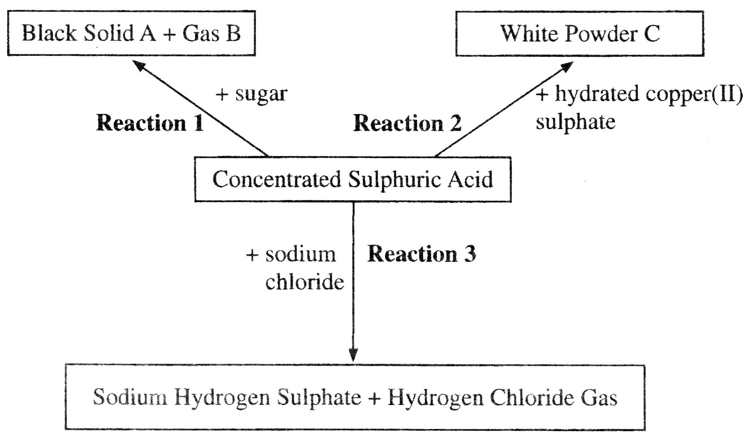
b) Some of the reactions of concentrated sulphuric acid are summarised in the diagram below.

Slide 99
(i) Identify Solid A and Gas B. Solid A _________________________ [1] Gas B __________________________ [1] (ii) What would you observe during Reaction 1? _______________________________ _______________________________ [3]

Slide 100
(i) Identify Solid Carbon / Charcoal [1] Gas B Steam / Water [1] (ii) What would you observe during Reaction 1? Solid rises up/swells [1] heat/warms up [1] pungent/caramel smell [1] reaction not immediate. Maximum [3] A and Gas B. Solid A

Slide 101
(iii) Name the white powder C. _______________________________ [1] (iv) What property of concentrated sulphuric acid is demonstrated in Reactions 1 and 2? _______________________________ [1]

Slide 102
(iii) Name the white powder C. anhydrous [1] copper(II) sulphate [1] (iv) What property of concentrated sulphuric acid is demonstrated in Reactions 1 and 2? Dehydrating [1]

Slide 103
(v) Write a balanced symbol equation for Reaction 3. _______________________________ [2]

Slide 104
(v) Write a balanced symbol equation for Reaction 3. H₂SO₄ + NaCl → NaHSO₄ + HCl [2]

Slide 105
(vi) Describe how you would carry out a chemical test for the presence of hydrogen chloride gas, stating the observations you would make for a positive test. Test: _____________________________ _________________________________ Observations: ______________________ _______________________________ [4]

Slide 106
(vi) Describe how you would carry out a chemical test for the presence of hydrogen chloride gas, stating the observations you would make for a positive test. Test: glass rod [1] dipped in concentrated [1] ammonia [1] Observations: White [1] smoke [1] (Maximum [4])

Slide 107
7 Sulphuric acid is used in the production of many chemicals. It is used to make ammonium sulphate, an important fertiliser. a) Write a balanced symbol equation for the reaction of sulphuric acid with ammonia to produce ammonium sulphate. _______________________________ [3]
2007, Paper 2

Slide 108
7 Sulphuric acid is used in the production of many chemicals. It is used to make ammonium sulphate, an important fertiliser. a) Write a balanced symbol equation for the reaction of sulphuric acid with ammonia to produce ammonium sulphate. 2NH₃ + H₂SO₄ → (NH₄)₂SO₄ [3] [1] [1] +[1] for balancing. Accept equation using NH₄OH

Slide 109
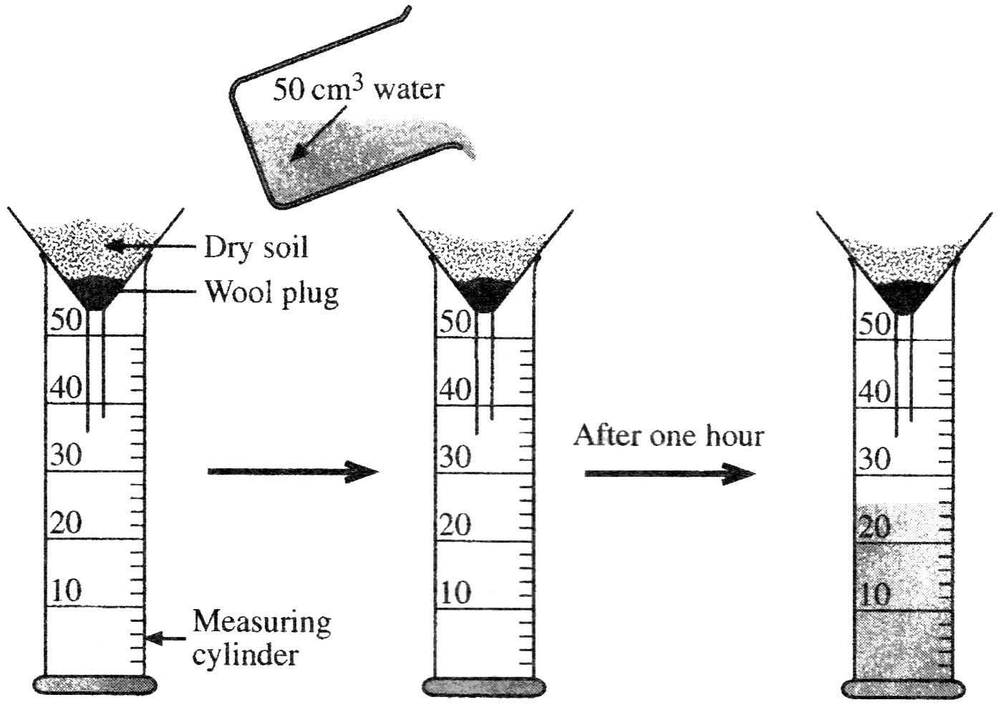
b) The method shown below is used to find out if ammonium sulphate would be washed out of soil by rain.

Slide 110
(i) Describe how you would find the pH of the water that has run through the soil. _______________________________ _______________________________ [2]

Slide 111
(i) Describe how you would find the pH of the water that has run through the soil. Use pH paper/universal indicator paper/universal indicator solution [1] compare to colour chart [1]. Accept use a pH meter for a full [2]

Slide 112
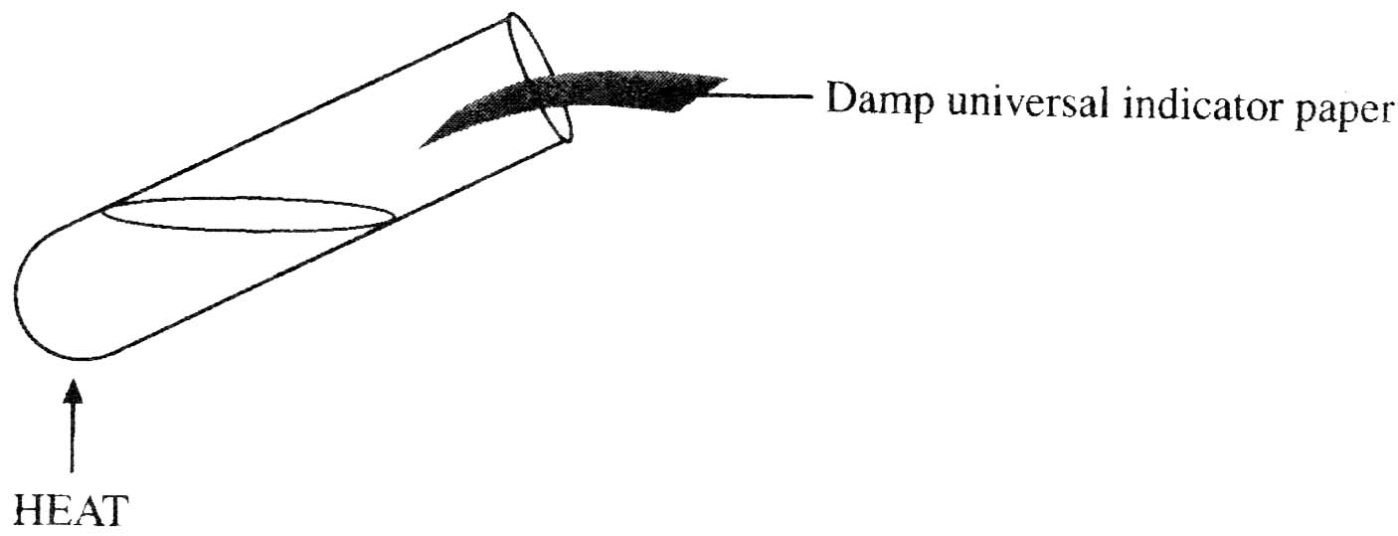
(ii) A sample of this water was heated with some sodium hydroxide solution in a boiling tube and the gas evolved was tested with damp universal indicator paper as shown below. What happens to the damp universal indicator paper if ammonium sulphate is present in the water? ___________________________________ [1]

Slide 113
(ii) A sample of this water was heated with some sodium hydroxide solution in a boiling tube and the gas evolved was tested with damp universal indicator paper as shown below. What happens to the damp universal indicator paper if ammonium sulphate is present in the water? Changes to blue [1]

Slide 114
(iii) Explain your answer to part (b)(ii) above. _______________________________ _______________________________ [2] (iv) Describe how you would test the water to shown that sulphate ions are present. State the observations you would make for a positive test. Test: _____________________________ Result: ____________________________ _______________________________ [3]

Slide 115
(iii) Explain your answer to part (b)(ii) above. Forms ammonia [1] gas which is alkaline [1] [2] (iv) Describe how you would test the water to shown that sulphate ions are present. State the observations you would make for a positive test. Test: Barium chloride solutions [1] Result: White [1] ppt [1] [3]

Slide 116
Thanks for viewing.
Do consider using others in this Series of Ten.

