Slide 1
REFRACTION OF LIGHT

Slide 2
Specification
Describe experiments to investigate the refraction of light, using rectangular blocks, semicircular blocks and triangular prisms
know and use the relationship: n = sin i / sin r
describe an experiment to determine the refractive index of glass, using a glass block
describe the role of total internal reflection in transmitting information along optical fibres and in prisms
explain the meaning of critical angle c
know and use the relationship: n = 1 / sin c

Slide 3
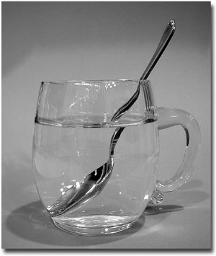
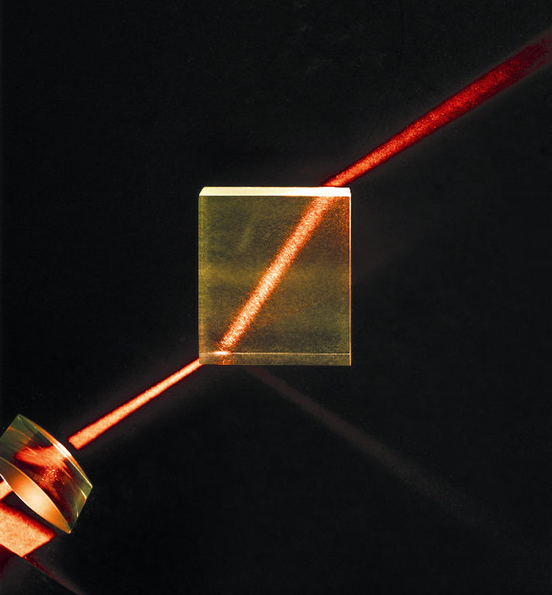
Light Refraction

Slide 4
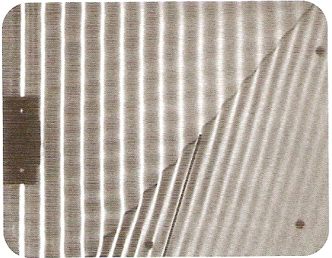
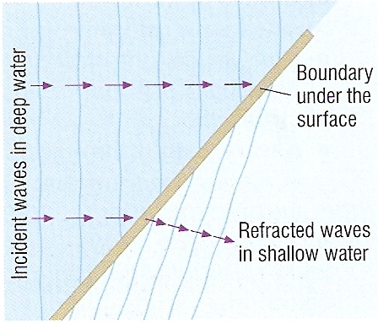
Refraction occurs when a wave changes speed as it passes from one region to another.
This speed change usually causes the wave to change direction.
Water waves slow down as they pass over from a deeper to a shallower region.
Light slows down as it passes from air into glass, perspex or water.

Slide 5
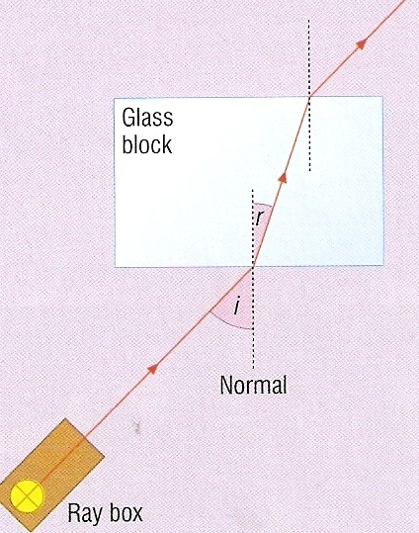
Refraction experiment
Typical results:
angle of incidence / ° | angle of refraction / ° | deviation / °
0 | 0 | 0
15 | 10 | 5
30 | 19 | 11
45 | 28 | 17
60 | 35 | 25
75 | 40 | 35
No deviation occurs when the angle of incidence is zero.
Increasing the angle of incidence increases the deviation.

Slide 6
Refraction of light at a plane surface
(a) Less to more optical dense transition (e.g. air to glass)
AIR GLASS
normal
angle of refraction
angle of incidence
Light bends TOWARDS the normal.
The angle of refraction is LESS than the angle of incidence.

Slide 7
(b) More to less optical dense transition (e.g. water to air)
angle of refraction
normal
angle of incidence
WATER AIR
Light bends AWAY FROM the normal.
The angle of refraction is GREATER than the angle of incidence.

Slide 8
Why a pool appears shallow
normals
observer
AIR
WATER
image
object at the bottom of a pool

Slide 9
Complete the paths of the RED light rays:
A
B
D
C
E
F

Slide 10
The refraction equation
When a light ray passes from one medium to another:
n = sin i
sin r
where:
i is the angle of incidence in the first medium
r is the angle of refraction in the second medium
n is a constant number called the refractive index.
i
r

Slide 11
An experiment to find the refractive index (n) of glass
Set up the equipment as shown in the diagram opposite
For an initial angle of incidence, i of 30º trace the path of the light ray.
Measure the angle refraction, r.
Calculate the refractive index using the formula: n = sin (i) / sin (r).
Repeat for a range of angles between 10º and 80º.
Calculate the average value of n.

Slide 12
Question 1
Calculate the refractive index when light passes from air to glass if the angle of incidence is 30° and the angle of refraction 19º.
n = sin i / sin r
= sin (30º) / sin (19º)
= 0.500 / 0.326
refractive index , n = 1.53

Slide 13
Question 2
Calculate the angle of refraction when light passes from air to perspex if the angle of incidence is 50° and the refractive index, n = 1.50.

Slide 14
Question 2
Calculate the angle of refraction when light passes from air to perspex if the angle of incidence is 50° and the refractive index, n = 1.50.
n = sin i / sin r
1.50 = sin (50º) / sin (r )
becomes: sin (r ) = sin (50º) / 1.50
= 0.766 / 1.50
sin (r ) = 0.511
angle of refraction = 30.7º

Slide 15
Question 3
Calculate the angle of incidence when light passes from air to water if the angle of refraction is 20° and the refractive index, n = 1.33.

Slide 16
Question 3
Calculate the angle of incidence when light passes from air to water if the angle of refraction is 20° and the refractive index, n = 1.33.
n = sin i / sin r
1.33 = sin (i) / sin 20º
becomes: sin (i) = 1.33 x sin (20º)
= 1.33 x 0.342
sin (i) = 0.455
angle of incidence = 27.1º

Slide 17
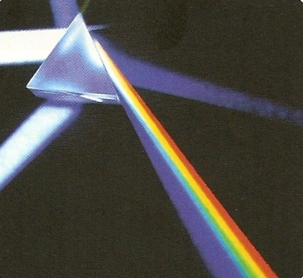
Dispersion
Dispersion occurs when a prism splits the colours of white light into the spectrum.
This occurs because the refractive index of the glass or perspex of the prism varies with the colours of the spectrum that make up white light.
Violet has the greatest refractive index and therefore deviates the most.
Red has the lowest and deviates the least.
white
light
prism
spectrum

Slide 18
Total internal reflection
critical angle
Total internal reflection occurs when:
Light is incident on a boundary between optically more to less dense substance (for example glass to air).
2. The angle of incidence is greater than the critical angle, c for the interface.
GLASS
AIR
NORMAL
Angle of incidence greater than the critical angle:
NO Refraction and
TOTAL INTERNAL REFLECTION
Angle of incidence equal to the critical angle:
Refraction at 90º and
PARTIAL reflection
Angle of incidence less than the critical angle:
Refraction and
PARTIAL reflection

Slide 19
Critical angle equation
critical angle
The critical angle is the angle of incidence in the denser medium that results in an angle of refraction of 90º
n = 1
sin c
where:
n is the refractive index of the denser medium (glass in the example opposite).
c is the critical angle.
GLASS
AIR
NORMAL
angle of refraction = 90º

Slide 20
Question 1
Calculate the critical angle of glass to air if the refractive index of glass is 1.5

Slide 21
Question 1
Calculate the critical angle of glass to air if the refractive index of glass is 1.5
n = 1 / sin c
= 1.0 / 1.5
= 0.67
critical angle for glass, c = 42°

Slide 22
Question 2
Calculate the critical angle of water to air if the refractive index of glass is 1.3

Slide 23
Question 2
Calculate the critical angle of water to air if the refractive index of glass is 1.3
n = 1 / sin c
= 1.0 / 1.3
= 0.75
critical angle for water, c = 49°

Slide 24
Question 3
Calculate the maximum refractive index of a medium if light is to escape from it into water (refractive index = 1.3) at all angles below 30°.

Slide 25
Question 3
Calculate the maximum refractive index of a medium if light is to escape from it into water (refractive index = 1.3) at all angles below 30°.
n = 1 / sin c
becomes:
sin c = 1 / n
sin 30° = 1.3 / n
0.5 = 1.3 / n
= 1.3 / 0.5
maximum refractive index, n = 2.6

Slide 26
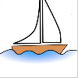

Uses of total internal reflection
1. Prismatic periscope
Glass and perspex both have critical angles of about 42º.
In each prism the light strikes the glass-air interface at an incidence angle of 45º
Total internal reflection therefore occurs and the light ray is deviated by 90º in each prism.

Slide 27
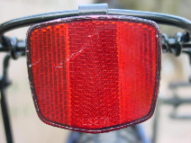
2. Reflectors
The reflector is made up of many small perspex prisms arranged so that light undergoes total internal reflection twice.
The overall result is that the light is returned in the direction from which it originally came.
The reflector will be seen to be lit up from the point of view of the light source for example the driver of a car with its headlights on.
A bicycle rear reflector contains many tiny red perspex prisms

Slide 28
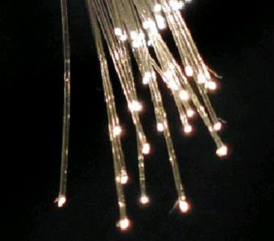
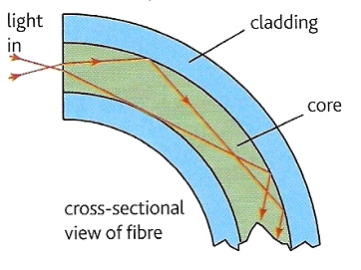
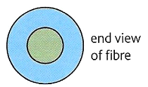
3. Optical fibres
Optical fibre consists of two concentric layers of different types of glass, core and cladding.
Light entering the inner core always strikes the boundary of the two glasses at an angle that is greater than the critical angle.
core
cladding

Slide 29
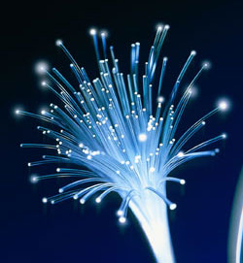
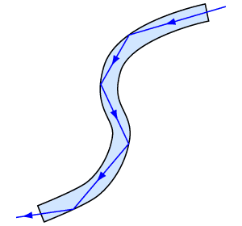
Optical fibre communication
Optical fibres can be used to transmit information using visible light or infra-red radiation. The light cannot escape from the fibre, it is continually reflected internally by the fibre.
Compared with microwaves and radio waves optical fibres:
  can carry far more information due to the higher frequency of light and infra-red.
  are more secure because the signals stay within the fibres.
The fastest broadband uses optical fibres.

Slide 30
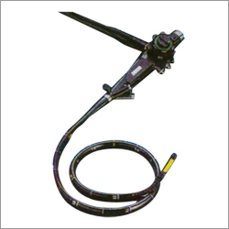
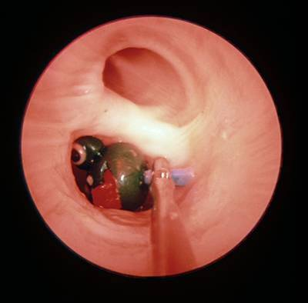
The Endoscope
The medical endoscope contains two bundles of fibres. One set of fibres transmits light into a body cavity and the other is used to return an image for observation.

