Slide 1
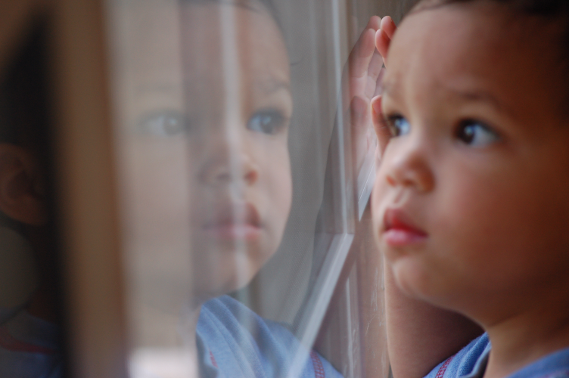
Refraction
Sometimes when you look out a window, you see what is outside as well as your own reflection
This is because some light reflects and some light refracts at a surface between two media that have different indices of refraction
This phenomenon is called partial reflection and refraction

Slide 2
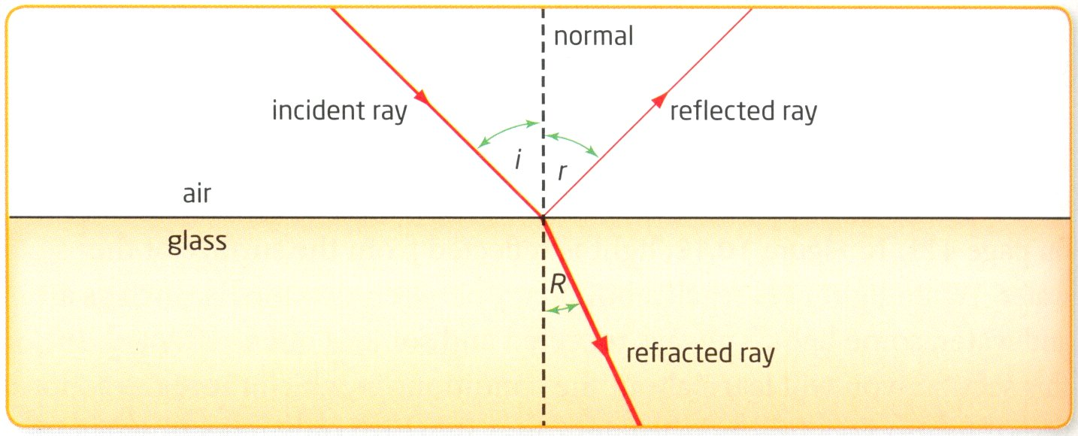
Partial Reflection and Refraction
Both reflection and refraction occur, but not equally
The amount of each depends on the angle
In this case, more light is refracted than reflected, as shown by the thickness of the rays

Slide 3
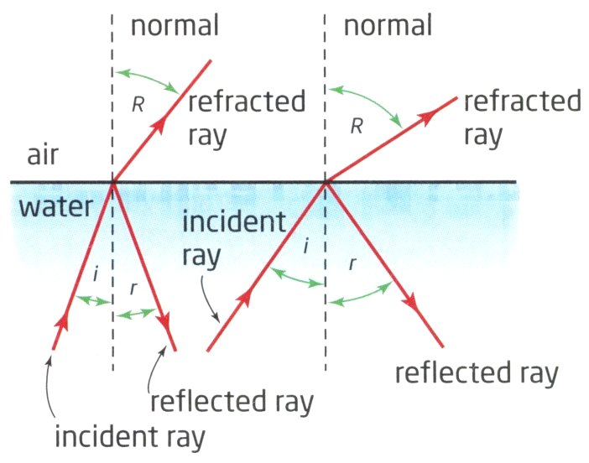
Refraction from Water to Air:
The Critical Angle
If you are standing in a clear lake, it is easy to see stones on the bottom that are near you, but impossible to see ones that are farther away
For you to see an object underwater, light must hit the object, reflect off it, and travel to your eyes
Because the incident rays are going from water to air, the refracted rays bend away from the normal
As the angle of incidence
increases, the angle of refraction
increases more rapidly

Slide 4
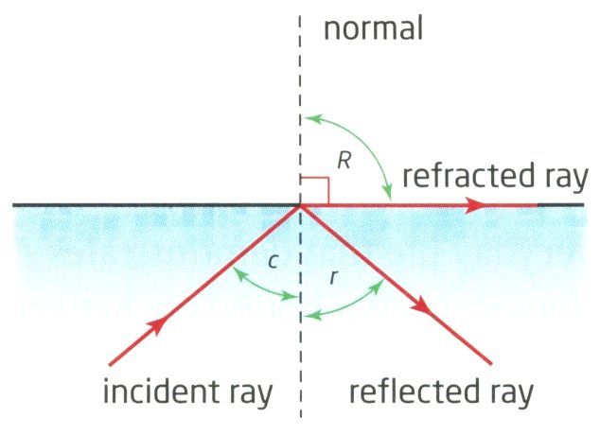
Refraction from Water to Air:
The Critical Angle
As the angle of incidence continues to increase, the angle of refraction will eventually reach 90°
At this angle of incidence, the refracted ray lies along the boundary between the two media
No light passes into the second medium (air in this case)
The angle of incidence that produces a refracted ray at an angle of 90° from the normal is called the critical angle, ∠c

Slide 5
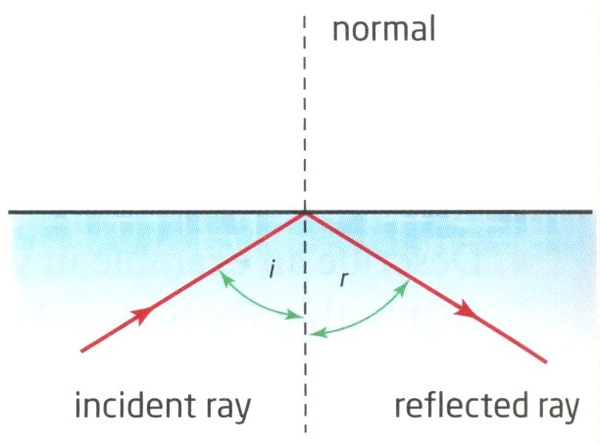
Refraction from Water to Air:
Total Internal Reflection
When the angle of incidence is larger than the critical angle, the angle of refraction cannot get any larger because the refracted ray would no longer be in the second medium
So, at angles of incidence greater than the critical angle, no refraction occurs – all the light is reflected back into the first medium
This phenomenon is called total internal reflection.

Slide 6
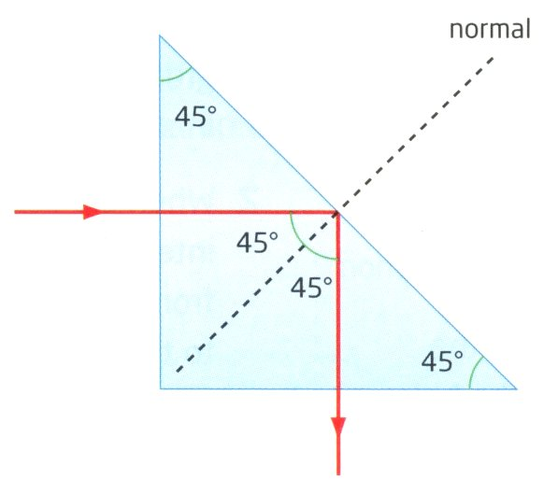
Prisms and Total Internal Reflection
A glass prism can change the direction of light by creating the conditions for total internal reflection
The critical angle between glass and air is less than 45°, so letting light hit an inner surface at exactly 45° will be totally reflected inside the glass
When light enters ⊥ to the short side of the prism, the angle of incidence is zero
  ∴ no refraction at surface
At the long side of the prism, the angle of incidence is 45°, so the angle of reflection is 45°
Total change in direction of the light is 90°

Slide 7
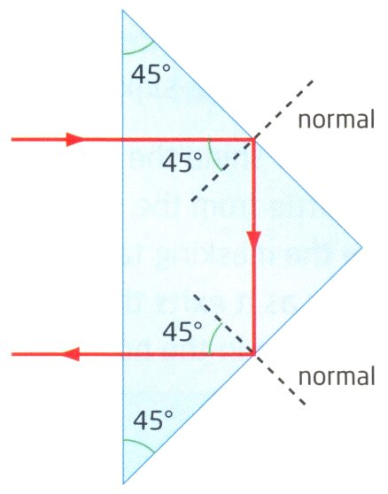
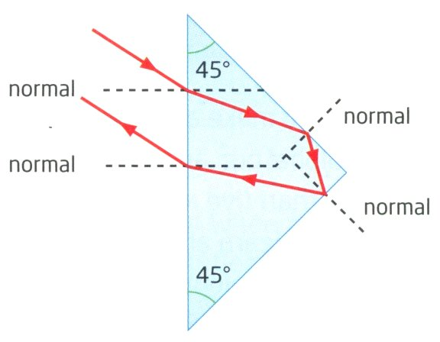
Prisms and Total Internal Reflection
When light enters the long side of the prism at any angle, the reflected light is reflected by 180°, or directly back in the direction that it came from
When the angle of incidence into the prism is not 0°, the light will be refracted
After the light has reflected off both inner short sides and then leaves the prism, it will refract at the same angle

Slide 8
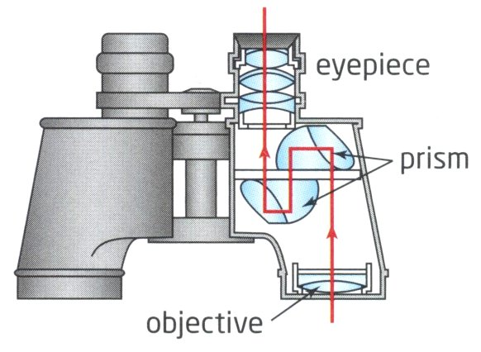
Applications of Total Internal Reflection
Binoculars
  The direction of light is reflected twice in binoculars by prisms to make the path of the light longer
  Need to extend the path due to the distance to the focal point of the lenses used (more on that later in this unit!)

Slide 9
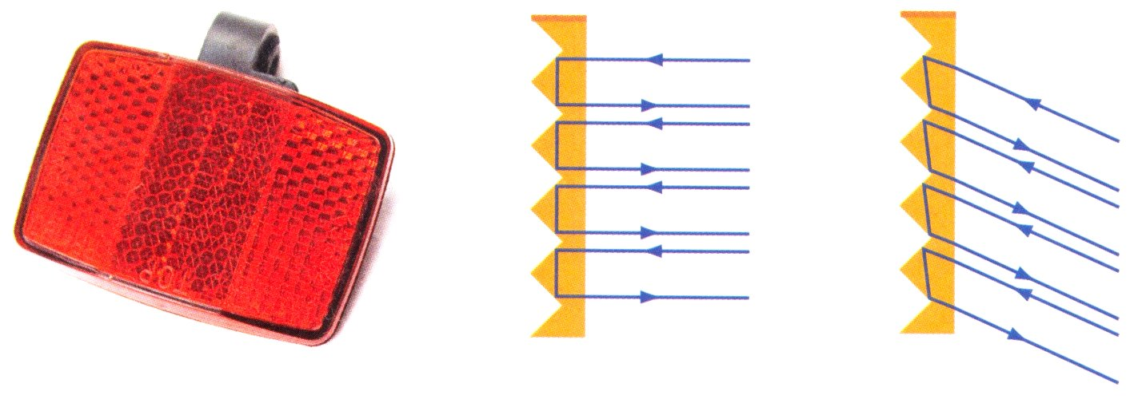
Applications of Total Internal Reflection
Retroreflectors
  Look like small plastic prisms
    e.g., bicycle reflectors
  Changes direction of incoming light by 180°
  Regardless of the direction that light from headlights hits the reflectors, the light is always reflected directly back to the car

Slide 10
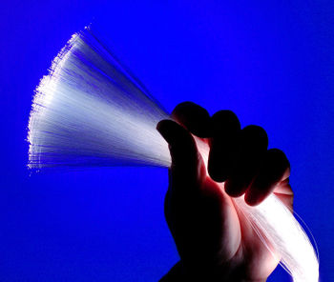
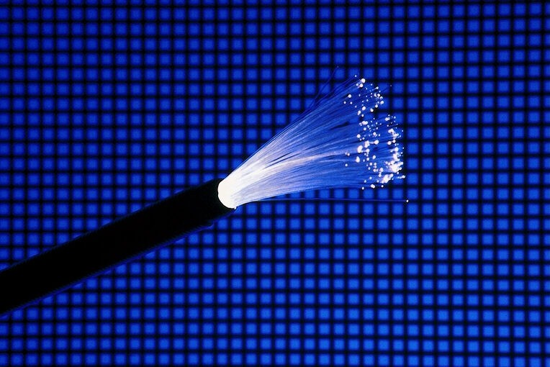
Applications of Total Internal Reflection
Fibre Optics
  Fibre optics have revolutionized all forms of communication, including the internet
  Allows information to be sent as pulses of light instead of pulses of electricity
  Optical fibres are made of a glass core which is surrounded by an optical cladding
  The cladding is a covering made of a different kind of glass than the fibre inside

Slide 11
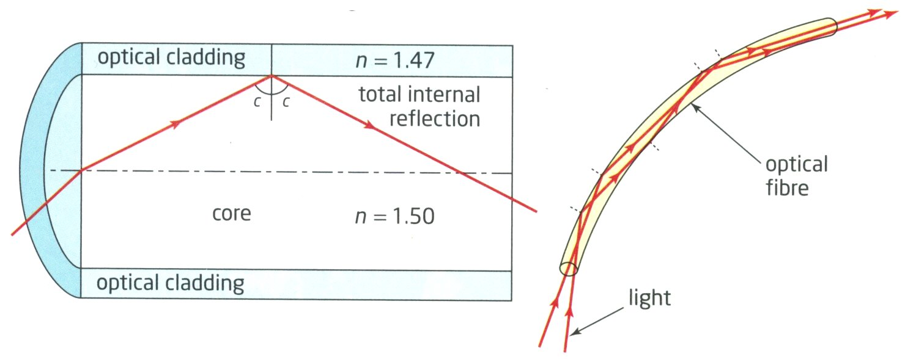
Fibre Optics
When light enters the end of the fibre in a direction that is almost parallel to the fibre, it hits the boundary between the core and the cladding at an angle that is larger than the critical angle
Even when the fibre is bent, the light is totally internally reflected along the entire fibre until it reaches the other end

Slide 12
Applications of Fibre Optics
Telecommunications:
  Many copper cables that used to carry information have been replaced by fibre optics
  Benefits include:
    Signals are not affected by electrical storms
    Can carry many more signals over longer distances
    Are smaller and lighter than copper cables
Medicine:
  An endoscope uses optical fibre bundles to assist a surgeon with minimally invasive surgery (a.k.a., “keyhole surgery” with small incisions)
  One bundle of fibres carries light into the surgery area, and another carries a video signal back to a monitor
  Allows faster recovery times and easier diagnostics

