Slide 1
MOMENTUM

Slide 2
Specification
Forces and motion
Forces, movement, shape and momentum
know and use the relationship:
momentum = mass × velocity p = m × v
use the ideas of momentum to explain safety features
use the conservation of momentum to calculate the mass, velocity or momentum of objects
use the relationship:
force = change in momentum / time taken
demonstrate an understanding of Newton’s third law

Slide 3
Momentum (p)
momentum = mass x velocity
p = m x v
mass is measured in kilograms (kg)
velocity is measured in metres per second (m/s)
momentum is measured in:
kilogram metres per second (kg m/s)
Notes:
3

Slide 4
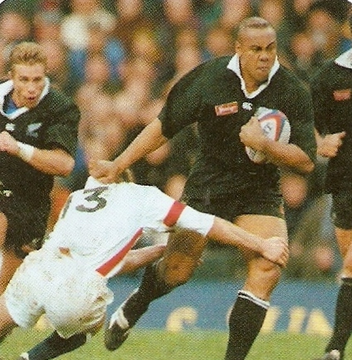
Momentum has both magnitude and direction.
Its direction is the same as the velocity.
The greater the mass of a rugby player the greater is his momentum
Notes:
4

Slide 5
Question 1
Calculate the momentum of a rugby player, mass 120kg moving at 3m/s.
p = m x v
= 120kg x 3m/s
momentum = 360 kg m/s
Notes:
5

Slide 6
Question 2
Calculate the mass of a car that when moving at 25m/s has a momentum of 20 000 kg m/s.
Notes:
6

Slide 7
Question 2
Calculate the mass of a car that when moving at 25m/s has a momentum of 20 000 kg m/s.
p = m x v
becomes: m = p ÷ v
= 20000 kg m/s ÷ 25 m/s
mass = 800 kg
Notes:
7

Slide 8
Complete
Complete
momentum | mass | velocity
kg m/s | 50 kg | 3 m/s
160 kg m/s | kg | 20 m/s
1500 kg m/s | 250 kg | m/s
kg m/s | 500 g | 8 m/s
3 kg m/s | kgkg | 50 cm/s
Notes:
8

Slide 9
Complete
Answers
momentum | mass | velocity
kg m/s | 50 kg | 3 m/s
160 kg m/s | kg | 20 m/s
1500 kg m/s | 250 kg | m/s
kg m/s | 500 g | 8 m/s
3 kg m/s | kgkg | 50 cm/s
150
8
6
4
6
Notes:
9

Slide 10
Force and momentum
A force will cause the velocity of an object to change and therefore also its momentum.
The greater the force the faster the momentum changes.
Notes:
10

Slide 11
Momentum, acceleration and force
Consider a body of mass m changing velocity from u to v in time t.
acceleration = velocity change ÷ time taken
a = (v – u) / t
Multiply both sides of this equation by the mass, m gives:
ma = m (v – u) / t
ma = (mv – mu) / t
ma is equal to the force, F causing the acceleration.
and (mv – mu) is equal to the momentum change
And so:
F = (mv – mu)
t
Notes:
11

Slide 12
momentum change
force =
time taken for the change
force is measured in newtons (N)
change in momentum is measured in:
kilogram metres per second (kg m/s)
time is measured in seconds (s)
Notes:
12

Slide 13
Question 1
Calculate the force required to change the momentum of a car by 24000 kgm/s over a 6 second period.
force = momentum change ÷ time taken
= 24000 kgm/s ÷ 6 s
force = 4000N
Notes:
13

Slide 14
Question 2
Calculate the time taken for a force of 6000N to cause the momentum of truck to change by 42000 kgm/s.
Notes:
14

Slide 15
Question 2
Calculate the time taken for a force of 6000N to cause the momentum of truck to change by 42000 kgm/s.
force = momentum change ÷ time taken
becomes:
time taken = momentum change ÷ force
= 42000 kgm/s ÷ 6000 N
force = 7 seconds
Notes:
15

Slide 16
Momentum conservation
Momentum is conserved in any collision or explosion provided no external forces act on the colliding or exploding bodies.
The initial momentum of the yellow car has been conserved and transferred to the red car
Notes:
16

Slide 17
Question 1
A truck of mass 0.5kg moving at 1.2m/s collides and remains attached to another, initially stationary truck of mass 1.5kg. Calculate the common velocity of the trucks after the collision.
Notes:
17

Slide 18
total momentum before collision
p = m x v
0.5 kg truck: = 0.5 kg x 1.2 m/s = 0.6 kg m/s
1.5 kg truck: = 1.5 kg x 0 m/s = 0 kg m/s
total initial momentum = 0.6 kg m/s
Momentum is conserved in the collision
so total momentum after collision = 0.6 kg m/s
total momentum = total mass x velocity
0.6 kg m/s = 2.0 kg x v
0.6 ÷ 2.0 = v
common velocity = 0.3 m/s
Notes:
18

Slide 19
Question 2
A train wagon of mass 800 kg moving at 4 m/s collides and remains attached to another wagon of mass 1200 kg that is moving in the same direction at 2 m/s. Calculate the common velocity of the wagons after the collision.
Notes:
19

Slide 20
total momentum before collision
p = m x v
800 kg wagon: = 800 kg x 4 m/s = 3200 kg m/s
1200 kg truck: = 1200 kg x 2 m/s = 2400 kg m/s
total initial momentum = 5600 kg m/s
Momentum is conserved in the collision
so total momentum after collision = 5600 kg m/s
total momentum = total mass x velocity
5600 kg m/s = 2000 kg x v
5600 ÷ 2000 = v
common velocity = 2.8 m/s
Notes:
20

Slide 21
Head-on collisions
In this case bodies are moving in opposite directions.
Momentum has direction.
One direction is treated as positive, the other as negative.
In calculations the velocity of one of the colliding bodies must be entered as a NEGATIVE number.
DIRECTION OF MOTION
NEGATIVE
POSITIVE
+ ve velocity
- ve velocity
Notes:
21

Slide 22
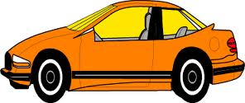
Question 1
A car of mass 1000 kg moving at 20 m/s makes a head-on collision with a lorry of mass 2000 kg moving at 16 m/s. Calculate their common velocity after the collision if they remain attached to each other.
lorry, mass 2000kg
car, mass 1000kg
20 m/s
16 m/s
DIRECTION OF MOTION
NEGATIVE
POSITIVE
Notes:
22

Slide 23
total momentum before collision
p = m x v
car: = 1000 kg x +20 m/s = +20000 kg m/s
lorry: = 2000 kg x -16 m/s = -32000 kg m/s
total initial momentum = -12000 kg m/s
Momentum is conserved in the collision
so total momentum after collision = -12000 kg m/s
total momentum = total mass x velocity
-12000 kg m/s = 3000 kg x v
-12000 ÷ 3000 = v
common velocity = - 4 m/s
The lorry/car combination will move in the original direction of the lorry.
Notes:
23

Slide 24
Question 2
A car of mass 1000 kg moving at 30 m/s makes a head-on collision with a lorry of mass 2000 kg moving at 15 m/s. Calculate their common velocity after the collision if they remain attached to each other.
lorry, mass 2000kg
car, mass 1000kg
30 m/s
15 m/s
DIRECTION OF MOTION
NEGATIVE
POSITIVE
Notes:
24

Slide 25
total momentum before collision
p = m x v
car: = 1000 kg x +30 m/s = +30000 kg m/s
lorry: = 2000 kg x -15 m/s = -30000 kg m/s
total initial momentum = 0 kg m/s
Momentum is conserved in the collision
so total momentum after collision = 0 kg m/s
The lorry/car combination will not move after the collision.
Notes:
25

Slide 26
Explosions
Before an explosion the total momentum is zero.
As momentum is conserved, the total momentum afterwards must also be zero.
This means that the different parts of the exploding body must move off in different directions.
Notes:
26

Slide 27
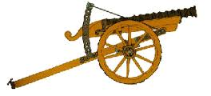
Question 1
An artillery gun of mass 1500kg fires a shell of mass 20kg at a velocity of 150m/s. Calculate the recoil velocity of the gun.
artillery gun, mass 1500kg
150 m/s
shell, mass 20kg
recoil
DIRECTION OF MOTION
NEGATIVE
POSITIVE
Notes:
27

Slide 28
The total momentum before and after the explosion
is ZERO
p = m x v
shell: = 20 kg x +150 m/s = +3000 kg m/s
This must cancel the momentum of the gun.
Therefore the gun’s momentum must be -3000 kg m/s
gun: = 1500 kg x recoil velocity = -3000 kg m/s
recoil velocity = - 3000 ÷ 1500
= - 2m/s
The gun will recoil (move to the left)
with a velocity of 2 m/s.
Notes:
28

Slide 29
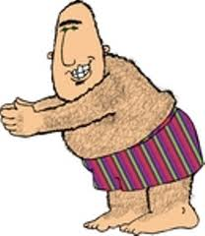
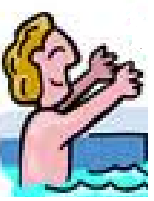
Question 2
A girl of mass 60kg throws a boy, mass 90kg out off a swimming pool at a velocity of 2m/s. What is the girl’s recoil velocity?
boy, mass 90kg
boy, mass 90kg
girl, mass 60kg
girl, mass 60kg
2 m/s
2 m/s
recoil
recoil
DIRECTION OF MOTION
NEGATIVE
POSITIVE
Notes:
29

Slide 30
The total momentum before and after throwing the boy is ZERO
p = m x v
boy: = 90 kg x +2 m/s = +180 kg m/s
This must cancel the momentum of the girl.
Therefore the girl’s momentum must be -180 kg m/s
gun: = 60 kg x recoil velocity = -180 kg m/s
recoil velocity = - 180 ÷ 60
= - 3m/s
The girl will recoil (move to the left)
with a velocity of 3 m/s.
Notes:
30

Slide 31
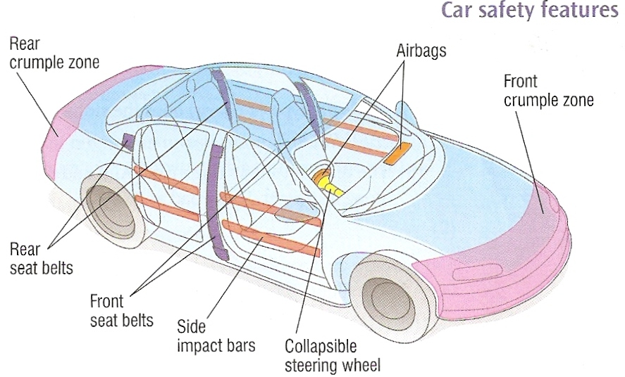
Car safety features
Notes:
31

Slide 32
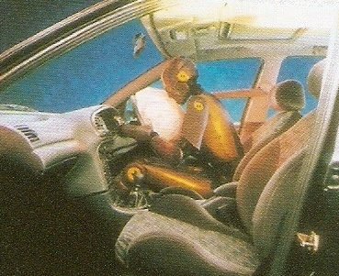
Crumple zones, air bags and a collapsible steering wheel are designed to increase the time taken for a driver or passenger to change momentum to zero during a crash.
The equation: force = momentum change ÷ time taken
shows that if the time taken is increased for the same momentum change the force exerted is decreased so is the injury to the driver or passenger.
Notes:
32

Slide 33
Playground flooring question
The picture shows rubber tiles used for playground flooring. Explain how these can reduce injury to children.
ANSWER:
When a child falls to the floor its momentum changes from a high value to zero.
The rubber flooring tiles increase the time taken for this change.
force = change in momentum ÷ time taken for the change
Therefore the force on the child is reduced and so is the potential injury.
Notes:
33

Slide 34
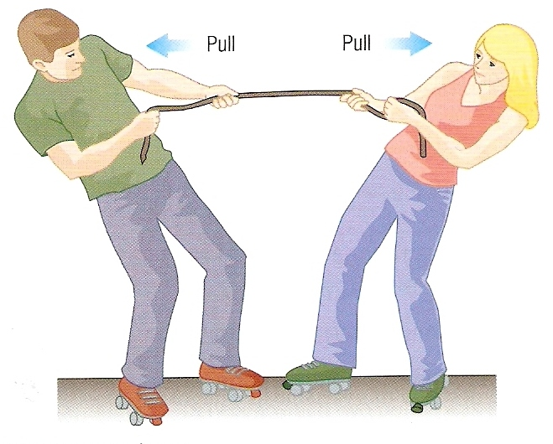
Newton’s 3rd law of motion
Newton’s 3rd law of motion states that forces always occur in pairs. Each force has the same size but acts in opposite directions.
The law is often expressed as: “To every action there is an equal and opposite reaction”
Example1: The boy and girl are exerting equal and opposite forces on each other
Notes:
34

Slide 35
Example 2: Rocket in flight
There are a pair of forces:
A = THRUST of the ROCKET ENGINES
DOWNWARDS
on the EJECTED GASES
B = CONTACT push of the EJECTED GASES
UPWARDS
on the ROCKET ENGINES
A
B
Notes:
35

Slide 36
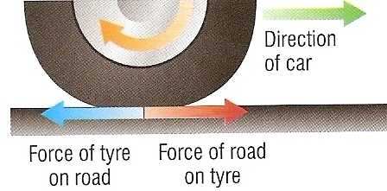
Example 3: Tyre-road friction
A car is able to move forwards due to friction acting between its tyres and the road.
The force of friction of the road on the tyre acts in the forward direction and is equal but in the opposite direction to the force of friction of the tyre on the road.
Notes:
36

Slide 37
Choose appropriate words to fill in the gaps below:
A _____ is a push or a pull. A force can cause an object to ___________ or change shape.
Force is measured in _______ (N) with a newtonmeter.
There are many types of force. ________ force occurs when two bodies touch each other.
Forces always occur in ______. If a force is exerted on an ________ there will always be another force, ______ in size, acting in the opposite ________.
WORD SELECTION:
newtons
accelerate
equal
force
direction
contact
pairs
object
Notes:
37

Slide 38
Choose appropriate words to fill in the gaps below:
A _____ is a push or a pull. A force can cause an object to ___________ or change shape.
Force is measured in _______ (N) with a newtonmeter.
There are many types of force. ________ force occurs when two bodies touch each other.
Forces always occur in ______. If a force is exerted on an ________ there will always be another force, ______ in size, acting in the opposite ________.
force
accelerate
newtons
contact
pairs
object
equal
direction
WORD SELECTION:
newtons
accelerate
equal
force
direction
contact
pairs
object
Notes:
38

