Slide 1
Newton’s laws of motion
Newton’s laws of motion describe to a high degree of accuracy how the motion of a body depends on the resultant force acting on the body.
They define what is known as ‘classical mechanics’.
They cannot be used when dealing with:
speeds close to the speed of light
– requires relativistic mechanics.
(b) very small bodies (atoms and smaller)
– requires quantum mechanics

Slide 2
Newton’s first law of motion
A body will remain at rest or move with a constant velocity unless it is acted on by a net external resultant force.
Notes:
‘constant velocity’ means a constant speed along a straight line.
The reluctance of a body to having its velocity changed is known as its inertia.

Slide 3
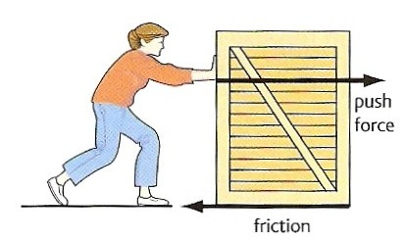
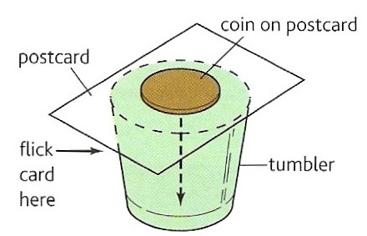
Examples of Newton’s first law of motion
Box stationary
The box will only move if the push force is greater than friction.
Box moving
If the push force equals friction there will be no net force on the box and it will move with a constant velocity.
Inertia Trick
When the card is flicked, the coin drops into the glass because the force of friction on it due to the moving card is too small to shift it sideways.

Slide 4
Newton’s second law of motion
The acceleration of a body of constant mass is related to the net external resultant force acting on the body by the equation:
resultant force = mass x acceleration
F = m a

Slide 5
Question 1
Calculate the force required to cause a car of mass 1200 kg to accelerate at 6 ms ⁻².
F = m a
F = 1200 kg x 6 ms ⁻²
Force = 7200 N

Slide 6
Question 2
Calculate the acceleration produced by a force of 20 kN on a mass of 40 g.

Slide 7
Question 2
Calculate the acceleration produced by a force of 20 kN on a mass of 40 g.
F = m a
20 000 N = 0.040 kg x a
a = 20 000 / 0.040
acceleration = 5.0 x 10⁵ ms ⁻²

Slide 8
Question 3
Calculate the mass of a body that accelerates from 2 ms ⁻¹ to 8 ms ⁻¹ when acted on by a force of 400N for 3 seconds.

Slide 9
Question 3
Calculate the mass of a body that accelerates from 2 ms ⁻¹ to 8 ms ⁻¹ when acted on by a force of 400N for 3 seconds.
acceleration = change in velocity / time
= (8 – 2) ms ⁻¹ / 3s
a = 2 ms ⁻²
F = m a
400 N = m x 2 ms ⁻²
m = 400 / 2
mass = 200 kg

Slide 10
Answers
Complete:
Force | Mass | Acceleration
 | 4 kg | 6 ms ⁻²
200 N |  | 5 ms ⁻²
600 N | 30 kg | ms ⁻²
 | 5 g | 400 ms ⁻²
5 μN | 10 mg | cms ⁻²

Slide 11
Answers
Complete:
Force | Mass | Acceleration
24 N | 4 kg | 6 ms ⁻²
200 N | 40 kg | 5 ms ⁻²
600 N | 30 kg | 20 ms ⁻²
2 N | 5 g | 400 ms ⁻²
5 μN | 10 mg | 50 cms ⁻²
24 N
40 kg
20
2 N
50

Slide 12
Types of force
1. Contact
Two bodies touch when their repulsive molecular forces (due to electrons) equal the force that is trying to bring them together. The thrust exerted by a rocket is a form of contact force.
2. Friction (also air resistance and drag forces)
When two bodies are in contact their attractive molecular forces (due to electrons and protons) try to prevent their common surfaces moving relative to each other.
3. Tension
The force exerted by a body when it is stretched. It is due to attractive molecular forces.
4. Compression
The force exerted by a body when it is compressed. It is due to repulsive molecular forces.
5. Fluid Upthrust
The force exerted by a fluid on a body because of the weight of the fluid that has been displaced by the body. Archimedes’ Principle states that the upthrust force is equal to the weight of fluid displaced.

Slide 13
6. Electrostatic
Attractive and repulsive forces due to bodies being charged.
7. Magnetic
Attractive and repulsive forces due to moving electric charges.
8. Electromagnetic
Attractive and repulsive forces due to bodies being charged. Contact, friction, tension, compression, fluid upthrust, electrostatic and magnetic forces are all forms of electromagnetic force.
9. Weak Nuclear
This is the force responsible for nuclear decay.
10. Electro-Weak
It is now thought that both the electromagnetic and weak nuclear forces are both forms of this FUNDAMENTAL force.
11. Strong Nuclear
This is the force responsible for holding protons and neutrons together within the nucleus. It is one of the FUNDAMENTAL forces.

Slide 14
12. Gravitational
The force exerted on a body due to its mass.
It is one of the FUNDAMENTAL forces.
The weight of a body is equal to the gravitational force acting on the body.
Near the Earth’s surface a body of mass 1kg in free fall (insignificant air resistance) accelerates downwards with an acceleration equal to g = 9.81 ms⁻²
From Newton’s 2nd law:
ΣF = m a
ΣF = 1 kg x 9.81 ms ⁻²
weight = 9.81 N
In general: weight = mg

Slide 15
Gravitational Field Strength, g
This is equal to the gravitational force acting on 1kg.
g = force / mass
= weight / mass
Near the Earth’s surface:
g = 9.81 Nkg⁻¹
Note: In most cases gravitational field strength is numerically equal to gravitational acceleration.

Slide 16
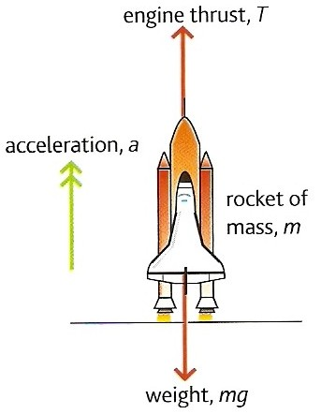
Rocket question
Calculate the engine thrust required to accelerate the space shuttle at 3.0 ms ⁻² from its launch pad.
mass of shuttle, m = 2.0 x 10 ⁶ kg
g = 9.8 ms ⁻²

Slide 17
Rocket question
F = m a
where :
F = (thrust – weight)
= T – mg
and so:
T – mg = ma
T = ma + mg

Slide 18
Rocket question
ma:
= 2.0 x 10⁶ kg x 3.0 ms ⁻²
= 6.0 x 10⁶ N
mg:
= 2.0 x 10⁶ kg x 9.8 ms ⁻²
= 19.6 x 10⁶ N
but: T = ma + mg
= (6.0 x 10⁶ N) + (19.6 x 10⁶ N)
Thrust = 25.6 x 10⁶ N

Slide 19
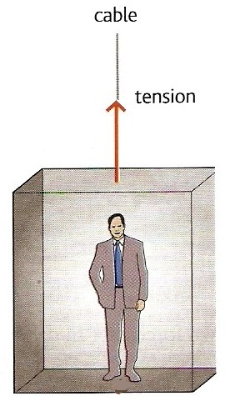
Lift question
A lift of mass 600 kg carries a passenger of mass 100 kg. Calculate the tension in the cable when the lift is:
(a) stationary
(b) accelerating upwards at 1.0 ms⁻²
(c) moving upwards but slowing down at 2.5 ms⁻²
(d) accelerating downwards at 2.0 ms⁻²
(e) moving downwards but slowing down at 3.0 ms⁻².
Take g = 9.8 ms⁻²

Slide 20
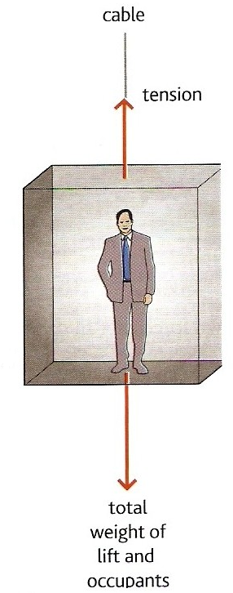
Let the cable tension = T
Mass of the lift = M
Mass of the passenger = m
(a) stationary lift
From Newton’s 1st law of motion:
A stationary lift means that resultant force acting on the lift is zero.
Hence:
Tension = Weight of lift and the passenger
T = Mg + mg
= (600kg x 9.8ms⁻²) + (100kg x 9.8ms⁻²)
= 5880 + 980
Cable tension for case (a) = 6 860 N

Slide 21
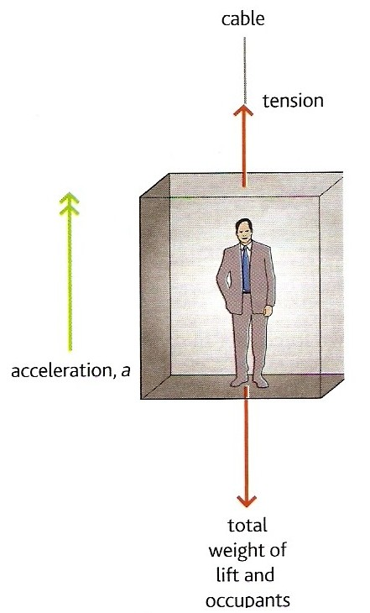
(b) accelerating upwards at 1.0 ms⁻²
Applying Newton’s 2nd law:
ƩF = (M + m) a
with
ƩF = Tension – Total weight
Therefore:
(M + m) a = T – (Mg + mg)
(600kg + 100kg) x 1.0 ms⁻²
= T – (5880N + 980N)
700 = T – 6860
T = 700 + 6860
Cable tension for case (b) = 7 560 N

Slide 22
(c) moving upwards but slowing down at 2.5 ms⁻²
Upward accelerations are positive in this question.
The acceleration, a is now
MINUS 2.5 ms⁻²
Therefore:
(M + m) a = T – (Mg + mg)
becomes:
(600kg + 100kg) x - 2.5 ms⁻²
= T – (5880N + 980N)
- 1750 = T – 6860
T = -1750 + 6860
Cable tension for case (c) = 5 110 N

Slide 23
(d) accelerating downwards
at 2.0 ms⁻²
Upward accelerations are positive in this question.
The acceleration, a is now
MINUS 2.0 ms⁻²
Therefore:
(M + m) a = T – (Mg + mg)
becomes:
(600kg + 100kg) x - 2.0 ms⁻²
= T – (5880N + 980N)
- 1400 = T – 6860
T = -1400 + 6860
Cable tension for case (d) = 5 460 N

Slide 24
(e) moving downwards but slowing down at 3.0 ms⁻²
This is an UPWARD acceleration
The acceleration, a is now
PLUS 3.0 ms⁻²
Therefore:
(M + m) a = T – (Mg + mg)
becomes:
(600kg + 100kg) x + 3.0 ms⁻²
= T – (5880N + 980N)
2100 = T – 6860
T = 2100 + 6860
Cable tension for case (e) = 8 960 N

Slide 25
Terminal Velocity
Consider a body falling through a fluid
(e.g. air or water)
When the body is initially released the only significant force acting on the body is due to its weight, the downward force of gravity.
The body will fall with an initial acceleration = g
Note: With dense fluids or with a low density body the upthrust force of the fluid due to it being displaced by the body will also be significant.
weight

Slide 26
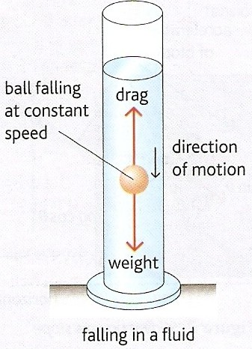
As the body accelerates downwards the drag force exerted by the fluid increases.
Therefore the resultant downward force on the body decreases causing the acceleration of the body to decrease.
F = (weight – drag) = ma
Eventually the upward drag force equals the downward gravity force acting on the body.

Slide 27
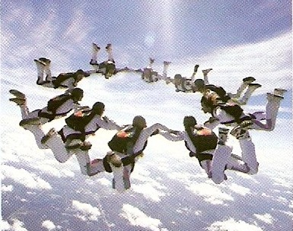
Therefore there is no longer any resultant force acting on the body.
F = 0 = ma
and so: a = 0
The body now falls with a constant velocity.
This is also known as ‘terminal speed’
Skydivers falling at their terminal speed

Slide 28
resultant force & acceleration
speed
initial acceleration = g
terminal speed
time from release

Slide 29
Newton’s third law of motion
When a body exerts a force on another body then the second body exerts a force back on the first body that:
has the same magnitude
is of the same type
acts along the same straight line
acts in the opposite direction
as the force exerted by the first body.

Slide 30

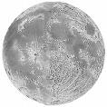
Examples of Newton’s third law of motion
1. Earth – Moon System
There are a pair of gravity forces:
A = GRAVITY pull of the EARTH to the LEFT on the MOON
B = GRAVITY pull of the MOON to the RIGHT on the EARTH
B
A
Notes:
Both forces act along the same straight line.
Force A is responsible for the Moon’s orbital motion
Force B causes the ocean tides.

Slide 31
2. Rocket in flight
There are a pair of contact (thrust) forces:
A = THRUST CONTACT push
of the ROCKET ENGINES
DOWN
on the EJECTED GASES
B = CONTACT push
of the EJECTED GASES
UP
on the ROCKET ENGINES
Note: Near the Earth there will also be a pair of gravity forces. If the rocket is accelerating upwards then the upward contact force B will be greater than the downward pull of gravity on the rocket.
A
B

Slide 32
3. Person standing on a floor
There are a pair of gravity forces:
A = GRAVITY pull of the EARTH
DOWN on the PERSON
B = GRAVITY pull of the PERSON
UP on the EARTH
And there are a pair of contact forces:
C = CONTACT push of the FLOOR
UP on the PERSON
D = CONTACT push of the PERSON
DOWN on the FLOOR
Note: Neither forces A & C nor forces D & B are Newton 3rd law force pairs as the are
NOT OF THE SAME TYPE
although all four forces will usually have the same magnitude.
A
D
C
B
EARTH

Slide 33
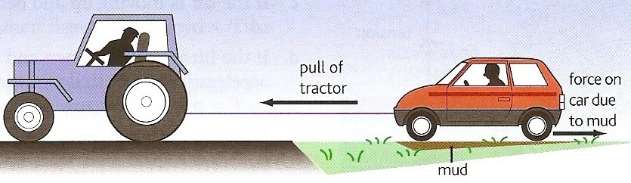
Tractor and car question
A tractor is pulling a car out of a patch of mud using a tow-rope as shown in the diagram opposite. Identify the Newton third law force pairs in this situation.
C₁
T₁ T₂
G₁
F₁ F₂
C₂
G₂
There are three pairs of GRAVITY forces between the tractor, rope, car and the Earth - for example forces G₁ & G₂.
There are two pairs of TENSION forces. The tractor exerts a TENSION force to the LEFT on the rope and the rope exerts an equal magnitude TENSION force to the RIGHT on the tractor. A similar but DIFFERENT magnitude pair exist between the rope and the car, T₁ & T₂.
There are eight pairs of CONTACT forces between the eight tyres and the ground - for example forces C₁ & C₂.
There are eight pairs of FRICTIONAL forces between the eight tyres of the tractor and car and the ground - for example forces F1 & F2.
For the tractor to succeed the tension force T₁ must be greater than the four frictional forces acting from the ground on the car’s four tyres.

Slide 34
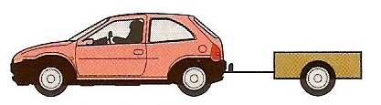
Trailer question
A car of mass 800 kg is towing a trailer of mass 200 kg. If the car is accelerating at 2 ms⁻² calculate:
(a) the tension force in the tow-bar
(b) the engine force required
Let the engine force = E
The tension force = T
Car mass = M
Trailer mass = m
Acceleration = a
The forces are as shown in the diagram.
The force acting on the trailer = T
= ma
= 200kg x 2 ms⁻²
Tension force in the tow-bar = 400 N
T
E
The resultant force acting on the car
ΣF = E – T
E – T = Ma
but: T = ma
Hence:
E – ma = Ma
E = Ma + ma
= (M + m) a
= (800kg + 200kg) x 2 ms⁻²
Engine force = 2000 N

Slide 35
ACTIVITY
State Newton’s first law of motion and give two examples of this law.
State the equation for Newton’s second law of motion.
Explain why a heavy object falls at the same rate as a heavy one.
What does the drag force acting on a body depend upon?
Describe and explain the motion of a body falling because of gravity through a fluid.
What is meant by terminal speed?

Slide 36
Activity
What does the drag force acting on a body depend upon?
Describe and explain the motion of a body falling because of gravity through a fluid.
What is meant by terminal speed?

