Slide 1
Energy Transfers
CONSERVATION OF ENERGY

Slide 2
ENERGY
Energy resources and energy transfer
b) Energy transfer
describe energy transfers involving the following forms of energy: thermal (heat), light, electrical, sound, kinetic, chemical, nuclear and potential (elastic and gravitational)
understand that energy is conserved
know and use the relationship:
efficiency = useful energy output / total energy input
describe a variety of everyday and scientific devices and situations, explaining the fate of the input energy in terms of the above relationship, including their representation by Sankey diagrams

Slide 3
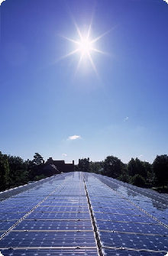
Energy
Energy is required to do work.
Fuels are burnt to release energy
The Sun is the ultimate source of most of our energy on Earth.
Notes:
3

Slide 4
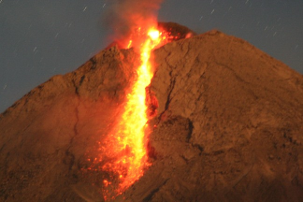

Forms of energy
Energy can exist in many forms.
1. THERMAL
or HEAT ENERGY
This is the energy of an object due to its temperature.
2. LIGHT ENERGY
This is energy in the form of visible electromagnetic radiation.
Notes:
4

Slide 5
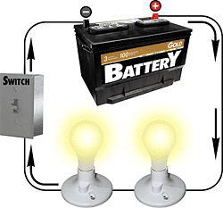

3. ELECTRICAL ENERGY
This is the energy transferred by an electric current.
4. SOUND ENERGY
This is energy in the form of a sound wave.
Notes:
5

Slide 6

5. KINETIC ENERGY
This is the energy possessed by a moving object.
Kinetic energy increases is the object’s speed is increased.
Also often called ‘Movement energy’
Notes:
6

Slide 7
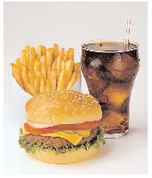
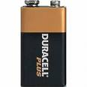
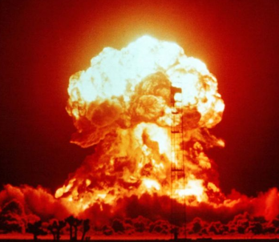
6. CHEMICAL ENERGY
This is energy that is released when chemical reactions take place.
Sources of chemical energy include:
fuel, food and batteries.
7. NUCLEAR ENERGY
This is energy that is released when nuclear reactions take place.
This is the source of the Sun’s energy.
Notes:
7

Slide 8
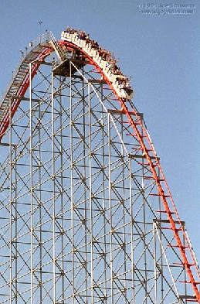

8. POTENTIAL ENERGY
This is the energy possessed an object due to its position.
Gravitational Potential Energy
The gravitational potential energy of an object increases if it is raised upwards.
Elastic Potential Energy
This is the energy stored in a stretched or squashed object
- also known as strain energy
Gravitational potential energy being converted into kinetic energy.
Notes:
8

Slide 9

Energy measurement
Energy is measured in joules (J)
To lift an apple upwards by one metre requires about one joule of energy.
1 kilojoule (kJ) = 1 000 J
1 megajoule (MJ) = 1 000 000 J
Notes:
9

Slide 10
Other energy measurement examples
4200 joules (4.2 kJ) | 1 food Calorie
1 000 000 J (1 MJ) | Energy of a Mars bar
0.000 02 J | Energy need to produce a syllable of a word
15 000 000 000 000 000 000 000 J | Energy received by the Earth from the Sun in one day
Notes:
10

Slide 11
Conservation of energy
Energy cannot be created or destroyed. It can only be transformed from one form to another form.
Conservation of energy also means that the total energy in the universe stays constant.
Notes:
11

Slide 12
Pendulum oscillation
GRAVITATIOINAL POTENTIAL ENERGY
MAXIMUM
MINIMUM
KINETIC ENERGY
MAXIMUM
ZERO
The total energy, gravitational potential plus kinetic, remains the same if there are no significant resistive forces
Notes:
12

Slide 13
Useful and wasted energy
Useful energy is energy transferred to where it is required in the form that it is wanted.
Other forms of energy are referred to as ‘wasted’.
Wasted energy spreads out into the surroundings.
This is usually in the form of heat energy causing the energy changing device and its surroundings to become warmer. It is very difficult to ‘concentrate’ this energy again to make use of it.
Notes:
13

Slide 14
Energy efficiency
Energy efficiency is a measure of how usefully energy is converted by a device.
useful energy output
efficiency =
total energy input
As the useful energy output can never be greater than the energy input the efficiency can never be greater than 1.0
Notes:
14

Slide 15
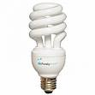
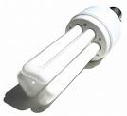
Energy efficient light bulbs
These produce more useful light energy for the same amount of input electrical energy.
They waste less energy to heat.
Notes:
15

Slide 16
Question 1
Calculate the efficiency of an electric motor if it produces 48J of useful kinetic energy when supplied with 80J of electrical energy.
Notes:
16

Slide 17
Question 1
Calculate the efficiency of an electric motor if it produces 48J of useful kinetic energy when supplied with 80J of electrical energy.
useful energy output
efficiency =
total energy input
efficiency = 48J ÷ 80J
efficiency of the motor = 0.6
Notes:
17

Slide 18
Question 2
Calculate the useful light output of a light bulb of efficiency 0.20 when it is of an electric motor if it supplied with 400J of electrical energy.
Notes:
18

Slide 19
Question 2
Calculate the useful light output of a light bulb of efficiency 0.20 when it is of an electric motor if it supplied with 400J of electrical energy.
useful energy output
efficiency =
total energy input
0.20 = useful energy ÷ 400J
useful energy = 0.20 x 400J
light output = 80J
Notes:
19

Slide 20
Percentage efficiency
percentage efficiency = efficiency x 100
The greater the percentage of the energy that is usefully transformed in a device, the more efficient the device is.
The maximum percentage efficiency is 100%
Notes:
20

Slide 21
Question
Calculate the percentage efficiency of a light bulb if it produces 30J of light when supplied with 240J of electrical energy.
Notes:
21

Slide 22
Question
Calculate the percentage efficiency of a light bulb if it produces 30J of light when supplied with 240J of electrical energy.
useful energy output
efficiency =
total energy input
efficiency = 30J ÷ 240J
= 0.125
% efficiency = efficiency x 100
Percentage efficiency of light bulb = 12.5%
Notes:
22

Slide 23
Improving efficiency
Decrease loss to heat by:
  Reducing friction by using a lubricant (eg oil).
  Reducing electrical resistance in electrical circuits.
  Reducing air resistance by using streamlined shapes.
Reduce loss to sound by tightening the loose parts of machinery.
Notes:
23

Slide 24
Energy flow diagrams
GENERAL DIAGRAM
USEFUL OUTPUT ENERGY
INPUT ENERGY
DEVICE CAUSING ENERGY CHANGE
WASTED ENERGY
Notes:
24

Slide 25

An electric light bulb
electrical energy
light energy
lightbulb
heat energy
Notes:
25

Slide 26

Microphone
sound energy
electrical energy
microphone
heat energy
Notes:
26

Slide 27

Car engine
chemical energy
kinetic energy
car engine
heat & sound energy
Notes:
27

Slide 28

Photosynthesis
light energy
chemical energy
plants
heat energy
Notes:
28

Slide 29
Complete the table below:
Device | Input energy | Main output energy
Electric motor | electrical
Car brakes |  | heat
 | gravitational potential | kinetic
Candle |  | light
Generator |  | electrical
Falling object
Notes:
29

Slide 30
Complete the table below:
Device | Input energy | Main output energy
Electric motor | electrical
Car brakes |  | heat
 | gravitational potential | kinetic
Candle |  | light
Generator |  | electrical
kinetic
kinetic
Falling object
chemical
kinetic
Notes:
30

Slide 31
Sankey Diagrams
These are energy flow diagrams that show how well a device uses energy.
The width of the flow arrows is proportional to the amount of energy
Wasted energy is shown flowing downwards.
USEFUL OUTPUT
INPUT
Device
WASTED OUTPUT
Notes:
31

Slide 32
Question
Draw a Sankey diagram for car of efficiency 20%
KINETIC ENERGY
CHEMICAL ENERGY
CAR
HEAT & SOUND ENERGY
The kinetic energy arrow should be 1/5th the width of the chemical energy arrow.
The heat & sound arrow should be 4/5th the width of the chemical energy arrow.
Notes:
32

Slide 33
Choose appropriate words to fill in the gaps below:
Energy is required to do ________.
Energy is measured in ________ (J)
Energy cannot be created or ___________ but can only change ________.
Kinetic energy is the energy possessed by __________ bodies.
When an object is lifted up it gains gravitational _____________ energy.
Heat or __________ energy is often produced as a _________ energy form.
WORD SELECTION:
potential
moving
joules
thermal
destroyed
wasted
form
work
Notes:
33

Slide 34
Choose appropriate words to fill in the gaps below:
Energy is required to do ________.
Energy is measured in ________ (J)
Energy cannot be created or ___________ but can only change ________.
Kinetic energy is the energy possessed by __________ bodies.
When an object is lifted up it gains gravitational _____________ energy.
Heat or __________ energy is often produced as a _________ energy form.
work
joules
destroyed
form
moving
potential
thermal
wasted
WORD SELECTION:
potential
moving
joules
thermal
destroyed
wasted
form
work
Notes:
34

