Slide 1
ELECTRIC CURRENT AND VOLTAGE

Slide 2
Specification
Electricity
Energy and potential difference in circuits
explain why a series or parallel circuit is more appropriate for particular applications, including domestic lighting
understand that the current in a series circuit depends on the applied voltage and the number and nature of other components
understand that current is the rate of flow of charge
know and use the relationship:
charge = current × time Q = I × t
know that electric current in solid metallic conductors is a flow of negatively charged electrons
know that:
• voltage is the energy transferred per unit charge passed
• the volt is a joule per coulomb.

Slide 3
Electrical conductors and insulators
An electrical conductor is a material through which electric current flows easily.
All metals are conductors.
Electrical insulators have a very high resistance to the flow of electric current.
Complete the table below:
copper | conductor
rubber | insulator
steel | conductor
mercury | conductor
paper | insulator
plastic | insulator
diamond | insulator
graphite | conductor
1
2
3
4
5
6

Slide 4
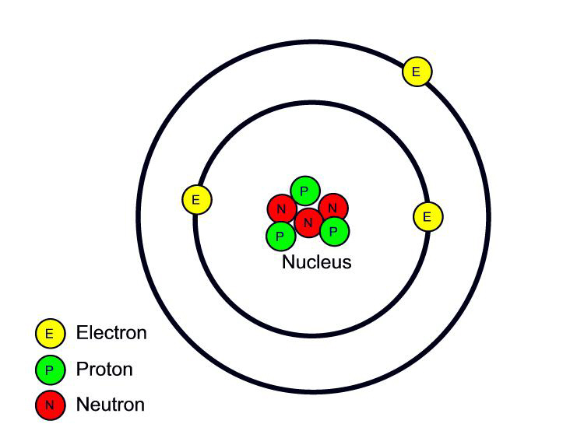
Electric charge
Electric charge can be either positive or negative.
In an atom an electron has a negative charge that is of the same size as the positive charge of a proton. Neutrons have no electric charge.
As an atom has the same number of electrons as protons it is uncharged.

Slide 5
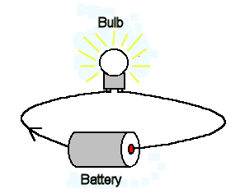
Electric current
An electric current is the rate of flow of electric charge.
An electric current of one ampere (A) flows when a charge of one coulomb (C) passes a point in an electric circuit in one second
In metallic conductors (e.g. copper wire) electrons carry negative charge from the negative side of a power supply, around a circuit and back into the positive side.
The arrow shows the direction of electron flow.

Slide 6
Charge-current equation
electric charge = current x time
Q = I x t
also: I = Q ∕ t
and: t = Q ∕ I
charge
current
time

Slide 7
Question 1
Calculate the charge passing through a device when a current of 500mA flows for 3 minutes.

Slide 8
Question 1
Calculate the charge passing through a device when a current of 500mA flows for 3 minutes.
Q = I x t
= 500 mA x 3 minutes
= 0.5A x 180s
charge = 90C

Slide 9
Question 2
Calculate the current flowing when a charge of 240C flows through a device in 80s.

Slide 10
Question 2
Calculate the current flowing when a charge of 240C flows through a device in 80s.
I = Q ÷ t
current = 240 C
80s
current = 3A

Slide 11
Complete:
Complete
Q | I | t
60 C | 2 A
 | 13 A | 5 s
960 C |  | 4 minutes
3 C | 50 mA

Slide 12
Complete:
Answers
Q | I | t
60 C | 2 A
 | 13 A | 5 s
960 C |  | 4 minutes
3 C | 50 mA
30 s
65 C
3 A
60 s

Slide 13
Voltage
A battery gives electrical charge energy.
The voltage of a battery is equal to the energy in joules provided when a charge of one coulomb passes through the battery.
voltage = energy ÷ charge
1 volt is the same as 1 joule per coulomb

Slide 14
Question
Calculate the voltage of a battery if it supplies 300 joules of energy to 50C of charge.

Slide 15
Question
Calculate the voltage of a battery if it supplies 300 joules of energy to 50C of charge.
voltage = energy ÷ charge
= 300 J
50 C
battery voltage = 6V

Slide 16
Complete:
Complete
Voltage | Energy | Charge
12V | 480J
 | 500J | 25C
6V |  | 20C
230V | 69kJ

Slide 17
Complete:
Answers
Voltage | Energy | Charge
12V | 480J
 | 500J | 25C
6V |  | 20C
230V | 69kJ
40C
20V
120J
300C

Slide 18
Choose appropriate words to fill in the gaps below:
Electric current is the rate of flow of electric _______.
Electric charge is measured in _________.
A battery provides electrical _______ . The amount of energy provided per _________ of electric charge passing is equal to the ________ of the battery.
The _______ supply gives 230 ________ to every coulomb of charge.
WORD SELECTION:
coulombs
charge
mains
joules
coulomb
voltage
energy

Slide 19
Choose appropriate words to fill in the gaps below:
Electric current is the rate of flow of electric _______.
Electric charge is measured in _________.
A battery provides electrical _______ . The amount of energy provided per _________ of electric charge passing is equal to the ________ of the battery.
The _______ supply gives 230 ________ to every coulomb of charge.
charge
coulombs
energy
coulomb
voltage
mains
joules
WORD SELECTION:
coulombs
charge
mains
joules
coulomb
voltage
energy

Slide 20
Electric circuits
An electric current will only flow if there is a complete, unbroken electric circuit, that contains a power supply.
A circuit diagram uses a standard set of symbols to show how electrical components are connected together.

Slide 21
Circuit symbols
cell
a cell is required to push electrons around a circuit
battery
a battery consists of two or more cells
wire
wires should always been drawn as straight lines
wire junction
switch
a switch enables the current in a circuit to be turned on or off

Slide 22
indicator
often a light bulb – this is used to show whether or not a circuit is on
light bulb
old symbol – the indicator symbol is now used
A
ammeter
measures electric current in amperes (A)
V
voltmeter
measures voltage in volts (V)

Slide 23
fixed resistor
a resistor is used to limit the current in a circuit
variable resistor
thermistor
a device whose resistance decreases with temperature
light dependent resistor (LDR)
a device whose resistance decreases with brightness

Slide 24
diode
a diode only allows current to flow in one direction (indicated by the arrow)
light emitting diode (LED)
a diode that emits light when it allows the flow of electric current
fuse
a fuse is designed to melt and so break an electric circuit when too much electric current flows
heater
a device used to convert electrical energy to heat

Slide 25
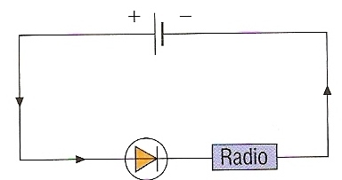
Electric current flow
Electric current flows from the POSITIVE terminal of a power supply around a circuit to the NEGATIVE terminal.
The longer thinner line of the symbol for a cell is the positive terminal.
In the circuit above the diode is aligned so that it allows current to flow through the radio.

Slide 26
Complete
symbol | component | symbol | component
A

Slide 27
Answers
symbol | component | symbol | component
A
ammeter
heater
diode
resistor
indicator
thermistor
cell
LDR

Slide 28
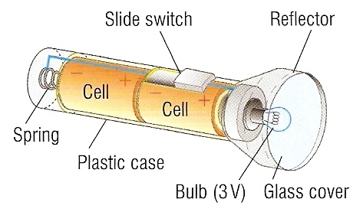
Question
Draw a circuit diagram for the torch shown below.

Slide 29
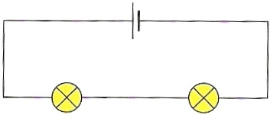
Series circuits
Circuit components are said to be connected in series if the same electric current passes through each of them in turn.
3A
3A
3A
3A
3A
3A
3A
The cell and the two lamps are in series with each other and so the same electric current passes through all of them.

Slide 30
In a series circuit all of the components can be controlled by using just one switch.
Each component shares the voltage of the power supply and so adding more bulbs in series will cause each bulb to become dimmer.

Slide 31
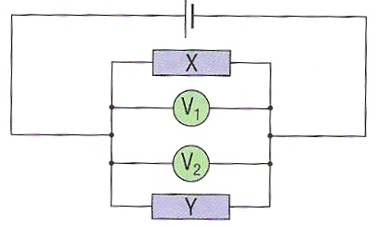
Parallel circuits
The voltage across each component connected in parallel is the same.
The voltmeter reading for component X, V₁ will be the same as the voltmeter reading for component Y, V₂.

Slide 32
In a parallel circuit all of the components can be individually controlled by using separate switches.
If one light bulb blows the other bulbs will still carry on working.

Slide 33
Currents in parallel circuits
The total current through the whole circuit is the sum of the currents through the separate components.
5A
5A
3A
3A
2A
2A

Slide 34
What are the advantages of connecting two lamps in parallel rather than in series to a power supply?
When connected in parallel:
the lamps are brighter than when connected in series
the lamps can be controlled individually with switches
one lamp will continue working even if the other does not

Slide 35
Calculate the currents measured by ammeters A1, A2 and A3 in the circuit below.
6A
A1 =
A2 =
A3 =
A3
A1
2A
A2

Slide 36
Calculate the currents measured by ammeters A1, A2 and A3 in the circuit below.
6A
A1 = 2A
A2 = 4A
A3 = 6A
A3
A1
2A
A2

Slide 37
Choose appropriate words to fill in the gaps below:
When components are _________ together in series they will all have the same _________ flowing through each of them.
When components are connected in parallel to each other they will each have the same _________.
Lamps are usually connected in __________ to each other as this allows them to be controlled individually by _________ and if one lamp __ the others can still continue to operate.
WORD SELECTION:
blows
current
switches
parallel
connected
voltage

Slide 38
Choose appropriate words to fill in the gaps below:
When components are _________ together in series they will all have the same _________ flowing through each of them.
When components are connected in parallel to each other they will each have the same _________.
Lamps are usually connected in __________ to each other as this allows them to be controlled individually by _________ and if one lamp _______ the others can still continue to operate.
connected
current
voltage
parallel
switches
blows
WORD SELECTION:
blows
current
switches
parallel
connected
voltage

