Slide 1
DIFFRACTION AND INTERFERENCE

Slide 2
Specification
 | Topics
 | Interference The concept of path difference and coherence The laser as a source of coherent monochromatic light used to demonstrate interference and diffraction; comparison with non-laser light; awareness of safety issues Candidates will not be required to describe how a laser works. Requirements of two source and single source double-slit systems for the production of fringes. The appearance of the interference fringes produced by a double slit system, fringe spacing w = λ D / s where s is the slit separation.
 | Diffraction Appearance of the diffraction pattern from a single slit. The plane transmission diffraction grating at normal incidence; optical details of the spectrometer will not be required. Derivation of d sin θ = nλ, where n is the order number. Applications; e.g. to spectral analysis of light from stars.

Slide 3
Superposition of waves
This is the process that occurs when two waves of the same type meet.
The principle of superposition
When two waves meet, the total displacement at a point is equal to the sum of the individual displacements at that point
reinforcement
cancellation

Slide 4
Stationary waves
A stationary wave can be formed by the superposition of two progressive waves of the same frequency travelling in opposite directions.
This is usually achieved by superposing a reflected wave with its incident wave.

Slide 5
Formation of a stationary wave
Consider two waves, A and B, each of amplitude a, frequency f and period T travelling in opposite directions.
(1) At time, t = 0
RESULTANT WAVEFORM
REINFORCEMENT
Wave A
N A N A N A N A N A N A N
Wave B
Amplitude = 2a

Slide 6
(2) One quarter of a cycle later, at time, t = T/4 both waves have moved by a quarter of a wavelength in opposite directions.
Wave A
RESULTANT WAVEFORM
CANCELLATION
N A N A N A N A N A N A
Amplitude = 0
Wave B

Slide 7
(3) After another quarter of a cycle, at time, t = T/2 both waves have now moved by a half of a wavelength in opposite directions.
RESULTANT WAVEFORM
REINFORCEMENT
Wave A
N A N A N A N A N A N A N
Wave B
Amplitude = 2a

Slide 8
(4) One quarter of a cycle later, at time, t = 3T/4 both waves will undergo cancellation again.
(5) One quarter of a cycle later, at time, t = T the two waves will undergo superposition in the same way as at time, t = 0
(6) Placing all four resultant waveforms on top of each other gives:
N A N A N A N A N A N

Slide 9
Nodes (N) and Antinodes (A)
NODES are points within a stationary wave that have the MINIMUM (usually zero) amplitude.
These have been marked by an ‘N’ in the previous waveforms.
ANTINODES are points within a stationary wave that have the MAXIMUM amplitude.
These have been marked by an ‘A’ in the previous waveforms and have an amplitude equal to ‘2a’

Slide 10
Comparison of stationary and progressive waves
Property | Stationary Wave | Progressive Wave
Energy & Momentum | No net transfer from one point to another | Both move with speed: c = f x λ
Amplitude | Varies from zero at NODES to a maximum at ANTINODES | Is the same for all particles within a wave
Frequency | All particles oscillate at the same frequency except those at nodes | All particles oscillate at the same frequency
Wavelength | This is equal to TWICE the distance between adjacent nodes | This is equal to the distance between particles at the same phase
Phase difference between two particles | Between nodes all particles are at the same phase. Any other two particles have phase difference equal to ‘mπ’ where ‘m’ is the number of nodes between the particles | Any two particles have phase difference equal to ‘2πd / λ’ where ‘d’ is the distance between the two particles

Slide 11
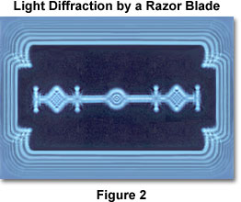
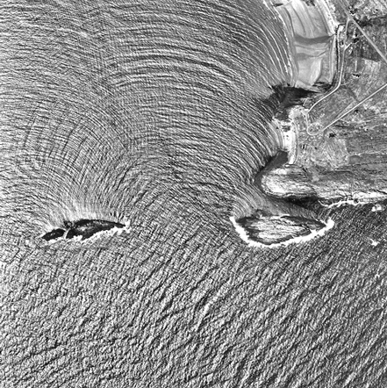
Diffraction
Diffraction occurs when waves spread out after passing through a gap or round an obstacle.
Sea wave diffraction

Slide 12
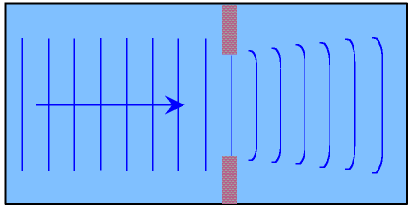
Diffraction becomes more significant when the size of the gap or obstacle is reduced compared with the wavelength of the wave.

Slide 13
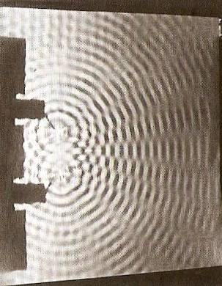
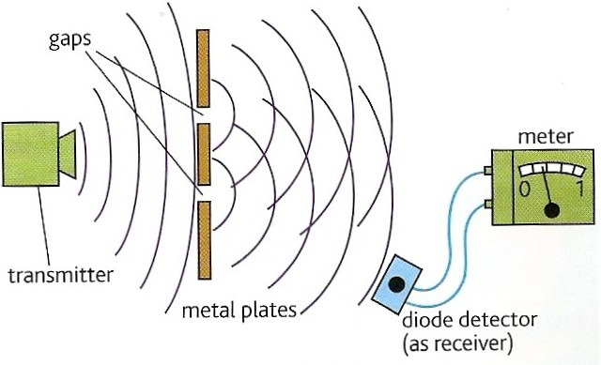
Interference
Interference occurs when two waves of the same type (e.g. both water, sound, light, microwaves etc.) occupy the same space.
Wave superposition results in the formation of an interference pattern made up of regions of reinforcement and cancellation.

Slide 14
Coherence
For an interference pattern to be observable the two overlapping waves must be coherent.
This means they will have:
1. the same frequency
2. a constant phase difference
If the two waves are incoherent the pattern will continually change usually too quickly for observations to be made.
Two coherent waves can be produced from a single wave by the use of a double slit.

Slide 15
Path difference
Path difference is the difference in distance travelled by two waves.
Path difference is often measured in ‘wavelengths’ rather than metres.
Example:
Two waves travel from A to B along different routes. If they both have a wavelength of 2m and the two routes differ in length by 8m then their path difference can be stated as ‘4 wavelengths’ or ‘4 λ’

Slide 16
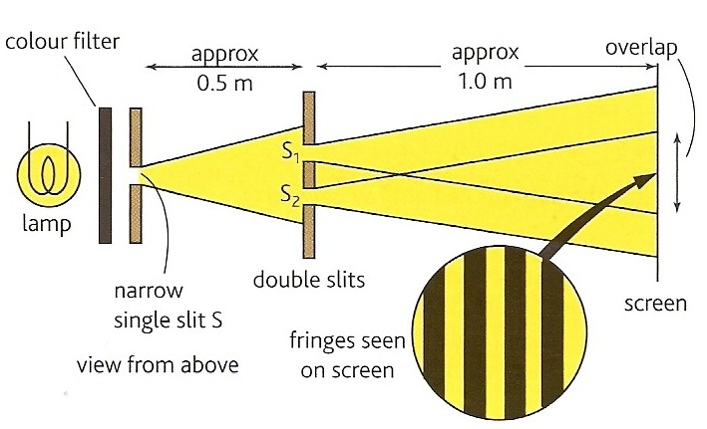
Double slit interference with light
This was first demonstrated by Thomas Young in 1801.
The fact that light showed interference effects supported the theory that light was a wave-like radiation.
Thomas Young 1773 - 1829

Slide 17
Experimental details
Light source:
This needs to be monochromatic (one colour or frequency).
This can be achieved by using a colour filter with a white light. Alternatives include using monochromatic light sources such as a sodium lamp or a laser.
Single slit:
Used to obtain a coherent light source. This is not needed if a laser is used.
Double slits:
Typical width 0.1mm; typical separation 0.5mm.
Double slit to fringe distance:
With a screen typically 1.0m.
The distance can be shorter if a microscope is used to observe the fringes.

Slide 19
Interference fringes
Interference fringes are formed where the two diffracted light beams from the double slit overlap.
A bright fringe is formed where the light from one slit reinforces the light from the other slit.
At a bright fringe the light from both slits will be in phase.
They will have path differences equal to a whole number of wavelengths: 0, 1λ, 2λ, 3λ etc…
A dark fringe is formed due to cancelation where the light from the slits is 180° out of phase.
They will have path differences of: ¹/₂λ, ³/₂ λ , ⁵/₂ λ etc..

Slide 20
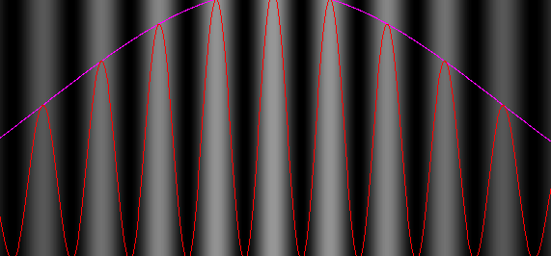
Young’s slits equation
fringe spacing, w = λ D / s
where:
s is the slit separation
D is the distance from the slits to the screen
λ is the wavelength of the light
w

Slide 21
Question 1
Calculate the fringe spacing obtained from a double slit experiment if the double slits are separated by 0.50mm and the distance from the slits to a screen is 1.5m with (a) red light (wavelength 650nm and (b) blue light (wavelength 450nm).
fringe spacing w = λ D / s
(a) red light:
w = (650nm x 1.5m) / (0.50mm)
= (650 x 10⁻⁹m x 1.5m)
/ (5 x 10⁻⁴m)
= 0.00195m
= 2.0mm
(b) blue light:
w = 1.4mm

Slide 22
Question 2
Calculate the wavelength of the green light that produces 10 fringes over a distance of 1.0cm if the double slits are separated by 0.40mm and the distance from the slits to the screen is 80cm
fringe spacing w = 1.0cm / 10
= 0.10 cm
fringe spacing w = λ D / s
becomes:
λ = ws / D
= (0.10cm x 0.40mm) / (80cm)
= (0.001m x 0.0004m) / (0.80m)
= 0.000 000 5m
wavelength = 500nm
1.0 cm

Slide 23
Demonstrating interference with a laser
A laser
(Light Amplification by Stimulated Emission of Radiation)
is a source of coherent monochromatic light.
0.5m to 2m

Slide 24
White light fringes
Every colour produces a bight central fringe.
Therefore with white light there is also a bright central white fringe.
The other fringes do not coincide resulting in fringes that are tinted blue on the inside and red on the outside.
The fringes become less distinct away from the centre.
central bright fringe

Slide 25
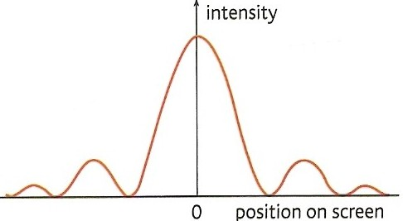
Diffraction from a single slit
A single slit also produces a fringe pattern.
The central fringe is much brighter than and twice the width of the others.
Diffraction fringe pattern produced by a red light laser

Slide 26
Double slit pattern with single slit diffraction

Slide 27
Transmission diffraction grating
A transmission diffraction grating consists of a glass or plastic slide with many closely spaced slits ruled onto it (typically 500 per mm).
500 lines per mm (magnified view)
100 lines per mm (magnified view)
Note: A CD or DVD disc acts as a reflection diffraction grating

Slide 28
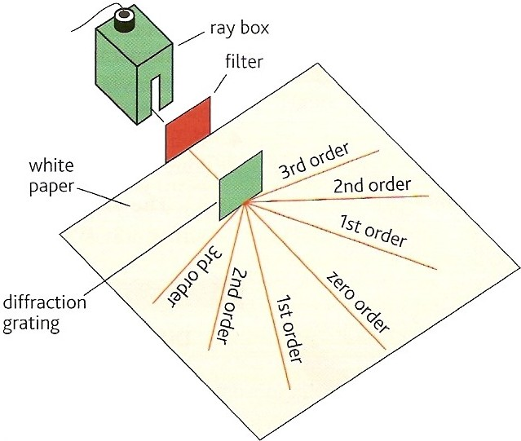
Grating and monochromatic light
When a parallel beam of monochromatic light is incident normally with the grating the light is transmitted in certain directions only.
This happens because:
the light is diffracted by each slit in the grating.
the diffracted light from adjacent slits reinforces only in a few directions. In all other directions cancellation occurs.

Slide 29
The central beam is referred as the ‘zero order beam’ and is in the same direction as the incident beam.
Other transmitted beams are numbered outwards from the zero order beam.
The pattern of beams is symmetric about the zero order beam.

Slide 30
The angle between the beams increases if:
the wavelength of the light is increased
the width of the slits in the grating is decreased (more lines per mm)

Slide 31
Grating and white light
Each wavelength produces its own set of lines.
The zero order beam is white.
The other beams are spectra with red showing the greatest angles

Slide 32
Diffraction grating equation
d sin θ = nλ
where:
d = the grating spacing (the distance
between the centres of adjacent slits
drawn on the grating)
n = the beam order number (0, 1, 2 etc..)
λ = the wavelength of the light
θ = the angle between the beam in
question and the zero order beam
Note: The number of slits per metre, N in
the grating is given by: N = 1 / n
d

Slide 33
Diffraction grating equation derivation
Let θ be the angle between the zero order maximum and the n^{th} order maximum.
For this to occur the path difference between the light from two adjacent slits must equal a nλ.
In the diagram opposite distance QY must equal nλ.
But: sin θ = QY / QP
sin θ = nλ / d
Hence: d sin θ = nλ
Q
Y
d
θ
P
θ

Slide 34
Question 1
Calculate the angle of the first order beam when red light, wavelength 650nm is incident on a diffracting grating that has 200 lines per mm.
d sin θ = nλ
becomes: sin θ = nλ / d
with grating spacing, d = ¹/₂₀₀ mm = 0.005 mm
sin θ = (1 x 650 nm) / (0.005 mm)
= (650 x 10⁻⁹ m) / (5 x 10⁻⁶ m)
sin θ = 0.13
First order angle, θ = 7.5°

Slide 35
Question 2
Calculate the wavelength of light the has a second order angle of 30° when used with a diffracting grating of 500 lines per mm.
d sin θ = nλ
becomes: λ = d sin θ / n
with grating spacing, d = ¹/₅₀₀ mm = 0.002 mm
λ = (0.002 mm x sin 30°) / (2)
= (2 x 10⁻⁶ m x 0.5) / (2)
wavelength = 5 x 10⁻⁷ m = 500 nm

Slide 36
Question 3
How many beams are formed when blue light, wavelength 450nm is used with a diffracting grating of 400 lines per mm.
d sin θ = nλ
becomes: n = d sin θ / λ
grating spacing, d = ¹/₄₀₀ mm = 0.0025 mm
sin θ cannot be greater than 1.0 (with θ = 90°)
n = (0.0025 mm x 1.0) / (450 nm)
= (2.5 x 10⁻⁶ m) / (4.5 x 10⁻⁷ m)
= 5.6
but n must be an integer
and so max n = 5
There will therefore be 11 beams

Slide 37
Answers:
Answers:
Complete:
d / μm | N / mm⁻¹ | θ / ° | n | λ / nm
2.00 |  |  | 1 | 400
2.00 |  |  | 2 | 400
2.00 |  |  | 4 | 400
 | 200 |  | 2 | 400
 | 400 | 30 | 5
500
11.5
500
23.6
500
53.1
5.00
9.21
2.50
250

Slide 38
Answers:
Answers:
Complete:
d / μm | N / mm⁻¹ | θ / ° | n | λ / nm
2.00 |  |  | 1 | 400
2.00 |  |  | 2 | 400
2.00 |  |  | 4 | 400
 | 200 |  | 2 | 400
 | 400 | 30 | 5

Slide 39
Answers:
Answers:
Complete:
d / μm | N / mm⁻¹ | θ / ° | n | λ / nm
2.00 |  |  | 1 | 400
2.00 |  |  | 2 | 400
2.00 |  |  | 4 | 400
 | 200 |  | 2 | 400
 | 400 | 30 | 5
500
11.5
500
23.6
500
53.1
5.00
9.21
2.50
250

Slide 40
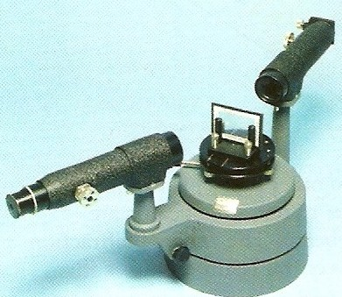
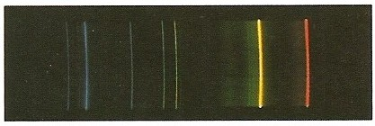
Applications of diffraction gratings
A diffraction grating can be used in a spectrometer to study the spectrum of light from any light source and to measure wavelengths very accurately.
For example the line spectrum given off by a gas can be used to identify its components.
diffraction grating
Spectrometer
A line spectrum

