Slide 1
Capacitor
An element that stores charge when a voltage is applied
Q = CV (definition)
C is the capacitance
  Unit is farad or C/V or C²/Nm or C²/J
Capacitance is a function of geometry and material

Slide 2
Capacitors
A capacitor can be of any two conductors isolated
Parallel plates are just a easy way to think of the problem
General method to calculate
a) Assume a charge on the conductors
b) Calculate the voltage difference due to the charge
` c) Ratio Q/V is the capacitance

Slide 3
Capacitor as a circuit element
Typical value of a capacitor
    A few μF
Adding capacitors in series and parallel
Calculating charge and voltage on a capacitor

Slide 4
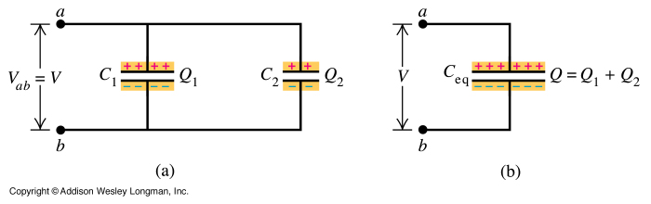
Parallel Capacitors
(a) Two capacitors in parallel, (b) the equivalent circuit.
Across C₁ and C₂
Voltage same
Charge splits
C_{eq} = C₁ + C₂

Slide 5
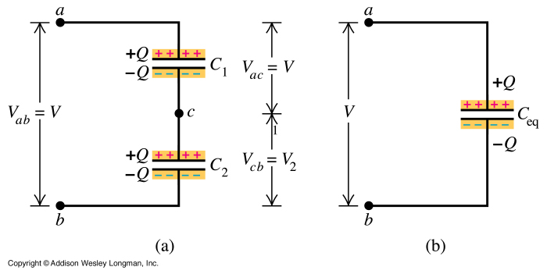
Series Capacitors
(a) Two capacitors in series (b) the equivalent capacitor.
Across C₁ and C₂
Charge same
Voltage splits
1 / Ceq = 1 / C₁ + 1 / C₂

Slide 6
Capacitor practice
C1
A
B
C2
C1 = 4 μF, C2 = 2 μF
What is total capacitance from A to B

Slide 7
Capacitor practice
A
C1
C2
C3
B
C1 = 4 μF, C2 = 2 μF, C3 = 2 μF
What is total capacitance from A to B
Notes:
¼ + ½ + ½ = 5/4 so C = 4/5 =.8 mF

Slide 8
Capacitor practice
C1
C2
A
C3
C4
B
C1 = 4 μF, C2 = 4 μF, C3 = 2 μF, C4 = 2 μF
What is total capacitance from A to B
Notes:
C1 + C2 = 2.0mF, C3 + C12 = 4mF, C4 + C123 = 4/3 mF

Slide 9
Typical Capacitance Problem: 1
Find the equivalent capacitance
What is the voltage across capacitor C₂
C₁ = 4.0 μF, C₂ = C₃ = 1.0μF, V_{AB} = 3.0 V
C₂
C₁
A
B
C₃

Slide 10
Typical Capacitance Problem: 2
Given 9V across the elements what is the charge on C₁
C₁ = C₂ = 1.5 nF, C₃ = C₄ = 3.0 nF, V_{AB} = 9.0 V
C₁
C₃
C₄
A
B
C₃

Slide 11
Energy Storage in Capacitors
When we charge a capacitor we have stored energy in the capacitor
    U = Q²/2C
Using C=Q/V can rewrite the above as:
    U = CV²/2 or QV/2

Slide 12
Capacitance Problem: What if numbers are not so convenient
10.0V across the elements, what is the charge on C₁
C₁ = 1.0 nF, C₂ = 4.0 nF, C₃ = 2.0 nF, C₄ = 7.0 nF, V_{AB} = 10.0 V
C₁
C₃
C₄
A
B
C₂

Slide 13
Energy Storage in Capacitors
When we charge a capacitor we have stored energy in the capacitor
    U = Q²/2C
Using C=Q/V can rewrite the above as:
    U = CV²/2 or QV/2

Slide 14
Energy Example
What energy was stored in C₁ of previous example ?

Slide 15
Cap energy multiple choice
Three identical caps are connected to an ideal battery.
Will the system store more energy in the caps are connected in parallel or series?
Parallel
Series

Slide 16
Capacitors
In real capacitors we place a material between the metal plates because:
  It keeps the metal plates from shorting
  It increases the capacitance
  It increase the “breakdown voltage”

Slide 17
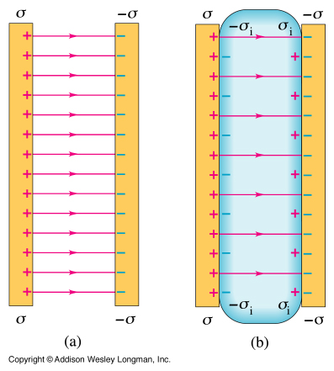
Dielectric in a capacitor
The charges induced on the surface of the dielectric reduce the electric field.

