Slide 1
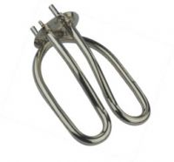
The heating effect of an electric current
House wiring is made of copper wire and is designed to let electric current flow through it easily. It is said to have a low resistance.
However, the parts of some devices such as the heating elements of kettles and toasters are designed to have a high resistance.
Resistance causes heat energy to be produced when an electric current flows.
The greater the resistance and current the hotter the heating element may become.
A kettle’s heating element

Slide 2
Electrical power (P)
The electrical power, P of a device is equal to the rate at which it transforms energy from electrical to some other form (such as heat).
electrical power = energy transferred ÷ time
electrical power is measured in watts (W)
energy in joules (J)
time in seconds (s)
also:
1 kilowatt (kW) = 1 000 watts
1 megawatt (MW) = 1 000 000 watts

Slide 3
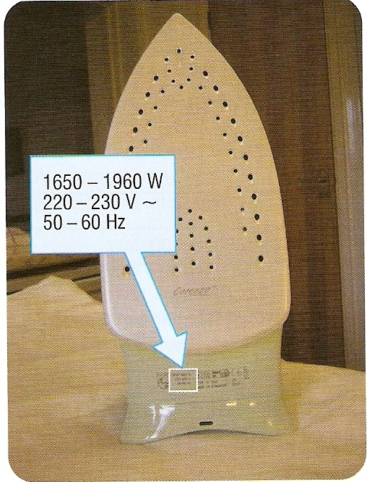
Electrical power ratings
These are always shown on an electrical device along with voltage and frequency requirements.

Slide 4
Electrical power examples
Device | Power rating
Torch
1W
Energy efficient lamp
11 W
Desktop computer
300 W
Hairdryer
1 000 W or 1 kW
Electric kettle
2 000 W or 2 kW
Electric shower
5 kW

Slide 5
Question 1
Calculate the power of a light bulb that uses 1800 joules of electrical energy in 90 seconds.

Slide 6
Question 1
Calculate the power of a light bulb that uses 1800 joules of electrical energy in 90 seconds.
electrical power = electrical energy
time
= 1800 J
90 s
electrical power = 20 watts

Slide 7
Question 2
Calculate the energy used in joules by a heater of power 3kW in 1 hour.

Slide 8
Question 2
Calculate the energy used in joules by a heater of power 3kW in 1 hour.
electrical power = electrical energy
time
becomes:
electrical energy = power x time
= 3 kW x 1 hour
= 3000 W x 3600 seconds
electrical energy used = 10 800 000 joules (or 10.8 MJ)

Slide 9
Complete:
Complete
Electrical energy used | Time | Power
600 J | 20 s
 | 15 s | 500 W
800 J |  | 20 W
60 kJ | 10 minutes

Slide 10
Complete:
Answers
Electrical energy used | Time | Power
600 J | 20 s
 | 15 s | 500 W
800 J |  | 20 W
60 kJ | 10 minutes
30 W
7 500 J
40 s
100 W

Slide 11
Electrical power, P electric current, I and voltage V
electrical power = current × voltage
P = I x V
electrical power is measured in watts (W)
electric current in amperes (A)
voltage in volts (V)

Slide 12
Question 1
Calculate the power of a 230V television that draws a current of 2.5A.

Slide 13
Question 1
Calculate the power of a 230V television that draws a current of 2.5A.
electrical power = current × voltage
= 2.5A x 230V
power = 575W

Slide 14
Question 2
Calculate the current drawn by a kettle of power 2kW when connected to the mains 230V power supply.

Slide 15
Question 2
Calculate the current drawn by a kettle of power 2kW when connected to the mains 230V power supply.
P = I x V
becomes:
I = P ÷ V
= 2kW ÷ 230V
= 2000W ÷ 230V
electric current = 8.7A

Slide 16
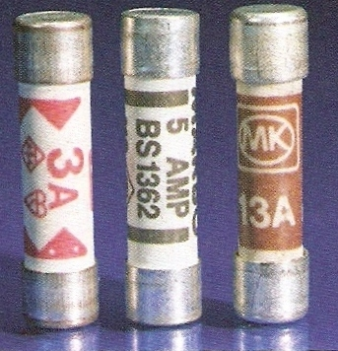
Fuse ratings
The equation:
current = electrical power
voltage
is used to find the fuse rating of a device.
The correct fuse rating is that next above the normal current required by an appliance.
Example:
A 5A fuse should be used with a device that needs a current of 3.5A.
A 3-pin plug will normally contain a 3A, 5A or 13A fuse.

Slide 17
Question
Fuses of 3A, 5A and 13A are available. What fuse should be used with a 60W, 230V lamp?

Slide 18
Question
Fuses of 3A, 5A and 13A are available. What fuse should be used with a 60W, 230V lamp?
I = P ÷ V
= 60W ÷ 230V
= 0.26A
Fuse to be used = 3A

Slide 19
Complete:
Answers
All of the devices below are 230V mains appliances.
Device and power (W) | Normal current (A) | Fuse choice from: 3A, 5A or 13A
Computer; 300W
Microwave; 900W
Charger; 10W
Heater; 2kW
Maximum power? | 13A
1.3 A
3.9 A
0.04A
8.7A
2990W

Slide 20
Complete:
Answers
All of the devices below are 230V mains appliances.
Device and power (W) | Normal current (A) | Fuse choice from: 3A, 5A or 13A
Computer; 300W
Microwave; 900W
Charger; 10W
Heater; 2kW
Maximum power? | 13A | 13A
1.3 A
3A
3.9 A
5A
0.04A
3A
8.7A
13A
2990W

Slide 21
Choose appropriate words to fill in the gaps below:
Electric power is the rate of conversion of electrical _______ to some other form and is measured in ______.
Electrical power is equal to electric current __________ by voltage. The greater the _______ for the same voltage the _________ is the current drawn.
The correct fuse for a device is the next available value _____ the normal current drawn by a device. The maximum fuse rating for a 3-pin plug is _______ for an appliance of power about _______.
WORD SELECTION:
multiplied
above
13A
watts
power
greater
3kW
energy

Slide 22
Choose appropriate words to fill in the gaps below:
Electric power is the rate of conversion of electrical _______ to some other form and is measured in ______.
Electrical power is equal to electric current __________ by voltage. The greater the _______ for the same voltage the _________ is the current drawn.
The correct fuse for a device is the next available value _____ the normal current drawn by a device. The maximum fuse rating for a 3-pin plug is _______ for an appliance of power about _______.
energy
watts
multiplied
power
greater
above
13A
3kW
WORD SELECTION:
multiplied
above
13A
watts
power
greater
3kW
energy

Slide 23
Electrical energy E
E = I x V x t
electrical energy (E ) is measured in joules (J)
electric current (I ) in amperes (A)
voltage (V ) in volts (V)
time (t ) in seconds (s)

Slide 24
Question 1
Calculate the energy used in joules by a 12V car starter motor when drawing a current of 80A for 3 seconds.
Notes:
24

Slide 25
Question 1
Calculate the energy used in joules by a 12V car starter motor when drawing a current of 80A for 3 seconds.
E = I x V x t
= 80A x 12V x 3s
electrical energy used = 2 880J
Notes:
25

Slide 26
Question 2
Calculate the energy used in joules by a hairdryer of power 1kW in 1 hour.
Notes:
26

Slide 27
Question 2
Calculate the energy used in joules by a hairdryer of power 1kW in 1 hour.
E = I x V x t
but electrical power P = I x V
and so: E = P x t
= 1 kW x 1 hour
= 1000 W x 3 600 seconds
electrical energy used = 3 600 000 joules (or 3.6 MJ)
Notes:
27

Slide 28
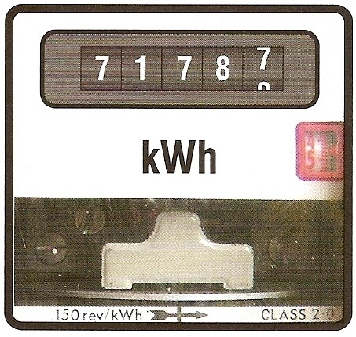
Paying for electricity
An electricity meter is used to measure the usage of electrical energy.
The meter measures in kilowatt-hours (kWh)
A kilowatt-hour is the electrical energy used by a device of power one kilowatt in one hour.
Notes:
28

Slide 29
Calculating cost
1 . Calculate kilowatt-hours used from:
kilowatt-hours = kilowatts x hours
2 . Calculate cost using:
cost in pence = kilowatt-hours x cost per kWh
Electricity currently costs about 12p per kWh
Notes:
29

Slide 30
Question 1
Calculate the cost of using an electric heater of power 2kW for 5 hours if each kWh costs 12cts.
Notes:
30

Slide 31
Question 1
Calculate the cost of using an electric heater of power 2kW for 5 hours if each kWh costs 12cts.
kilowatt-hours = kilowatts x hours
= 2kW x 5 hours
= 10 kWh
cost in pence = kilowatt-hours x cost per kWh
= 10 kWh x 12cts
= 120cts
cost of using the heater = Sh1.20
Notes:
31

Slide 32
Question 2
Calculate the cost of using a mobile phone charger power 10W for 6 hours if each kWh costs 12cts.
Notes:
32

Slide 33
Question 2
Calculate the cost of using a mobile phone charger power 10W for 6 hours if each kWh costs 12cts.
kilowatt-hours = kilowatts x hours
= 10W x 6 hours
= 0.01 kW x 6 hours
= 0.06 kWh
cost in cents = kilowatt-hours x cost per kWh
= 0.06 kWh x 12cts
cost of using the heater = Sh 0.72
Notes:
33

Slide 34

Electricity bill
Calculate the cost of the electricity that you use over a three month period (90 days).
Typical power values:
energy efficient light bulb – 15 W
desk-top computer – 300 W
hairdryer – 2 kW
television – 100 W
charger – 10 W
Example: light bulb used for 4 hours per day:
kWh = (0.015 x 4 x 90) = 5.4 kWh; cost = 5.4 x 12cts = Sh 64.8
Notes:
34

