Slide 1
KS4 Mathematics
N4 Decimals and rounding

Slide 2



Contents
N4 Decimals and rounding
A
N4.1 Decimals and place value
A
N4.2 Terminating and recurring decimals
A
N4.3 Calculating with decimals
A
N4.4 Rounding
A
N4.5 Upper and lower bounds

Slide 3
The decimal number system
The decimal number system allows us to use the digits 0 to 9 and the place value system to represent numbers of any size.
To represent whole numbers we label columns using increasing powers of 10:
×10
×10
×10
×10
Ten thousands
Units
Thousands
Hundreds
Tens
10⁴
10³
10²
10¹
10⁰
For example,
5
7
4
0
6
Notes:
Explain the place value system for whole numbers.
Discuss the example given and ask pupils to tell you the value of each digit in its given position. For example, ask what the 4 is worth. Also stress the importance of the zero place holder.

Slide 4
The decimal number system
To represent fractions of whole numbers in our place value system we extend the column headings in the other direction by dividing by 10.
Starting with the tens column we have:
÷10
÷10
÷10
÷10
Tens
Units
Tenths
Hundredths
Thousandths
10¹
10⁰
10⁻¹
10⁻²
10⁻³
For example,
4
8
0
3
5
The decimal point
Notes:
Explain the place value system for fractions of whole numbers and ask pupils to explain the function of the decimal point.
Make sure that pupils understand that the number shown in the example is read as “forty-eight point naught three five” and not “forty-eight point nought thirty-five”.
Again, ask pupils to tell you the value of each digit in its given position. For example, ask what the 3 is worth.
Stress the importance of the zero place holder.

Slide 5
The decimal number system
Hundreds
Tens
Units
Tenths
Hundredths
Thousandths
10²
10¹
10⁰
10⁻¹
10⁻²
10⁻³
2
4
3
5
7
4
WHOLE NUMBER PART
DECIMAL PART
The decimal point separates the whole number part from the fractional part.
We can think of the number in this example as:
243.574 =
200 + 40 + 3 +
5
+
7
+
4
10
100
1000

Slide 6
Contents
N4 Decimals and rounding
A
N4.1 Decimals and place value
A
N4.2 Terminating and recurring decimals
A
N4.3 Calculating with decimals
A
N4.4 Rounding
A
N4.5 Upper and lower bounds

Slide 7
Terminating decimals
A terminating decimal is a decimal that has a fixed number of digits after the decimal point.
For example,
0.6,
0.85
and
3.536
Terminating decimals can be written as vulgar fractions by writing them over the appropriate power of 10 and canceling if possible.
For example,
17
85
17
0.85 =
=
100
20
20
Notes:
If necessary, explain that ⁸⁵/₁₀₀ is equal to ⁸/₁₀ + ⁵/₁₀₀ because we can write this as ⁸⁰/₁₀₀ + ⁵/₁₀₀.
The activity on the next slide shows in detail how these fractions can be broken down.

Slide 8
Recurring decimals
8
Convert into a decimal using your calculator.
11
A calculator displays this as:
0.72727273
This decimal has been rounded to eight decimal places.
The last digit is a 3 because it has been rounded up.
The digits 2 and 7 actually repeat infinitely. This is an example of a recurring decimal.
We can show this by writing dots above the 7 and the 2.
8
.
.
= 0.72
11
Notes:
Discuss how a calculator can be used to convert a fraction into a decimal using division.
Ask pupils to explain why the last digit has been rounded up to a 3.

Slide 9
Recurring decimals
Here are some more examples of recurring decimals:
4
.
This decimal is made up of an infinite number of repeating 4’s.
= 0.4
9
5
.
This decimal starts with an 8 and is followed by an infinite number of repeating 3’s.
= 0.83
6
2
.
.
In this decimal, the six digits 285714 repeat an infinite number of times in the same order.
= 0.285714
7
9
.
.
This decimal starts with a 4. The two digits 09 then repeat an infinite number of times.
= 0.409
22
Notes:
Explain that when a single digit repeats we put a dot above it. When a series of digits repeat we put a dot above the first number in the series and the last digit in the series.
Explain that some recurring decimals are difficult to spot because there repeating cycles are so long. For example the fraction ¹/₁₇ when converted to decimal repeats every 16 digits. Calculators don’t display numbers to this number of decimal places and so a computer (or short division) would have to be used.

Slide 10
Recurring decimals and fractions
It is important to remember that all fractions convert to either terminating or recurring decimals.
If the denominator of the fraction divides into a power of 10 then the fraction will convert into a terminating decimal.
If the denominator of the fraction does not divide into a power of 10 then the fraction will convert into a recurring decimal.
The converse is also true. All terminating and recurring decimals can be written as fractions in the form where a and b are integers and b ≠ 0.
a
b
Notes:
We can check whether a number divides into a power of ten be writing it as a product of its prime factors. If the prime factors are 2’s and 5’s the number will divide into a power of 10. If the number has any prime factor that is not a 2 or a 10 then the decimal form of the fraction will recur. You may wish pupils to investigate this individually.

Slide 11
Converting recurring decimals to fractions
We can use place value to convert terminating decimals to fractions.
Converting recurring decimals to fractions is more difficult. For example,
Write 0.88888… as a fraction.
Start by letting the recurring decimal be equal to x.
x = 0.88888…
One digit recurs so multiply both sides by 10.
10x = 8.88888…

Slide 12
Converting recurring decimals to fractions
Write 0.88888… as a fraction.
Call these equations ¹ and ² .
x = 0.88888…
1
10x = 8.88888…
2
Now, subtracting ¹ from ² we have,
9x = 8
Dividing both sides of the equation by 9 we have,
8
x =
9
Notes:
Explain that subtracting equations 1 and 2 eliminates the recurring decimal part.
Pupils can check this on their calculators by dividing 8 by 11.

Slide 13
Converting recurring decimals to fractions
Write 0.63636… as a fraction.
Let
x = 0.63636…
1
Two digits recur so multiply both sides by 100,
100x = 63.63636…
2
Now, subtracting ¹ from ² we have,
99x = 63
Dividing both sides of the equation by 99 we have,
63
7
7
x =
=
99
11
11
Notes:
Pupils can check this on their calculators by dividing 7 by 11.

Slide 14
Converting recurring decimals to fractions
Write 0.370370… as a fraction.
Let
x = 0.370370…
1
Three digits recur so multiply both sides by 1000,
1000x = 370.370370…
2
Now, subtracting ¹ from ² we have,
999x = 370
Dividing both sides of the equation by 999 we have,
370
10
10
x =
=
999
27
27
Notes:
Explain that this time we multiply by 1000 to eliminate the decimal part. Explain to pupils that to make equation 2 they should always multiply both side of equation 1 by the smallest power of 10 necessary to form a number that has the same recurring decimal as equation 1.
It is not obvious that 999 is divisible by 37. Show pupils how this fraction could be cancelled down using the fraction key on the calculator.
Pupils can check the solution on their calculators by dividing 10 by 27.

Slide 15
Nought point nine recurring
The number 0.99999… gives us an interesting result when we use this method to convert it into a fraction.
Let
x = 0.99999…
1
Multiply both sides by 10,
10x = 9.99999…
2
Now, subtracting ¹ from ² we have,
9x = 9
Dividing both sides of the equation by 9 we have,
x = 1
0.99999… is exactly equal to 1.
Notes:
This slide shows that 0.9 recurring is exactly equal to 1.
This result has important implications when considering the upper bounds of rounded numbers. For example, the upper bound of a measurement given as 3 cm to the nearest cm is 3.5 cm. If the measurement was exactly 3.5 cm it would be rounded up to 4 cm. We could therefore consider that the most that this measurement could by is 3.49 recurring. However, if we use the method shown on this slide it can be shown that 3.49 recurring is not slightly less than 3.5 as we may imagine but actually exactly equal to 3.5. This proves that there cannot be any number between 3.49 recurring and 3.5 (because they occupy the same position on the number line). So when we write 2.5 < length ≤ 3.5 we know that this includes every value between 2.5 and 3.5.

Slide 16
Rational numbers
a
Any number that can be written in the form (where a and b are integers and b ≠ 0) is called a rational number.
b
All of the following are rational:
.
6
7
–12
0.3
8
3
43.721
7
4
All integers are rational because they can be written as
the integer
1
We have seen that all terminating and recurring decimals can be written as fractions in the form . This means that they are also rational.
a
b
Notes:
Conclude that any number that can be written exactly as a positive or negative whole number, fraction or decimal is rational.

Slide 17
Irrational numbers
a
Some numbers cannot be written in the form .
b
These numbers are called irrational numbers.
If we tried to write an irrational number as a decimal it would neither terminate nor recur. It would be represented by an infinite non-repeating string of digits.
This means that irrational numbers can only be written as approximations to a given number of decimal places.
Examples of irrational numbers include:
π
√3
and
sin 50°
Notes:
Tell pupils that to overcome the problems associated with representing irrational numbers using digits we often represent them with letters, such as π and leave them in this form. This not only looks neater but it is more accurate.
Irrational numbers involving square roots are often written using surds.
See N2.5 Surds.

Slide 18

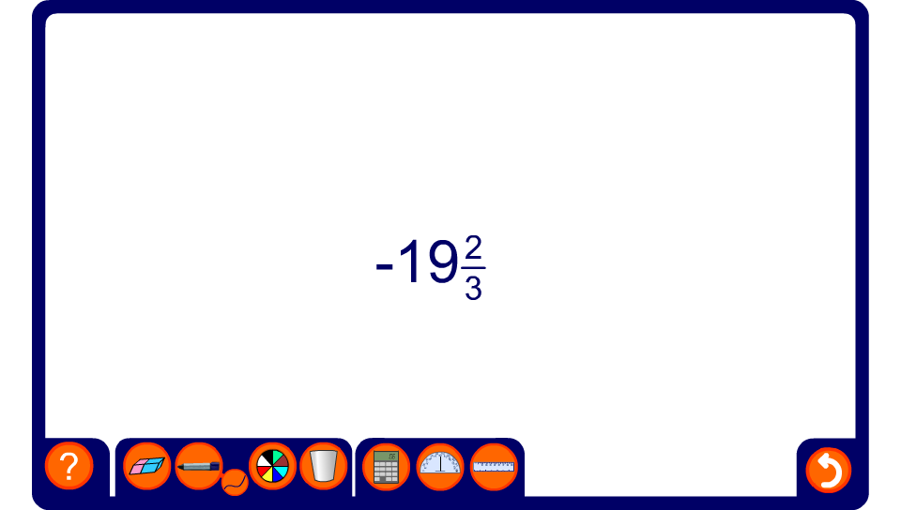
Rational or irrational?
Notes:
Decide whether the number shown is rational of irrational.

Slide 19
Contents
N4 Decimals and rounding
A
N4.1 Decimals and place value
A
N4.2 Terminating and recurring decimals
A
N4.3 Calculating with decimals
A
N4.4 Rounding
A
N4.5 Upper and lower bounds

Slide 20
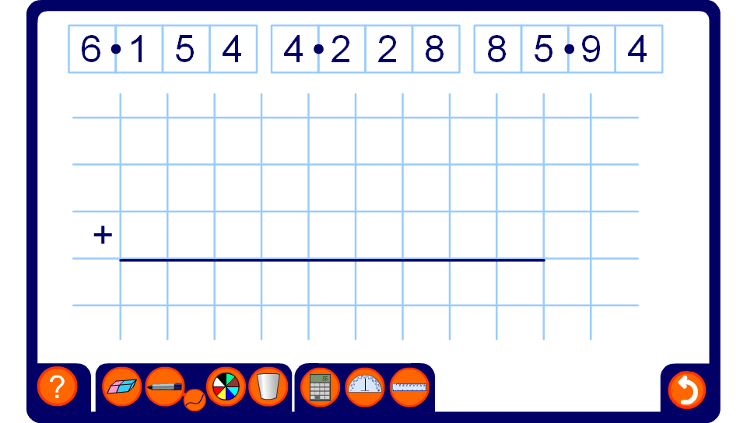
Adding and subtracting decimals
Notes:
Use this activity to demonstrate that the decimal points must be lined up when adding and subtracting decimals by dragging the given decimals into the correct position on the square grid.
Use the pen tool to fill in any zero place holders and to complete the calculation.
Ask volunteers to come to the board and complete calculations.

Slide 21
Short multiplication
What is 2.28 × 7?
Start by finding an approximate answer:
2.28 × 7 ≈
2 × 7 =
14
2.28 × 7 is equivalent to 228 × 7 ÷ 100.
228
× 7
Answer
15
9
6
2.28 × 7 = 1596 ÷ 100
= 15.96
1
5
Notes:
Put this multiplication into context. For example, suppose you are at a supermarket and you want to buy 7 boxes of cola cans costing £2.28 a box. You have £15 in your wallet. Do you have enough money?
Start by establishing that 2.28 × 7 is too difficult to work out mentally. (If necessary, we could work out 2.28 × 8 by doubling 3 times and then subtract 2.28 to get 2.28 × 7).
We will have to use a written method. We could use the grid method or, as shown here, the column method. (Pupils may have met other written methods such as the Chinese or lattice method.)
Stress that whatever method we use we should start by writing down an approximate answer.
Explain that it is easier to multiply by whole numbers than it is to multiply by decimals. It is therefore sensible to find an equivalent whole number calculation, in this case 2.28 × 7 ÷ 100.
Talk through the standard column method for multiplying 7 and 228. Remind pupils that we always write down the units and carry the tens to the next column.
Explain that what we are actually doing when we perform this calculation is work out 7 × 8, then 7 × 20 and then 7 × 200. As we carry the tens across each time, we are adding these three together as we go along. (This method is therefore more efficient than the grid method.)
To find 2.28 × 7 we need to divide by 100. Check this answer by comparing it to the approximation made at the beginning.

Slide 22
Short multiplication
What is 392.7 × 0.8?
Again, start by finding an approximate answer:
392.7 × 0.8 ≈
400 × 1 =
400
392.7 × 0.8 is equivalent to 3927 × 8 ÷ 100
3927
Answer
× 8
392.7 × 0.8 = 31416 ÷ 100
31
4
1
6
= 314.16
7
2
5
Notes:
Again, explain that it is easier to multiply by whole numbers than it is to multiply by decimals. It is therefore sensible to find an equivalent whole number calculation in this case 3927 × 8 ÷ 10 ÷ 10 = 3927 × 8 ÷ 100
Talk through the standard column method for multiplying 8 and 3927. Remind pupils that we always write down the units and carry the tens to the next column.
To find 392.7 × 0.8 we need to divide by 100. Check this answer by comparing it to the approximation made at the beginning.

Slide 23
Long multiplication
Calculate 57.4 × 24
Estimate: 60 × 25 = 1500
Equivalent calculation: 57.4 × 10 × 24 ÷ 10
= 574 × 24 ÷ 10
574
× 24
4 × 574 =
2296
20 × 574 =
11480
13776
Answer: 13776 ÷ 10 = 1377.6
Notes:
Talk through possible estimates for this calculation.
The next step is to form an equivalent calculation using whole numbers. For example, if we are multiplying together 57.4 and 24, we can multiply 57.4 by 10 to make a whole number. We must then divide by 10 to undo the effect of multiplying by 10. Therefore 57.4 × 24 = 57.4 × 10 × 24 ÷ 10.
Explain that when we multiply by a two digit whole number we have to partition the number into tens and units. We multiply by the units first, in this case 4, and then by the tens, in this case 20. these tow answers are then added together.
Stress that the final answer should be compared with the estimate to check the order of magnitude.

Slide 24
Long multiplication
Calculate 23.2 × 1.8
Estimate: 23 × 2 = 46
Equivalent calculation: 23.2 × 10 × 1.8 × 10 ÷ 100
= 232 × 18 ÷ 100
232
× 18
8 × 232 =
1856
10 × 232
2320
4176
Answer: 4176 ÷ 100 = 41.76

Slide 25
Long multiplication
Calculate 394 × 0.47
Estimate: 400 × 0.5 = 200
Equivalent calculation: 394 × 0.47 × 100 ÷ 100
= 394 × 47 ÷ 100
394
× 47
7 × 394 =
2758
40 × 394
15760
18518
Answer: 18518 ÷ 100 = 185.18

Slide 26
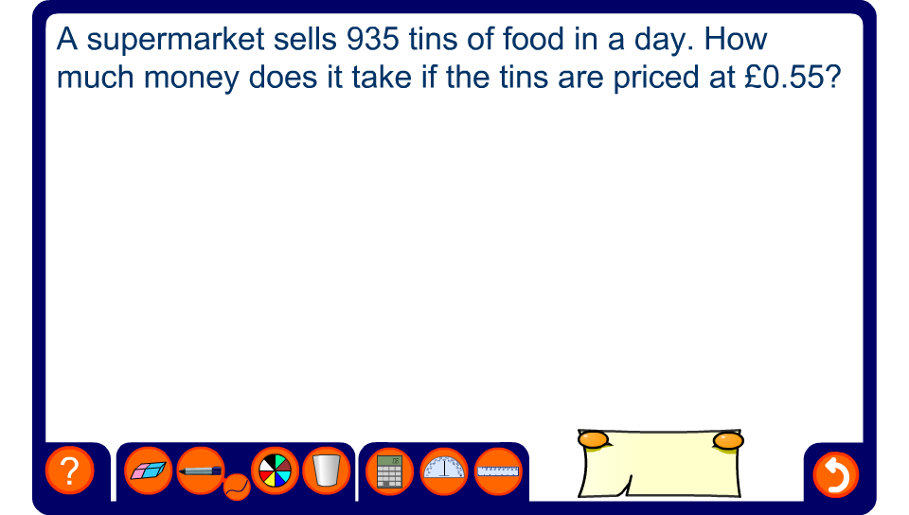
Long multiplication
Notes:
Use the pen tool to complete the calculation on the board.

Slide 27
Short division
Calculate 259.2 ÷ 6
Start by finding an approximate answer:
259.2 ÷ 6 ≈
240 ÷ 6 =
40
0
4
3
.
2
6
2 5 9 . 2
2
1
1
259.2 ÷ 6 = 43.2
Notes:
We can also work this out using short division. This method can be used when dividing by a single digit and is much quicker than subtracting multiples.
Once again, we start by writing down an approximate answer.
Explain that when dividing 2 by 6, it is not strictly necessary to write down the 0 at the front. However, doing this helps to keep the digits lined up in the correct position. Stress the position of the decimal point, which must be lined up with the decimal point beneath it.
Ensure that pupils are able to divide mentally and can find remainders mentally by subtraction or otherwise.

Slide 28
Short division by a decimal
Calculate 57.23 ÷ 0.8 to 2 decimal places.
When we are asked to divide by a decimal we should first write an equivalent calculation with a whole number divider.
×10
57.23
572.3
=
0.8
8
×10
We can then find an approximate answer:
572.3 ÷ 8 ≈
560 ÷ 8 =
70

Slide 29
Short division by a decimal
Calculate 57.23 ÷ 0.8 to 2 decimal places.
We are dividing by a single digit and so it is most efficient to use short division:
We need to find the value of this digit to see whether we need to round up or down.
0
7
1
.
5
3
7
8
5 7 2 . 3
5
1
4
3
0
6
0
57.23 ÷ 0.8 = 71.54 (to 2 d.p.)

Slide 30
Dividing by two-digit numbers
Calculate 75.4 ÷ 3.1
Estimate: 75 ÷ 3 = 25
Equivalent calculation: 75.4 ÷ 3.1 = 754 ÷ 31
31
754
- 620
20 × 31
134
- 124
4 × 31
10.0
- 9.3
0.3 × 31
0.70
- 0.62
0.02 × 31
0.08
Answer: 75.4 ÷ 3.1 = 24.32 R 0.08
= 24.3 to 1 d.p.
Notes:
Talk through the standard method of repeated subtraction for division.
Stress that we should always start by estimating the answer. When dividing we should always round to numbers that divide exactly.
When dividing by a decimal, we write an equivalent calculation with a whole number divisor. We then use repeated subtraction to divide.
Emphasize the need to work systematically when using this method.
If we wish to find the the quotient to one decimal place, as shown in this examples, then it is necessary to find the value of the number in the second decimal place so that we know whether to round up or down.

Slide 31
Dividing by two-digit numbers
Calculate 8.12 ÷ 0.46
Estimate: 8 ÷ 0.5 = 16
Equivalent calculation: 8.12 ÷ 0.46 = 812 ÷ 46
46
812
- 460
10 × 46
352
- 322
7 × 46
30.0
- 27.6
0.6 × 46
2.40
- 2.30
0.05 × 46
0.10
Answer: 8.12 ÷ 0.43 = 17.65 R 0.1
= 17.7 to 1 d.p.
Notes:
In this example, we multiply both numbers by 100 to make an equivalent whole number calculation.
If required copy this slide and change the numbers to give more examples.
Set pupils variety of divisions by two-digit decimals to practise.

Slide 32
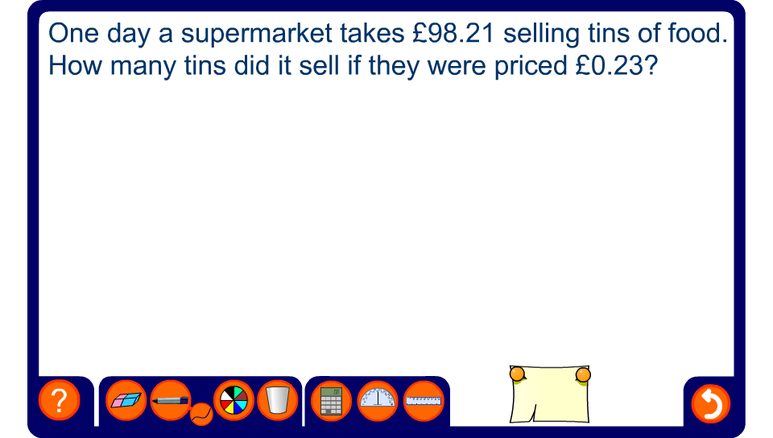
Long division
Notes:
Use the pen tool to complete the calculation on the board.

Slide 33
Contents
N4 Decimals and rounding
A
N4.1 Decimals and place value
A
N4.2 Terminating and recurring decimals
A
N4.3 Calculating with decimals
A
N4.4 Rounding
A
N4.5 Upper and lower bounds

Slide 34

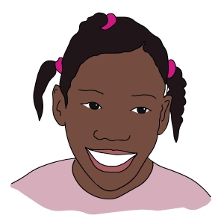
Rounding
We do not always need to know the exact value of a number.
For example,
There are 1432 pupils at Eastpark Secondary School.
There are about one and a half thousand pupils at Eastpark Secondary School.
Notes:
Talk about rounding in real life contexts, for example the number of people at a football match. Ask pupils to give examples.
State that we can also use rounding in maths to give approximate answers to calculations.
We can round numbers to the nearest 1000, 100, 10, whole number, 0.1, 0.01 0.001, and so on, depending on the level of accuracy required.

Slide 35
Rounding
There are four main ways of rounding a number:
1) To the nearest 10, 100, 1000, or other power of ten.
2) To the nearest whole number.
3) To a given number of decimal places.
4) To a given number of significant figures.
The method of rounding used usually depends on what kind of numbers we are dealing with.
Whole numbers, for example, can be rounded to the nearest power of ten or to a given number of significant figures.
Notes:
Point out that in some cases we may by required to give a whole number to a given number of decimal places. When this happens the decimal places are filled with 0’s. For example, 8 to three decimal places is 8.000.
In some cases we may round to other numbers, for example to the nearest 0.5, 5, 50, 500 etc. but this is less usual.

Slide 36
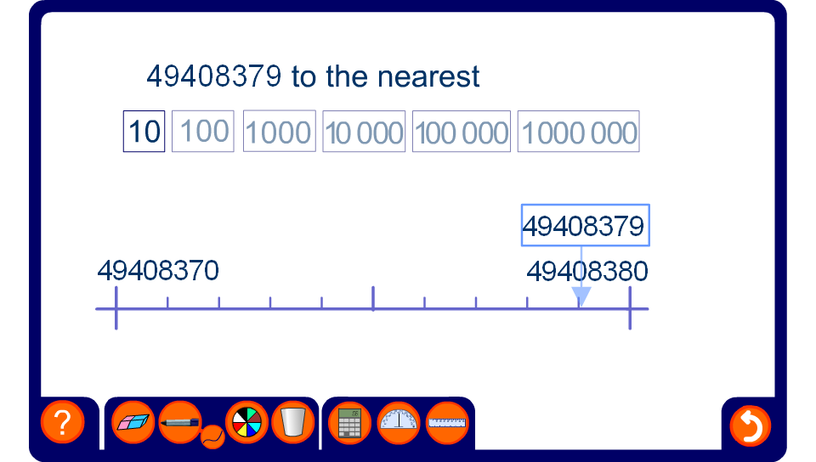
Rounding to powers of ten
Notes:
This activity illustrates the rounding of large whole numbers to the nearest 10, 100, 1000, 10 000, 100 000 or 1 000 000 using a number line.
For each example ask pupils to round the number by deciding which end-point it is closest to.

Slide 37
Rounding to powers of ten
Example
Round 34 871 to the nearest 100.
Round 34 871
Round 34 871
Look at the digit in the hundreds position.
We need to write down every digit up to this.
Look at the digit in the tens position.
If this digit is 5 or more then we need to round up the digit in the hundreds position.
Solution:
34871 = 34900 (to the nearest 100)
Notes:
Talk through the example.
Note that 34871 is not equal to 34900. 34900 is an approximation. We must include ‘to the nearest 100’ to ensure that the equals sign is not used incorrectly.

Slide 38
Rounding to powers of ten
Complete this table:
to the nearest 1000
to the nearest 100
to the nearest
10
37521
38000
37500
37520
274503
275000
274500
274500
7630918
7631000
7630900
7630920
9875
10000
9900
9880
452
0
500
450
Notes:
Talk through each answer in the table. The numbers can be modified as required.

Slide 39
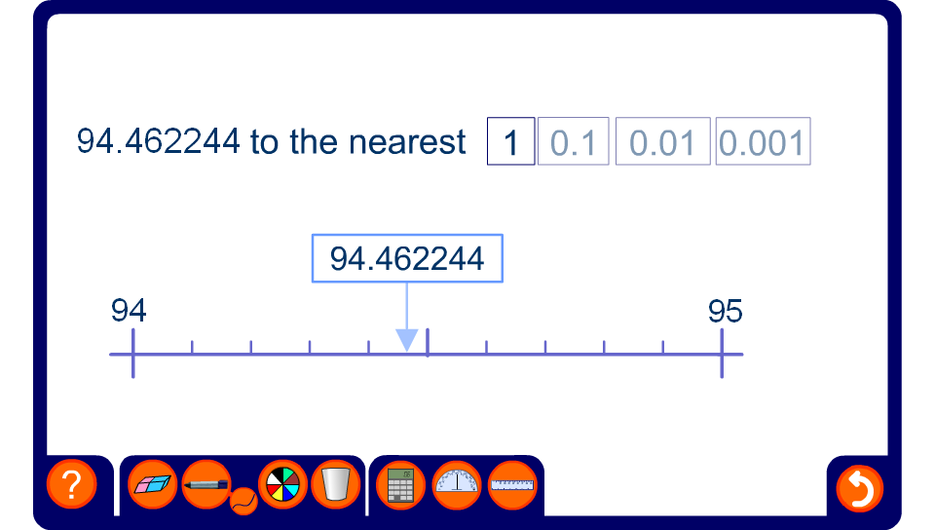
Rounding to decimal places
Notes:
This activity illustrates the rounding of decimal numbers on a number line to the nearest whole number, 0.1, 0.001 or 0.0001.
For each example ask pupils to round the number by deciding which end-point it is closest to.

Slide 40
Rounding to decimal places
Example
Round 2.75241302
Round 2.75241302 to one decimal place.
Round 2.75241302
Round 2.75241302
Look at the digit in the first decimal place.
We need to write down every digit up to this.
Look at the digit in the second decimal place.
If this digit is 5 or more then we need to round up the digit in the first decimal place.
2.75241302 to 1 decimal place is 2.8.
Notes:
Talk through the example.
Emphasize that 2.75241302 is not equal to 2.8. 2.8 is an approximation.

Slide 41
Rounding to decimal places
Complete this table:
to the nearest whole number
to 1 d.p.
to 2 d.p.
to 3 d.p.
63.4721
63
63.5
63.47
63.472
87.6564
88
87.7
87.66
87.656
149.9875
150
150.0
149.99
149.988
3.54029
4
3.5
3.54
3.540
0.59999
1
0.6
0.60
0.600
Notes:
Talk through each answer in the table. The numbers can be modified as required.
Stress that the number of decimal places tells you the number of digits that must be written after the decimal point, even if the last digit (or digits) are zero.

Slide 42
Rounding to significant figures
Numbers can also be rounded to a given number of significant figures.
The first significant figure of a number is the first digit which is not a zero.
For example,
4 890 351
4 890 351
This is the first significant figure
and
0.0007506
0.0007506
This is the first significant figure

Slide 43
Rounding to significant figures
The second, third and fourth significant figures are the digits immediately following the first significant figure, including zeros.
For example,
4 890 351
4 890 351
4 890 351
4 890 351
4 890 351
This is the first significant figure
This is the second significant figure
This is the third significant figure
This is the fourth significant figure
and
0.0007506
0.0007506
0.0007506
0.0007506
0.0007506
This is the first significant figure
This is the second significant figure
This is the third significant figure
This is the fourth significant figure

Slide 44
Rounding to significant figures
Complete this table:
to 3 s. f.
to 2 s. f.
to 1 s. f.
6.3528
6.35
6.4
6
34.026
34.0
34
30
0.005708
0.00571
0.0057
0.006
150.932
151
150
200
0.00007835
0.0000784
0.000078
0.00008
Notes:
Discuss each example, including the use of zero place holders and zeros that are significant figures. The numbers can be modified as required.

Slide 45
Contents
N4 Decimals and rounding
A
N4.1 Decimals and place value
A
N4.2 Terminating and recurring decimals
A
N4.3 Calculating with decimals
A
N4.4 Rounding
A
N4.5 Upper and lower bounds

Slide 46
Discrete and continuous quantities
Numerical data can be discrete or continuous.
Discrete data can only take certain values.
For example,
shoe sizes,
the number of children in a class,
amounts of money
Continuous data comes from measuring and can take any value within a given range.
For example,
the weight of a banana,
the time it takes for pupils to get to school,
heights of 15 year-olds.

Slide 47
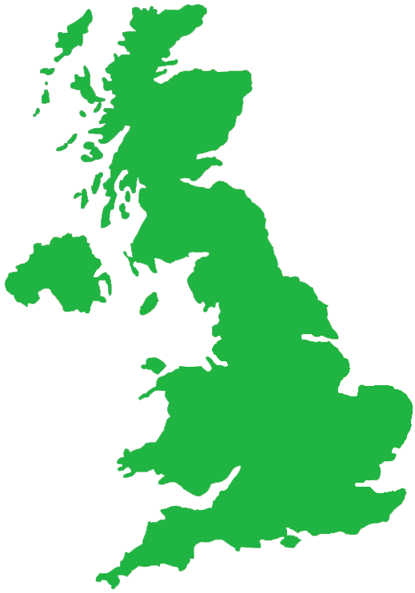
Upper and lower bounds for discrete data
The population of the United Kingdom is 59 million to the nearest million.
What is the least this number could be?
The least this number could be before being rounded up is:
58 500 000
What is the most this number could be?
The most this number could be before being rounded down is:
59 499 999
Notes:
Discuss the fact that if the population has been given to the nearest million the actual amount could be half a million more or less either way. Because of the convention of rounding up when a number is half way between two others, the most the population could be is 59 500 000 – 1 (= 59 499 999).

Slide 48
Upper and lower bounds
We can give the possible range for the population as:
58 500 000 ≤ population ≤ 59 499 999
This value is called the lower bound …
… and this value is called the upper bound.
This is an inequality. It says that the actual population of the United Kingdom is between 58 500 000 and 59 499 999.
Because we have used ≤ symbols it means that these two numbers are included in the range of possible values. We could also write the range as:
58 500 000 ≤ population < 59 500 000
Notes:
Remind pupils that because the population is discrete data, we can only have whole numbers between the two values given.

Slide 49
Upper and lower bounds for discrete data
Last year a shopkeeper made a profit of £43 250, to the nearest £50.
What range of values could this amount be in?
The lower bound is half-way between £43 200 and £43 250:
£43 225
The upper bound is half-way between £43 250 and £43 300, minus 1p:
£43 274.99
The range for this profit is:
£43 225 ≤ profit ≤ £43 274.99
Notes:
Explain that because the amount has been rounded to the nearest £50, the lower bound must be half-way between the given amount and the given amount – £50.
The upper bound must be half-way between the given amount and the given amount + £50. We then subtract 1p because if the amount was equal to £43 275 it would be rounded up to £43 300. 1p is the smallest amount we can subtract because we consider amounts of money to be discrete since they are given in a whole number pence.

Slide 50
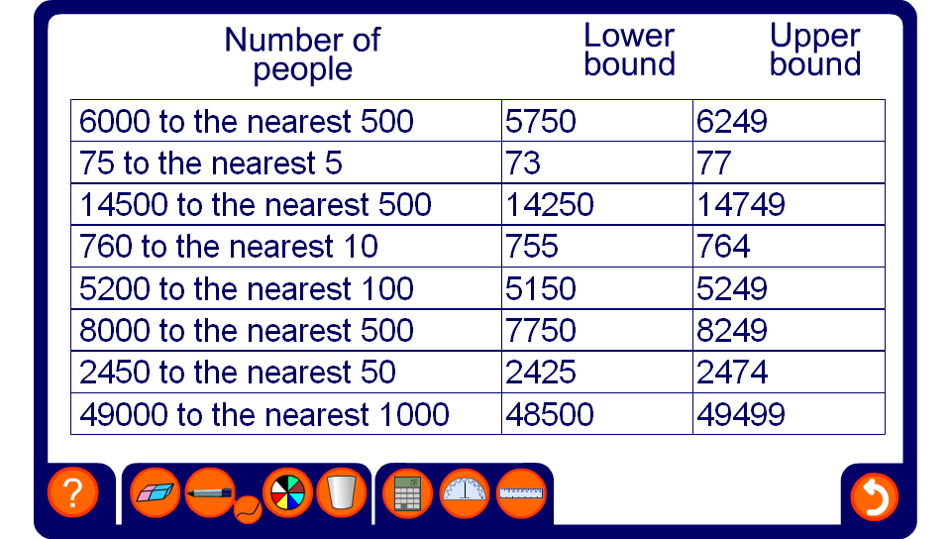
Upper and lower bounds for discrete data

Slide 51

Upper and lower bounds for continuous data
The height of the Eiffel Tower is 324 meters to the nearest meter.
What is the least this measurement could be?
The least this measurement could be before being rounded up is:
323.5 m
What is the most this measurement could be?
The most this measurement could be before being rounded down is up to but not including:
324.5 m

Slide 52
Upper and lower bounds
We can write the range for this measurement as:
323.5 m ≤ height < 324.5 m
This value is called the lower bound …
… and this value is called the upper bound.
The height could be equal to 323.5 m so we use a greater than or equal to symbol.
If the length was equal to 324.5 m however, it would have been rounded up to 325 m. The length is therefore “strictly less than” 324.5 m and so we use the < symbol.
Notes:
We can read the inequality as “the height is between 323.5 m and 324.5 m, but doesn’t include 324.5 m”.
Explain that if the length is strictly less than 324.5 cm, it can be any value up to 324.4999…
It is interesting to note that if we convert 324.49 recurring using the method shown in 4.2 Terminating and recurring decimals, we can show that it is actually equal to 324.5.
See S8.3 Calculations involving bounds to investigate the combined effect of bounds in calculations.

Slide 53
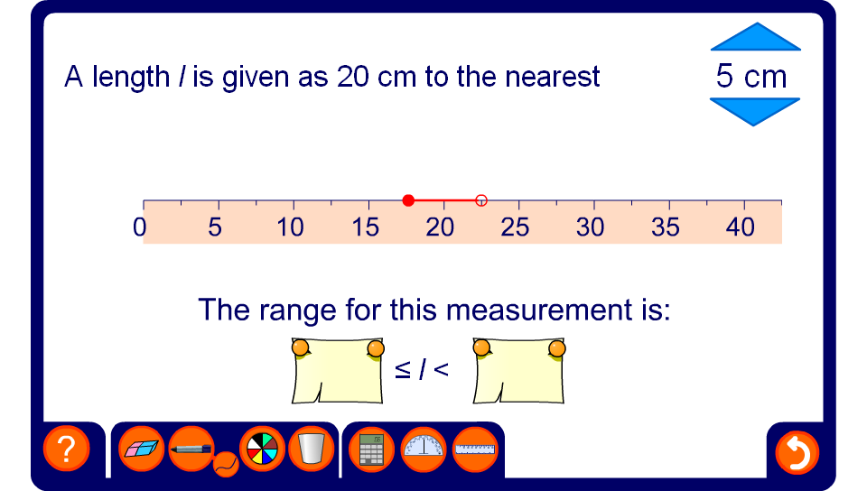
Upper and lower bounds
Notes:
Use this activity to demonstrate how to locate the upper and lower bounds of measurements given to the nearest 0.01, 0.1, 1, 5, or 10 centimeters. The measurement can be changed by dragging on the ruler.
Stress that when we illustrate an inequality on a number line the value indicated by the empty circle is not included.
Upper and lower bounds for measurements in also covered in S8.3 Accuracy in measurement.

