Slide 1
VECTORS
3D Vectors
Properties 3D
Section formula
Scalar Product
Component Form
Angle between vectors
Perpendicular
Properties of Scalar Product
Exam Type Questions

Slide 2
Collinearity
Reminder from chapter 1
Points are said to be collinear if they lie on the same straight line.
For vectors

Slide 3
Collinearity
Prove that the points A(2,4), B(8,6) and C(11,7) are collinear.

Slide 4
Collinearity

Slide 5
Section Formula
B
3
2
S
b
1
s
A
a
O

Slide 6
General Section Formula
B
m + n
n
P
b
m
p
A
a
O

Slide 7
General Section Formula
Summarising we have
B
If p is a position vector
of the point P that divides
AB in the ratio m : n
then
n
P
m
A

Slide 8
General Section Formula
A and B have coordinates (-1,5)
and (4,10) respectively.
Find P if AP : PB is 3:2
B
2
P
3
A

Slide 9
3D Coordinates
In the real world points in space can be located using a 3D coordinate system.
For example, air traffic controllers find the location a plane by its height and grid reference.
z
y
(x, y, z)
x
O

Slide 10
3D Coordinates
Write down the coordinates for the 7 vertices
z
y
E
(0, 1, 2)
A
(6, 1, 2)
(0, 0, 2)
F
2
B
H
(6, 0, 2)
(0,0, 0)
D
(6, 1, 0)
G
1
x
O
6
C
(6, 0, 0)
What is the coordinates of the vertex H so that it makes a cuboid shape.
H(0, 1, 0 )

Slide 11
3D Vectors
3D vectors are defined by 3 components.
For example, the velocity of an aircraft taking off can be illustrated by the vector v.
z
(7, 3, 2)
2
y
v
2
3
3
x
O
7
7

Slide 12
3D Vectors
Any vector can be represented in terms of the i , j and k
Where i, j and k are unit vectors
in the x, y and z directions.
z
y
k
j
O
i
x

Slide 13
3D Vectors
Any vector can be represented in terms of the i , j and k
Where i, j and k are unit vectors
in the x, y and z directions.
z
(7, 3, 2)
y
v
2
v = ( 7i+ 3j + 2k )
3
O
x
7

Slide 14
3D Vectors
Good News
All the rules for 2D vectors apply in the same way for 3D.

Slide 15
Magnitude of a Vector
A vector’s magnitude (length) is represented by
A 3D vector’s magnitude is calculated using Pythagoras Theorem twice.
z
y
v
1
2
O
x
3

Slide 16
Addition of Vectors
Addition of vectors

Slide 17
Addition of Vectors
In general we have
For vectors u and v

Slide 18
Negative Vector
Negative vector
For any vector u

Slide 19
Subtraction of Vectors
Subtraction of vectors

Slide 20
Subtraction of Vectors
For vectors u and v

Slide 21
Multiplication by a Scalar
Multiplication by a scalar ( a number)
Hence if u = kv then u is parallel to v
Conversely if u is parallel to v then u = kv

Slide 22
Multiplication by a Scalar
Show that the two vectors are parallel.
If z = kw then z is parallel to w

Slide 23
Position Vectors
A (3,2,1)
z
a
y
1
2
O
x
3

Slide 24
Position Vectors

Slide 25
General Section Formula
Summarising we have
B
If p is a position vector
of the point P that divides
AB in the ratio m : n
then
n
P
m
A

Slide 26
The scalar product
Must be
tail to tail
The scalar product is defined as being:
a
θ
b

Slide 27
The Scalar Product
Find the scalar product for a and b when
|a|= 4 , |b|= 5 when (a) θ = 45º (b) θ = 90º

Slide 28
The Scalar Product
Find the scalar product for a and b when
|a|= 4 , |b|= 5 when (a) θ = 45º (b) θ = 90º
Important : If a and b are perpendicular then
a . b = 0

Slide 29
Component Form Scalar Product
If
then

Slide 30
Angle between Vectors
To find the angle between two vectors we simply use the scalar product formula rearranged
or

Slide 31
Angle between Vectors
Find the angle between the two vectors below.

Slide 32
Angle between Vectors
Find the angle between the two vectors below.

Slide 33
Perpendicular Vectors
Show that for
a . b =0
a and b are perpendicular

Slide 34
Perpendicular Vectors
Then
If a . b = 0 then a and b are perpendicular

Slide 35
Properties of a Scalar Product
Two properties that you need to be aware of

Slide 36
Vectors
Higher Maths
Strategies
Click to start

Slide 37
Vectors Higher
The following questions are on
Vectors
Non-calculator questions will be indicated
You will need a pencil, paper, ruler and rubber.
Click to continue

Slide 38
Vectors Higher
The questions are in groups
General vector questions (15)
Points dividing lines in ratios
Collinear points (8)
Angles between vectors (5)
Quit
Quit

Slide 39
Vectors Higher
General Vector Questions
Continue
Quit
Quit
Back to menu

Slide 40
Vectors Higher
Vectors u and v are defined by and
Determine whether or not u and v are perpendicular to each other.
Is Scalar product = 0
Hence vectors are perpendicular
Hint
Previous
Quit
Quit
Next

Slide 41
Vectors Higher
For what value of t are the vectors and perpendicular ?
Put Scalar product = 0
Perpendicular ⇒ u.v = 0
Hint
Previous
Quit
Quit
Next

Slide 42
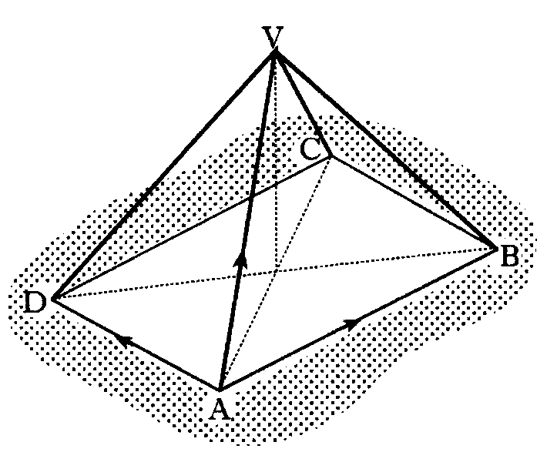
Vectors Higher
VABCD is a pyramid with rectangular base ABCD.
The vectors are given by
Express in component form.
Ttriangle rule Δ ACV
Re-arrange
Triangle rule Δ ABC
also
Hint
Previous
Quit
Quit
Next

Slide 43
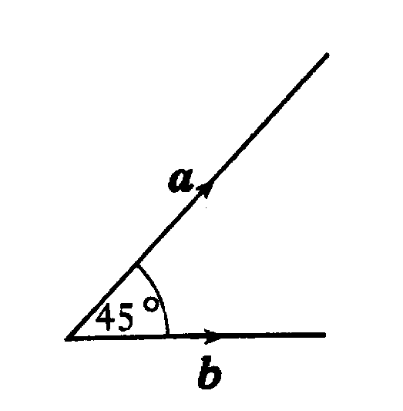
Vectors Higher
The diagram shows two vectors a and b, with | a | = 3 and | b | = 2√2.
These vectors are inclined at an angle of 45° to each other.
a) Evaluate
i) a.a ii) b.b iii) a.b
b) Another vector p is defined by
Evaluate p.p and hence write down | p |.
i)
ii)
iii)
b)
Since p.p = p²
Hint
Previous
Quit
Quit
Next

Slide 44
Vectors Higher
Vectors p, q and r are defined by
a) Express in component form
b) Calculate p.r
c) Find |r|
a)
b)
c)
Hint
Previous
Quit
Quit
Next

Slide 45
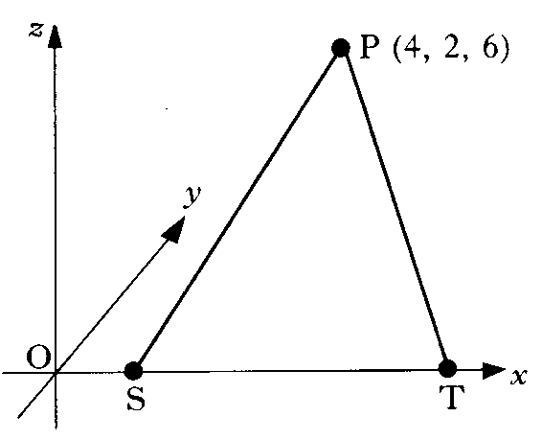
Vectors Higher
The diagram shows a point P with co-ordinates
(4, 2, 6) and two points S and T which lie on the x-axis.
If P is 7 units from S and 7 units from T,
find the co-ordinates of S and T.
Use distance formula
hence there are 2 points on the x axis that are 7 units from P
i.e. S and T
and
Hint
Previous
Quit
Quit
Next

Slide 46
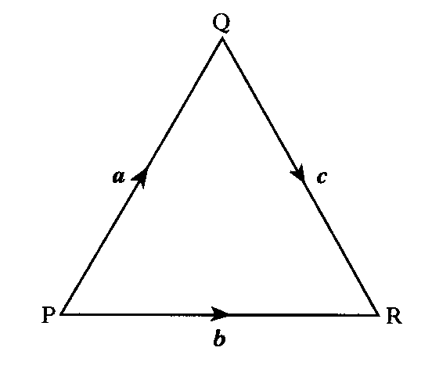
Vectors Higher
The position vectors of the points P and Q are
p = –i +3j+4k and q = 7 i – j + 5 k respectively.
a) Express in component form.
b) Find the length of PQ.
a)
b)
Hint
Previous
Quit
Quit
Next

Slide 47
Vectors Higher
PQR is an equilateral triangle of side 2 units.
Evaluate a.(b + c) and hence identify
two vectors which are perpendicular.
P
60°
a
b
Diagram
60°
60°
Q
R
c
NB for a.c vectors must point OUT of the vertex ( so angle is 120° )
Hence
so, a is perpendicular to b + c
Hint
Previous
Table of
Exact Values
Quit
Quit
Next

Slide 48
Vectors Higher
Calculate the length of the vector 2i – 3j + √3k
Length
Hint
Previous
Quit
Quit
Next

Slide 49
Vectors Higher
Find the value of k for which the vectors and are perpendicular
Put Scalar product = 0
Hint
Previous
Quit
Quit
Next

Slide 50
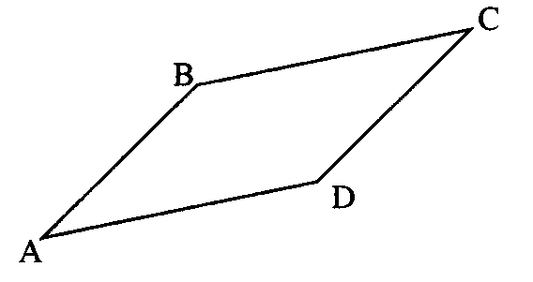
Vectors Higher
A is the point (2, –1, 4), B is (7, 1, 3) and C is (–6, 4, 2).
If ABCD is a parallelogram, find the co-ordinates of D.
D is the displacement
from A
hence
Hint
Previous
Quit
Quit
Next

Slide 51
Vectors Higher
If and write down the components of u + v and u – v
Hence show that u + v and u – v are perpendicular.
look at scalar product
Hence vectors are perpendicular
Hint
Previous
Quit
Quit
Next

Slide 52
Vectors Higher
The vectors a, b and c are defined as follows:
a = 2i – k, b = i + 2j + k, c = –j + k
a) Evaluate a.b + a.c
b) From your answer to part (a), make a deduction about the vector b + c
a)
b)
b + c is perpendicular to a
Hint
Previous
Quit
Quit
Next

Slide 53
Vectors Higher
A is the point ( –3, 2, 4 ) and B is ( –1, 3, 2 )
Find:
a) the components of
b) the length of AB
a)
b)
Hint
Previous
Quit
Quit
Next

Slide 54
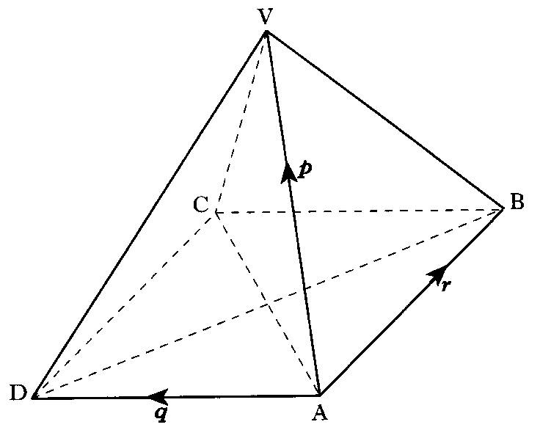
Vectors Higher
In the square based pyramid,
all the eight edges are of length 3 units.
Evaluate p.(q + r)
Triangular faces are all equilateral
Hint
Previous
Table of
Exact Values
Quit
Quit
Next

Slide 55
Vectors Higher
You have completed all 15 questions in this section
Previous
Quit
Quit
Back to start

Slide 56
Vectors Higher
Points dividing lines in ratios
Collinear Points
Continue
Quit
Quit
Back to menu

Slide 57
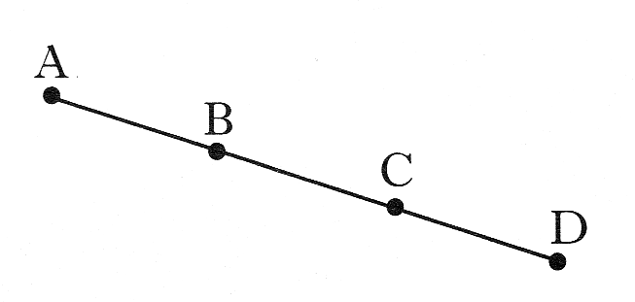
Vectors Higher
A and B are the points (-1, -3, 2)
and (2, -1, 1) respectively.
B and C are the points of trisection of AD.
That is, AB = BC = CD.
Find the coordinates of D
Hint
Previous
Quit
Quit
Next

Slide 58
Vectors Higher
The point Q divides the line joining P(–1, –1, 0) to R(5, 2 –3) in the ratio 2:1.
Find the co-ordinates of Q.
1
R
Q
Diagram
2
P
Hint
Previous
Quit
Quit
Next

Slide 59
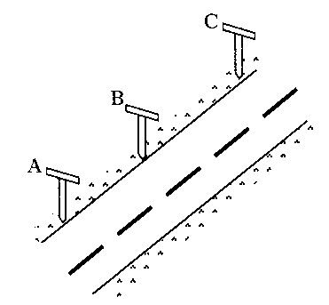
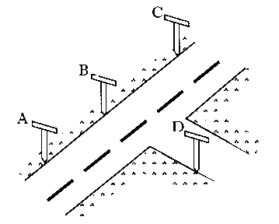
Vectors Higher
a) Roadmakers look along the tops of a set of T-rods to ensure
that straight sections of road are being created.
Relative to suitable axes the top left corners of the T-rods are
the points A(–8, –10, –2), B(–2, –1, 1) and C(6, 11, 5).
Determine whether or not the section of road ABC has been
built in a straight line.
b) A further T-rod is placed such that D has co-ordinates (1, –4, 4).
Show that DB is perpendicular to AB.
a)
are scalar multiples, so are parallel. A is common. A, B, C are collinear
b)
Use scalar product
Hence, DB is perpendicular to AB
Hint
Previous
Quit
Quit
Next

Slide 60
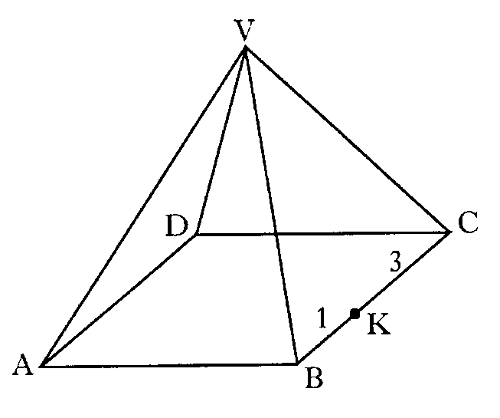
Vectors Higher
VABCD is a pyramid with rectangular base ABCD.
Relative to some appropriate axis,
represents – 7i – 13j – 11k
represents 6i + 6j – 6k
represents 8i – 4j – 4k
K divides BC in the ratio 1:3
Find in component form.
Hint
Previous
Quit
Quit
Next

Slide 61
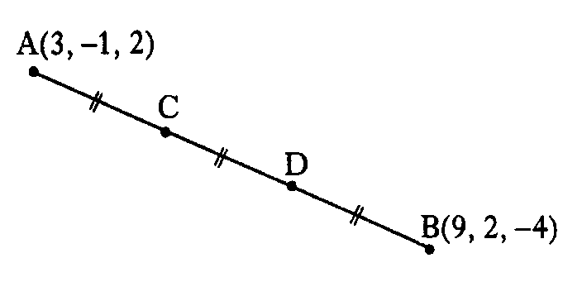
Vectors Higher
The line AB is divided into 3 equal parts by
the points C and D, as shown.
A and B have co-ordinates (3, –1, 2) and (9, 2, –4).
a) Find the components of and
b) Find the co-ordinates of C and D.
a)
b)
C is a displacement of from A
similarly
Hint
Previous
Quit
Quit
Next

Slide 62
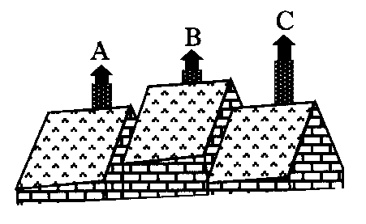
Vectors Higher
Relative to a suitable set of axes, the tops of three chimneys have
co-ordinates given by A(1, 3, 2), B(2, –1, 4) and C(4, –9, 8).
Show that A, B and C are collinear
are scalar multiples, so are parallel. A is common. A, B, C are collinear
Hint
Previous
Quit
Quit
Next

Slide 63
Vectors Higher
A is the point (2, –5, 6), B is (6, –3, 4) and C is (12, 0, 1).
Show that A, B and C are collinear
and determine the ratio in which B divides AC
are scalar multiples, so are parallel. B is common. A, B, C are collinear
3
C
2
B
A
B divides AB in ratio 2 : 3
Hint
Previous
Quit
Quit
Next

Slide 64
Vectors
Relative to the top of a hill, three gliders
have positions given by
R(–1, –8, –2), S(2, –5, 4) and T(3, –4, 6).
Prove that R, S and T are collinear
are scalar multiples, so are parallel. R is common. R, S, T are collinear
Hint
Previous
Quit
Quit
Next

Slide 65
Vectors Higher
You have completed all 8 questions in this section
Previous
Quit
Quit
Back to start

Slide 66
Vectors
Angle between two vectors
Continue
Quit
Quit
Back to menu

Slide 67
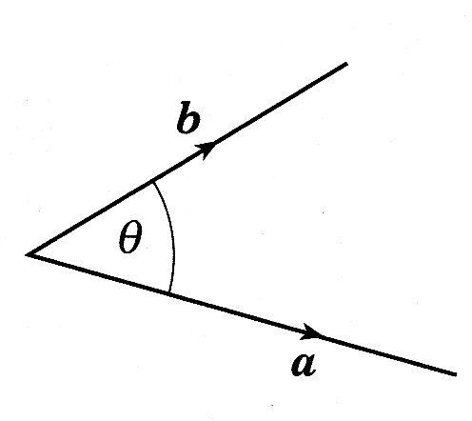
Vectors Higher
The diagram shows vectors a and b.
If |a| = 5, |b| = 4 and a.(a + b) = 36
Find the size of the acute angle
between a and b.
Hint
Previous
Quit
Quit
Next

Slide 68
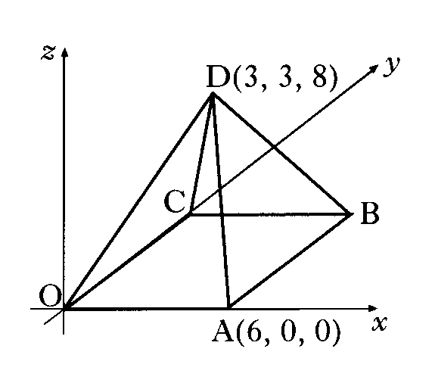
Vectors Higher
The diagram shows a square based pyramid of height 8 units.
Square OABC has a side length of 6 units.
The co-ordinates of A and D are (6, 0, 0) and (3, 3, 8).
C lies on the y-axis.
a) Write down the co-ordinates of B
b) Determine the components of
c) Calculate the size of angle ADB.
a)
B(6, 6, 0)
b)
c)
Hint
Previous
Quit
Quit
Next

Slide 69
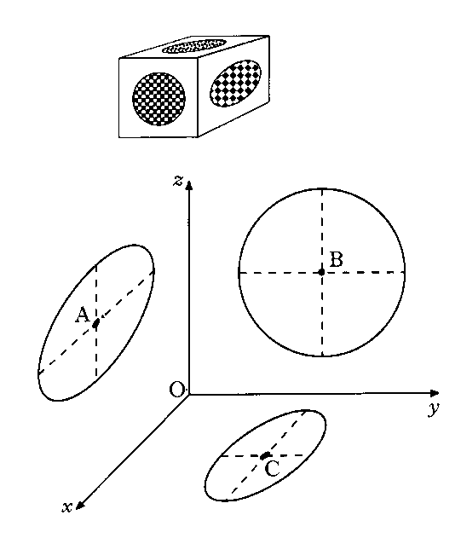
Vectors Higher
A box in the shape of a cuboid designed with circles of different
sizes on each face.
The diagram shows three of the circles, where the origin represents
one of the corners of the cuboid.
The centres of the circles are A(6, 0, 7), B(0, 5, 6) and C(4, 5, 0)
Find the size of angle ABC
Vectors to point
away from vertex
Hint
Previous
Quit
Quit
Next

Slide 70
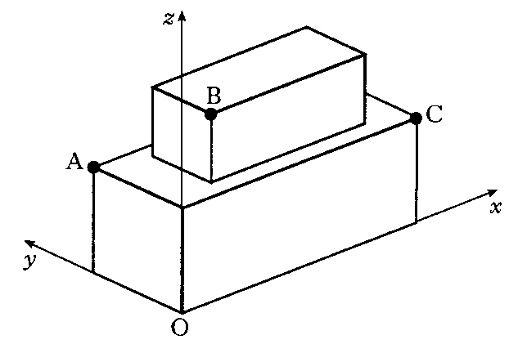
Vectors Higher
A cuboid measuring 11cm by 5 cm by 7 cm is placed centrally on top of another cuboid measuring 17 cm by 9 cm by 8 cm.
Co-ordinate axes are taken as shown.
a) The point A has co-ordinates (0, 9, 8) and C has
co-ordinates (17, 0, 8).
Write down the co-ordinates of B
b) Calculate the size of angle ABC.
a)
b)
Hint
Previous
Quit
Quit
Next

Slide 71
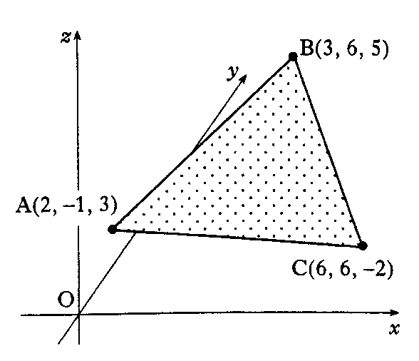
Vectors Higher
A triangle ABC has vertices A(2, –1, 3), B(3, 6, 5) and C(6, 6, –2).
a) Find and
b) Calculate the size of angle BAC.
c) Hence find the area of the triangle.
a)
b)
∠ BAC =
c)
Area of Δ ABC =
Hint
Previous
Quit
Quit
Next

