Slide 1
Chapter 18
Genetics Ahead
Biology 3201

Slide 2
18.1 - Diagnosis & Treatment of Genetic Disorders
Until recently, it was very difficult to determine the health of an unborn baby.
Today, with new research and technology, information can be gathered during fetal development and can even be predicted before conception

Slide 3
Genetic Counseling
A genetic counselor is a medical professional who gathers detailed information from individuals who have a history of genetic disorders in their family. This information is gathered through interviews, blood tests, and discussions with geneticists.
After gathering the necessary information, the counselor will then construct a family pedigree.
The counselor can also use the information to predict the probability of a child inheriting a particular disorder.
Once this information is communicated to the parents, they then need to make a decision as to whether or not they should conceive a child.

Slide 4
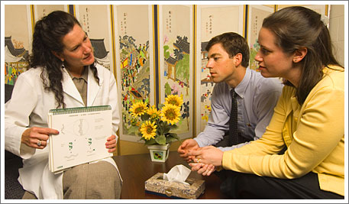
Diagnosis
Diagnosis can occur at two stages
  Pre-implantation diagnosis
  Prenatal diagnosis

Slide 5
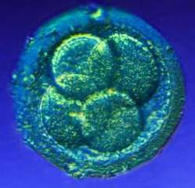
Pre-implantation Diagnosis
Pre-implantation diagnosis is performed before pregnancy has occurred.
Sperm and eggs of prospective parents are placed inside a glass dish with a growth medium. Several eggs are fertilized and allowed to develop. After two days, eight cells have formed.
One of these cells is removed and a karyotype is produced, the remaining cells continue to divide.
Karyotype is analyzed for any genetic disorders. If none are found, the hollow ball of cells is placed in the female’s uterus to continue its development.

Slide 6
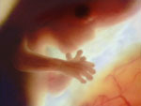
Prenatal Diagnosis
Performed after a woman has conceived a child.
There are several methods which can be performed here ;
1. Ultrasound
2. Amniocentesis
3. Chorionic villus sampling
4. Fetoscopy

Slide 7
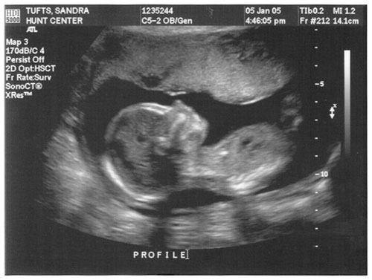
Ultrasound
Involves sending sound waves through the amniotic fluid which the fetus is suspended in.
The sound waves bounce of the fetus and are used to create a black and white image of the fetus.
The image is studied to determine any physical abnormalities such as missing limbs, a malformed heart, etc.

Slide 8
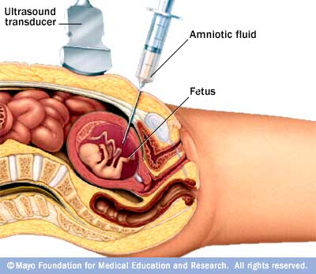
Amniocentesis
A small amount of the amniotic fluid around a fetus is extracted with a long thin needle.
This fluid is placed in a special nutrient rich medium and the cells are allowed to multiply for several weeks until there are enough cells to get a karyotype of the fetal cell’s chromosomes.
Observation of the karyotype will allow scientists to see disorders such as Down Syndrome, etc.
Due to a potential risk to the fetus, this procedure cannot be done before the fourteenth week of pregnancy.

Slide 9
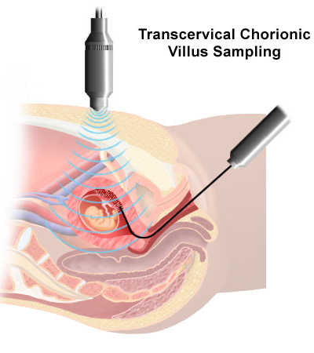
Chorionic Villus Sampling (CVS)
Performed around the ninth week of pregnancy.
Cells are removed from the membrane called the chorion which surrounds the amniotic sac.
The chorion membrane contains fetal cells which have genetic information inside them.
These cells are grown in a special medium until a karyotype can be made.
The karyotype is then used to diagnose a genetic disorder.

Slide 10
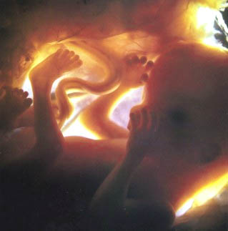
Fetoscopy
an endoscope, a long tube with a camera on one end, is inserted through a small incision which is made in the woman’s abdomen.
Procedures such as drainage of excess fluid surrounding the brain and blood transfusions can be performed on the fetus while still in the womb.
Allows for the safe collection of blood samples from the fetus.
Genetic material from the blood sample can be used to create a karyotype or to test for a number of different genetic disorders.
Identification of proper blood type and detection of blood disorders are also possible using the process of fetoscopy.

Slide 11

Genetic Markers
Any characteristic that provides information about an organism’s genome.
Are identified at the molecular level within DNA
  Provides clues about the genes associated with particular disorders
There are two types of DNA genetic markers:
1. Linked markers
2. Gene - specific markers

Slide 12
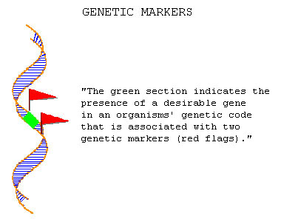
Linked Genetic Markers
A known sequence of nucleotides which is located close to a gene that causes a disorder.
If a linked marker is found, then the gene which causes a particular disorder is usually nearby.

Slide 13
Gene - Specific Marker
Sequence of DNA which is actually a part of the gene itself. This type of marker always indicates the present of a disorder causing gene.
These DNA markers are found using a probe which consists of a nucleic acid sequence which is complementary to the marker sequence.
When the probe is mixed with a solution which may contain the suspected gene, the DNA marker and the probe join together, indicating the gene is indeed present

Slide 14
Treatment of Genetic Disorders
Genetic Screening and Prevention
Genetic disorders can be detected at birth.
Blood tests can be used to detect a number of disorders early and thus allow doctors to carry out preventive measures.
Phenylketonuria (PKU) is an example of such a disorder. If detected early, a child with PKU can be given a special diet to promote healthy growth and allow them to lead normal lives
Surgery
Some genetic conditions can be treated through surgery.
Babies born with certain disorders can have them corrected through surgical procedures.
Cleft palate or a vertical groove in the roof of a child’s mouth can be corrected through reconstructive surgery.

Slide 15
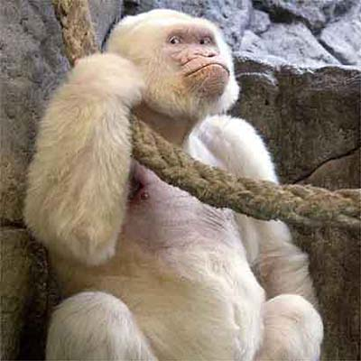
Treatment of Genetic Disorders
Environmental Control
Sometimes, treatment of a disorder involves manipulation or control of the affected individual’s environment.
An example of such a disorder is albinism.
  An individual with albinism lacks the pigment melanin. This pigment, in normal individuals, offers protection from the Sun’s harmful radiation.
  Since there is no treatment for albinism, individual’s with the disorder must limit their exposure to direct sunlight.

Slide 16
Gene Therapy
Medical procedure in which a normal or modified gene is transferred into the defective cells of an individual.
The normal gene will, in theory, reverse the symptoms of the genetic disorder by allowing the recipient’s cells to function normally and synthesize any missing polypeptides (proteins)
Viruses are usually used to transfer the normal gene to a defective cell.
  Though viruses usually work well, their protein coat can trigger a severe and sometimes fatal immune response in some patients. Thus, scientists are attempting to find an alternative method of inserting genes into defective cells.
So far, all gene therapy techniques that have been used have focused on somatic gene therapy.
  Modifying the genes which are located in a patient’s somatic (body) cells. Therapy performed on these cells will benefit the individual being treated, but not his / her offspring.
In the future, most gene therapy will focus on germ line therapy. This would involve altering the DNA of an individual’s germ cells or sperm or egg cells

Slide 17
Limits to Diagnosis & Treatment
Some genetic disorders are easy to diagnose or predict, using pedigree information, genetic markers, etc.
  Examples: Down syndrome, Turner Syndrome, Hemophilia, Huntington Disease.
However, there are some disorders which are more difficult to diagnose or predict.
  Example: Alzheimer’s.

Slide 18
Alzheimer’s
Alzheimer’s is a genetic disorder which is common in people over the age of 65.
This form of dementia begins with mild forgetfulness and progresses to severe loss of memory, language abilities, and conceptual skills.
The brains of people who die from Alzheimer’s show abnormalities which include tangles and clumps of nerve fibres.

Slide 19
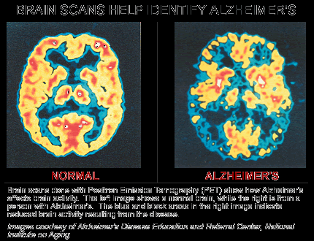
Types of Alzheimer’s
Familial Alzheimer’s Disease
  (FAD) can strike people as early as the age of 40.
Sporadic Alzheimer’s Disease
  (SAD) affects people over the age of 60. A gene called EpoA, located on chromosome 19, has been found to be associated with this form of Alzheimer’s.

Slide 20
Ethical Issues
There is debate concerning the moral and ethical issues involved with the field of gene therapy.
Through the use of genetic engineering techniques, DNA can be sequenced, analyzed, and altered.
This manipulation of genetic material can be seen in either a positive or negative light depending on the individuals involved

Slide 21
18.2 – The Sequence of Life
In 1977, Frederick Sanger and his colleagues made breakthrough in genetic engineering when they worked out the complete nucleotide sequence of the DNA in a virus called phage 0X174.
By studying this DNA sequence, they made new discoveries about how genetic material is organized and their work opened the door to genome sequencing as a way to better understand the genetics of living cells.
The work of Sanger’s team relied on three important discoveries
  The discovery of a way to break a DNA strand at specific sites along its nucleotide sequence.
  The development of a process for copying or amplifying DNA samples.
  The improvement of methods for sorting and analyzing DNA molecules.
The three techniques above are the basis of much of our genetic technology today.

Slide 22
Restriction Endonucleases
Restriction endonucleases are enzymes which prokaryotic organisms produce to defend themselves against infection.
These enzymes are able to recognize a specific sequence of nucleotides on a strand of DNA and can then “cut“ or restrict the strand at a particular point in that sequence.
The point at which the strand is cut is called the restriction site.
Two characteristics which have made restriction endonucleases useful to genetic researchers are:
    Specificity
    Staggered cuts

Slide 23
Specificity
The cuts made by these enzymes are specific and predictable. A certain enzyme will cut a particular strand of DNA the same way each time. The small pieces which are produced are called restriction fragments.

Slide 24
Staggered Cuts
Most restriction endonucleases produce a staggered cut. This leaves a few unpaired nucleotides at the end of a restriction fragment.
These short, unpaired sequences are called sticky ends. The sticky ends can join with other short strands of DNA. This helps to create what we call recombinant DNA.
Sticky end
Sticky end

Slide 25
DNA Amplification
DNA amplification is the process of generating a large sample of a DNA sequence from a single gene or DNA fragment.
There are two different methods of doing this
  Cloning Using A Bacterial Vector
  Polymerase Chain Reaction

Slide 26
Cloning Using A Bacterial Vector
A target sample of DNA is treated with an endonuclease.
The DNA sample is then broken into a specific pattern of restriction fragments.
These fragments are then spliced into bacterial plasmids. This produces a molecule of recombinant DNA.
The recombinant DNA (plasmid) is then returned to a bacterial cell. As the cell multiplies it replicates the plasmid containing the foreign DNA. This allows for millions of copies of the DNA fragment to be produced.
In this case the plasmid is called a cloning vector since it has replicated foreign DNA within a cell.

Slide 27
Polymerase Chain Reaction (PCR)
PCR method allows researchers to target and amplify a very specific sequence within a DNA sample doing the following:
  The DNA sample fragment is placed in a solution with nucleotides and primers.
  The solution is then heated to break the hydrogen bonds between nitrogen base pairs, thus allowing the DNA double helix to open.
  Next, the solution is cooled, heat resistant DNA polymerase is added and replication begins.
  Both DNA strands replicate which results in two copies of the original DNA. The cycle then repeats itself.
Each cycle doubles the amount of DNA which allows the polymerase chain reaction to generate billions of copies of a DNA sequence.

Slide 28
Sorting DNA Fragments
A process called gel electrophoresis can be used to separate molecules according to their mass and electrical charge. This same process can be used to separate DNA fragments so that they can be analyzed.
A solution containing DNA fragments is applied to one end of a gel.
An electric current is then applied to the two ends of the gel making it polarized.
Since DNA has a negative charge, the fragments tend to move towards the positive end of the current.
The smaller fragments move more quickly than the larger fragments and this causes a separation of fragments into a pattern of bands called a DNA fingerprint.
Check out the virtual lab activity: http://learn.genetics.utah.edu/units/biotech/gel/

Slide 29
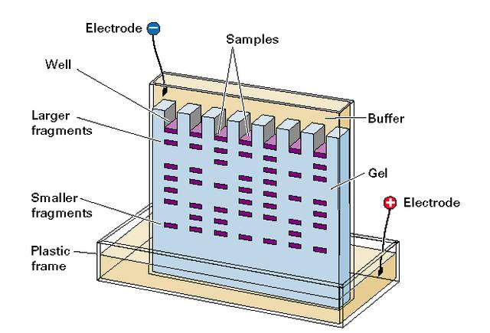
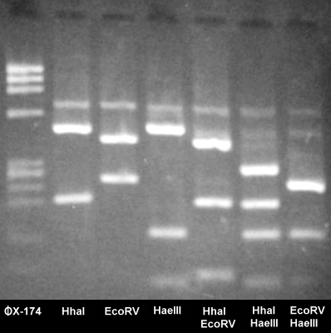
Electrophoresis and Fingerprinting
PAGE 616 – Thinking Lab – Reading a DNA Fingerprint

Slide 30
Analyzing DNA
The processes of using restriction enzymes, DNA amplification, and gel electrophoresis can be used by researchers to analyze and compare DNA samples.
Determining a particular DNA pattern is very useful in crime scene investigation.
It is also useful in solving disputes over parentage. (As in the thinking lab)

Slide 31
Sequencing DNA
Allows us to determine the nucleotide sequence of a DNA fragment.
The process which is used to sequence DNA is known as chain termination sequencing.
The replicated section of DNA is made from a series of small fragments instead of a whole strand.
A radioactive or fluorescent marker is placed on the nucleotide which ends each fragment, a procedure called tagging.
The fragments are run on a gel electrophoresis to properly identify the fragments and determine the nucleotide sequence of the original DNA strand

Slide 32
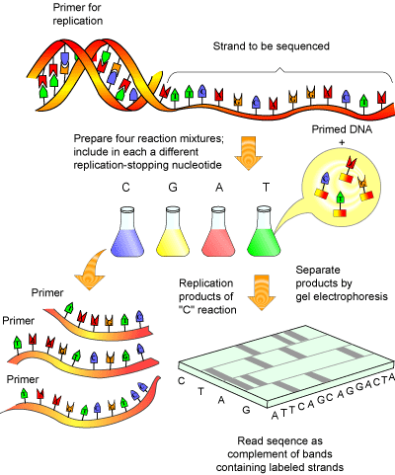
DNA Sequencing

Slide 33
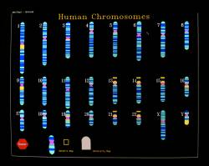
Human Genome Project
In February 2001, the first draft of the complete human genome was published.
The human genome project determined the sequence of the three billion base pairs which make up the human genome.
Some findings from this project are
  The DNA of all humans is more than 99.9% identical.
  The human genome contains only about 35,000 genes.
  Both the DNA sequence and the proteins which it makes are responsible for guiding the development of complex organisms.

Slide 34
Knowledge of the Genome
Some of the potential benefits of this discovery include
  Better ways to assess an individual’s risk of developing a disease.
  Better ways to prevent a disorder.
The development of new drugs and other treatments which are precisely tailored to an individual’s personal genetic make-up.
Comparison of the human genome with the genomes of other species

Slide 35
New Knowledge, New Problems
Advances in knowledge such as the completion of the Human Genome Project raises significant legal and ethical issues.
  Who should have access to genetic information and for what purposes?
  Another issue is; who owns the genetic information which is gathered from individuals or groups?
From these questions we can see that there are a number of issues which people need to be concerned with when it comes to genetic information.

Slide 36
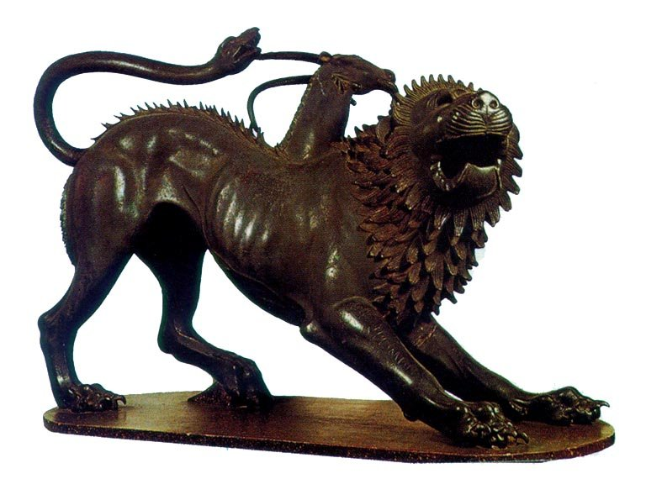
18.3 The Chimera:
From Legend to Lab
In Greek mythology, the Chimera is a fire breathing monster which had the head and shoulders of a lion, the body of a goat, and a serpent for a tail.
Today, geneticists use the term chimera to describe a genetically engineered organism which contains genes from unrelated species.
In 1973, the first chimeric organism was created by two scientists, Stanley Cohen and Herbert Boyer, who developed a bacteria which could express an amphibian gene. This work is the foundation of the genetic engineering which is done today

Slide 37
Inserting Animal Genes Into Bacterial Cells
In 1990, scientists produced the first transgenic or genetically engineered product which was approved for use in North America.
In cattle, the growth hormone somatotropin makes them grow bigger, develop large udders, and produce extra milk.
Scientists took the gene which is responsible for coding this hormone and successfully cloned and inserted it into a bacterial vector.
In order to insert a gene from one organism ( eukaryotic ) into another (prokaryotic ), two requirements must be met:
  Researchers must isolate the target gene from the eukaryotic organism’s genome.
  They must ensure that the eukaryotic gene can be correctly expressed by the prokaryotic organism.

Slide 38
Inserting DNA into Plant or Animal Cells
In some cases plant or animal cells can be used as a cloning vector instead of bacterial cells.
Plant and animal cells can be grown in special culture dishes, however, since they are difficult to culture it is harder to insert foreign DNA into them.
Several methods have been developed to solve this problem:
  Bacteria plasmids ( DNA ) can be used to infect a plant cell by inserting the bacteria’s DNA into the plant’s DNA.
  Special devices such as a DNA particle gun can be used to open pores in the cell’s nuclear membrane and DNA particles can be fired directly into the nucleus of the plant cell.

Slide 39
Putting Genetic Technologies To Use
Any new strains of organisms which are developed by the use of genetic technologies must be examined by government agencies to determine the benefits and risks before they are used for commercial use.
Different countries have different standards with regards to the use of these new strains of organisms.
Genetic engineering technologies are being put to use in a variety of fields including agriculture, medicine, and environmental protection.
As more transgenic organisms are produced, needs for standards and criteria will have to be developed

Slide 40
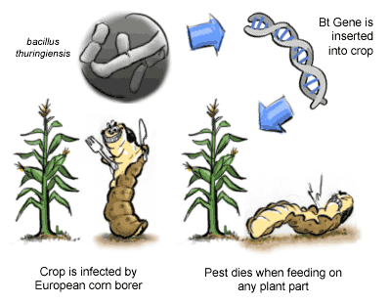
Herbicide - Resistant Corn
Over 50 types of genetically modified crop plants have been approved for use in Canada.
An example of such a plant is herbicide resistant corn.
Scientists have isolated and cloned a bacterial gene which provides resistance to certain herbicides.
DNA fragments from this gene were sprayed onto gold particles and fired into corn cells. The cells developed into corn which were resistant to the herbicide.
Since the corn is resistant to herbicides, farmers can apply them to their fields to control weeds, but not damage the corn plants.
This form of transgenic corn does not present a risk to human health and was approved for use in Canada in 2001.

Slide 41
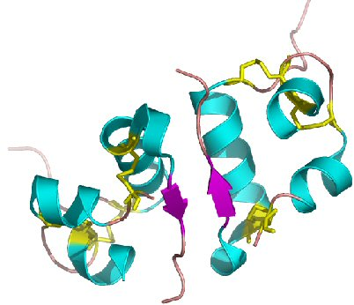
Human Insulin
In 1982, a form of human insulin which was synthesized by transgenic bacteria was approved for use in the United States. This was the first example of a genetically engineered pharmaceutical product.
By developing a process for inserting the human gene for insulin into bacteria, scientists were able to produce high volumes of human insulin.
This lowered the cost of insulin treatment and reduced the number of side effects.
Since this time, other pharmaceutical products have been produced using bacterial vectors.

Slide 42
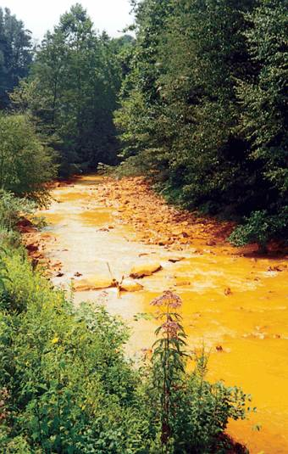
Bioremediation: PCB Eating Bacteria
PCBs or polychlorinated biphenyls are a by-product of a number of industrial processes.
These compounds are highly toxic and environmentally persistent. They build up in the soil and accumulate in food chains, thus presenting a risk to animal and human populations.
Since cleanup of areas which are contaminated with PCBs is difficult and expensive, biotechnology companies are developing recombinant bacteria which can break down PCBs into harmless compounds.
The use of living cells to perform environmental remediation tasks is called bioremediation.

Slide 43
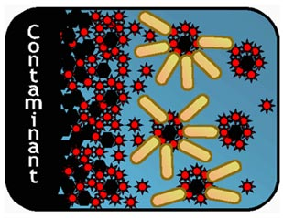
Other Forms of Bioremediation
Bacteria which can clean up oil spills.
Bacteria which filter air from factory smokestacks.
Bacteria which remove heavy metals from water

Slide 44
Better Nutrition
Millions of people worldwide suffer from malnutrition due to lack of sufficient foods and balanced diets. This can lead to disease.
Development of genetically modified foods such as rice, wheat, etc. which contain a number of necessary vitamins and other materials is an answer to these problems.
Foods which are higher in nutrients will prevent malnutrition and limit the amount of disease in people who live in poorly developed countries.

Slide 45
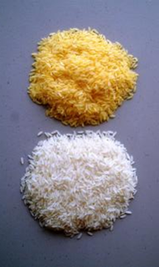
Weighing the Risks
Genetically modified products such as corn, golden rice, etc. have been marketed as demonstrating the benefits of genetic engineering.
However, along with the benefits come a number or risks.
Potential risks from the use of transgenic organisms include:
  Environmental threats
  Health effects.
  Social and economic issues

Slide 46
Environmental Threats
The creation of herbicide resistant crops encourages farmers to use more herbicides to protect their crops. These herbicides leach into the water supplies and various ecosystems causing problems in non-target or even wild organisms, limiting biodiversity
Herbicide resistant crops may crossbreed with other plants such creating what are called super-weeds. These weeds would then be very difficult to destroy.
As insects feed on herbicide resistant crops, they may eventually develop into what are called super-bugs. These insects may then become resistant to certain pesticides

Slide 47

Health Effects
Not enough is known about the long-term effects of transgenic products.
Consumption of transgenic products may have effects which do not show up in studies done today, but may occur at a later time

Slide 48
Social & Economic Issues
Some people argue that transgenic crops will help rid the world of hunger. Others argue that world hunger is a result of uneven food distribution, not food shortages, thus we do not need transgenic crop production.
Others argue that if development of transgenic organisms continues by large companies, control of the world’s food supplies could be controlled by large corporations.
A final concern is that we, the human species, are treating other living organisms as commodities which we can manipulate, patent, and sell at our will.
$$$$

Slide 49
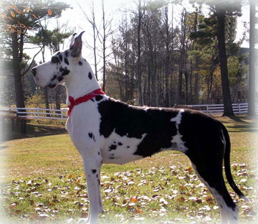
Transforming Animal DNA
Researchers hope to create certain organisms through the process of artificial selection.
By the process of artificial selection, humans are able to select particular traits by breeding certain organisms. This is also called selective breeding.
Scientists have chosen to use the method of artificial selection because it is much more difficult to insert foreign DNA into animal cells than it is in plant cells

Slide 50
Cloning Animals
A clone is an organism which is genetically identical to its parent.
Recently, scientists have developed techniques for cloning animals.
In the 1950’s, Briggs & King, performed experiments in which they were able to clone tadpoles.
In the early 1990s, researchers cloned mice using the nuclei of cells taken from mouse embryos.
In 1997, a lamb called Dolly was the first mammal to be successfully cloned using cells taken from an adult donor.

Slide 51
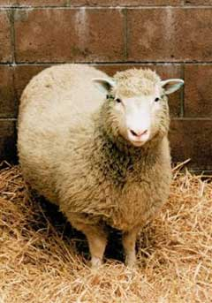
Steps Involved in Cloning Dolly
Collection of unfertilized eggs from a donor sheep and the removal of the nuclei from these eggs.
Collection of udder cells (body cells) from a second sheep.
Culturing of the udder cells in a special medium.
Removal of the nuclei from the udder cells and the placement of the nuclei into the eggs.
Culturing of the new egg cells to form an embryo.
Implantation of the embryo into the uterus of a third sheep which acted as a surrogate mother.

Slide 52
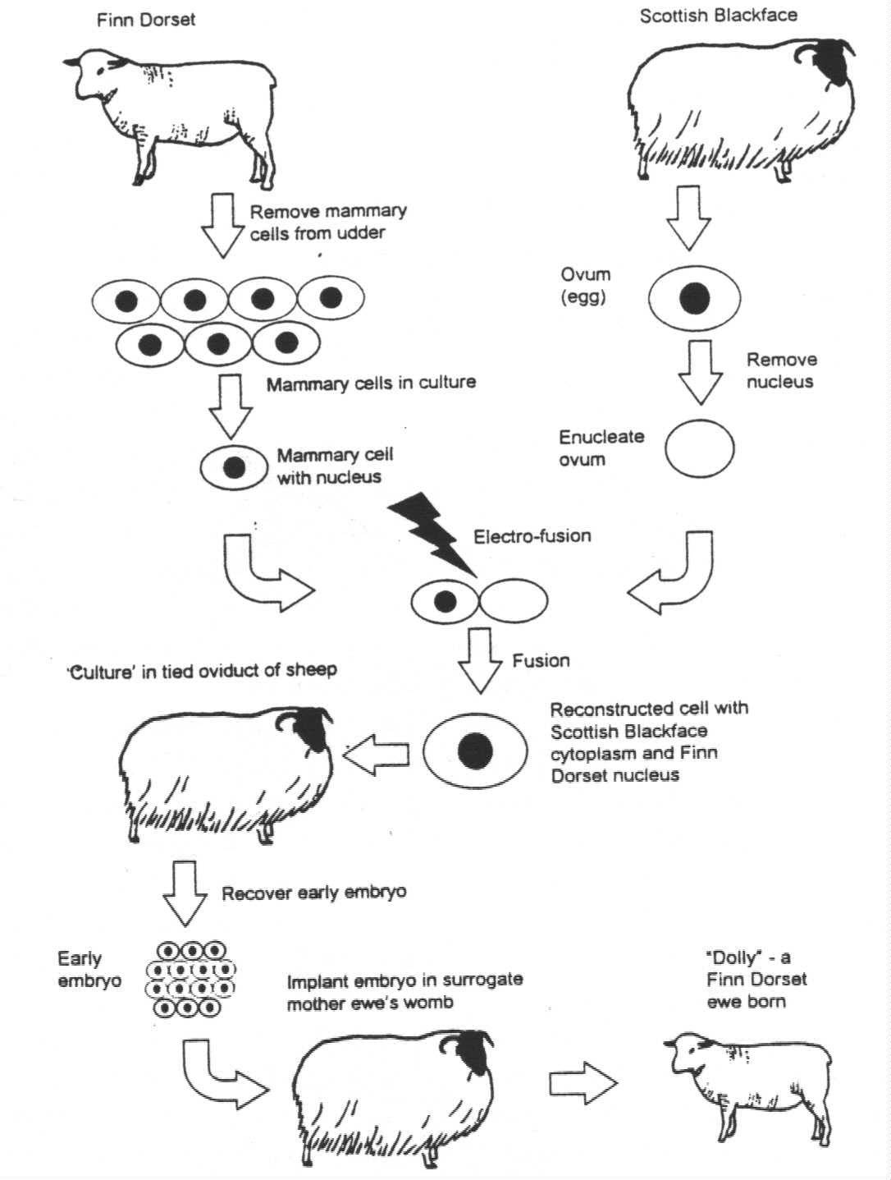

Slide 53
Human Cloning
In 2001, scientists at an American research facility successfully cloned human cells.
Two different techniques were used:
  Using a procedure similar to the Dolly experiment.
  Using a procedure whereby human eggs were induced to divide and produce a multi-cellular ball of cells or blastula.

Slide 54
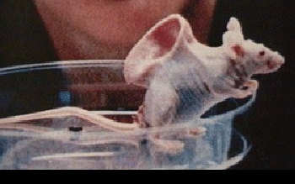
More Human Cloning
Two types of human cloning:
  Therapeutic cloning
  Reproductive cloning
Therapeutic cloning is the culturing of human cells for use in treating medical disorders.
Reproductive cloning is the development of a cloned human embryo for the purpose of creating a cloned human.
There are many legal, moral, and ethical issues involved with the process of human cloning.

Slide 55
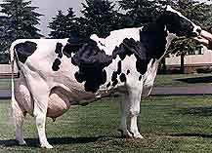
Transgenic Animals
By using the process of genetic engineering, scientists are able to create transgenic animals.
In the aquaculture industry, for example, companies have produced different transgenic varieties of salmon. These include ; salmon which produce their own form of antifreeze to keep them from freezing during the winter, and salmon which grow ten times faster than normal fish

Slide 56
Transgenic Animals
This type of research has created much controversy. On the positive side, researches point out that there is no risk to consumers and there is potential for restoring wild fish stocks and helping to solve the problem of world hunger.
On the negative side there are concerns for consumer safety and possible ecological impacts from competition between the transgenic fish and natural stocks as well as possible interbreeding between these two types of fish.
As new genetic engineering technologies are developed it is hoped that the potential benefits will outweigh the potential risks.

Slide 57
Chapter Review Problems
Do NOT hand these in. They are to be completed as review for the chapter only
Page 633 – Understanding Concepts
  Questions 1 – 13, 18 - 22

Slide 58
CHAPTER 18 ASSIGNMENT
“GENETIC IMPLICATIONS” WORKSHEET
ANSWER ALL QUESTIONS
DUE DATE: THURSDAY MAY 3, 2007

