Slide 1
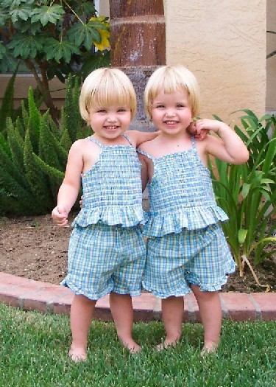

Cloning

Slide 2
Objective
To extract DNA from banana.
Success Criteria
By the end of the lesson I:
can identify how to extract DNA from a banana.
can work safely in a laboratory.
can work as part of a team to complete an investigation.

Slide 3
STARTER
If the population of the prey increases due to
good conditions,
then there is more food for the predator
and their population increases
This causes a decrease in the prey population
because they are being eaten
Which in turn causes a decrease
in the predator population
as there is not enough food
This continues to cycle
Name 3 factors that affect the numbers of organisms in a population.
What is this called?
Why do predator/prey relationships cycle (increased population size to decreased population size)?
Limiting factors
Amount of food and water available
Predators or grazing (who may eat them)
Disease
Climate, temperature, floods, drought, storms
Competition for space, light, mates, food and water
Human activity such as pollution, deforestation,
habitat destruction

Slide 4
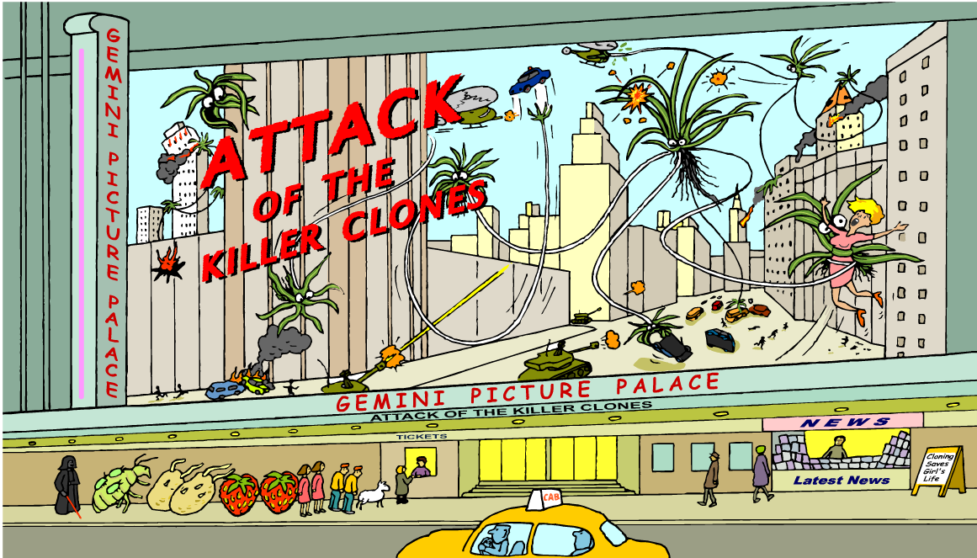
Cloning fact and fiction
How is cloning portrayed by the media?
Notes:
Teacher notes
Small groups could be asked to list as many examples of clones as they can think of using the illustration as a prompt. The clones in the illustration are the spider plants appearing in the film and, in the cinema queue:
two sets of human twins – natural clones
Dolly the sheep – the word’s first mammal cloned from an adult cell
strawberries – these can reproduce asexually, and therefore produce clones, by forming runners
potatoes – if left to sprout, these will also reproduce asexually
aphid with babies on back – female aphids can reproduce asexually, which is called parthenogenesis (‘virgin birth’)
Darth Vadar – a nod to the Star Wars film ‘Attack of the Clones’, where a vast army of clones is created
Students could also consider whether or not clones have a positive image so that they are primed to consider the examples of bias in the next activity.

Slide 5

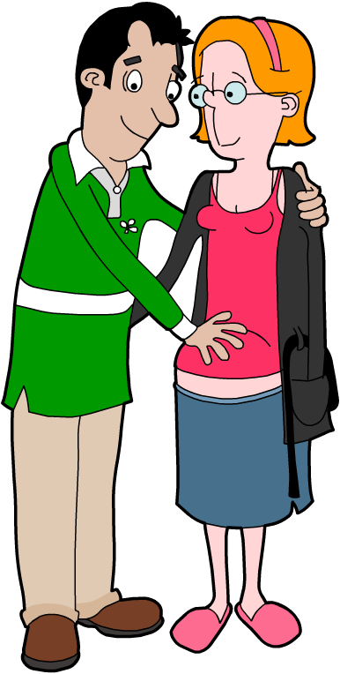
Quick Review: Sexual Reproduction
There are two main ways by which organisms can reproduce: sexual reproduction and asexual reproduction.
In sexual reproduction, genes from two parent organisms are combined to produce an organism with a unique genetic code.
The advantage of sexual reproduction is that it produces natural variation among a species, enabling it to adapt to environmental change.
Most animals and many plants reproduce sexually.

Slide 6

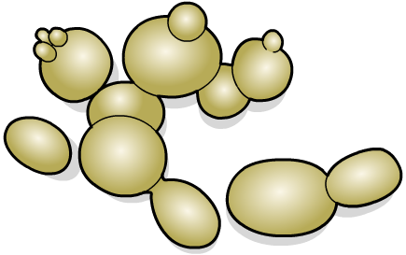
Quick Review: Asexual Reproduction
In asexual reproduction, a single organism makes a copy of itself with exactly the same genetic code. The new organism is a clone of the original.
Asexual reproduction enables an organism to quickly populate a new habitat and ensures that, if it is well-adapted to its environment, successful characteristics are passed on.
Organisms that reproduce asexually include:
many plants, such as spider plants, strawberries and potatoes
micro-organisms, such as bacteria and yeast
some insects, such as aphids.

Slide 7

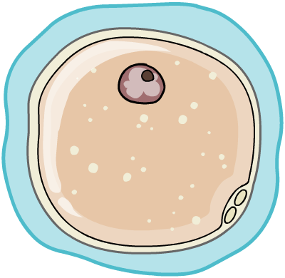
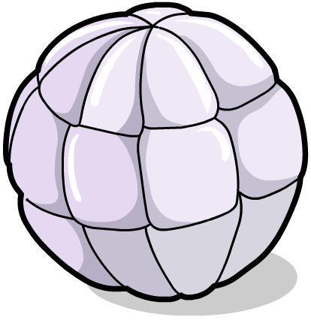

Natural human clones????
Human clones already exist! Identical twins have exactly the same genes and are therefore clones of each other.
Identical twins are created when a fertilized egg splits in two, creating two separate but genetically-identical embryos.
+
=
+
How does the creation of identical twins differ from that of non-identical twins?

Slide 8
Extraction of Banana DNA
Use the provided resource and your partners brilliance to FIGURE OUT how to extract banana DNA….
If you were to use this method on a large scale why would it be good?

Slide 9
Objective
To extract DNA from banana.
Success Criteria
By the end of the lesson I:
can identify how to extract DNA from a banana.
can work safely in a laboratory.
can work as part of a team to complete an investigation.

Slide 10
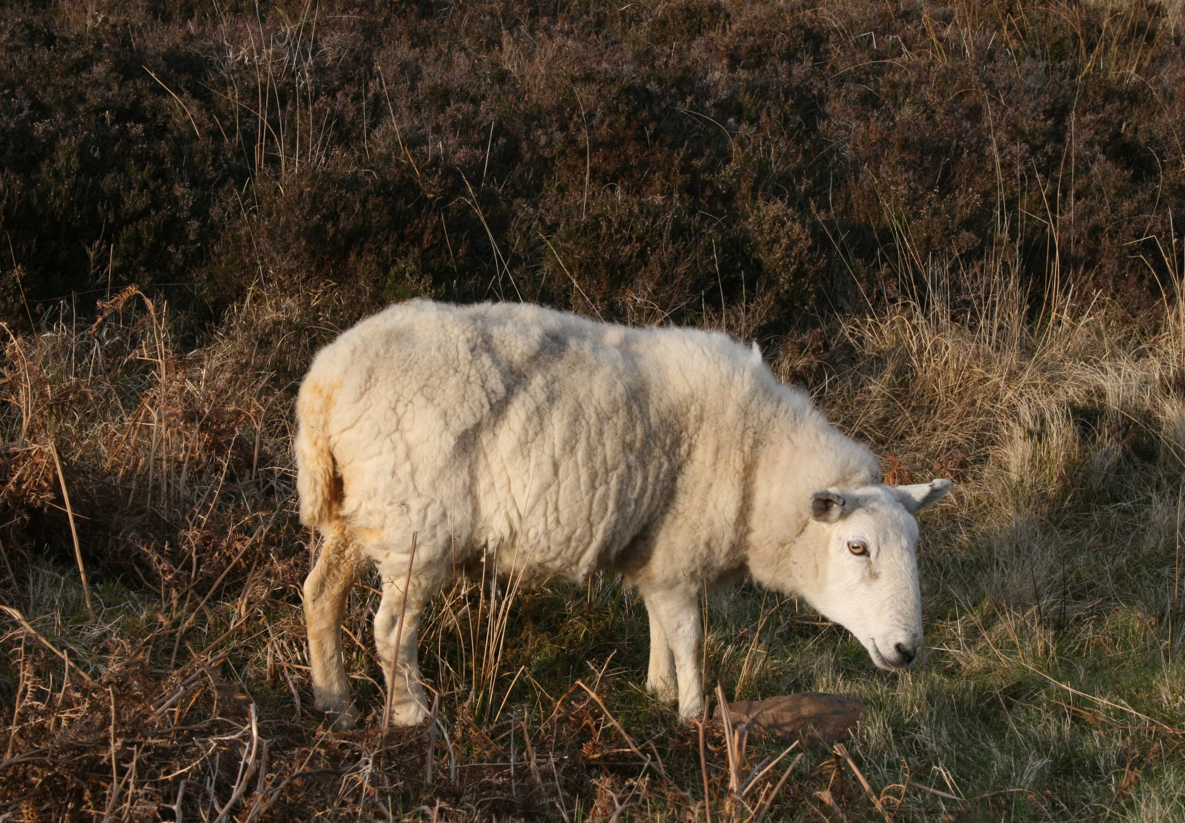
Cloning
Keywords: Clone, cutting, tissue culture, embryo transplant, host, fusion cell cloning, adult cell cloning

Slide 11












Review: Characteristics from sexual reproduction leading to variation
Characteristics
Meet our Mr Men
And our Little Misses
Now lets meet their children!

Slide 12






Review: Characteristics from sexual reproduction leading to variation

Slide 13
Objective
To investigate different forms of cloning and the ethical arguments for and against.
Success Criteria
By the end of the lesson I:
can identify different forms of plant (cutting and tissue culture) and animal cloning (embryo transplant, fusion cell, adult cell cloning).
explain how different types of cloning work.
can provide arguments for and against cloning.

Slide 14
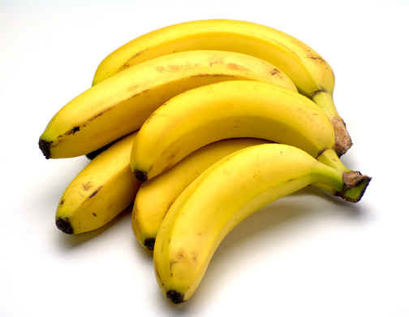
starter
Why is SOME cloning good?

Slide 15
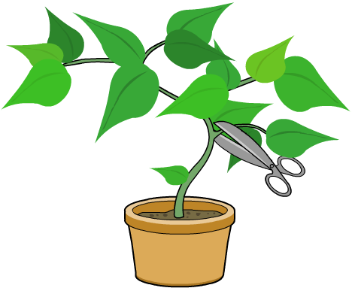


1) Plant clones: Taking cuttings
A plant can easily and quickly be cloned by taking a cutting. This is a fast way of cloning. It is cheap and effective
cutting dipped in rooting powder and planted
stem cut from parent plant
The problem with this method is that it cannot produce many clones at once.

Slide 16
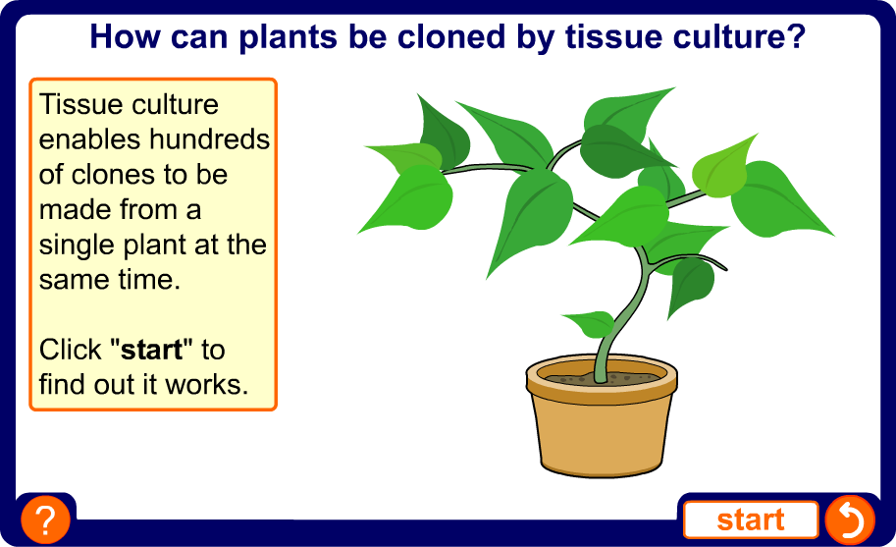
Tissue culture
2) Plant clones: Tissue culture
Notes:
Teacher notes
This five-stage sequence shows how plants can be cloned by tissue culture. Suitable prompts could include:
Human clones only form when very early foetuses split. Would you expect it to be the same for plants?
What does the sterilization process get rid of?
What might be used to separate the cells and remove their walls?
What will the cells need to keep them alive? How could you make sure they don't dry up or run out of nutrients?

Slide 17
3) Animal clone: Embryo transplantation
It is more difficult to clone animals than plants. A technique used to create clone animals is embryo transplanting. For example, a cattle farmer would follow this process:
1. Sperm is taken from the best bull and used to fertilize an egg from the best cow.
2. The fertilized egg divides to form an embryo containing several cells.
3. The embryo is separated into individual cells, which go on to form new embryos. Each embryo contains the same genes.
4. The embryos are implanted into surrogate cows.
5. The cows give birth to calves, which are all clones of each other.

Slide 18
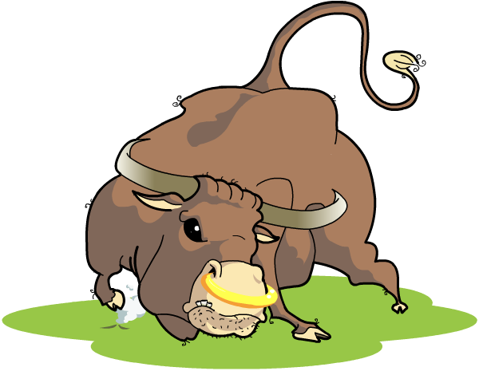
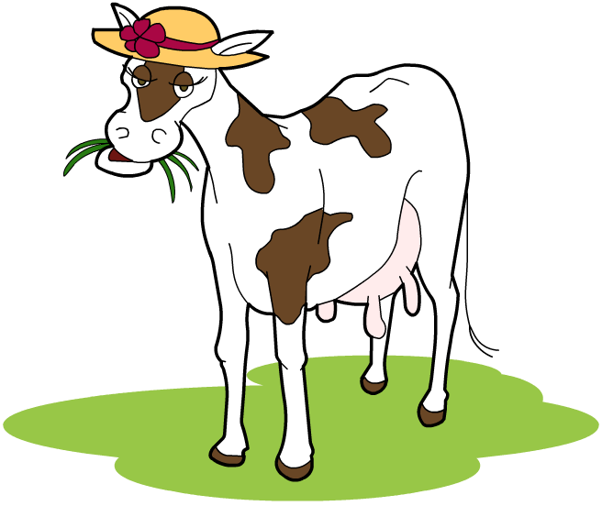
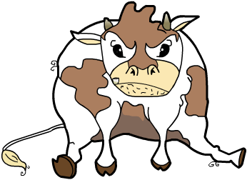

3) Animal clone: Embryo transplantation
Embryo transplantation enables a farmer to produce several new animals that have the characteristics of the best bull and best cow.
Before embryo transplantation takes place, the cow is given fertility drugs to increase the number of eggs she produces. How does that improve the procedure?

Slide 19
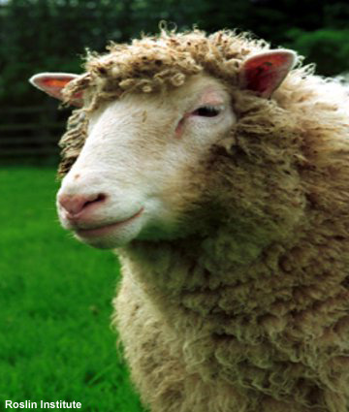
4) Adult cloning
Embryo transplantation enables animals to be created that are clones of each other, but not clones of the parent.
Cloning a single adult animal, especially a mammal, is much more complicated.
The most famous animal clone is Dolly the sheep, who was born on 5 July 1996.
Dolly was not the first animal clone, but the first mammal to be cloned from an adult cell.
Notes:
Photo credit: Roslin Institute

Slide 20
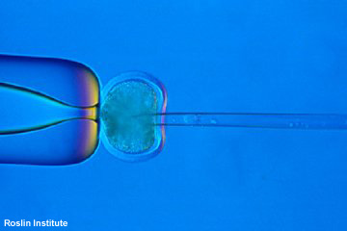
4) Adult cloning: Fusion cell
Dolly was created using a technique called nuclear transfer.
In this technique, the nucleus (i.e. DNA) from a body cell of the adult (a somatic cell) is removed.
This nucleus is then inserted into an egg cell that has had its own nucleus removed.
The egg cell is then made to divide and develop like a normal fertilized egg. The important difference is that it only contains the DNA from one, rather than two, animals.
Why couldn’t the DNA be taken from a sperm or egg cell?
Because they only contain half the genes of the animal.
Notes:
Photo credit: Roslin Institute

Slide 21
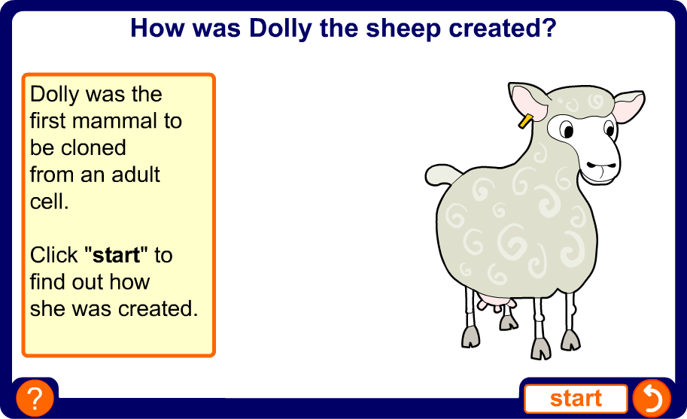
How was Dolly created?
5) Adult cloning: Adult cell or reproductive cloning
Notes:
Teacher notes
This interactive experiment illustrates how Dolly the sheep was created by nuclear transfer.
Some interesting facts that might be worth pointing out:
Dolly was born on 5 July 1996. She died in 2003, aged six and a half, after developing progressive lung disease – sheep can normally live to 11 or 12 years of age
It took 277 attempts to successfully create Dolly
Three ewes were involved in creating Dolly: a six-year-old Finn Dorset ewe whose DNA was cloned, a Poll Dorset ewe who donated the egg cell, and a Scottish Blackface ewe who acted as the surrogate mother
Dolly was not the first cloned animal – she was the first mammal to be cloned from an adult cell
Nuclear transfer was first used in 1952 to study the development of frogs. In the 1980s, it was used to clone cattle and sheep using cells taken from early embryos.

Slide 22
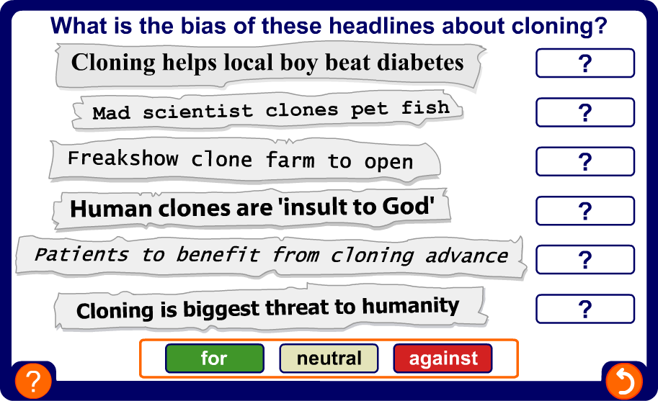
Cloning in the media
Advertising bias
Notes:
Teacher notes
This headlines activity can be used to explore media reports about cloning. Students could get into groups and identify bias in the headlines. They could then explore the reasons for the bias and perhaps predict what type of newspaper might run headlines like these. There are no correct answers for this activity.

Slide 23
EXAM TIP
There are arguments for and against cloning animals.
Some people have very strong views so in an exam you MUST give both sides of the argument AND a conclusion to achieve full marks.

Slide 24
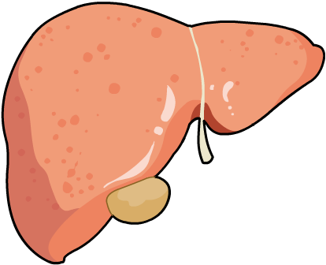

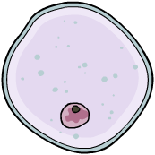

What are stem cells?
Stem cells are unspecialized cells that can develop into any type of cell. Early embryos are good sources of stem cells.
stem cells
red blood cells
liver cells
muscle cells

Slide 25
Using stem cells
Stem cells could be injected into damaged organs to rebuild the tissues. This would reduce the need for organ transplants.
injected into patient with diseased liver
stem cells
liver is repaired
The stem cells would need to have the same genes as the patient, otherwise they would be rejected by the patient’s immune system. They would need to be clones.
How could you make an embryo that only contained your genes?

Slide 26
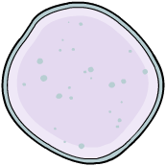
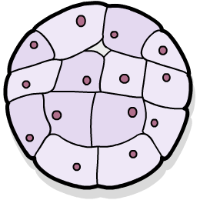
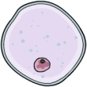


Human therapeutic cloning
The DNA of an embryo cell can be replaced with the DNA from a patient’s cell.
patient’s
DNA inserted
embryo cell
nucleus removed
5 day-old
embryo
stem cells removed
– the embryo dies
The embryo produces stem cells containing the patient’s genes. The cells will not be rejected, so immune-suppressing drugs are not needed. This process is therapeutic cloning.

Slide 27
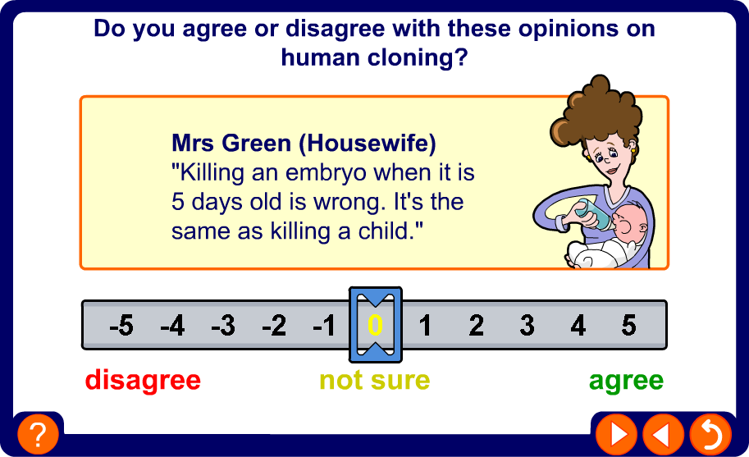
Opinions on human cloning
Notes:
Teacher notes
This evaluating opinions activity about human cloning could be used in a number of different ways. For example, students could be asked to get into groups and try to reach a consensus decision on whether they agree or disagree with the opinion on screen.
Alternatively, students could be asked to vote (possibly with traffic light cards) or individual students could be asked at random to give their opinion and justify it.
There are no correct answers for this activity.

Slide 28
What do you think?
List the advantages and disadvantages of cloning and give your opinion as to whether work on cloning should continue.

Slide 29
plenary
Reproduction that involves only one parent. There is no joining of gametes and the offspring are genetically identical to the parent.
Splitting cells apart from a developing embryo, before they become specialised, to produce several identical embryos.
Embryo
cloning
Asexual
reproduction
Getting a few cells from a desirable plant to make a big mass of identical cells, each of which can produce a tiny identical plant.
Taking a small piece of stem or leaf and growing it in the right conditions to produce a new plant.
Tissue
Cloning
Cuttings

Slide 30
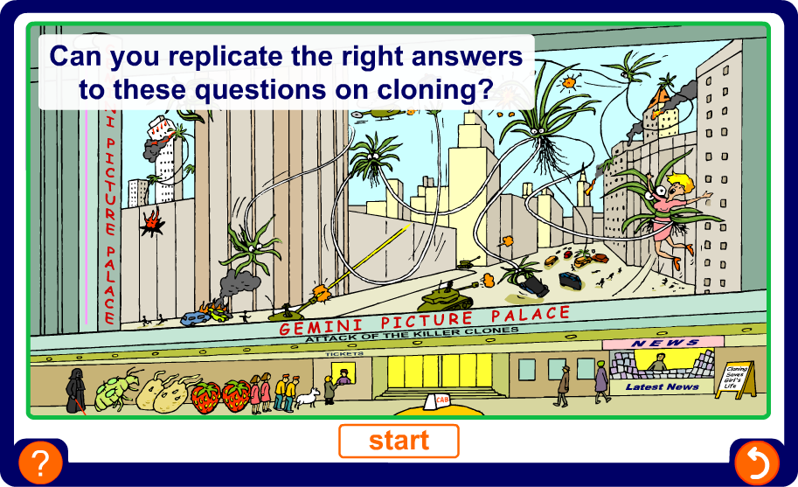
Multiple-choice quiz
Notes:
Teacher notes
This multiple-choice quiz could be used as a plenary activity to assess students’ understanding of cloning. The questions can be skipped through without answering by clicking “next”. Students could be asked to complete the questions in their books and the activity could be concluded by the completion on the IWB.

Slide 31
Research
Use the internet to research the term ‘cloning’
Identify different types of cloning (at least one plant and one animal)
Explain how these cloning types work
Provide for and against arguments for one type of animal cloning
Present your work as an academic newsletter on cloning which provides communities with the above information.
Use publisher and the newsletter tool.
Get the information in first and then work on presentation which must include one picture.

Slide 32
Objective
To investigate different forms of cloning and the ethical arguments for and against.
Success Criteria
By the end of the lesson I:
can identify different forms of plant (cutting and tissue culture) and animal cloning (embryo transplant, fusion cell, adult cell cloning).
explain how different types of cloning work.
can provide arguments for and against cloning.

