Slide 1
Genetics and Heredity

Slide 2
History
Genetics is the study of genes.
Inheritance is how traits, or characteristics, are passed on from generation to generation.
Chromosomes are made up of genes, which are made up of DNA.
Genetic material (genes,chromosomes, DNA) is found inside the nucleus of a cell.
Gregor Mendel is considered “The Father of Genetics"

Slide 3
Gregor Mendel
Austrian Monk.
Experimented with “pea plants”.
Used pea plants because:
  They were available
  They reproduced quickly
  They showed obvious differences in the traits
Understood that there was something that carried traits from one generation to the next- “FACTOR”.

Slide 4
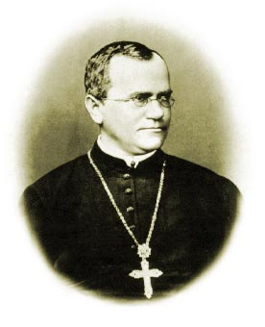
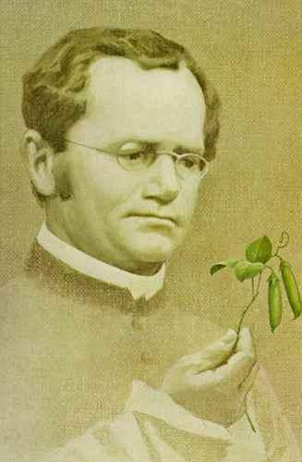
Mendel cont……
In the mid-1800s, the rules underlying patterns of inheritance were uncovered in a series of experiments performed by an Austrian monk named Gregor Mendel.

Slide 5
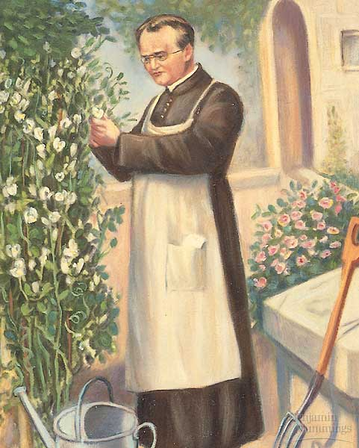
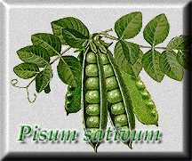
Mendel's Plant Breeding Experiments
Gregor Mendel was one of the first to apply an experimental approach to the question of inheritance.
For seven years, Mendel bred pea plants and recorded inheritance patterns in the offspring.
Particulate Hypothesis of Inheritance
Parents pass on to their offspring separate and distinct factors (today called genes) that are responsible for inherited traits.

Slide 6
Mendelian Genetics
Dominant traits- traits that are expressed.
Recessive traits- traits that are covered up.
Alleles- the different forms of a characteristic.
Punnett Squares- show how crosses are made.
Probability- the chances/ percentages that something will occur.
Genotype- the types of genes (Alleles) present.
Phenotype- what it looks like.
Homozygous- two of the same alleles.
Heterozygous- two different alleles.

Slide 7
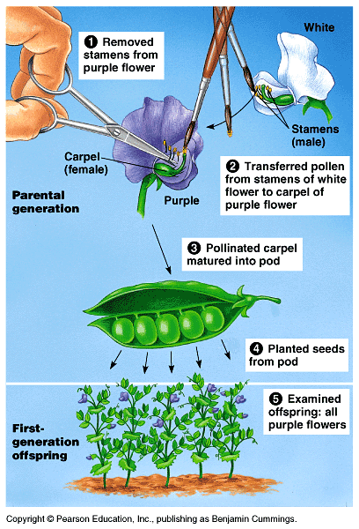
Mendel was fortunate he chose the Garden Pea
Mendel probably chose to work with peas because they are available in many varieties.
The use of peas also gave Mendel strict control over which plants mated.
Fortunately, the pea traits are distinct and were clearly contrasting.

Slide 8
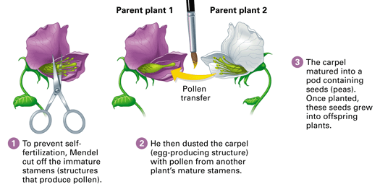
To test the particulate hypothesis, Mendel crossed true-breeding plants that had two distinct and contrasting traits—for example, purple or white flowers.
What is meant by “true breeding?”
Mendel cross-fertilized his plants by hand. Why is it important to control which plants would serve as the parents?

Slide 9
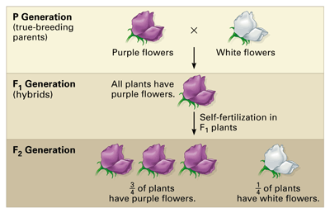
For each monohybrid cross, Mendel cross-fertilized true-breeding plants that were different in just one character—in this case, flower color. He then allowed the hybrids (the F1 generation) to self-fertilize.

Slide 10
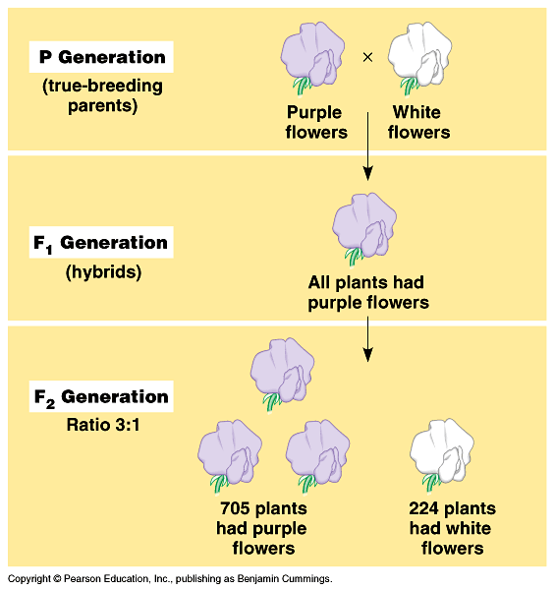
Typical breeding experiment
P generation (parental generation)
F1 generation (first filial generation, the word filial from the Latin word for "son") are the hybrid offspring.
Allowing these F1 hybrids to self-pollinate produces:
F2 generation (second filial generation).
It is the analysis of this that lead to an understanding of genetic crosses.

Slide 11
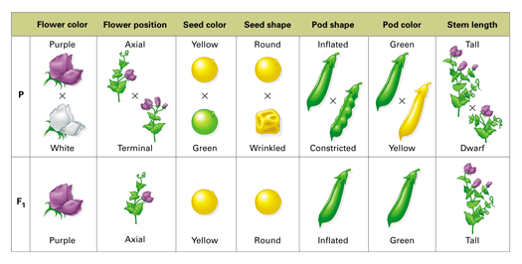
Mendel studies seven characteristics in the garden pea

Slide 12
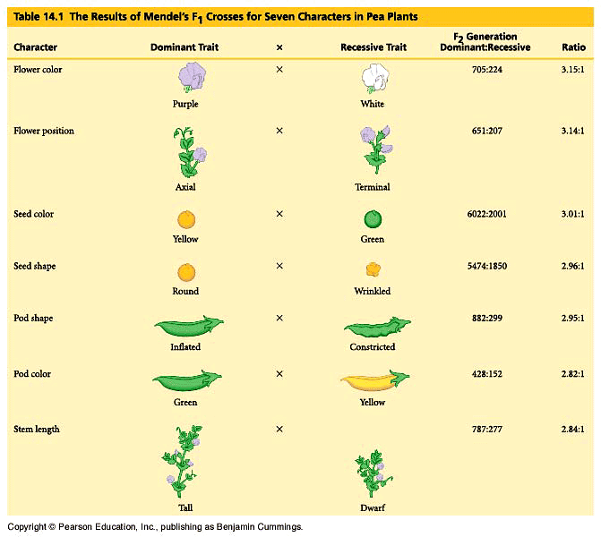
:
Statistics indicated a pattern.

Slide 13
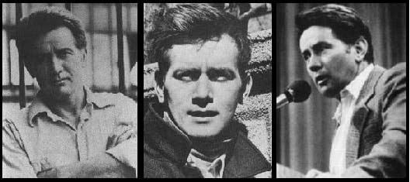
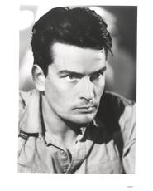
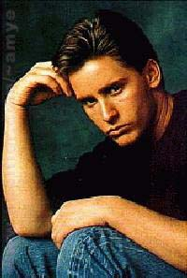
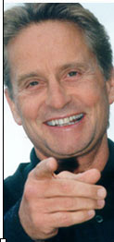
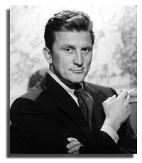
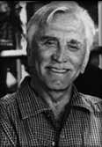
Martin Sheen
Charlie Sheen
How is it possible to maintain such genetic continuity?
Kirk
Kirk Douglas
Michael
Emilio Estevez

Slide 14
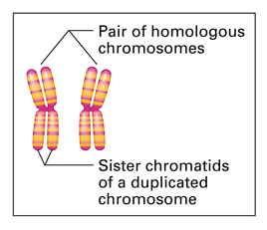
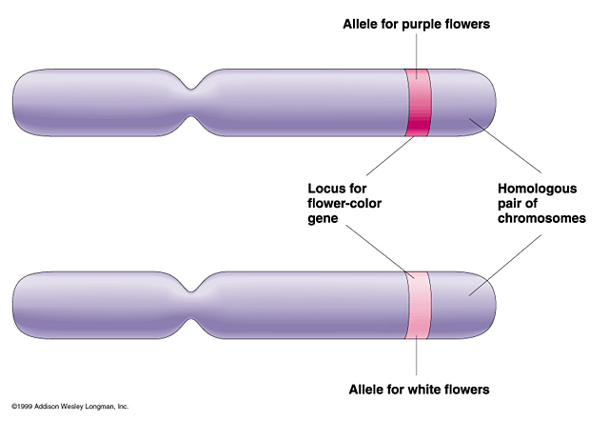
Chromosomes
Homologous chromosome: one of a matching pair of chromosomes, one inherited from each parent.
Sister chromatids are identical

Slide 15
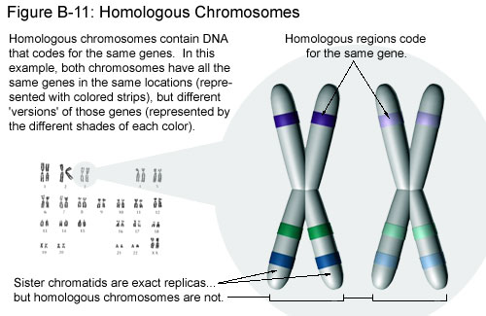

Slide 16
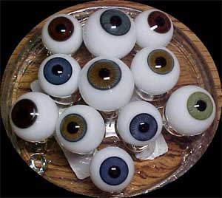
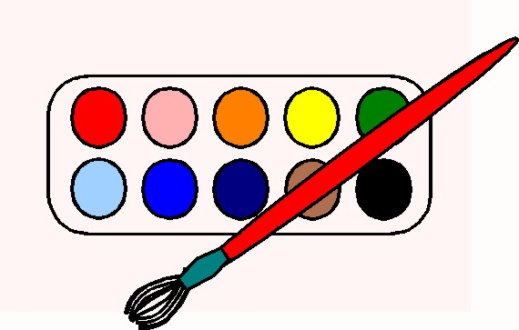
What genetic principles account for the transmission of such traits from parents to offspring?
The Blending Hypothesis of Inheritance
In the early 1800’s the blending hypothesis was proposed. Genetic material contributed by the two parents mixes in a manner analogous to the way blue and yellow paints blend to make green.
What would happen if this was the case?

Slide 17
Law of Dominance
In the monohybrid cross (mating of two organisms that differ in only one character), one version disappeared.
What happens when the F1’s are crossed?

Slide 18
The F1 crossed produced the F2 generation and the lost trait appeared with predictable ratios.
This led to the formulation of the current model of inheritance.

Slide 19
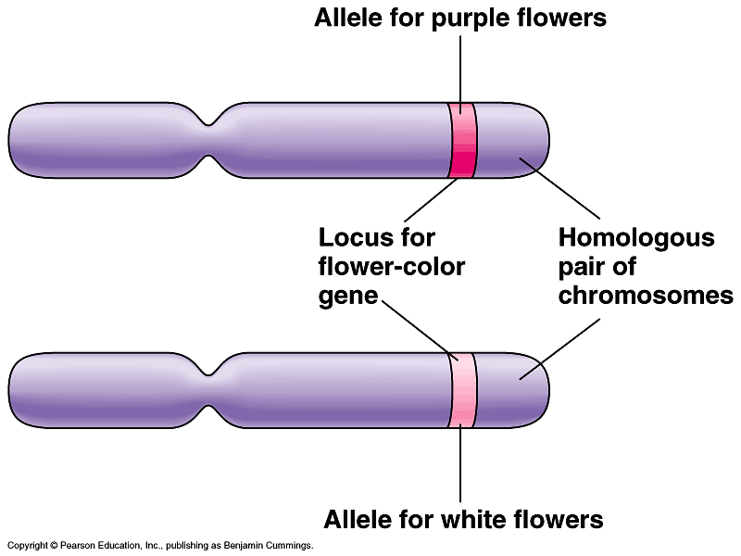
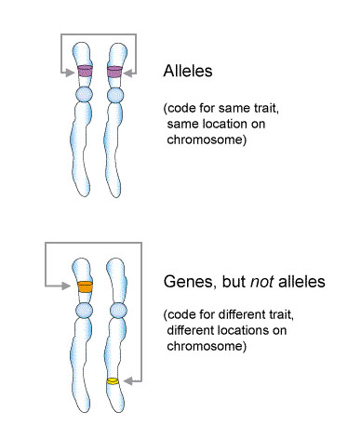
Alleles: alternative versions of a gene.
The gene for a particular inherited character resides at a specific locus (position) on homologous chromosome.
For each character, an organism inherits two alleles, one from each parent

Slide 20
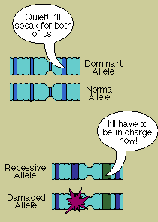
How do alleles differ?
Dominant allele
Recessive allele
Recessive allele
Recessive allele
Dominant - a term applied to the trait (allele) that is expressed irregardless of the second allele.
Recessive - a term applied to a trait that is only expressed when the second allele is the same (e.g. short plants are homozygous for the recessive allele).

Slide 21
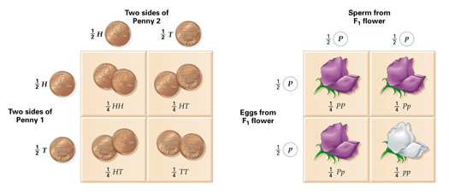
Probability and Punnett Squares
Punnett square: diagram showing the probabilities of the possible outcomes of a genetic cross

Slide 22
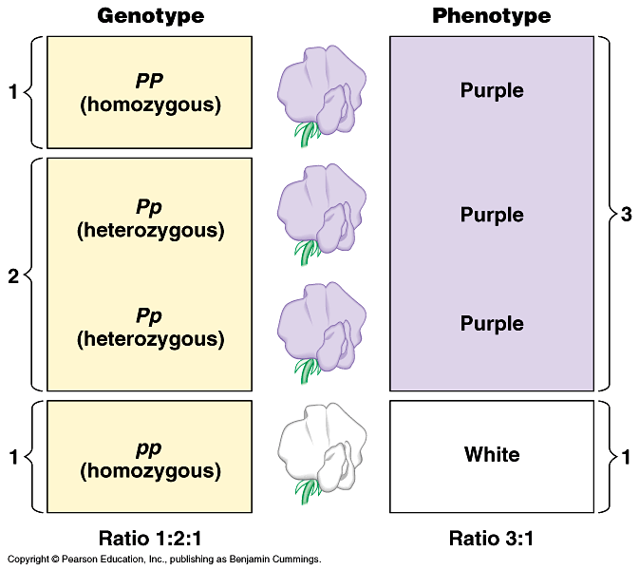
Genotype versus phenotype.
How does a genotype ratio differ from the phenotype ratio?

Slide 23
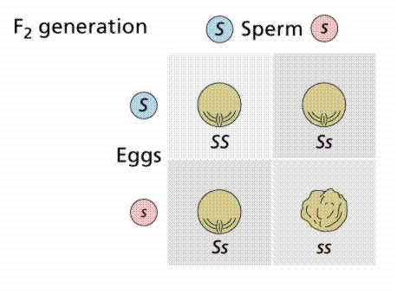
Punnett squares - probability diagram illustrating the possible offspring of a mating.
Ss X Ss
gametes

Slide 24
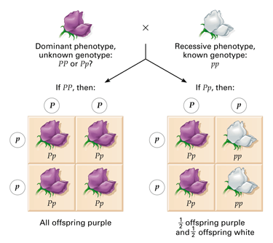
Testcross
A testcross is designed to reveal whether an organism that displays the dominant phenotype is homozygous or heterozygous.

Slide 25
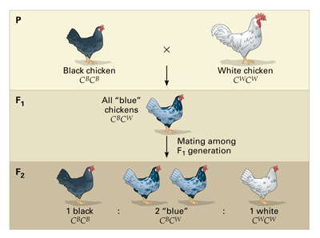
Variation in Patterns of Inheritance
Intermediate Inheritance (blending): inheritance in which heterozygotes have a phenotype intermediate between the phenotypes of the two homozygotes

Slide 26
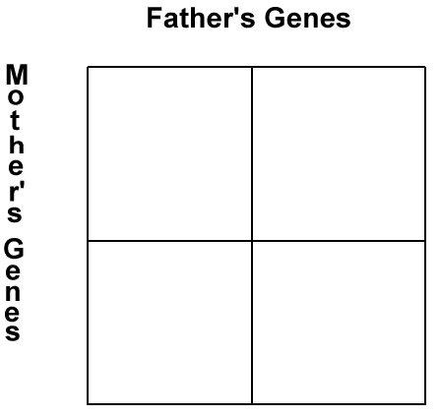
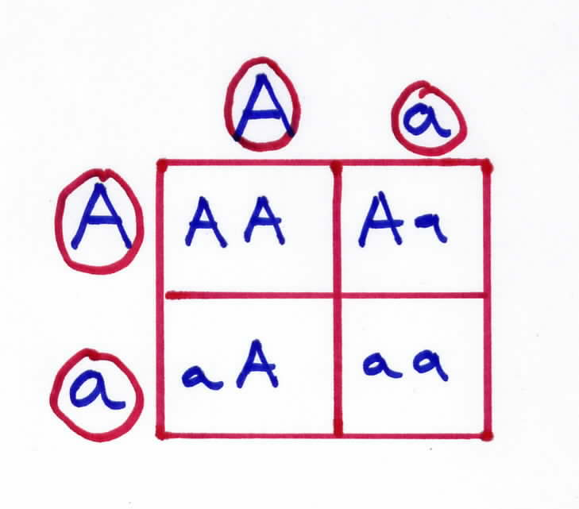
How Does it Work?

Slide 27
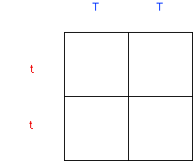

Slide 28

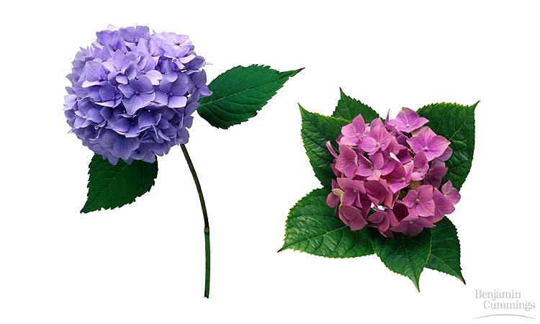
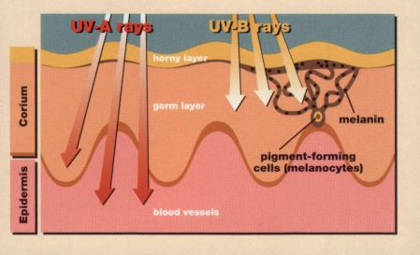
The Importance of the Environment
The environmental influences the expression of the genotype so the phenotype is altered.
Hydrangea flowers of the same genetic variety range in color from blue-violet to pink, depending on the acidity of the soil.
Multifactorial; many factors, both genetic and environmental, collectively influence phenotype in examples such as skin tanning

Slide 29
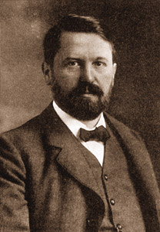
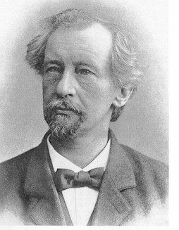
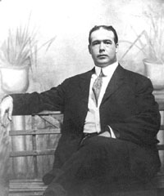
Chromosome Theory of Inheritance
Improved microscopy techniques, understand cell processes and genetic studies converged during the late 1800’s and early 1900’s.
It was discovered that Mendelian inheritance has its physical basis in the behavior of chromosomes during sexual life cycles.
Walter S. Sutton
Theodor Boveri
Hugo de Vries

Slide 30
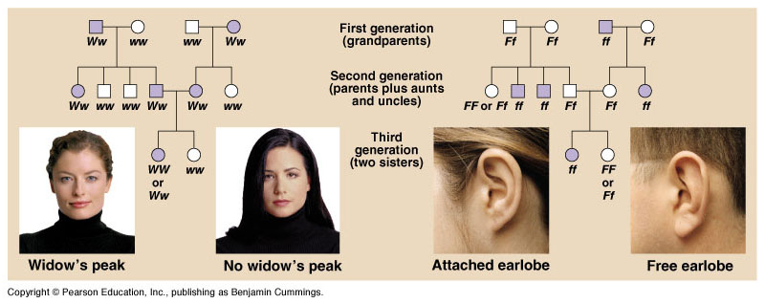
Pedigree analysis reveals Mendelian patterns in human inheritance
In these family trees, squares symbolize males and circles represent females. A horizontal line connecting a male and female (--) indicates a mating, with offspring listed below in their order of birth, from left to right. Shaded symbols stand for individuals with the trait being traced.

Slide 31
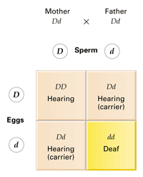
Disorders Inherited as Recessive Traits
Over a thousand human genetic disorders are known to have Mendelian inheritance patterns. Each of these disorders is inherited as a dominant or recessive trait controlled by a single gene. Most human genetic disorders are recessive.
A particular form of deafness is inherited as a recessive trait.

Slide 32
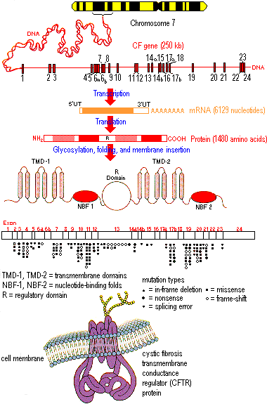
Many human disorders follow Mendelian patterns of inheritance
Cystic fibrosis, which strikes one out of every 2,500 whites of European descent but is much rarer in other groups. One out of 25 whites (4% ) is a carrier.
The normal allele for this gene codes for a membrane protein that functions in chloride ion transport between certain cells and the extracellular fluid. These chloride channels are defective or absent.
The result is an abnormally high concentration of extracellular chloride, which causes the mucus that coats certain cells to become thicker and stickier than normal.

Slide 33
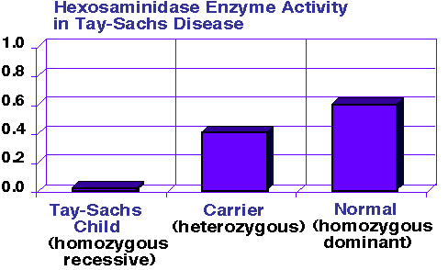
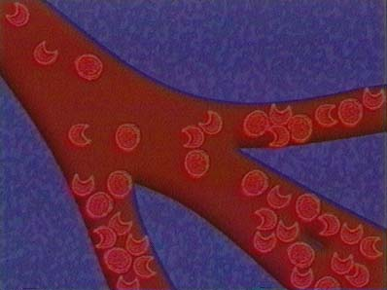
Tay-Sachs disease is caused by a dysfunctional enzyme that fails to break down brain lipids of a certain class. Is proportionately high incidence of Tay-Sachs disease among Ashkenazic Jews, Jewish people whose ancestors lived in central Europe
Sickle-cell disease, which affects one out of 400 African Americans. Sickle-cell disease is caused by the substitution of a single amino acid in the hemoglobin protein of red blood cells

Slide 34
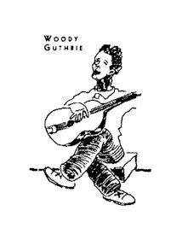
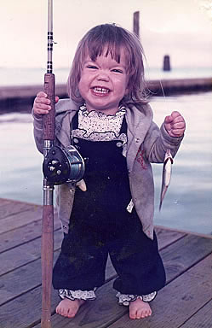
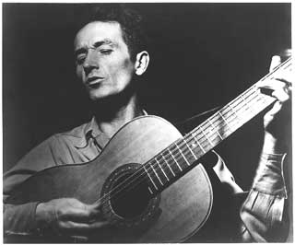
Dominantly Inherited Disorders
Achondroplasia, a form of dwarfism with an incidence of one case among every 10,000 people. Heterozygous individuals have the dwarf phenotype.
Huntington’s disease, a degenerative disease of the nervous system, is caused by a lethal dominant allele that has no obvious phenotypic effect until the individual is about 35 to 45 years old.

Slide 35
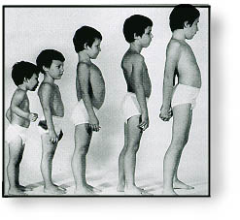
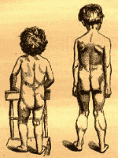
Sex-Linked Disorders in Humans
Duchenne muscular dystrophy, affects about one out of every 3,500 males born in the United States. People with Duchenne muscular dystrophy rarely live past their early 20s. The disease is characterized by a progressive weakening of the muscles and loss of coordination. Researchers have traced the disorder to the absence of a key muscle protein called dystrophin and have tracked the gene for this protein to a specific locus on the X chromosome.
Posture changes during progression of Duchenne muscular dystrophy.

Slide 36
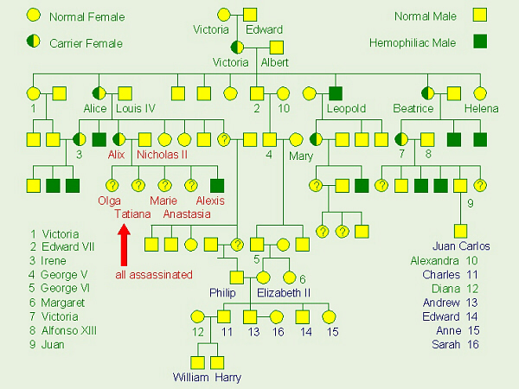
Hemophilia is a sex-linked recessive trait defined by the absence of one or more of the proteins required for blood clotting.

Slide 37
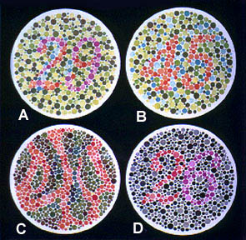
Color Blindness In Humans: An X-Linked Trait
Numbers That You Should See If You Are In One Of The Following
Four Categories: [Some Letter Choices Show No Visible Numbers]
Sex-Linked Traits:
Normal Color Vision:
A: 29, B: 45, C: --, D: 26
Red-Green Color-Blind:
A: 70, B: --, C: 5, D: --
Red Color-blind:
A: 70, B: --, C: 5, D: 6
Green Color-Blind:
A: 70, B: --, C: 5, D: 2

Slide 38
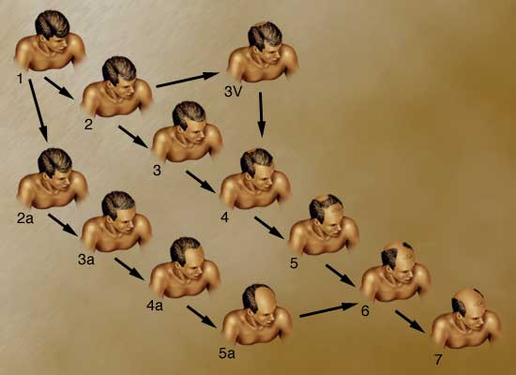

Pattern Baldness In Humans: A Sex Influenced Trait
Baldness is an autosomal trait and is apparently influenced by sex hormones after people reach 30 years of age or older.
In men the gene is dominant, while in women it is recessive. A man needs only one allele (B) for the baldness trait to be expressed, while a bald woman must be homozygous for the trait (BB).
What are the probabilities for the children for a bald man and woman with no history of baldness in the family?

Slide 39

DNA
DNA is often called the blueprint of life.
In simple terms, DNA contains the instructions for making proteins within the cell.
Notes:
Why is DNA called the blueprint of life?

Slide 40

Why do we study DNA?
We study DNA for many reasons:
its central importance to all life on Earth
medical benefits such as cures for diseases
better food crops.
Notes:
About better food crops, this area is controversial. There is a Dr. Charles Arntzen who is working on bioengineering foods with vaccines in them. People in poor countries could be immunized against diseases just by eating a banana, for instance.

Slide 41
Chromosomes and DNA
Chromosomes are made up of genes.
Genes are made up of a chemical called DNA.
Notes:
{Ask students where the chromosomes are in this picture. Or ask them where the DNA is. Remind them that the mitochondria also have DNA.}

Slide 42

The Shape of the Molecule
DNA is a very long molecule.
The basic shape is like a twisted ladder or zipper.
This is called a double helix.
Notes:
{Show students a model of the double helix. Explain what a spiral is and a helix is.}

Slide 43
One Strand of DNA
The backbone of the molecule is alternating phosphate and deoxyribose, a sugar, parts.
The teeth are nitrogenous bases.
phosphate
deoxyribose
bases
Notes:
{Point to the 3-D mode, if you have one, to show the parts as you discuss them.}

Slide 44

The Double Helix Molecule
The DNA double helix has two strands twisted together.
(In the rest of this unit we will look at the structure of one strand.)
Notes:
We will take apart the DNA molecule to see how it is put together.
First, we will look at one strand.

Slide 45


Slide 46

The Nucleus
DNA is located in the nucleus

Slide 47

DNA deoxyribonucleic acid
The code of life

Slide 48
Nucleotides
O -P O
O
One deoxyribose together with its phosphate and base make a nucleotide.
O
O -P O
O
O
O -P O
O
O
Nitrogenous
base
C
O
Phosphate
C
C
C
C
Deoxyribose
O
ribose
Notes:
{Ask students where they have seen a similar molecule before in this class.
Answer: ATP . Emphasize that nucleotides are the basic building blocks or units of a DNA molecule and that a single molecule has many millions of nucleotides.}

Slide 49

The Basics
Each side of the ladder is made up of nucleic acids.
The backbone is a phosphate and a sugar
The rung of the ladder is the nitrogen base.

Slide 50
Hydrogen Bonds
O
When making hydrogen bonds, cytosine always pairs up with guanine,
And adenine always pairs up with thymine.
(Adenine and thymine are shown here.)
N
C
O
C
C
C
N
N
C
N
C
C
C
N
N
C
N
C

Slide 51
Four nitrogenous bases
DNA has four different bases:
Cytosine C
Thymine T
Adenine A
Guanine G
Notes:
These four bases are abbreviated by using their respective first letters.

Slide 52
Two Stranded DNA
Remember, DNA has two strands that fit together something like a zipper.
The teeth are the nitrogenous bases but why do they stick together?
Notes:
{Point to the 3-D model to show the parts as you discuss them.}

Slide 53
Important
Adenine and Thymine always join together
A -- T
Cytosine and Guanine always join together
C -- G

Slide 54

Types of nitrogen bases
A= adenine
G= guanine
C= cytosine
T= thymine

Slide 55

Do Now!
Where is DNA located?
What does it look like?
What are its bases?
Why do you think DNA is located there?

Slide 56

Copying DNA
Step 1- DNA unwinds and unzips
Step 2- Once the molecule is separated it copies itself.
The new strand of DNA has bases identical to the original

Slide 57

DNA by the numbers
Each cell has about 2 m of DNA.
The average human has 75 trillion cells.
The average human has enough DNA to go from the earth to the sun more than 400 times.
DNA has a diameter of only 0.000000002 m.
The earth is 150 billion m
or 93 million miles from
the sun.
Notes:
If you unravel all the DNA in the chromosomes of one of your cells, it would stretch out 2 meters. If you did this to the DNA in all your cells, it would stretch from here to sun more than 400 hundred times!

Slide 58


What’s the main difference between DNA and RNA

Slide 59

RNA
In RNA Thymine is replaced by Uracil
A-U (RNA)
not
A-T (DNA)

Slide 60
IF the DNA strand is GTACCAGATTAGC
What would the RNA strand be?

Slide 61


Transcription
When a secretary transcribes a speech, the language remains the same. However, the form of the message changes from spoken to written

Slide 62

Transcription
Transcription- RNA is made from a DNA template in the nucleus.
This type of RNA is called messenger RNA or mRNA
Notes:
When a reporter transcribes a speech, the language remains the same. However, the form of the message changes from spoken to written

Slide 63

Transcription
DNA is protected inside the nucleus.
mRNA carries the message of DNA into the cytoplasm to the ribosome's

Slide 64


Slide 65


Translation
To translate English into Chinese requires an interpreter.
Some person must recognize the worlds of one language and covert them into the other.

Slide 66

tRNA Transfer RNA
The cells interpreter
tRNA translated the three-letter codons of mRNA to the amino acids that make up protein.

Slide 67

Translation
Genetic translation converts nucleic acid language into amino acid language.

Slide 68

Codon
The flow of information from gene to protein is based on codons.
A codon is a three-base word that codes for one amino acid

Slide 69

The flow of information from gene to protein is based on codons.

Slide 70


Slide 71

Information Flow: DNA to RNA to Protein

Slide 72


Slide 73


Slide 74
Let’s Go to the Video!
DNA to RNA

Slide 75
Let’s Go to the Video! DNA TRANSLATION

Slide 76
Comparing DNA and RNA

Slide 77
Transcription/Translation Review

