Slide 1
Chapter 9 Review

Slide 2
Gametogenesis
The production of gametes (sex cells)
Males = spermatogenesis in the testes
Females = oogenesis in the ovaries

Slide 3
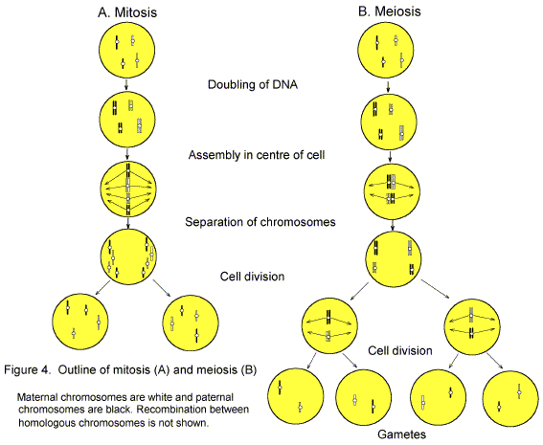
Mitosis vs Meiosis

Slide 4
(Remember)
Diploid
Contain the full number (set) of chromosomes
Represented by: 2n

Slide 5
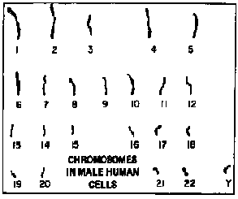
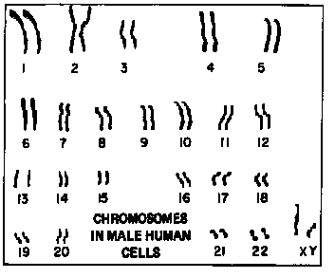
2n = 46 n=23
(Sperm/Egg)
Diploid Monoploid

Slide 6
Chapter 11 Chromosomes and Human Genetics

Slide 7
11.1 The Chromosomal Basis of Inheritance
Reasons we are not the same:
  Random Chromosomal Mutations
  Crossing Over
  Genetic Recombination (Fertilization)
    ½ from mom
    ½ from dad (hopefully)

Slide 8
11.1 The Chromosomal Basis of Inheritance
Genes and Chromosomes
Genes are units of information about heritable traits that have particular locations or loci (singular is locus) on particular chromosomes.
In humans, one homolog of each chromosome is inherited from each parent.
2n=46, 23 homologous Pairs
Pairs of chromosomes that are similar in structure and function are called homologous chromosomes

Slide 9
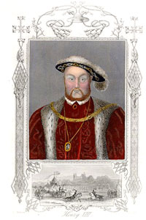
11.1 The Chromosomal Basis of Inheritance
1. Autosomes
All non sex-determining genes are the same in males and females
Homologous autosomes are identical in length, size, shape, and gene sequence.
  First 22 pairs
2. Sex chromosomes are nonidentical but still homologous.

Slide 10
11.1 Sex determination
Gender is determined by sex chromosomes.
  Human males have one X and one Y chromosome
    Y carries 330 genes
    SRY gene is the master gene, trigger teste formation that will produce testosterone
  Human females have two X chromosomes.
    X carries 2,062 genes
    NO SRY gene

Slide 11
Sex determination in humans
Males are XY
Female XX
Who determines the sex of the offspring?
X Y
X
X

Slide 12
Sex determination in humans
Males are XY
Female XX
Who determines the sex of the offspring?
DAD!!!
X Y
X XX XY
X XX XY

Slide 13
23 Pairs of chromosomes of a human cell

Slide 14
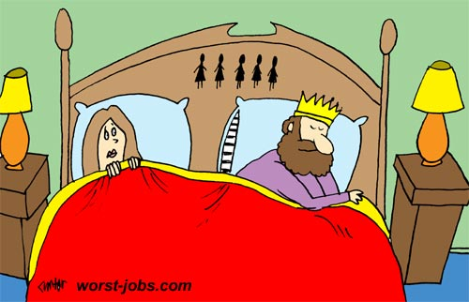
11.1 Sex determination problems in history

Slide 15
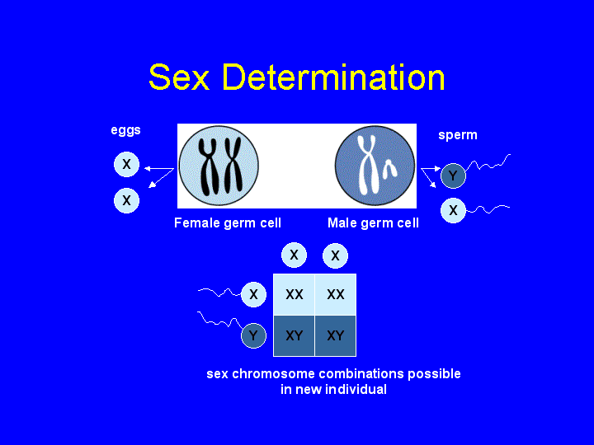
Sex determination

Slide 16
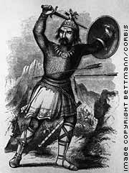
Genghis Khan, the ultimate alpha male
Are you distantly related to Genghis Khan?
  If you have Asian and/or European ancestors, you just might be.
A recent study was done to look at the Y chromosomes of 2,123 men across Asia.
  1 in 12 men shared the same Y chromosome.
  If this ratio holds up, that would mean 16 million males or 1 out of every 200 living males share this Y chromosome.
http://www.thetech.org/genetics/news.php?id=11

Slide 17
Genghis Khan, the ultimate alpha male
After a conquest looting, pillaging, and rape were the spoils of war for all soldiers, but that Khan got first pick of the beautiful women.
Khan's eldest son of four, Tushi, is reported to have had 40 sons.
His grandson, Kubilai Khan had 22 legitimate sons, and was reported to have added 30 virgins to his harem each year
http://news.nationalgeographic.com/news/2003/02/0214_030214_genghis_2.html

Slide 18
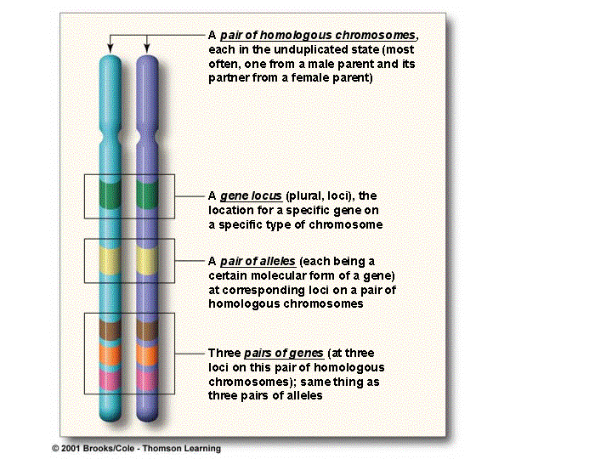
Homologs, Loci, Genes, and Alleles

Slide 19
11.2 Karyotyping Made Easy
Karyotypes are pictures of homologous chromosomes lined up together during Metaphase I of meiosis. The chromosome pictures are then arranged by size and pasted onto a sheet of paper.
Spectral Karyotypes use a range of fluorescent dyes that binds to specific regions of varying chromosomes
  Used to identify structural abnormalities

Slide 20
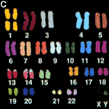
11.2 Karyotyping Made Easy

Slide 21
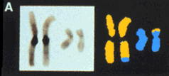
11.2 Karyotyping Made Easy
Chromosomes from the father of a retarded child. The conventional chromosome picture doesn't show any change, but the spectrally classified chromosomes show that a portion of chromosome 11 (blue) has been transferred to chromosome 1(yellow).

Slide 22
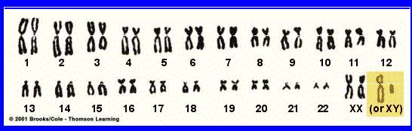
11.2 Karyotyping Made Easy

Slide 23
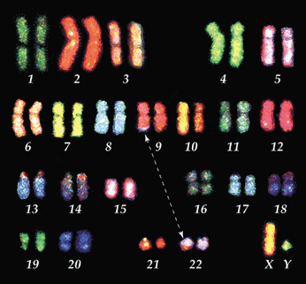
11.2 Karyotyping Made Easy
Translocation: a fragment is moved from one chromosome to another -

Slide 24
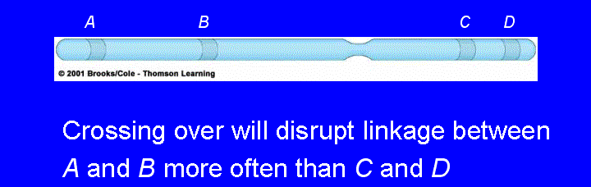
11.3 Impact of Crossing Over on Inheritance
Gene Linkage (Linkage group )
  Several linked genes on each type of chromosome .
Crossing Over
  Linkage can be disrupted by crossing over.
  Crossing over is an exchange of parts of homologous chromosomes.
The animation describes (Audio - Important) on crossing over.

Slide 25
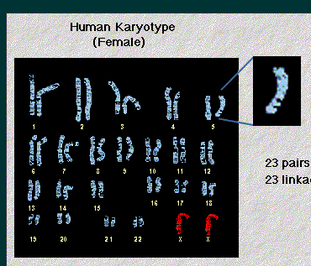
Gene Linkage
One human cell contains about 30,00 genes
Each cell has 46 chromosome, SO
Each chromosome has thousands of genes
*****Linked genes are located on the same gene

Slide 26
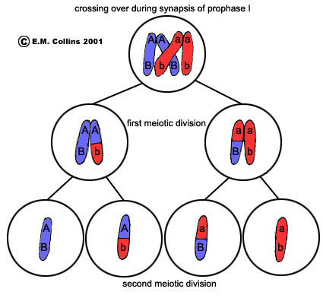
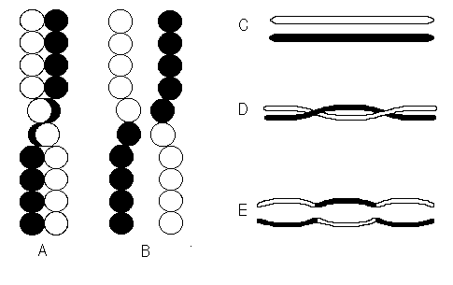
Crossing-Over
The chromatids of homologous chromosomes often twist around each other, break, exchange segments and rejoin. Crossing-over is a source of genetic variation in sexual reproduction

Slide 27

Crossing Over With Mr. Rizzo
Crossing Over: Two different strands of DNA exchange information
Recombination: result from crossing over, forms
”recombinate chromatids”

Slide 28
For Monday
Start reading Chapter 15

Slide 29
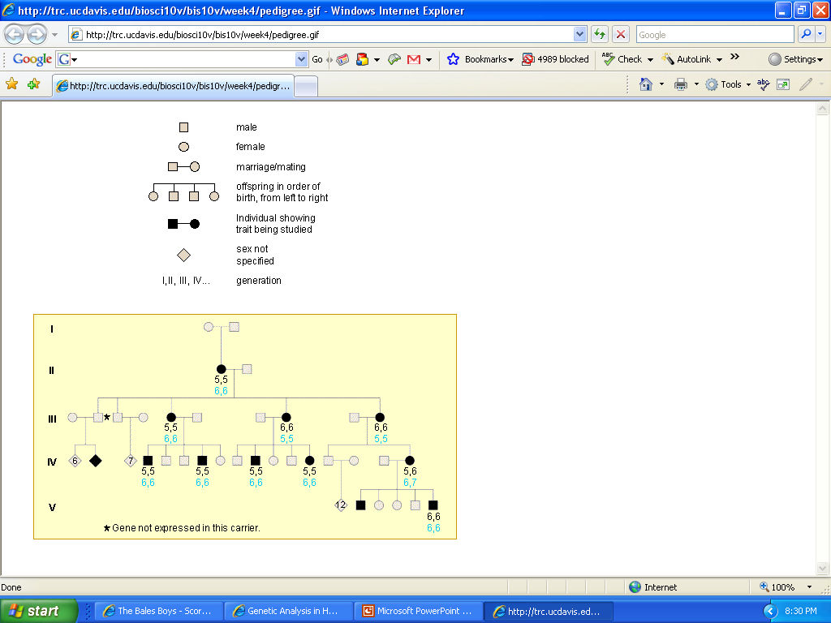
11.4 Human Genetic Analysis
A pedigree chart shows genetic connections among individuals using standardized symbols
A pedigree for polydactyly,
This animation (Audio - Important) describes pedigree charts.
Black#s: fingers
Blue#s: toes

Slide 30
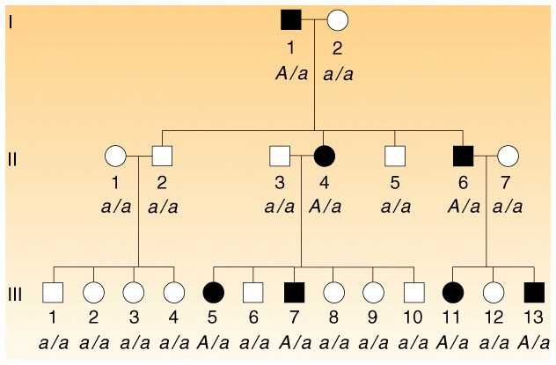
11.4 Human Genetic Analysis
A pedigree chart shows genetic connections among individuals using standardized symbols
A pedigree for polydactyly,
This animation (Audio - Important) describes pedigree charts.
Black#s: fingers
Blue#s: toes

Slide 31
11.4 Human Genetic Disorders
Genetic abnormality applied to a genetic condition that is a deviation from the usual, or average, and is not life-threatening.
  Ex: polydactyly
Genetic disorder is more appropriately used to describe conditions that cause medical problems.
A Syndrome is a recognized set of symptoms that characterize a given disorder.
  Symptoms: changes in the body or its functions, experienced by the patient and indicative of disease
A Disease is illness caused by infectious, dietary, or environmental factors

Slide 32
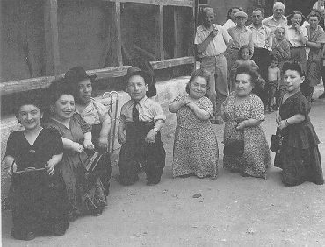
11.5 Examples of Human Inheritance Patterns
Autosomal Dominant Inheritance
Autosomal Recessive Inheritance
Sex linked Inheritance

Slide 33
11.5 Examples of Human Inheritance Patterns
Autosomal Dominant Inheritance
  Achondroplasia: 1/10,000 (dwarfism)
  Polydactyly
  Progeria
  Huntington's chorea

Slide 34
11.5 Examples of Human Inheritance Patterns
  A . Achondroplasia: (dwarfism)
    1/10,000
    In the homozygous form, it usually leads to stillbirth
    Heterozygotes display a type of dwarfism with short arms and legs relative to other body parts.
    AA = Homozygous dominant is lethal - fatal (spontaneous abortion of fetus).
    Aa = dwarfism.
    aa = no dwarfism. 99.96% of all people in the world are homozygous recessive (aa)..
B. Polydactyly (extra fingers or toes):
  PP or Pp = extra digits,
  aa = 5 digits. 98% of all people in the world are homozygous recessive (pp).

Slide 35
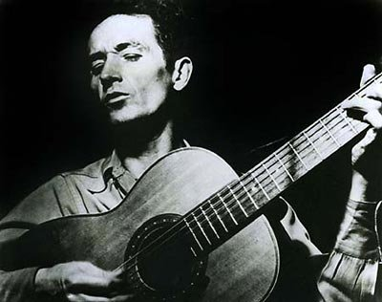
11.5 Examples of Human Inheritance Patterns
  C. Progeria (very premature aging): Spontaneous mutation of one gene creates a dominant mutation that rapidly accelerates aging
  D. Huntington's chorea is also a lethal dominant condition
  (HH = fatal) but homozygous dominant
  (Hh) people live to be ~40 or so, then their nervous system starts to degenerate.
    Woody Guthrie died of Huntington's.
  The genetic locus for Huntington's has been pinpointed to the tip of chromosome 4 - there is now a test for Huntington's - if you were from a Huntington's family, would you want to know?

Slide 36
11.5 Examples of Human Inheritance Patterns
Autosomal Recessive Inheritance
  Galactosemia:
  Cystic fibrosis:
  Tay-Sachs:
  Sickle-cell disease

Slide 37
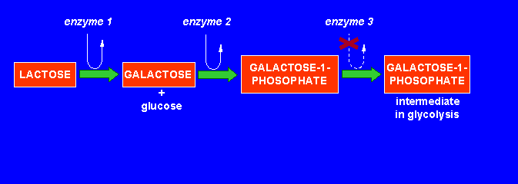
11.5 Examples of Human Inheritance Patterns
Autosomal Recessive Inheritance
  Galactosemia: Gene specifies a mutant enzyme in the pathway that breaks down lactose

Slide 38
11.5 Examples of Human Inheritance Patterns
Autosomal Recessive Inheritance
A.Cystic fibrosis: Homozygous recessives (cc) have cystic fibrosis - body cannot make needed chloride channel, high concentrations of extracellular chloride causes mucous to build up, infections, pneumonia. Diet, antibiotics and treatment can extend life to 25 years or more.
B.Tay-Sachs: Enzyme that breaks down brain lipids is non-functional in homozygous recessives (tt). Buildup of lipids causes death by age 2-3. Hexosaminidase A
  common among certain ethnic groups, such as Ashkenazi Jews 1/27, national avg 1/250
C. Sickle-cell disease: The most common inherited disease of African-Americans (1:400 affected). Homozygous recessives (ss) make abnormal form of hemoglobin that deforms red blood cells and causes a cascade of symptoms (clogging of blood vessels, organ damage, kidney failure).

Slide 39
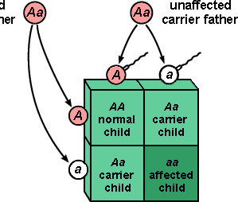
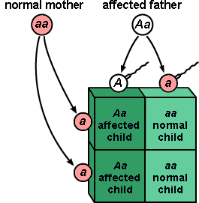
11.5 Examples of Human Inheritance Patterns
Autosomal Recessive Inheritance

Slide 40
11.5 Examples of Human Inheritance Patterns
Sex linked Inheritance, The mutated gene occurs only on the X chromosome.
  1. Color blindness is an example of an X-linked recessive trait that is not very serious.
    This three generation pedigree for color blindness demonstrates some of the distinctive characteristics of an X-linked recessive trait. These include:
        more affected males than affected females?????? Why?????
      no male to male transmission.
2. hemophilia A , the inability of the blood to clot because the genes do not code for the necessary clotting agent(s).
It was common in the European royal families. .
This animation (No Audio) describes x-linked disorders.

Slide 41
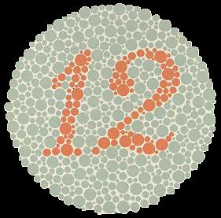
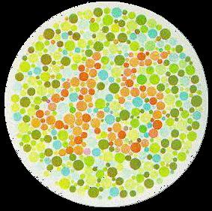
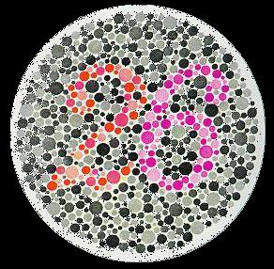
Everyone should see a 12.
Normal visioned people should see 45.
Colorblind people won't see any numbers.
Normal visioned people will see 26.
If you are red-blind, you should only clearly see the 6.
If you are green-blind, you should only see the 2.
A totally colorblind person won't see any number in this plate.

Slide 42
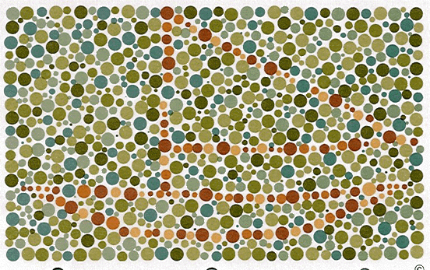

Slide 43
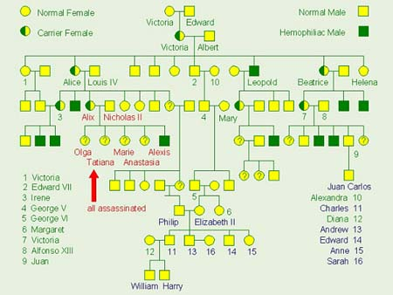
Queen Victoria’s Descendants

Slide 44
The Story of Hemophilia
Late in the summer of 1818, a human sperm and egg united to form a human zygote. One of those gametes, we don't know which, was carrying a newly mutated gene. A single point mutation in a nucleotide sequence coding for a particular amino acid in a protein essential for blood clotting. The zygote became Queen Victoria of England and the new mutation was for hemophilia, bleeder's disease, carried on the X chromosome.
A century later, after passing through three generations, that mutation may have contributed to the overthrow of the Tsar and the emergence of communism in Russia.
  Victoria passed the gene on to some of her children and grandchildren, including Princess Alexandra, who married Nicholas II, Tsar of Russia, in 1894.
  By 1903, the couple had produced four daughters.
  The next year, the long awaited male heir appeared - His Imperial Highness Alexis Nicolaievich, Sovereign Heir Tsarevich, Grand Duke of Russia. From his father, the baby Alexis inherited the undisputed claim to the throne of all the Russias.
  From his mother, he inherited an X chromosome carrying a copy of the mutant gene for hemophilia. Soon after his birth, signs of Alexis' mutant gene appeared.
  At six weeks, he experienced a bout of uncontrolled bleeding and by early 1905 the royal physicians had concluded that he was suffering from hemophilia.

Slide 45
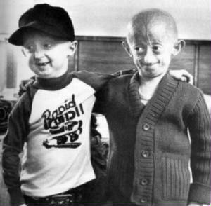
11.6 Too Young, Too Old
Hutchinson- Gilford Progeria Syndrome:
affect one in 8 million newborns worldwide.
autosomal disorder, #1
caused by a tiny, point mutation in a single gene, known as lamin A (LMNA).
  LMNA gene codes for two proteins that are known to play a key role in stabilizing the inner membrane of the cell's nucleus
  The altered protein makes the nuclear envelope unstable and progressively damages the nucleus,
nearly all cases are found to arise from the substitution of just one base pair among the approximately 25,000 DNA base pairs that make up the LMNA gene

Slide 46
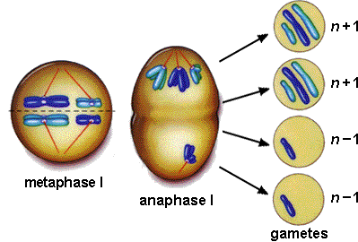
11.7 Altered Chromosomes
Changes in the chromosomal structure
  Duplication
  Inversion
  Deletion
    cri-du-chat
  Translocation
  Nondisjunction

Slide 47
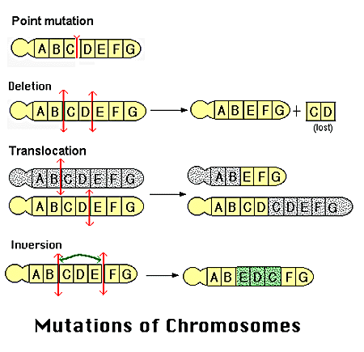
Chromosome and Gene Mutations

Slide 48
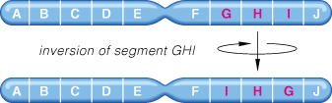
Inversion:
a fragment can be broken and rejoined in the reverse orientation, reversing the fragment within a chromosome.

Slide 49
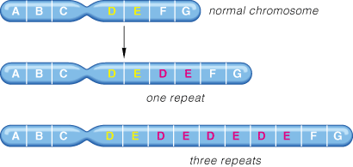
Duplication:
if the fragment joins the homologous chromosome, then that region is repeated

Slide 50
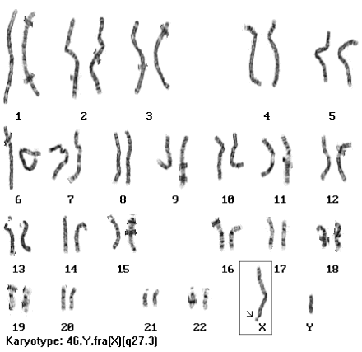
Duplication:
Fragile X: the most common form of mental retardation.
The X chromosome of some people is unusually fragile at one tip - seen "hanging by a thread" under a microscope.
Affects:
  1:1500 males,
  1:2500 females.

Slide 51
11.2 Karyotyping Made Easy
Translocation: a fragment is moved from one chromosome to another -

Slide 52
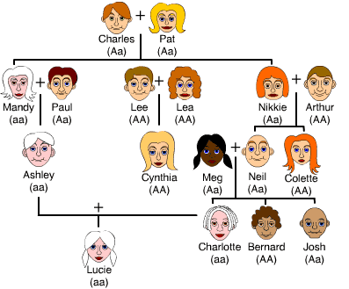
N= Normal Pigmentation n = Albinism recessive

Slide 53

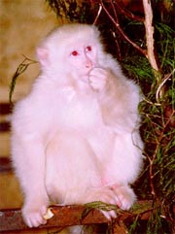
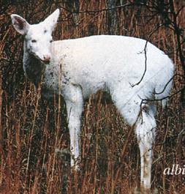
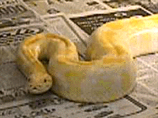

Gene Mutations albinism
About one in every 17,000 people have Albinism. These individuals fail to produce melanin, a photoprotective pigment. While melanin's role in protecting us from ultraviolet light is understood, it also has other important functions in the development of the retina and brain and their interconnection of which we know much less..

Slide 54
11.8 Changes in the Chromosome #
Changes in the number or in the structure
Aneuploidy is a change in the number of chromosomes that can lead to a chromosomal disorder.
  Monosomy: (X,O)
    Turners Syndrome
  Disomy (Normal)
  Trisomy (polyploidy)
    Trisomy 21 (Down syndrome)
    Trisomy 18 (Edwards syndrome)
    Trisomy 13 (Patau syndrome)
    Trisomy 12 (Chronic Lymphocytic Leukemia)
    Trisomy 8 (Warkany syndrome 2) Polyploidy (More then 3)
  Nondisjuction of sex chromosomes
    Turners Syndrome, XO, 1/25000
    Klinefelter Syndrome, XXY 1/500
    47,XYY, no really that’s its name

Slide 55
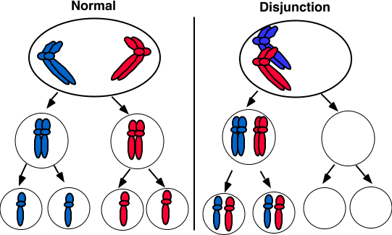
Nondisjunction During meiosis (Aneuploidy)

Slide 56
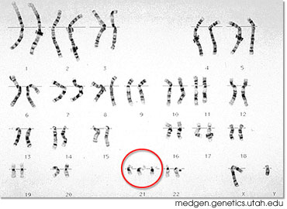
Karyotype, Trisomy
Down Syndrome
Down's Syndrome is correlated with age of mother but can also be the result of nondisjunction of the father's chromosome 21.

Slide 57
Karyotype, Trisomy, Down Syndromes
*trend of increasing risk with the mother's age is the same
Age of Mother | Frequency of Down Syndrome | Frequency of Any Chromosomal Disorder
20 25 30 35 36 37 38 39 40 41 42 43 44 45 | 1 in 1667 1 in 1250 1 in 952 1 in 378 1 in 289 1 in 224 1 in 173 1 in 136 1 in 106 1 in 82 1 in 63 1 in 49 1 in 38 1 in 30 | 1 in 526 1 in 476 1 in 385 1 in 192 1 in 156 1 in 127 1 in 102 1 in 83 1 in 66 1 in 53 1 in 42 1 in 33 1 in 26 1 in 21

Slide 58
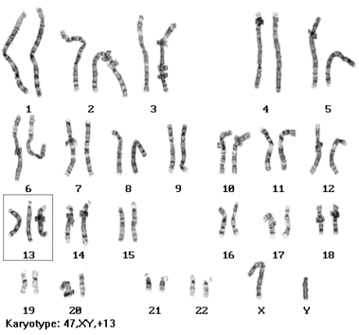
Patau syndrome (trisomy 13):
1:5000 live births.
serious eye, brain, circulatory defects as well as cleft palate.
Children rarely live more than a few months.

Slide 59
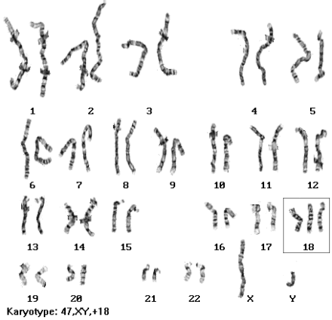
Edward's syndrome (trisomy 18):
1:10,000 live births
Children rarely live more than a few months
almost every organ system affected

Slide 60
Nondisjuction of the Sex Chromosomes
Turners Syndrome
Klinefelter Syndrome
47, XYY males

Slide 61
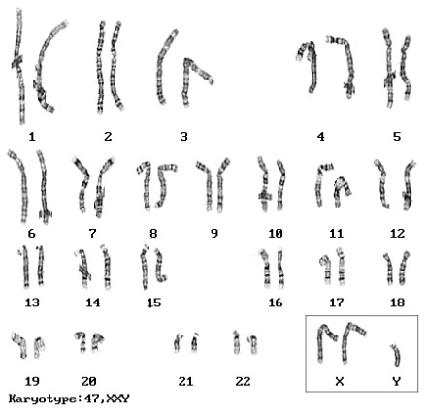
A. Klinefelter Syndrome:
47, XXY males.
Male sex organs; unusually small testes, sterile.
Breast enlargement and other feminine body characteristics.
Normal intelligence.

Slide 62
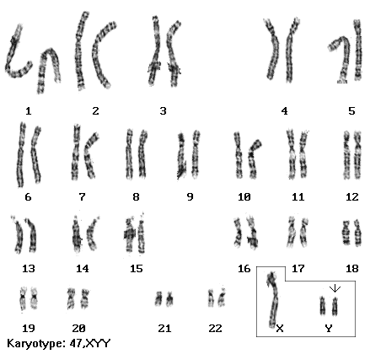
B. 47, XYY males:
Individuals are somewhat taller than average and have below normal intelligence.
At one time (~1970s), it was thought that these men were likely to be criminally aggressive,
but this hypothesis has been disproven over time.

Slide 63
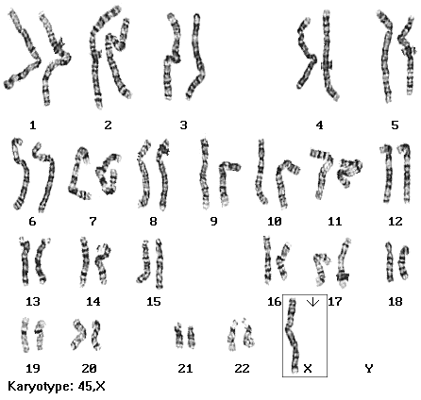
C. Monosomy X
(Turner's syndrome):
1:5000 live births;
the only viable monosomy in humans.
XO individuals are genetically female, however, they do not mature sexually during puberty and are sterile.
Short stature and normal intelligence. (98% die before birth)

Slide 64
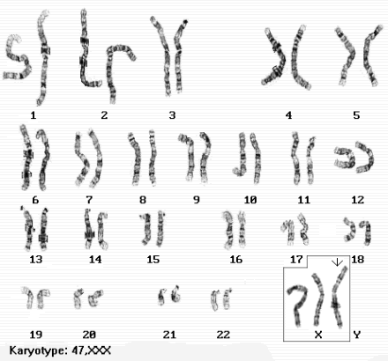
D. Triploid Human Cell * Trisomy X: 47, XXX
females. 1:1000 live births - healthy and fertile - cannot be distinguished from normal female except by Karyotype

Slide 65
11.9 Some Prospects in Human Genetics
How can prospective parents determine whether their child will be affected and how best to optimize outcome?
Carrier recognition: Testing the lineage .
Fetal Testing: Tests the fetus - Genetic disorders can be determined before birth, giving the parents time to adjust to their child's condition and make informed decisions.
Newborn Screening: Tests the newborn for genetic disorders .

Slide 66
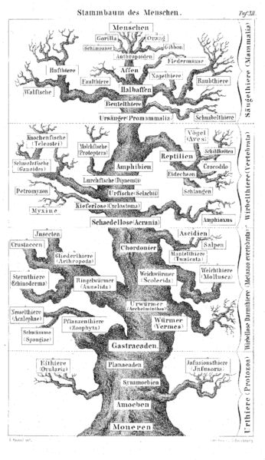
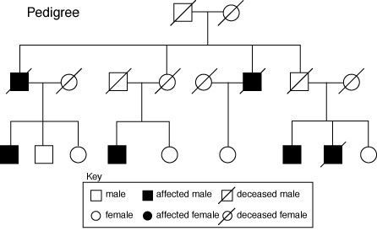
11.9 Some Prospects in Human Genetics
1. Carrier recognition:
  Genetic Counseling

Slide 67
11.9 Some Prospects in Human Genetics
2. Prenatal Diagnosis
  Amniocentesis: cells in amniotic fluid are cultured for 2 weeks and DNA karyotyped. Can clearly detect various chromosomal abnormalities
    Performed after week 8
    1 to 2 % miscarriage risk
  Chemicals present in amniotic fluid are diagnostic of Tay-Sachs, anencephaly, spina bifida.
  Fetoscopy: endoscope pulsed sound waves, fetal blood sampled
    Sickle cell and hemophilia
    2-10% miscarriage risk
  CVS: chorionic villi sampling - small amount of placental tissue removed - results are available within a few days, can be done pre 8 weeks , 0.3% risk

Slide 68
11.9 Some Prospects in Human Genetics
2. Prenatal Diagnosis
Human Chorionic Gonadotropin ( HCG) is the hormone that is produced by the placenta during pregnancy.
This hormone is what detects pregnancy during a pregnancy test.
During a normal pregnancy, the HCG levels will steadily rise throughout pregnancy.
The HCG levels will peak around the 8th to 10th week of pregnancy and then decline until delivery.

Slide 69
11.9 Some Prospects in Human Genetics
A woman normally produces 25 milli-international units per milliliter (mIU/ml) of Human Chorionic Gonadotropin (hCG) 10 days after conception
0-1 week: 0-50 IU/L
1-2 weeks: 40 – 300
3-4: 500 - 6,000
1-2 months: 5,000 - 200,000
2-3 months: 10,000 - 100,000
2nd trimester: 3,000 - 50,000
3rd trimester: 1,000 - 50,000
Non-pregnant females: < 5.0
Postmenopausal: < 9.5

Slide 70
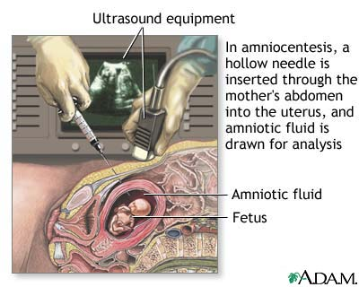
11.9 Some Prospects in Human Genetics

Slide 71
11.9 Some Prospects in Human Genetics
3. Newborn Screening: Tests the newborn for genetic disorders .
Example PKU (phenylketonuria) recessively inhertied 1:10,000 births. Children can't break down Phe, converted to toxic by-product that causes retardation.
If PKU test (done in hospital) detects deficiency, a low-Phe diet must be maintained for life. (
  See warning on Nutrasweet-containing products).
Thus, PKU is a treatable disorder if caught early enough. All newborns in the US are screened for PKU.

Slide 72
Videos
http://www.biology.iupui.edu/biocourses/N100H/ch11humgenetics.html
http://www.copernicusproject.ucr.edu/ssi/HSBiologyResources.htm

