Slide 1
Variation and Evolution
LEARNING OUTCOMES
Define the term variation.
Discuss the fact that variation occurs within, as well as between, species.
Describe the differences between continuous and discontinuous variation, using examples of a range of characteristics found in plants, animals and other organisms.
Explain both the genetic and the environmental causes of variation.

Slide 2
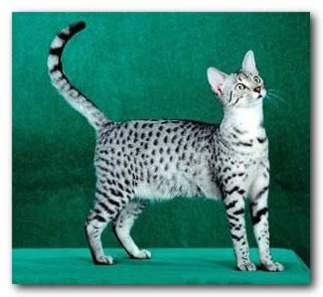
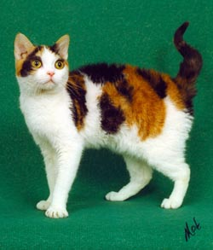
Variation and Evolution
Give a definition of Variation
Variation is the range of differences that there are between individual organisms.

Slide 3
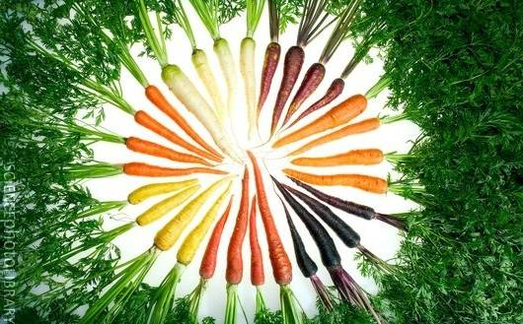
Variation and Evolution
Variation can be within species
(Think of all the differences between individual humans)
These are different varieties of the same species

Slide 4
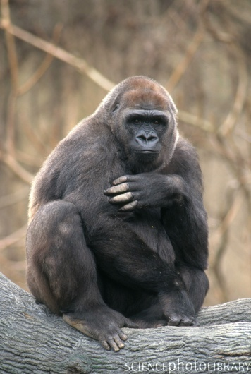
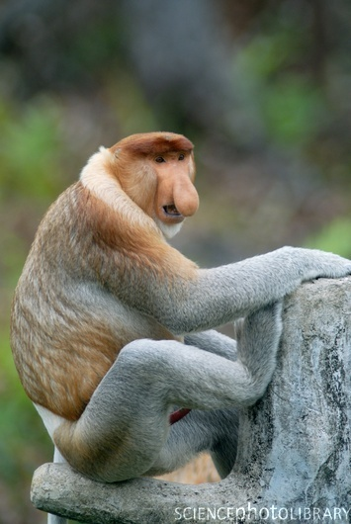
Variation and Evolution
Or between species:
Gorilla Proboscis monkey

Slide 5
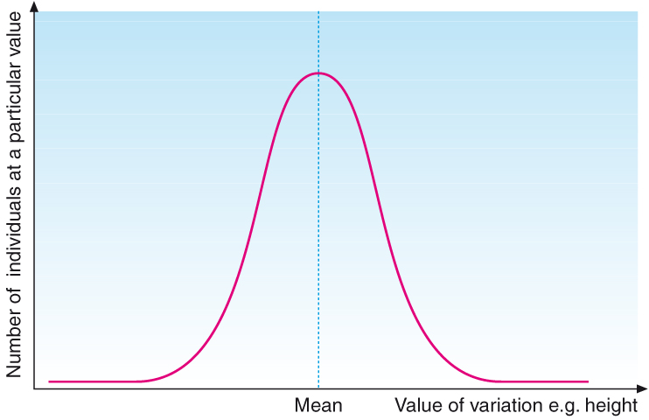
Variation and Evolution
Variation can be CONTINUOUS,
ie have any value between two extremes.
Eg:
Height of human
Body mass of cats
Trumpet length of daffodils
Leaf width of shrub
Length of bacteria
All these features
show normal
distribution (see graph)

Slide 6
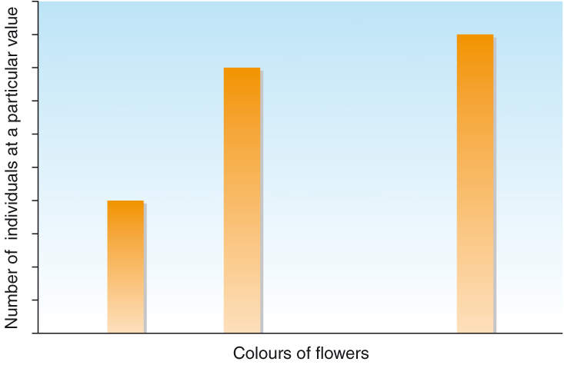
Variation and Evolution
Variation can be DISCONTINUOUS , in this case there only a few possible categories that the characteristic can fall into.
EG:
Flower colour in a single species
Human blood group or
ear lobe type
Bacteria that are or are not resistant to an antibiotic

Slide 7
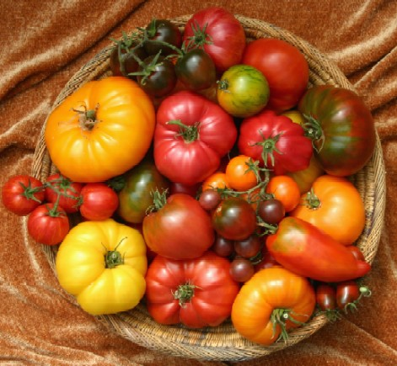
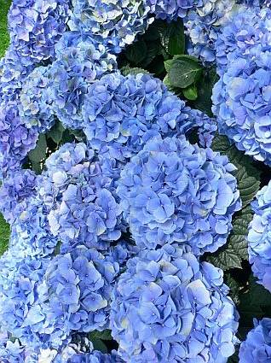
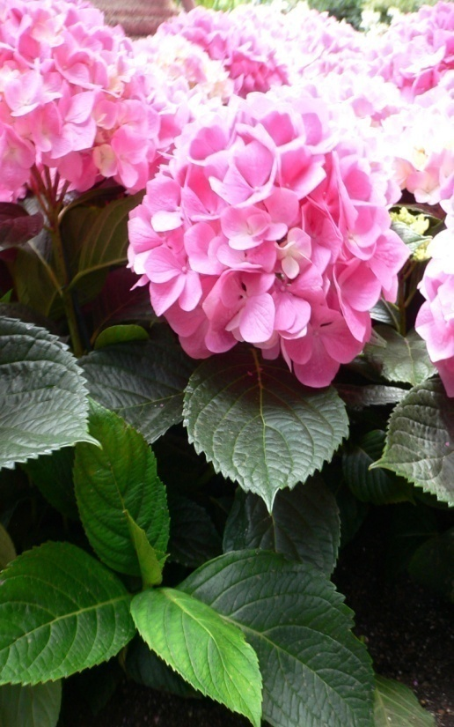
Variation and Evolution
Genetic variation
Each tomato is different because it comes from a plant with different alleles, that code for different characteristics
Environmental variation
These plants are genetically identical, the flower colour difference is due to the effects of soil pH.

Slide 8
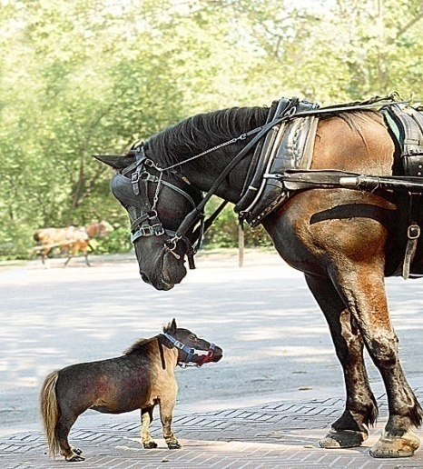
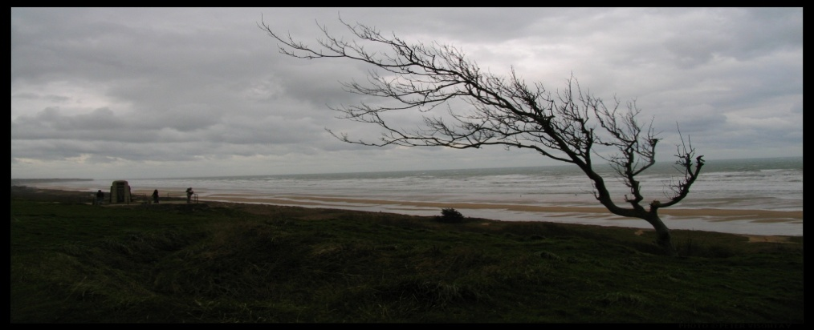
Variation and Evolution
genetic
environmental
Differences that are due to the DNA inside the cells of the organism rather than the effect that its surroundings have on it.
Differences that are due to the external environment. For example availability of water, nutrients, light, prevailing winds.

Slide 9
Variation and Evolution
Many of the differences between species are present because they help the individuals to survive.
We call these differences ADAPTATIONS.
You should understand that there are Adaptations to:
ANATOMY or body FORM,
PHYSIOLOGY or body FUNCTION
BEHAVIOUR

Slide 10
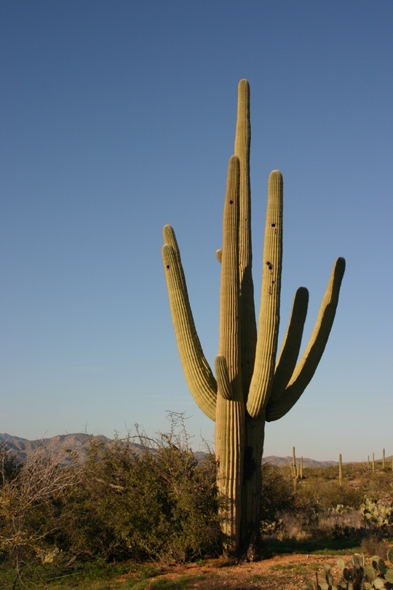
Variation and Evolution
SAGUARO CACTUS
Accordion folded stem is fleshy to store water
Roots mostly less than 15cm deep but cover huge area
1 deep tap root
Can absorb 750 litres water in a single storm
Leaves reduced to spines to reduce transpiration rate
Waxy cuticle reduces transpiration
Stomata only open at night

Slide 11
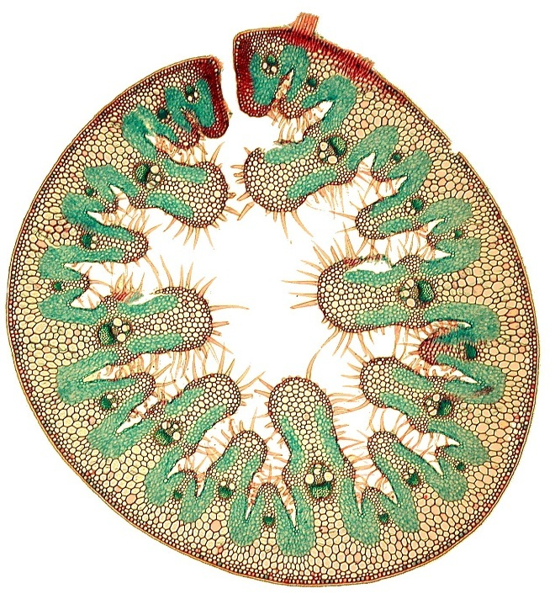
Variation and Evolution
Adaptations of Marram Grass, a xerophyte
Rolled leaf
Thick cuticle
Sunken stomata
Epidermal hairs
What is the purpose of these adaptations?
Explain how they work using AS vocabulary
Make notes on the diagram provided

Slide 12
Variation and Evolution
Outline the behavioural, physiological and anatomical (structural) adaptations of organisms to their environments
You should be able to suggest several different types of adaptations of organisms that help them to survive.
Make note of some examples from the “Journey of Life” DVD
Choose one example from the DVD and research further

Slide 13
Variation and Evolution
Explain the consequences of the four observations made by Darwin in proposing his theory of natural selection.
What are the 4 observations that Darwin made?
1. Offspring generally appear similar to parents.
2. No two individuals are identical. (Why not?)
3. organisms have the ability to produce large numbers of offspring
4. Populations in nature tend to remain fairly stable in size.
SO what are the consequences?

Slide 14
Variation and Evolution
Because individuals over produce, yet populations remain stable COMPETITION must take place.
In COMPETITION there are “winners” and “losers”. Winners are better adapted with more useful characteristics, they are more able to survive and breed, so pass on their beneficial alleles.
Over time when this happens continually, accumulated changes can give rise to a new species.

Slide 15
Variation and Evolution
Outline how variation, adaptation and selection are major components of evolution.
Differences in organisms
How do they arise?
Where do these changes happen?
How can they be passed on?

Slide 16
Natural Selection
Variation in organisms characteristics are caused by the organisms having different alleles of genes.
Some differences enable the organism to survive better (compete more successfully)
The ones with beneficial alleles survive, breed and pass on their alleles to the next generation
Those without beneficial alleles die before they reproduce, so their alleles are less likely to be passed on.
The beneficial alleles increase in frequency in the population and may eventually produce a new species.

Slide 17
Selection Pressures
Competition for food, water, minerals
Predation, grazing
Disease
Physical and chemical factors
Competition for mates
Competition for space, nesting sites, territory etc
An allele that helps an organism compete better is “selected for”, increases in frequency
An allele that fails to help an organism survive is usually “selected against”, decreases in frequency

Slide 18
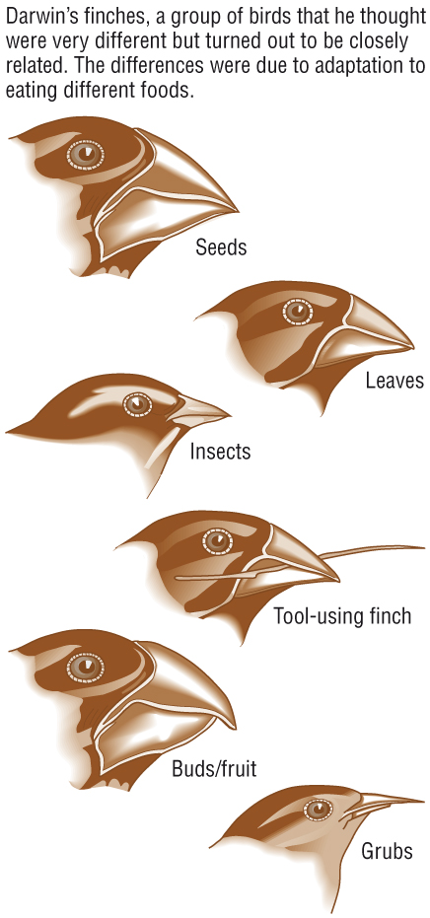
The sequence described is termed
NATURAL SELECTION
Darwin proposed that Natural Selection could lead to new species being produced over time.
This was his explanation for the large number of different species of finch found in the Galapagos Islands.
Each species has adaptations to its body, beak and feet that allow it to feed on specific types of food in specific areas.

Slide 19
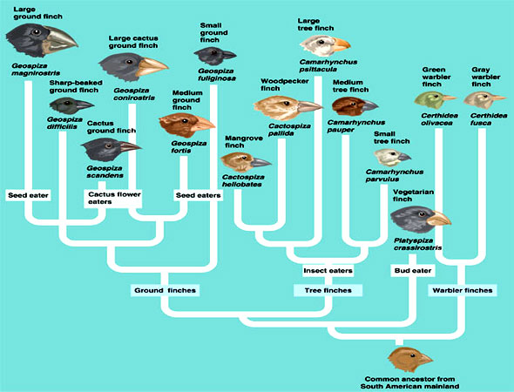
Darwin’s Finches

Slide 20
Evolution of a new species
“Speciation”
Speciation occurs when there is a “Reproductive Barrier”, some thing that stops members of an original population passing their alleles freely among all members
The barrier may be a geographical barrier = ALLOPATRIC speciation
The barrier may be behavioural, biochemical, or anatomical =SYMPATRIC speciation

Slide 21
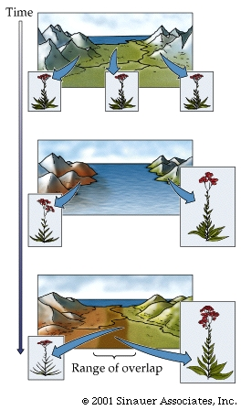
Allopatric speciation
One large interbreeding population exists at the start of the process
Two isolated populations are created by the formation of a barrier - in this case, rising sea level.
Subsequent to their separation, the two populations diverge in response to differing selective pressures.
At this point, the two populations are proto-species.
They may diverge even further and become unable to interbreed at all.

Slide 22
Sympatric Speciation
When there is NO geographical barrier
Initially individuals in the original species may have variations that can be divisive of the population.
Eg in birds some might have slightly: different shaped beaks
shorter wings,
better nocturnal vision,
different colour plumage or courting behaviour, etc

Slide 23
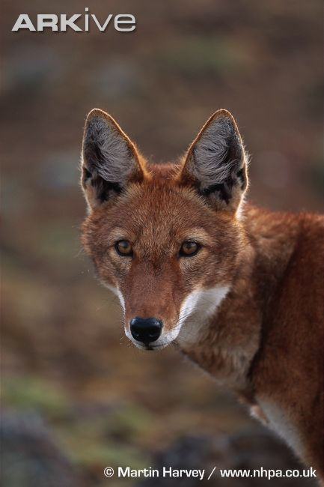
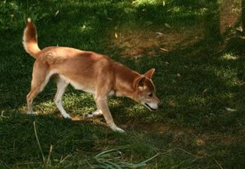
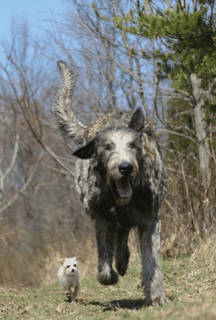
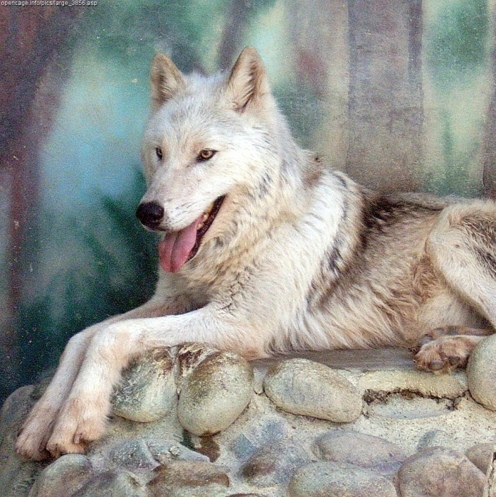
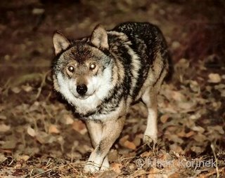
Speciation in the Genus CANIS

Slide 24
Evidence for Evolution
Fossil record- simplest organisms in oldest rocks, old species extinct, new species develop. Reptile/bird link, horse evolution, human evolution.
Biochemical- Similar biochemistry of all living things, closely related species have similar biochemistry, the longer ago they diverged the more different the biochemistry.
Amino acid sequences in cytochrome c (used in respiration). Species with same amino acid sequences are closely related, the bigger the differences the less closely related they are and the further back they diverged
DNA and RNA polymerase are made of basic polypeptide chains in all organisms but higher organisms have extra sub units to help regulation of DNA and RNA production. Similar sub units can indicate closely related species
DNA differences are greater between species which are not closely related

Slide 25
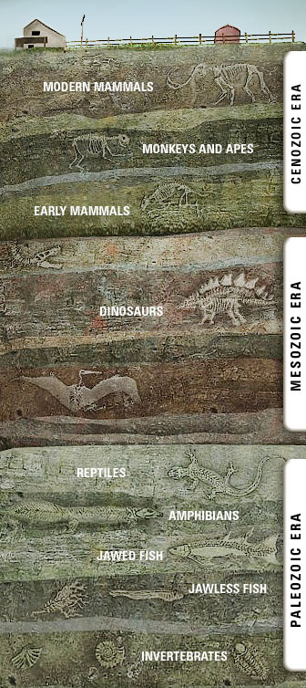
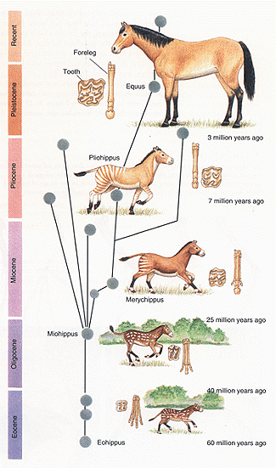
Evidence for Evolution

Slide 26
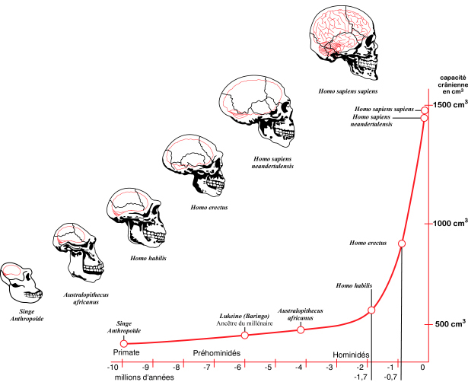
Evolution and growth of Human Brain

Slide 27
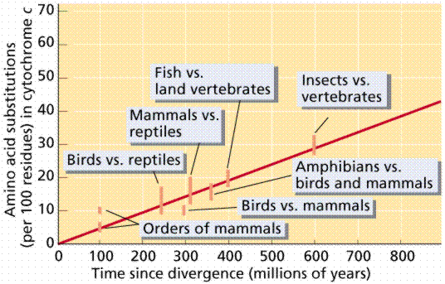
Cytochrome C differences
The larger the number of differences between the 2 groups the further back in time they diverged.

Slide 28
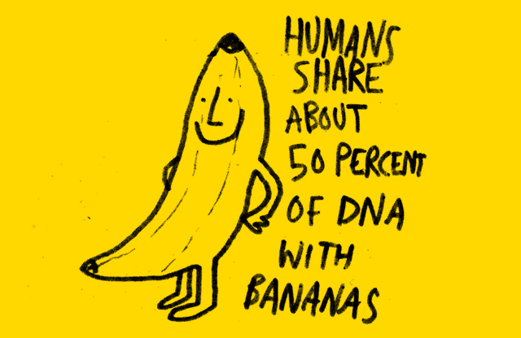
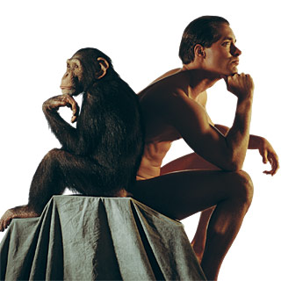
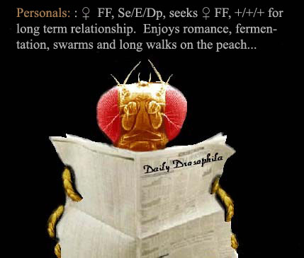
Shared DNA
Humans have about 95% of their DNA in common with Chimpanzees
Humans have about 75% of their DNA the same as Fruit Flies

Slide 29
Using the Evidence for Evolution
This evidence can be used to support decisions made about classification.
Phylogeny is the study of evolutionary relationships between organisms (p201)
Decisions are made using the criteria from the previous slide and other tests
Natural Classification groups organisms according to how closely related they are; this should match the evolutionary tree produced by considering how recently organisms shared a common ancestor.

Slide 30
Discuss why the evolution of pesticide resistance in insects and of drug resistance in microorganisms has implications for humans.
© Pearson Education Ltd 2008
This document may have been altered from the original

Slide 31
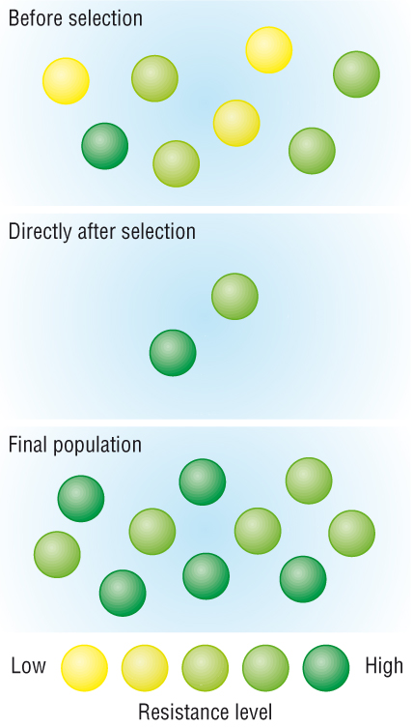
Resistance to antibiotics or pesticides
Variation amongst individuals (caused by mutations to genes) in a population means some are better adapted to survive the presence of these chemicals than others
The individuals able to survive in the presence of antibiotic or pesticide have beneficial alleles.
Those without the beneficial alleles die and do not reproduce
Those with the beneficial alleles reproduce and pass on their alleles to the next generation
Resistance in the population increases
The frequency of the alleles in the population changes

Slide 32
Mechanisms of Resistance
Enzymes may break down the antibiotic/ pesticide/ toxin
Receptors for pesticide/ antibiotic/ toxin may be altered so binding no longer occurs
Membrane or body is less permeable to antibiotic/ pesticide/ toxin
Excretion rate of antibiotic/ pesticide/ toxin increases and keeps levels in cells too low to have an effect.

Slide 33
F212 Jan 2010 Q3 parts c,d,e

Slide 34
Classification 1
Old system-”Plants” and “Animals”
Plants included anything that wasn’t an animal! Not just photosynthetic organisms but also fungi and bacteria
Developments in microscopy and other techniques showed big differences in the structure and biochemistry of many organisms in the “plant” group that prompted changes to the classification system

Slide 35
Classification 2
In 1969 Robert Whittaker proposed that living organisms should be divided into 5 “Kingdoms”
Prokaryotes/ Monera
Protoctista
Fungi
Plants
Animals
Look at important features of each kingdom and LEARN! Page 202 -203

Slide 36
Classification 2
Make a table to include the following features of each kingdom:
Nucleus
Cell walls
Organelles and microtubules
Type of nutrition
Motility (ability to move themselves)
Nervous co-ordination
Give an example of an organism from each kingdom

Slide 37
Features | Kingdoms
 | Prokaryote | Protoctista | Fungi | Plants | Animals
Nucleus
Cell wall
Organelle + microtubule
Type of nutrition
Motility
Nerves co-ordination
Examples

Slide 38
Features | Kingdoms
 | Prokaryote | Protoctista | Fungi | Plants | Animals
Nucleus | no | yes | Yes | yes | yes
Cell wall | Yes, made of peptidoglycan | Sometimes present | Yes, made of chitin | Yes, made of cellulose | no
Organelle + microtubule | no | yes | yes | yes | yes
Type of nutrition | Autotrophic or heterotrophic | Autotrophic or heterotrophic | Heterotrophic | Autotrophic | Heterotrophic
Motility | Some have flagella | Some have undulipodia or cilia | no | no | Yes, muscular tissue
Nerves co-ordination | no | no | no | no | yes
Examples | Bacteria and cyanobacteria | Algae, slime moulds, paramecium | Mould fungi, yeast | Liverworts, mosses, ferns, conifers, flowering plants | Jellyfish, corals, worms, insects, vertebrates

Slide 39
Classification 2
Divisions of the Kingdoms into “taxa” (classification groups/levels). See pages 204-205
Kingdom
Phyla
Class
Order
Family
Genus
Species
Make up a mnemonic for KPCOFGS
The Genus and species give us the binomial Latin names of organisms
Eg Homo erectus, Pongo pygmaeus

Slide 40
Outline the binomial system
Use a dichotomous key
See pages 206-207

Slide 41
Classification 3
As more and more information has become available scientists have considered reorganising classification into 3 “Domains” which are then divided further
1990 Carl Woese suggested the following domains
Bacteria (Eubacteria-true bacteria)
Archae (Archaebacteria)
Eukaryote

