Slide 1
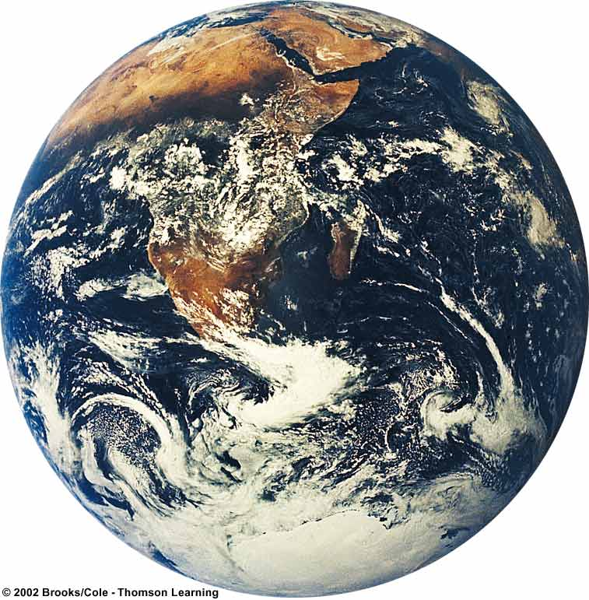
Evolution and Biodiversity
Miller Chapter 5
Powerpoint Adapted from: http://yhspatriot.yorktown.arlington.k12.va.us/~mzito/APES/PPTs/Evolution.ppt

Slide 2
Essential Questions
Be able to describe how the earth is “just right” for life
What is evolution? How has evolution lead to the current diversity of organisms?
What is an ecological niche? How does it relate to adaptation to changing environmental conditions?
How do extinction of species and formation of new species affect biodiversity?

Slide 3
Earth: The “Goldilocks” Planet
Temperature
  Distance from Sun
  Geothermal energy from core
  Temperature fluctuated only 10-20ºC over 3.7 billion years despite 30-40% increase in solar output
Water exists in 3 phases
Right size (=gravitational mass to keep atmosphere)
Resilient and adaptive
Each species here today represents a long chain of evolution and each plays a role in its respective ecosystem

Slide 4
Origins of Life on Earth
4.7-4.8 Billion Year History
Evidence from chemical analysis and measurements of radioactive elements in primitive rocks and fossils.
Life developed over two main phases:
  Chemical evolution (took about 1 billion years)
    Organic molecules, proteins, polymers, and chemical reactions to form first “protocells”
  Biological evolution (3.7 billion years)
    From single celled prokaryotic bacteria to eukaryotic creatures to eukaryotic multicellular organisms (diversification of species)

Slide 5



Summary of Evolution of Life
Chemical Evolution
(1 billion years)
Formation
of the
earth’s
early
crust and
atmosphere
Small
organic
molecules
form in
the seas
Large
organic
molecules
(biopolymers)
form in
the seas
First
protocells
form in
the seas
Biological Evolution
(3.7 billion years)
Single-cell
prokaryotes
form in
the seas
Single-cell
eukaryotes
form in
the seas
Variety of
multicellular
organisms
form, first
in the seas
and later
on land

Slide 6
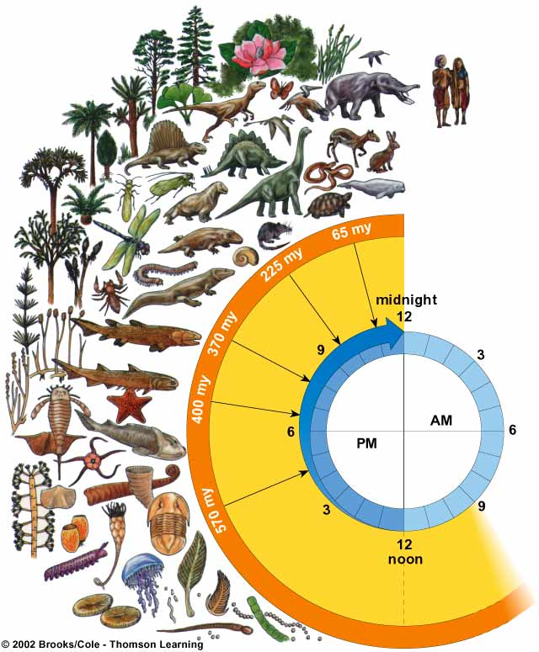
Biological Evolution
Modern humans (Homo sapiens) appear about 2 seconds before midnight
Age of mammals
Recorded human history begins 1/4 second before midnight
Age of reptiles
Insects and amphibians invade the land
Origin of life (3.6–3.8 billion years ago)
Plants invade the land
Fossils become abundant
Fossils present but rare
Evolution and expansion of life

Slide 7
Fossil Record
Most of what we know of the history of life on earth comes from fossils (SJ Gould)
Give us physical evidence of organisms
  Show us internal structure
Uneven and incomplete record of species
  We have fossils for 1% of species believed to have lived on earth
  Some organisms left no fossils, others decomposed, others have yet to be found.
Other info from ancient rocks, ice core, DNA
The whale as an example Other evidence here

Slide 8
4 major mechanisms that drive evolution:
Natural Selection
Mutation
Gene Flow
Genetic Drift

Slide 9
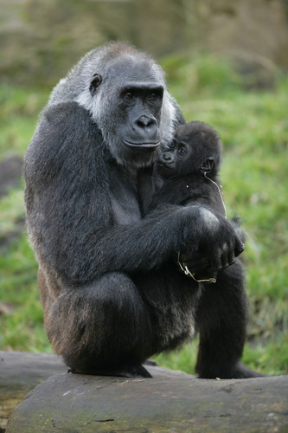
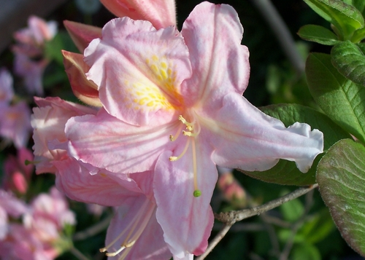
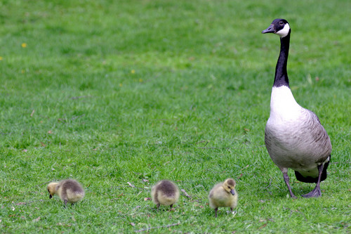
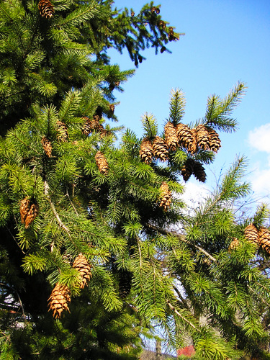
Unifying Principles of Evolution
Perpetual Change: All species are in a continuous state of change
Notes:
Any organism that reproduces sexually (e.g., plants, animals, algae, fungi) will produce offspring that are genetically distinct from either parent. This is a genetic certainty due to the process (meiosis) by which gametes (eggs and sperm) are produced as well as the randomness of fertilizations. This continuous diversification of offspring ensures a “perpetual change” in genetic composition between generations. The genetic diversity of offspring produced sexually is a result of: 1) the crossing over of homologous chromosomes in prophase I of meiosis and 2) the random alignment of homologs at metaphase I of meiosis and 3) the random fusion of gametes at fertilization.
Instructor note- There is no basis for any doubt as to the validity of this first principle of evolution. The biological evidence (genetics, molecular) of perpetual change is quite substantial.

Slide 10
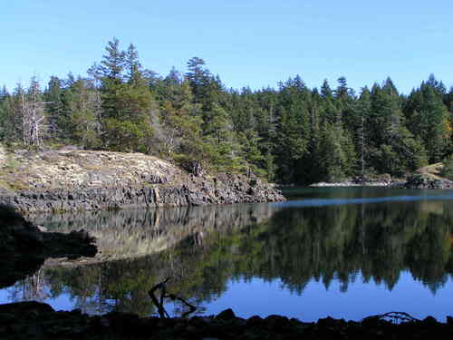
Unifying Principles of Evolution
*Nature- The combined influences of physical and biological limiting factors* acting upon an organism.
Notes:
Instructor note: It is important for the student to understand that natural selection and therefore evolution is not a goal-oriented (teleological) or anticipatory process. Natural selection is governed by the rules of nature (physical & biological limiting factors). Although it is appropriate to describe nature as “...selecting for or against certain traits,” caution should be exercised not to personify nature or to give the impression that nature is “working towards a goal” of a better adapted species. Natural selection acts upon an organism in its current environment and does not “select” for traits that may be favorable or adaptive in future environments. Natural selection is NOT an anticipatory process as selection acts upon the individual in the current environment.

Slide 11
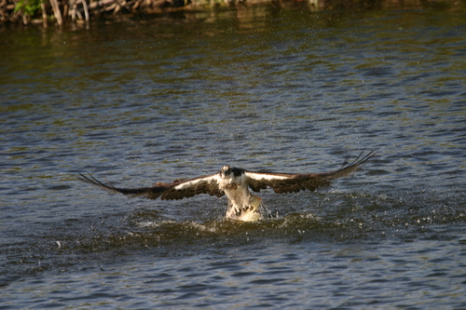
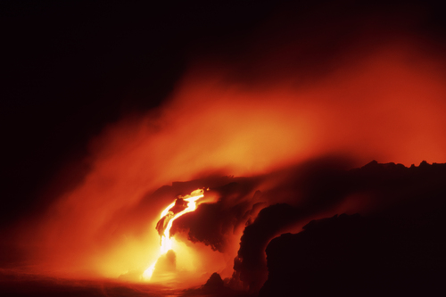
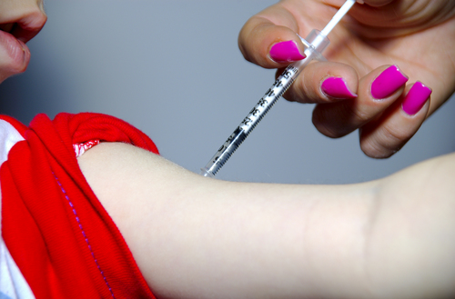
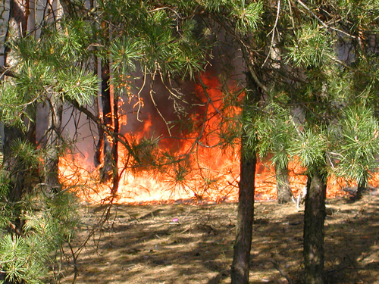
Unifying Principles of Evolution
*Limiting Factor- Any factor (physical or biological) which regulates
the welfare of an organism
  Disease, competition, predation, environmental change, etc.
Notes:
Biological limiting factors include any influence of biological origin, that may regulate the welfare of an organism, e.g., predation, competition, disease. Physical limiting factors include any influence of a non-biological origin that may regulate the welfare of an organism such as drought, flood, wind, temperature extremes, etc.
Activity- Ask your students what limiting factors they may face if they found themselves stranded in the northern tundra in late fall or early winter. What would be there first concern, physical or biological limiting factors? What limiting factors might they face if they were stranded on a remote jungle covered island? Would their first concern be biological or physical limiting factors? In extreme environments (e.g., very hot, cold or windy), physical limiting factors have a greater selection influence upon organisms. In moderate environments (e.g., jungle island), biological limiting factors exercise a greater selection influence.

Slide 12
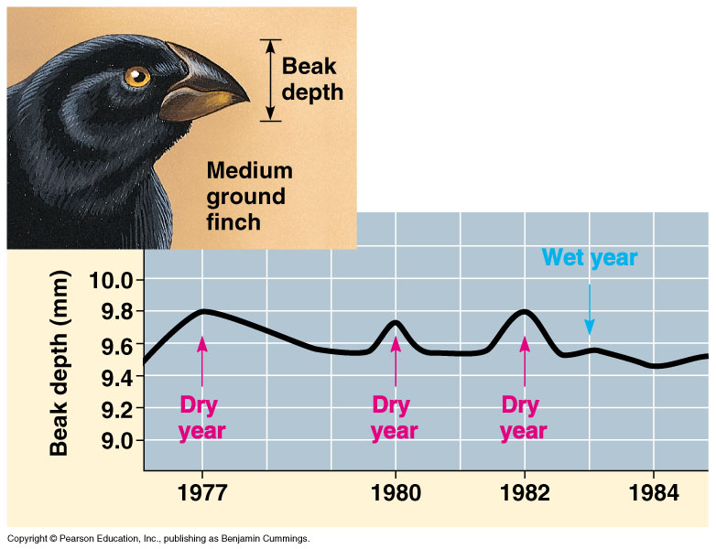
Notes:
The work of Peter and Rosemary Grant with Galapagos finches represents another excellent example of directional natural selection. In this case, the selection pressure is a result of physical environmental factors, principally rainfall. The Grants documented a change in the shape of finch beaks as a function of available foods which is turn was a result of rainfall (physical limiting factor). In dry years, when thick seeds with hard coats were readily available, those finches with large, strong beaks increased their representation in the population. During wet years when more delicate seeds were available, those finches with the smaller and more manipulative beaks increased their percentage in the population/gene pool.
Grant, P. and R. Grant 2002. “Unpredictable evolution in a 30 Year study of Darwin’s finches”. Science 2002 296: 707-711

Slide 13
Darwinian Natural Selection
Three conditions necessary for evolution by natural selection to occur:
  Natural variability for a trait in a population
  Trait must be heritable
  Trait must lead to differential reproduction
A heritable trait that enables organisms to survive AND reproduce is called an adaptation

Slide 14
Steps of Evolution by Natural Selection
Genetic variation is added to genotype by mutation
Mutations lead to changes in the phenotype
Phenotype is acted upon by nat’l selection
Individuals more suited to environment produce more offspring (contribute more to total gene pool of population)
Population’s gene pool changes over time
Speciation may occur if geographic and reproductive isolating mechanisms exist…
Natural Selection in action ...
A demonstration...

Slide 15
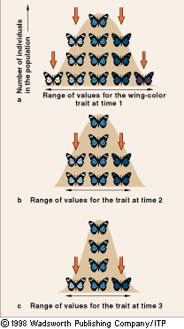
Selection Against or in Favor of Extreme Phenotypes
Stabilizing Selection
  Intermediate forms of a trait are favored
  Alleles that specify extreme forms are eliminated from a population
  EX: Birth Weight and Clutch Size

Slide 16
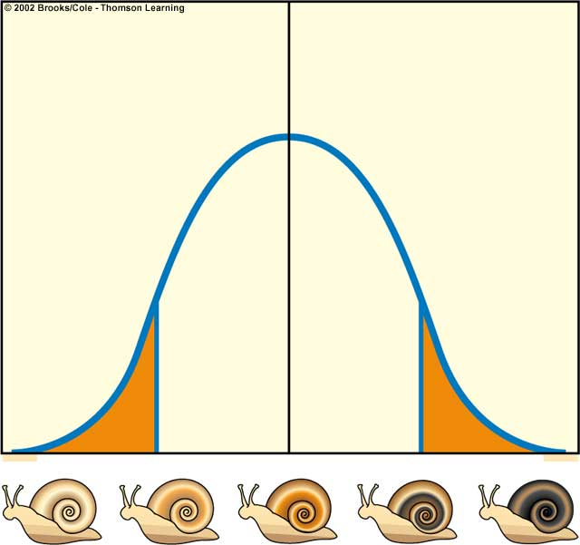
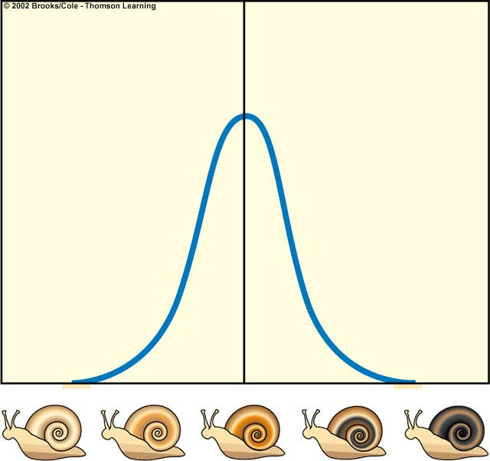
Stabilizing Selection
Light snails
eliminated
Dark snails
eliminated
Natural
selection
Snails with
extreme
coloration are
eliminated
Number of individuals
Number of individuals
Coloration of snails
Coloration of snails
Average remains the same
Number of individuals with
intermediate coloration increases
Eliminates Fringe Individuals

Slide 17
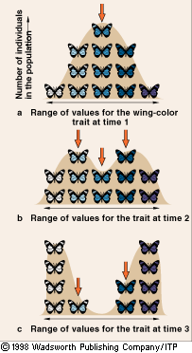
Selection Against or in Favor of Extreme Phenotypes
Disruptive Selection
  Both forms at extreme ends are favored
  Intermediate forms are eliminated
  Bill size in African finches

Slide 18
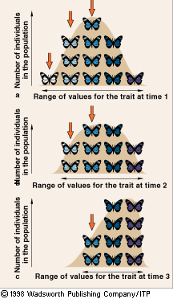
Directional Change in the Range of Variation
Directional Selection
  Shift in allele frequency in a consistent direction
Phenotypic Variation in a population of butterflies

Slide 19
Directional Selection
Pesticide Resistance
  Pest resurgence
Antibiotic Resistance
Grant’s Finch Beak Data
With directional selection, allele frequencies tend to shift in response to directional changes in the environment
http://www.pbs.org/wgbh/evolution/library/05/2/l_052_04.html

Slide 20
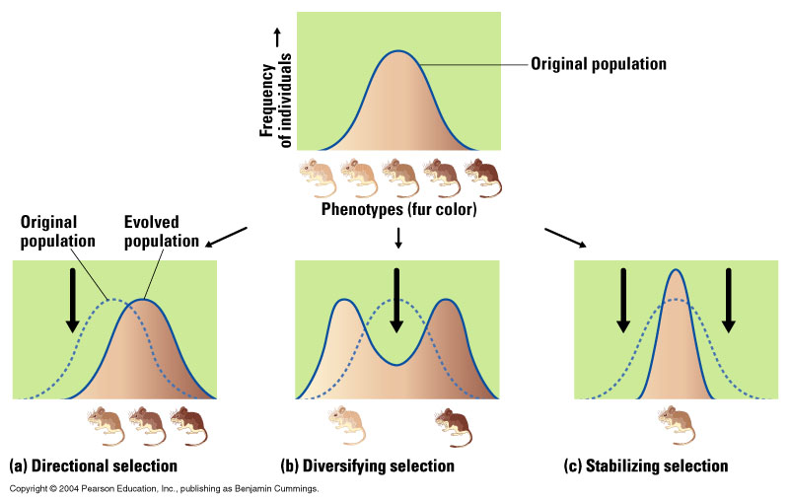
Three types of Natural Selection
Directional
  Allele frequencies shift to favor individuals at one extreme of the normal range
    Only one side of the distribution reproduce
    Population looks different over time
Stabilizing
  Favors individuals with an average genetic makeup
    Only the middle reproduce
    Population looks more similar over time (elim. extremes)
Disruptive (aka Diversifying)
  Environmental conditions favor individuals at both ends of the genetic spectrum
    Population split into two groups
http://www.pbs.org/wgbh/evolution/library/05/2/l_052_04.html

Slide 22
Why won’t our lungs evolve to deal with air pollution?
Limits to adaptation:
  A change in the environment can only lead to adaptation for traits already present in the gene pool
  Reproductive capacity may limit a population’s ability to adapt
    If you reproduce quickly (insects, bacteria) then your population can adapt to changes in a short time
    If you reproduce slowly (elephants, tigers, corals) then it takes thousands or millions of years to adapt through natural selection
  Most individuals without trait would have to die in order for the trait to predominate and be passed on

Slide 23
Take Home #1
When faced with a change in environmental condition, a population of a species can get MAD:
  MIGRATE to a more favorable location
  ALREADY be adapted
  DIE
Natural selection can only act on inherited alleles already present in the population—do not think that the environment creates favorable heritable characteristics!
Soooo….how do new alleles arise??????

Slide 24
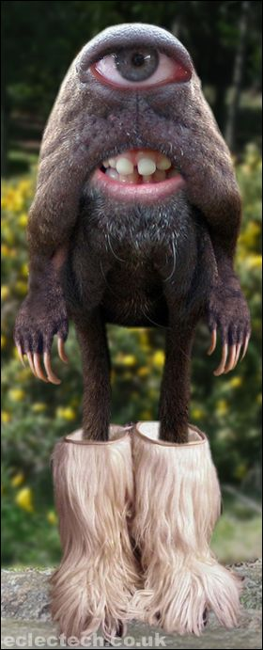

MUTATIONS, MY FRIENDS!
Changes in the structure of the DNA
Adds genetic diversity to the population
May or may not be adaptive
  Depends on the environment!

Slide 25
Sooooo….What’s Evolution?
The change in a POPULATION’S genetic makeup (gene pool) over time (successive generations)
  Those with selective advantages (i.e., adaptations), survive and reproduce
  All species descended from earlier ancestor species
Microevolution
Small genetic changes in a population such as the spread of a mutation or the change in the frequency of a single allele due to selection (changes to gene pool)
  Not possible without genetic variability in a pop…
Macroevolution
  Long term, large scale evolutionary changes through which new species are formed and others are lost through extinction

Slide 26
Microevolution
Changes in a population’s gene pool over time.
  Genetic variability within a population is the catalyst
Four Processes cause Microevolution
  Mutation (random changes in DNA—ultimate source of new alleles) [stop little]
    Exposure to mutagens or random mistakes in copying
    Random/unpredictable relatively rare
  Natural Selection (more fit = more offspring)
  Gene flow (movement of genes between pop’s)
  Genetic drift (change in gene pool due to random/chance events)

Slide 27
The Case of the
Peppered Moths
Industrial revolution
  Pollution darkened tree trunks
Camouflage of moths increases survival from predators
Directional selection caused a shift away from light-gray towards dark-gray moths

Slide 28
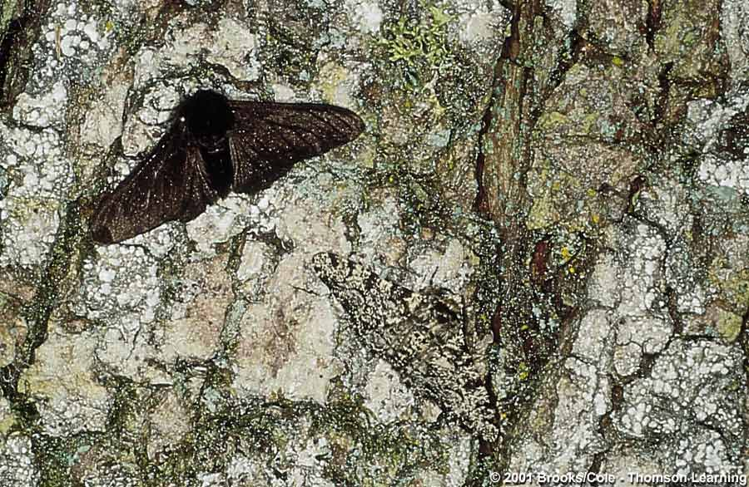
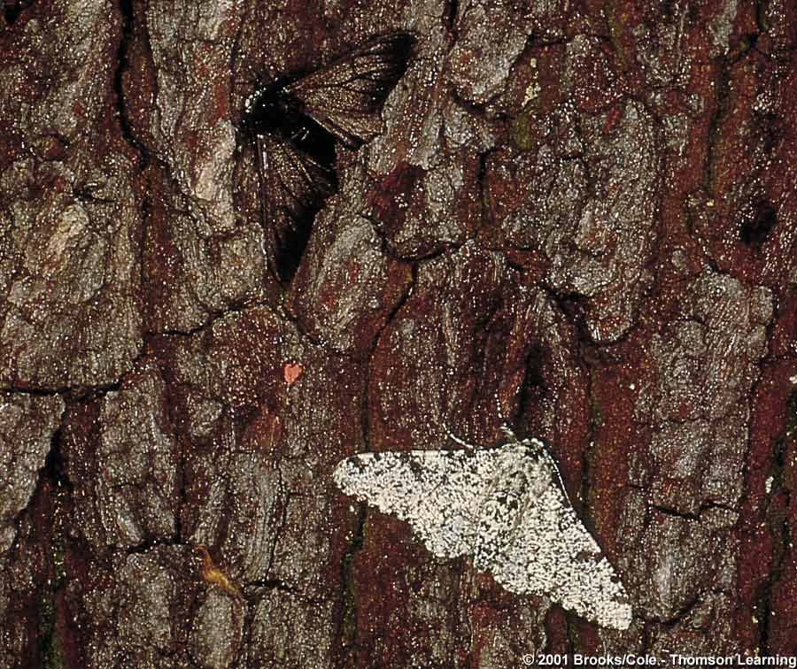
Fig. 18.5, p. 287

Slide 29
Gene Flow and Genetic Drift
Gene Flow
  Flow of alleles
    Emigration and immigration of individuals
Genetic Drift
  Random change in allele frequencies over generations brought about by chance
  In the absence of other forces, drift leads to loss of genetic diversity
    Elephant seals, cheetahs

Slide 30
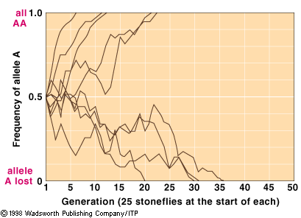
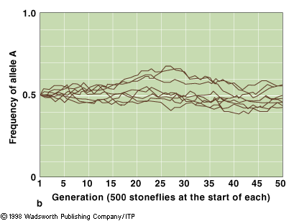
Genetic Drift
Magnitude of drift is greatest in small populations

Slide 31
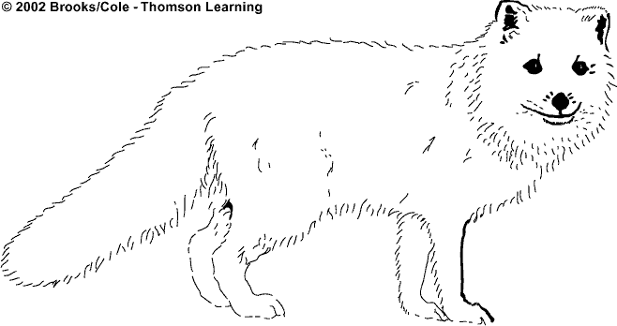
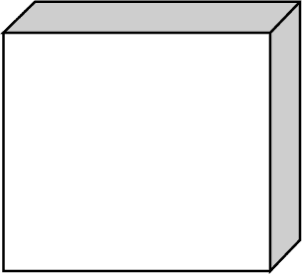

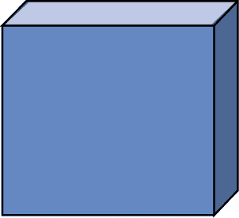
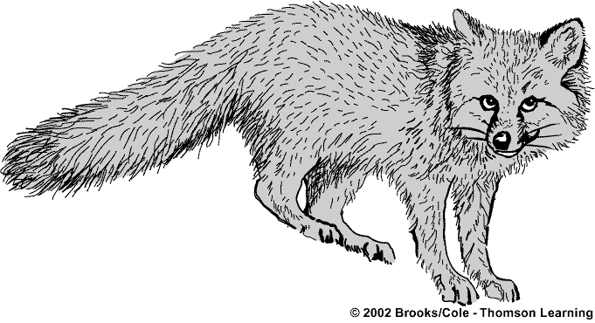
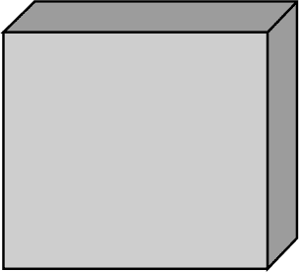
Speciation
Adapted to cold
through heavier
fur, short ears,
short legs, short
nose. White fur
matches snow
for camouflage.
Northern
population
Arctic Fox
Spreads
northward
and
southward
and
separates
Different environmental
conditions lead to different
selective pressures and evolution
into two different species.
Early fox
population
Adapted to heat
through lightweight
fur and long ears,
legs, and nose, which
give off more heat.
Southern
population
Gray Fox

Slide 32
Speciation
Two species arise from one
  Requires Reproductive isolation
    Geographic: Physically separated
    Temporal: Mate at different times
    Behavioral: Bird calls / mating rituals
    Anatomical: Picture a mouse and an elephant hooking up
    Genetic Inviability: Mules
Allopatric
  Speciation that occurs when 2 or more populations of a species are geographically isolated from one another
  The allele frequencies in these populations change
  Members become so different that that can no no longer interbreed
  See animation
Sympatric
  Populations evolve with overlapping ranges
  Behavioral barrier or hybridization or polyploidy

Slide 33
TAKE HOME #2
Macroevolution is the cumulative result of a series of microevolutionary events
  Typically seen in fossil record
  Nobody around to see the small, gene pool changes over time.

Slide 34
COEVOLUTION: Interaction Biodiversity
Species so tightly connected, that the evolutionary history of one affects the other and vice versa.
  Ant Farmers of the Amazon

Slide 35
Coevolution
Interactions between species can cause microevolution
  Changes in the gene pool of one species can cause changes in the gene pool of the other
Adaptation follows adaptation in something of a long term “arms race” between interacting populations of different populations
  The Red Queen Effect
Can also be symbiotic coevolution
  Angiosperms and insects (pollinators)
  Corals and zooxanthellae
  Rhizobium bacteria and legume root nodules

Slide 36


And NUH is the letter I use to spell Nutches,
Who live in small caves, known as Niches, for hutches.
These Nutches have troubles, the biggest of which is
The fact there are many more Nutches than Niches.
Each Nutch in a Nich knows that some other Nutch
Would like to move into his Nich very much.
So each Nutch in a Nich has to watch that small Nich
Or Nutches who haven't got Niches will snitch.
-On Beyond Zebra (1955)
Dr. Seuss

Slide 37
Niches
A species functional role in an ecosystem
Involves everything that affects its survival and reproduction
  Includes range of tolerance of all abiotic factors
  Trophic characteristics
  How it interacts with biotic and abiotic factors
  Role it plays in energy flow and matter cycling
Fundamental Niche
  Full potential range of physical chemical and biological conditions and resources it could theoretically use if there was no direct competition from other species
Realized Niche
  Part of its niche actually occupied
Generalist vs. Specialist
  Lives many different places, eat many foods, tolerate a wide range of conditions vs few, few, intolerant…
  Which strategy is better in a stable environment vs unstable?

Slide 38
POLLENPEEPERS
POLLENPEEPER EVOLUTION

Slide 39
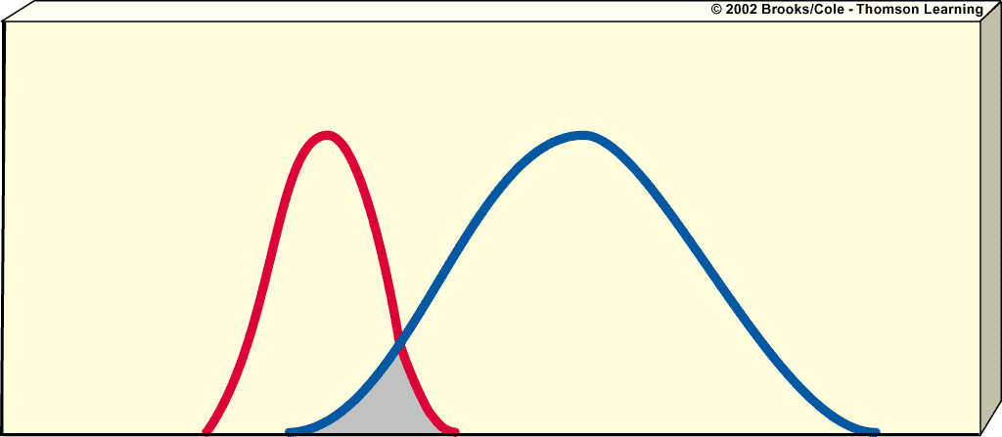
Niche Overlap
Niche
separation
Number of individuals
Generalist species
with a broad niche
Generalist species
with a narrow niche
Niche
breadth
Region of
niche overlap
Resource use

Slide 40
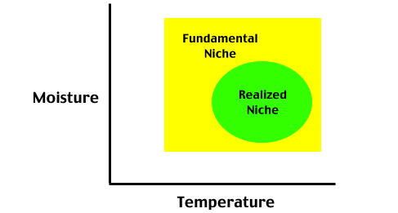
Competition Shrinks Niches

Slide 41
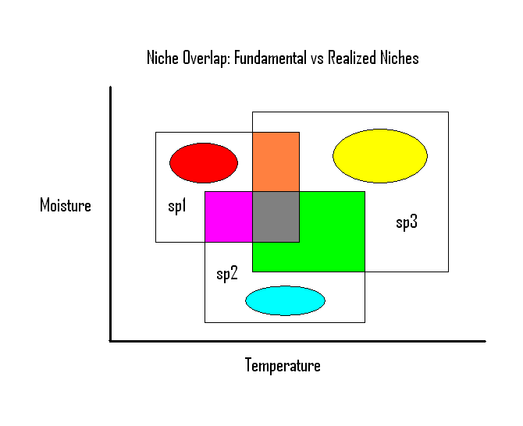
Competition and Community Diversity
Species evolve to minimize competition and niche overlap
Results in a diverse matrix of differing species within a community

Slide 42
What’s This Niche Stuff Got to do with Evolution and Biodiversity?
Hmmmmm….
Let’s think about three key points….
  The more niches you have in an ecosystem…
  The more of a generalist species you are…
  The more of a specialist species you are…

Slide 43
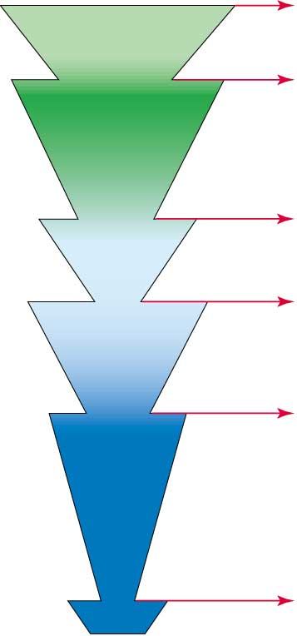
Era
Period
Millions of
years ago
Bar width represents relative
number of living species
Species and families experiencing
mass extinction
Today
Extinction
Current extinction crisis caused
by human activities.
Quaternary
Cenozoic
Tertiary
65
Extinction
Cretaceous: up to 80% of ruling
reptiles (dinosaurs); many marine
species including many
foraminiferans and mollusks.
Cretaceous
Mesozoic
Jurassic
180
Extinction
Triassic: 35% of animal families, including
many reptiles and marine mollusks.
Triassic
250
Extinction
Permian: 90% of animal families, including
over 95% of marine species; many trees,
amphibians, most bryozoans and
brachiopods, all trilobites.
Permian
Carboniferous
Extinction
345
Devonian: 30% of animal families,
Paleozoic
Devonian
Silurian
Ordovician
500
Extinction
Ordovician: 50% of animal families,
Cambrian

Slide 44
Extinction
Local, ecological and true extinction
The ultimate fate of all species just as death is for all individual organisms
99.9% of all the species that have ever existed are now extinct
  To a very close approximation, all species are extinct
Background vs. Mass Extinction
  Low rate vs. 25-90% of total
  Five great mass extinctions in which numerous new species (including mammals) evolved to fill new or vacated niches in changed environments
  10 million years or more for adaptive radiations to rebuild biological diversity following a mass extinction
Extinctions open up new opportunities for speciation and adaptive radiation..BUT you can have too much of a good thing!

Slide 45
Factors Affecting Extinction Rates
Natural Extinctions
  Climate change
  Cataclysmic event (volcano, earthquake)
Human Activities
  Habitat Loss/Fragmentation
  Introduction of exotic/invasive species
  Pollution
  Commercial harvesting
  Accidental killing (tuna nets)
  Harassing
  Pet Trade
  Urbanization
  Damming/Flooding
  Agricultural conversion

Slide 46
Extinction in the Context of Evolution
If
  the environment changes rapidly and
  The species living in these environments do not already possess genes which enable survival in the face of such change and
  Random mutations do not accumulate quickly enough then,
All members of the unlucky species may die

Slide 47
Biodiversity
Speciation – Extinction=Biodiversity
Humans major force in the premature extinction of species. Extinction rate increased by 100-1000 times the natural background rate.
As we grow in population over next 50 years, we are expected to take over more of the earth’s surface and productivity. This may cause the premature extinction of up to a QUARTER of the earth’s current species and constitute a SIXTH mass extinction
  Genetic engineering won’t solve this problem
  Only takes existing genes and moves them around
Know why this is so important and what we are losing as it disappears….

Slide 48
USING EVOLUTION AND GENETICS TO INFORM CONSERVATION
EcoRegions Approach
  Identifying biodiversity “hotspots” and focusing conservation efforts on maintaining those ecosystems
  Ex. Tropics, Appalachian Mountains, etc.
“Umbrella Species” Conservation
  Conserve one “sexy”, species and you conserve several others because if the interactions they have with one another
  Keystone species concept
Species Survival Plan (SSP)
  Zoo captive breeding programs
  Population genetics in wild populations
    Ex. Cheetahs, Primates, Bears, etc.

Slide 49
Federal and International Legislation
Endangered Species Act (1973)
  Protection for endangered and threatened plant and animal species & their habitats
    Effectiveness??? Exemptions are often granted if
      No alternatives to the project
      National or regional significance of project
      Benefits outweigh those of any alternatives
CITES (late 1970s)-prohibits trade and commerce of threatened and endangered species
  By 1998: signed by 144 countries

