Slide 1
Evolution
Darwin verses Lamarck

Slide 2
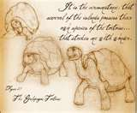
Darwin’s Observations
The
The Galapagos Islands - Darwin observed that the characteristics of animals and plants varied noticeably among the different islands.
In part two groups of organisms led Darwin to developing his theory
  The shells of giant tortoises on the islands varied in predictable ways. The shape of their shell could be used to identify which island they came from
  Darwin collected several specimens of birds with different shaped beaks, he came to no conclusion about this at first.

Slide 3
Darwin
Inherited Variation and Artificial Selection
Darwin was aware that variation existed in nature
- some plants in a species naturally bear larger fruit then others
- some cows give more milk than others.
Darwin was familiar with the concept of artificial selection
- nature provides the variation
- humans selected those variations that they found useful
- Darwin wondered if artificial selection occurred in nature

Slide 4
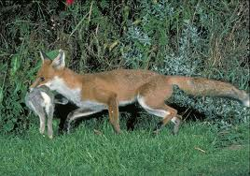
Darwin
Evolution by Natural Selection
Darwin suggested that there was a…
A “Struggle for Existence” - members of each species compete regularly to obtain resources.
-The predators that are faster or
more cunning, could catch
more prey
- the prey that were faster,
used camouflaged or protected
themselves could avoid
being caught.

Slide 5
Darwin
Evolution by Natural Selection
Darwin stated that natural selection led to…
“Survival of the Fittest” – organisms that are better suited to there environment survive and reproduce
  Fitness, the ability of an individual to survive and reproduce in its specific environment.
  Adaptation, any inherited characteristic that increases an organism’s chance of survival is
  Over time natural selection results in changes in the inherited characteristics of a population.

Slide 6
Darwin
Evolution by Natural Selection
Darwin’s Theory includes the principles of
Descent with Modification - principle that each living species has descended, with changes, from other species, over time
Common descent - principle that all living species, living and extinct, have a common ancestor.

Slide 7
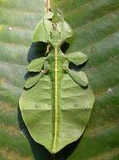
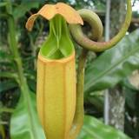
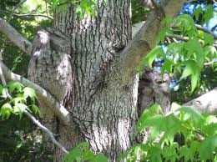
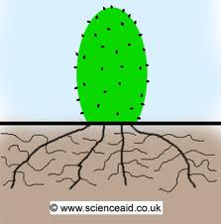
Evolution by Natural Selection
Types of Adaptations
Mimicry to copy other organisms for safety
Carnivores plant to obtain nitrogen
Camouflage to hide from predators or prey
Long roots to increase surface area and large chance of gaining water in dry conditions

Slide 8
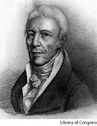
Jean Baptiste Lamarck
Born 1744 and died 1829.
Like Darwin, Lamarck studied organisms and had ideas about how life on Earth got to be the way it is now.

Slide 9
Lamarck
Lamarck published a book titled “Theory of Inheritance of Acquired Characteristics,” 58 years before Darwin published his book. Lamarck proposed that…..
- living things changed over time
- if an organism changed during its life, those changes
would pass on to it’s offspring.
- Evolution occurs according to a predetermined plan and
the results of the process have already been decided.

Slide 10
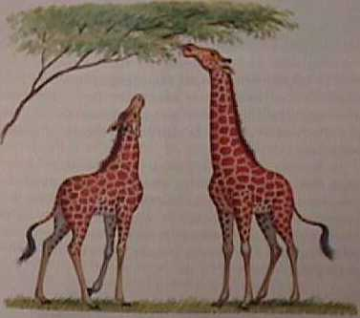
Lamarck versus Darwin
Lamarck believed it was the organism’s needs and desires that caused it to change and then pass those changes on to its offspring.
  Through experiments and
  examples we see that changes
  in an animals life are not
  passed on to its offspring.
  (example: ear cropping in dogs)

Slide 11
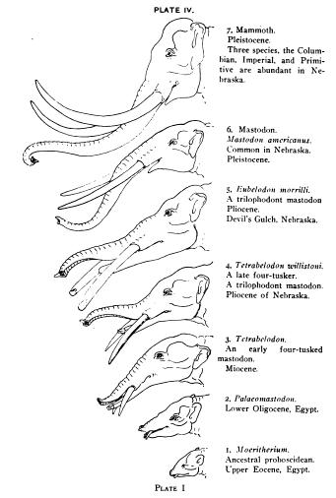
Lamarck versus Darwin
  Darwin knew traits were passed from parent to offspring but didn’t know how.
  We now know that genes carry traits from parents to offspring and that genes cannot be affected by the outside world.
  The only thing that can be affected is which gene sets there are in a population and this is determined by which organisms dies and which ones live.

Slide 12
How they agreed:
Both thought that life had changed gradually over time and was still changing.
Living things change to be better suited and adapted to their environments.
All organisms are related.
Life evolved from fewer simpler organisms to large numbers of more complex organisms.

Slide 13
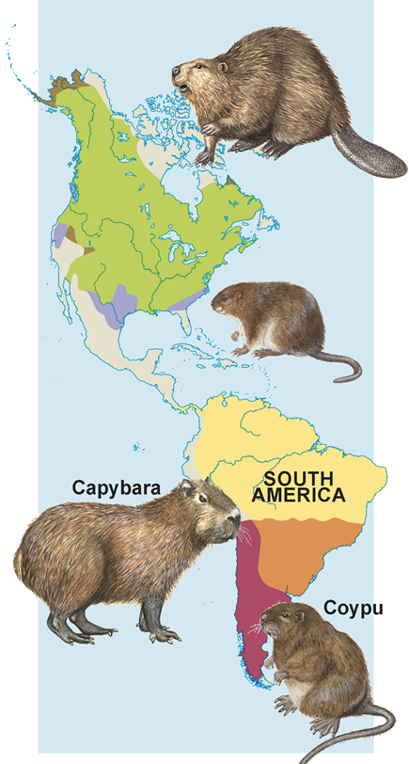
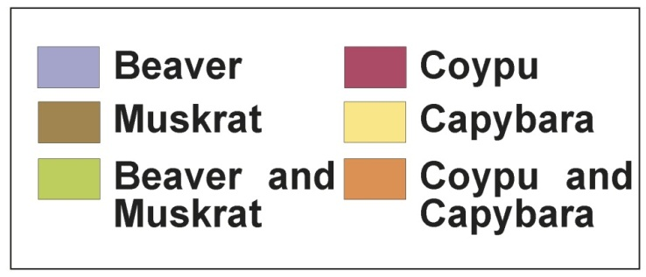
Evidence of Evolution
Geographical Distribution of living things
- similar animals living in different
places were the product of
different lines of evolutionary
descent.

Slide 14
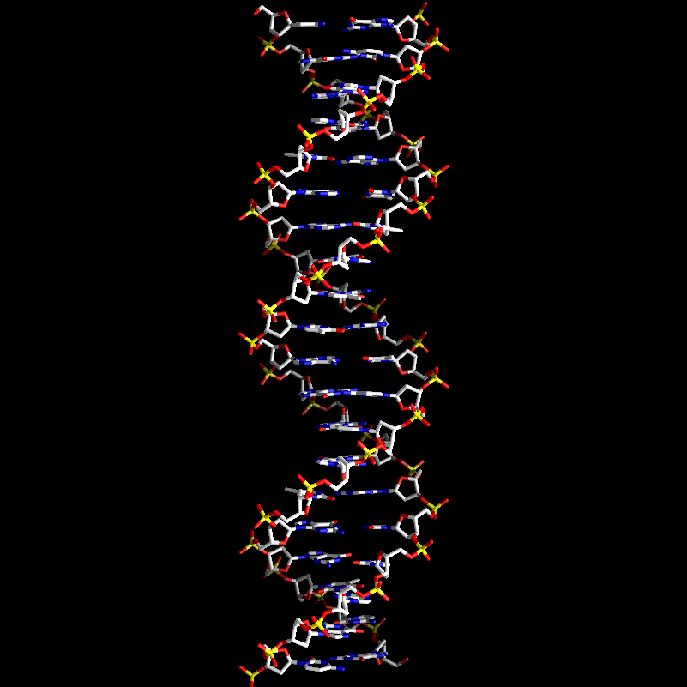
Evidence of Evolution
DNA
  closely related species will
  have more similarities in
  their DNA and genes.
  - knowledge of DNA and
  protein synthesis is very
  recent.

Slide 15
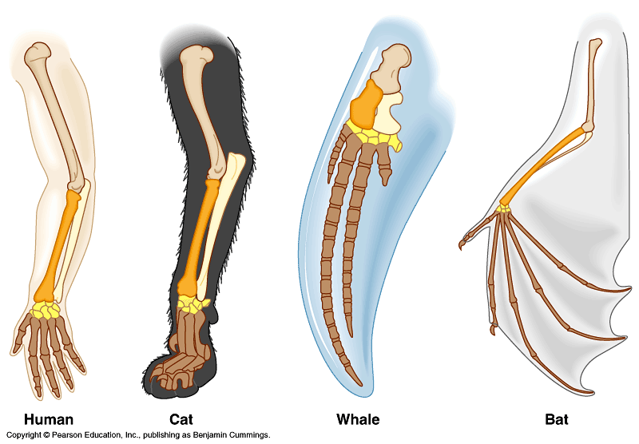
Evidence of Evolution
Homologous Structures
- structures that share
common ancestry.
- Example: wing, arm, and fin
all have very similar number
and organization of bones.

Slide 16
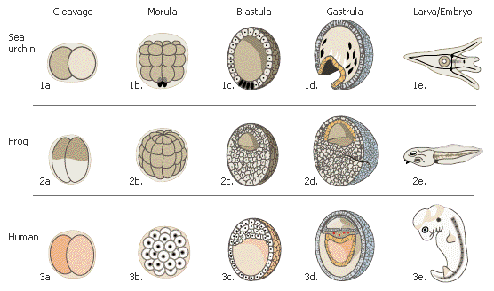
Evidence of Evolution
Developmental Patterns
- Embryos off different
organisms are very
similar during embryonic
development

Slide 17
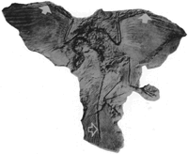
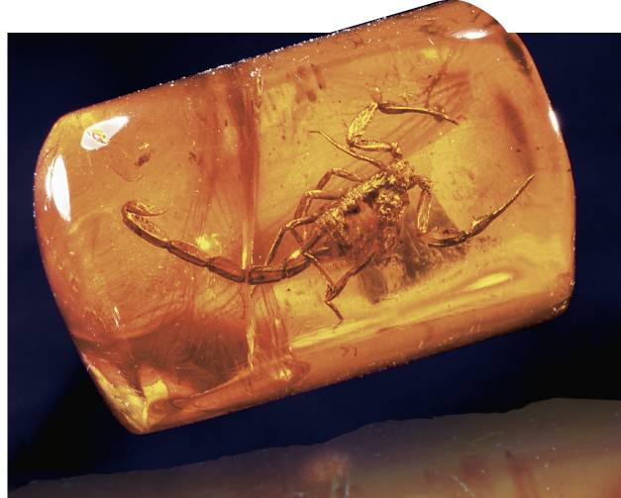
Evidence of Evolution
Fossil Record
- The fossil record provides evidence for history of life on
earth.
- Fossils are traces of dead organisms such as footprints,
insects, bones, leaf impressions, etc.
- Many things are now extinct (no longer living on earth) and
fossils are the proof of their existence.

Slide 18
Evidence of Evolution
Evidence supporting Darwin’s theory has come from many sources:
  Earth is many millions of years old. (Hutton & Lyle)
  The processes that changed the earth in the past are the same as those changing the earth today (Hutton & Lyle)
  If a population was left unchecked it would run out of space and food (Malthus)

