Slide 1
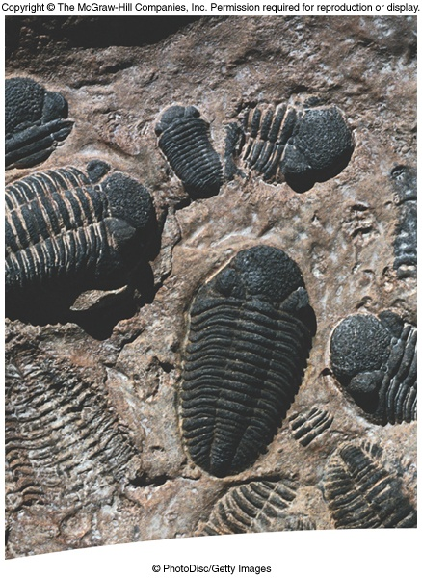
The Evidence for the Law of Evolution

Slide 2
Pre-Darwinian Theories
Idea of evolution did not originate w/ Charles Darwin
Earliest references are from the Greeks; even Darwin’s grandfather believed in the common ancestry of all organisms
Jean Baptiste Lamarck (French zoologist) believed species were derived from preexisting species

Slide 3
Inheritance of Acquired Characteristics
Widely accepted in early 1800s – believed organisms develop new organs or modify existing organs as environmental problems present themselves
Organs change as the need arises
Used giraffes as his explanation

Slide 4
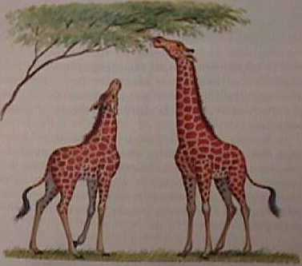
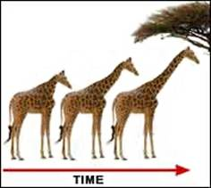

Slide 5
Lamarck then suggested that those acquired traits were then passed on to the offspring (hence, offspring receiving acquired traits)
Another example would be a couple who enjoy bike riding, and become very proficient at it
What happens when they reproduce?...

Slide 6

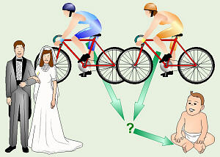


Slide 7
Lamarck also believed the spontaneous generation of traits was an ongoing process that was PURPOSE driven
Eventually lead to “perfect” form
Although Lamarck’s mechanism of change was incorrect, he should be remembered for promoting idea of evolutionary change

Slide 8
Darwin’s Theories
Summed up in 2 theories
1. Descent with Modification: new forms appearing in the fossil record are actually the modified descendents of older species
Inferred that ALL species had descended from one or a few original types of life
Accounted for biogeography: similar organisms arise in the same geographic location
Modern kangaroos evolved from now-extinct ancestor

Slide 9
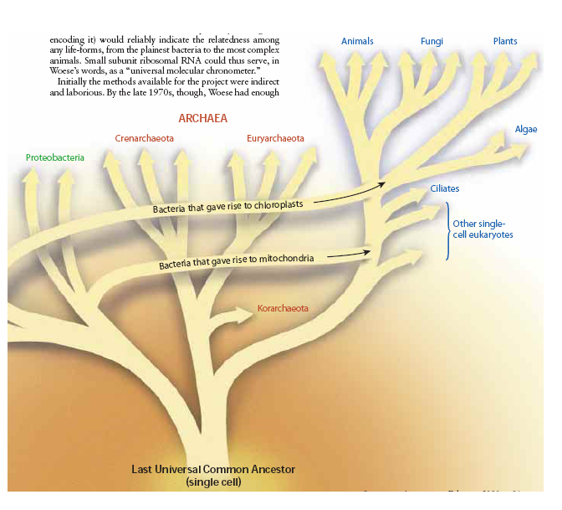
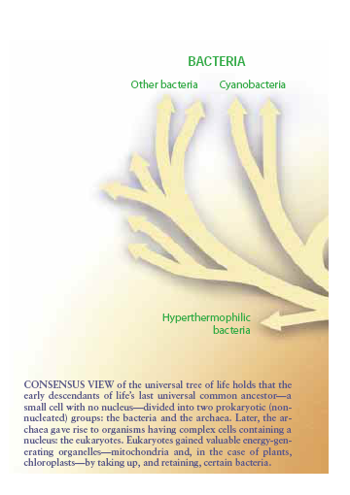

Slide 10
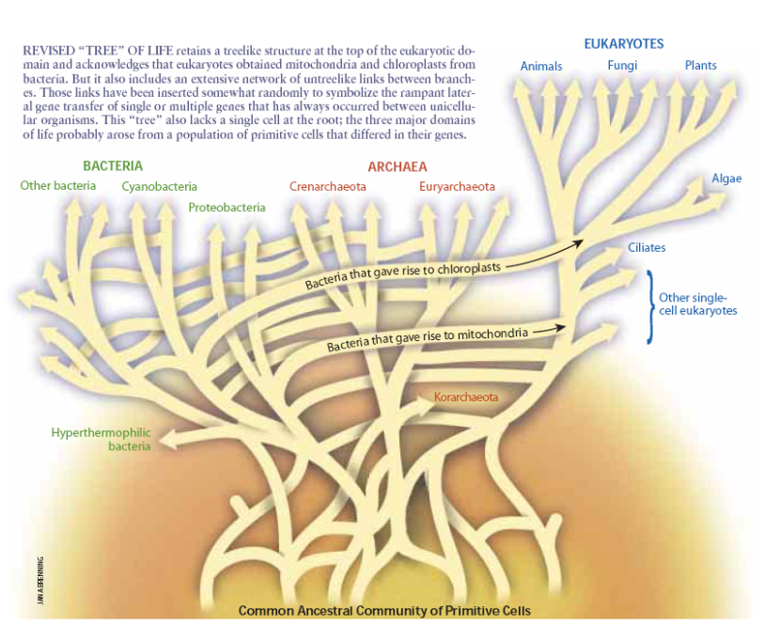

Slide 11
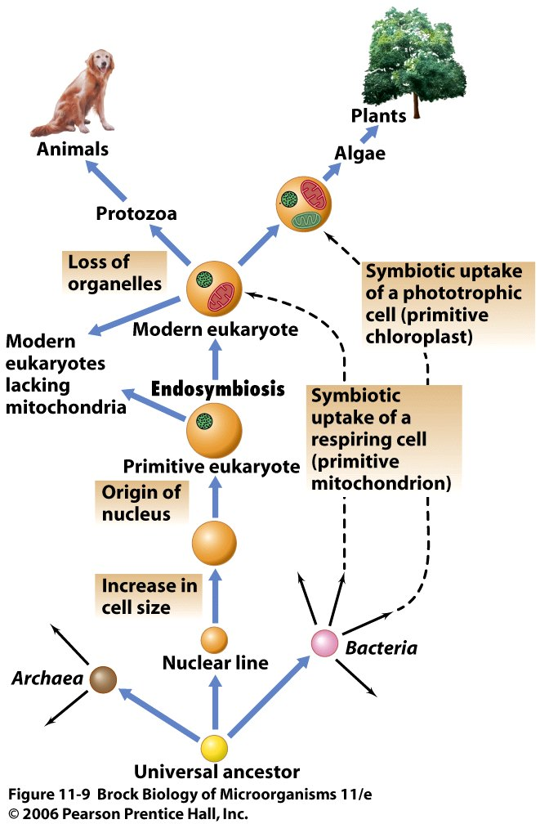
Mitochondria arose from the Proteobacteria, a major group of Bacteria.
Origin of the modern life

Slide 12
Eukaryotes and Organelles: Endosymbiosis
The eukaryotic nucleus and mitotic apparatus probably arose as a necessity for ensuring the orderly partitioning of DNA in large-genome organisms.
Mitochondria and chloroplasts, the principal energy-producing organelles of eukaryotes, arose from the symbiotic association of prokaryotes of the domain Bacteria within eukaryotic cells, a process called endosymbiosis (Figure 11.9).

Slide 13
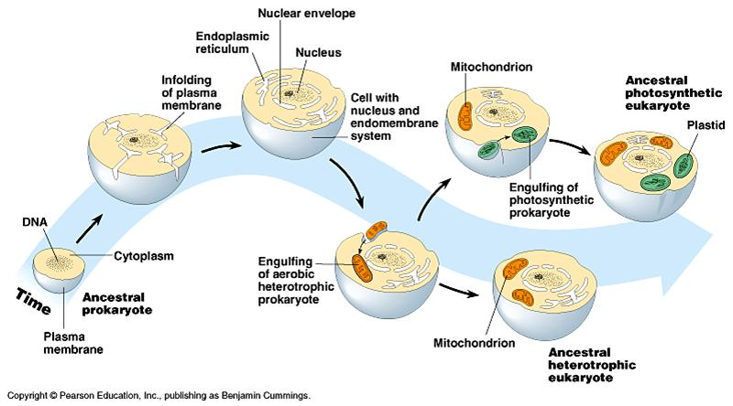

Slide 14
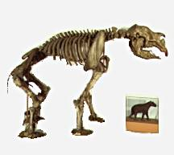
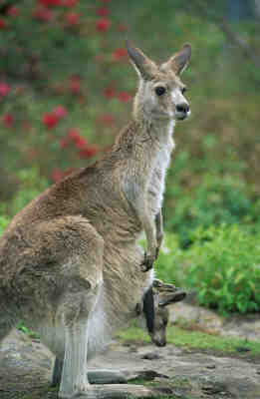
The giant marsupial Diprotodon was related to the kangaroo, but grew to the size of a present day rhinoceros. The skull alone was over 1 m (3 ft) in length and was adapted for eating plants. The fossil remains of this giant marsupial are restricted in their distribution to Pleistocene deposits in Australia.

Slide 15
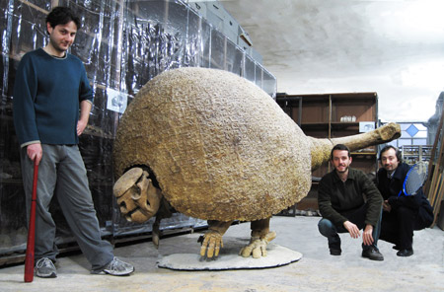
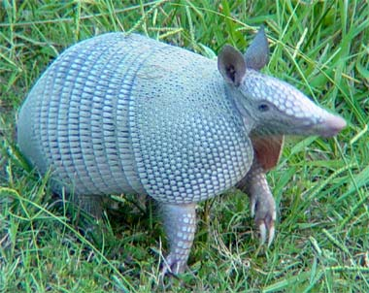

Slide 16
Biogeographical Record
Darwin noted on his voyage that
  Islands are often missing plants and animals common on continents
  Species present on islands often diverged from continental relatives
  Island species usually are more closely related to species on nearby continents

Slide 17
Biogeographical Record
Darwin concluded:
  Species arrive on islands by dispersing across the water
  Dispersal from nearby areas is more likely than distant sources
  Species that can fly, float or swim can inhabit islands
  Colonizers often evolve into many species

Slide 18
Natural Selection
Fitness

Slide 19
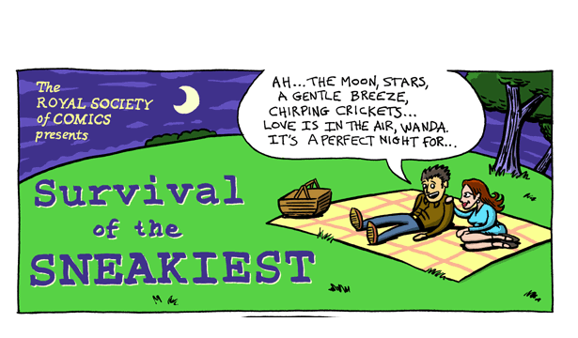

Slide 20
2. Modification by Natural Selection – states how evolution occurs; environment limits the growth of populations by increasing the rate of death or decreasing the rate of reproduction, or both
May affect individual organisms in a population in different ways
Organisms w/ greater number of favorable traits will leave more offspring
Different degrees of successful reproduction is natural selection

Slide 21
If a trait both increases the reproductive success of an organism AND is inherited, then that trait will be passed on to many offspring
A population of organisms adapt to their environment as their proportion of genes for favorable traits increases
Resulting change is evolution (change over time)
A single org. genetic contribution to next generation is termed fitness

Slide 22
Organisms DO NOT purposefully acquire traits that they need (it would be nice though)
The environment ‘selects’ the traits that will increase
A favorable trait gives an organism an adaptive advantage
If environmental change occurs too rapidly, adaptations cannot occur fast enough

Slide 23
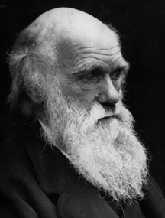
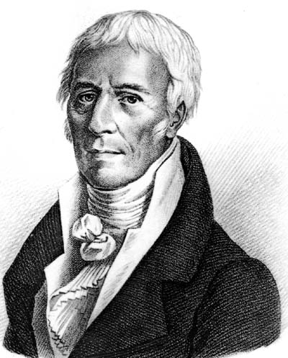
Lamarck vs. Darwin
Use and disuse
Transmission of acquired traits
Increasing complexity
No extinction
Variation
Inheritance
Differential survival
extinction

Slide 24
Evidence of Natural Selection
When the environment changes, natural selection often favors different traits in a species
Biston betularia: peppered moth
  Light gray with black specks to jet black coloration
  Black individuals have the dominant allele
  Dominant allele was rare in the population until 1850s

Slide 25
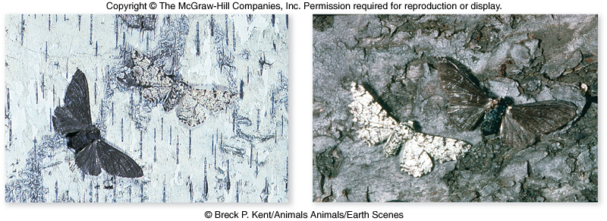
Evidence of Natural Selection
J.W. Tutt hypothesized that light-colored moths declined because of predation
Light moths were easily seen by birds on darkened (sooty) trees

Slide 26
http://www.techapps.net/interactives/peppermoths.htm

Slide 27
Evidence of Natural Selection
Bernard Kettlewell tested the hypothesis
  Dark tree trunks = more dark-colored moths survived
  Light tree trunks = more light-colored moths survived
When environmental conditions reverse, so does selection pressure

Slide 28
Evidence of Natural Selection
Industrial melanism: phenomenon in which darker individuals come to predominate over lighter ones
Pollution control resulted in lichen growing on trees and bark color being lighter again
Light-colored peppered moths now are dominant in the population

Slide 29
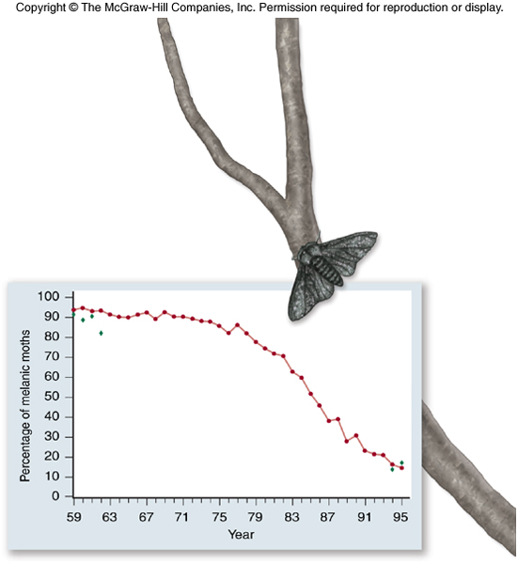
Evidence of Natural Selection
The agent of selection may be difficult to pin down
Could poisoning by pollution be the agent of natural selection?
Selection against melanism

Slide 30
Evidence of Natural Selection
Darwin collected a closely related group of 14 finch species in the Galápagos Islands
  All were similar except for beak characteristics
  Darwin hypothesized that different beak shapes were related to food gathering
  Darwin wrote “…one might really fancy that…one species has been taken and modified for different ends.”

Slide 31
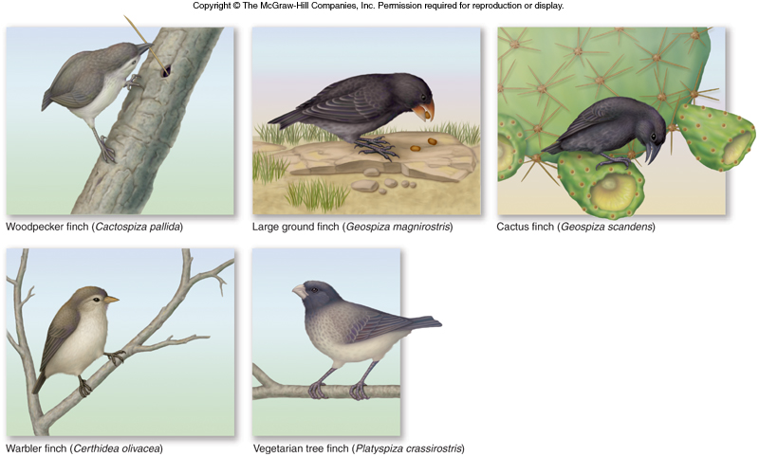
Evidence of Natural Selection
Darwin’s finches

Slide 32
Evidence of Natural Selection
Modern research has verified Darwin’s selection hypothesis
3 conditions of natural selection
  Variation must exist in the population
  This variation must lead to differences among individuals in reproductive success
  Variation among individuals must be genetically transmitted to the next generation

Slide 33
Evidence of Natural Selection
Peter and Rosemary Grant studied medium ground finch
Found beak depth variation among members of the population
Average beak depth changed from one year to the next in a predictable fashion
- Droughts: birds with deeper, more powerful beaks survived better
- Normal rains: average beak depth decreased to its original size

Slide 34
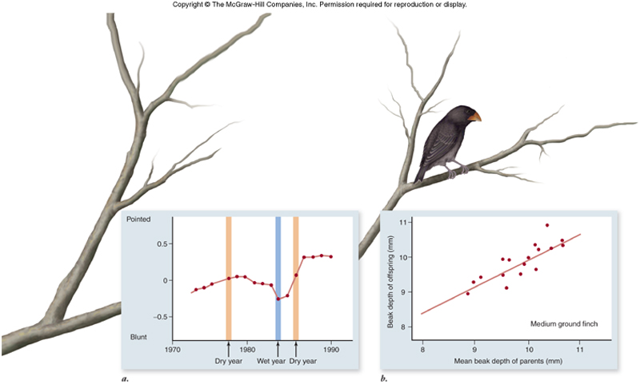
Evidence of Natural Selection
Evidence that natural selection alters beak shape

Slide 35
Bacterial speciation may occur from a combination of repeated periodic selection for a favorable trait within an ecotype and lateral gene flow (Figure 11.26).

Slide 36
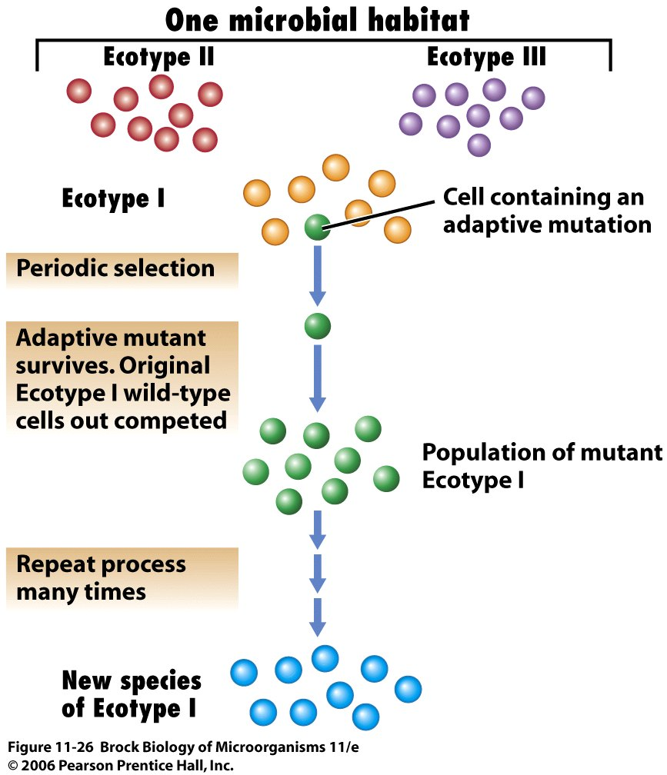
A model for bacterial
speciation

Slide 37
The model for speciation shown is based solely on the assumption of vertical (mother to daughter) gene flow. However, bacterial speciation is also affected to some degree by lateral (horizontal) gene transfer. Lateral flow is the transfer of genes between species by conjugation, transduction, and transformation.

Slide 38
http://www.pbs.org/wgbh/nova/beta/evolution/arms-race-superbug.html

Slide 39
Artificial Selection
Laboratory Experiments
Drosophila melanogaster (fruit fly)
  Selected fruit flies with many bristles on abdomen
  Chose only those with most bristles to reproduce
  86 generations later: average number of bristles had quadrupled

Slide 40
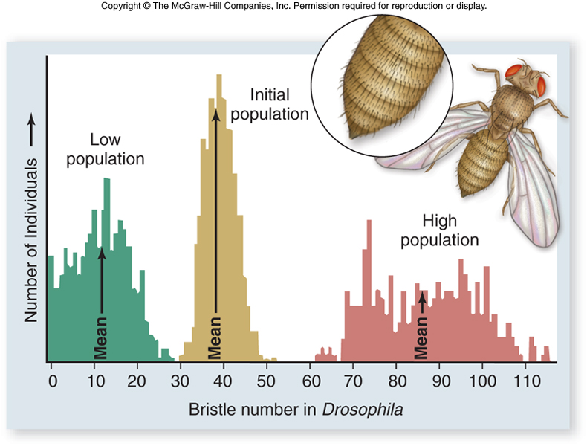
Artificial Selection
Artificial selection in the laboratory

Slide 41
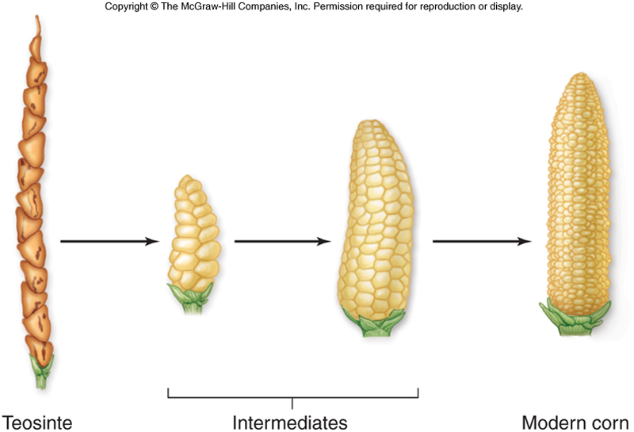
Artificial Selection
Agriculture
Corn looks very different from its ancestor

Slide 42
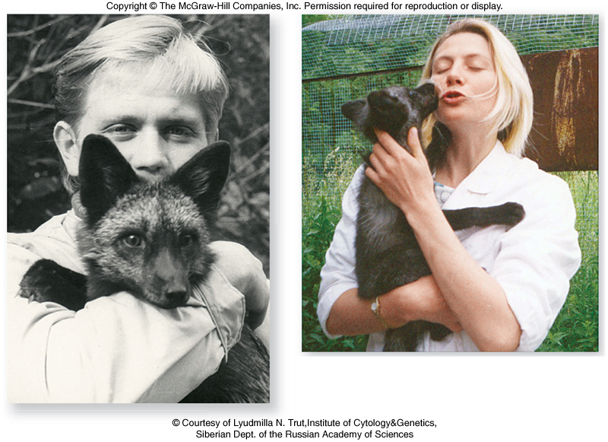
Artificial Selection
Domestication of silver foxes are a result of artificial selection

Slide 43
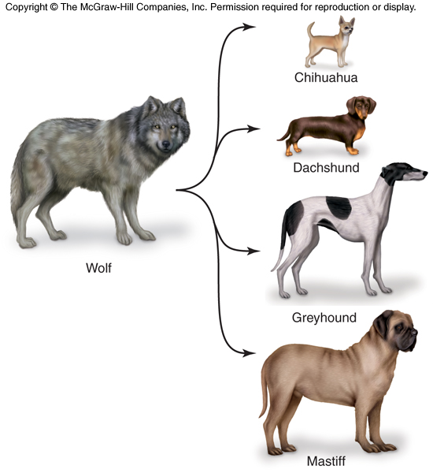
Artificial Selection
Can selection produce major evolutionary changes?
Breeds of dogs: The differences among dog breeds are greater than the differences displayed among wild species of canids.

Slide 44
Fossil Evidence of Evolution
Fossils are the preserved remains of once-living organisms
Rock fossils are created when three events occur
  organism buried in sediment
  calcium in bone or other hard tissue mineralizes
  surrounding sediment hardens to form rock

Slide 45
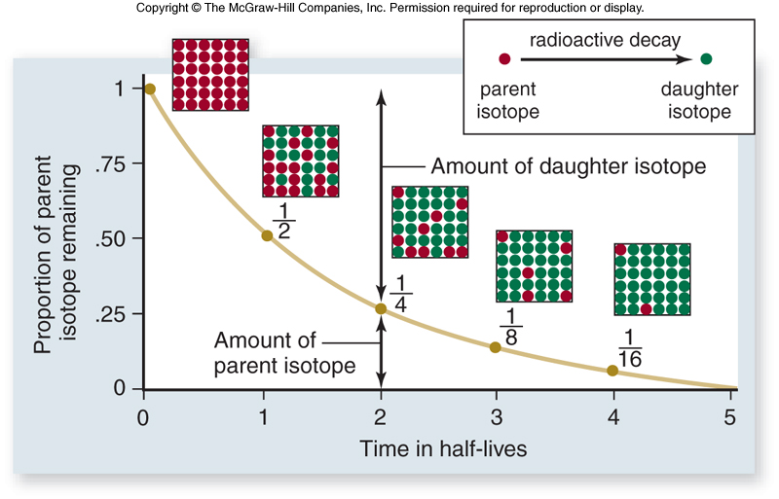
Fossil Evidence of Evolution
Absolute dating: age of fossils is estimated by rates of radioactive decay
Relative dating: position of the fossil in the sediment
Isotopes, like U²³⁸, transform at precisely known rates into nonradioactive forms.
The rate of decay is known as an isotope’s half-life

Slide 46
Fossil Evidence of Evolution
Radioactive Decay

Slide 47
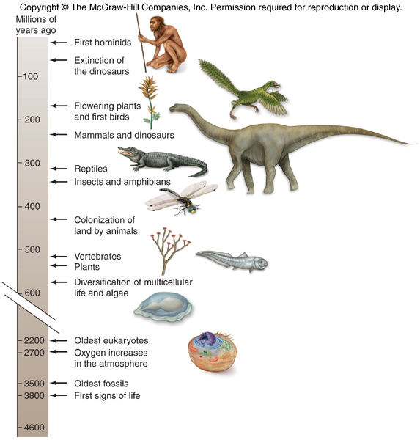
Fossil Evidence of Evolution
Fossil
records
document
the course
of life through
time

Slide 48
Fossil Evidence of Evolution
Fossils document evolutionary transition
The oldest known bird fossil is the Archaeopteryx
It is intermediate between bird and dinosaur
Possesses some ancestral traits and some traits of present day birds
Archaeopteryx was first found in 1859

Slide 49
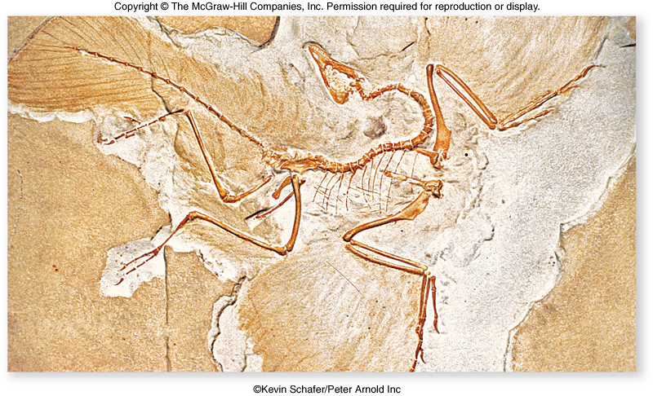
Fossil Evidence of Evolution
Fossil of Archaeopteryx

Slide 50
Fossil Evidence of Evolution
Recent discoveries
  Four-legged aquatic mammal
    Important link in the evolution of whales and dolphins from land-dwelling, hoofed ancestors
  Fossil snake with legs
  Tiktaalik: a species that bridged the gap between fish and the first amphibian
  Oysters: small curved shells to large flat shells

Slide 51
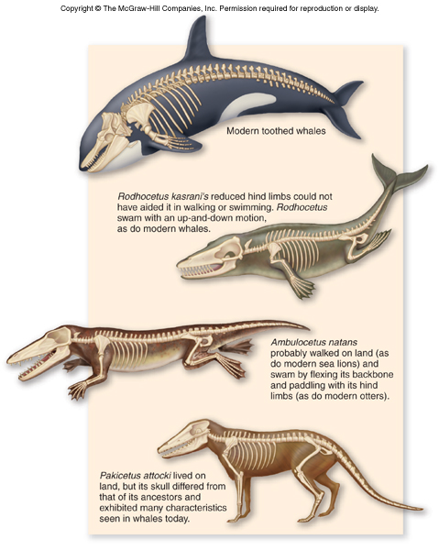
Fossil Evidence of Evolution
Whale “missing links”

Slide 52
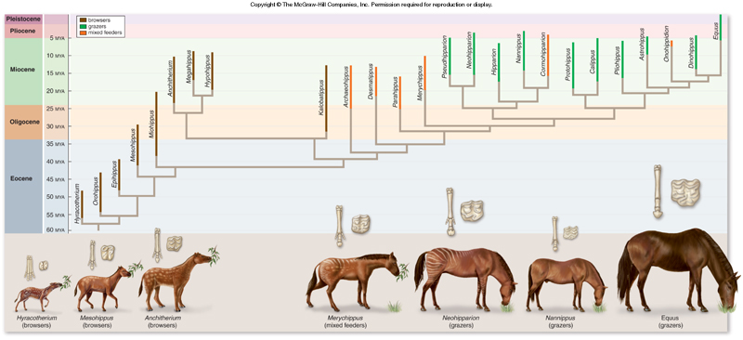
Fossil Evidence of Evolution
Evolutionary change in body size and toe reduction of horses

Slide 53
http://www.pbs.org/wgbh/evolution/library/11/2/quicktime/e_s_3.html

Slide 54
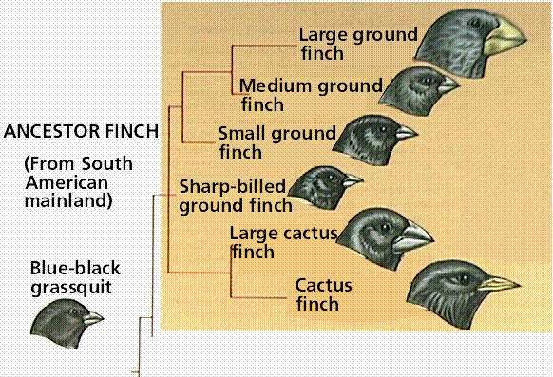
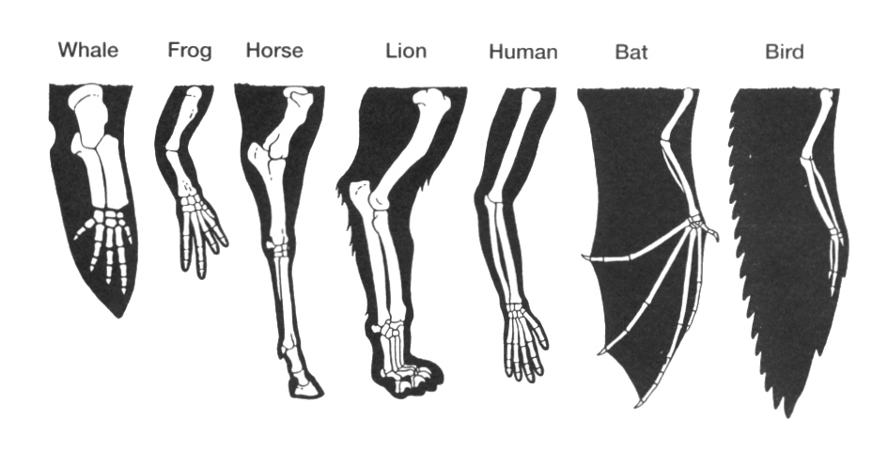
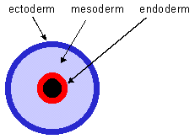
HOMOLOGOUS STRUCTURE
Similar features that originate in a shared ancestor (derive from same embryonic structure)
Can result from modifications that change an original feature to 2 extremely different types (wing and arm)

Slide 55
Anatomical Evidence for Evolution
Homologous structures: structures with different appearances and functions that all derived from the same body part in a common ancestor
The bones in the forelimb of mammals are homologous structures
Different functions, same ancestor structure

Slide 56
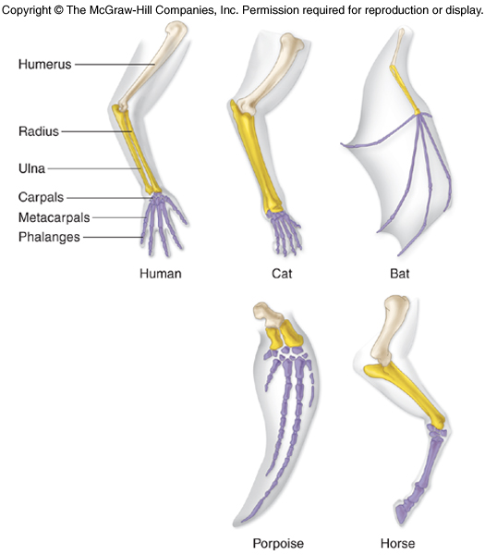
Anatomical Evidence for Evolution
Homology of the bones of the forelimb of mammals

Slide 57
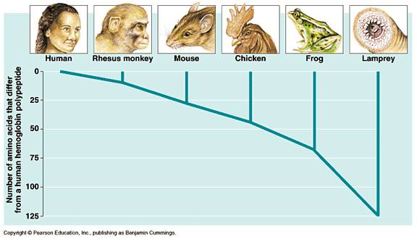
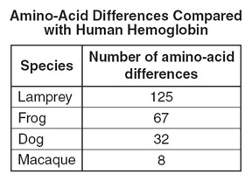

Slide 58
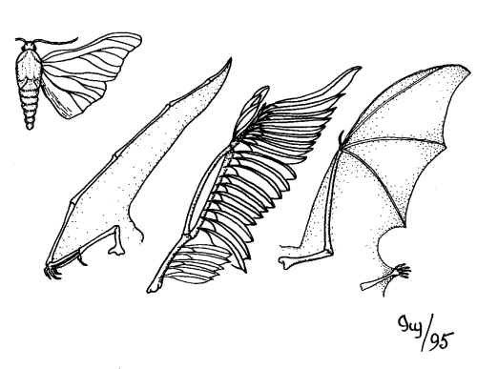
ANALAGOUS FEATURE
Serve identical functions and look similar
No anatomical/embryological similarity
Wing developed independently and differently in more-recent ancestors of each animal
Analogous structures: wing of an insect, bird bat and pterosaur

Slide 59
Anatomical Evidence for Evolution
Strongest anatomical evidence supporting evolution comes from comparisons of how organisms develop.
Early vertebrate embryos possess pharyngeal pouches that develop into:
  In humans: glands and ducts
  In fish: gill slits

Slide 60
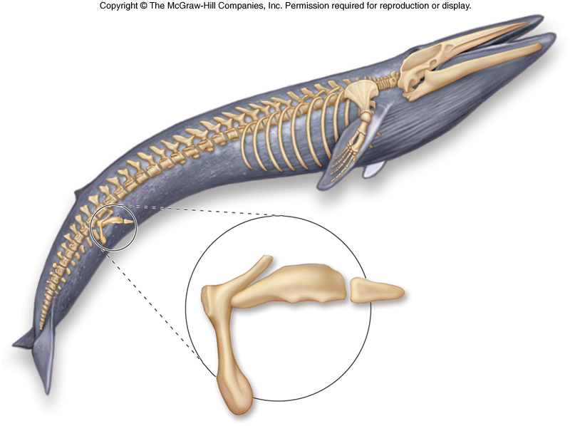
Anatomical Evidence for Evolution
Vestigial structures: have no apparent function, but resemble structures their ancestors possessed
Vestigial structures of a whale

Slide 61
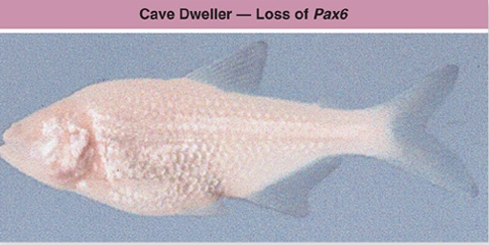
Anatomical Evidence for Evolution
Humans
  Muscles for wiggling ears
Boa constrictors
  Hip bones and rudimentary hind legs
Manatees
  Fingernails on their fins
Blind cave fish
  Nonfunctional eyes

Slide 62
Anatomical Evidence for Evolution
Neck vertebrae
  Geese: 25
  Plesiosaurs: 76
  Mammals: 7
    The giraffe has 7 vertebrae, very large in size, to make up for the length of the neck

Slide 63
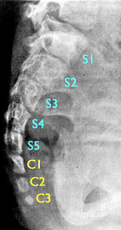
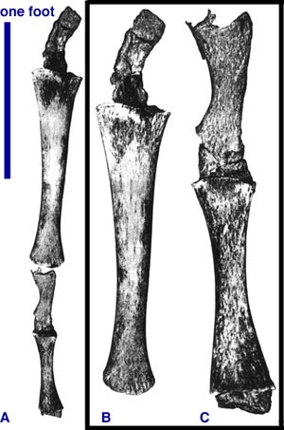
ATAVISMS
An atavism is the reappearance of a lost character specific to a remote evolutionary ancestor and not observed in the parents or recent ancestors of the organism displaying the atavistic character.
Atavisms have several essential features: (1) presence in adult stages of life, (2) absence in parents or recent ancestors, and (3) extreme rarity in a population

Slide 64
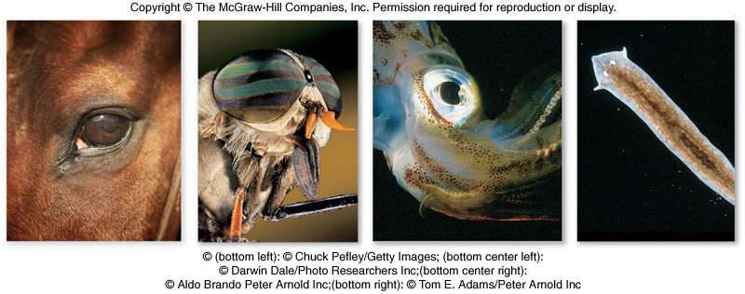
Anatomical Evidence for Evolution
Eyes
  Mollusks: photoreceptors face forward
  Vertebrate: photoreceptors face backward

Slide 65
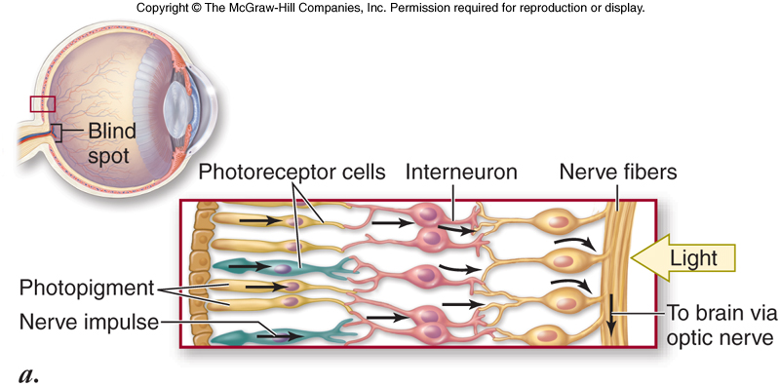
Anatomical Evidence for Evolution
Eyes of vertebrates

Slide 66
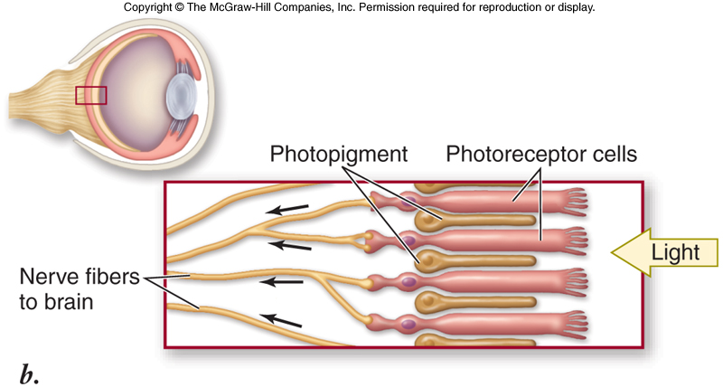
Anatomical Evidence for Evolution
Eyes of Mollusks

Slide 67
http://www.pbs.org/wgbh/evolution/library/01/1/quicktime/l_011_01.html

Slide 68
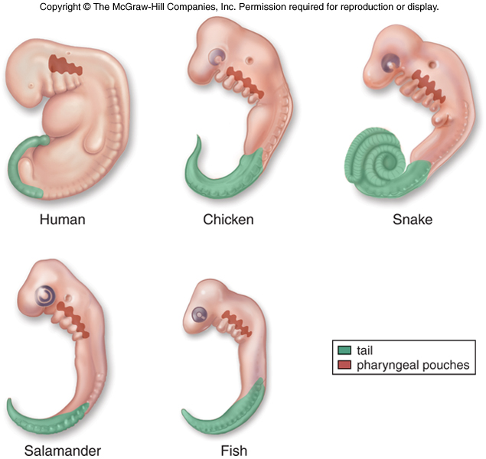
Anatomical Evidence for Evolution
Developmental similarities reflect descent from a common ancestor

Slide 69
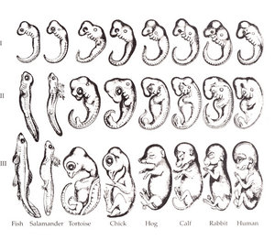
EMBRYOLOGY
During development, ALL vertebrates are similar, but fade as development proceeds

Slide 70
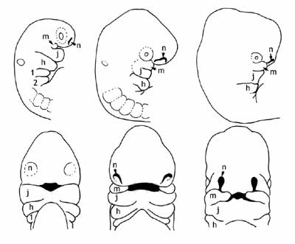
Figure 2. Drawings of the developing human head and face between the 4th and 5th week (adapted from Nelson, 1953). The top row are side views, and the bottom row are face views of the same stages. The face develops from extensions and fusions of the pharyngeal arches, structures which are found in all other vertebrates, and which are modified in different ways in different species. Abbreviations: m, maxillary process (upper jaw); j, lower jaw; h, hyoid; n, nasal pit.

Slide 71
http://www.pbs.org/wgbh/evolution/library/04/2/quicktime/l_042_02.html

Slide 72
Convergent Evolution
Biogeography: the study of the geographic distribution of species
  Some plants and animals have similar appearance but are only distantly related
Convergent evolution: the independent development of similar structures in organisms that are not directly related
Convergent evolution is usually seen in animals and plants that live in similar environments

Slide 73
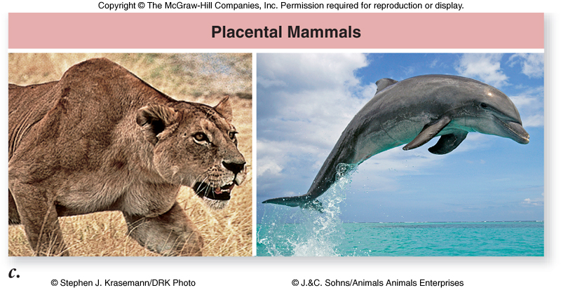
Convergent Evolution
Marsupials and placentals
  Marsupials: young are born in an immature condition and held in a pouch until they develop
  Placentals: young are not born until they can safely survive in the external environment

Slide 74
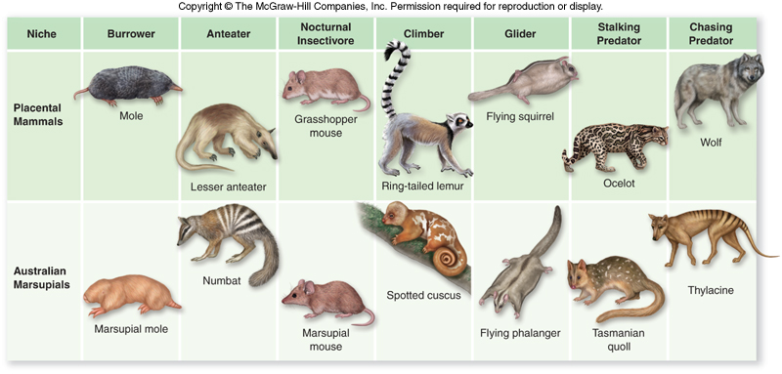
Convergent Evolution

Slide 75
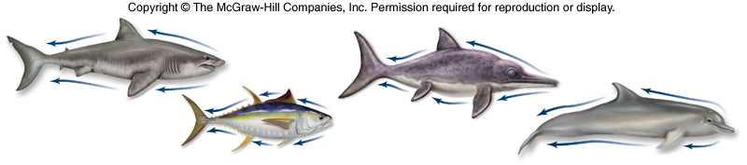
Convergent Evolution
Convergence among fast-swimming predators

