Slide 1
The Nervous and Endocrine Systems
Biology 155
B. L. Krilowicz
Spring 2010

Slide 2
I. Function:
A. Two systems in the body are responsible for integration = regulation of other body systems
  Nervous System
  Endocrine System
B. Why are regulatory systems needed?
maintenance of homeostasis

Slide 3
How do the Nervous and Endocrine Systems Differ?
Nervous System
  Rapid acting
  Involved in control of things that change over short time periods (seconds to minutes)
  Examples –
    Heart rate
    Respiration
    Voluntary muscle contractions
Endocrine System
  More slowly acting
  Involved in control of things that change over long time periods (minutes to years)
  Examples –
    Growth
    reproduction

Slide 4
II. Basic Design and Evolution of Nervous Systems:
Fig. 28.1A
a) Interprets incoming information, b) generates response when needed
A. Design -
Sensory = afferent nerves, carry info to central processor as action potentials
Central Processor
(brain or ganglion)
Motor = efferent nerves, carry info toward effectors
Sensory Receptors
Effectors
(muscles or glands)
Special nervous tissue to collect information that is important to the animal
Organs that can cause a change in the body

Slide 5
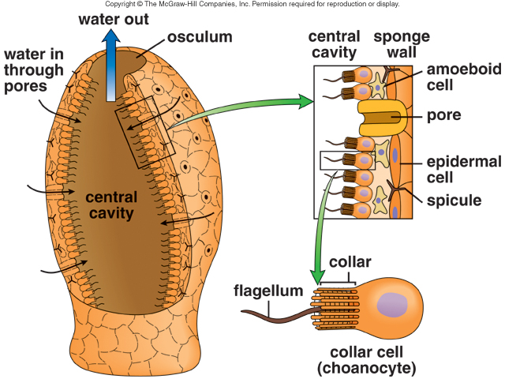
B. Evolutionary Trends:
1. Sponges – lack a nervous system, are they really animals?

Slide 6
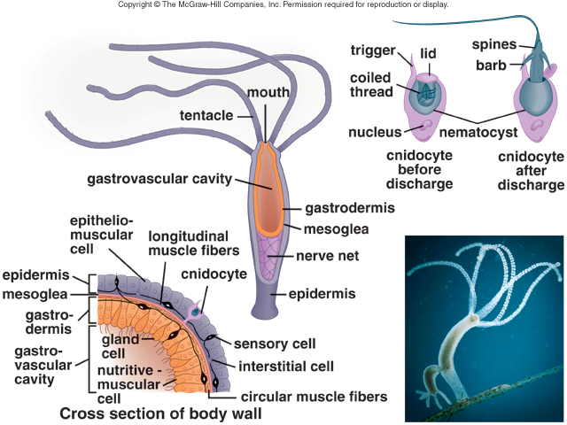
B. Evolutionary Trends Continued:
2. Jellyfish and their relatives have a nerve net nervous system – lacks a central processor so only capable of reflex behavior that is not modifiable
Fig. 28.10
Motor cell

Slide 7
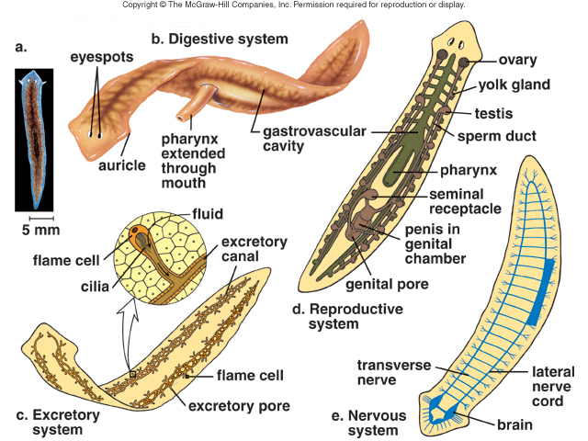
B. Evolutionary Trends Continued:
3. Flatworms and their relatives exhibit cephalization (a concentration of nervous tissues at one end of the animal to form a simple central processor = ganglion), simple learning possible, but much behavior is still reflex
ganglion
Fig. 28.10

Slide 8
B. Evolutionary Trends Continued:
Round and Segmented Worms, Insects, Vertebrates (Fish through Mammals) all have true brains
  Enlarged, highly specialized rostral ganglion where much information processing occurs
  Very complex behaviors emerge

Slide 9
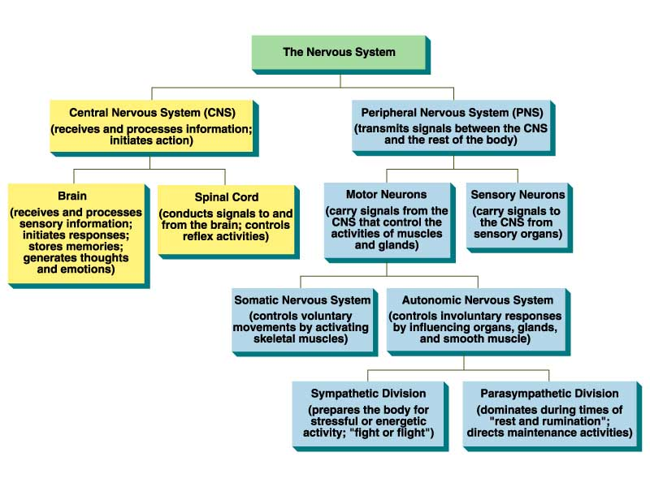
III. Overall Design of the Vertebrate Nervous System
1. Function = integration
A.
B.
1. Function -
(Collects sensory info)
2. Parts are nerves and sensory receptors
2. Parts
Fig. 28.11A

Slide 10
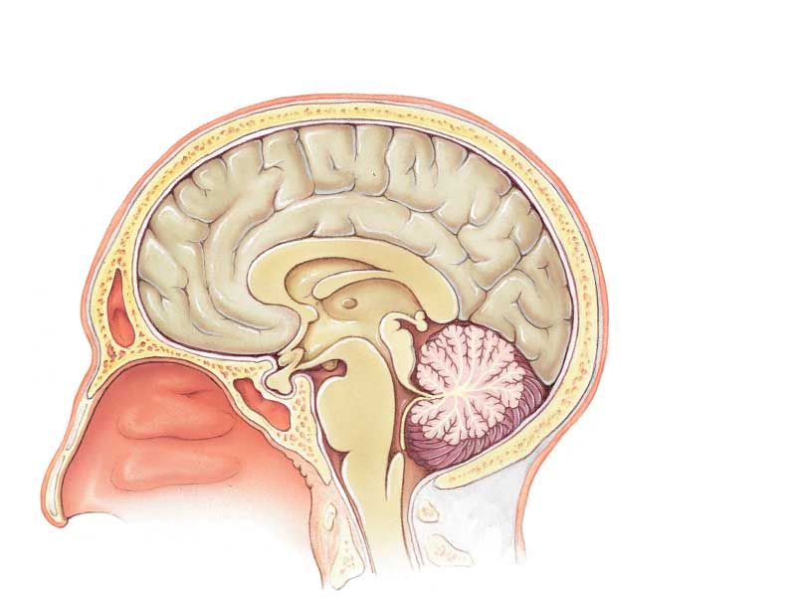
IV. The Brain = site of the highest levels of integration
Fig. 28.15A
Hypothalamus = controls “ancient drives” and regulates the pituitary gland, essentially conserved in all vertebrates
Cerebrum = “newest” part of the vertebrate brain, site of all higher brain functions, increases in size from fish to mammals
Cerebellum = balance and motor control, size depends on intricacy of movements
Brainstem = midbrain, pons and medulla, regulates all autonomic functions, essentially conserved in all vertebrates
Pituitary gland = endocrine gland

Slide 11
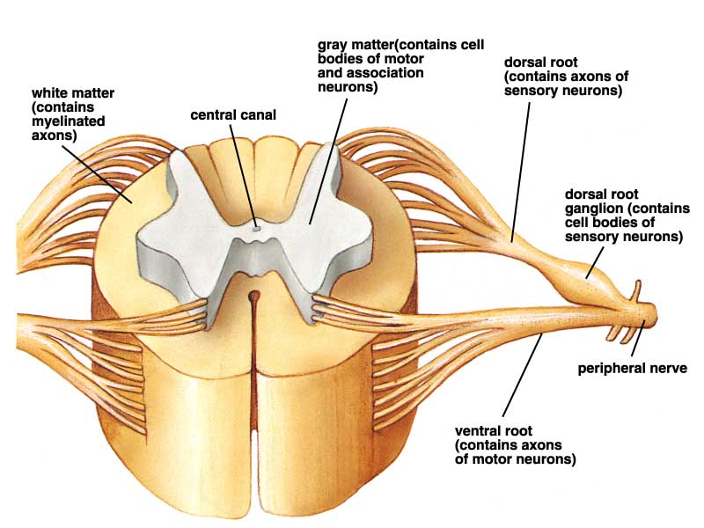
V. A. Spinal Cord function – connects the brain to everything below the neck and conducts simple information processing in the form of the reflex arch
Fig. 28.11B

Slide 12
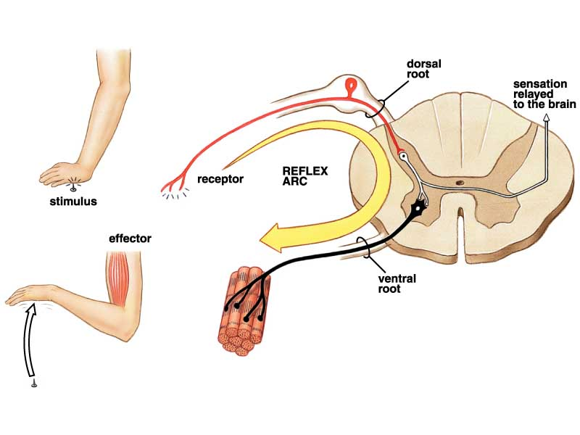
V. B. The Withdrawal Reflex = negative feedback loop that controls pain
2) Nocioreceptor in hand is activated, action potential conveys info to spinal cord over spinal nerve
6) Sensory info is conveyed to the brain, reaches cerebrum after reflex
1) Hand contacts sharp or hot object
3) Interneuron in spinal cord coveys info to motor neuron
4) Motor neuron conveys info to biceps muscle over spinal nerve
5) Biceps muscle contracts and removes hand from painful stimulus
Fig. 28.1B

Slide 13
VI. A. The Peripheral Nervous System contains nerves and sensory receptors
1. Nerves can be (a) spinal (arise from the spinal cord) or (b) cranial (arise from the brain); groups of nerve cell processes bundled together with connective tissue
2. Sensory receptors are located throughout the body (a. general receptors) or are localized in one place (b. special receptors), they can also be classified based on (c) what they detect
Fig. 28.12

Slide 14
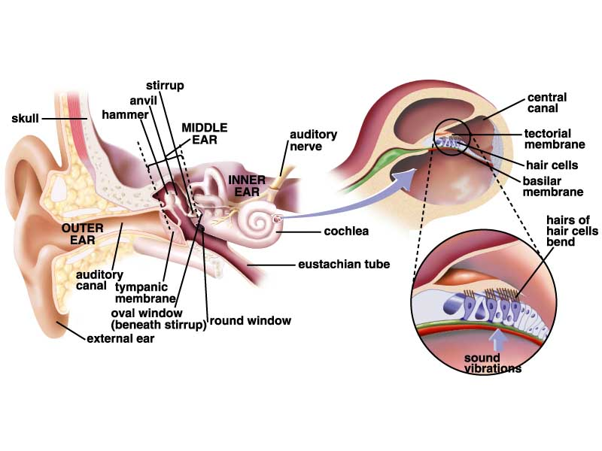
1. Mechanoreceptors respond to mechanical stimulation (touch, vibration, etc.)
Ears and semi-circular canals are special mechanoreceptors
Touch and proprioreception (not shown) are general mechanoreceptive senses

Slide 15
2. Thermoreceptors
Respond to temperature
Examples –
  Mammalian thermoreceptors located throughout skin and hypothalamus (general receptors)
  Pit organs of snakes are special thermoreceptors

Slide 16
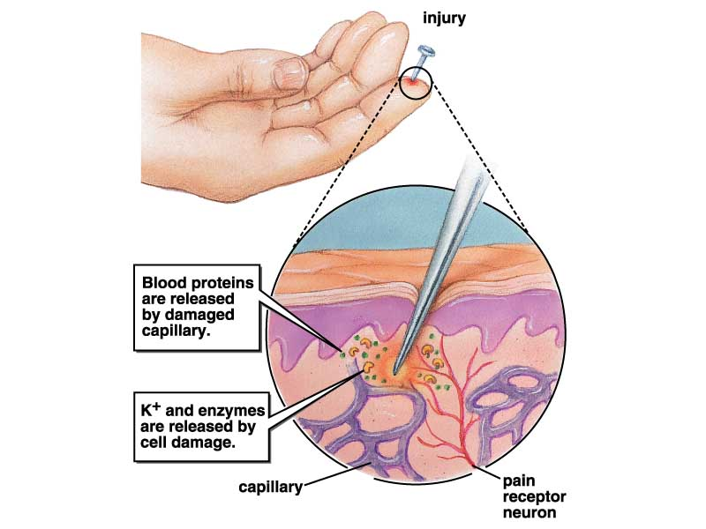
3. Nocioreceptors respond to painful stimuli (probably chemicals released from damaged tissues) – general receptors

Slide 17
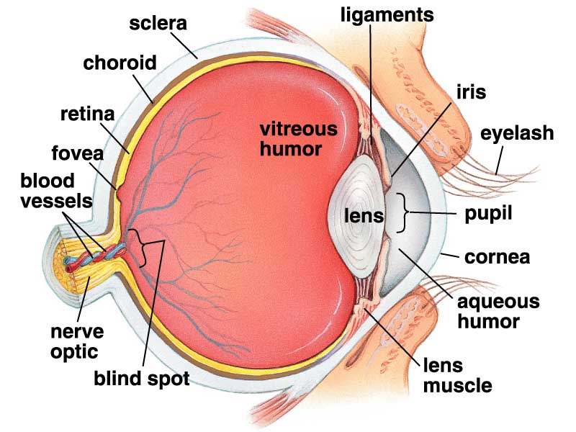
4. Photoreceptors respond to light
Vertebrate eyes are special receptors

Slide 18
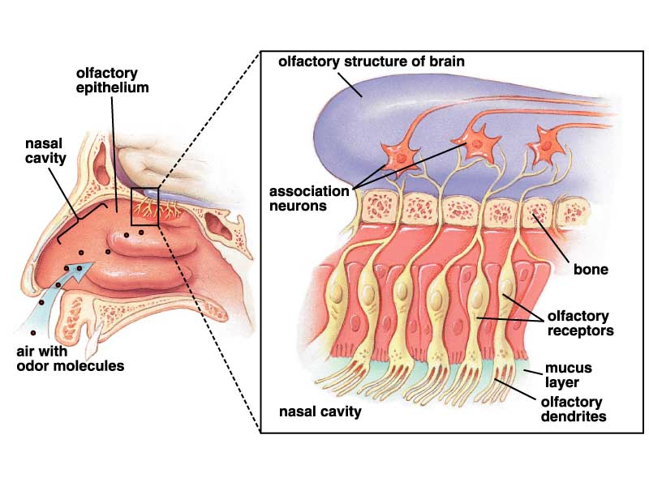
5. Chemoreceptors respond to chemicals
Smell (a special receptor in mammals) allows perception of far chemicals

Slide 19
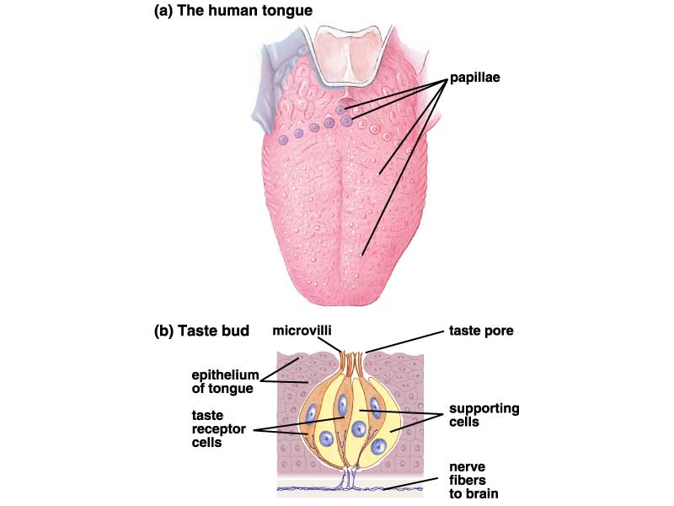
Taste (special receptor in mammals) allows perception of close chemicals
Do fish smell or taste?

Slide 20
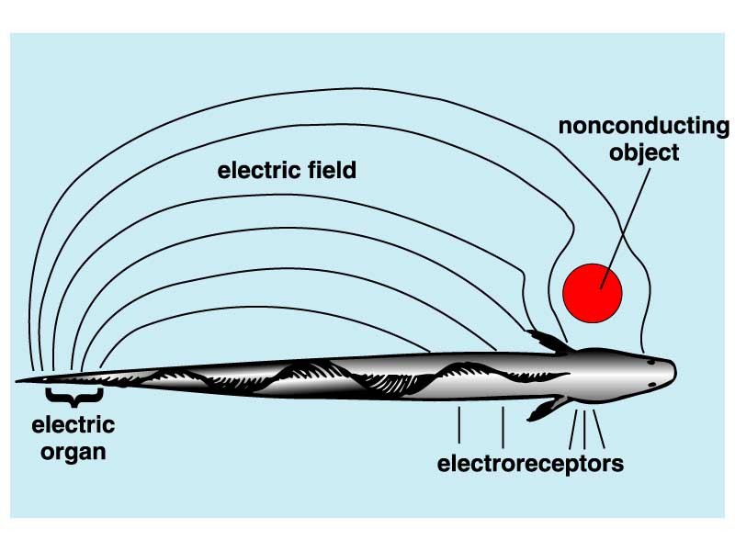
6. Electrical Receptors allow detection of electrical (below) and magnetic fields (bird navigation)

Slide 21
VI. B. The Peripheral Nervous System is Divided into the Somatic and Autonomic Nervous Systems
Both divisions have motor and sensory subdivisions
Fig. 28.12
Activation causes adrenalin release

Slide 22
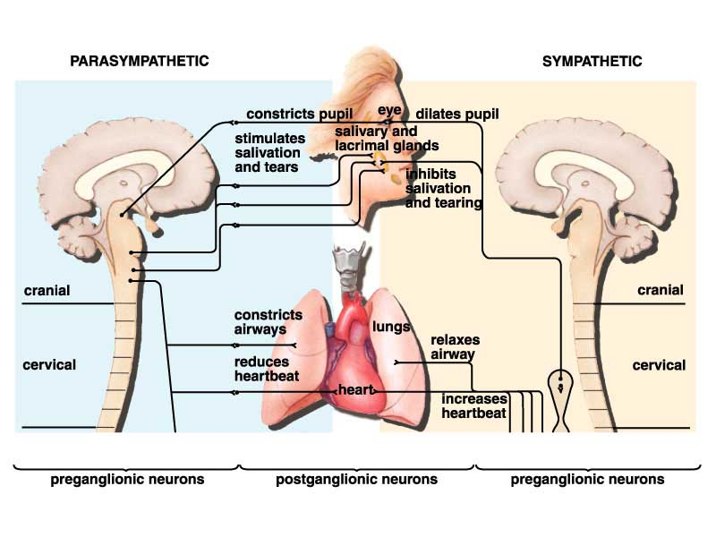
Actions of the Sympathetic versus Parasympathetic Nervous Systems
Fig. 28.13

Slide 23
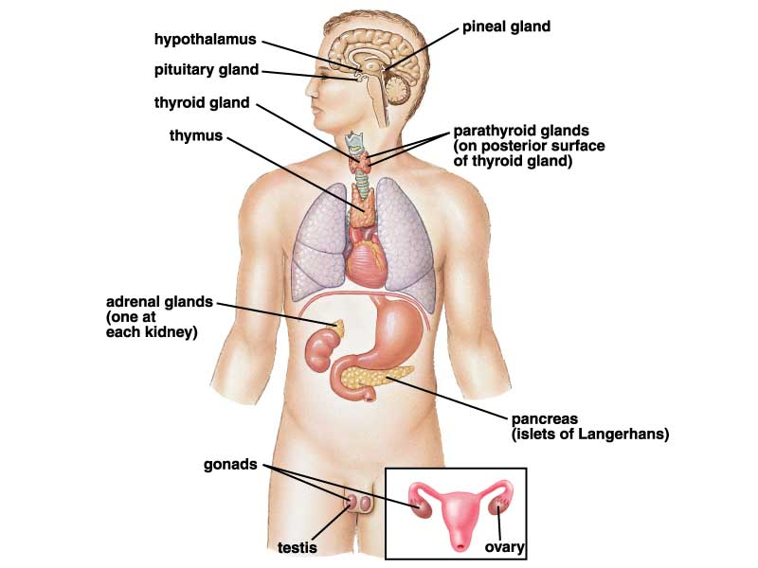
VII. Some Endocrine System Definitions
A. Endocrine glands are ductless glands that release a product into the bloodstream for transport to body targets
B. Exocrine glands (not shown) release their products through ducts onto the body surface or into the lumen of an organ
Fig. 26.3

Slide 24
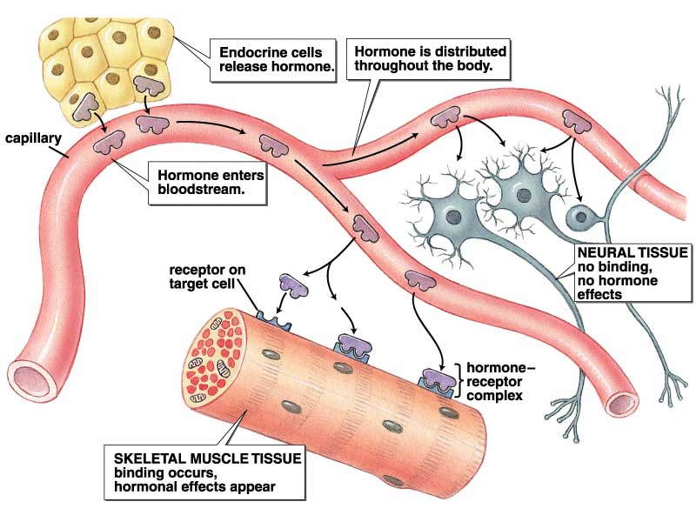
VII. Some Endocrine System Definitions (continued)
C. Hormones are chemical signals produced by an endocrine gland that act at some distance from the gland
D. Targets are organs, tissues or cells capable of responding to the hormone due to the presence of a receptor that binds the hormone
Fig. 26.1A

Slide 25
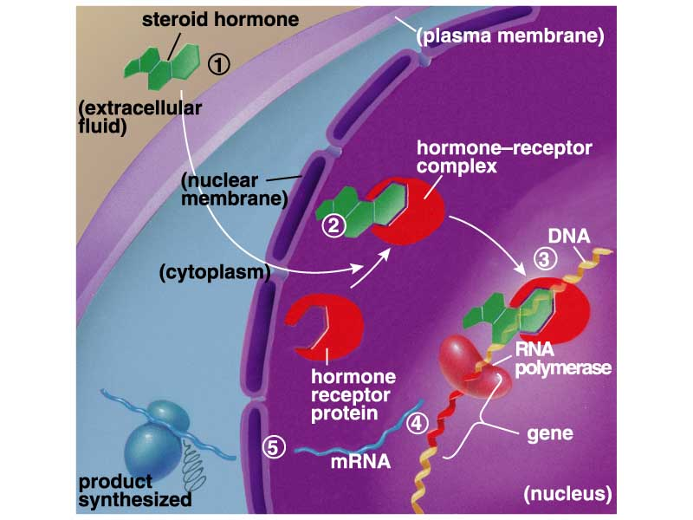
VIII. Mechanism of Hormone Action – A. Gene Activation
1. Must be lipid soluble hormones (ex. Steroids)
4. How can two different targets exhibit two different responses to the same hormone?
2. Response is slow (1 to many hours)
3. steps
Fig. 26.2B

Slide 26
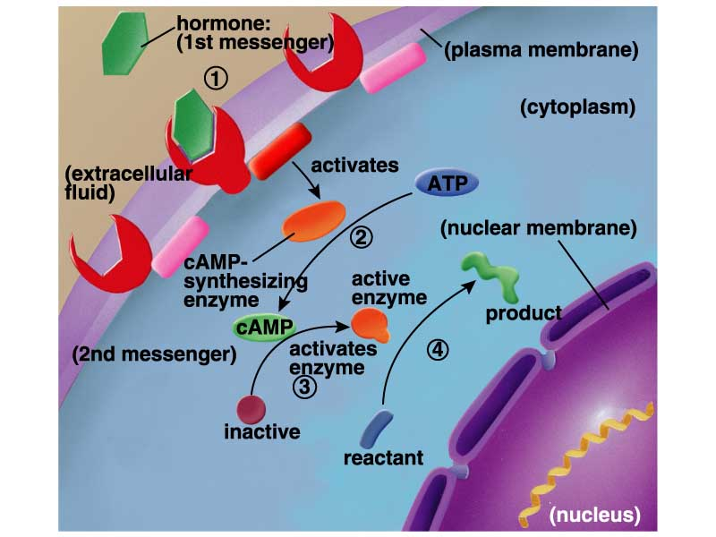
VIII. Mechanism of Hormone Action – B. Second Messengers
4. How can two different targets exhibit two different response to the same hormone?
1. Protein and other hormones that cannot pass the plasma membrane
2. Rapid response, within minutes
3. steps
Fig. 26.2A

Slide 27
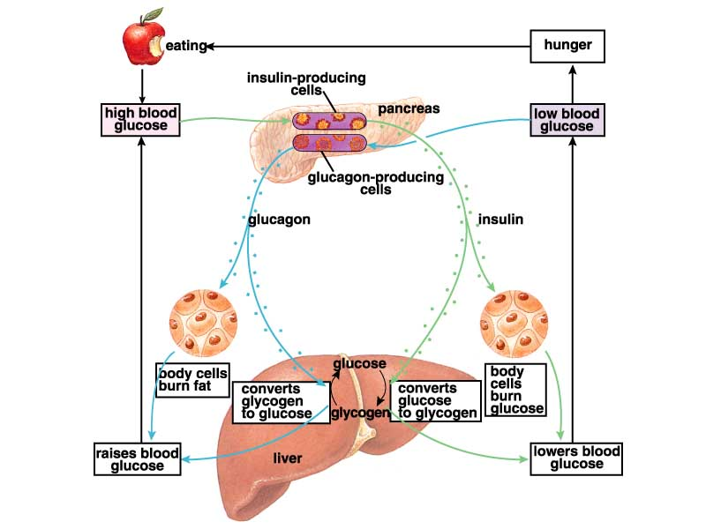
IX. Example of Negative Feedback Regulation in the Endocrine System – insulin’s control of blood glucose levels
3. Insulin secreting cells in the pancreas (in Islets of Langerhans) sense high glucose levels (i.e. serve as the sensor) and release insulin (i.e. serve as the central processor and send a chemical signal to body)
1. Eating due to low blood glucose/hunger leads to digestion and glucose absorption
2. Blood glucose (controlled variable) is elevated
4. Most body cells take up glucose in response to insulin binding, serve as targets for the hormone and thus as effectors
5. Blood glucose levels return to normal and insulin release stops
Fig. 26.7

