Slide 1
Signal transduction pathways link signal reception to response
Plants have cellular receptors that detect changes in their environment
For a stimulus to elicit a response, certain cells must have an appropriate receptor
Stimulation of the receptor initiates a specific signal transduction pathway
A potato left growing in darkness produces shoots that look unhealthy and lacks elongated roots

Slide 2
These are morphological adaptations for growing in darkness, collectively called etiolation
After exposure to light, a potato undergoes changes called de-etiolation, in which shoots and roots grow normally
A potato’s response to light is an example of cell-signal processing
The stages are reception, transduction, and response

Slide 3
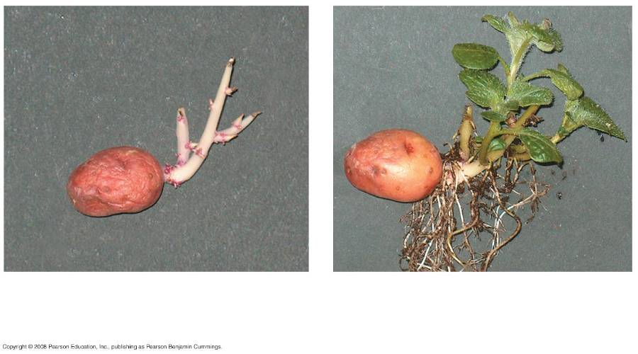
(a) Before exposure to light
(b) After a week’s exposure to
natural daylight
Notes:
Figure 39.2 Light-induced de-etiolation (greening) of dark-grown potatoes

Slide 4
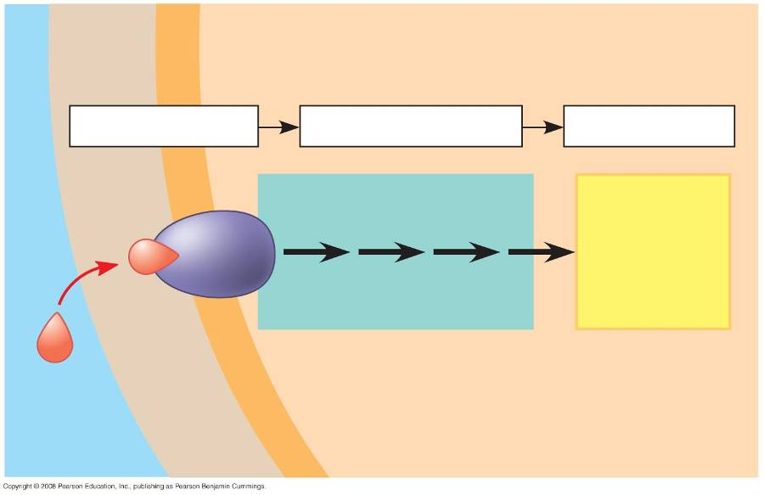
CELL
WALL
CYTOPLASM
1
Reception
2
Transduction
3
Response
Relay proteins and
Activation
of cellular
responses
second messengers
Receptor
Hormone or
environmental
stimulus
Plasma membrane
Notes:
Figure 39.3 Review of a general model for signal transduction pathways

Slide 5
Reception and Transduction
Internal and external signals are detected by receptors, proteins that change in response to specific stimuli
Second messengers transfer and amplify signals from receptors to proteins that cause responses

Slide 6
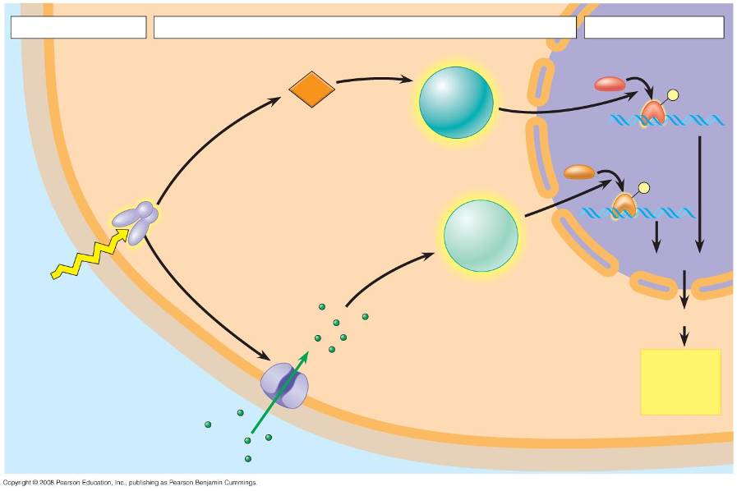
1
Reception
2
Transduction
3
Response
CYTOPLASM
Transcription
factor 1
NUCLEUS
Specific
protein
kinase 1
activated
NUCLEUS
Plasma
membrane
cGMP
P
Second messenger
produced
Transcription
factor 2
Phytochrome
activated
by light
P
Cell
wall
Specific
protein
kinase 2
activated
Transcription
Light
Translation
Ca²⁺ channel
opened
De-etiolation
(greening)
response
proteins
Ca²⁺
Notes:
Figure 39.4 An example of signal transduction in plants: the role of phytochrome in the de-etiolation (greening) response

Slide 7
Response
A signal transduction pathway leads to regulation of one or more cellular activities
In most cases, these responses to stimulation involve increased activity of enzymes
This can occur by transcriptional regulation or post-translational modification

Slide 8
Transcriptional Regulation
Specific transcription factors bind directly to specific regions of DNA and control transcription of genes
Positive transcription factors are proteins that increase the transcription of specific genes, while negative transcription factors are proteins that decrease the transcription of specific genes

Slide 9
Post-Translational Modification of Proteins
Post-translational modification involves modification of existing proteins in the signal response
Modification often involves the phosphorylation of specific amino acids

Slide 10
De-Etiolation (“Greening”) Proteins
Many enzymes that function in certain signal responses are directly involved in photosynthesis
Other enzymes are involved in supplying chemical precursors for chlorophyll production

Slide 11
Plant Hormones
Hormones are chemical signals that coordinate different parts of an organism
Any response resulting in curvature of organs toward or away from a stimulus is called a tropism
Tropisms are often caused by hormones

Slide 12
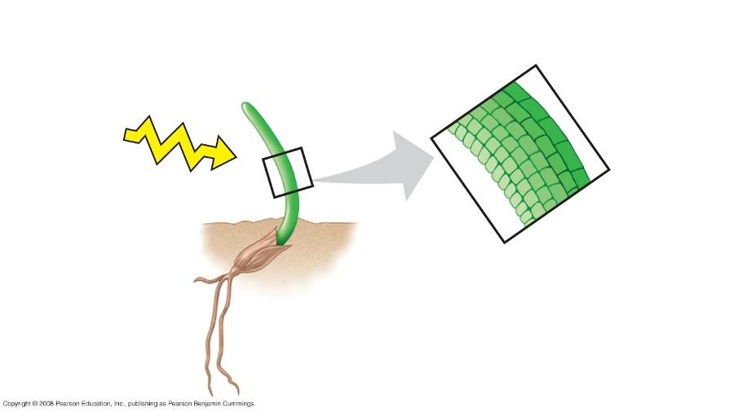
RESULTS
Shaded
side of
coleoptile
Control
Light
Illuminated
side of
coleoptile
Notes:
Figure 39.5 What part of a grass coleoptile senses light, and how is the signal transmitted?

Slide 13
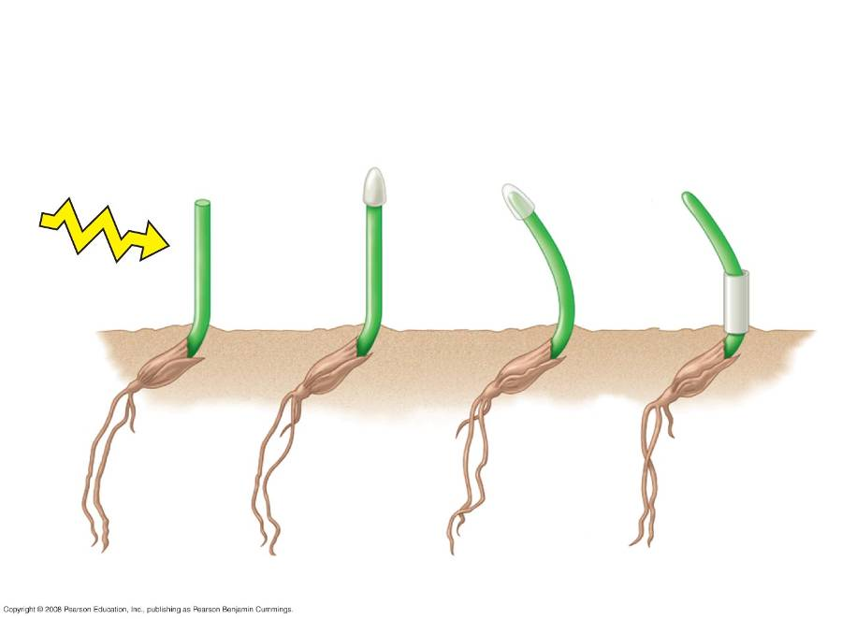
RESULTS
Darwin and Darwin: phototropic response
only when tip is illuminated
Light
Tip
removed
Tip covered
by opaque
cap
Tip
covered
by trans-
parent
cap
Site of
curvature
covered by
opaque
shield
Notes:
Figure 39.5 What part of a grass coleoptile senses light, and how is the signal transmitted?

Slide 14
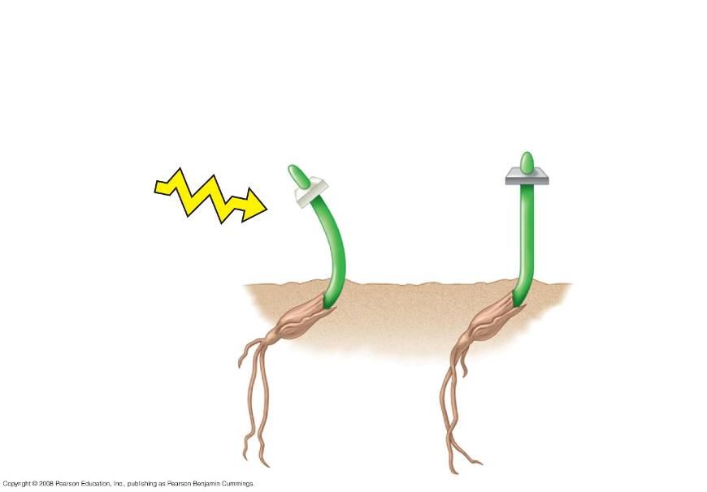
RESULTS
Boysen-Jensen: phototropic response when tip is separated
by permeable barrier, but not with impermeable barrier
Light
Tip separated
by gelatin
(permeable)
Tip separated
by mica
(impermeable)
Notes:
Figure 39.5 What part of a grass coleoptile senses light, and how is the signal transmitted?

Slide 15
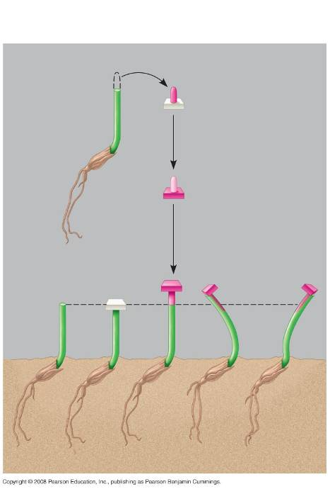
RESULTS
Excised tip placed
on agar cube
Growth-promoting
chemical diffuses
into agar cube
Control
(agar cube
lacking
chemical)
has no
effect
Agar cube
with chemical
stimulates growth
Offset cubes
cause curvature
Control
Notes:
Figure 39.6 Does asymmetric distribution of a growth-promoting chemical cause a coleoptile to grow toward the light?

Slide 16
A Survey of Plant Hormones
In general, hormones control plant growth and development by affecting the division, elongation, and differentiation of cells
Plant hormones are produced in very low concentration, but a minute amount can greatly affect growth and development of a plant organ

Slide 17
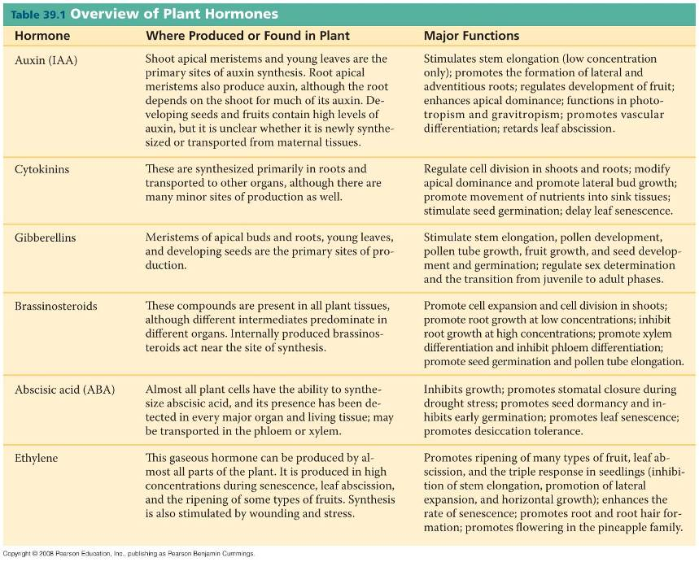

Slide 18
Auxin
The term auxin refers to any chemical that promotes elongation of coleoptiles
Indoleacetic acid (IAA) is a common auxin in plants; in this lecture the term auxin refers specifically to IAA
Auxin transporter proteins move the hormone from the basal end of one cell into the apical end of the neighboring cell

Slide 19
The Role of Auxin in Cell Elongation
According to the acid growth hypothesis, auxin stimulates proton pumps in the plasma membrane
The proton pumps lower the pH in the cell wall, activating expansins, enzymes that loosen the wall’s fabric
With the cellulose loosened, the cell can elongate

Slide 20
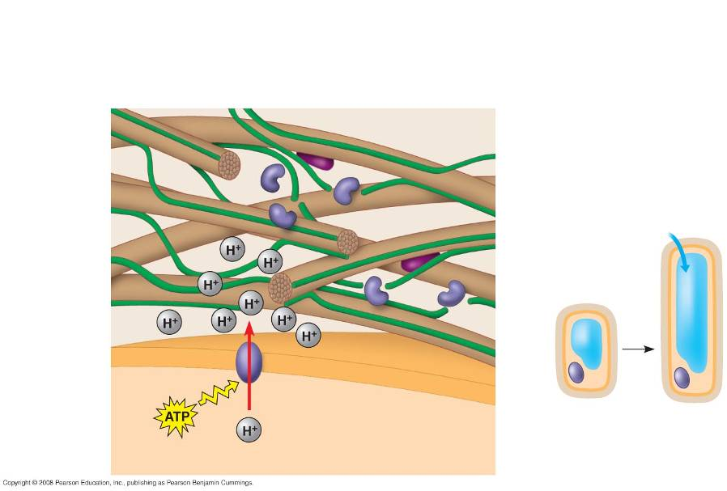
3
Expansins separate
microfibrils from cross-
linking polysaccharides.
Cell wall–loosening
enzymes
Cross-linking
polysaccharides
Expansin
CELL WALL
4
Cleaving allows
microfibrils to slide.
Cellulose
microfibril
H₂O
Cell wall
becomes
more acidic.
Cell
wall
2
Plasma
membrane
1
Auxin
increases
proton pump
activity.
Plasma membrane
Nucleus
Cytoplasm
Vacuole
CYTOPLASM
5
Cell can elongate.
Notes:
Figure 39.8 Cell elongation in response to auxin: the acid growth hypothesis

Slide 21
Lateral and Adventitious Root Formation
Auxin is involved in root formation and branching
Auxins as Herbicides
An overdose of synthetic auxins can kill eudicots
Other Effects of Auxin
Auxin affects secondary growth by inducing cell division in the vascular cambium and influencing differentiation of secondary xylem

Slide 22
Cytokinins
Cytokinins are so named because they stimulate cytokinesis (cell division)
Control of Cell Division and Differentiation
Cytokinins are produced in actively growing tissues such as roots, embryos, and fruits
Cytokinins work together with auxin to control cell division and differentiation

Slide 23
Control of Apical Dominance
Cytokinins, auxin, and other factors interact in the control of apical dominance, a terminal bud’s ability to suppress development of axillary buds
If the terminal bud is removed, plants become bushier
Anti-Aging Effects
Cytokinins retard the aging of some plant organs by inhibiting protein breakdown, stimulating RNA and protein synthesis, and mobilizing nutrients from surrounding tissues

Slide 24
Gibberellins
Gibberellins have a variety of effects, such as stem elongation, fruit growth, and seed germination
Gibberellins stimulate growth of leaves and stems
In stems, they stimulate cell elongation and cell division
In many plants, both auxin and gibberellins must be present for fruit to set
Gibberellins are used in spraying of Thompson seedless grapes

Slide 25
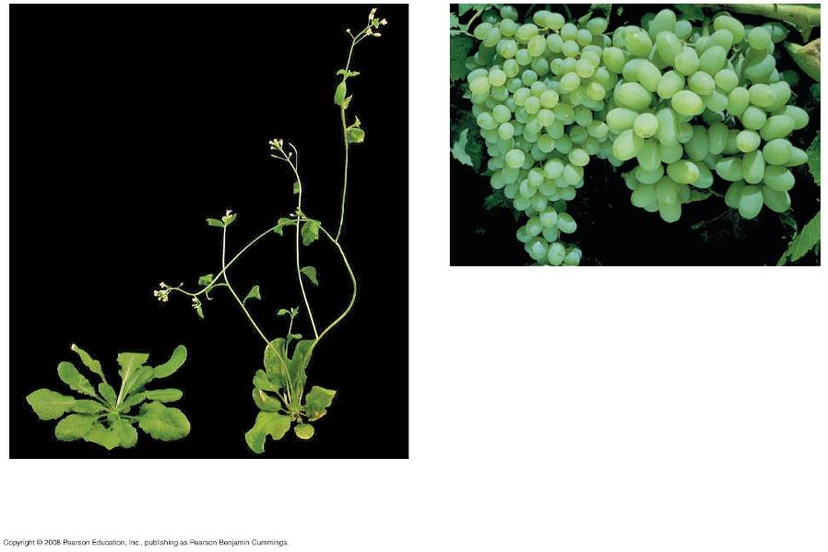
(b) Gibberellin-induced fruit
growth
Gibberellin-induced stem
growth
Notes:
Figure 39.10 Effects of gibberellins on stem elongation and fruit growth

Slide 26
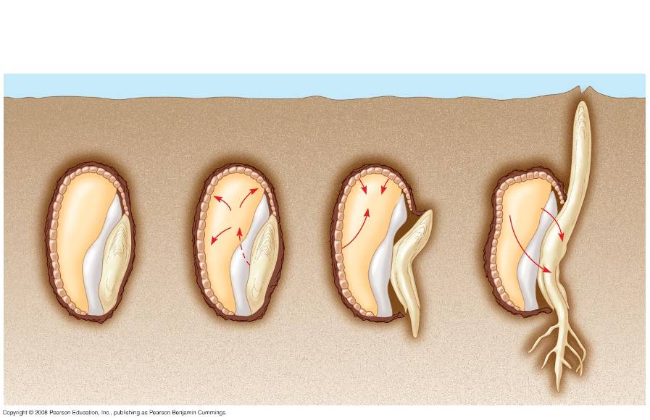
Gibberellins (GA)
send signal to
aleurone.
1
2
Sugars and other
nutrients are consumed.
Aleurone secretes
-amylase and other enzymes.
3
Aleurone
Endosperm
-amylase
Sugar
GA
GA
Water
Scutellum
(cotyledon)
Radicle
Notes:
Figure 39.11 Mobilization of nutrients by gibberellins during the germination of grain seeds such as barley

Slide 27
Ethylene
Plants produce ethylene in response to stresses such as drought, flooding, mechanical pressure, injury, and infection
The effects of ethylene include response to mechanical stress, leaf abscission, and fruit ripening

Slide 28
The Triple Response to Mechanical Stress
Ethylene induces the triple response, which allows a growing shoot to avoid obstacles
The triple response consists of a slowing of stem elongation, a thickening of the stem, and horizontal growth

Slide 29
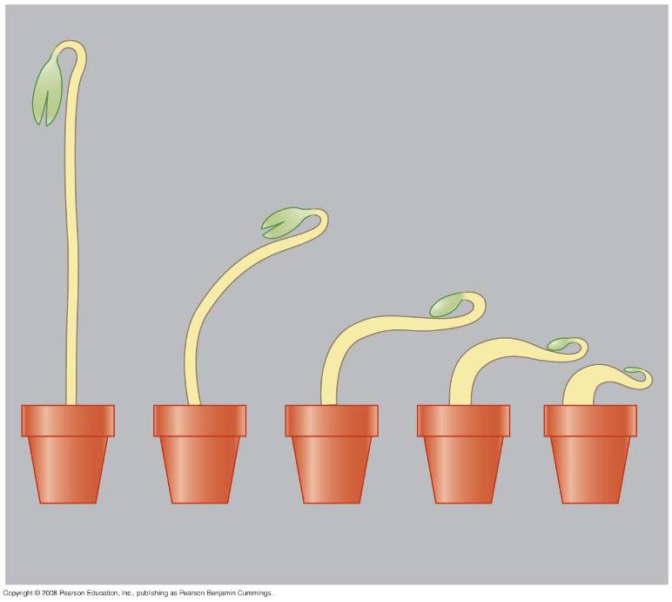
0.00
0.10
0.20
0.40
0.80
Ethylene concentration (parts per million)
Notes:
Figure 39.13 The ethylene-induced triple response

Slide 30
Ethylene-insensitive mutants fail to undergo the triple response after exposure to ethylene
Other mutants undergo the triple response in air but do not respond to inhibitors of ethylene synthesis

Slide 31
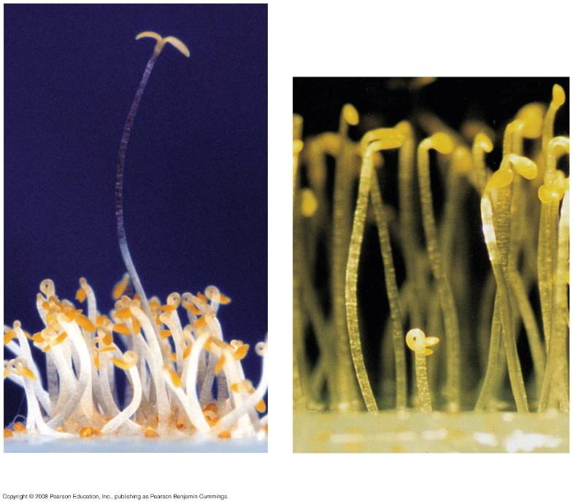
ein mutant
ctr mutant
(a) ein mutant
(b) ctr mutant
Notes:
Figure 39.14 Ethylene triple-response Arabidopsis mutants

Slide 32
Senescence
Senescence is the programmed death of plant cells or organs
A burst of ethylene is associated with apoptosis, the programmed destruction of cells, organs, or whole plants

Slide 33
Leaf Abscission
A change in the balance of auxin and ethylene controls leaf abscission, the process that occurs in autumn when a leaf falls
Fruit Ripening
A burst of ethylene production in a fruit triggers the ripening process

Slide 34
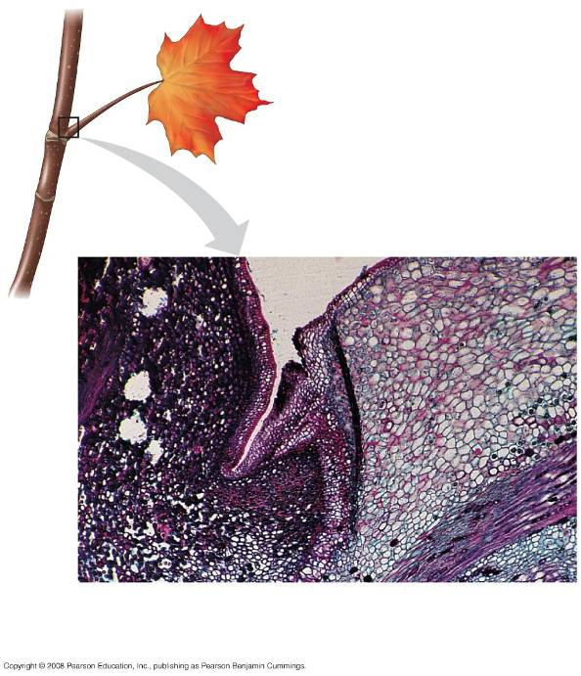
0.5 mm
Protective layer
Abscission layer
Stem
Petiole
Notes:
Figure 39.15 Abscission of a maple leaf

Slide 35
Responses to light are critical for plant success
Light cues many key events in plant growth and development
Effects of light on plant morphology are called photomorphogenesis

Slide 36
Plants detect not only presence of light but also its direction, intensity, and wavelength (color)
A graph called an action spectrum depicts relative response of a process to different wavelengths
Action spectra are useful in studying any process that depends on light

Slide 37
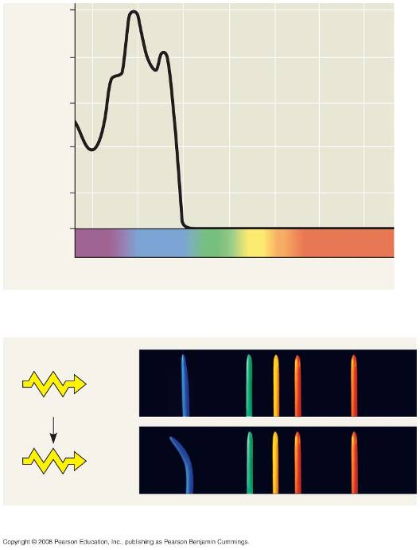
1.0
436 nm
0.8
0.6
Phototropic effectiveness
0.4
0.2
0
400
450
500
550
600
650
700
Wavelength (nm)
(a) Action spectrum for blue-light phototropism
Light
Time = 0 min
Time = 90 min
(b) Coleoptile response to light colors
Notes:
Figure 39.16 Action spectrum for blue-light-stimulated phototropism in maize coleoptiles

Slide 38
Blue-Light Photoreceptors
There are two major classes of light receptors: blue-light photoreceptors and phytochromes
Various blue-light photoreceptors control hypocotyl elongation, stomatal opening, and phototropism
Phytochromes are pigments that regulate many of a plant’s responses to light throughout its life
These responses include seed germination and shade avoidance

Slide 39
Biological Clocks and Circadian Rhythms
Many plant processes oscillate during the day
Many legumes lower their leaves in the evening and raise them in the morning, even when kept under constant light or dark conditions

Slide 40
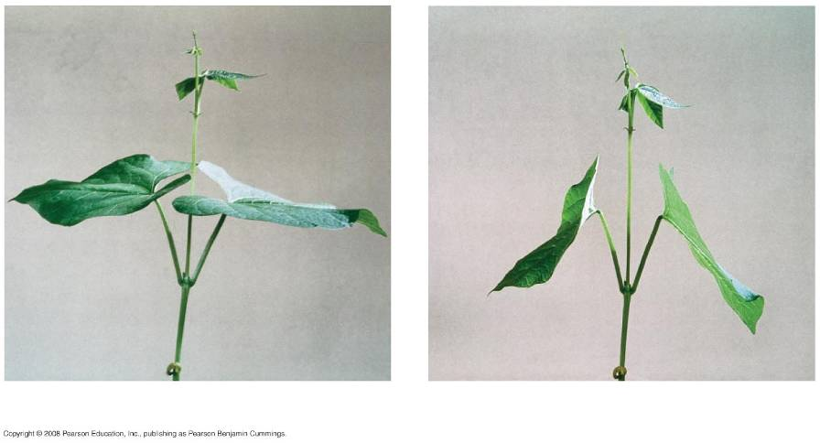
Noon
Midnight
Notes:
Figure 39.20 Sleep movements of a bean plant (Phaseolus vulgaris)

Slide 41
Circadian rhythms are cycles that are about 24 hours long and are governed by an internal “clock”
Circadian rhythms can be entrained to exactly 24 hours by the day/night cycle
The clock may depend on synthesis of a protein regulated through feedback control and may be common to all eukaryotes

Slide 42
The Effect of Light on the Biological Clock
Phytochrome conversion marks sunrise and sunset, providing the biological clock with environmental cues

Slide 43
Photoperiodism and Responses to Seasons
Photoperiod, the relative lengths of night and day, is the environmental stimulus plants use most often to detect the time of year
Photoperiodism is a physiological response to photoperiod

Slide 44
Photoperiodism and Control of Flowering
Some processes, including flowering in many species, require a certain photoperiod
Plants that flower when a light period is shorter than a critical length are called short-day plants
Plants that flower when a light period is longer than a certain number of hours are called long-day plants
Flowering in day-neutral plants is controlled by plant maturity, not photoperiod

Slide 45
Short-day plants are governed by whether the critical night length sets a minimum number of hours of darkness
Long-day plants are governed by whether the critical night length sets a maximum number of hours of darkness

Slide 46
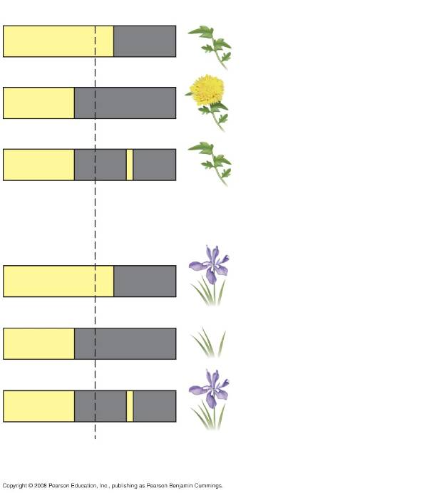
24 hours
(a) Short-day (long-night)
plant
Light
Flash
of
light
Darkness
Critical
dark period
(b) Long-day (short-night)
plant
Flash
of
light
Notes:
Figure 39.21 Photoperiodic control of flowering

Slide 47
Red light can interrupt the nighttime portion of the photoperiod
Action spectra and photoreversibility experiments show that phytochrome is the pigment that receives red light

Slide 48
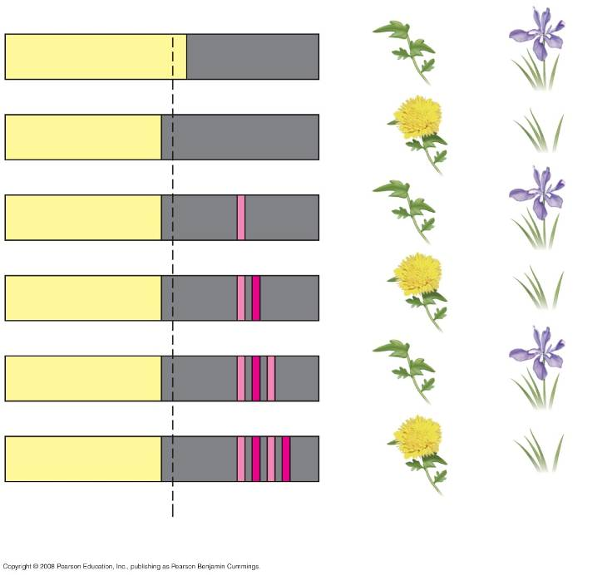
24 hours
R
RFR
RFRR
RFRRFR
Short-day
(long-night)
plant
Long-day
(short-night)
plant
Critical dark period
Notes:
Figure 39.22 Reversible effects of red and far-red light on photoperiodic response

Slide 49
Some plants flower after only a single exposure to the required photoperiod
Other plants need several successive days of the required photoperiod
Still others need an environmental stimulus in addition to the required photoperiod
For example, vernalization is a pretreatment with cold to induce flowering

Slide 50
A Flowering Hormone?
The flowering signal, not yet chemically identified, is called florigen
Florigen may be a macromolecule governed by the CONSTANS gene

Slide 51
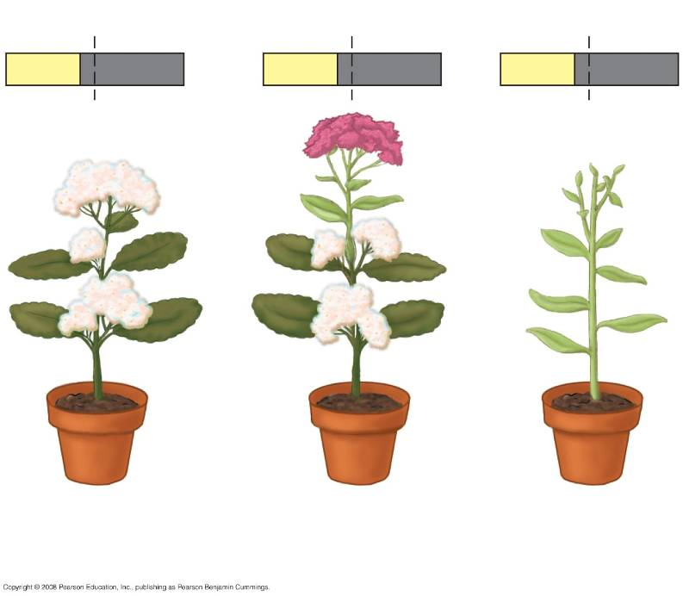
24 hours
24 hours
24 hours
Graft
Short-day
plant
Long-day plant
grafted to
short-day plant
Long-day
plant
Notes:
Figure 39.23 Experimental evidence for a flowering hormone

Slide 52
Meristem Transition and Flowering
For a bud to form a flower instead of a vegetative shoot, meristem identity genes must first be switched on
Researchers seek to identify the signal transduction pathways that link cues such as photoperiod and hormonal changes to the gene expression required for flowering

Slide 53
Plants respond to a wide variety of stimuli other than light
Because of immobility, plants must adjust to a range of environmental circumstances through developmental and physiological mechanisms

Slide 54
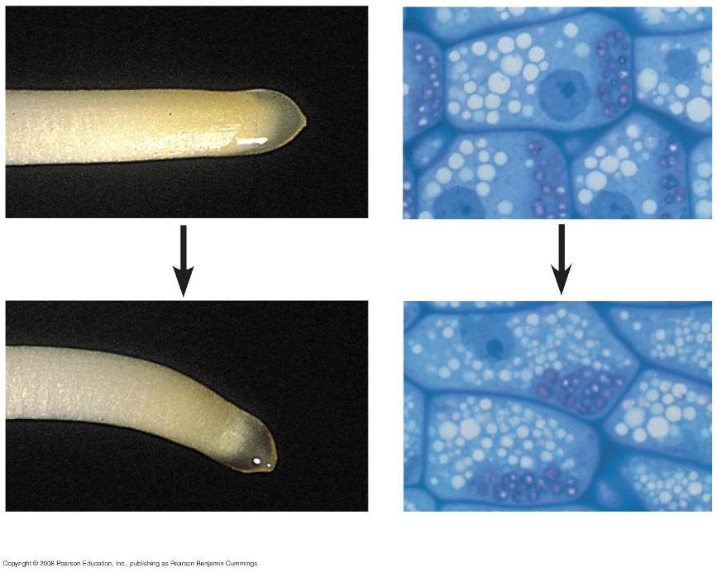
Statoliths
20 µm
(a) Root gravitropic bending
(b) Statoliths settling
Notes:
Figure 39.24 Positive gravitropism in roots: the statolith hypothesis

Slide 55
Mechanical Stimuli
The term thigmomorphogenesis refers to changes in form that result from mechanical disturbance
Rubbing stems of young plants a couple of times daily results in plants that are shorter than controls

Slide 56
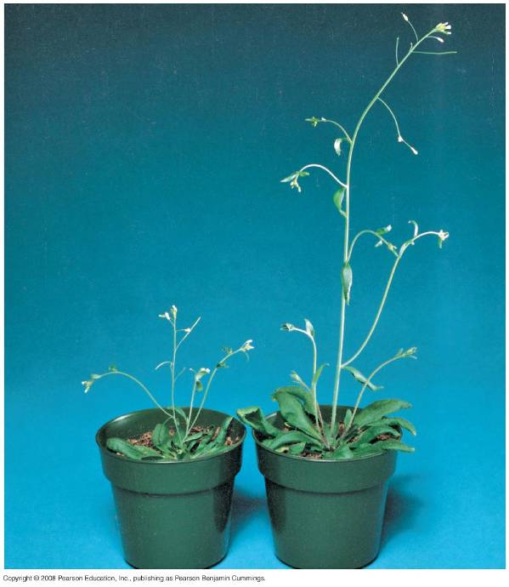
Notes:
Figure 39.25 Altering gene expression by touch in Arabidopsis

Slide 57
Thigmotropism is growth in response to touch
It occurs in vines and other climbing plants
Rapid leaf movements in response to mechanical stimulation are examples of transmission of electrical impulses called action potentials

Slide 58
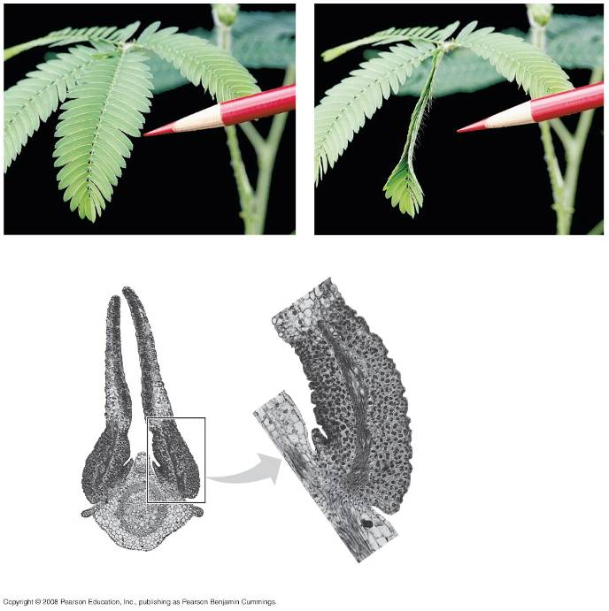
(a) Unstimulated state
(b) Stimulated state
Side of pulvinus with
flaccid cells
Leaflets
after
stimulation
Side of pulvinus with
turgid cells
Pulvinus
(motor
organ)
Vein
0.5 µm
(c) Cross section of a leaflet pair in the stimulated state (LM)
Notes:
Figure 39.26 Rapid turgor movements by the sensitive plant (Mimosa pudica)

Slide 59
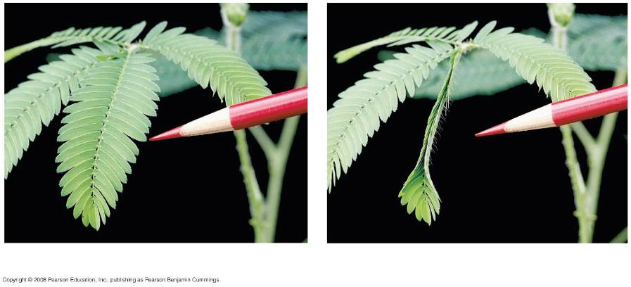
(a) Unstimulated state
(b) Stimulated state
Notes:
Figure 39.26 Rapid turgor movements by the sensitive plant (Mimosa pudica)

Slide 60
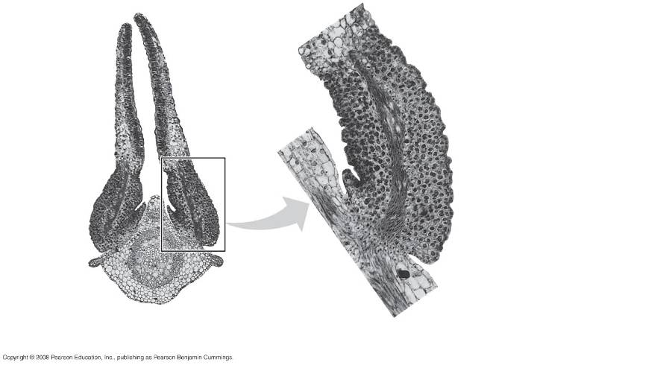
Side of pulvinus with
flaccid cells
Leaflets
after
stimulation
Side of pulvinus with
turgid cells
Pulvinus
(motor
organ)
Vein
0.5 µm
(c) Cross section of a leaflet pair in the stimulated state (LM)
Notes:
Figure 39.26 Rapid turgor movements by the sensitive plant (Mimosa pudica)

Slide 61
Environmental Stresses
Environmental stresses have a potentially adverse effect on survival, growth, and reproduction
Stresses can be abiotic (nonliving) or biotic (living)
Abiotic stresses include drought, flooding, salt stress, heat stress, and cold stress

Slide 62
Drought and Flooding
During drought, plants reduce transpiration by closing stomata, slowing leaf growth, and reducing exposed surface area
Growth of shallow roots is inhibited, while deeper roots continue to grow
Enzymatic destruction of root cortex cells creates air tubes that help plants survive oxygen deprivation during flooding

Slide 63
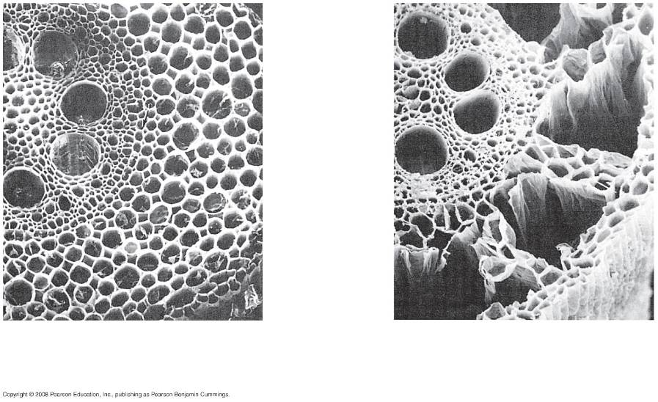
Vascular
cylinder
Air tubes
Epidermis
100 µm
100 µm
(a) Control root (aerated)
(b) Experimental root (nonaerated)
Notes:
Figure 39.27 A developmental response of maize roots to flooding and oxygen deprivation

Slide 64
Salt Stress
Salt can lower the water potential of the soil solution and reduce water uptake
Plants respond to salt stress by producing solutes tolerated at high concentrations
This process keeps the water potential of cells more negative than that of the soil solution

Slide 65
Heat and Cold Stress
Excessive heat can denature a plant’s enzymes
Heat-shock proteins help protect other proteins from heat stress
Cold temperatures decrease membrane fluidity
Altering lipid composition of membranes is a response to cold stress
Freezing causes ice to form in a plant’s cell walls and intercellular spaces

Slide 66
Defenses Against Herbivores
Herbivory, animals eating plants, is a stress that plants face in any ecosystem
Plants counter excessive herbivory with physical defenses such as thorns and chemical defenses such as distasteful or toxic compounds
Some plants even “recruit” predatory animals that help defend against specific herbivores

Slide 67
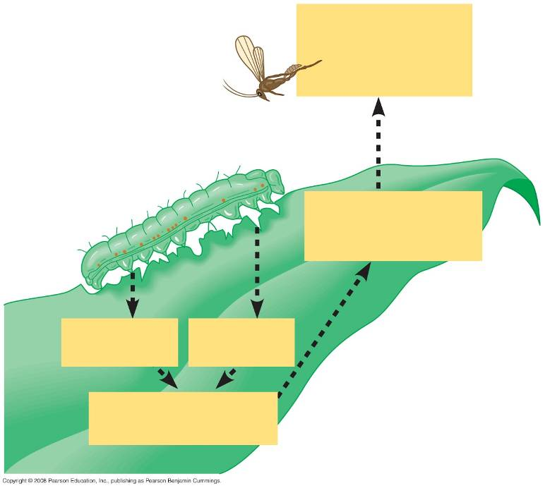
4
Recruitment of
parasitoid wasps
that lay their eggs
within caterpillars
3
Synthesis and
release of
volatile attractants
1
Wounding
Chemical
in saliva
1
2
Signal transduction
pathway
Notes:
Figure 39.28 A maize leaf “recruiting” a parasitoid wasp as a defensive response to an armyworm caterpillar, an herbivore

Slide 68
Plants damaged by insects can release volatile chemicals to warn other plants of the same species
Methyljasmonic acid can activate the expression of genes involved in plant defenses

Slide 69
Defenses Against Pathogens
A plant’s first line of defense against infection is the epidermis and periderm
If a pathogen penetrates the dermal tissue, the second line of defense is a chemical attack that kills the pathogen and prevents its spread
This second defense system is enhanced by the inherited ability to recognize certain pathogens

Slide 70
A virulent pathogen is one that a plant has little specific defense against
An avirulent pathogen is one that may harm but does not kill the host plant

Slide 71
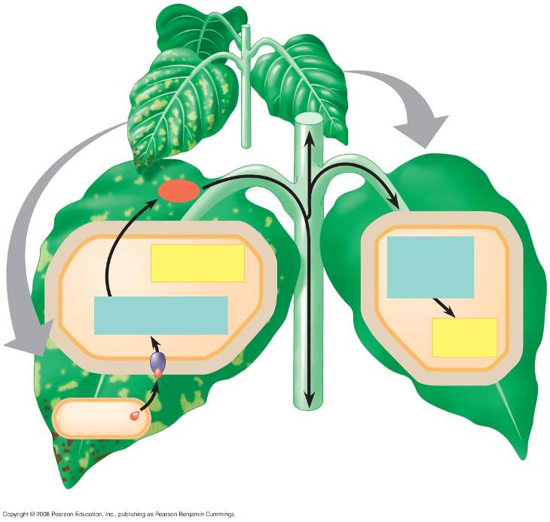
Signal
Hypersensitive
response
Signal
transduction
pathway
Signal transduction
pathway
Acquired
resistance
Avirulent
pathogen
R-Avr recognition and
hypersensitive response
Systemic acquired
resistance
Notes:
Figure 39.29 Defense responses against an avirulent pathogen

Slide 72
Systemic Acquired Resistance
Systemic acquired resistance causes systemic expression of defense genes and is a long-lasting response
Salicylic acid is synthesized around the infection site and is likely the signal that triggers systemic acquired resistance

Slide 73
Animations and Videos
Tropisms
Auxin Affects Cell Wall
Went's Experiment
The Effect of Interrupted Day and Night
Phytochrome Signaling
Bozeman - Phototropism and Photoperiodism
Signaling Between Plants and Pathogens
Chapter Quiz Questions -1
Chapter Quiz Questions – 2

