Slide 2
Why do Organisms need Skeletons?
enable organisms to support and carry weight of their bodies and that structure involved in vertebrates is skeleton
aquatic animals receive some lift from surrounding water called buoyancy

Slide 3
support is more important to terrestrial animals since they are under the influence of gravity, without support, they will collapse
ALL vertebrates have an endoskeleton which means their bones are inside the body
the bones form a supporting framework which offers a firm base for muscle attachment

Slide 4
Skeletal Tissues
endoskeleton of mammal is made up of bones and cartilage
bone cells
Structure of Bone
consist of living cells surrounded by non-living mineral materials which are mainly calcium phosphate and carbonate, organic matter and water
transverse section of compact bones

Slide 5
cartilage
blood vessels and nerves run through bone tissue to supply oxygen and food for bones to develop and grow
outer part of a bone is compact bone which is hard and dense and consists of calcium phosphate and carbonate
spongy bone containing red bone marrow
compact bone
cavity containing yellow bone marrow

Slide 6
both ends are filled with loose spongy bone which contains many small cavities filled with red bone marrow
red blood cells and white blood cells are made in red bone marrow
inner part of bone is a central cavity which is hollow and filled with yellow bone marrow
yellow bone marrow is a kind of fatty tissue

Slide 7
Investigation13.1
To find out How the Chemical Components of Bone Affects its Properties

Slide 8
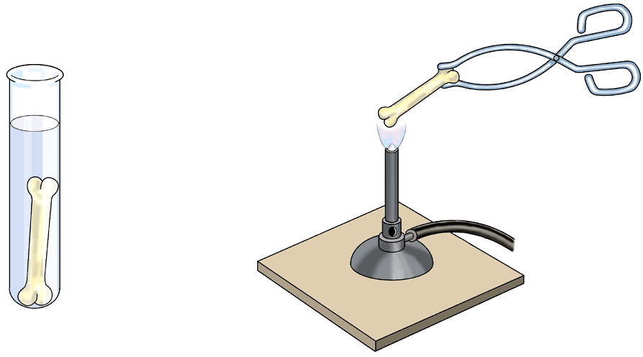
dilute hydrochloric acid
chicken bone
Can you bend the bone after acid treatment ?
Ans: Yes.

Slide 9
dilute hydrochloric acid
chicken bone
What effect does the acid have on the bone ?
Ans: It dissolves away calcium salt, cause bone to lose its strength and rigidity.

Slide 10
dilute hydrochloric acid
chicken bone
What is the purpose of heating the bone in a strong Bunsen flame ?
Ans: It is used to burn away the organic substance of bone.

Slide 11
dilute hydrochloric acid
chicken bone
Describe the nature of bone after strong heating.
Ans: The bone becomes brittle.

Slide 12
Structure of Cartilage
cartilage is the main substance supporting animal body during the embryonic stage
cartilage will generally replaced by bones as animals grow
all composed of living cells so it is able to grow and repair
softer than bone and found on two ends of bones
structure of cartilage

Slide 13
Functions of Cartilage
cushion-like and acts as a shock-absorber
reduces friction between two bones during movement
prevent wearing of bones
cartilage are also found in cartilage in the pinna of ears and in the end of nose to give shape of the organs

Slide 14
General Plan of Mammalian Skeleton
skeleton of a mammal is divided into two main parts:
Axial Skeleton:
- lies in the centre of the body
- include skull, vertebral column, ribs and sternum

Slide 15
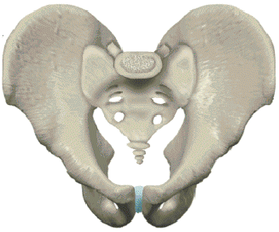
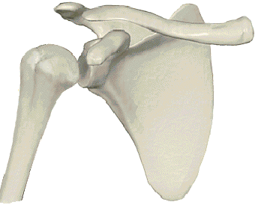
Appendicular Skeleton:
- lies on either side of the body
- include pectoral girdles, pelvic girdles and limb bones
pelvic girdle
pectoral girdle

Slide 16
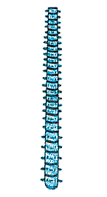
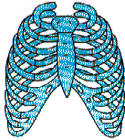
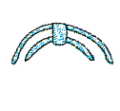
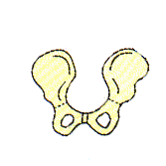
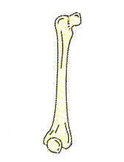
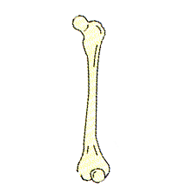
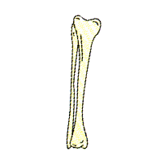
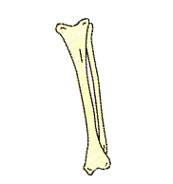
Two parts of Skeleton
Axial skeleton
Appendicular skeleton
pectoral girdle
skull
pectoral limb
(arm)
ribs
pelvic girdle
sternum
pelvic limb
(leg)
vertebral column

Slide 17
Functions of Skeleton
Support and Maintenance of Body Shape
skeleton holds body upright and gives animal shape and form
provide a framework for tissues and organs

Slide 18
Attachment of Muscles for Movement
muscles are attached across joints to bone surfaces
with alternate contraction and relaxation of muscles, body can move
Protection of Internal Organs
lungs and heart are protected by rib cage
spinal cord is protected by vertebral column

Slide 19
Production of Blood Cells
red blood cells and white blood cells are made by red bone marrow of certain long bones
Storage
yellow marrow stores fat
compact bone tissue stores calcium and phosphorus

Slide 20
Joints
joint is formed wherever two or more bones meet
two types of joints: immovable and movable joints
movable joints which allow a lot of movement is synovial joints examples of synovial joints: elbow joint and shoulder joint

Slide 21
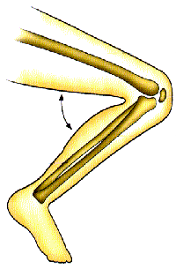
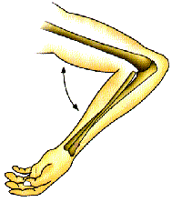
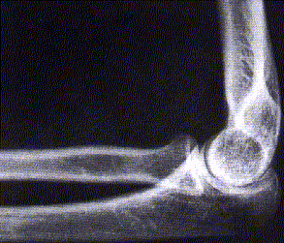
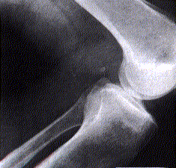
Joints - Hinge Joint
movement in one plane only
found at knee and elbow
elbow joint
knee joint

Slide 22
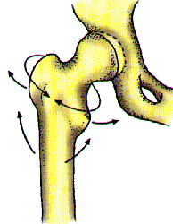
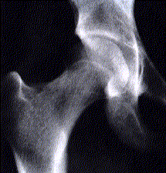
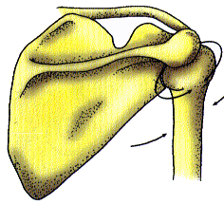
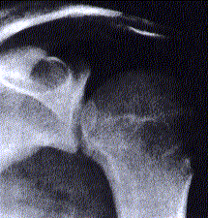
Joints - Ball and Socket Joint
allow movement in three planes and in all directions
found at shoulder and hip
hip joint
shoulder joint

Slide 23
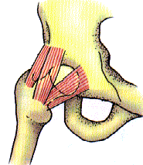
Ligament
fibrous tissue found at movable joint to hold bones together
tough and strong
prevent dislocation of joint during movement
ligament
pelvic girdle
femur

Slide 24
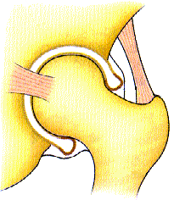
Structure of Synovial Joint
beneath ligament is synovial membrane which secretes synovial fluid into synovial cavity
synovial fluid serves as lubricant so movement of bones are friction-free
synovial fluid
ligaments
synovial membrane
cartilage
femur

Slide 25
ends of bones are covered with articular cartilage
it is softer and can act as shock-absorber to protect bones at the joint
it is also used to minimize friction between bones and to ensure bone surfaces will not be worn away when bones move against one another

Slide 26
Muscles
muscles are attached to bone surface
bones in mammals are joined to form a lever system
force in a lever comes from muscle contraction which energy results from respiration but energy does not require when muscle relaxes

Slide 27
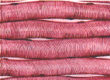
skeletal muscle:
- muscles attached to bone surface
- voluntary, under conscious control
- gives powerful contraction and become thicker and shorter so movement of bones results
skeletal muscle

Slide 28
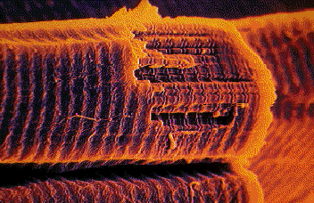
- fatigue results when it contracts too long, as lactic acid accumulated in muscle cells due to anaerobic respiration
skeletal muscle
muscle contract
keep posture
muscle tone
body in fixed position

Slide 29
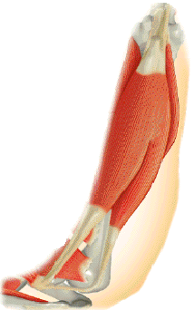
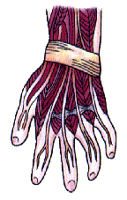
Muscles and Skeleton
muscles are attached to skeleton by tendon
tendons are tough connective tissue, collagen
muscle
tendons

Slide 30
begins inside bone and penetrates deep into muscle
cannot stretch
insertion is the end of muscle attached to a movable bone during muscle contraction while origin is the end attached to a fixed bone during muscle contraction

Slide 31
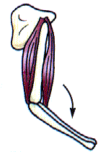
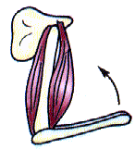
How is movement achieved? Movement of Forearm
triceps contracts
biceps and triceps are involved
forearm bends when biceps contracts and triceps relaxes and it straightens when their roles exchanged
biceps relaxes
limb straightens
triceps relaxes
biceps contracts
limb bends

Slide 32
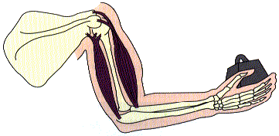
How is movement achieved?
Biceps and triceps are antagonistic muscles involved in the movement of the forearm. They work in pairs and in opposing directions.

Slide 33
members in antagonistic pair are flexor and extensor
flexor contracts to bend the limb while extensor straightens the limb when it contracts

Slide 34
biceps attach to its origin and insertion by two tendons while triceps attach to origin and insertion with three tendons
contraction of biceps together with relaxation of triceps make forearm to move close to upper arm and vice versa for straightening of the limb

Slide 35
Investigation13.4
To show the Action of Opposing Muscles by using a Model of the Forelimb

Slide 36
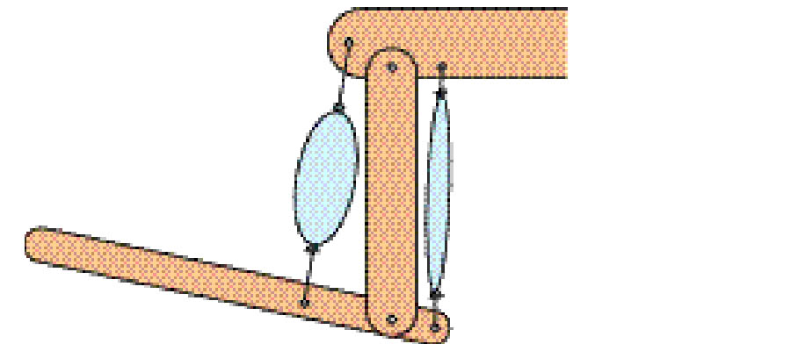
wood X
nail
string tying balloons to a nail
balloon B
balloon A
wood Y
screw allowing movement of wood Z
wood Z
What parts of the forelimb are represented by the two balloons, the screw between woods Y and Z and the wood?
Ans: The two balloons, the screw between woods Y and Z and the wood represent triceps and biceps, elbow joint and bones respectively.

Slide 37
wood X
nail
string tying balloons to a nail
balloon B
balloon A
wood Y
screw allowing movement of wood Z
wood Z
Which balloon represents the biceps? Which represents the triceps?
Ans: Balloon A represent triceps while balloon B represents biceps.

Slide 38
wood X
nail
string tying balloons to a nail
balloon B
balloon A
wood Y
screw allowing movement of wood Z
wood Z
What happens to biceps and triceps as the forearm is bent?
Ans: As forearm is bent, biceps contracts and becomes shorter and fatter and triceps relaxes and becomes longer and thinner.

Slide 39
Lever
lever is a bar which is turned about a fixed point which is called fulcrum
on one side of fulcrum is load and effort is applied on the other side. Force is transmitted along lever to the load
e.g. elbow joint

Slide 40
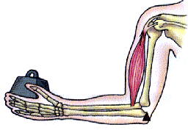
contraction of biceps (effort)
E
elbow joint
(fulcrum)
L
hand (load)
F
third order lever system
Hinge joints act as the fulcrum
Lower arm and hand act as load
Contraction of biceps creates the effort to lift up the arm and bends elbow

Slide 41
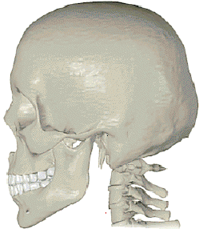
Other Types of Lever System in our Body
E
Standing on tiptoes
Second order
lever system
L
F
Nodding of head
L
first order
lever system
F
E

Slide 42
Importance of Support in Plants
display leaves in the best position to absorb enough light for photosynthesis
lift flowers to higher positions so fruits and seeds can be dispersed over a wide area. This helps species to propagate to new area

Slide 43
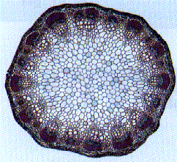
Support
mainly provided by turgidity of cells and rigidity of xylem
Turgidity of Cells
thin walled cells
mainly support young plants and non-woody parts of a dicotyledonous plant which the cells are thin-walled

Slide 44
thin-walled cells absorb water by osmosis and become turgid
turgid cells then press against each other and keep the whole stem upright
if cells lose water and become flaccid, plant will wilt and becomes soft and droopy

Slide 45
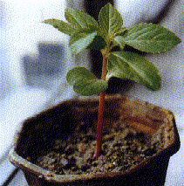
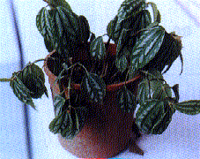
on hot days, when transpiration proceeds faster than water absorption
In this case, transpiration is faster than absorption of water
wilting occurs

Slide 46
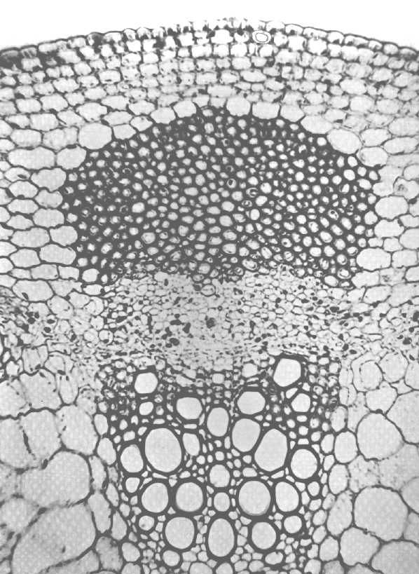
Rigidity of Xylem
When dicotyledonous plant grows older, more secondary xylem tissue formed by vascular cambium, plant becomes woody
xylem vessels

Slide 47
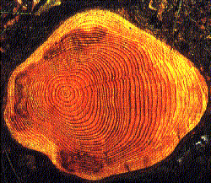
xylem vessels support plant mechanically as they have thick walls containing lignin
lignified cells give strength and rigidity to plant

Slide 48
~ END ~

