Slide 1
Support, Protection, and Movement
Chapter 29

Slide 2
Integument
The integument is the protective outer covering of the body.
  Includes the skin and structures associated with the skin such as hair, setae, scales, feathers, and horns.

Slide 3
Invertebrate Integument
Many invertebrates have a single-layered epidermis covering the body.
Others have added a secreted noncellular cuticle over the epidermis.
  Additional protection

Slide 4
Invertebrate Integument
Molluscs have a delicate epidermis.
  Protection is provided by the shell.
  Cephalopods have a more complex epidermis with a cuticle, simple epidermis, layer of connective tissue, & a layer of iridocytes.

Slide 5
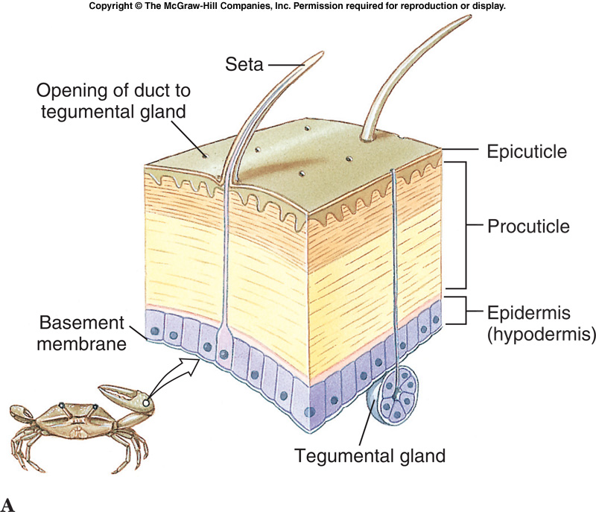
Invertebrate Integument
Arthropods have a complex integument that provides protection and skeletal support.
  Single layered epidermis (hypodermis) which secretes a complex cuticle.
    Procuticle – layers of chitin and protein.
    Epicuticle – moisture proofing barrier.

Slide 6
Invertebrate Integument
The arthropod cuticle may remain tough, but flexible as in many small crustaceans and insect larvae, or it may become hardened.
  Decapod crustaceans have a cuticle stiffened by calcification (deposition of calcium carbonate in the procuticle.
  In insects, hardening occurs by sclerotization where protein molecules bond together producing the insoluble protein sclerotin.

Slide 7
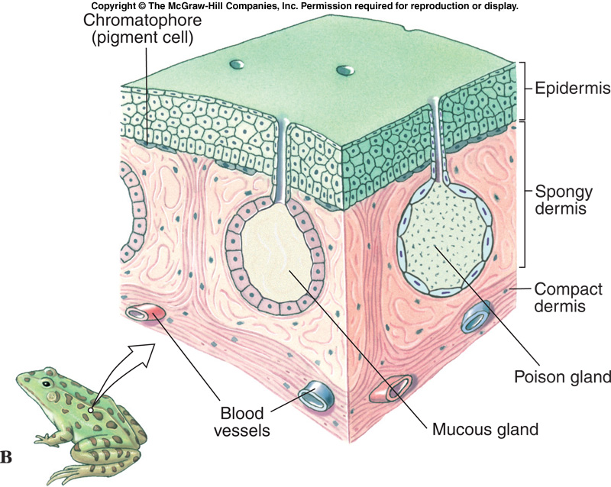
Vertebrate Integument
Vertebrate Integument includes:
  Epidermis – thin outer stratified epithelial layer, derived from ectoderm.
  Dermis – thick inner layer, derived from mesoderm.

Slide 8
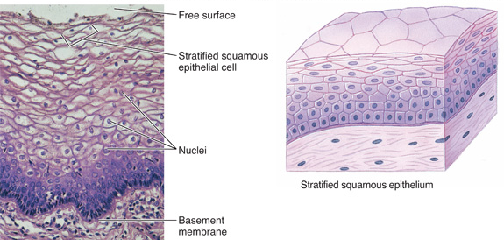
Epidermis
The epidermis gives rise to hair, feathers, claws, and hooves.
Epidermis is stratified squamous epithelium.
Cells in the basal part undergo frequent mitosis.
As cells are displaced upward, cytoplasm is replaced by keratin.

Slide 9
Epidermis
Keratin is a tough protein that is also light and flexible.
Reptile scales are composed of keratin.
Birds have keratin in feathers, beaks, and claws.
Mammals use keratin in hair, hooves, claws, and nails.

Slide 10
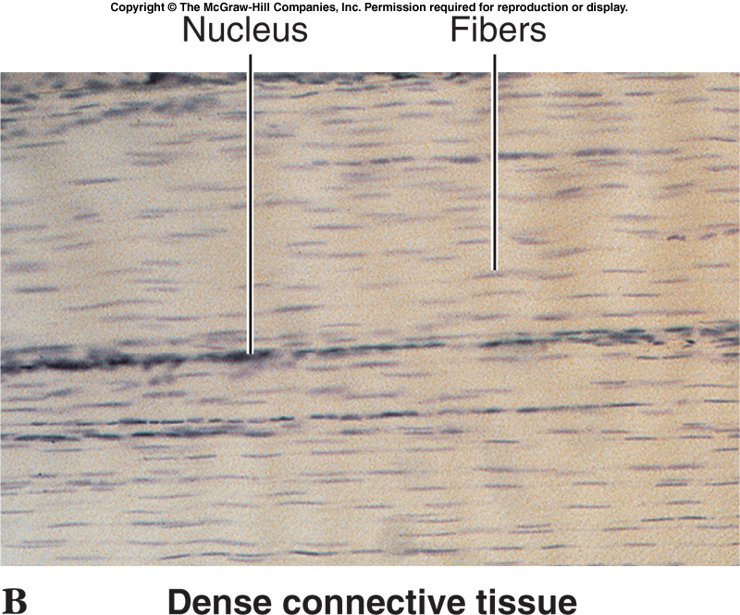
Dermis
The dermis is a dense connective tissue layer containing blood vessels, collagenous fibers, nerves, pigment cells, fat cells, and fibroblasts.
Dermis serves to support, nourish, and cushion the epidermis.

Slide 11
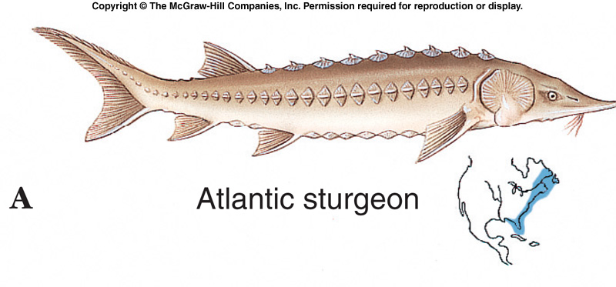
Dermis
The dermis may contain bony structures of dermal origin.
Ostracoderms and placoderms had heavy bony plates.
  Living sturgeons

Slide 12
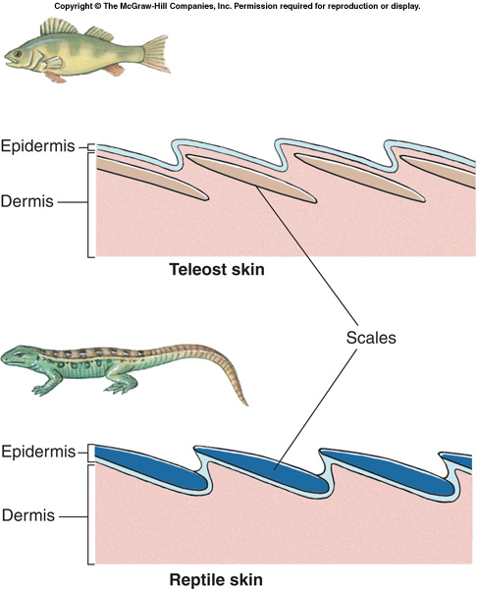
Dermis
Scales of fishes are bony dermal structures that evolved from the armor of Paleozoic fishes.

Slide 13
Dermis
In reptiles, dermal bone contributes to the armor of crocodilians, the beaded skin of some lizards, and portions of a turtle’s shell.
Dermal bone is found in the antlers of mammals.

Slide 14
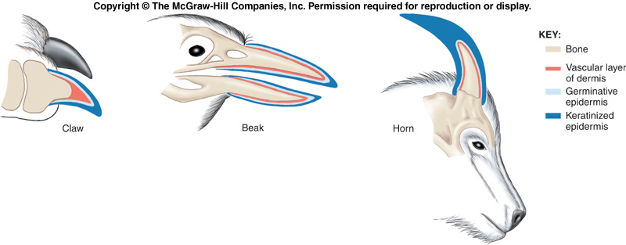
Dermis
Claws, beaks, nails, and horns are composed of a combination of epidermal (keratinized) and dermal components.

Slide 15
Animal Coloration
Coloration in animals may be bright as in warning coloration, or subdued as in cryptic coloration.
Colors may be produced by pigments or structurally.

Slide 16
Animal Coloration
Structural colors are produced by the physical structure of the surface tissue which reflects certain light wavelengths and eliminates others.
  Iridescent or metallic hues
  Blue

Slide 17
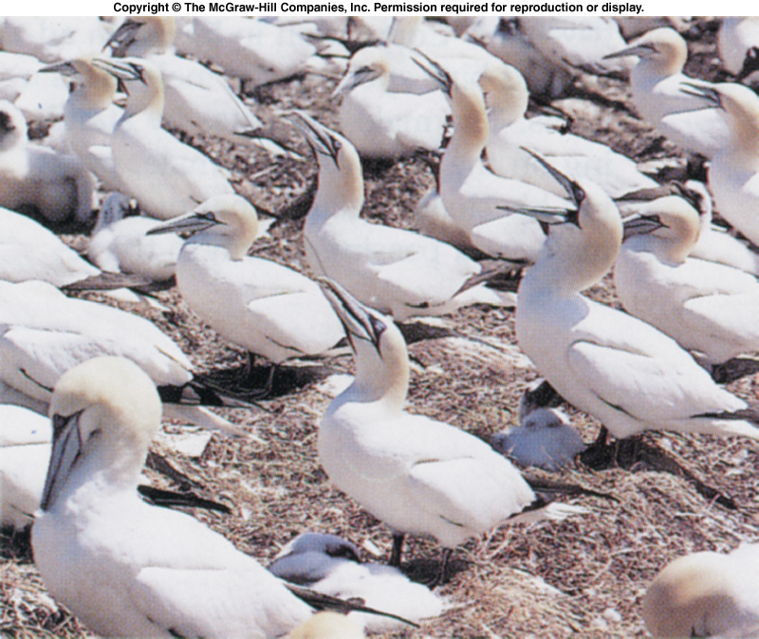
Animal Coloration
The white of these feathers is produced by minute air filled spaces that reflect white light.

Slide 18
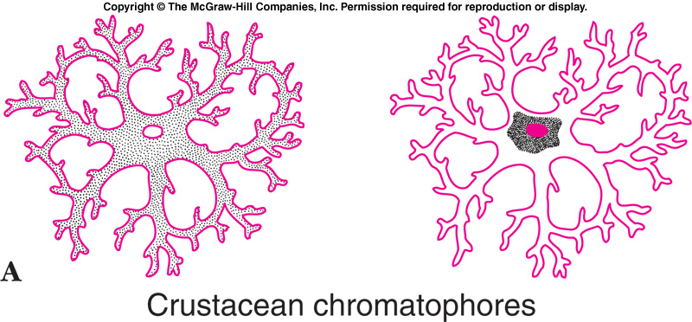
Animal Coloration
Pigments are a varied group of large molecules that reflect light rays producing a particular color.
Most ectothermic invertebrates have chromatophores with branching processes.
  Pigment granules can be dispersed or concentrated.

Slide 19
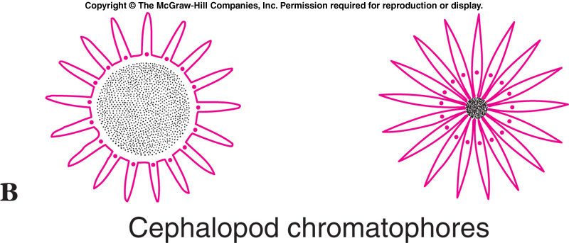
Animal Coloration
In cephalopods, each chromatophore is a sac-like cell filled with pigment granules and surrounded by muscle cells.
  When the muscles contract, they spread the granules into a pigmented sheet.

Slide 20
Animal Coloration
Melanins produce black & brown, contained in melanophores.
Carotenoid pigments produce yellow and red colors.
  Frequently contained in special pigment cells called xanthophores.
Iridophores are a type of chromatophore that contain crystals of guanine instead of pigment.
  Silvery or metallic

Slide 21
Skeletal Systems
Skeletons are supportive systems that provide protection, support, and a place for muscle attachment.

Slide 22
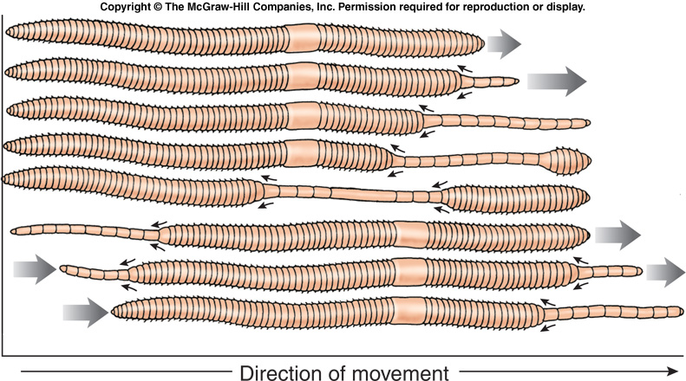
Hydrostatic Skeletons
In the hydrostatic skeleton of an earthworm, muscles in the body wall develop force by contracting against incompressible coelomic fluids.
Alternate contractions of circular and longitudinal muscles of the body wall enable a worm to move forward.

Slide 23
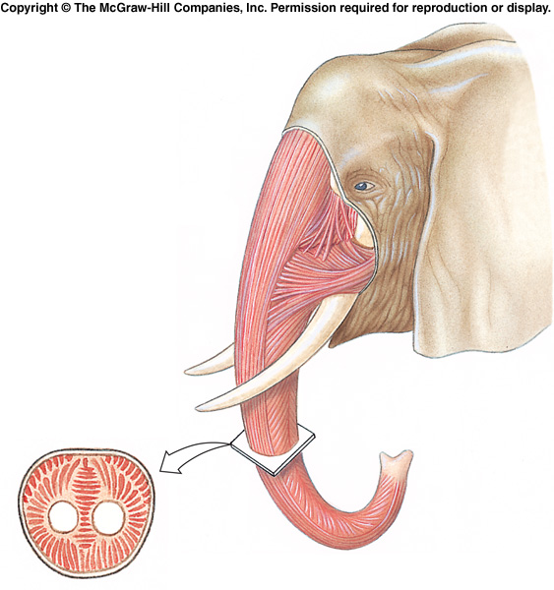
Muscular Hydrostats
Muscular hydrostats work because they are composed of incompressible tissues.
Complex movements are a result of complex arrangements of muscles.
Elephant’s trunk, mammal & reptile tongues, cephalopod tentacles are examples.

Slide 24
Rigid Skeletons
Rigid skeletons contain some kind of rigid elements.
  Provide anchor points for pairs of opposing muscles.
  Provides protection & support
  Exoskeleton – found in molluscs & arthropods and some other invertebrates.
  Endoskeleton – found in echinoderms, chordates, and some cnidarians.

Slide 25
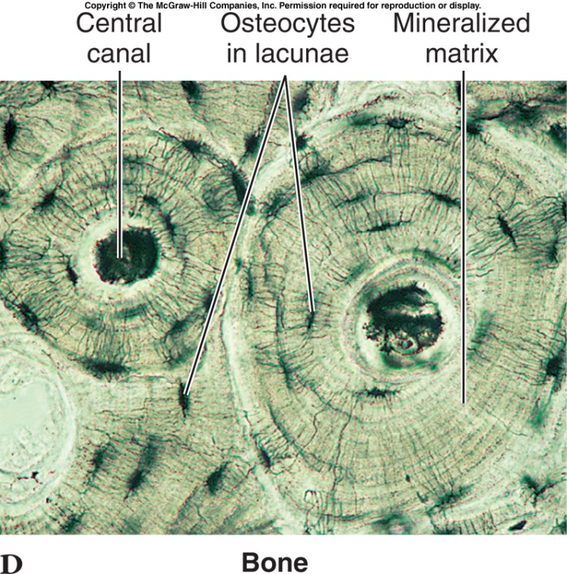
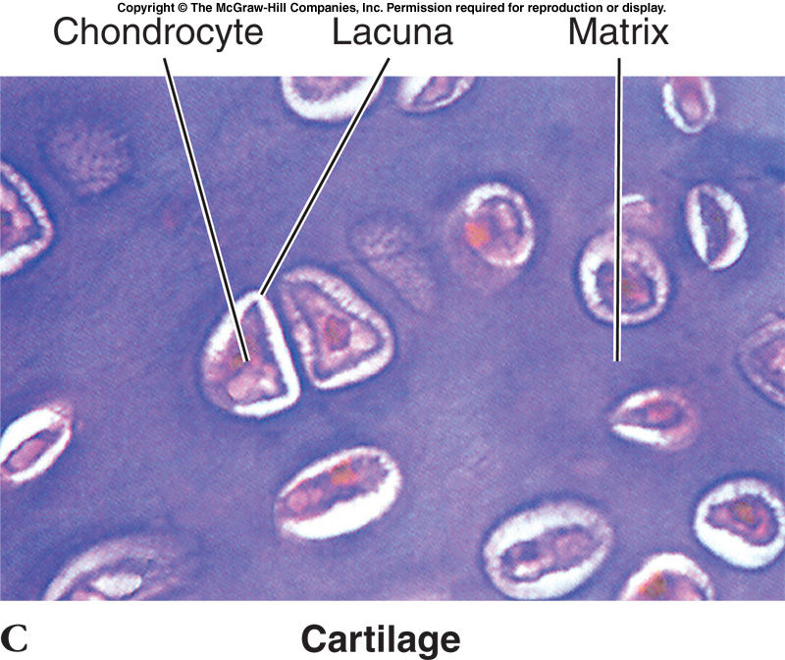
Vertebrate Endoskeleton
The vertebrate endoskeleton is composed of bone and cartilage (types of connective tissue).
Bone provides support, protection, and serves as a reservoir for calcium and phosphorous.

Slide 26
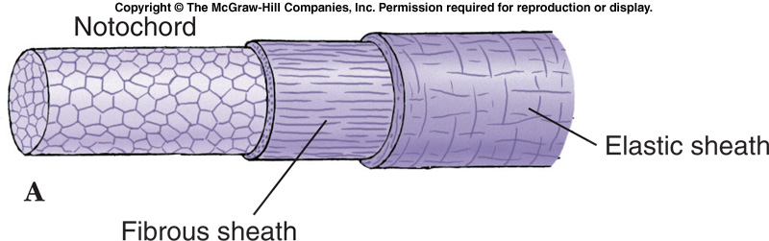
Notochord and Cartilage
The notochord is a supportive rod found in protochordates and developing vertebrates.
  Derived from mesoderm.
  Except in jawless vertebrates, the notochord is replaced by the backbone.

Slide 27
Notochord and Cartilage
Jawless fishes and elasmobranchs have cartilaginous skeletons – a derived feature since their ancestors had bony skeletons.
Most vertebrates have bony skeletons, with some cartilaginous parts.

Slide 28
Notochord and Cartilage
Cartilage is a soft, pliable tissue that resists compression and is variable in form.
Hyaline cartilage has a clear, glassy appearance with chondrocytes surrounded by a matrix.
  No blood vessels.

Slide 29
Notochord and Cartilage
Cartilage is often found at articulating surfaces of many bone joints, and as supporting rings of the passageways in the respiratory system.

Slide 30
Notochord and Cartilage
Cartilage similar to hyaline cartilage is found in many invertebrates.
  Radula of gastropods
  Lophophore of brachiopods

Slide 31
Bone
Bone is highly vascular living tissue that contains significant deposits of inorganic calcium salts.
  Endochondral (replacement) bone develops from another form of connective tissue – usually cartilage.
  Intramembranous bone develops directly from sheets of embryonic cells.
    Face, cranium, clavicle, dermal bone.

Slide 32
Bone
Bone can vary in density.
  Spongy bone consists of open, interlacing framework of bony tissue, oriented to give strength.
  Compact bone is dense – the open framework of spongy bone has been filled in by additional calcium salts.

Slide 33
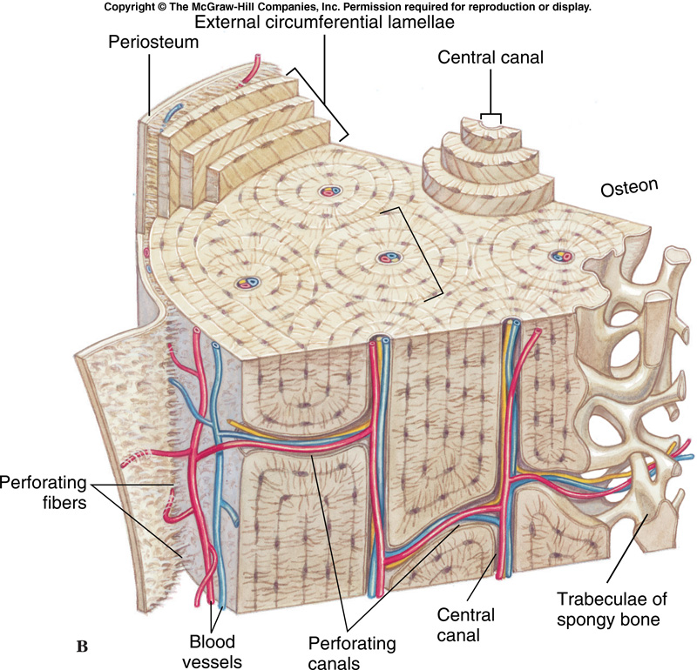
Bone
Compact bone is composed of a calcified bone matrix arranged in sets of concentric rings - osteons.
  Bones consist of bundles of osteons interconnected with blood vessels and nerves.

Slide 34
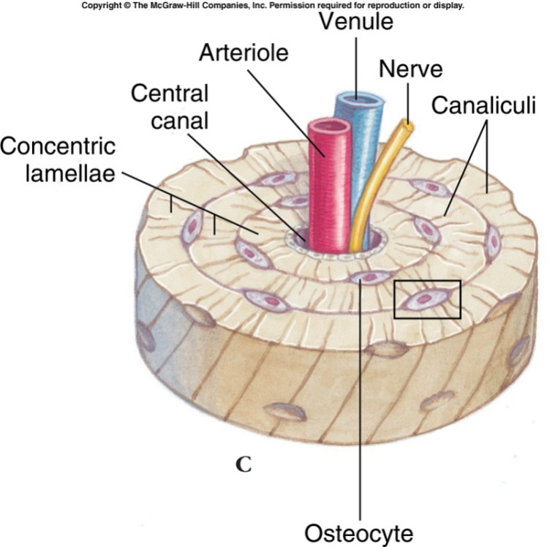
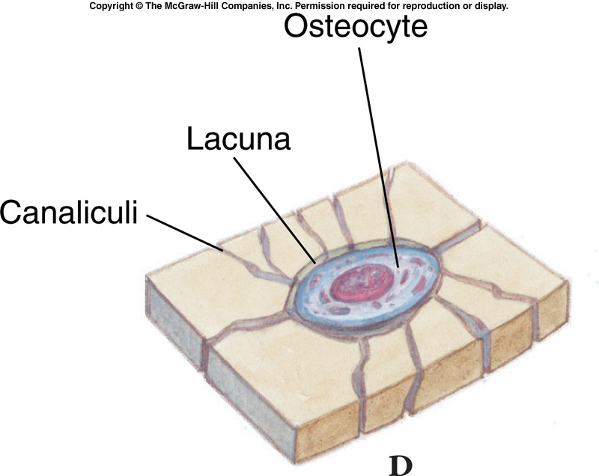
Bone
Between the rings are lacunae (cavities) filled with osteocytes (bone cells) connected by tiny passageways that distribute nutrients.

Slide 35
Bone – Dynamic Tissue
Bone is a dynamic tissue.
  Osteoclasts are bone resorbing cells.
  Osteoblasts are bone building cells.
Both processes occur together so that new osteons are formed as old ones are resorbed.

Slide 36
Bone – Dynamic Tissue
Hormones (parathyroid hormone for resorption and calcitonin for deposition) are responsible for maintaining a constant calcium level in the blood.

Slide 37
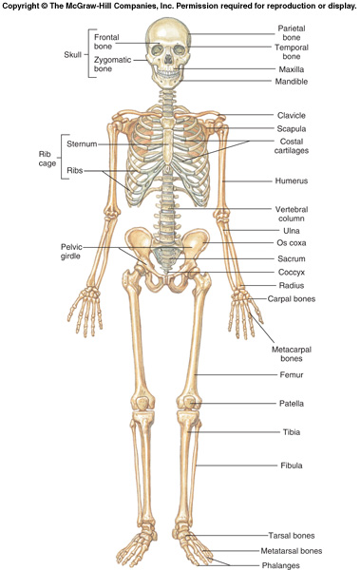
Vertebrate Skeleton
Axial skeleton includes the skull, vertebral column, ribs, and sternum.
Appendicular skeleton includes the limbs and pectoral and pelvic girdles.

Slide 38
Vertebrate Skeleton
Over time, the number of skull bones has been reduced from as many as 180 in some early fishes to 35 or fewer in mammals.

Slide 39
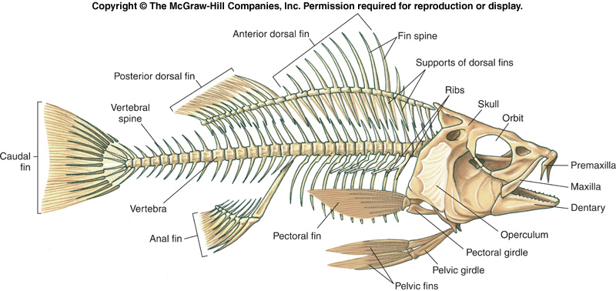
Vertebrate Skeleton
The vertebral column serves as the main stiffening axis.
  In fishes it provides points for muscle attachment, provides stiffness, and preserves body shape during muscle contraction – much like the notochord from which it is derived.

Slide 40
Vertebrate Skeleton
Most vertebrates have paired appendages.
  Pectoral and pelvic fins in fishes supported by the pectoral and pelvic girdles.
  Tetrapods have two pairs of pentadactyl limbs (although they may be highly modified through bone loss or fusion).
  The pelvic girdle is generally firmly attached to the axial skeleton, while the pectoral girdle is more loosely attached.

Slide 41
Animal Movement
Most animal movement depends on contractile proteins which can change their shape to relax or contract.
  These fibrils will contract when powered by ATP.
  Actin and myosin form a contractile system found in most animals.
  Cilia and flagella utilize different proteins.

Slide 42
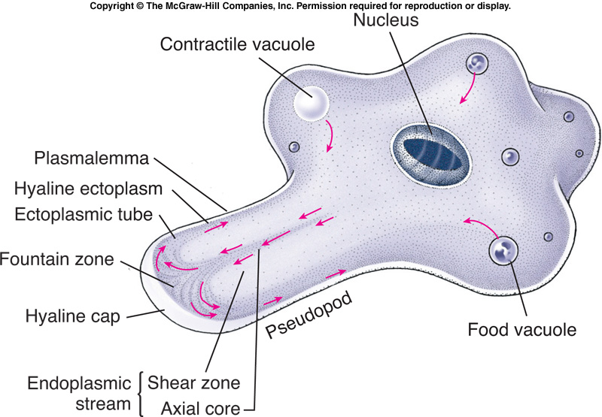
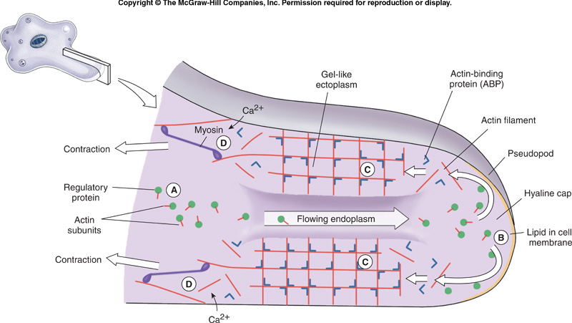
Ameboid Movement
Ameboid movement is found in amebas, white blood cells, and embryonic cells.
Movement using pseudopods depends on actin and myosin.

Slide 43
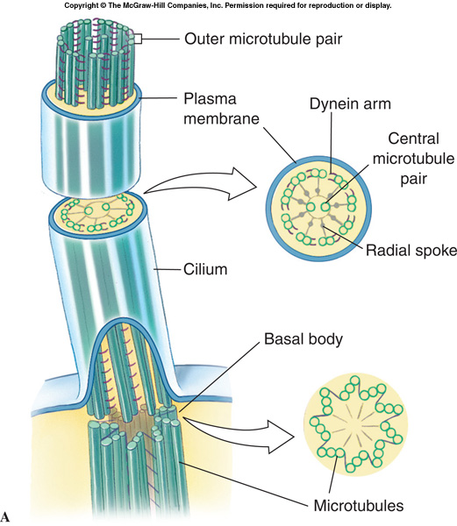
Ciliary and Flagellar Movement
Cilia are found throughout the animal kingdom (except in nematodes, rare in arthropods).
  Uniform in diameter (.2-.5 µm) and structure.
  Basal body similar to a centriole – 9 triplets of microtubules composed of the protein tubulin.
  Cilium has 9 pairs surrounding two individual microtubules.

Slide 44
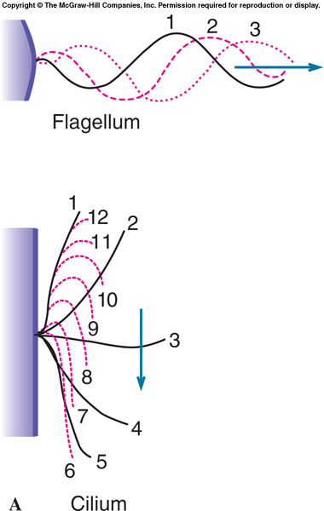
Ciliary and Flagellar Movement
A flagellum is a whiplike structure longer than a cilium and usually present singly.
Structure is the same.
Different beating pattern.

Slide 45
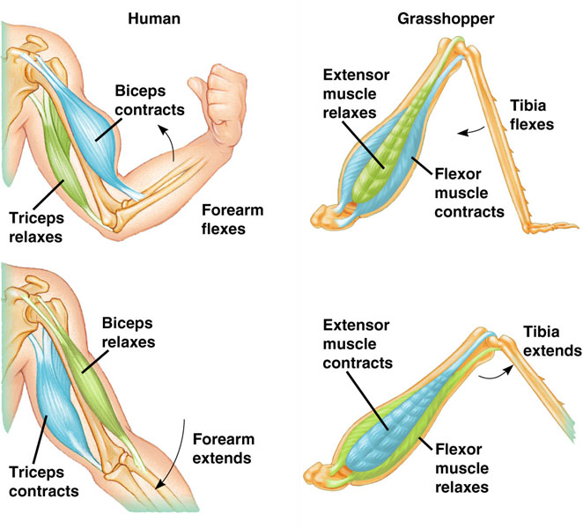
Muscular Movement
Muscle cells (fibers) can only do work by contraction.
  They can’t actively lengthen.
  They are often arranged in opposing pairs.
  Three types of muscle tissue.
    Skeletal
    Smooth
    Cardiac

Slide 46
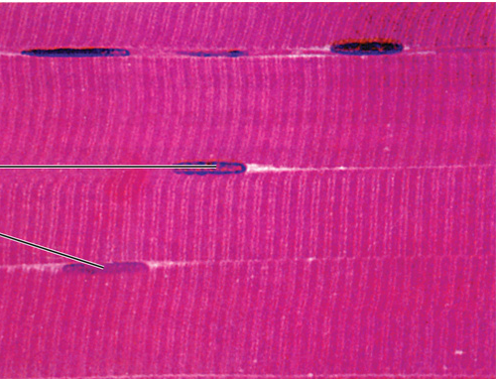
Skeletal Muscle
Skeletal, (striated) muscle appears to be striped.
Multinucleate fibers
Attached to skeletal elements.
Voluntary
Fast acting, but fatigues quickly.

Slide 47
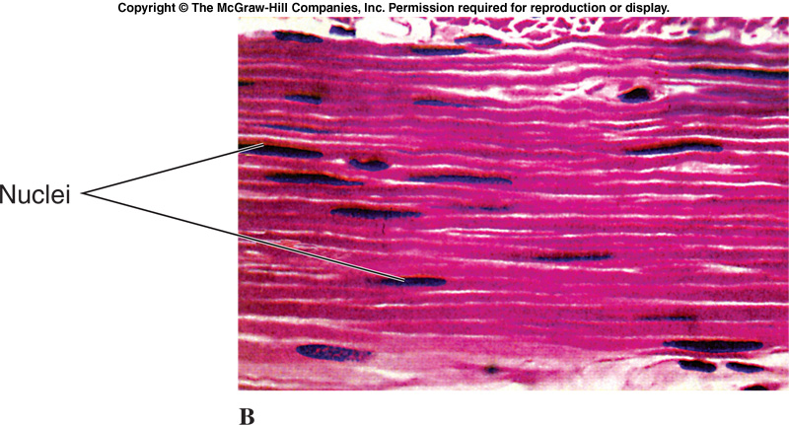
Smooth Muscle
Smooth muscle lacks striations.
Single nucleus
Involuntary
Slow acting, but can maintain prolonged contractions.
Muscles of the stomach, intestines, uterus are smooth muscle.

Slide 48
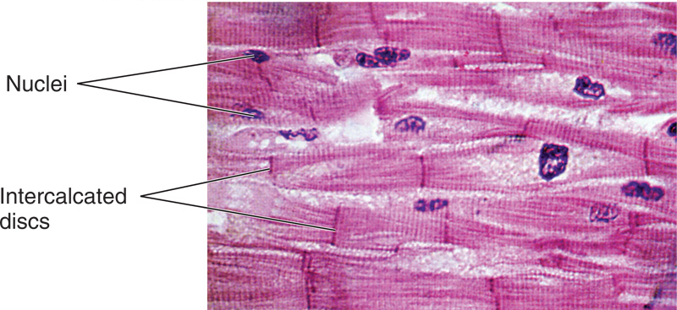
Cardiac Muscle
Cardiac muscle, found only in the heart, is striated and fast acting like skeletal muscle.
Involuntary, with one nucleus per fiber like smooth muscle.
Fibers are joined by junctional complexes called intercalated discs.

Slide 49
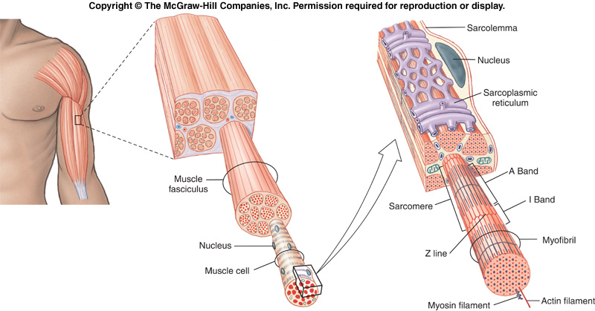
Muscles
A skeletal muscle consists of a bundle of long fibers running parallel to the length of the muscle.
A muscle fiber is itself a bundle of smaller myofibrils arranged longitudinally.

Slide 50
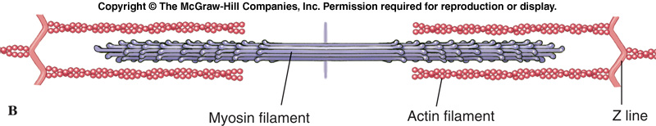
Muscles
The myofibrils are composed of two kinds of filaments:
  Thin filaments, consisting of two strands of actin and one strand of regulatory protein.
  Thick filaments, staggered arrays of myosin molecules.
  The functional unit of the myofibril is a sarcomere.

Slide 51
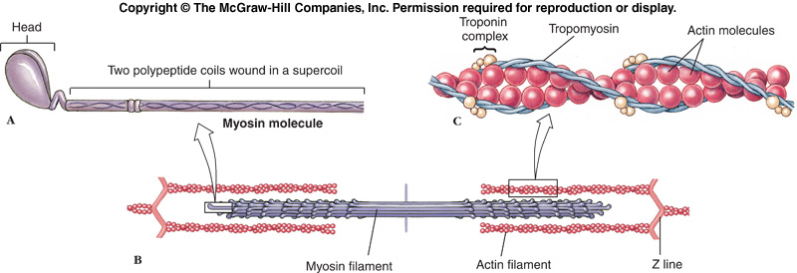
Muscles
Actin and myosin are contractile proteins.

Slide 52
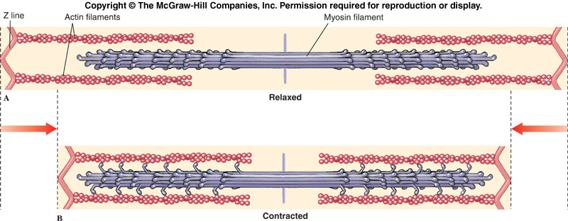
Muscle Contraction
Striated muscle contraction is explained by the sliding filament hypothesis.
Actin & myosin filaments become linked together by cross bridges (myosin heads), which act as levers to pull the filaments past each other.
Z-lines pulled closer together, sarcomere shortens.

Slide 53
Muscle Contraction
Muscles contract in response to nerve stimulation.
Skeletal muscles are innervated by motor neurons whose cell bodies are in the spinal cord.

Slide 54
Muscle Contraction
One motor neuron has many terminal branches that may innervate many muscle fibers.
A motor unit includes the motor neuron and all the fibers it innervates.

Slide 55
The Neuromuscular Junction
The place where a motor axon terminates on a muscle fiber is called the neuromuscular junction.
The synaptic cleft is a small gap that separates the nerve fiber & muscle fiber.
  Acetylcholine is stored in synaptic vesicles in the neuron.

Slide 56
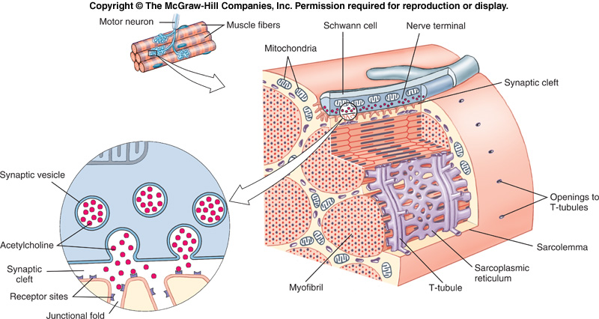
The Neuromuscular Junction
When a nerve impulse arrives, acetylcholine is released into the cleft starting a wave of depolarization in the muscle fiber.

Slide 57
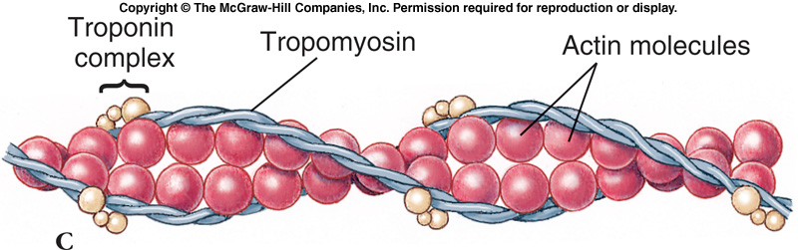
Excitation-Contraction Coupling
In the resting state, muscle shortening does not occur because thin tropomyosin strands on the actin myofilaments lie in a position that prevents the myosin heads from attaching to actin.

Slide 58
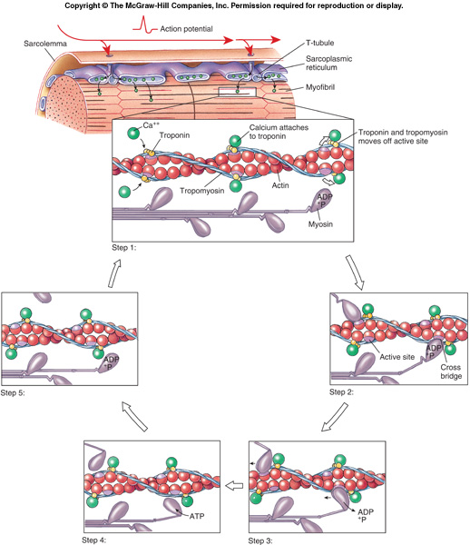
Excitation-Contraction Coupling
When the muscle is stimulated, calcium ions are released that bind to troponin.
  This causes a change in shape that causes the tropomyosin to move out of the way exposing binding sites on the actin molecule.

Slide 59

Energy for Contraction
Energy for muscle contraction comes from ATP.
  ATP is synthesized during aerobic metabolism.
http://www.youtube.com/watch?v=gJ309LfHQ3M

Slide 60
Energy for Contraction
During prolonged exercise, blood flow can’t supply oxygen fast enough for aerobic metabolism to continue.
  Anaerobic glycolysis is not as efficient, but still produces some ATP.
  An oxygen debt builds up because the accumulated lactic acid must be oxidized.

Slide 61
Fast and Slow Fibers
Skeletal muscles consist of different types of fibers.
  Slow oxidative fibers (red muscles) specialized for slow, sustained contractions.
    Maintaining posture
  Fast glycolytic fibers (white muscles) lack an efficient blood supply and function anaerobically.
    Running muscles in cats.
  Fast oxidative fibers have an efficient blood supply and function aerobically for fast, sustained activities.
    Wing muscles in migratory birds.

Slide 62
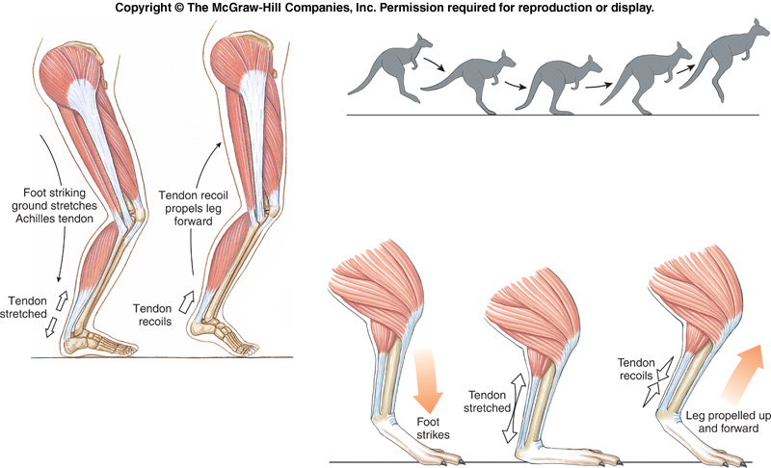
Importance of Tendons
When mammals walk, kinetic energy is stored in the tendons.
  The tendon stretches, then recoils extending the foot while the muscle is contracted, propelling the leg forward.

