Slide 1
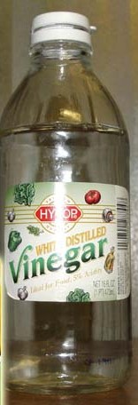

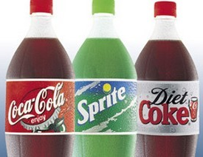
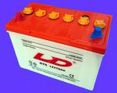
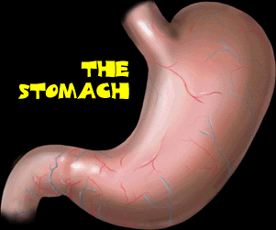
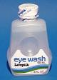

Acids are everywhere
Acids present in fruits
citric acid
malic acid
tartaric acid
quinic acid
ascorbic acid
Carbonic acid/Phosphoric acid
HCl
sulfuric acid
boric acid
lactic acid
Ethanoic acid

Slide 2
Acids
In daily-life
Ethanoic acid( in vinegar) CH₃COOH
Citric acid ( in fruit)
Carbonic acid ( in soft drink) H₂CO₃

Slide 3
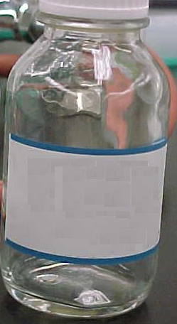
Common acids in lab
HCl
H₂SO₄
HNO₃
Hydrochloric acid
Sulphuric acid
Nitric acid

Slide 4
Mineral acids (in organic acids)
Hydrochloric acid, HCl
Sulphuric acid, H₂SO₄
Nitric acid,HNO₃
Carbonic acid, H₂CO₃
Others mainly are organic acids
Acids – H containing covalent molecules

Slide 5
Definition of an acid
An acid is a substance that produces hydrogen ions (H⁺) as the only positive ions in water.
The properties and reactions of acids are due to these hydrogen ions.
Hence acids only have acid properties when dissolved in water.

Slide 6
Acids in water
When dissolved in water, acids dissociate or ionize to yield ions.
HCl (aq) → H⁺ (aq) + Cl⁻ (aq)
H₂O
+
-
H
Cl
H
Cl
+
HCl gas
No acidic properties
H⁺ produced in presence of
Water, giving rise to
acidic properties
HNO₃ (aq) → H⁺ (aq) + NO₃⁻ (aq)

Slide 7
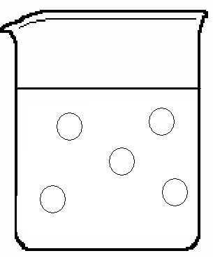
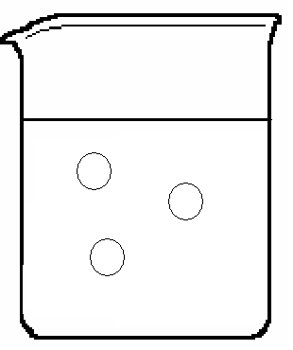
Acid used in lab are usually aqueous solutions.
Acid molecule
Dilute acid
Concentrated acid

Slide 8
Physical Properties of Dilute Acids
a) Taste
b) pH
c) Electrical conductivity
a) sour
b) acidic; it turn blue litmus paper to red
c) it conduct electricity only in aqueous state.

Slide 9
Chemical Properties of Dilute Acids
Reaction with metal (K→Pb)
Reaction with oxides/ hydroxides
Reaction with carbonates/ Hydrogencarbonates

Slide 10
Chemical Properties of Acids
Acid + metal → salt + hydrogen gas
Most reactive metal
Potassium
Sodium
Group I
Calcium
Magnesium
Metals above H are more reactive than it and can displace it from acid
Group II
Aluminium
Group III
Zinc
Iron
Lead
(Hydrogen)
Reference
Copper
Silver
Gold
Metals below H are less reactive than it and CANNOT displace it from acid
Least reactive metal

Slide 11
Reaction with metals
They react with metals higher than copper in the reactivity series, liberating hydrogen gas:
acid + metal → salt + hydrogen
For example,
H₂SO₄(aq) + Mg(s) → MgSO₄(aq) + H₂(g)
2HCl(aq) + Zn(s) → ZnCl₂(aq) + H₂(g)
Dilute acids: Only dilute HCl, H₂SO₄,very dilute HNO₃

Slide 12
Chemical Properties of Acids
Unreactive metals such as
copper, silver and gold have no reaction with dilute acids.
Eg
Zn (s) + H₂SO₄ →
ZnSO₄ (aq) + H₂ (g)
Observations:
Effervescence of a colourless and odourless gas.
Heat is liberated.
Zinc reduces in size to give a colourless solution.
effervescence
Zinc being more reactive than hydrogen is able to displace H from acid, forming hydrogen gas.

Slide 13
Action on metal oxides and hydroxides
acid + metal oxide → salt + water
e.g. H₂SO₄(aq) + CuO(s) → CuSO₄(aq) + H₂O(l)
acid + metal hydroxide → salt + water
e.g. H₂SO₄(aq) + 2NaOH(aq) → Na₂SO₄(aq) + 2H₂O(l)

Slide 14
Chemical properties of acids
Acid + base → salt + water NEUTRALISATION
Eg
CuO (s) + H₂SO₄ (aq) →
CuSO₄ (aq) + H₂O (l)
Observations:
Heat is liberated.
Copper (II) oxide, a black powder, reduces in
amount to give a blue solution.

Slide 15
Action on carbonates and hydrogencarbonates
acid + carbonate → salt + carbon dioxide + water
For example,
2HCl(aq) + CaCO₃(s) → CaCl₂(aq) + CO₂(g) + H₂O(l)
acid + hydrogencarbonate → salt + carbon dioxide + water
For example,
HNO₃(aq) + NaHCO₃(s) → NaNO₃(aq) + CO₂(g) + H₂O(l)

Slide 16
Chemical properties of acids
2. Acid + carbonate → salt + water + carbon dioxide
Eg
CuCO₃ (s) + H₂SO₄ (aq) → CuSO₄ (aq) + H₂O (l) + CO₂ (g)
Observations:
Effervescence of colourless and odourless gas.
Heat is liberated.
Copper (II) carbonate, a green powder, reduces in
amount to give a blue solution.

Slide 17
How to test for the existence of carbon dioxide?
Limewater
test
15.2 Characteristics and chemical properties of acids

Slide 18
Limewater test for carbon dioxide
Carbon dioxide is a colourless gas. It turns limewater milky.
lime water
Ca(OH)₂(aq) + CO₂(g) → CaCO₃(s) + H₂O(l)
colourless solution white solid

Slide 19
All oxides are insoluble, (s)
All hydroxides except gp 1 are insoluble, (s)
All carbonates except gp 1 are insoluble, (s)
AgX and PbX₂ are insoluble, (s) (X= Cl⁻, Br⁻, I⁻)
CaSO₄, PbSO₄, BaSO₄ are insoluble, (s)
All hydrogencarbonates are soluble ---(aq)
***Even though some compounds are soluble in water, we may use its solid form for a reaction.

Slide 20
SULPHURIC ACID AND NITRIC ACID IN WATER
Pure sulphuric acid and nitric acid are colourless liquids. They both consist of covalent molecules. When they dissolve in water, ions are formed. Acids are also electrolytes.
H⁺(aq)
H₂SO₄(l)
H⁺(aq)
SO₄²⁻(aq)
water molecules

Slide 21
HNO₃(l)
H⁺ (aq)
NO₃⁻(aq)
water molecules

Slide 22
When acid molecules dissolve in water, ions are formed.
ionization
HCl(aq)
H⁺ (aq) + Cl⁻ (aq)
H₂SO₄ (aq)
2H⁺ (aq) + SO₄²⁻ (aq)
HNO₃ (aq)
H⁺ (aq) + NO₃⁻ (aq)
Acid is a H containing covalent compound, when dissolved in water, it forms H+ ions.
(as an only kind of positive ion)
＾only
Is NaHSO₄ / NaHCO₃ an acid?

Slide 23
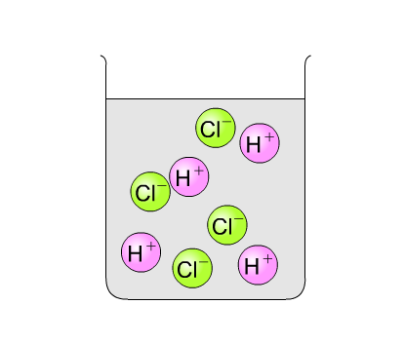
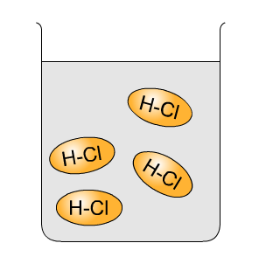
HYDROGEN CHLORIDE IN WATER AND IN METHYLBENZENE
HCl in water
HCl in methlybenzene (non-aqueous solvent)
HCl(aq) → H⁺(aq) + Cl⁻(aq)

Slide 24
Test
Hydrogen chloride in water (hydrochloric acid)
Hydrogen chloride in dry methylbenzene
Effect on dry blue litmus paper
turns to red colour
no colour change
Electrical conductivity
good
none
Action on magnesium
bubbles of hydrogen evolved:
Mg(s) + 2H⁺(aq) →
Mg²⁺(aq) + H₂(g)
no gas evolved
(no apparent reaction)
Action on solid sodium carbonate
bubbles of carbon dioxide evolved:
Na₂CO₃(s) + 2H⁺(aq) → 2Na⁺(aq) + CO₂(g) + H₂O(l)
no gas evolved
(no apparent reaction)
15.3 The role of water for acids

Slide 25
Hydrogen ions (H⁺(aq)) are responsible for all the acidic properties. Without water, acids cannot ionize to form H⁺(aq) and hence do not have acidic properties.
15.3 The role of water for acids

Slide 26
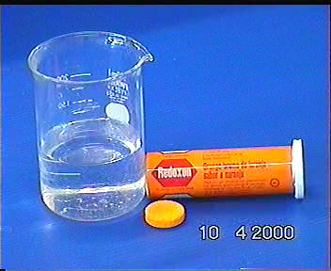
Fizzy drink tablet
Ingredients: solid acid
+ solid carbonate/hydrogencarbonate

Slide 27
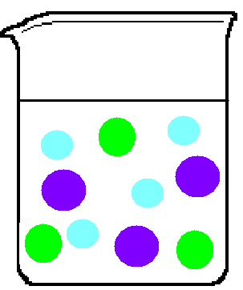
Ingredients: solid acid
+ solid carbonate/hydrogencarbonate
CO₃²⁻(aq) + 2H⁺ (aq)
CO₂ (g) + H₂O(l)
HCO₃⁻ (aq) + H⁺ (aq)
CO₂ (g) + H₂O(l)
Without water, acids do not have acidic properties.
H⁺
CO₃²⁻
CO₃²⁻
HCO₃⁻
HCO₃⁻
CO₃²⁻
H⁺
CO₃²⁻
HCO₃⁻
H⁺

Slide 28
When acid dissolves in water→
Ionization
HCl(aq)
H⁺ (aq) + Cl⁻ (aq)
H₂SO₄(aq)
2H⁺ (aq) + SO₄²⁻ (aq)
HNO₃(aq)
H⁺ (aq) + NO₃⁻ (aq)
CH₃COOH(aq)
H⁺ (aq) + CH₃COO⁻ (aq)
H₃PO₄(aq)
3H⁺ (aq) + PO₄³⁻ (aq)
Basicity = no.of ionizable H+ in an acid
molecule

Slide 29
15.4 BASICITY OF AN ACID
Different acids may give different numbers of hydrogen ions per molecule in aqueous solution.
The BASICITY of an acid is the number of hydrogen ions produced by one molecule of the acid.
15.4 Basicity of an acid

Slide 30
Acid
Ionization in water
Basicity
of acid
Hydrochloric acid
Nitric acid
Nitrous acid
Ethanoic acid
HCl(aq) → H⁺(aq) + Cl⁻(aq)
HNO₃(aq) → H⁺(aq) + NO₃⁻(aq)
HNO₂(aq) H⁺(aq) + NO₂⁻(aq)
CH₃COOH(aq) H⁺(aq) + CH₃COO⁻(aq)
1
(monobasic)
H₂SO₄(aq) 2H⁺(aq) + SO₄²⁻(aq)
H₂SO₃(aq) 2H⁺(aq) + SO₃²⁻(aq)
H₂CO₃(aq) 2H⁺(aq) + CO₃²⁻(aq)
H₂C₂O₄(aq) 2H⁺(aq) + C₂O₄²⁻(aq)
2
(dibasic)
Sulphuric acid
Sulphurous acid
Carbonic acid
Oxalic acid
Phosphoric acid
H₃PO₄(aq) 3H⁺(aq) + PO₄³⁻(aq)
3
(tribasic)
Acids in “red” are strong acids.
15.4 Basicity of an acid

Slide 31
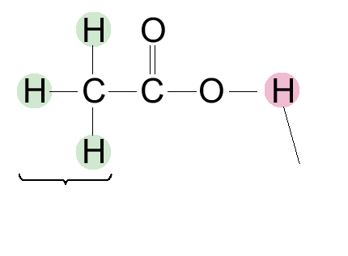
only this hydrogen atom (connected with O) can form hydrogen ion, H⁺.
Figure 15.12 Ethanoic acid (CH₃COOH) is monobasic because each molecule can only give one hydrogen ion.
15.4 Basicity of an acid

Slide 32
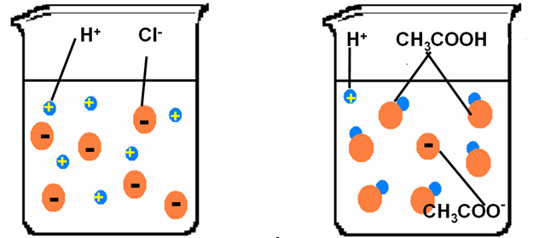
Strong acid exists mainly as ions. It ionizes completely in water.
Weak acid exists mainly in molecular forms, it contains less ions since it only slightly ionizes in water.

Slide 33

15.5 CORROSIVE NATURE OF CONCENTRATED ACIDS
High acidity
(High concentration of H⁺ ions)
All concentrated mineral acids are highly corrosive.
Figure 15.13 This hazard warning label means ‘corrosive’. Concentrated mineral acids always carry this label.
15.5 Corrosive nature of concentrated acids

Slide 34
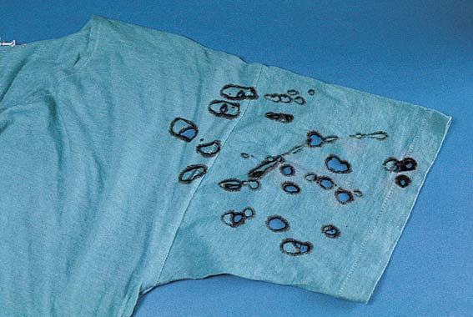
Figure 15.14 Holes appear in clothes in contact with concentrated sulphuric acid.
15.5 Corrosive nature of concentrated acids

Slide 35
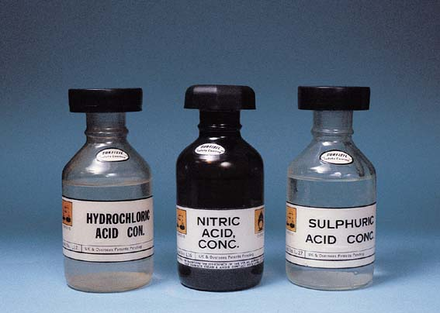
Figure 15.15 Concentrated mineral acids are highly corrosive.
15.5 Corrosive nature of concentrated acids

Slide 36
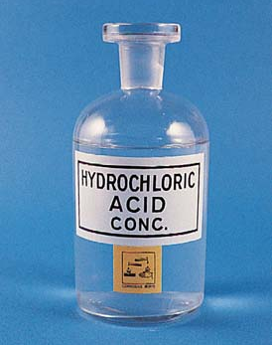
CONCENTRATED HYDROCHLORIC ACID
• an aqueous solution of hydrogen chloride gas
• 35% by mass (~11 M)
• a colourless liquid
• gives out white fumes (acid mist) in air.
15.5 Corrosive nature of concentrated acids

Slide 37
Corrosiveness explained
• Con HCl reacts with metals, carbonates, oxide in the same way as the dilute acid, but at a faster rate.
• The acidity increases as concentration increases.

Slide 38
CONCENTRATED NITRIC ACID
Ordinary concentrated nitric acid (about 16 M) contains about 70 % nitric acid by mass. It is a colourless liquid, but often turns yellow on storage.
light
4HNO₃ (aq) 2H₂O (l) + 2NO₂ (g) + O₂ (g)
a yellowish brown gas
15.5 Corrosive nature of concentrated acids

Slide 39
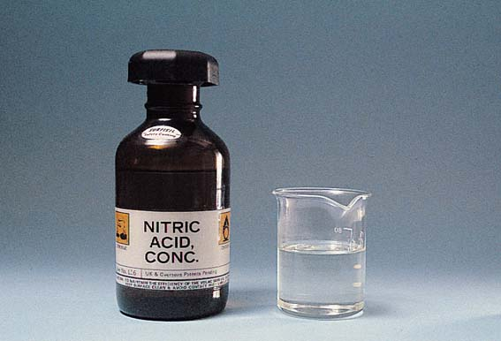
Figure 15.17 Concentrated nitric acid is a colourless or pale yellow liquid. It is kept in a brown bottle since it would decompose much more quickly in light.
15.5 Corrosive nature of concentrated acids

Slide 40
Corrosiveness explained
• Conc. nitric acid shows the usual acidic properties, except towards metals
• Very dilute nitric acid is not corrosive, but concentrated nitric acid is very corrosive.
oxidizing
properties
Conc. nitric acid is highly corrosive
15.5 Corrosive nature of concentrated acids

Slide 41
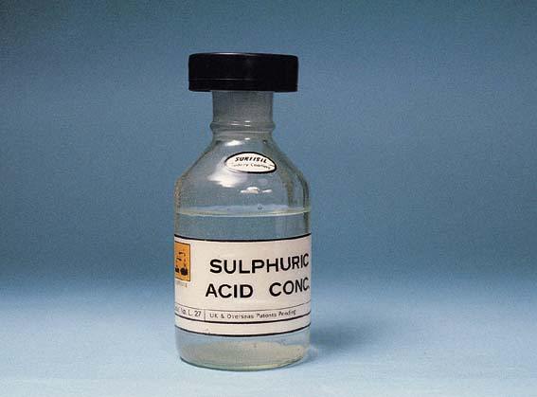
CONCENTRATED SULPHURIC ACID
Ordinary concentrated sulphuric acid (about 18 M) is a colourless oily liquid.
Figure 15.18 Concentrated sulphuric acid is a colourless oily liquid.
15.5 Corrosive nature of concentrated acids

Slide 42
Corrosiveness explained
• Concentrated sulphuric acid has the usual acidic properties, except towards metals.
• Dilute sulphuric acid is irritant, but concentrated sulphuric acid is very corrosive.
Corrosiveness
Dehydrating property
Oxidizing property
15.5 Corrosive nature of concentrated acids

Slide 43
Bases and Alkalis
Bases
mostly metal oxides or hydroxide
Formula of oxide :
O²⁻
Formula of hydroxide:
OH⁻
Question:
Give an exception of a base which is not metal oxide or hydroxide
Aq NH₃

Slide 44
Bases and Alkalis
Alkalis
Alkalis =Soluble bases
Examples of alkalis:
all group 1 hydroxide such as NaOH, KOH
calcium hydroxide (limewater),
  Ca(OH)₂
aqueous ammonia (NH₃.H₂O)
aqueous barium hydroxide, Ba(OH)₂

Slide 45
Bases and Alkalis
Alkalis
When alkalis dissolve in water, hydroxide ions, OH⁻ are produecd.
Why is aqueous ammonia (Formula NH₃.H₂O) an alkali?
Ammonia dissociates in water to give hydroxide ions and ammonium ions.
The alkaline properties of aqueous ammonia is due to
hydroxide ions.

Slide 46
Strong and Weak Alkalis
Examples of strong and weak Alkalis
Alkalis
Strong alkalis
Weak alkalis
NaOH, KOH
(mostly hyroxides formed by Group I)
Aqueous ammoia (NH₃.H₂O)

Slide 47
Types of Oxides
Oxides
acidic
basic
neutral
amphoteric
SO₃
SO₂
CO₂
P₄O₁₀
MgO
Na₂O
CaO
CuO
H₂O
CO
N₂O
Al₂O₃
PbO
PbO₂
ZnO
Non-metallic oxides
Metallic oxides

Slide 48
Types of Oxides
Note
Dioxides or polyoxides of non-metals are usually acidic. E.g CO₂, SO₂, NO₂, SO₃, P₄O₁₀
Monoxides of non-metals are usually neutral. E.g CO, NO

Slide 49
Oxides
3. An acidic oxide is a non-metallic oxide which reacts with water to produce an acid.
Examples:
SO₂ (g) + H₂O (l)
H₂SO₃ (aq) sulfurous acid
CO₂ (g) + H₂O (l)
H₂CO₃ (aq) carbonic acid

Slide 50
Oxides
Acidic Oxides
Acidic oxide reacts with alkalis to form a salt and water.
Example:
CO₂ (g) + 2NaOH (aq)
Na₂CO₃(aq) + H₂O (l)
SO₂ (g) + 2NaOH
→ Na₂SO₃ (aq) + H₂O (l)

Slide 51
Oxides
5.
Few Basic oxides
Addition of water
ALKALI
Examples:
Na₂O (s) + H₂O (l) → 2NaOH (aq)
CaO (s) + H₂O (l)→ Ca(OH)₂ (aq)
Partially soluble

Slide 52
Oxides
6. Amphoteric oxides
-react with both acid and alkali to produce a salt and water only.
-oxides which have both acidic and basic properties
E.g.
ZnO, Al₂O₃, PbO (Remember ZAP)

Slide 53
Oxides
Amphoteric oxides
E.g. ZnO
As a base
zinc + hydrochloric -> zinc + water
oxide acid chloride
ZnO (s) + 2HCl (aq) -> ZnCl₂ (aq)+ H₂O(l)
base
acid

Slide 54
Oxides
Amphoteric oxides
E.g. ZnO
As an acid
zinc + sodium -> sodium + water
oxide hydroxide zincate
ZnO(s) + 2NaOH(aq) -> Na₂ZnO₂(aq) + H₂O(l)
acid
alkali
Colourless solution

Slide 55
Oxides
7. Neutral oxides
-Neither acidic nor basic
E.g.
CO, NO, N₂O, H₂O

Slide 56
Metal Hydroxides
- metals form hydroxides which have similar
acid/base properties as their oxides
E.g.
ZnO - amphoteric oxide
Zn(OH)₂ - amphoteric hydroxide

Slide 57
Critical thinking
Carbon dioxide liberated can be tested by bubbling it into limewater (aq. Calcium hydroxide). A white ppt will be observed in the limewater, why?
Eqn: CO₂ (g) + Ca(OH)₂ (aq) → CaCO₃ (s) + H₂O (l)
Carbon dioxide, an
acidic oxide, is
neutralised by limewater which is an alkali to give calcium carbonate, a white insoluble solid and water. The white precipitate is calcium carbonate.

Slide 58
Bases and Alkalis
Chemical Reactions
Bases react with acid to form salt and water, a process called neutralisation.
Alkalis give precipitates with solutions of most metal salts.
2NaOH (aq) + CuSO₄ (aq)
→ Cu(OH)₂ + Na₂SO₄
(s) (aq)
Blue ppt

Slide 59
Bases and Alkalis
Chemical Reactions
When warmed, bases react with ammonium salts to give salt, water and ammonia.
Ammonium salt + base → salt + water+ ammonia
NaOH + NH₄Cl → NaCl + H₂O + NH₃
Observation
Colourless and pungent gas liberated. The sodium hydroxide solution remains colourless.

Slide 60
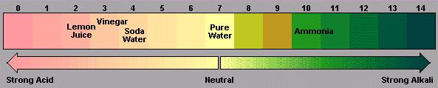
The pH scale
pH - measure of the concentration of H⁺ in solution.
- between 0 and 14
Acidic
lower pH
-> higher conc. of H⁺
Alkaline
higher pH
-> higher conc. of OH-

Slide 61
The pH scale
Enrichment:
Formula of pH
pH = - lg [H⁺]
Where [H⁺] is the concentration of hydrogen ions.
What does pH stand for?
P stands for potenz, a german word which mean power.

Slide 62
Indicators
- Substances that have different colours in acidic and alkaline solutions.
- most are regarded as weak acids

Slide 63
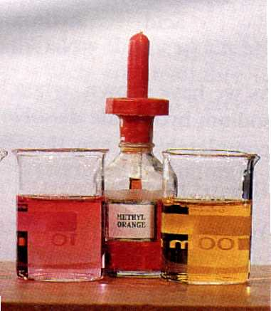
Indicators
E.g.
Methyl Orange
in acidic medium - red
in allkaline medium - yellow
pH at which it changes colour - pH 4
colour at this pH -
orange

Slide 64
The pH scale
Critical thinking (Not in note)
2. If a solution is acidic, it will not contain any OH⁻, true or false?
False. For acidic solution, concentration of H⁺ is higher than concentration of OH^{-.} It does not mean that acidic solution will not have OH⁻. Hydroxide ions come from water which dissociates to a very small extent to give a small amount of H⁺ and OH⁻

Slide 65
Indicators
Methyl orange
red
yellow
0
4
14
Phenolphthalein
colourless
pink
0
9
14
What is the colour of
HCl if 2 drops of methyl orange are added to it?
NaOH if 2 drops of phenolphthalein are added to it?
red
pink

Slide 66
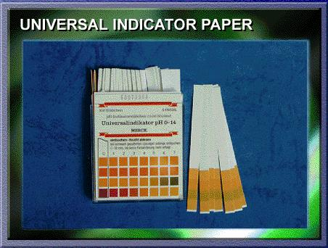
Indicators
- Some indicators are used as mixtures
- gives different colours at different pH
numbers
=>
Universal Indicator / pH indicator
- Dip universal indicator
paper into solutions
- Observe colour change
- Compare colour with
colour chart
=> pH of solution

Slide 67
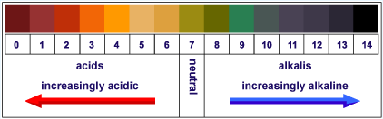
Indicators
Universal Indicator / pH indicator

Slide 68
pH and Agriculture
- plants grow well in soil with pH about pH 6.5
(about neutral)
- soil becomes acidic from
-> acid rain
-> fertiliser such as ammonium sulfate
-To neutralise excess acid in soil,
- add solid calcium hydroxide (slaked lime)
or solid calcium oxide (lime)
- spread calcium hydroxide powder over
fields => liming the soil

