Slide 1
Transition metal ions
All transition metals lose electrons when they react, and so form positive ions.
Some transition metals only make one type of ion, for example:
silver only forms Ag⁺ ions;
zinc only forms Zn²⁺ ions.
However, most transition metals can form more than one type of ion. They have variable valency. For example:
Metal Ion Example of compound
Cu⁺ copper (I) oxide – Cu₂O
copper
Cu²⁺ copper (II) oxide – CuO
Fe²⁺ iron (II) chloride – FeCl₂
iron
Fe³⁺ iron (III) chloride – FeCl₃

Slide 2
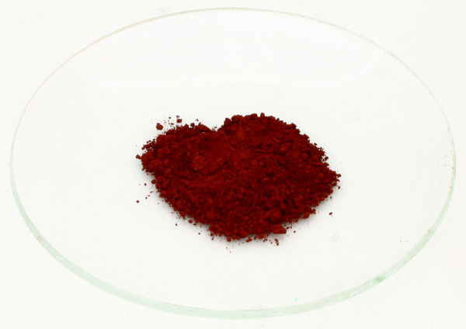
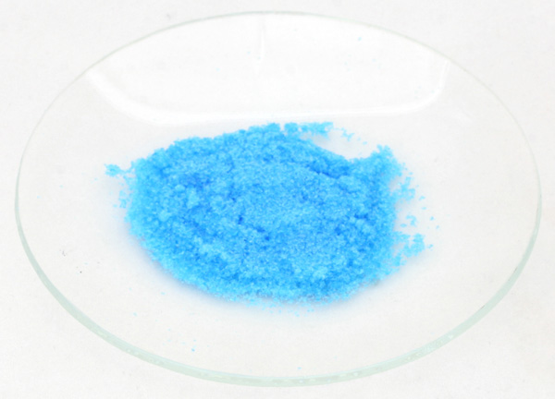
Colour and transition metals
Most transition metals form coloured compounds.
For example:
iron (II) compounds are usually green
e.g. iron (II) chloride (FeCl₂)
iron (III) compounds are usually orange/brown
e.g. iron (III) oxide (Fe₂O₃) – when hydrated this is rust
copper (II) compounds are blue
e.g. copper (II) sulfate (CuSO₄.H₂O) – these can be turned white by heating the crystals to remove the water.

Slide 3
Identifying transition metal ions
The presence of transition metal ions in a solution can be tested by adding sodium hydroxide solution.
If they are present, a metal hydroxide is formed. This is insoluble so it appears as a solid called a precipitate.
Different metal ions produce different coloured precipitates.
For example:
Fe²⁺ ions produce a grey/green precipitate of Fe(OH)₂
Fe³⁺ ions produce an orange/brown precipitate of Fe(OH)₃
Cu²⁺ ions produce a blue precipitate of Cu(OH)₂

