Slide 1
Reading Solubility Curves

Slide 2
What is Solubility?
Solubility: the maximum amount of solute that will dissolve in a certain amount of solvent at a given temperature
Solute = substance dissolved
Solvent = does the dissolving
Example: __ grams of salt (NaCl) in 100 g of water at __ ˚C.

Slide 3
Temperature and Solubility
Temperature affects how much of the solute can be dissolved by the solvent.
  Note: Increasing the temperature does not always increase the solubility…think about what happens to dissolved gas in your soda when its heated
Solubility curves: used to show how the solubility of a substance changes with temperature.

Slide 4
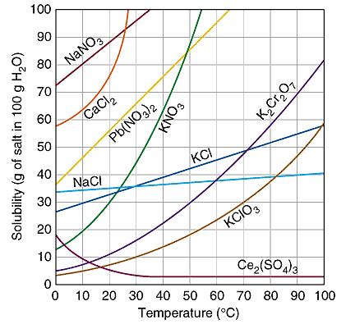

Slide 5
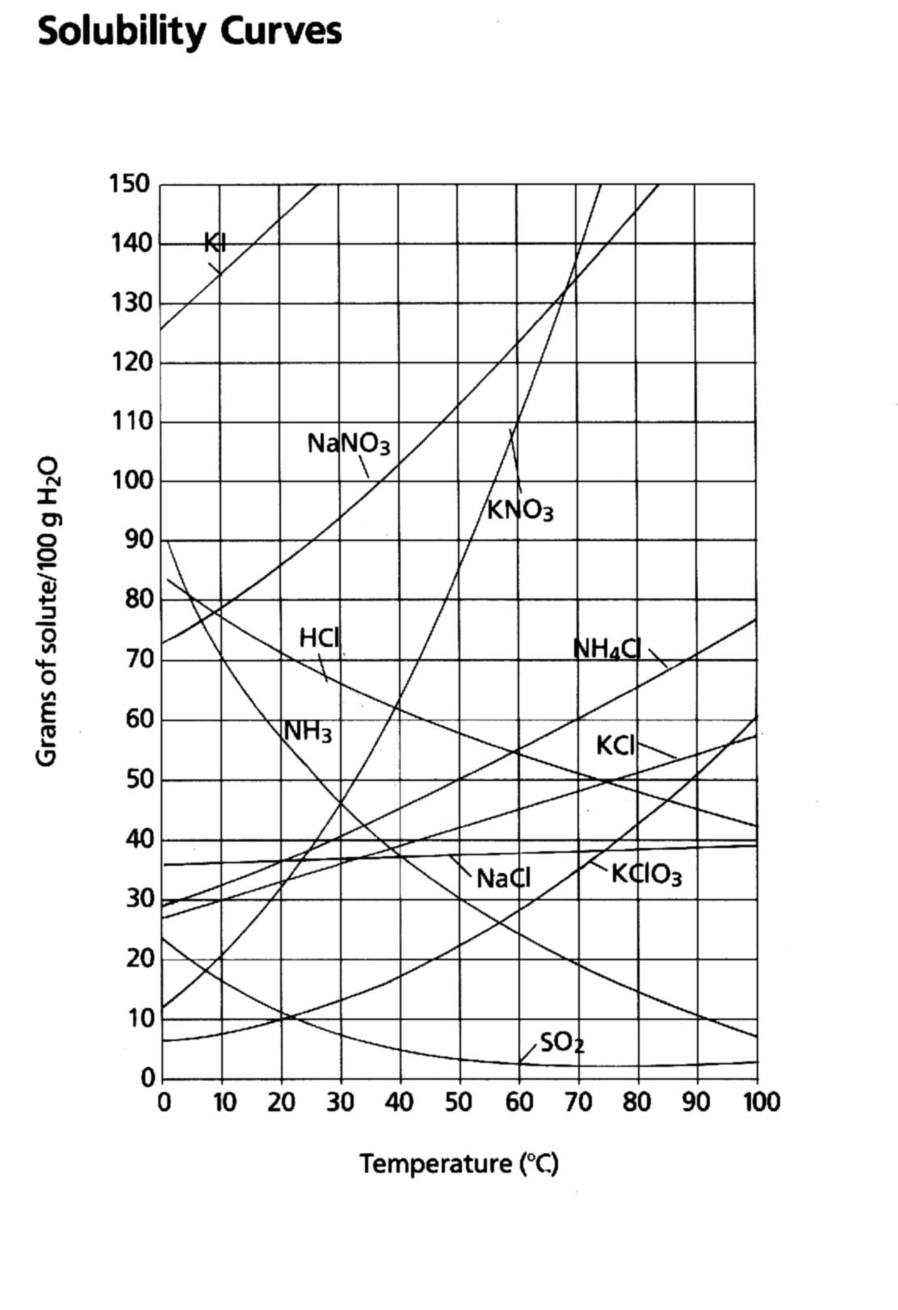
To read the graph:
1. Find the line for the substance.
2. The amount that dissolves at a given temp. is on the y-axis.

Slide 6
How much KNO₃ dissolves in 100g H₂O at 50ºC?
Find the line (red)
Find the temperature and follow up to the line. (green)
Read across to the y-axis and this is the answer. (blue)
Since it is above the ½-way between 80 and 90, 87g KNO₃ will dissolve.

Slide 7
Types of Solutions:
Saturated solution: point on the line
  Contains maximum amount of solute at given temp
  Contains what it should hold
Supersaturated: above the line
  Contains more solute than a saturated solution
  Contains more than it should hold
Unsaturated: below the line is
  Contains less solute than saturated solution
  Contains less solute than it could hold

Slide 8
supersaturated
Saturated
Unsaturated

Slide 9
.
SOLUBILITY GRAPHS
KNO3
140
120
KBr
100
NaNO3
NH4Cl
80
60
40
Concentration (g/100 g water)
NaCl
Na2SO3
20
10
20
30
40
50
60
70
80
temperature

Slide 10
SOLUBILITY FORMULAS
amount of solute
amount of solvent
amount of solute
amount of solvent
=
Given solubility unknown

Slide 11
SOLUBILITY PROBLEMS
1.The solubility of a solid is
15g / 100g of water. How many grams of the solid must be dissolved in 1 kg of water to make a saturated solution?

Slide 12
SOLUBILITY PROBLEMS
amount of solute
amount of solvent
amount of solute
amount of solvent
=
15 g
-------
100g
X
-------
1000g
=
X=150g

Slide 13
SOLUBILITY EXAMPLES
2. If you have 50g in 500g of water, using solubility from problem #1, is the solution saturated?
15g
------
100g
X
------
500g
X=75g is saturated
=
No, 50 g is not saturated!

Slide 14
SOLUBILITY EXAMPLES
3. The solubility of a solute is 5g/100g water at 20 C and 7.5g/100g water at 50 C. How much of the solute must be dissolved in 250g of water at 20 C to prepare a saturated solution?
5g
-----
100g
X
-----
250g
X=12.5g to prepare a saturated solution
=

Slide 15
SOLUBILITY EXAMPLES
4. The solubility of a solute is 5g/100g water at 20 C and 7.5g/100g water at 50 C. If a saturated solution is prepared using 200g water at 50 C, then allowed to cool to 20 C:
a. Will it still be saturated?
b. How much solute will precipitate out?

Slide 16
SOLUBILITY EXAMPLES
Will it still be saturated? @ 50 C:
7.5g
-----
100g
X
-----
200g
X=15g to prepare a saturated solution @ 50 C
=

Slide 17
SOLUBILITY EXAMPLES
Will it still be saturated? Now cool it to 20 C:
5g
-----
100g
X
-----
200g
X=10g to prepare a saturated solution @ 20 C
=

Slide 18
SOLUBILITY EXAMPLES
Will it still be saturated? Now cool it to 20 C:
15g
>
10g
@ 20 C so its supersaturated!!

Slide 19
SOLUBILITY EXAMPLES
How much will precipitate out?
5g
-----
100g
X
-----
200g
X=10g to prepare a saturated solution @ 20 C
=
7.5g
-----
100g
X
-----
200g
X=15g to prepare a saturated solution @ 50 C
=

Slide 20
SOLUBILITY EXAMPLES
How much will precipitate out?
15g - 10g = 5g will precipitate out!

Slide 21
To do Calculations:
To calculate how much extra has been dissolved:
Extra = Dissolved amt - saturated
in soln (given value) line value @ that temp.
To calculate how much more can be dissolved:
? Much more = saturated - given value
line value @ that temp

Slide 22
Example 1:
How much less KCl is dissolved at 20ºC than at 60ºC in 100g H₂O?
Read the line value:
32g at 20ºC
Subtract it from the
given value:
    45g – 32g = 13 g

Slide 23
Example 2:
How much more KCl is required to saturate the solution if 25g are dissolved at 40ºC?
Read the line value:
40g
Subtract the given
value:
    40g – 25g = 15 g

Slide 24
Your turn! Use your graph
How much NaCl will dissolve in 100g H₂O at 35ºC?
How much NH₄Cl will dissolve at 50ºC?
What is the solubility of SO₂ at 25ºC?
What is the solubility of potassium chlorate in 100 grams of water at 35ºC?
What is the solubility of potassium iodide in 100 grams of water at 10ºC?

Slide 25
What minimum temperature needed to dissolve 80 grams of sodium nitrate in 100 grams of water?
What minimum temperature needed to dissolve 42 grams of potassium chloride in 100 grams of water?
What minimum temperature needed to dissolve 20 grams of KClO₃ in 100 grams of water?
If 95 grams of potassium nitrate are mixed with 100 grams of water at 45ºC, how much will not dissolve?
If 85 grams of potassium iodide are mixed with 100 grams of water at 0ºC, how much more must be added to saturate the solution?

Slide 26
If 55 grams of potassium chlorate are mixed with 100 grams of water at 55ºC, how much will not dissolve?
If 125 grams of potassium iodide are mixed with 100 grams of water at 10ºC, how much more must be added to saturate the solution?
What is the solubility of potassium chlorate in 50 grams of water at 35ºC?

Slide 27
What is the solubility of potassium chlorate in 100 grams of water at 35 oC?
What is the solubility of potassium iodide in 100 grams of water at 10 oC?
What is the minimum temperature needed to dissolve 80 grams of sodium nitrate in 100 grams of water?
What is the minimum temperature needed to dissolve 42 grams of potassium chloride in 100 grams of water?
What is the minimum temperature needed to dissolve 20 grams of KClO3 in 100 grams of water?

Slide 28
If 95 grams of potassium nitrate are mixed with 100 grams of water at 45 oC, how much will not dissolve?
If 55 grams of potassium chlorate are mixed with 100 grams of water at 55 oC, how much will not dissolve?
If 125 grams of potassium iodide are mixed with 100 grams of water at 10 oC, how much more must be added to saturate the solution?
If 85 grams of potassium iodide are mixed with 100 grams of water at 0 oC, how much more must be added to saturate the solution?
What is the solubility of potassium chlorate in 50 grams of water at 35 oC?

Slide 29
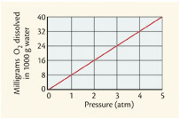
Factors Affecting Gas Solubility
What relationship is shown in the graph?
What type of relationship is this?
Based on what we’ve discussed, what factors would you say affect gas solubility?
  Temperature
  Nature of Solvent
  Pressure
Pressure ↑
Solubility ↑
Direct
A linear graph with a positive slope = direct relationship

