Slide 1

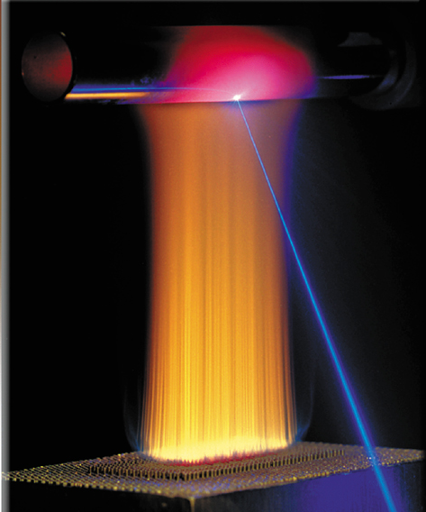
Thermochemistry
ENERGY CHANGES
.

Slide 2
Energy is the capacity to do work
Thermal energy is the energy associated with the random motion of atoms and molecules
Chemical energy is the energy stored within the bonds of chemical substances
Nuclear energy is the energy stored within the collection of neutrons and protons in the atom
Electrical energy is the energy associated with the flow of electrons
Potential energy is the energy available by virtue of an object’s position
6.1

Slide 3
Energy Changes in Chemical Reactions
Heat is the transfer of thermal energy between two bodies that are at different temperatures.
Temperature is a measure of the thermal energy.
Temperature = Thermal Energy
90⁰C
40⁰C
greater thermal energy
6.2

Slide 4
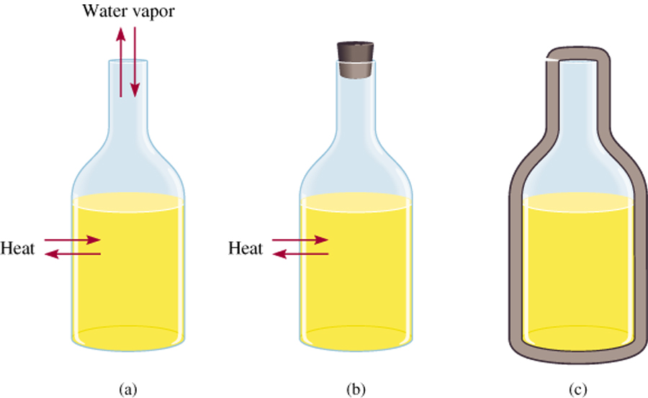
Thermochemistry is the study of heat change in chemical reactions.
SURROUNDINGS
The system is the specific part of the universe that is of interest in the study.
SYSTEM
open
closed
isolated
Exchange:
mass & energy
energy
nothing
6.2

Slide 5
Exothermic process is any process that gives off heat – transfers thermal energy from the system to the surroundings.
2H₂ (g) + O₂ (g) 2H₂O (l) + energy
H₂O (g) H₂O (l) + energy
Endothermic process is any process in which heat has to be supplied to the system from the surroundings.
energy + 2HgO (s) 2Hg (l) + O₂ (g)
energy + H₂O (s) H₂O (l)
6.2

Slide 6
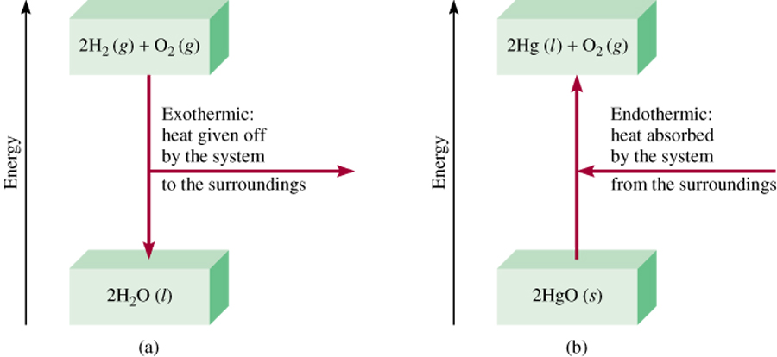
Enthalpy (H) is used to quantify the heat flow into or out of a system in a process that occurs at constant pressure.
ΔH = H (products) – H (reactants)
ΔH = heat given off or absorbed during a reaction at constant pressure
H_{products} < H_{reactants}
H_{products} > H_{reactants}
ΔH < 0
ΔH > 0
6.3

Slide 7
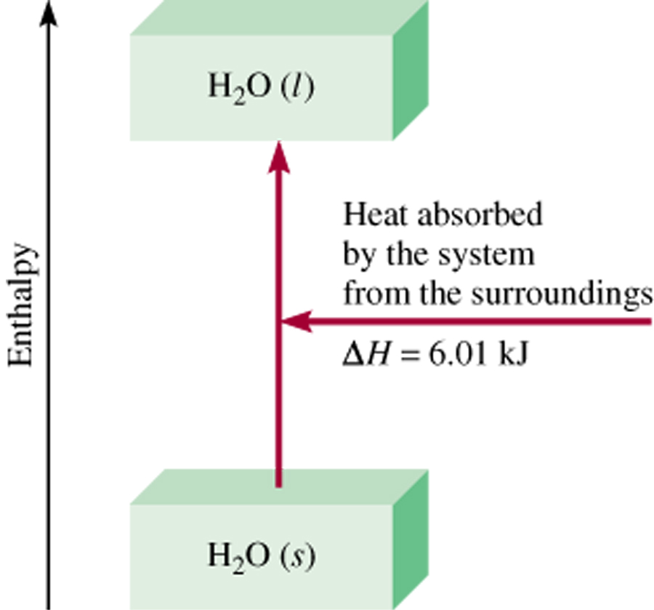
Thermochemical Equations
Is ΔH negative or positive?
System absorbs heat
Endothermic
ΔH > 0
6.01 kJ are absorbed for every 1 mole of ice that melts at 0⁰C and 1 atm.
H₂O (s) H₂O (l)
ΔH = 6.01 kJ
6.3

Slide 8
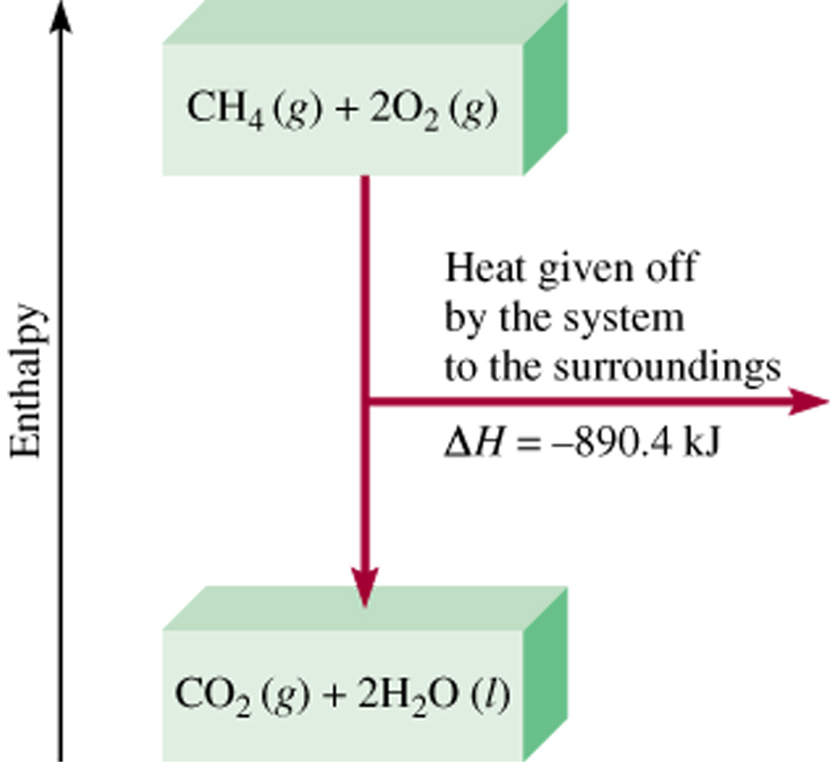
Thermochemical Equations
Is ΔH negative or positive?
System gives off heat
Exothermic
ΔH < 0
890.4 kJ are released for every 1 mole of methane that is combusted at 25⁰C and 1 atm.
CH₄ (g) + 2O₂ (g) CO₂ (g) + 2H₂O (l)
ΔH = -890.4 kJ
6.3

Slide 9
Thermochemical Equations
The stoichiometric coefficients always refer to the number of moles of a substance
H₂O (s) H₂O (l)
ΔH = 6.01 kJ
If you reverse a reaction, the sign of ΔH changes
H₂O (l) H₂O (s)
ΔH = -6.01 kJ
If you multiply both sides of the equation by a factor n, then ΔH must change by the same factor n.
2H₂O (s) 2H₂O (l)
ΔH = 2 x 6.01 = 12.0 kJ
6.3

Slide 10
Thermochemical Equations
The physical states of all reactants and products must be specified in thermochemical equations.
H₂O (s) H₂O (l)
ΔH = 6.01 kJ
H₂O (l) H₂O (g)
ΔH = 44.0 kJ
How much heat is evolved when 266 g of white phosphorus (P₄) burn in air?
P₄ (s) + 5O₂ (g) P₄O₁₀ (s) ΔH = -3013 kJ
1 mol P₄
3013 kJ
266 g P₄
x
x
= 6470 kJ
123.9 g P₄
1 mol P₄
6.3

Slide 11
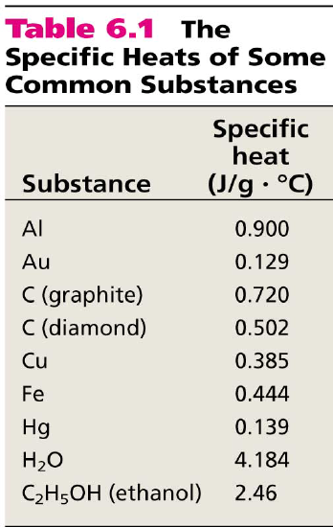
The specific heat (s) of a substance is the amount of heat (q) required to raise the temperature of one gram of the substance by one degree Celsius.
The heat capacity (C) of a substance is the amount of heat (q) required to raise the temperature of a given quantity (m) of the substance by one degree Celsius.
C = ms
Heat (q) absorbed or released:
q = msΔt
q = CΔt
Δt = t_{final} - t_{initial}
6.4

Slide 12

How much heat is given off when an 869 g iron bar cools from 94⁰C to 5⁰C?
s of Fe = 0.444 J/g • ⁰C
Δt = t_{final} – t_{initial} = 5⁰C – 94⁰C = -89⁰C
q = msΔt
= 869 g x 0.444 J/g • ⁰C x –89⁰C
= -34,000 J
6.4

Slide 13
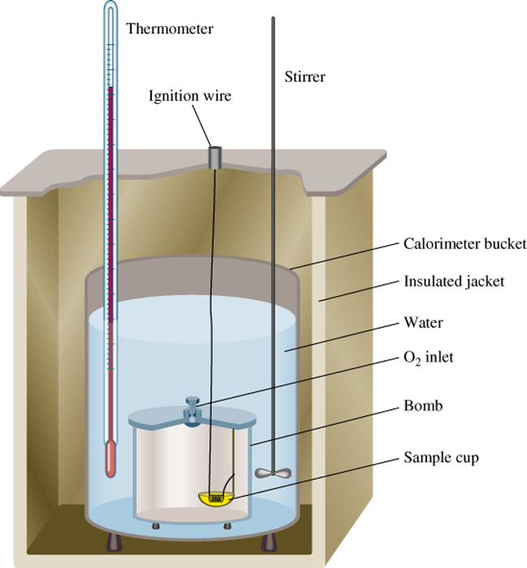
Constant-Volume Calorimetry
q_{sys} = q_{water} + q_{bomb} + q_{rxn}
q_{sys} = 0
q_{rxn} = - (q_{water} + q_{bomb})
q_{water} = msΔt
q_{bomb} = C_{bomb}Δt
Reaction at Constant V
ΔH = q_{rxn}
ΔH ~ q_{rxn}
No heat enters or leaves!
6.4

Slide 14
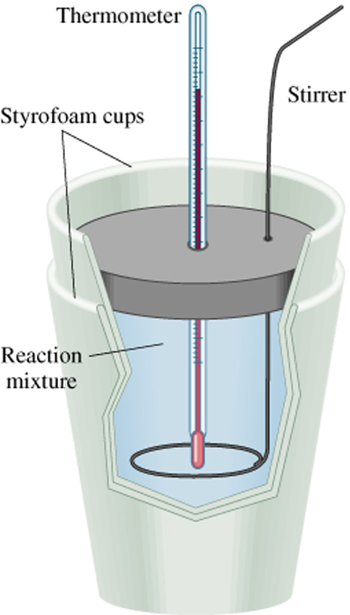
Constant-Pressure Calorimetry
q_{sys} = q_{water} + q_{cal} + q_{rxn}
q_{sys} = 0
q_{rxn} = - (q_{water} + q_{cal})
q_{water} = msΔt
q_{cal} = C_{cal}Δt
Reaction at Constant P
ΔH = q_{rxn}
No heat enters or leaves!
6.4

Slide 15
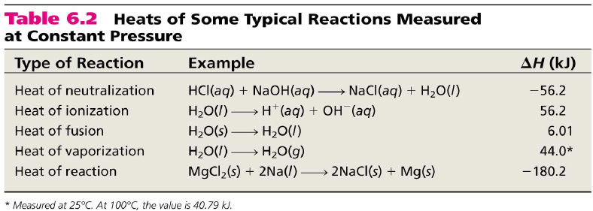
6.4

Slide 16
Because there is no way to measure the absolute value of the enthalpy of a substance, must I measure the enthalpy change for every reaction of interest?
Establish an arbitrary scale with the standard enthalpy of formation (ΔH⁰) as a reference point for all enthalpy expressions.
f
Standard enthalpy of formation (ΔH⁰) is the heat change that results when one mole of a compound is formed from its elements at a pressure of 1 atm.
f
The standard enthalpy of formation of any element in its most stable form is zero.
ΔH⁰ (O₂) = 0
ΔH⁰ (C, graphite) = 0
f
f
ΔH⁰ (O₃) = 142 kJ/mol
ΔH⁰ (C, diamond) = 1.90 kJ/mol
f
f
6.5

Slide 17
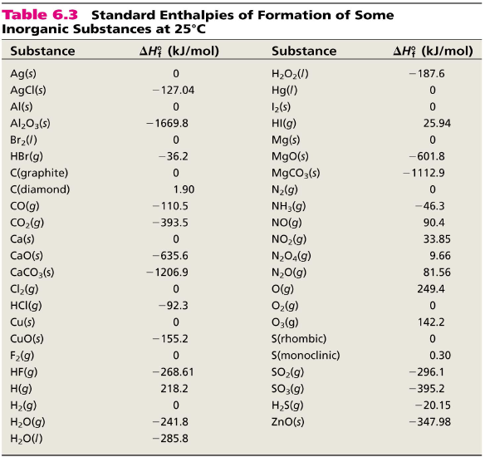
6.5

Slide 18
The standard enthalpy of reaction (ΔH⁰ ) is the enthalpy of a reaction carried out at 1 atm.
rxn
aA + bB cC + dD
ΔH⁰
cΔH⁰ (C)
dΔH⁰ (D)
-
aΔH⁰ (A)
bΔH⁰ (B)
=
[
+
]
[
+
]
rxn
f
f
f
f
ΔH⁰
=
Σ
nΔH⁰ (products)
-
Σ
mΔH⁰ (reactants)
rxn
f
f
Hess’s Law: When reactants are converted to products, the change in enthalpy is the same whether the reaction takes place in one step or in a series of steps.
(Enthalpy is a state function. It doesn’t matter how you get there, only where you start and end.)
6.5

Slide 19
Calculate the standard enthalpy of formation of CS₂ (l) given that:
C(graphite) + O₂ (g) CO₂ (g) ΔH⁰ = -393.5 kJ
rxn
S(rhombic) + O₂ (g) SO₂ (g) ΔH⁰ = -296.1 kJ
rxn
CS₂(l) + 3O₂ (g) CO₂ (g) + 2SO₂ (g) ΔH⁰ = -1072 kJ
rxn
1. Write the enthalpy of formation reaction for CS₂
C(graphite) + 2S(rhombic) CS₂ (l)
2. Add the given rxns so that the result is the desired rxn.
C(graphite) + O₂ (g) CO₂ (g) ΔH⁰ = -393.5 kJ
rxn
2S(rhombic) + 2O₂ (g) 2SO₂ (g) ΔH⁰ = -296.1x2 kJ
rxn
+
CO₂(g) + 2SO₂ (g) CS₂ (l) + 3O₂ (g) ΔH⁰ = +1072 kJ
rxn
C(graphite) + 2S(rhombic) CS₂ (l)
ΔH⁰ = -393.5 + (2x-296.1) + 1072 = 86.3 kJ
6.5
rxn

Slide 20
Benzene (C₆H₆) burns in air to produce carbon dioxide and liquid water. How much heat is released per mole of benzene combusted? The standard enthalpy of formation of benzene is 49.04 kJ/mol.
2C₆H₆ (l) + 15O₂ (g) 12CO₂ (g) + 6H₂O (l)
ΔH⁰
=
Σ
nΔH⁰ (products)
-
Σ
mΔH⁰ (reactants)
rxn
f
f
ΔH⁰
12ΔH⁰ (CO₂)
6ΔH⁰ (H₂O)
-
[
2ΔH⁰ (C₆H₆)
=
[
+
]
]
rxn
f
f
f
ΔH⁰
=
[ 12x–393.5 + 6x–187.6 ] – [ 2x49.04 ] = -5946 kJ
rxn
-5946 kJ
= - 2973 kJ/mol C₆H₆
2 mol
6.5

Slide 21
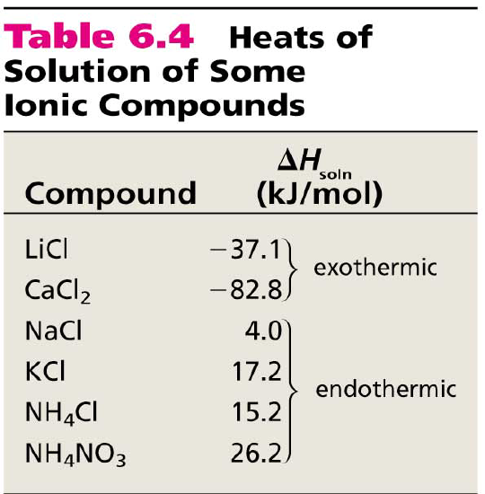
The enthalpy of solution (ΔH_{soln}) is the heat generated or absorbed when a certain amount of solute dissolves in a certain amount of solvent.
ΔH_{soln} = H_{soln} - H_{components}
Which substance(s) could be used for melting ice?
Which substance(s) could be used for a cold pack?
6.6

Slide 22
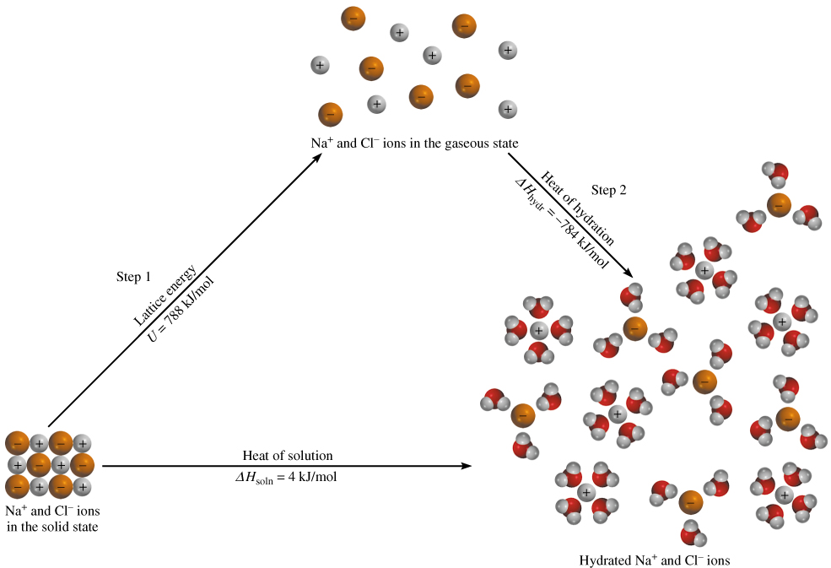
The Solution Process for NaCl
ΔH_{soln} = Step 1 + Step 2 = 788 – 784 = 4 kJ/mol
6.6

