Slide 1
RATES OF REACTION

Slide 2
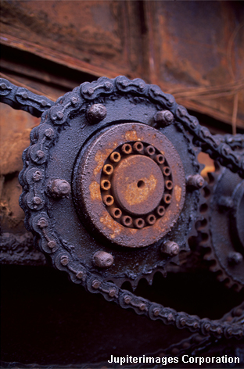

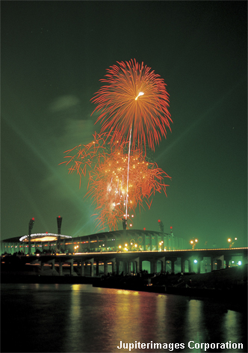
What does rate of reaction mean?
The speed of different chemical reactions varies hugely. Some reactions are very fast and others are very slow.
The speed of a reaction is called the rate of the reaction.
What is the rate of these reactions?
rusting
baking
explosion
slow
fast
very fast
Notes:
Photo credit: © 2007 Jupiterimages Corporation

Slide 3
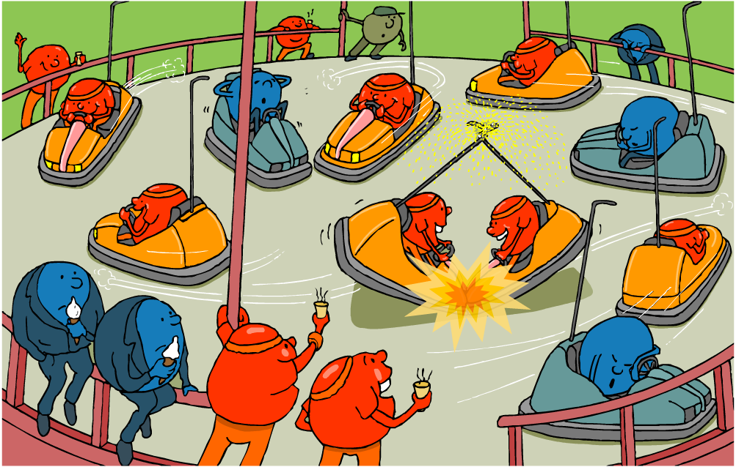
Rates of reaction
Why are some reactions faster than others?
Notes:
Teacher notes
This illustration contains several discussion points relating to rates of reaction, including:
Red characters: these represent particles that have a large amount of kinetic energy and are therefore likely to react.
Blue characters : these represent particles that have a small amount of kinetic energy and are therefore unlikely to react (hence why some are asleep).
Bumper cars: the collision between two bumper cars represents the large amount of energy released during a reaction.

Slide 4
Reactions, particles and collisions
Reactions take place when particles collide with a certain amount of energy.
The minimum amount of energy needed for the particles to react is called the activation energy, and is different for each reaction.
The rate of a reaction depends on two things:
the frequency of collisions between particles
the energy with which particles collide.
If particles collide with less energy than the activation energy, they will not react. The particles will just bounce off each other.
Notes:
Teacher notes
See the ‘Energy Transfer’ presentation for more information on activation energy.

Slide 5

Changing the rate of reactions
Anything that increases the number of successful collisions between reactant particles will speed up a reaction.
What factors affect the rate of reactions?
increased temperature
increased concentration of dissolved reactants, and increased pressure of gaseous reactants
increased surface area of solid reactants
use of a catalyst.

Slide 6
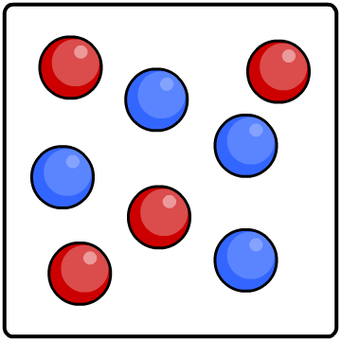
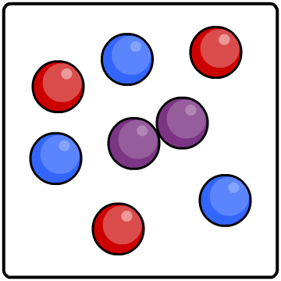
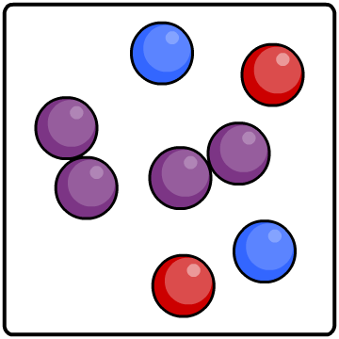
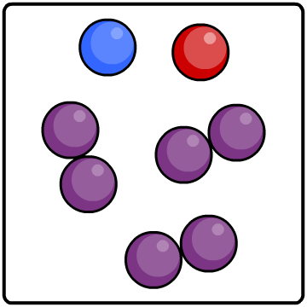
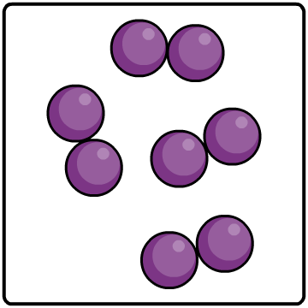



Slower and slower!
Reactions do not proceed at a steady rate. They start off at a certain speed, then get slower and slower until they stop.
As the reaction progresses, the concentration of reactants decreases.
This reduces the frequency of collisions between particles and so the reaction slows down.
0%
25%
50%
75%
100%
reactants
percentage completion of reaction
product

Slide 7
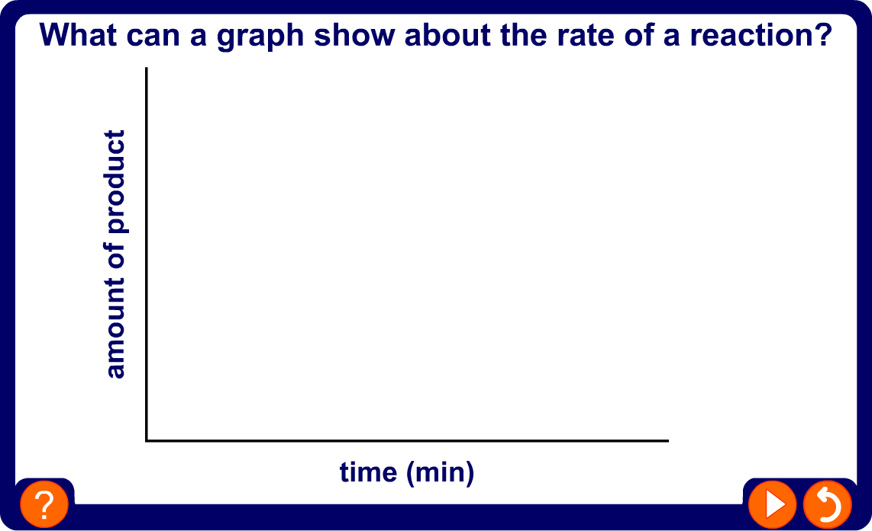
Graphing rates of reaction
Notes:
Teacher notes
This animated graph summarizes the qualitative information provided by the gradient of a graph that plots amount of product in a reaction against time.

Slide 8
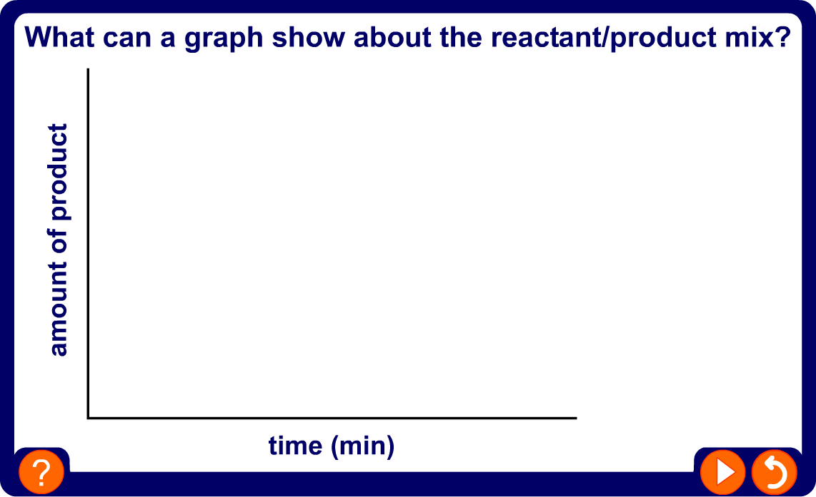
Reactant–product mix
Notes:
Teacher notes
This animated graph follows-on from the graph on the previous slide, and illustrates how the change in the rate of a reaction can be explained in terms of changing amounts of reactants and product.

Slide 9
How can rate of reaction be measured?
Measuring the rate of a reaction means measuring the change in the amount of a reactant or the amount of a product.
What can be measured to calculate the rate of reaction between magnesium and hydrochloric acid?
+
hydrochloric
acid
magnesium
chloride
+
magnesium
➔
hydrogen
The amount of hydrochloric acid used up (cm³/min).
The amount of magnesium chloride produced (g/min).
The amount of hydrogen product (cm³/min).

Slide 10
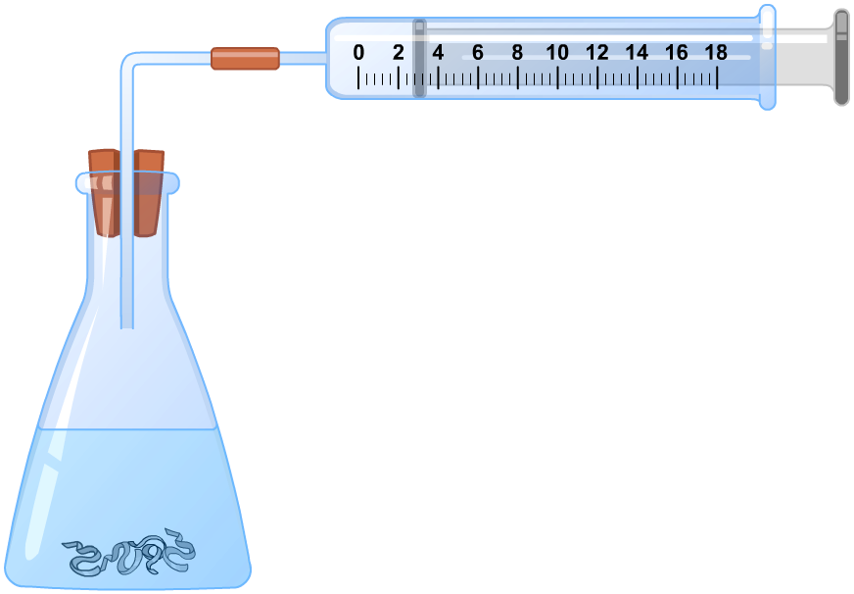
Setting up rate experiments
What equipment is needed to investigate the rate of hydrogen production?
glass tube
rubber connecter
gas syringe
conical
flask
rubber bung
hydrochloric
acid
magnesium

Slide 11
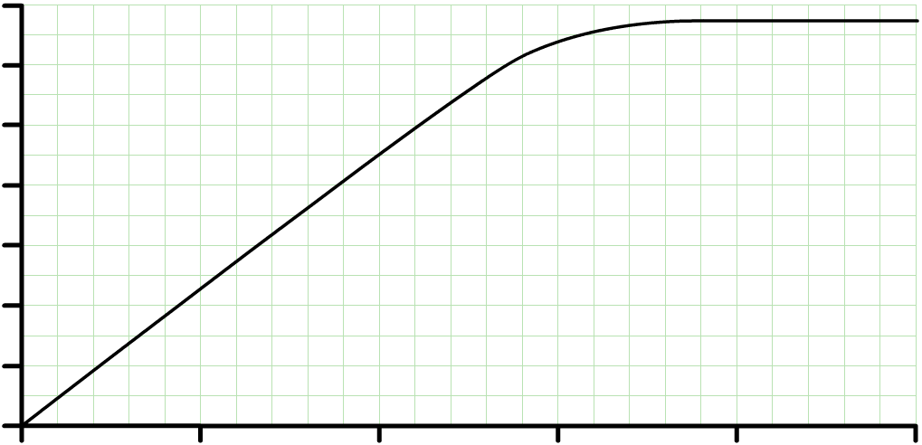
Calculating rate of reaction from graphs
How can the rate of reaction be calculated from a graph?
70
60
50
x
rate of reaction =
y
40
hydrogen produced (cm³)
x
30
20
y
10
0
0
10
20
30
40
50
time (seconds)
The gradient of the graph is equal to the initial rate of reaction at that time
rate of reaction =
45 cm³
rate of reaction =
2.25 cm³/s
20 s

Slide 12
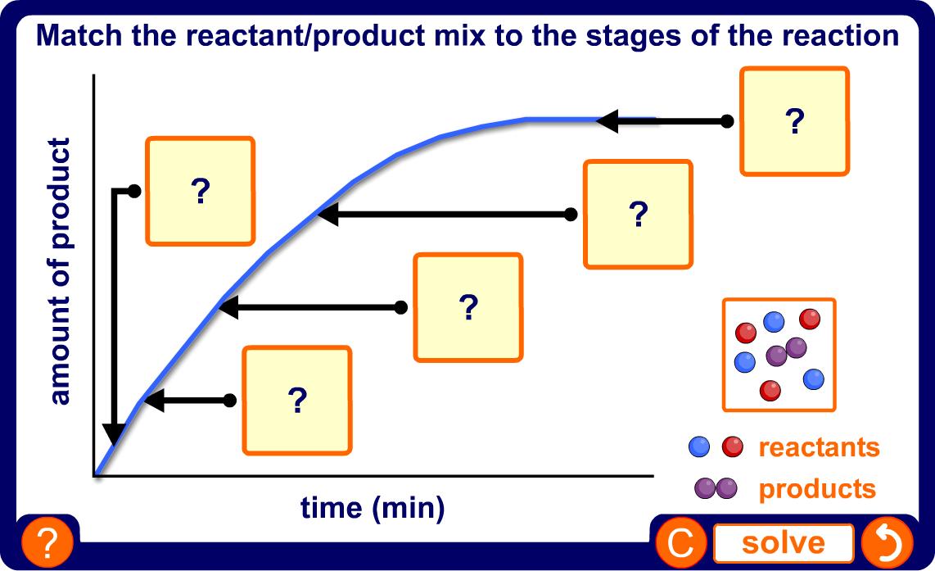
The reactant/product mix
Notes:
Teacher notes
This drag and drop activity provides the opportunity for informal assessment of students’ understanding of how the rate of reaction varies with the relative amounts of reactants and product.

Slide 13
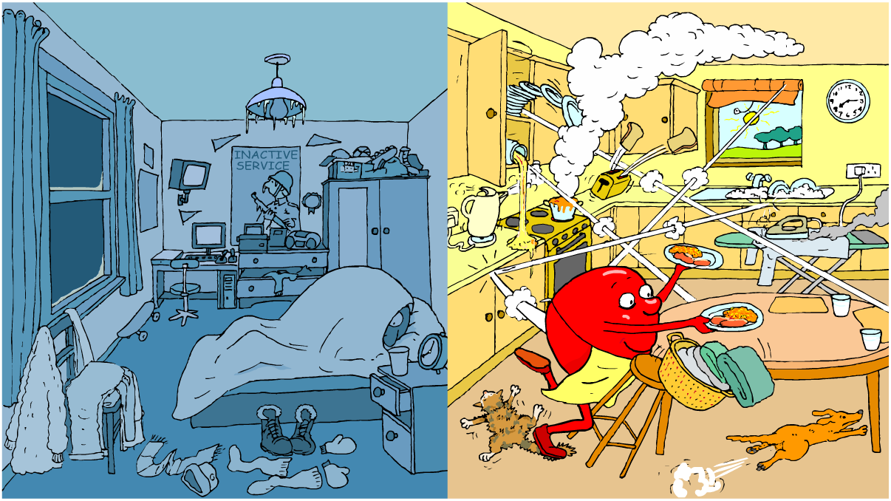
Temperature and collisions
How does temperature affect the rate of particle collision?

Slide 14

Effect of temperature on rate
The higher the temperature, the faster the rate of a reaction. In many reactions, a rise in temperature of 10 °C causes the rate of reaction to approximately double.
Why does increased temperature increase the rate of reaction?
At a higher temperature, particles have more energy. This means they move faster and are more likely to collide with other particles.
When the particles collide, they do so with more energy, and so the number of successful collisions increases.

Slide 15
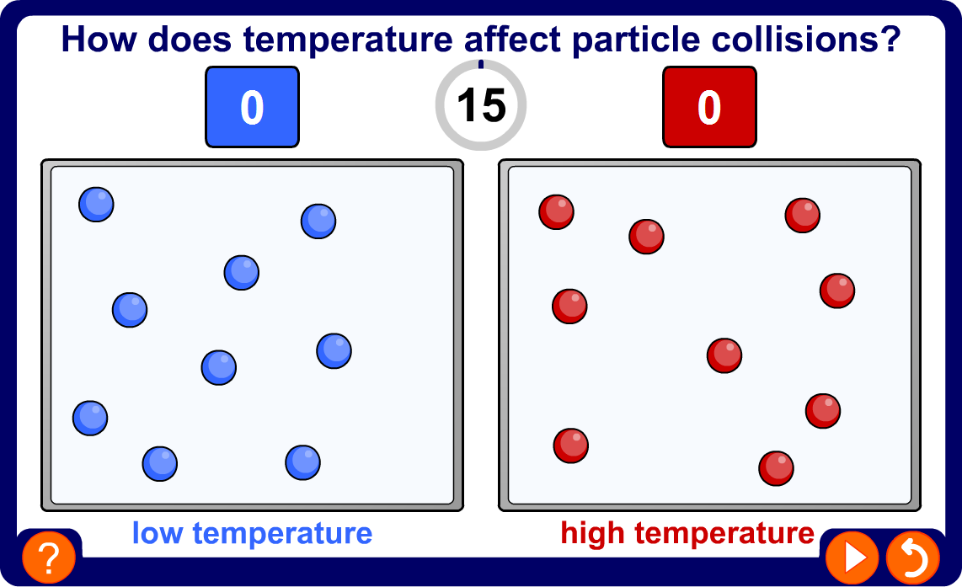
Temperature and particle collisions
Notes:
Teacher notes
This simulation illustrates how increasing the temperature increases the number of collisions between particles.

Slide 16
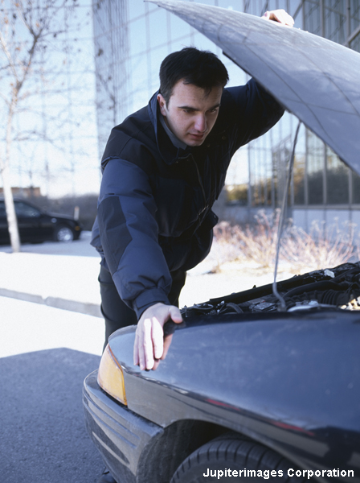
Temperature and batteries
Why are batteries more likely to rundown more quickly in cold weather?
At low temperatures the reaction that generates the electric current proceeds more slowly than at higher temperatures.
This means batteries are less likely to deliver enough current to meet demand.
Notes:
Photo credit: © 2007 Jupiterimages Corporation
If a battery is not in use it will discharge more slowly at low temperatures than at higher temperatures. However, if a battery needs to be used at low temperatures then warming it up speeds up the reaction that generates the electric current, giving you more power.

Slide 17
How does temperature affect rate?
The reaction between sodium thiosulfate and hydrochloric acid produces sulfur.
sodium
thiosulfate
+
hydrochloric
acid
➔
sodium
chloride
+
sulfur
dioxide
+
+
sulfur
water
Na₂S₂O₃
(aq)
+
2HCl
(aq)
2NaCl
(aq)
+
SO₂
(g)
+
S
(s)
+
H₂O
(l)
➔
Sulfur is solid and so it turns the solution cloudy.
How can this fact be used to measure the effect of temperature on rate of reaction?

Slide 18
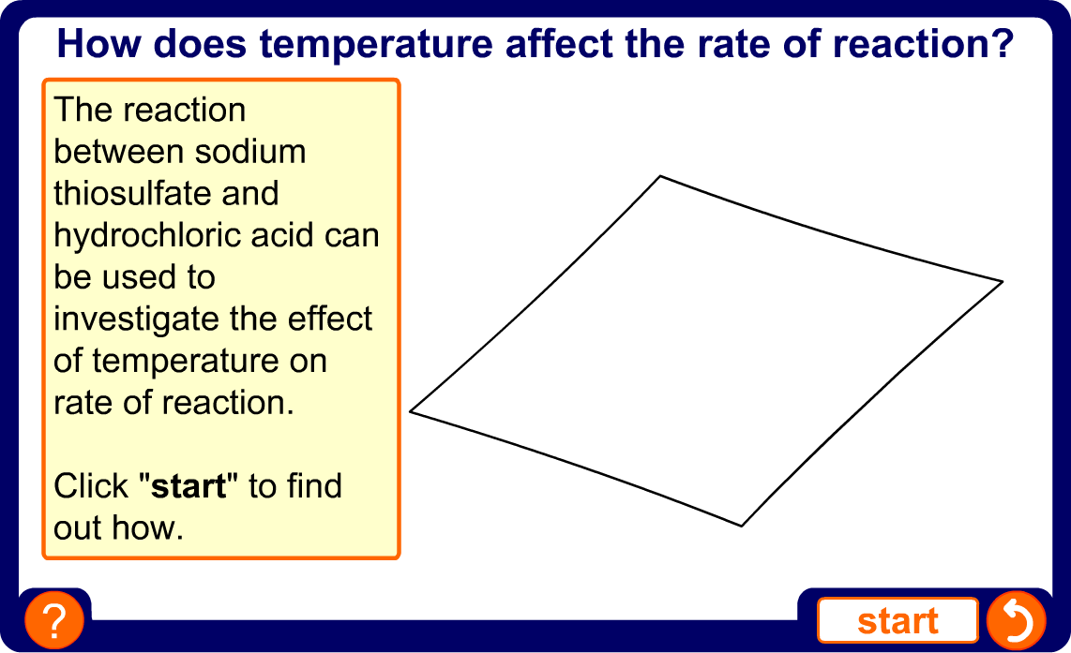
The effect of temperature on rate
Notes:
Teacher notes
This animation can be used to introduce the reaction between sodium thiosulfate and hydrochloric acid as a way of measuring the effect of temperature on rate of reaction. It could be shown as precursor to running the experiment in the lab, or as a revision exercise.

Slide 19
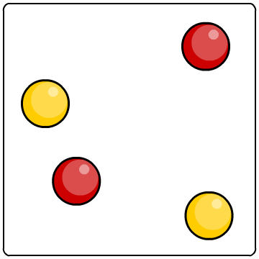
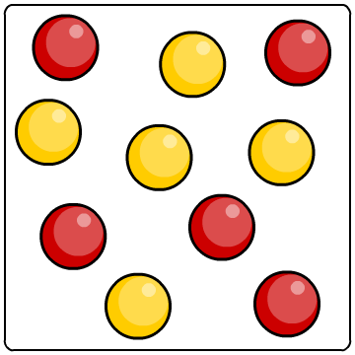
Effect of concentration on rate of reaction
The higher the concentration of a dissolved reactant, the faster the rate of a reaction.
Why does increased concentration increase the rate of reaction?
At a higher concentration, there are more particles in the same amount of space. This means that the particles are more likely to collide and therefore more likely to react.
lower concentration
higher concentration

Slide 20
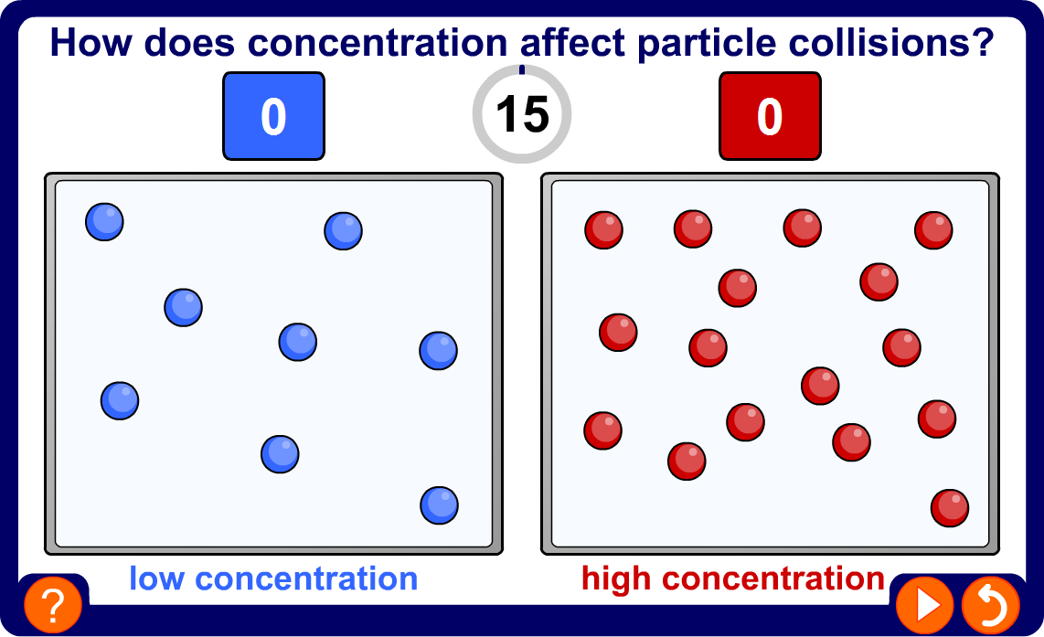
Concentration and particle collisions
Notes:
Teacher notes
This simulation illustrates how increasing the concentration increases the number of collisions between particles.

Slide 21
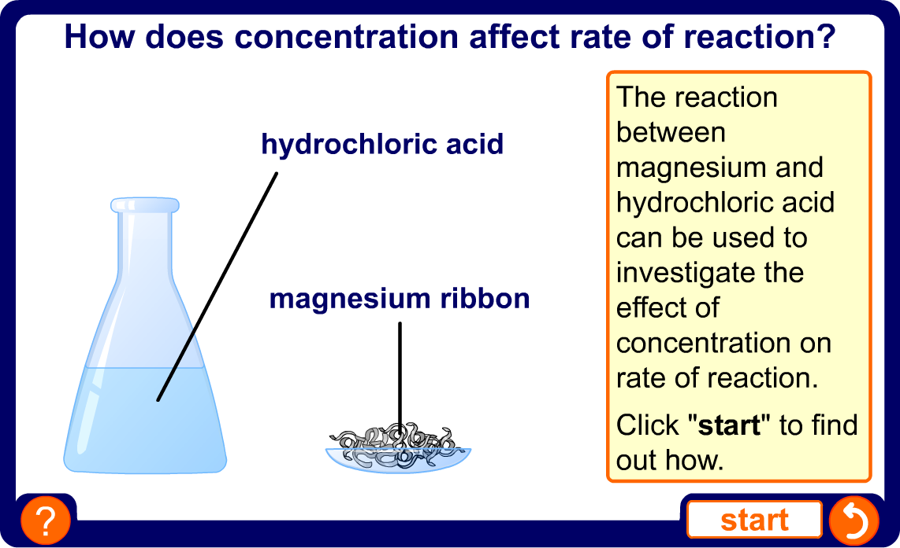
The effect of concentration on rate
Notes:
Teacher notes
This animation can be used to introduce the reaction between magnesium and hydrochloric acid as a way of measuring the effect of concentration on rate of reaction. It could be shown as precursor to running the experiment in the lab, or as a revision exercise.

Slide 22
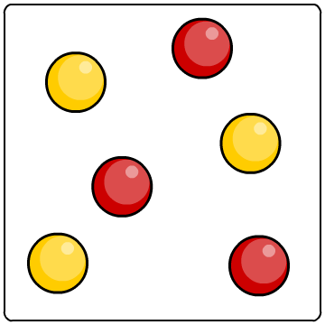
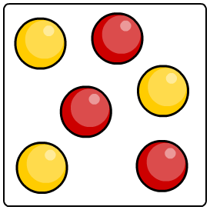
Effect of pressure on rate of reaction
Why does increasing the pressure of gaseous reactants increase the rate of reaction?
As the pressure increases, the space in which the gas particles are moving becomes smaller.
The gas particles become closer together, increasing the frequency of collisions. This means that the particles are more likely to react.
lower pressure
higher pressure

Slide 23
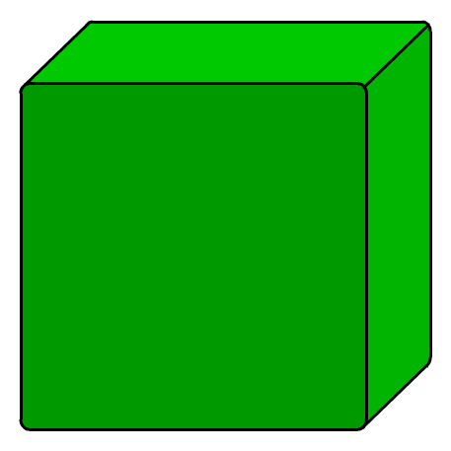
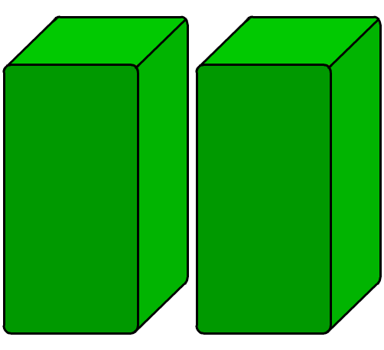
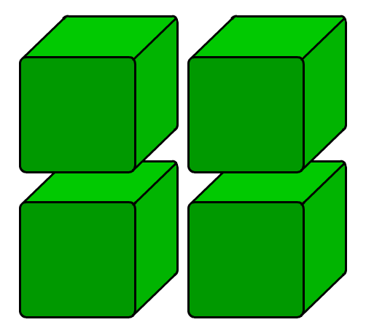
Effect of surface area on rate of reaction
Any reaction involving a solid can only take place at the surface of the solid.
If the solid is split into several pieces, the surface area increases. What effect will this have on rate of reaction?
low surface area
high surface area
This means that there is an increased area for the reactant particles to collide with.
The smaller the pieces, the larger the surface area. This means more collisions and a greater chance of reaction.

Slide 24
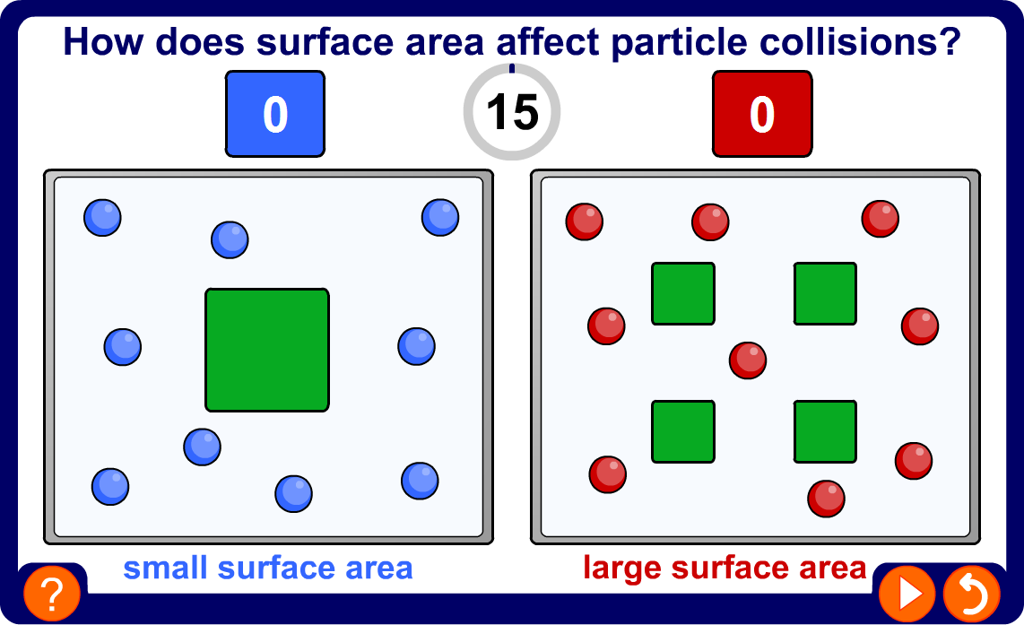
Surface area and particle collisions
Notes:
Teacher notes
This simulation illustrates how increasing the surface area increases the number of collisions between particles and solid reactants

Slide 25
Reaction between a carbonate and acid
Marble chips are made of calcium carbonate. They react with hydrochloric acid to produce carbon dioxide.
calcium
carbonate
+
hydrochloric
acid
calcium
chloride
+
+
carbon
dioxide
➔
water
CaCO₃ (aq)
+
2HCl
(aq)
CaCl₂
(aq)
H₂O
(aq)
CO₂
(g)
➔
+
+
The effect of increasing surface area on the rate of reaction can be measured by comparing how quickly the mass of the reactants decreases using marble chips of different sizes.

Slide 26
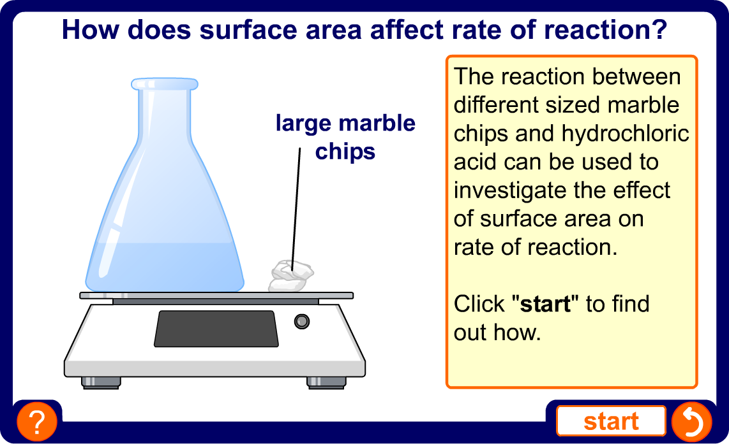
The effect of surface area on rate
Notes:
Teacher notes
This animation can be used to introduce the reaction between marble chips (calcium carbonate) and hydrochloric acid as a way of measuring the effect of surface on rate of reaction. It could be shown as precursor to running the experiment in the lab, or as a revision exercise.

Slide 27
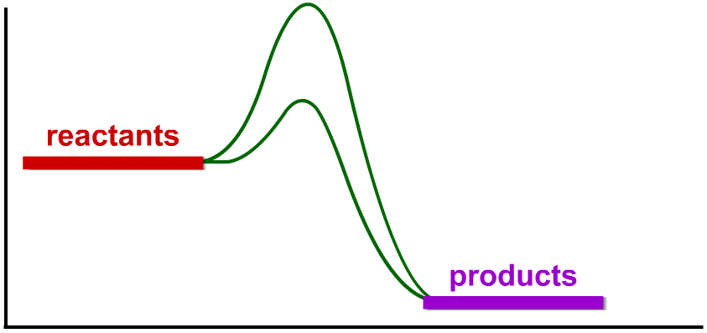
What are catalysts?
Catalysts are substances that change the rate of a reaction without being used up in the reaction.
Catalysts never produce more product – they just produce the same amount more quickly.
E_{a} without
catalyst
Different catalysts work in different ways, but most lower the reaction’s activation energy (E_{a}).
energy (kJ)
E_{a} with
catalyst
reaction (time)
Notes:
Teacher notes
See the ‘Energy Transfer’ presentation for more information on activation energy.

Slide 28
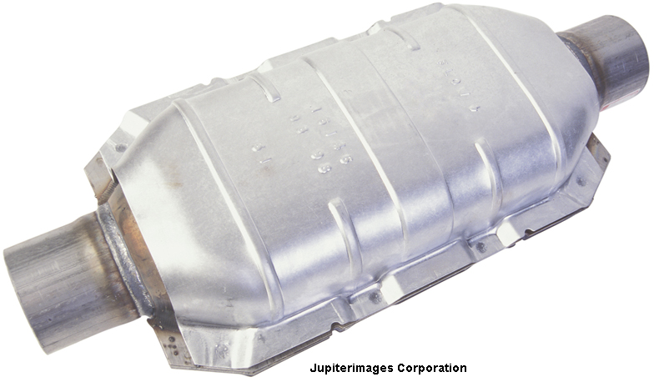
Everyday catalysts
Many catalysts are transition metals or their compounds. For example:
Nickel is a catalyst in the production of margarine (hydrogenation of vegetable oils).
Iron is a catalyst in the production of ammonia from nitrogen and hydrogen (the Haber process).
Platinum is a catalyst in the catalytic converters of car exhausts. It catalyzes the conversion of carbon monoxide and nitrogen oxide into the less polluting carbon dioxide and nitrogen.
Notes:
Photo credit: © 2007 Jupiterimages Corporation
Teacher notes
See the ‘Reversible Reactions’ presentation for more information on the Haber process.

Slide 29
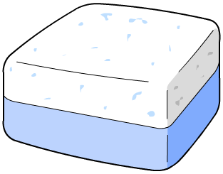

Catalysts in industry
Why are catalysts so important for industry?
Products can be made more quickly, saving time and money.
Catalysts reduce the need for high temperatures, saving fuel and reducing pollution.
Catalysts are also essential for living cells. Biological catalysts are special types of protein called enzymes.
Notes:
Teacher notes
See the ‘Enzymes’ Biology presentation for more information on enzymes as catalysts and their use in industrial processes.

Slide 30
Glossary
activation energy – The amount of energy needed to start a reaction.
catalyst – A substance that increases the rate of a chemical reaction without being used up.
concentration – The number of molecules of a substance in a given volume.
enzyme – A biological catalyst.
rate of reaction – The change in the concentration over a certain period of time.

