Slide 1
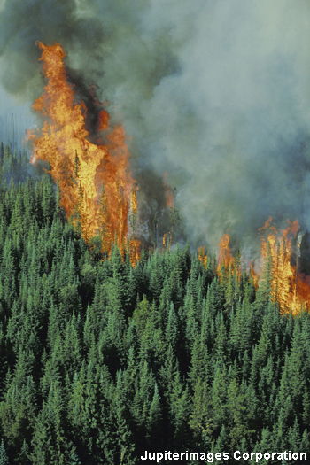
Irreversible reactions
Most chemical reactions are considered irreversible – the products that are made cannot readily be changed back into their reactants.
For example, when wood burns it is impossible to turn it back into unburnt wood again!
Similarly, when magnesium reacts with hydrochloric acid to form magnesium chloride and hydrogen, it is not easy to reverse the reaction and obtain the magnesium.
Notes:
Photo credit: © 2007 Jupiterimages Corporation

Slide 2
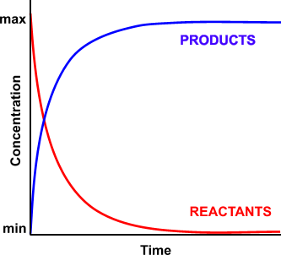
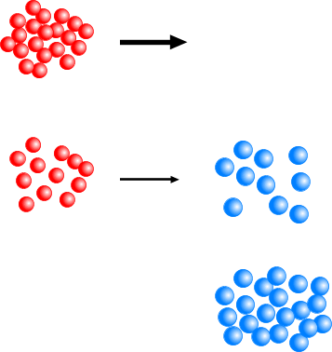
CONCENTRATION CHANGE IN A REACTION
As the rate of reaction is dependant on the concentration of reactants... the forward reaction starts off fast but slows as the reactants get less concentrated
FASTEST AT
THE START
THE STEEPER THE GRADIENT, THE FASTER THE REACTION
SLOWS DOWN AS REACTANTS ARE USED UP
TOTAL CONVERSION TO PRODUCTS
In an ordinary reaction; all reactants end up as products; there is 100% conversion

Slide 3

What are reversible reactions?
Reversible reactions occur when the backwards reaction (products → reactants) takes place relatively easily under certain conditions. The products turn back into the reactants.
A
+
B
C
+
D
(reactants)
(products)
For example, during a reversible reaction reactants A and B react to make products C and D.
However, products C and D can also undergo the reverse reaction, and react together to form reactants A and B.
Notes:
Teacher notes
In equations for reversible reactions, reactants and products are joined by a ‘two-way’ arrow.

Slide 4
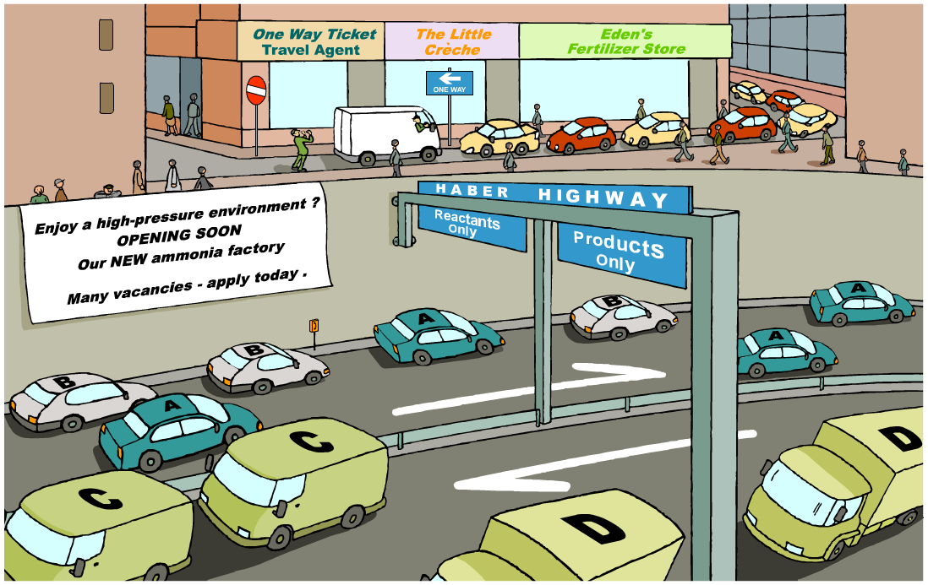
Reversible and irreversible reactions
What kind of reactions are reversible and irreversible?

Slide 5
Reversible biochemical reactions
Many biochemical reactions (those that take place inside organisms) are reversible.
For example, in the lungs, oxygen binds to haemoglobin (Hb) in red blood cells to create oxyhaemoglobin.
When the red blood cells are transported to tissues, the oxyhaemoglobin dissociates back to haemoglobin and oxygen.
Hb
+
4O₂
Hb.4O₂
There are also some very important industrial reactions, like the Haber process, that are reversible.

Slide 6
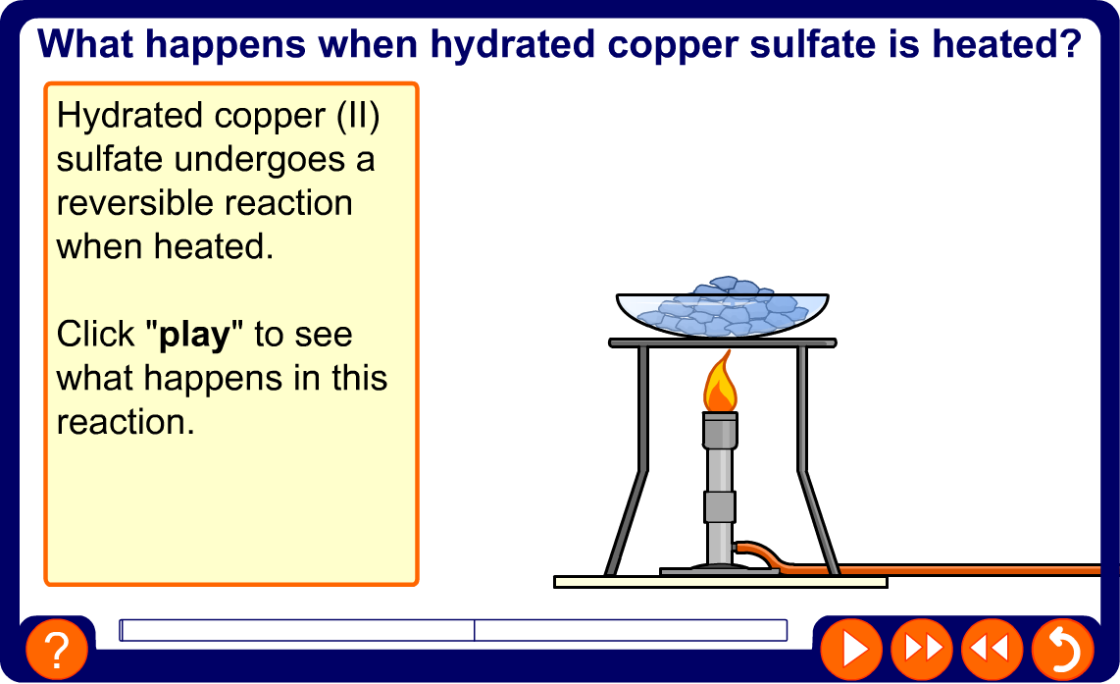
Heating copper sulfate
Notes:
Teacher notes
This animation can be used to introduce the heating of hydrated copper (II) sulfate, and subsequent rehydration of anhydrous copper (II) sulfate as an example of a reversible reaction. It could be shown as precursor to running the experiment in the lab, or as a revision exercise.

Slide 7

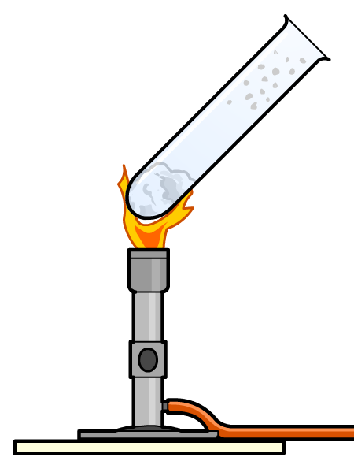
Heating ammonium chloride
An ammonium salt can be made by reacting ammonia with an acid. Some of the salt will decompose back into the reactants when heated.
+
hydrogen
chloride
ammonium chloride
ammonia
NH₃ (g)
+
HCl (g)
NH₄Cl (s)
NH₄Cl reforms in the cooler part of the test tube
NH₄Cl decomposes back into NH₃ and HCl gases when heated
Notes:
Teacher notes
See the ‘Chemical Reactions’ presentation for more information on thermal decomposition.

Slide 8
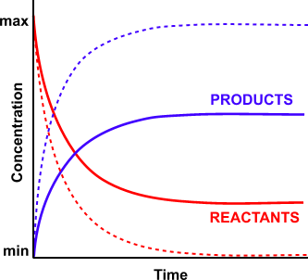
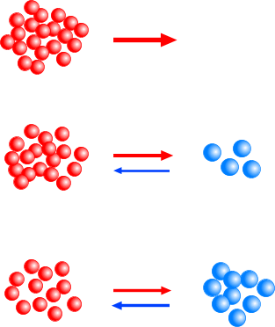
EQUILIBRIUM REACTIONS
Initially, there is no backward reaction but, as products form, it speeds up and provided the temperature remains constant there will come a time when the backward and forward reactions are equal and opposite; the reaction has reached equilibrium.
FASTEST AT THE START
NO BACKWARD REACTION
FORWARD REACTION SLOWS DOWN AS REACTANTS ARE USED UP
BACKWARD REACTION
STARTS TO INCREASE
In an equilibrium reaction, not all the reactants end up as products; there is not a 100% conversion.
BUT IT DOESN’T MEAN THE REACTION
IS STUCK IN THE MIDDLE
AT EQUILIBRIUM THE BACKWARD AND FORWARD REACTIONS ARE EQUAL AND OPPOSITE

Slide 9
DYNAMIC EQUILIBRIUM
IMPORTANT REMINDERS
• a reversible chemical reaction is a dynamic process
• everything may appear stationary but the reactions are moving both ways
• the position of equilibrium can be varied by changing certain conditions
Trying to get up a “down” escalator gives an excellent idea of a non-chemical situation involving dynamic equilibrium.
Summary When a chemical equilibrium is established ...
• both the reactants and the products are present at all times
• the equilibrium can be approached from either side
• the reaction is dynamic - it is moving forwards and backwards
• the concentrations of reactants and products remain constant

Slide 10
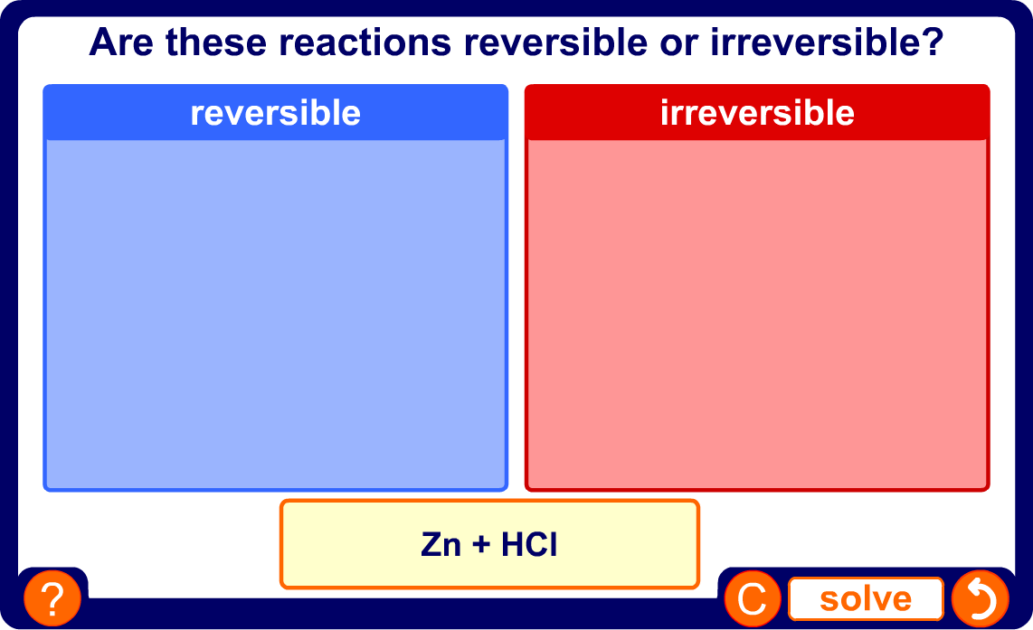
Reversible or irreversible?
Notes:
Teacher notes
Appropriately coloured voting cards could be used with this classification activity to increase class participation.

Slide 11
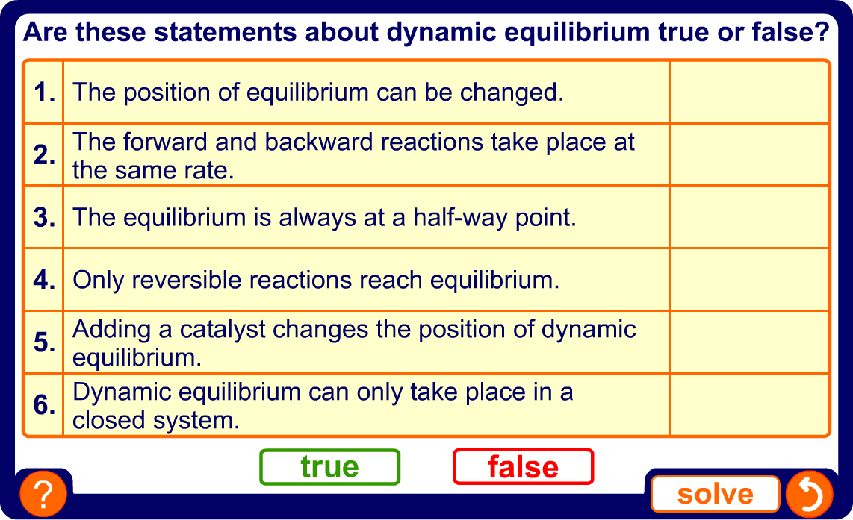
True or false?
Notes:
Teacher notes
This true-or-false activity could be used as a plenary or revision exercise on dynamic equilibrium, or at the start of the lesson to gauge students’ existing knowledge of the subject matter. Coloured traffic light cards (red = false, yellow = don’t know, green = true) could be used to make this a whole-class exercise.

Slide 12
LE CHATELIER’S PRINCIPLE
”When a change is applied to a system in dynamic equilibrium, the
system reacts in such a way as to oppose the effect of the change.”

Slide 13
FACTORS AFFECTING THE POSITION OF EQUILIBRIUM
CONCENTRATION
The equilibrium constant is not affected by a change in concentration at constant temperature. To maintain the constant, the composition of the equilibrium mixture changes.
If you increase the concentration of a substance, the value of K_{c} will theoretically be affected. As it must remain constant at a particular temperature, the concentrations of the other species change to keep the constant the same.

Slide 14
FACTORS AFFECTING THE POSITION OF EQUILIBRIUM
SUMMARY
REACTANTS PRODUCTS
THE EFFECT OF CHANGING THE CONCENTRATION ON THE POSITION OF EQUILIBRIUM
INCREASE CONCENTRATION OF A REACTANT
EQUILIBRIUM MOVES TO THE RIGHT
DECREASE CONCENTRATION OF A REACTANT
EQUILIBRIUM MOVES TO THE LEFT
INCREASE CONCENTRATION OF A PRODUCT
EQUILIBRIUM MOVES TO THE LEFT
DECREASE CONCENTRATION OF A PRODUCT
EQUILIBRIUM MOVES TO THE RIGHT
Predict the effect of increasing the concentration of O₂ on the equilibrium position
2SO₂(g) + O₂(g) 2SO₃(g)
EQUILIBRIUM MOVES TO RHS
Predict the effect of decreasing the
concentration of SO₃ on the equilibrium position
EQUILIBRIUM MOVES TO RHS

Slide 15
FACTORS AFFECTING THE POSITION OF EQUILIBRIUM
PRESSURE
When studying the effect of a change in pressure, we consider the number of gaseous molecules only.
The more particles you have in a given volume, the greater the pressure they exert.
If you apply a greater pressure they will become more crowded (i.e. they are under a greater stress). However, if the system can change it will move to the side with fewer gaseous molecules - it is less crowded.
No change occurs when equal numbers of gaseous molecules appear on both sides.
THE EFFECT OF PRESSURE ON THE POSITION OF EQUILIBRIUM
INCREASE PRESSURE
MOVES TO THE SIDE WITH FEWER GASEOUS MOLECULES
DECREASE PRESSURE
MOVES TO THE SIDE WITH MORE GASEOUS MOLECULES
Predict the effect of an increase of pressure on the equilibrium position of..
2SO₂(g) + O₂(g) 2SO₃(g)
H₂(g) + CO₂(g) CO(g) + H₂O(g)
MOVES TO RHS :- fewer gaseous molecules
NO CHANGE:- equal numbers on both sides

Slide 16
FACTORS AFFECTING THE POSITION OF EQUILIBRIUM
TEMPERATURE
• temperature is the only thing that can change the value of the equilibrium constant.
• altering the temperature affects the rate of both backward and forward reactions
• it alters the rates to different extents
• the equilibrium thus moves producing a new equilibrium constant.
• the direction of movement depends on the sign of the enthalpy change.

Slide 17
FACTORS AFFECTING THE POSITION OF EQUILIBRIUM
TEMPERATURE
• temperature is the only thing that can change the value of the equilibrium constant.
• altering the temperature affects the rate of both backward and forward reactions
• it alters the rates to different extents
• the equilibrium thus moves producing a new equilibrium constant.
• the direction of movement depends on the sign of the enthalpy change.
REACTION TYPE
ΔΗ
INCREASE TEMP
DECREASE TEMP
EXOTHERMIC
-
TO THE LEFT
TO THE RIGHT
ENDOTHERMIC
+
TO THE RIGHT
TO THE LEFT

Slide 18
FACTORS AFFECTING THE POSITION OF EQUILIBRIUM
TEMPERATURE
• temperature is the only thing that can change the value of the equilibrium constant.
• altering the temperature affects the rate of both backward and forward reactions
• it alters the rates to different extents
• the equilibrium thus moves producing a new equilibrium constant.
• the direction of movement depends on the sign of the enthalpy change.
REACTION TYPE
ΔΗ
INCREASE TEMP
DECREASE TEMP
EXOTHERMIC
-
TO THE LEFT
TO THE RIGHT
ENDOTHERMIC
+
TO THE RIGHT
TO THE LEFT
Predict the effect of a temperature increase on the equilibrium position of...
H₂(g) + CO₂(g) CO(g) + H₂O(g) ΔΗ = + 40 kJ mol⁻¹
2SO₂(g) + O₂(g) 2SO₃(g) ΔΗ = - ive

Slide 19
FACTORS AFFECTING THE POSITION OF EQUILIBRIUM
TEMPERATURE
• temperature is the only thing that can change the value of the equilibrium constant.
• altering the temperature affects the rate of both backward and forward reactions
• it alters the rates to different extents
• the equilibrium thus moves producing a new equilibrium constant.
• the direction of movement depends on the sign of the enthalpy change.
REACTION TYPE
ΔΗ
INCREASE TEMP
DECREASE TEMP
EXOTHERMIC
-
TO THE LEFT
TO THE RIGHT
ENDOTHERMIC
+
TO THE RIGHT
TO THE LEFT
Predict the effect of a temperature increase on the equilibrium position of...
H₂(g) + CO₂(g) CO(g) + H₂O(g) ΔΗ = + 40 kJ mol⁻¹ moves to the RHS
2SO₂(g) + O₂(g) 2SO₃(g) ΔΗ = - ive moves to the LHS

Slide 20
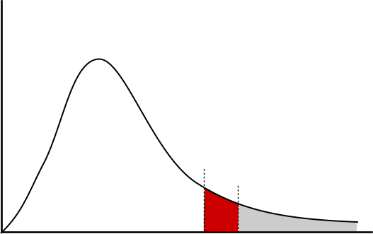
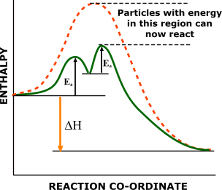
FACTORS AFFECTING THE POSITION OF EQUILIBRIUM
CATALYSTS
Catalysts work by providing an alternative reaction pathway involving a lower activation energy.
MAXWELL-BOLTZMANN DISTRIBUTION OF MOLECULAR ENERGY
NUMBER OF MOLECUES WITH
A PARTICULAR ENERGY
EXTRA MOLECULES WITH SUFFICIENT ENERGY TO OVERCOME THE ENERGY BARRIER
MOLECULAR ENERGY
E_{a}

Slide 21
FACTORS AFFECTING THE POSITION OF EQUILIBRIUM
CATALYSTS
An increase in temperature is used to speed up chemical reactions but it can have an undesired effect when the reaction is reversible and exothermic.
In this case you get to the equilibrium position quicker but with a reduced yield because the increased temperature moves the equilibrium to the left.
In many industrial processes a compromise temperature is used (see Haber and Contact Processes). To reduce the problem one must look for a way of increasing the rate of a reaction without decreasing the yield i.e. with a catalyst.

Slide 22
FACTORS AFFECTING THE POSITION OF EQUILIBRIUM
CATALYSTS
An increase in temperature is used to speed up chemical reactions but it can have an undesired effect when the reaction is reversible and exothermic.
In this case you get to the equilibrium position quicker but with a reduced yield because the increased temperature moves the equilibrium to the left.
In many industrial processes a compromise temperature is used (see Haber and Contact Processes). To reduce the problem one must look for a way of increasing the rate of a reaction without decreasing the yield i.e. with a catalyst.
Adding a catalyst DOES NOT AFFECT THE POSITION OF EQUILIBRIUM. However, it does increase the rate of attainment of equilibrium. This is especially important in reversible, exothermic industrial reactions such as the Haber or Contact Processes where economic factors are paramount.

Slide 23


Opposing change
Whenever a change is made to a reversible reaction in dynamic equilibrium, the equilibrium will shift to try and oppose the change.
Condition
Effect
Temperature
Increasing the temperature shifts the equilibrium in the direction that takes in heat.
Concentration
Increasing the concentration of a substance shifts the equilibrium in the direction that produces less of that substance.
Pressure
Increasing the pressure shifts the equilibrium in the direction that produces less gas.
Notes:
Teacher notes
This is Le Chatelier’s principle.

Slide 24
Exothermic and endothermic reactions
All reactions are exothermic (give out heat) in one direction and endothermic (take in heat) in the other.
If the temperature is increased:
equilibrium shifts to decrease the temperature
equilibrium shifts in the endothermic direction
If the temperature is decreased:
equilibrium shifts to increase the temperature
equilibrium shifts in the exothermic direction
Notes:
Teacher notes
See the ‘Energy Transfer’ presentation for more information on exothermic and endothermic reactions.

Slide 25
Opposing changes in temperature
Nitrogen dioxide is in constant equilibrium with dinitrogen tetroxide. The forward reaction is exothermic and the backwards reaction is endothermic.
nitrogen dioxide
dinitrogen tetroxide
2NO₂ (g)
N₂O₄ (g)
What will happen if the temperature is increased?
The equilibrium will shift to decrease the temperature, i.e. to the left (endothermic).
More NO₂ will be produced.
If the temperature is decreased, more N₂O₄ will be produced.

Slide 26
Concentration and equilibrium
Changing the concentration of a substance affects the equilibrium of reversible reactions involving solutions.
increasing the
concentration of substance A
equilibrium shifts to
decrease the amount of substance A
=
decreasing the
concentration of substance A
equilibrium shifts to
increase the amount of substance A
=

Slide 27
Opposing changes in concentration (1)
Bismuth chloride reacts with water to produce a white precipitate of bismuth oxychloride and hydrochloric acid.
bismuth
chloride
+
bismuth oxychloride
+
hydrochloric acid
water
BiCl₃ (aq)
+
H₂O (l)
BiOCl (s)
+
2HCl (aq)
What will happen if more H₂O is added?
The equilibrium will shift to decrease the amount of water, i.e. to the right.
More BiOCl and HCl will be produced.
If H₂O is removed, more BiCl₃ and H₂O will be produced.

Slide 28
Opposing changes in concentration (2)
Chlorine gas reacts with iodine chloride to produce iodine trichloride.
+
iodine
chloride
iodine
trichloride
chlorine
Cl₂ (g)
+
ICl (l)
ICl₃ (s)
pale green
brown
yellow
What effect will adding more Cl₂ have on the colour of the mixture?
It will become more yellow.
What effect will removing Cl₂ have on the colour of the mixture?
It will become more brown.

Slide 29
Pressure and equilibrium
Changing the pressure has an effect on the equilibrium of reversible reactions involving gases.
If the pressure is increased:
equilibrium shifts to decrease the pressure
equilibrium shifts in the direction of fewest molecules
If the pressure is decreased:
equilibrium shifts to increase the pressure
equilibrium shifts in the direction of most molecules

Slide 30
Opposing changes in pressure
Nitrogen dioxide is in constant equilibrium with dinitrogen tetroxide. Two molecules of nitrogen dioxide react to form one molecule of dinitrogen tetroxide.
nitrogen dioxide
dinitrogen tetroxide
2NO₂ (g)
N₂O₄ (g)
What will happen if the pressure is increased?
The equilibrium will shift to reduce the number of molecules, i.e. to the right (only 1 molecule).
More N₂O₄ will be produced.
If the pressure is decreased, more NO₂ will be produced.

Slide 31

What is ammonia?
Ammonia is an important compound in the manufacture of fertilizer and other chemicals such as cleaning fluids and floor waxes.
It is made industrially by reacting nitrogen with hydrogen in the Haber process. It is a reversible reaction, so it never goes to completion.
Why is this a problem for companies making ammonia?
nitrogen
+
hydrogen
ammonia
N₂ (g)
+
3H₂ (g)
2NH₃ (g)
Notes:
Photo credit: © 2007 Jupiterimages Corporation

Slide 32

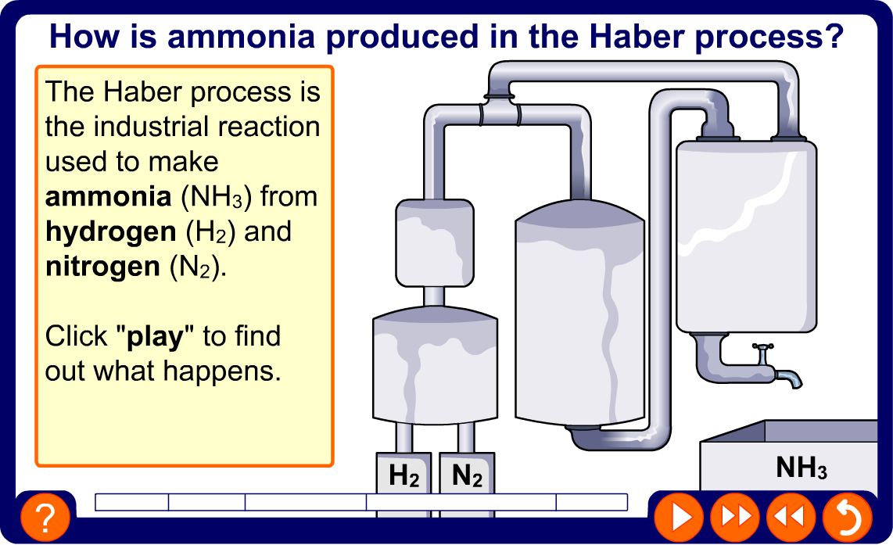
The Haber process
Notes:
Teacher notes
This five-stage animation illustrates how ammonia is made in the Haber process.

Slide 33
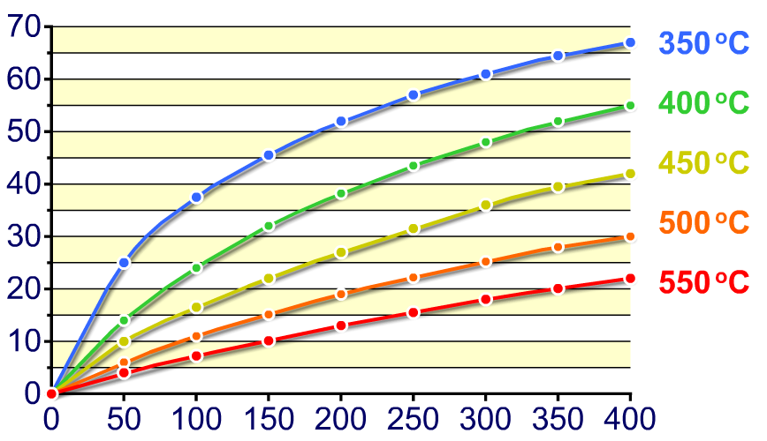
What is yield?
The amount of product made in a reaction is called the yield and is usually expressed as a percentage.
The yield of ammonia produced by the Haber process depends on the temperature and pressure of the reaction.
ammonia yield (%)
pressure (atm)
Notes:
Teacher notes
See the ‘Quantitative Chemistry’ presentations for more information on yields.

Slide 34
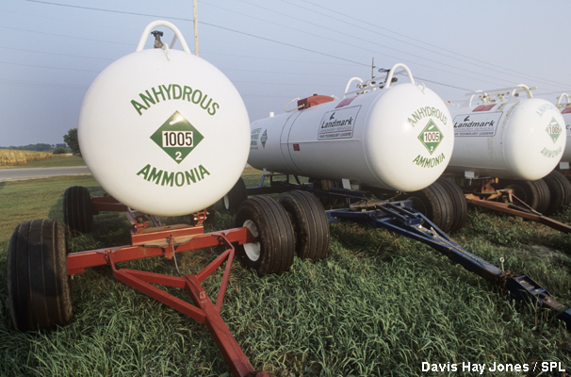
What is the Haber compromise?
The highest yield of ammonia is theoretically produced by using a low temperature and a high pressure.
In practice, though, these conditions are not used. Why?
Lowering the temperature slows down the rate of reaction. This means it takes longer for ammonia to be produced.
Increasing the pressure means stronger, more expensive equipment is needed. This increases the cost of producing the ammonia.
A compromise is reached to make an acceptable yield in a reasonable timeframe while keeping costs down.
Notes:
Photo credit: Davis Hay Jones / Science Photo Library

Slide 35
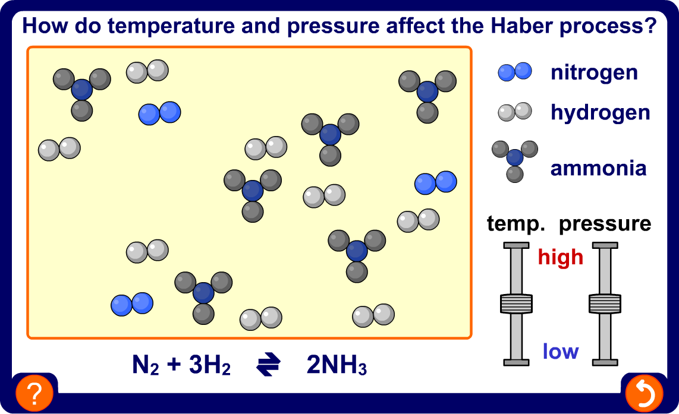
Temperature, pressure and yield
Notes:
Teacher notes
This activity could be used as a plenary or revision exercise on the effects of temperature and pressure on the Haber process.

Slide 36
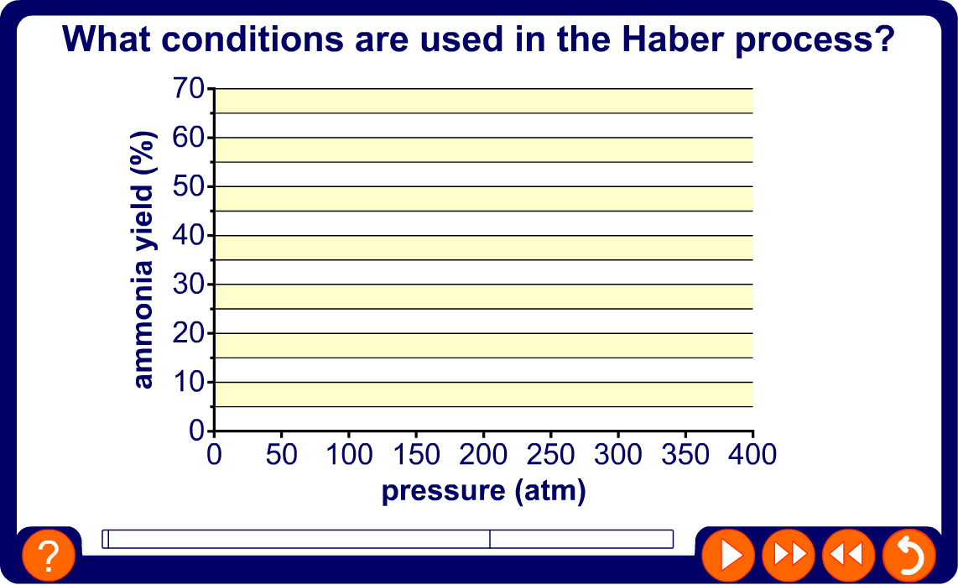
Changing the yield of ammonia

Slide 37
HABER PROCESS
N₂(g) + 3H₂(g) 2NH₃(g) : ΔΗ = - 92 kJ mol⁻¹
Conditions Pressure 20000 kPa (200 atmospheres)
Temperature 380-450°C
Catalyst iron

Slide 38
HABER PROCESS
N₂(g) + 3H₂(g) 2NH₃(g) : ΔΗ = - 92 kJ mol⁻¹
Conditions Pressure 20000 kPa (200 atmospheres)
Temperature 380-450°C
Catalyst iron
Equilibrium theory favours
low temperature exothermic reaction - higher yield at lower temperature
high pressure decrease in number of gaseous molecules

Slide 39
HABER PROCESS
N₂(g) + 3H₂(g) 2NH₃(g) : ΔΗ = - 92 kJ mol⁻¹
Conditions Pressure 20000 kPa (200 atmospheres)
Temperature 380-450°C
Catalyst iron
Equilibrium theory favours
low temperature exothermic reaction - higher yield at lower temperature
high pressure decrease in number of gaseous molecules
Kinetic theory favours
high temperature greater average energy + more frequent collisions
high pressure more frequent collisions for gaseous molecules
catalyst lower activation energy

Slide 40
HABER PROCESS
N₂(g) + 3H₂(g) 2NH₃(g) : ΔΗ = - 92 kJ mol⁻¹
Conditions Pressure 20000 kPa (200 atmospheres)
Temperature 380-450°C
Catalyst iron
Equilibrium theory favours
low temperature exothermic reaction - higher yield at lower temperature
high pressure decrease in number of gaseous molecules
Kinetic theory favours
high temperature greater average energy + more frequent collisions
high pressure more frequent collisions for gaseous molecules
catalyst lower activation energy
Compromise conditions
Which is better? A low yield in a shorter time or
a high yield over a longer period.
The conditions used are a compromise with the catalyst
enabling the rate to be kept up, even at a lower temperature.

Slide 41
HABER PROCESS
IMPORTANT USES OF AMMONIA AND ITS COMPOUNDS
MAKING
FERTILISERS 80% of the ammonia produced goes to make fertilisers such as
ammonium nitrate (NITRAM) and ammonium sulphate
NH₃ + HNO₃ ——> NH₄NO₃
2NH₃ + H₂SO₄ ——> (NH₄)₂SO₄
MAKING
NITRIC ACID ammonia can be oxidised to nitric acid
nitric acid is used to manufacture... fertilisers (ammonium nitrate)
explosives (TNT)
polyamide polymers (NYLON)

Slide 42
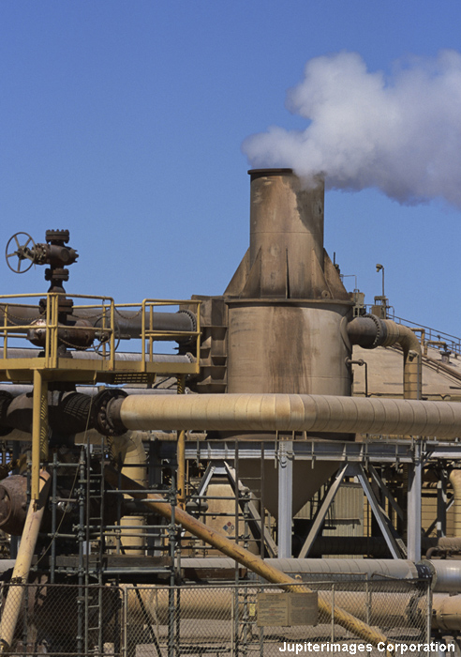
The Haber compromise
To produce a high yield of ammonia, but with a fast rate of reaction and without the need for overly expensive equipment, the Haber process is carried out at 450 °C and 200 atmospheres.
The most important factor in deciding what conditions to use is therefore not yield, but total cost.
What costs are involved in the industrial production of ammonia?
raw materials
equipment
energy
wages
Notes:
Photo credit: © 2007 Jupiterimages Corporation

Slide 43
Maximizing productivity
What else can be done to maximise productivity in the manufacture of ammonia?
An iron catalyst is used to increase the rate of reaction. It speeds up both the forward and backward reaction, so the position of equilibrium is not affected.
The ammonia is cooled, liquefied and then removed as it is produced. This causes the equilibrium to shift to the right to produce more ammonia.
Unreacted nitrogen and hydrogen are recycled and given another chance to react.

Slide 44
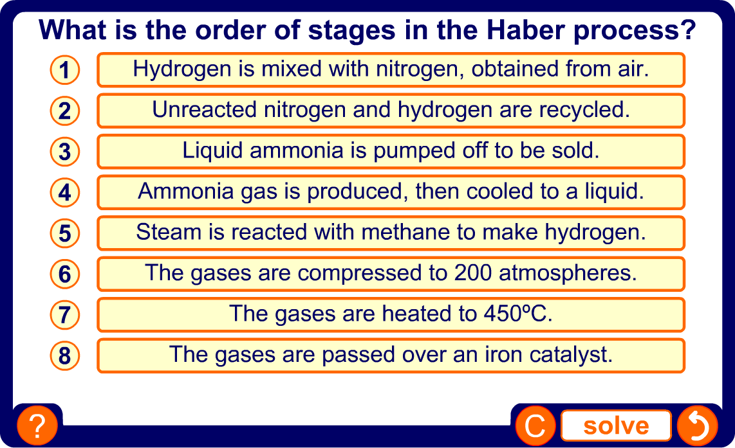
Stages of the Haber process
Notes:
Teacher notes
This ordering activity could be used as a plenary or revision exercise on the stages in the Haber process. Mini-whiteboards could be used to make this a whole-class exercise.

Slide 45
Glossary
closed system – A system in which reactants and products cannot be added or removed once the reaction has begun.
dynamic – An equilibrium in which the forward and backward reactions take place at the same rate, so no overall change takes place.
Haber process – The industrial-scale process for making ammonia from nitrogen and hydrogen.
irreversible – A reaction that is impossible or very difficult to reverse.
reversible – A reaction in which the product(s) can be turned back into the reactants.
yield – The amount of product obtained from a reaction,
usually expressed as a percentage.

